Slide 1
Scleroderma
XXXXXXXXXX
Biology 1406 Class XXXXXX
Fall 2010
Dr. Andrei Nesterovitch

Slide 2
What is scleroderma?
From the Greek words “sklerosis,” meaning hardness, and “derma,”meaning skin, scleroderma means hard skin.
Scleroderma is a chronic, often progressive
autoimmune connective tissue disorder,
in which the body’s immune system attacks
its own tissues.

Slide 3
Scleroderma is in the same category as rheumatoid arthritis, lupus, and multiple sclerosis (MS).
Hard, tight skin is usually the extent of the disorder, however, the problem can affect blood vessels and internal organs, such as
the heart, lungs, kidneys, esophagus, and
gastrointestinal tract.

Slide 4
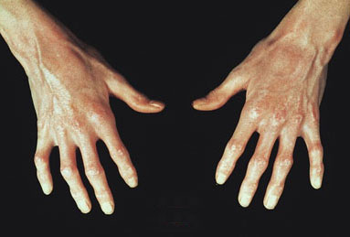
The immune system is thought to stimulate
cells called fibroblasts so they produce too
much collagen forming thick connective
tissue that builds up within the skin and
internal organs.

Slide 5
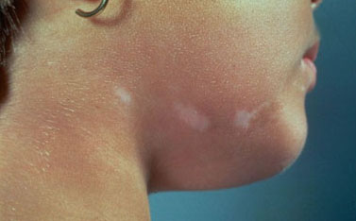
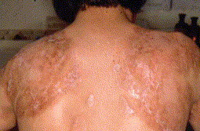
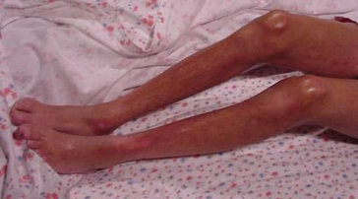
In the United States, an estimated 300,000 people have some form of scleroderma.

Slide 6
Causes
The exact cause is unknown, but scientists are certain that scleroderma is not transmitted from one person to another.
Several factors may include genetic makeup,
environmental triggers, and hormones.

Slide 7
Genetic makeup
Most persons with scleroderma do not have
relatives with scleroderma, nor do their children.
Research indicates there is a “susceptibility
gene” which raises one’s chances of having
scleroderma, but does not cause the disease
by itself.

Slide 8
The idea of the susceptibility gene has been confirmed by scientists at the University of Texas Health Science Center (UTHSC) Houston.
A research team headed
by Dr. Maureen Mayes
at UTHSC is a quarter of the
way to finding the genes and
pathways responsible
for systemic scleroderma.

Slide 9
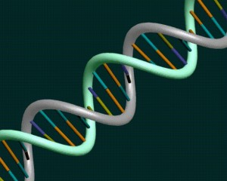
A genetic research technique called a genome-
wide association study was used, allowing
researchers to detect genetic variations
associated with a particular disease.
When the important genes
are found, scientists
can focus on developing
interventions to
block their activity.

Slide 10
Environmental triggers
If one is genetically predisposed to
scleroderma, suspected triggers include
viral infections, certain adhesive and coating
materials, and organic solvents such as vinyl
chloride or trichloroethylene.
No environmental agent has been shown
to cause scleroderma.

Slide 11
Hormones
Because of female predominance of
scleroderma, scientists suspect that hormonal
differences between women and men play a
part in the disease.
However, the role of estrogen or other female
hormones has not been proven.

Slide 12
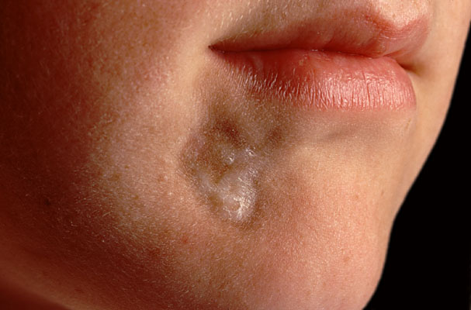
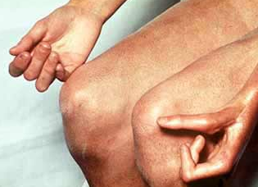
Types of scleroderma
There are two basic types of scleroderma—
the Localized form and the Systemic form.

Slide 13
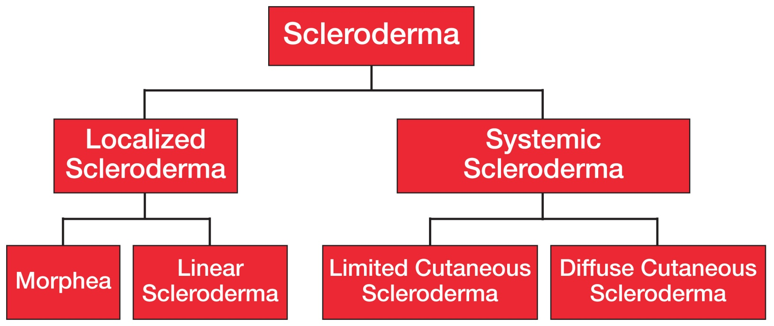
Forms of scleroderma

Slide 14
Localized scleroderma
Localized types of scleroderma are those limited to the skin and related tissues and,
in some cases, the muscle below.
Internal organs are not affected by localized
scleroderma, and localized scleroderma can
never progress to the systemic form of
the disease.

Slide 15
Often, localized conditions improve or go away on their own over time, but the
skin changes and damage that occur when
the disease is active can be permanent.
For some people, localized scleroderma
is serious and disabling.
There are two generally recognized types of
localized scleroderma: morphea and linear.

Slide 16
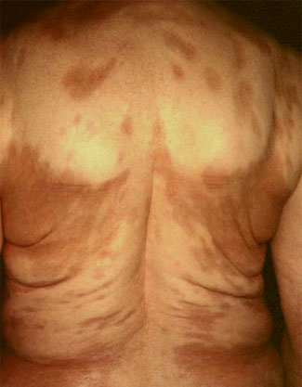
Morphea comes from a Greek word that means “form” or “structure.”
The word refers to local
patches of scleroderma.
The first signs of the disease
are reddish patches of skin
that thicken into firm,
oval-shaped areas.

Slide 17
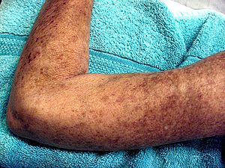
The center of each patch becomes ivory colored with violet borders. These patches sweat very little and have little hair growth.
Patches appear most
often on the chest,
stomach, and back.
Sometimes they
appear on the face,
arms, and legs.

Slide 18
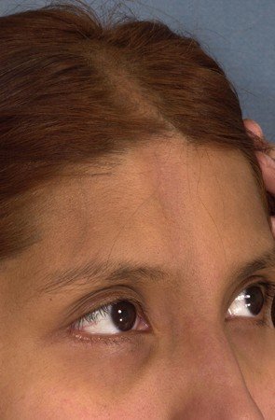
Linear scleroderma is characterized by a single line or band of thickened or abnormally colored skin.
Usually, the line runs down
an arm or leg, but in some
people it runs down
the forehead.

Slide 19
Systemic scleroderma
This form of the disease not only includes the skin, but also involves the tissues beneath, the blood vessels, and the major organs.
Systemic scleroderma is typically broken down
into limited cutaneous scleroderma and
diffuse cutaneous scleroderma.

Slide 20
Limited cutaneous scleroderma affects the skin only in certain areas: the fingers, hands, face, lower arms, and legs.
People with limited disease often have all
or some of the symptoms that some doctors
call CREST syndrome, which stands for the
following conditions: Calcinosis, Raynaud’s,
Esophageal dysfunction, Sclerodactyly,
and Telangiectasia.

Slide 21
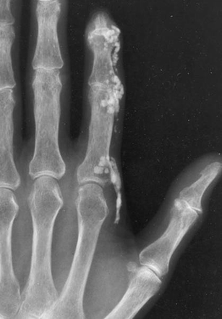
Calcinosis is the formation of calcium deposits in the connective tissues.
These deposits are typically
found on the fingers, hands,
face, and trunk, and on
the skin above elbows
and knees.
Deposits can break through
the skin.

Slide 22
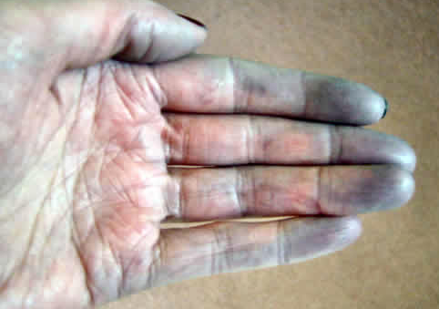
Raynaud’s phenomenon is a condition in which the small blood vessels of the hands or feet contract in response to cold or anxiety.
Hands or feet turn white and cold, then blue.
As blood flow returns,
they become red.

Slide 23
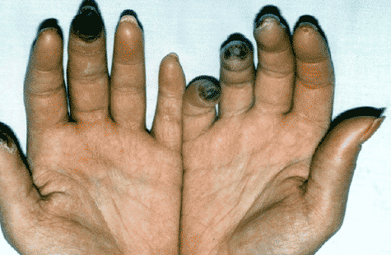
Fingertip tissues may suffer damage, leading
to ulcers, scars, or gangrene.

Slide 24
Esophageal dysfunction is impaired function
of the esophagus that occurs when smooth
muscles in the esophagus lose normal
movement.
In the upper and lower esophagus, the result
can be swallowing difficulties. In the lower
esophagus, the result can be chronic
heartburn or inflammation.

Slide 25
Sclerodactyly is thick and tight skin on the
fingers, resulting from deposits of collagen
within skin layers. The condition makes it
harder to bend or straighten the fingers.
Sclerodactyly also
causes the skin
to appear shiny
and darkened,
with hair loss.

Slide 26
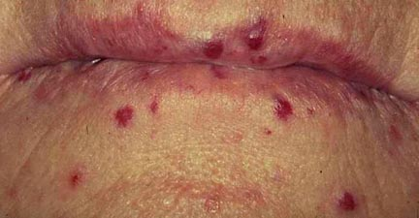
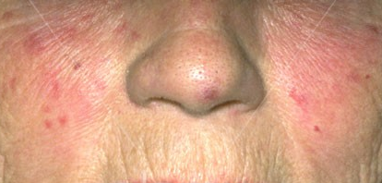
Telangiectasia is a condition caused by the
swelling of blood vessels, in which small
red spots appear on the hands and face.
A “butterfly rash” on
the cheeks is common.

Slide 27
Diffuse cutaneous scleroderma typically comes on suddenly. Skin thickening begins in the hands and spreads quickly and over much of the body, affecting the hands, face, upper arms, upper legs, chest, and stomach in a symmetrical fashion.
Internally, this condition can damage key
organs such as the intestines, lungs, heart,
and kidneys.

Slide 28
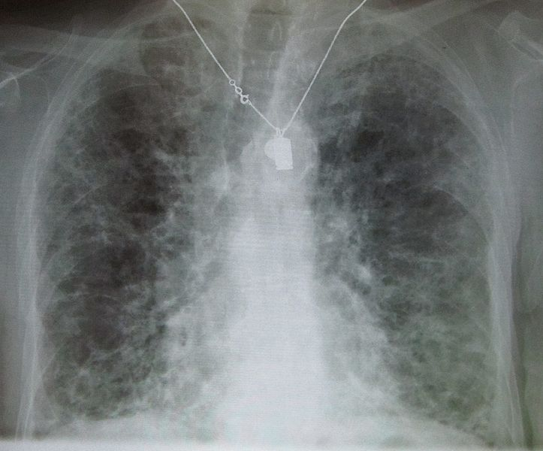
Death occurs most often from pulmonary, heart, and kidney complications. In diffuse cutaneous disease, 5-year survival is 70%,
10-year survival 55%.
About 10% to 15% of
people with scleroderma
develop severe lung
disease during the
course of their illness.

Slide 29
Pulmonary complications
Virtually all people with systemic sclerosis
have some loss of lung function.
Severe lung disease, comes in two forms:
pulmonary fibrosis, hardening or scarring of
lung tissue because of excess collagen, and
pulmonary hypertension, high blood pressure
in the artery that carries blood from the heart
to the lungs.

Slide 30
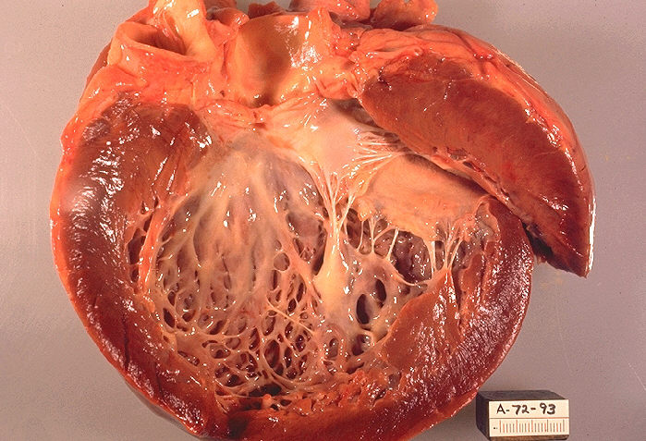
Heart complications
Heart problems include cardiomyopathy,
scarring and weakening of the heart;
myocarditis, inflamed
heart muscle; and
arrhythmia, abnormal
heartbeat.

Slide 31
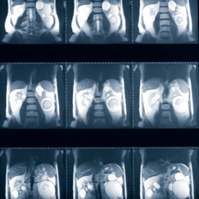
Kidney complications
Renal crisis occurs in about 10% of all patients with scleroderma.
Renal crisis results
in severe uncontrolled
high blood pressure,
which can quickly lead
to kidney failure.

Slide 32
Treatment
There is no direct cure for scleroderma.
Because the cause is unknown, any treatment
is patient-specific and aimed at ameliorating
symptoms of the disease.
Example: Patients with Raynaud’s phenomenon
may be treated with agents to increase blood
flow to the fingers.

Slide 33
Fibrosis of the skin has been treated with varying degrees of success with agents such
as d-penicillamine, colchicine, PUVA, Relaxin,
and cyclosporine.
Because scleroderma is
an autoimmune disease,
one of the major pillars of
treatment involves the use
of immunosuppressive
agents.

Slide 34
With systemic scleroderma, skin changes
may occur suddenly and progressively
worsen during the first one to two years
of the disease.
After that, changes level off or subside, and
sometimes even resolve on their own without
treatment.
When internal organ damage has occurred,
treatment for the specific condition is required.

Slide 35
Pulmonary fibrosis may be treated with drugs that suppress the immune system, along with low doses of corticosteroids.
Pulmonary hypertension may be treated with
drugs that dilate the blood vessels, or with newer
medications that are prescribed specifically for
treating pulmonary hypertension.

Slide 36
Treatment for heart conditions related to
scleroderma ranges from drugs to surgery
and varies depending on the nature of
the condition.
Treatment for kidney conditions related to
scleroderma, includes regular blood pressure
checks and prescribed medications such as
ACE inhibitors.

Slide 37
Summary
Learning to live with scleroderma can be
challenging. There are many areas of one’s
life that are changed by the disease.
Finding ways to remain active and cope with
uncertainty will lead those affected by the
condition to feel better physically and
emotionally.

Slide 38
For more information
Scleroderma Foundation
www.scleroderma.org
The University of Texas Health Science
Center at Houston
Scleroderma research and DNA registry
www.uth.tmc.edu

Slide 39
References/Resources
National Institute of Arthritis and Musculoskeletal
and Skin Diseases
http://www.niams.nih.gov/Health_Info/Scleroderma/default.asp
The University of Texas Health Science Center at Houston
http://www.uthouston.edu/media/newsreleases/nr2010/index
.htm?id=1963629
The University of Texas Health Science Center at Houston
http://www.uth.tmc.edu/schools/med/imed/divisions/
medical-genetics/scleroderma.html

Slide 40
The Mayo Clinic
http://www.mayoclinic.com/health/scleroderma/DS00362
The Scleroderma Foundation
http://www.scleroderma.org/media/overview.shtm
Wikipedia
http://en.wikipedia.org/wiki/Scleroderma
Johns Hopkins University
http://www.hopkinsscleroderma.org/scleroderma/

Slide 41
Web Health Centre
http://www.webhealthcentre.com/drugix/D_Penicillamine
_DI0052.aspx
Wikipedia
http://en.wikipedia.org/wiki/Colchicine
MedicineNet.com
http://www.medterms.com/script/main/art.asp?articlekey=9867

Slide 42
Glossary
ACE inhibitors- a group of pharmaceuticals that are used
primarily in the treatment of hypertension and congestive heart
failure.
autoimmune disease- conditions that arise from an overactive
immune response of the body against substances and tissues
normally present in the body. (The body actually attacks its
own cells.)
colchicine- a medication used in the treatment of rheumatic
disorders, especially gout

Slide 43
collagen- an insoluble fibrous protein of vertebrates that
Is the chief constituent of the fibrils of connective tissue
corticosteroids- any of the steroid hormones made by the
cortex (outer layer) of the adrenal gland
cyclosporine- medication used in the treatment of psoriasis
and other skin disorders
d-penicillamine- a degradation product of penicillin used in
the treatment of severe and active rheumatoid arthritis

Slide 44
fibroblasts- a type of cell that synthesizes the extracellular
matrix and collagen, the structural framework for animal
tissues, and plays a critical role in wound healing.
genome-wide association study- an examination of all or
most of the genes (the genome) of different individuals of a
particular species to see how much the genes vary from
individual to individual. Different variations are then associated
with different traits.
immunosuppressant- an agent that can suppress or prevent
the immune response, used to treat autoimmune disorders

Slide 45
lupus- a chronic inflammatory disease that can affect various
parts of the body, especially the skin, joints, blood, and kidneys
multiple sclerosis (MS)- a debilitating disease in which your
body’s immune system eats away at the protective sheath that
covers your nerves, interfering with the communication
between your brain and the rest of your body
PUVA- (psoralen ultraviolet A) a medication used to treat
vitiligo (white patches on the skin)

Slide 46
rheumatoid arthritis- an autoimmune disease that causes
chronic inflammation of the joints
Relaxin- a synthetic form of a hormone used to soften skin

