Slide 1
Chapter 13
0
How Populations Evolve
http://youtu.be/faRlFsYmkeY

Slide 2
Biology and Society: Persistent Pests
Mosquitoes and malaria - http://uccpbank.k12hsn.org/courses/APEnvironmentalScience/course%20files/multimedia/lesson85/animations/5c_malaria.html
Life cycle of the parasite - http://glencoe.mcgraw-hill.com/sites/9834092339/student_view0/chapter20/malaria__life_cycle_of_plasmodium.html
In the 1960s, the World Health Organization (WHO) began a campaign to eradicate the mosquitoes that transmit malaria.
It used DDT, to which some mosquitoes have evolved resistance.
Here is a solution - http://youtu.be/JxMFL-a8VfY - but how effective will it be, what are the possible resistance mechanisms that the mosquitoes may develop?
Resistance can occur in many different ways - http://youtu.be/FC13AAg_Ry0
© 2010 Pearson Education, Inc.

Slide 3
The evolution of pesticide-resistant insects is just one of the ways that evolution affects our lives.
What is evolution - http://glencoe.mcgraw-hill.com/sites/9834092339/student_view0/chapter20/animation_-_mechanisms_of_evolution.html
An understanding of evolution informs every field of biology, for example:
Agriculture
Medicine
Biotechnology
Conservation biology

Slide 4
Concept Check
0
Darwin proposed the theory of natural selection as the mechanism of evolution based on three observations about nature. Which of the following were part of Darwin’s observations?
Populations have the potential to produce more individuals than the environment can support.
Individuals in some populations have varied characteristics.
Variation in individuals appears to be inherited.
All of the above are correct.
Notes:
Correct Answer: d

Slide 5
CHARLES DARWIN AND THE ORIGIN OF SPECIES
http://www.edutube.org/video/charles-darwins-tree-life-animation
Charles Darwin published On the Origin of Species by Means of Natural Selection, November 24, 1859.
Darwin presented two main concepts:
Life evolves
Change occurs as a result of “descent with modification,” with natural selection as the mechanism
Natural selection is a process in which organisms with certain inherited characteristics are more likely to survive and reproduce than are individuals with other characteristics.
Notes:
Student Misconceptions and Concerns
1. Students often think that the application of pesticides somehow causes the changes necessary for members of a species to survive. It is important to point out that selection simply favors traits already present. The short phrase, first diversity, then selection, can help students remember this important point.
2. Continuing the point above, species do not evolve because of need. Biological diversity exists and the environment selects. Evolution is not deliberate, it is reactive. As teachers, we must be careful in how we express evolution to best reflect this process. For example: birds evolved wings seems as if birds did something deliberately, that there might have been a planning committee! wings evolved in birds is more accurate, in that something was done to birds in the process. This use of the passive voice in our descriptions of evolution better reflects the reactive nature of evolution.
3. Students often think of evolution as a process that improves. However, an adaptation in one context might be a handicap in another. Bats are not better animals than sharks. Neither could survive long in the other’s environment. Instead, the adaptations found in bats best reflect their terrestrial environment, distinct from the aquatic lifestyle and adaptations of sharks.
4. Students often believe that Charles Darwin first suggested that life evolves: the early contributions by Greek philosophers (such as Anaximander) and the work of Jean Baptiste Lamarck remain unappreciated. Consider emphasizing this earlier work.
5. Students might become confused by some scientific debates. Evolution can be considered on three levels, sometimes referred to as a) fact, b) course, and c) mechanism: a) Does evolution occur? b) Who gave rise to whom? and c) Is natural selection the only mechanism of evolution that produces adaptations? Students that listen to scientific debates about the course of evolution might think that evolution itself is under attack. Doubts about ancestry can be misconstrued as doubts about evolution itself. Consider sharing these distinctions with your class.
Teaching Tips
1. Consider beginning your unit on evolution by asking each student to explain how a particular adaptation evolved. Reviewing these student explanations can provide great insight into the misconceptions and confusion that your students bring to the class.
2. Many excellent evolution resources are available:
a. Two extensive sites rich with details and references are (www.ucmp.berkeley.edu/history/evolution.html) and (http://ncseweb.org/).
b. The complete works of Charles Darwin can be accessed at (http://darwin-online.org.uk/).
c. An extensive usenet newsgroup devoted to the discussion and debate of biological and physical origins can be found at (www.talkorigins.org/).
3. Consider asking your students to consider “Can individuals evolve?” Sometimes such simple questions require complex answers. Might Lamarck have answered this question differently than Darwin?

Slide 6
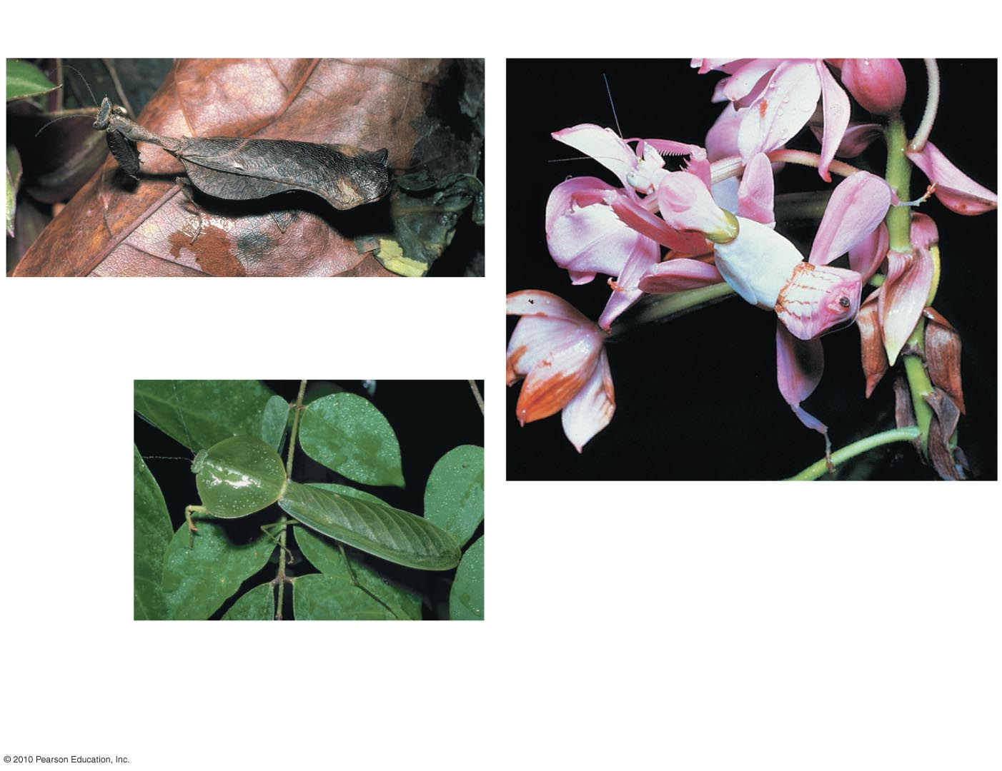
A Trinidad tree mantid that
mimics dead leaves
A flower mantid in Malaysia
A leaf mantid in
Costa Rica
Figure 13.1
Notes:
Figure 13.1 Camouflage as an example of evolutionary adaptation

Slide 7
Natural selection leads to:
A population (a group of individuals of the same species living in the same place at the same time) changing over generations
Evolutionary adaptation
In one modern definition of evolution, the genetic composition of a population changes over time.
The Origin of Species challenged the notion that the Earth was:
Relatively young
Populated by unrelated species
The Greek philosopher Aristotle held the belief that species are fixed and do not evolve.
The Judeo-Christian culture fortified this idea with a literal interpretation of the Bible and suggested the Earth may only be 6,000 years old.
Notes:
Student Misconceptions and Concerns
1. Students often think that the application of pesticides somehow causes the changes necessary for members of a species to survive. It is important to point out that selection simply favors traits already present. The short phrase, first diversity, then selection, can help students remember this important point.
2. Continuing the point above, species do not evolve because of need. Biological diversity exists and the environment selects. Evolution is not deliberate, it is reactive. As teachers, we must be careful in how we express evolution to best reflect this process. For example: birds evolved wings seems as if birds did something deliberately, that there might have been a planning committee! wings evolved in birds is more accurate, in that something was done to birds in the process. This use of the passive voice in our descriptions of evolution better reflects the reactive nature of evolution.
3. Students often think of evolution as a process that improves. However, an adaptation in one context might be a handicap in another. Bats are not better animals than sharks. Neither could survive long in the other’s environment. Instead, the adaptations found in bats best reflect their terrestrial environment, distinct from the aquatic lifestyle and adaptations of sharks.
4. Students often believe that Charles Darwin first suggested that life evolves: the early contributions by Greek philosophers (such as Anaximander) and the work of Jean Baptiste Lamarck remain unappreciated. Consider emphasizing this earlier work.
5. Students might become confused by some scientific debates. Evolution can be considered on three levels, sometimes referred to as a) fact, b) course, and c) mechanism: a) Does evolution occur? b) Who gave rise to whom? and c) Is natural selection the only mechanism of evolution that produces adaptations? Students that listen to scientific debates about the course of evolution might think that evolution itself is under attack. Doubts about ancestry can be misconstrued as doubts about evolution itself. Consider sharing these distinctions with your class.
Teaching Tips
1. Consider beginning your unit on evolution by asking each student to explain how a particular adaptation evolved. Reviewing these student explanations can provide great insight into the misconceptions and confusion that your students bring to the class.
2. Many excellent evolution resources are available:
a. Two extensive sites rich with details and references are (www.ucmp.berkeley.edu/history/evolution.html) and (http://ncseweb.org/).
b. The complete works of Charles Darwin can be accessed at (http://darwin-online.org.uk/).
c. An extensive usenet newsgroup devoted to the discussion and debate of biological and physical origins can be found at (www.talkorigins.org/).
3. Consider asking your students to consider “Can individuals evolve?” Sometimes such simple questions require complex answers. Might Lamarck have answered this question differently than Darwin?

Slide 8
1837
Darwin begins analyzing his
specimens and writing his
notebooks on the origin
of species.
1809
Lamarck
publishes
his theory
of evolution.
1844
Darwin writes his essay
on the origin of species.
1830
Lyell publishes
Principles of Geology.
1865
Mendel publishes
papers on genetics.
1800
1870
1809
Charles Darwin
is born.
1858
Wallace sends an
account of his
theory to Darwin.
1859
Darwin publishes
The Origin of Species.
1831–36
Darwin travels
around the world
on the HMS Beagle.
Green sea turtle in the
Galápagos Islands
Figure 13.2
Notes:
Figure 13.2 The historical context of Darwin's life and ideas

Slide 9
Darwin in 1840
Great
Britain
Asia
Europe
North
America
ATLANTIC
OCEAN
HMS Beagle
Africa
Galápagos
Islands
PACIFIC
OCEAN
Pinta
Marchena
Genovesa
South
America
Equator
Santiago
Equator
Pinzón
Daphne Islands
Australia
Fernandina
Cape of
Good Hope
Isabela
Santa
Cruz
Santa
Fe
PACIFIC
OCEAN
Andes
San
Cristobal
0
40 km
Florenza
Española
Cape Horn
Tasmania
0
40 miles
New
Zealand
Tierra del Fuego
Figure 13.3
Notes:
Figure 13.3 The voyage of the Beagle

Slide 10
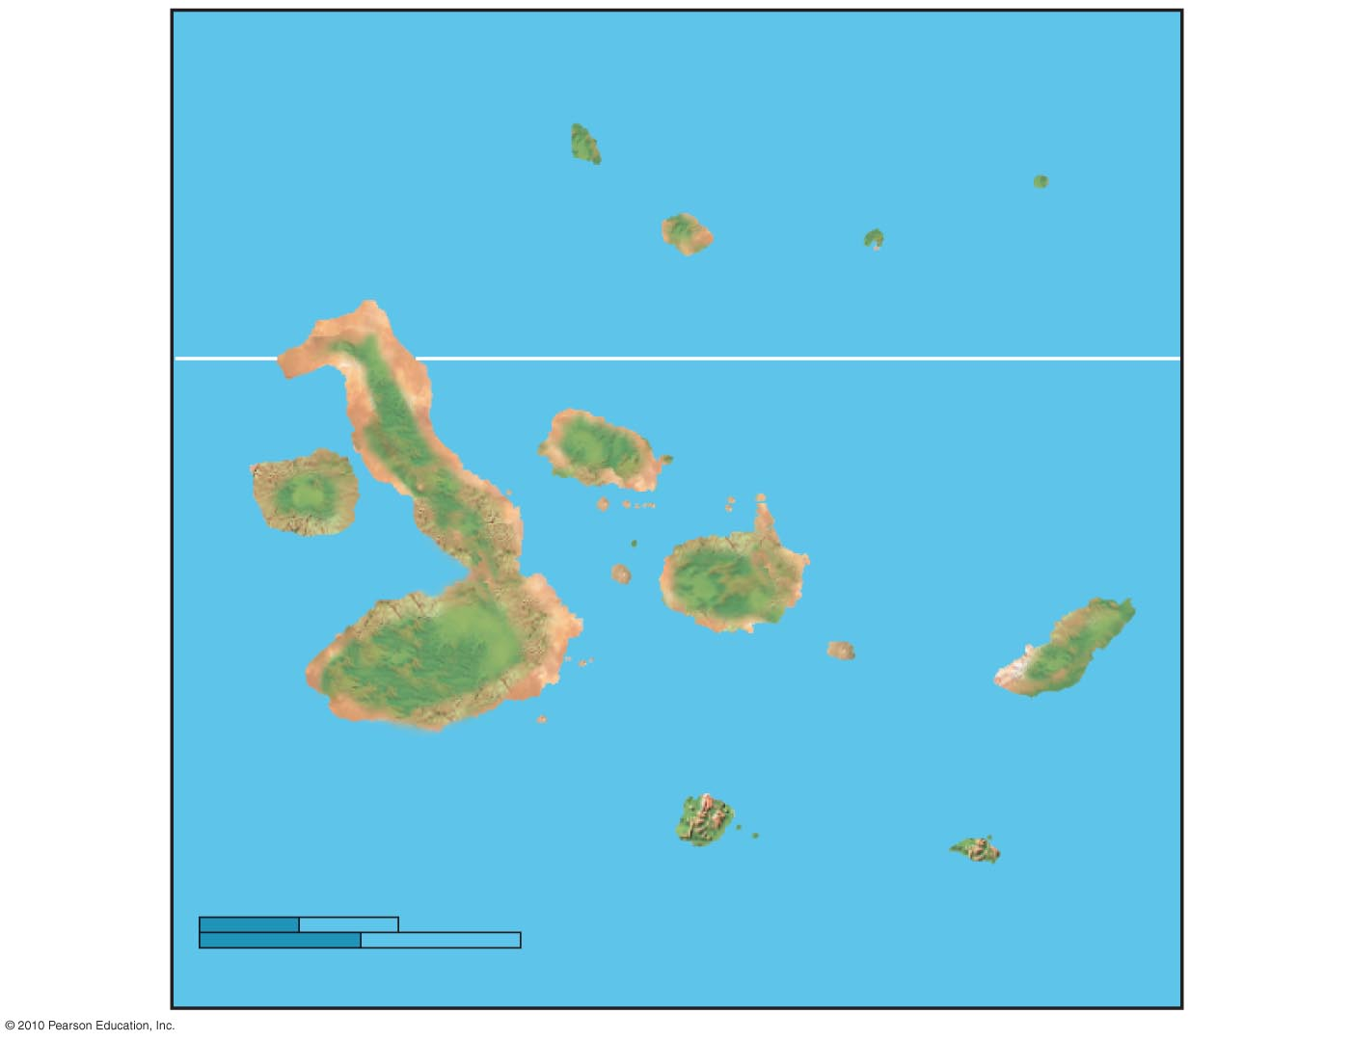
Galápagos
Islands
PACIFIC
OCEAN
Pinta
Genovesa
Marchena
Equator
Santiago
Daphne Islands
Pinzón
Fernandina
Isabela
Santa
Cruz
Santa
Fe
San
Cristobal
0
40 km
Florenza
Española
0
40 miles
Figure 13.3c
Notes:
Figure 13.3c The Galápagos Islands

Slide 11
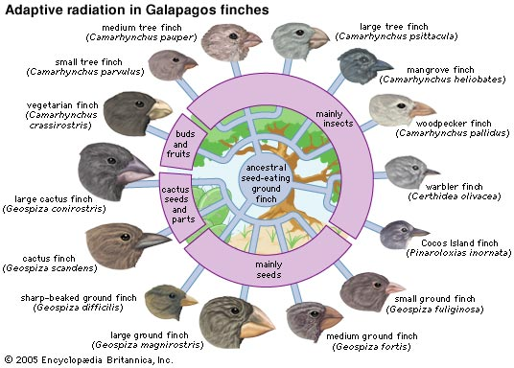
Darwin was intrigued by:
The geographic distribution of organisms on the Galápagos Islands
Similarities between organisms in the Galápagos and those in South America
Darwin made two main points in The Origin of Species:
Organisms inhabiting Earth today descended from ancestral species
Natural selection was the mechanism for descent with modification
Notes:
Student Misconceptions and Concerns
1. Students often think that the application of pesticides somehow causes the changes necessary for members of a species to survive. It is important to point out that selection simply favors traits already present. The short phrase, first diversity, then selection, can help students remember this important point.
2. Continuing the point above, species do not evolve because of need. Biological diversity exists and the environment selects. Evolution is not deliberate, it is reactive. As teachers, we must be careful in how we express evolution to best reflect this process. For example: birds evolved wings seems as if birds did something deliberately, that there might have been a planning committee! wings evolved in birds is more accurate, in that something was done to birds in the process. This use of the passive voice in our descriptions of evolution better reflects the reactive nature of evolution.
3. Students often think of evolution as a process that improves. However, an adaptation in one context might be a handicap in another. Bats are not better animals than sharks. Neither could survive long in the other’s environment. Instead, the adaptations found in bats best reflect their terrestrial environment, distinct from the aquatic lifestyle and adaptations of sharks.
4. Students often believe that Charles Darwin first suggested that life evolves: the early contributions by Greek philosophers (such as Anaximander) and the work of Jean Baptiste Lamarck remain unappreciated. Consider emphasizing this earlier work.
5. Students might become confused by some scientific debates. Evolution can be considered on three levels, sometimes referred to as a) fact, b) course, and c) mechanism: a) Does evolution occur? b) Who gave rise to whom? and c) Is natural selection the only mechanism of evolution that produces adaptations? Students that listen to scientific debates about the course of evolution might think that evolution itself is under attack. Doubts about ancestry can be misconstrued as doubts about evolution itself. Consider sharing these distinctions with your class.
Teaching Tips
1. Consider beginning your unit on evolution by asking each student to explain how a particular adaptation evolved. Reviewing these student explanations can provide great insight into the misconceptions and confusion that your students bring to the class.
2. Many excellent evolution resources are available:
a. Two extensive sites rich with details and references are (www.ucmp.berkeley.edu/history/evolution.html) and (http://ncseweb.org/).
b. The complete works of Charles Darwin can be accessed at (http://darwin-online.org.uk/).
c. An extensive usenet newsgroup devoted to the discussion and debate of biological and physical origins can be found at (www.talkorigins.org/).
3. Consider asking your students to consider “Can individuals evolve?” Sometimes such simple questions require complex answers. Might Lamarck have answered this question differently than Darwin?

Slide 12
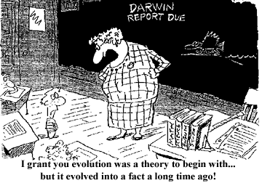
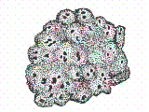
EVIDENCE OF EVOLUTION
Biological evolution leaves observable signs.
We will examine five of the many lines of evidence in support of evolution - http://www.sumanasinc.com/webcontent/animations/content/evolution/evolution.html:
The fossil record
Biogeography
Comparative anatomy
Comparative embryology
Molecular biology
Notes:
Student Misconceptions and Concerns
1. Students may struggle with the concept of evolution and bring personal objections to the classroom. This section focuses on the evidence of evolution. This portion of the chapter allows a demonstration of the scientific process in which the strength of our confidence builds with multiple, independent lines of evidence. Science requires evidence and cannot rely upon faith or supernatural events for explanations.
2. Students might expect that every living organism will leave fossils, and that we should be able to find them. Further, they might falsely conclude, the absence of evidence is evidence of absence. Understanding the rare circumstances under which fossils form (the scientific study of fossil formation is “aphonomy), the geological processes that distort and destroy layers (e.g. earthquakes and glaciers), and the unlikely discovery of fossils helps students understand why the fossil record is limited.
3. The experiences of beginning college students with the subject of fossils are likely to be uneven and weak. For example, the many ways that fossil ages are determined also demonstrates the strength of independent lines of evidence and consistency. Here is a chance to describe the many ways that a fossil’s age can be determined (e.g., radiometric dating, association with other fossils of known age in the same layer, correlation to other strata of known ages).
4. Students often do not understand the significance of evolution, the power of its explanation. The authors contrast evidence for common descent versus independent origins. This clear distinction between these hypotheses helps to identify evidence that is best explained by evolution.
Teaching Tips
1. If you have any sort of a fossil, it makes a nice visual aid (of course, the larger the better). Many shops in natural history museums carry large and common fossils that can be purchased for less than $50.00. The more unusual the better. Crinoid stems or other marine fossils from the Midwest are the types of fossils that make the point that life and ecosystems change over time.
2. The sequence but not absolute ages are revealed by the stratifications in sedimentary rocks. This is like peeling the layers of wallpaper from the walls of a very old house that has been inhabited by many owners. By the sequence, we can tell which layers are older, but not the absolute ages of each layer.
3. Another popular example of biogeography is the distribution of lungfish in Australia, southern South America, and southern Africa. At one time, these three continents were united as Gondwanaland.
4. One striking example of evolutionary remodeling is the shell of turtles primarily made from its vertebrae and modified ribs. If you find an old turtle shell and soak it in water, the shell may fall apart leaving isolated ribs that make interesting visual aids.
5. The evolution of the three inner ear bones in mammals, the malleus and incus joining the stapes (already present as the columella in reptiles), is another wonderful transitional sequence in the fossil record.
6. Building upon the earlier point about the evolution of the middle ear bones from the lower jaw of reptiles, consider the conflicting problems of hearing while chewing. Ask your students to consider the problems of chewing carrots and listening to a lecture. The mammalian hearing apparatus clearly conflicts with the crunching noises of chewing, one of the costs of remodeling. Adaptations typically represent a compromise of functions.
7. You can have some fun with this analogy to molecular evidence for evolution. As teachers, we have to be keen to acts of cheating. Certainly, if two students turned in written assignments that differed by just a few words, we would conclude that they had a common heritage.

Slide 13
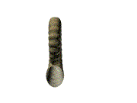
The Fossil Record
Fossils - http://youtu.be/SiN0jxZ6I2w
Imprints or remains of organisms that lived in the past
Often found in sedimentary rocks
The fossil record:
Is the ordered sequence of fossils as they appear in rock layers
Reveals the appearance of organisms in a historical sequence
Fits the molecular and cellular evidence that prokaryotes are the ancestors of all life
Notes:
Student Misconceptions and Concerns
1. Students may struggle with the concept of evolution and bring personal objections to the classroom. This section focuses on the evidence of evolution. This portion of the chapter allows a demonstration of the scientific process in which the strength of our confidence builds with multiple, independent lines of evidence. Science requires evidence and cannot rely upon faith or supernatural events for explanations.
2. Students might expect that every living organism will leave fossils, and that we should be able to find them. Further, they might falsely conclude, the absence of evidence is evidence of absence. Understanding the rare circumstances under which fossils form (the scientific study of fossil formation is “aphonomy), the geological processes that distort and destroy layers (e.g. earthquakes and glaciers), and the unlikely discovery of fossils helps students understand why the fossil record is limited.
3. The experiences of beginning college students with the subject of fossils are likely to be uneven and weak. For example, the many ways that fossil ages are determined also demonstrates the strength of independent lines of evidence and consistency. Here is a chance to describe the many ways that a fossil’s age can be determined (e.g., radiometric dating, association with other fossils of known age in the same layer, correlation to other strata of known ages).
4. Students often do not understand the significance of evolution, the power of its explanation. The authors contrast evidence for common descent versus independent origins. This clear distinction between these hypotheses helps to identify evidence that is best explained by evolution.
Teaching Tips
1. If you have any sort of a fossil, it makes a nice visual aid (of course, the larger the better). Many shops in natural history museums carry large and common fossils that can be purchased for less than $50.00. The more unusual the better. Crinoid stems or other marine fossils from the Midwest are the types of fossils that make the point that life and ecosystems change over time.
2. The sequence but not absolute ages are revealed by the stratifications in sedimentary rocks. This is like peeling the layers of wallpaper from the walls of a very old house that has been inhabited by many owners. By the sequence, we can tell which layers are older, but not the absolute ages of each layer.
3. Another popular example of biogeography is the distribution of lungfish in Australia, southern South America, and southern Africa. At one time, these three continents were united as Gondwanaland.
4. One striking example of evolutionary remodeling is the shell of turtles primarily made from its vertebrae and modified ribs. If you find an old turtle shell and soak it in water, the shell may fall apart leaving isolated ribs that make interesting visual aids.
5. The evolution of the three inner ear bones in mammals, the malleus and incus joining the stapes (already present as the columella in reptiles), is another wonderful transitional sequence in the fossil record.
6. Building upon the earlier point about the evolution of the middle ear bones from the lower jaw of reptiles, consider the conflicting problems of hearing while chewing. Ask your students to consider the problems of chewing carrots and listening to a lecture. The mammalian hearing apparatus clearly conflicts with the crunching noises of chewing, one of the costs of remodeling. Adaptations typically represent a compromise of functions.
7. You can have some fun with this analogy to molecular evidence for evolution. As teachers, we have to be keen to acts of cheating. Certainly, if two students turned in written assignments that differed by just a few words, we would conclude that they had a common heritage.

Slide 14
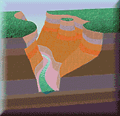
Biogeography
Biogeography is the study of the geographic distribution of species that first suggested to Darwin that today’s organisms evolved from ancestral forms.
http://youtu.be/2VIOOM3efvg
Many examples from biogeography would be difficult to understand, except from an evolutionary perspective.
One example is the distribution of marsupial mammals in Australia - http://youtu.be/QRBOj53MSos.
Notes:
Student Misconceptions and Concerns
1. Students may struggle with the concept of evolution and bring personal objections to the classroom. This section focuses on the evidence of evolution. This portion of the chapter allows a demonstration of the scientific process in which the strength of our confidence builds with multiple, independent lines of evidence. Science requires evidence and cannot rely upon faith or supernatural events for explanations.
2. Students might expect that every living organism will leave fossils, and that we should be able to find them. Further, they might falsely conclude, the absence of evidence is evidence of absence. Understanding the rare circumstances under which fossils form (the scientific study of fossil formation is “aphonomy), the geological processes that distort and destroy layers (e.g. earthquakes and glaciers), and the unlikely discovery of fossils helps students understand why the fossil record is limited.
3. The experiences of beginning college students with the subject of fossils are likely to be uneven and weak. For example, the many ways that fossil ages are determined also demonstrates the strength of independent lines of evidence and consistency. Here is a chance to describe the many ways that a fossil’s age can be determined (e.g., radiometric dating, association with other fossils of known age in the same layer, correlation to other strata of known ages).
4. Students often do not understand the significance of evolution, the power of its explanation. The authors contrast evidence for common descent versus independent origins. This clear distinction between these hypotheses helps to identify evidence that is best explained by evolution.
Teaching Tips
1. If you have any sort of a fossil, it makes a nice visual aid (of course, the larger the better). Many shops in natural history museums carry large and common fossils that can be purchased for less than $50.00. The more unusual the better. Crinoid stems or other marine fossils from the Midwest are the types of fossils that make the point that life and ecosystems change over time.
2. The sequence but not absolute ages are revealed by the stratifications in sedimentary rocks. This is like peeling the layers of wallpaper from the walls of a very old house that has been inhabited by many owners. By the sequence, we can tell which layers are older, but not the absolute ages of each layer.
3. Another popular example of biogeography is the distribution of lungfish in Australia, southern South America, and southern Africa. At one time, these three continents were united as Gondwanaland.
4. One striking example of evolutionary remodeling is the shell of turtles primarily made from its vertebrae and modified ribs. If you find an old turtle shell and soak it in water, the shell may fall apart leaving isolated ribs that make interesting visual aids.
5. The evolution of the three inner ear bones in mammals, the malleus and incus joining the stapes (already present as the columella in reptiles), is another wonderful transitional sequence in the fossil record.
6. Building upon the earlier point about the evolution of the middle ear bones from the lower jaw of reptiles, consider the conflicting problems of hearing while chewing. Ask your students to consider the problems of chewing carrots and listening to a lecture. The mammalian hearing apparatus clearly conflicts with the crunching noises of chewing, one of the costs of remodeling. Adaptations typically represent a compromise of functions.
7. You can have some fun with this analogy to molecular evidence for evolution. As teachers, we have to be keen to acts of cheating. Certainly, if two students turned in written assignments that differed by just a few words, we would conclude that they had a common heritage.

Slide 15
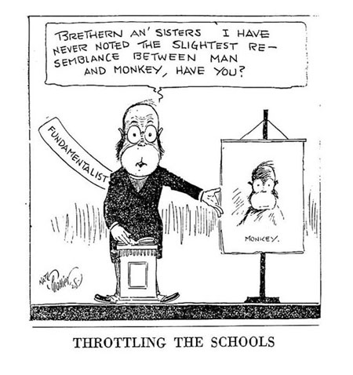
Comparative Anatomy
Is the comparison of body structure between different species
Confirms that evolution is a remodeling process
Notes:
Student Misconceptions and Concerns
1. Students may struggle with the concept of evolution and bring personal objections to the classroom. This section focuses on the evidence of evolution. This portion of the chapter allows a demonstration of the scientific process in which the strength of our confidence builds with multiple, independent lines of evidence. Science requires evidence and cannot rely upon faith or supernatural events for explanations.
2. Students might expect that every living organism will leave fossils, and that we should be able to find them. Further, they might falsely conclude, the absence of evidence is evidence of absence. Understanding the rare circumstances under which fossils form (the scientific study of fossil formation is “aphonomy), the geological processes that distort and destroy layers (e.g. earthquakes and glaciers), and the unlikely discovery of fossils helps students understand why the fossil record is limited.
3. The experiences of beginning college students with the subject of fossils are likely to be uneven and weak. For example, the many ways that fossil ages are determined also demonstrates the strength of independent lines of evidence and consistency. Here is a chance to describe the many ways that a fossil’s age can be determined (e.g., radiometric dating, association with other fossils of known age in the same layer, correlation to other strata of known ages).
4. Students often do not understand the significance of evolution, the power of its explanation. The authors contrast evidence for common descent versus independent origins. This clear distinction between these hypotheses helps to identify evidence that is best explained by evolution.
Teaching Tips
1. If you have any sort of a fossil, it makes a nice visual aid (of course, the larger the better). Many shops in natural history museums carry large and common fossils that can be purchased for less than $50.00. The more unusual the better. Crinoid stems or other marine fossils from the Midwest are the types of fossils that make the point that life and ecosystems change over time.
2. The sequence but not absolute ages are revealed by the stratifications in sedimentary rocks. This is like peeling the layers of wallpaper from the walls of a very old house that has been inhabited by many owners. By the sequence, we can tell which layers are older, but not the absolute ages of each layer.
3. Another popular example of biogeography is the distribution of lungfish in Australia, southern South America, and southern Africa. At one time, these three continents were united as Gondwanaland.
4. One striking example of evolutionary remodeling is the shell of turtles primarily made from its vertebrae and modified ribs. If you find an old turtle shell and soak it in water, the shell may fall apart leaving isolated ribs that make interesting visual aids.
5. The evolution of the three inner ear bones in mammals, the malleus and incus joining the stapes (already present as the columella in reptiles), is another wonderful transitional sequence in the fossil record.
6. Building upon the earlier point about the evolution of the middle ear bones from the lower jaw of reptiles, consider the conflicting problems of hearing while chewing. Ask your students to consider the problems of chewing carrots and listening to a lecture. The mammalian hearing apparatus clearly conflicts with the crunching noises of chewing, one of the costs of remodeling. Adaptations typically represent a compromise of functions.
7. You can have some fun with this analogy to molecular evidence for evolution. As teachers, we have to be keen to acts of cheating. Certainly, if two students turned in written assignments that differed by just a few words, we would conclude that they had a common heritage.

Slide 16
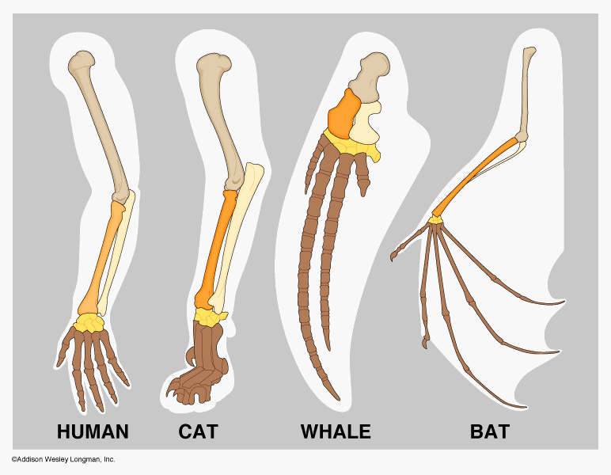
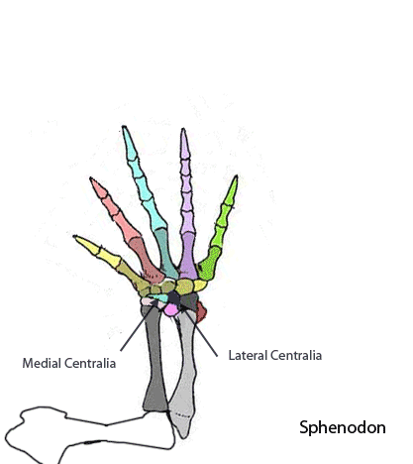
Homology is:
The similarity in structures due to common ancestry
Illustrated by the remodeling of the pattern of bones forming the forelimbs of mammals
Notes:
Student Misconceptions and Concerns
1. Students may struggle with the concept of evolution and bring personal objections to the classroom. This section focuses on the evidence of evolution. This portion of the chapter allows a demonstration of the scientific process in which the strength of our confidence builds with multiple, independent lines of evidence. Science requires evidence and cannot rely upon faith or supernatural events for explanations.
2. Students might expect that every living organism will leave fossils, and that we should be able to find them. Further, they might falsely conclude, the absence of evidence is evidence of absence. Understanding the rare circumstances under which fossils form (the scientific study of fossil formation is “aphonomy), the geological processes that distort and destroy layers (e.g. earthquakes and glaciers), and the unlikely discovery of fossils helps students understand why the fossil record is limited.
3. The experiences of beginning college students with the subject of fossils are likely to be uneven and weak. For example, the many ways that fossil ages are determined also demonstrates the strength of independent lines of evidence and consistency. Here is a chance to describe the many ways that a fossil’s age can be determined (e.g., radiometric dating, association with other fossils of known age in the same layer, correlation to other strata of known ages).
4. Students often do not understand the significance of evolution, the power of its explanation. The authors contrast evidence for common descent versus independent origins. This clear distinction between these hypotheses helps to identify evidence that is best explained by evolution.
Teaching Tips
1. If you have any sort of a fossil, it makes a nice visual aid (of course, the larger the better). Many shops in natural history museums carry large and common fossils that can be purchased for less than $50.00. The more unusual the better. Crinoid stems or other marine fossils from the Midwest are the types of fossils that make the point that life and ecosystems change over time.
2. The sequence but not absolute ages are revealed by the stratifications in sedimentary rocks. This is like peeling the layers of wallpaper from the walls of a very old house that has been inhabited by many owners. By the sequence, we can tell which layers are older, but not the absolute ages of each layer.
3. Another popular example of biogeography is the distribution of lungfish in Australia, southern South America, and southern Africa. At one time, these three continents were united as Gondwanaland.
4. One striking example of evolutionary remodeling is the shell of turtles primarily made from its vertebrae and modified ribs. If you find an old turtle shell and soak it in water, the shell may fall apart leaving isolated ribs that make interesting visual aids.
5. The evolution of the three inner ear bones in mammals, the malleus and incus joining the stapes (already present as the columella in reptiles), is another wonderful transitional sequence in the fossil record.
6. Building upon the earlier point about the evolution of the middle ear bones from the lower jaw of reptiles, consider the conflicting problems of hearing while chewing. Ask your students to consider the problems of chewing carrots and listening to a lecture. The mammalian hearing apparatus clearly conflicts with the crunching noises of chewing, one of the costs of remodeling. Adaptations typically represent a compromise of functions.
7. You can have some fun with this analogy to molecular evidence for evolution. As teachers, we have to be keen to acts of cheating. Certainly, if two students turned in written assignments that differed by just a few words, we would conclude that they had a common heritage.

Slide 17
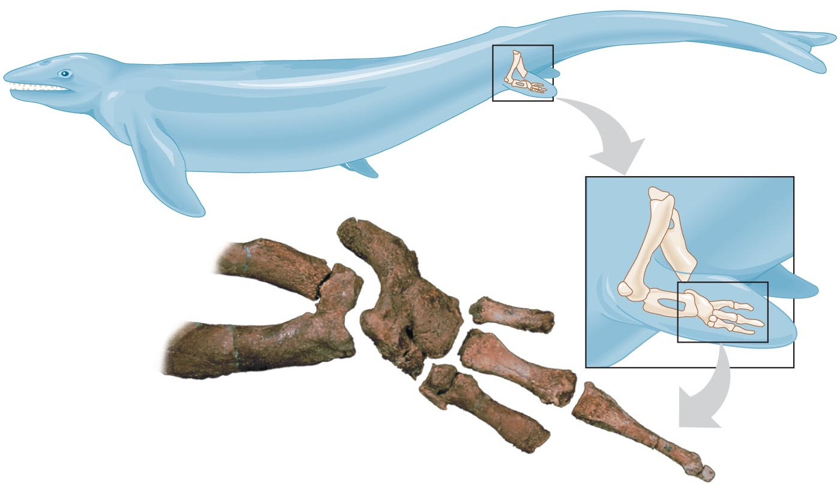
Concept Check
0
This Basilosaurus fossil (an extinct, early whale) provides strong evidence that
whales originated in marine environments.
whale ancestors were four-legged terrestrial animals.
ancient whales swam faster than modern whales.
Notes:
Correct Answer: b

Slide 18
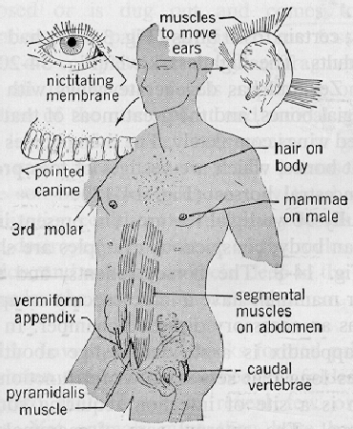
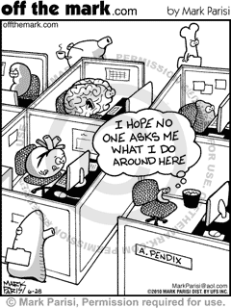
Vestigial structures - http://youtu.be/pbc7ee9u1JE:
Are remnants of features that served important functions in an organism’s ancestors
Now have only marginal, if any, importance
Notes:
Student Misconceptions and Concerns
1. Students may struggle with the concept of evolution and bring personal objections to the classroom. This section focuses on the evidence of evolution. This portion of the chapter allows a demonstration of the scientific process in which the strength of our confidence builds with multiple, independent lines of evidence. Science requires evidence and cannot rely upon faith or supernatural events for explanations.
2. Students might expect that every living organism will leave fossils, and that we should be able to find them. Further, they might falsely conclude, the absence of evidence is evidence of absence. Understanding the rare circumstances under which fossils form (the scientific study of fossil formation is “aphonomy), the geological processes that distort and destroy layers (e.g. earthquakes and glaciers), and the unlikely discovery of fossils helps students understand why the fossil record is limited.
3. The experiences of beginning college students with the subject of fossils are likely to be uneven and weak. For example, the many ways that fossil ages are determined also demonstrates the strength of independent lines of evidence and consistency. Here is a chance to describe the many ways that a fossil’s age can be determined (e.g., radiometric dating, association with other fossils of known age in the same layer, correlation to other strata of known ages).
4. Students often do not understand the significance of evolution, the power of its explanation. The authors contrast evidence for common descent versus independent origins. This clear distinction between these hypotheses helps to identify evidence that is best explained by evolution.
Teaching Tips
1. If you have any sort of a fossil, it makes a nice visual aid (of course, the larger the better). Many shops in natural history museums carry large and common fossils that can be purchased for less than $50.00. The more unusual the better. Crinoid stems or other marine fossils from the Midwest are the types of fossils that make the point that life and ecosystems change over time.
2. The sequence but not absolute ages are revealed by the stratifications in sedimentary rocks. This is like peeling the layers of wallpaper from the walls of a very old house that has been inhabited by many owners. By the sequence, we can tell which layers are older, but not the absolute ages of each layer.
3. Another popular example of biogeography is the distribution of lungfish in Australia, southern South America, and southern Africa. At one time, these three continents were united as Gondwanaland.
4. One striking example of evolutionary remodeling is the shell of turtles primarily made from its vertebrae and modified ribs. If you find an old turtle shell and soak it in water, the shell may fall apart leaving isolated ribs that make interesting visual aids.
5. The evolution of the three inner ear bones in mammals, the malleus and incus joining the stapes (already present as the columella in reptiles), is another wonderful transitional sequence in the fossil record.
6. Building upon the earlier point about the evolution of the middle ear bones from the lower jaw of reptiles, consider the conflicting problems of hearing while chewing. Ask your students to consider the problems of chewing carrots and listening to a lecture. The mammalian hearing apparatus clearly conflicts with the crunching noises of chewing, one of the costs of remodeling. Adaptations typically represent a compromise of functions.
7. You can have some fun with this analogy to molecular evidence for evolution. As teachers, we have to be keen to acts of cheating. Certainly, if two students turned in written assignments that differed by just a few words, we would conclude that they had a common heritage.

Slide 19
Comparative Embryology
Early stages of development in different animal species reveal additional homologous relationships.
For example, pharyngeal pouches appear on the side of the embryo’s throat, which:
Develop into gill structures in fish
Form parts of the ear and throat in humans
Comparative embryology of vertebrates supports evolutionary theory.
Notes:
Student Misconceptions and Concerns
1. Students may struggle with the concept of evolution and bring personal objections to the classroom. This section focuses on the evidence of evolution. This portion of the chapter allows a demonstration of the scientific process in which the strength of our confidence builds with multiple, independent lines of evidence. Science requires evidence and cannot rely upon faith or supernatural events for explanations.
2. Students might expect that every living organism will leave fossils, and that we should be able to find them. Further, they might falsely conclude, the absence of evidence is evidence of absence. Understanding the rare circumstances under which fossils form (the scientific study of fossil formation is “aphonomy), the geological processes that distort and destroy layers (e.g. earthquakes and glaciers), and the unlikely discovery of fossils helps students understand why the fossil record is limited.
3. The experiences of beginning college students with the subject of fossils are likely to be uneven and weak. For example, the many ways that fossil ages are determined also demonstrates the strength of independent lines of evidence and consistency. Here is a chance to describe the many ways that a fossil’s age can be determined (e.g., radiometric dating, association with other fossils of known age in the same layer, correlation to other strata of known ages).
4. Students often do not understand the significance of evolution, the power of its explanation. The authors contrast evidence for common descent versus independent origins. This clear distinction between these hypotheses helps to identify evidence that is best explained by evolution.
Teaching Tips
1. If you have any sort of a fossil, it makes a nice visual aid (of course, the larger the better). Many shops in natural history museums carry large and common fossils that can be purchased for less than $50.00. The more unusual the better. Crinoid stems or other marine fossils from the Midwest are the types of fossils that make the point that life and ecosystems change over time.
2. The sequence but not absolute ages are revealed by the stratifications in sedimentary rocks. This is like peeling the layers of wallpaper from the walls of a very old house that has been inhabited by many owners. By the sequence, we can tell which layers are older, but not the absolute ages of each layer.
3. Another popular example of biogeography is the distribution of lungfish in Australia, southern South America, and southern Africa. At one time, these three continents were united as Gondwanaland.
4. One striking example of evolutionary remodeling is the shell of turtles primarily made from its vertebrae and modified ribs. If you find an old turtle shell and soak it in water, the shell may fall apart leaving isolated ribs that make interesting visual aids.
5. The evolution of the three inner ear bones in mammals, the malleus and incus joining the stapes (already present as the columella in reptiles), is another wonderful transitional sequence in the fossil record.
6. Building upon the earlier point about the evolution of the middle ear bones from the lower jaw of reptiles, consider the conflicting problems of hearing while chewing. Ask your students to consider the problems of chewing carrots and listening to a lecture. The mammalian hearing apparatus clearly conflicts with the crunching noises of chewing, one of the costs of remodeling. Adaptations typically represent a compromise of functions.
7. You can have some fun with this analogy to molecular evidence for evolution. As teachers, we have to be keen to acts of cheating. Certainly, if two students turned in written assignments that differed by just a few words, we would conclude that they had a common heritage.

Slide 20
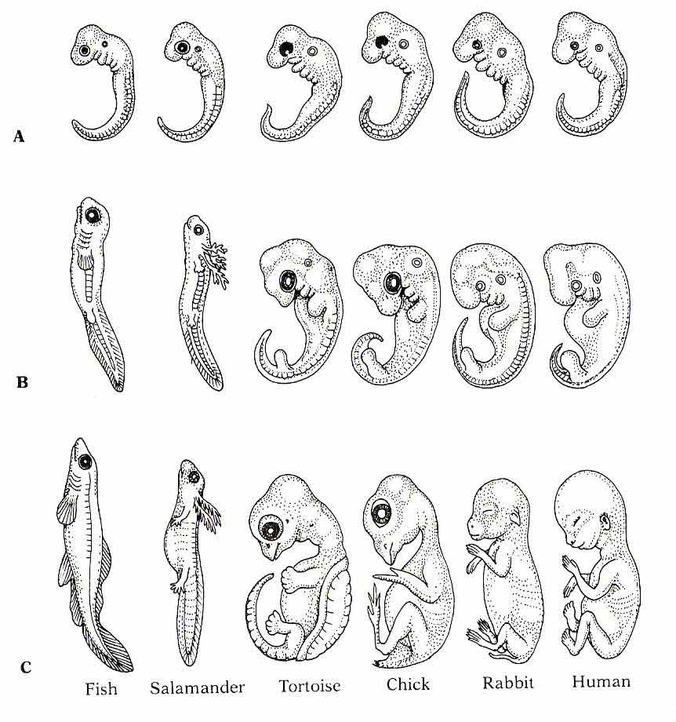
Notes:
Figure 13.9 Evolutionary signs from comparative embryology

Slide 21
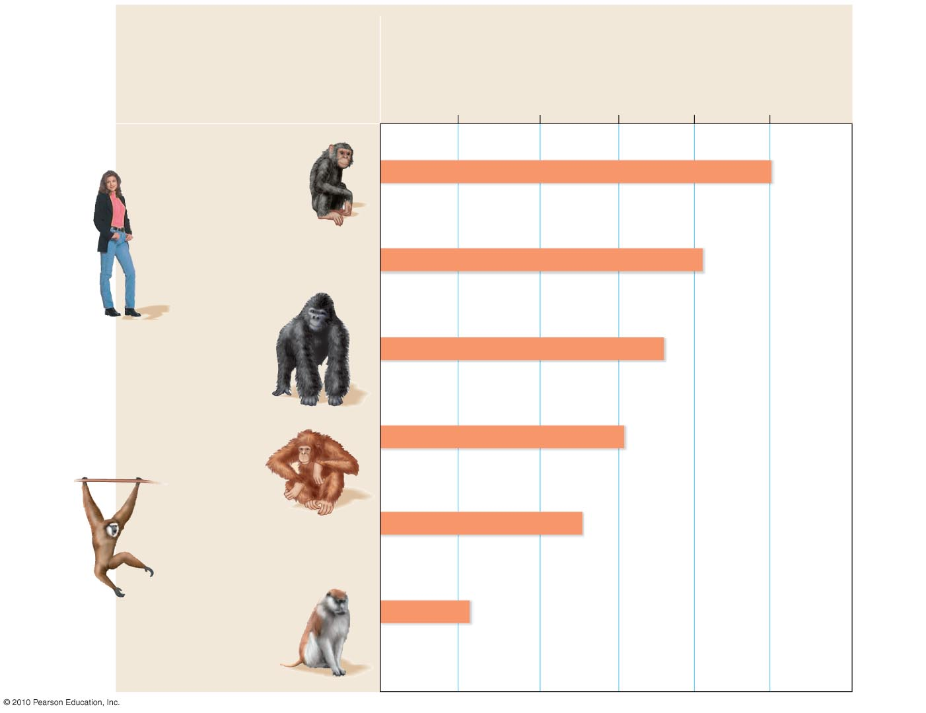
Molecular Biology
Primate
Percent of selected DNA sequences
that match a chimpanzee’s DNA
92%
96%
100%
Chimpanzee
Human
Gorilla
Orangutan
Gibbon
Old World
monkey
Notes:
Student Misconceptions and Concerns
1. Students may struggle with the concept of evolution and bring personal objections to the classroom. This section focuses on the evidence of evolution. This portion of the chapter allows a demonstration of the scientific process in which the strength of our confidence builds with multiple, independent lines of evidence. Science requires evidence and cannot rely upon faith or supernatural events for explanations.
2. Students might expect that every living organism will leave fossils, and that we should be able to find them. Further, they might falsely conclude, the absence of evidence is evidence of absence. Understanding the rare circumstances under which fossils form (the scientific study of fossil formation is “aphonomy), the geological processes that distort and destroy layers (e.g. earthquakes and glaciers), and the unlikely discovery of fossils helps students understand why the fossil record is limited.
3. The experiences of beginning college students with the subject of fossils are likely to be uneven and weak. For example, the many ways that fossil ages are determined also demonstrates the strength of independent lines of evidence and consistency. Here is a chance to describe the many ways that a fossil’s age can be determined (e.g., radiometric dating, association with other fossils of known age in the same layer, correlation to other strata of known ages).
4. Students often do not understand the significance of evolution, the power of its explanation. The authors contrast evidence for common descent versus independent origins. This clear distinction between these hypotheses helps to identify evidence that is best explained by evolution.
Teaching Tips
1. If you have any sort of a fossil, it makes a nice visual aid (of course, the larger the better). Many shops in natural history museums carry large and common fossils that can be purchased for less than $50.00. The more unusual the better. Crinoid stems or other marine fossils from the Midwest are the types of fossils that make the point that life and ecosystems change over time.
2. The sequence but not absolute ages are revealed by the stratifications in sedimentary rocks. This is like peeling the layers of wallpaper from the walls of a very old house that has been inhabited by many owners. By the sequence, we can tell which layers are older, but not the absolute ages of each layer.
3. Another popular example of biogeography is the distribution of lungfish in Australia, southern South America, and southern Africa. At one time, these three continents were united as Gondwanaland.
4. One striking example of evolutionary remodeling is the shell of turtles primarily made from its vertebrae and modified ribs. If you find an old turtle shell and soak it in water, the shell may fall apart leaving isolated ribs that make interesting visual aids.
5. The evolution of the three inner ear bones in mammals, the malleus and incus joining the stapes (already present as the columella in reptiles), is another wonderful transitional sequence in the fossil record.
6. Building upon the earlier point about the evolution of the middle ear bones from the lower jaw of reptiles, consider the conflicting problems of hearing while chewing. Ask your students to consider the problems of chewing carrots and listening to a lecture. The mammalian hearing apparatus clearly conflicts with the crunching noises of chewing, one of the costs of remodeling. Adaptations typically represent a compromise of functions.
7. You can have some fun with this analogy to molecular evidence for evolution. As teachers, we have to be keen to acts of cheating. Certainly, if two students turned in written assignments that differed by just a few words, we would conclude that they had a common heritage.

Slide 22
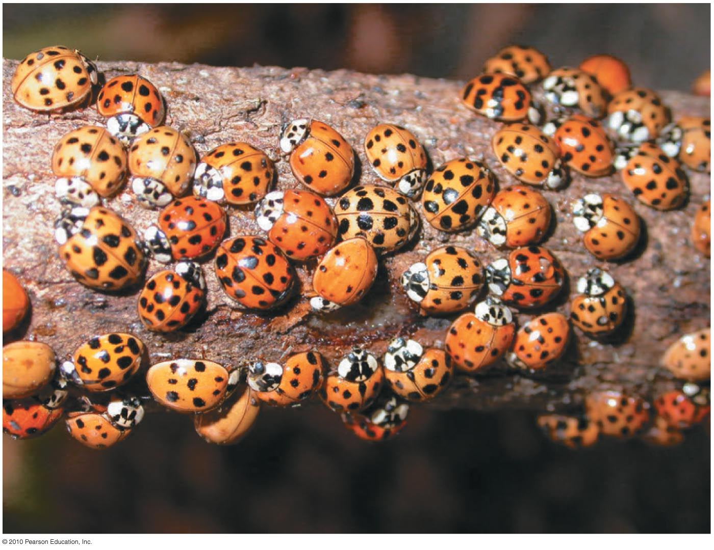
Darwin’s Theory of Natural Selection
Darwin based his theory of natural selection on two key observations:
All species tend to produce excessive numbers of offspring
Organisms vary, and much of this variation is heritable
Observation 1: Overproduction
All species tend to produce excessive numbers.
This leads to a struggle for existence.
Observation 2: Individual variation
Variation exists among individuals in a population.
Much of this variation is heritable.
Spore cloud
Notes:
Student Misconceptions and Concerns
1. Students must understand that the environment does the selecting (editing) in natural selection. Species do not evolve because of want or need. Biological diversity exists and the environment selects. Evolution is not deliberate, it is reactive.
2. A related point is what we learn from extinction. As Darwin noted, species become extinct because they do not get what they want or need!
3. The authors note that evolution is not goal directed and does not lead to perfectly adapted organisms. These excellent points represent two misunderstandings: 1) Instructors need to be clear that evolutionary change is a consequence of an immediate advantage, not a distant goal. Three-chambered hearts in amphibians evolved from two-chambered fish hearts because the three-chambered hearts conveyed an advantage, not because evolution was directed toward producing a four-chambered heart! 2) Evolutionary change only reflects improvement in the context of the immediate environment. What is better today may not be better tomorrow. Thus, species do not steadily get better, they respond to the environment or go extinct.
Teaching Tips
1. An analogy might be made between the specialized functions of finch beaks and the many types of screwdrivers that exist today. Each type of screwdriver (Phillips, flathead, long-handled, interchangeable tips) represents a specialization for a particular job.
2. Based upon the human condition, students are likely to think that reproduction is largely a choice, and less a consequence of good health or other adaptations. Yet, in our natural world, there are thousands of examples of the overproduction of offspring and resulting death or failure to reproduce. Thousands of acorns hanging from one tree, spores escaping from a puffball, or a salmon spawning thousands of eggs, are all easy examples of overproduction. Bring a few solid illustrations from your geographic region to bring home this point.

Slide 23
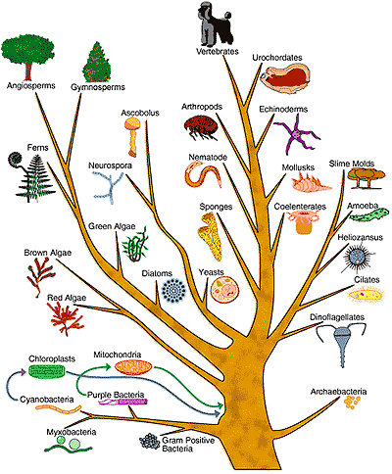
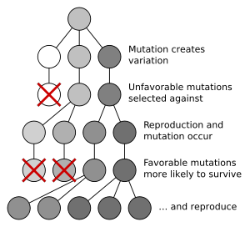
Inference: Differential reproductive success (natural selection)
http://youtu.be/PDuAFBCst1U
Those individuals with traits best suited to the local environment generally leave a larger share of surviving, fertile offspring.
Notes:
Student Misconceptions and Concerns
1. Students must understand that the environment does the selecting (editing) in natural selection. Species do not evolve because of want or need. Biological diversity exists and the environment selects. Evolution is not deliberate, it is reactive.
2. A related point is what we learn from extinction. As Darwin noted, species become extinct because they do not get what they want or need!
3. The authors note that evolution is not goal directed and does not lead to perfectly adapted organisms. These excellent points represent two misunderstandings: 1) Instructors need to be clear that evolutionary change is a consequence of an immediate advantage, not a distant goal. Three-chambered hearts in amphibians evolved from two-chambered fish hearts because the three-chambered hearts conveyed an advantage, not because evolution was directed toward producing a four-chambered heart! 2) Evolutionary change only reflects improvement in the context of the immediate environment. What is better today may not be better tomorrow. Thus, species do not steadily get better, they respond to the environment or go extinct.
Teaching Tips
1. An analogy might be made between the specialized functions of finch beaks and the many types of screwdrivers that exist today. Each type of screwdriver (Phillips, flathead, long-handled, interchangeable tips) represents a specialization for a particular job.
2. Based upon the human condition, students are likely to think that reproduction is largely a choice, and less a consequence of good health or other adaptations. Yet, in our natural world, there are thousands of examples of the overproduction of offspring and resulting death or failure to reproduce. Thousands of acorns hanging from one tree, spores escaping from a puffball, or a salmon spawning thousands of eggs, are all easy examples of overproduction. Bring a few solid illustrations from your geographic region to bring home this point.

Slide 24
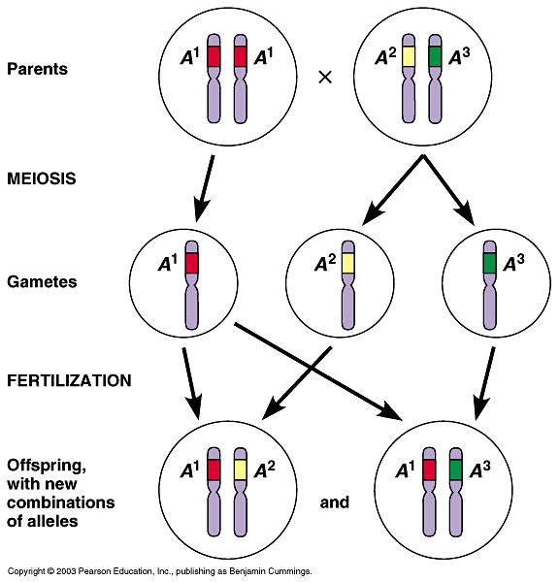
Concept Check
0
Natural selection works with genetic variation. The ultimate source of genetic variation is mutation in the DNA (or RNA in some organisms). However, in sexually reproducing organisms with long generation time, what process(es) account(s) for individual variation?
random fertilization
crossing over
independent assortment
all of the above
Notes:
Correct Answer: d

Slide 25
Natural Selection in Action
Examples of natural selection include:
Pesticide-resistant insects
Antibiotic-resistant bacteria - http://youtu.be/zjR6L38yReE
Drug-resistant strains of HIV - http://highered.mcgraw-hill.com/sites/007337797x/student_view0/chapter33/animation_quiz_-_treatment_of_hiv_infection.html
Notes:
Student Misconceptions and Concerns
1. Students must understand that the environment does the selecting (editing) in natural selection. Species do not evolve because of want or need. Biological diversity exists and the environment selects. Evolution is not deliberate, it is reactive.
2. A related point is what we learn from extinction. As Darwin noted, species become extinct because they do not get what they want or need!
3. The authors note that evolution is not goal directed and does not lead to perfectly adapted organisms. These excellent points represent two misunderstandings: 1) Instructors need to be clear that evolutionary change is a consequence of an immediate advantage, not a distant goal. Three-chambered hearts in amphibians evolved from two-chambered fish hearts because the three-chambered hearts conveyed an advantage, not because evolution was directed toward producing a four-chambered heart! 2) Evolutionary change only reflects improvement in the context of the immediate environment. What is better today may not be better tomorrow. Thus, species do not steadily get better, they respond to the environment or go extinct.
Teaching Tips
1. An analogy might be made between the specialized functions of finch beaks and the many types of screwdrivers that exist today. Each type of screwdriver (Phillips, flathead, long-handled, interchangeable tips) represents a specialization for a particular job.
2. Based upon the human condition, students are likely to think that reproduction is largely a choice, and less a consequence of good health or other adaptations. Yet, in our natural world, there are thousands of examples of the overproduction of offspring and resulting death or failure to reproduce. Thousands of acorns hanging from one tree, spores escaping from a puffball, or a salmon spawning thousands of eggs, are all easy examples of overproduction. Bring a few solid illustrations from your geographic region to bring home this point.

Slide 26
Concept Check
0
Evolutionary fitness is an often-misunderstood concept. Which of the following imaginary individuals would have the greatest evolutionary fitness?
sparrow A
sparrow B
sparrow C
sparrow D
 | Sparrow A | Sparrow B | Sparrow C | Sparrow D
Beak size | 13 mm | 15 mm | 17 mm | 16 mm
Life span | 2.5 years | 2 years | 3 years | 3 years
Offspring that survive to adulthood | 10 | 16 | 12 | 14
Notes:
Correct Answer: b

Slide 27
The Process of Science: Does Predation Drive the Evolution of Lizard Horn Length?
Observation: Flat-tailed horned lizards defend against attack by:
Thrusting their heads backward
Stabbing a shrike with the spiked horns on the rear of their skull
Question: Are longer horns a survival advantage?
Hypothesis: Longer horns are a survival advantage.
© 2010 Pearson Education, Inc.
Notes:
Student Misconceptions and Concerns
1. Students must understand that the environment does the selecting (editing) in natural selection. Species do not evolve because of want or need. Biological diversity exists and the environment selects. Evolution is not deliberate, it is reactive.
2. A related point is what we learn from extinction. As Darwin noted, species become extinct because they do not get what they want or need!
3. The authors note that evolution is not goal directed and does not lead to perfectly adapted organisms. These excellent points represent two misunderstandings: 1) Instructors need to be clear that evolutionary change is a consequence of an immediate advantage, not a distant goal. Three-chambered hearts in amphibians evolved from two-chambered fish hearts because the three-chambered hearts conveyed an advantage, not because evolution was directed toward producing a four-chambered heart! 2) Evolutionary change only reflects improvement in the context of the immediate environment. What is better today may not be better tomorrow. Thus, species do not steadily get better, they respond to the environment or go extinct.
Teaching Tips
1. An analogy might be made between the specialized functions of finch beaks and the many types of screwdrivers that exist today. Each type of screwdriver (Phillips, flathead, long-handled, interchangeable tips) represents a specialization for a particular job.
2. Based upon the human condition, students are likely to think that reproduction is largely a choice, and less a consequence of good health or other adaptations. Yet, in our natural world, there are thousands of examples of the overproduction of offspring and resulting death or failure to reproduce. Thousands of acorns hanging from one tree, spores escaping from a puffball, or a salmon spawning thousands of eggs, are all easy examples of overproduction. Bring a few solid illustrations from your geographic region to bring home this point.

Slide 28
Live
Killed
(a) A flat-tailed horned lizard
20
Length (mm)
10
Killed
Live
0
Rear horns
Side horns
(tip to tip)
(b) The remains of a lizard impaled
by a shrike
(c) Results of measurement of lizard horns
Figure 13.15
Notes:
Figure 13.15 The effect of predation on lizard horn length

Slide 29
Prediction: Live horned lizards have longer horn lengths than dead ones.
Experiment: Measure the horn lengths of dead and living lizards.
Results: The average horn length of live lizards is about 10% longer than that of dead lizards.
Another Example to Work Out with:
http://www.sumanasinc.com/webcontent/animations/content/evolution/evolution.html
Notes:
Student Misconceptions and Concerns
1. Students must understand that the environment does the selecting (editing) in natural selection. Species do not evolve because of want or need. Biological diversity exists and the environment selects. Evolution is not deliberate, it is reactive.
2. A related point is what we learn from extinction. As Darwin noted, species become extinct because they do not get what they want or need!
3. The authors note that evolution is not goal directed and does not lead to perfectly adapted organisms. These excellent points represent two misunderstandings: 1) Instructors need to be clear that evolutionary change is a consequence of an immediate advantage, not a distant goal. Three-chambered hearts in amphibians evolved from two-chambered fish hearts because the three-chambered hearts conveyed an advantage, not because evolution was directed toward producing a four-chambered heart! 2) Evolutionary change only reflects improvement in the context of the immediate environment. What is better today may not be better tomorrow. Thus, species do not steadily get better, they respond to the environment or go extinct.
Teaching Tips
1. An analogy might be made between the specialized functions of finch beaks and the many types of screwdrivers that exist today. Each type of screwdriver (Phillips, flathead, long-handled, interchangeable tips) represents a specialization for a particular job.
2. Based upon the human condition, students are likely to think that reproduction is largely a choice, and less a consequence of good health or other adaptations. Yet, in our natural world, there are thousands of examples of the overproduction of offspring and resulting death or failure to reproduce. Thousands of acorns hanging from one tree, spores escaping from a puffball, or a salmon spawning thousands of eggs, are all easy examples of overproduction. Bring a few solid illustrations from your geographic region to bring home this point.

Slide 30
EVOLUTIONARY TREES
Lungfishes
Amphibians
Tetrapods
Mammals
Tetrapod
limbs
Amniotes
Lizards
and snakes
Amnion
Crocodiles
Ostriches
Birds
Feathers
Hawks and
other birds
Figure 13.16
Notes:
Figure 13.16 An evolutionary tree of tetrapods

Slide 31
Populations as the Units of Evolution
A population is:
A group of individuals of the same species, living in the same place, at the same time
The smallest biological unit that can evolve
(a) Two dense populations of
trees separated by a lake
(b) A nighttime satellite view of
North America
Notes:
Student Misconceptions and Concerns
1. Students may suggest that individuals evolve. As this chapter section clarifies, populations are the smallest units that can evolve. Individuals cannot have diversity from which to select. However, individuals can change during their lifetime in response to activities. Muscles can grow stronger because of use. However, these individual changes are not passed on to the next generation (after all, boys have been circumcised for thousands of years but are still born with a foreskin).
2. Another misperception is that evolution results from need. Challenge your students to explain how need and want have nothing to do with evolution (because neither need nor want can generate genetic variation!)
3. Students may think of mutations in a positive sense, as if they come as needed. Yet, mutations in key genes are the cause of cancer and other diseases. Only rarely does a mutation lead to a change that increases the chances for survival. However, these rare events can become significant if given enough time. (As the authors note: A random mutation is like a shot in the dark; it is not likely to improve a genome any more than shooting a bullet through the hood of a car is likely to improve engine performance.)
Teaching Tips
1. It might be interesting to discuss with students whether the Internet would have helped Mendel and Darwin. Is the Internet facilitating scientific communication? Has this technology created new problems in the process?
2. Try to find good, local examples of populations. If you live near a seashore, the many invertebrate populations (starfish, sea urchin, and kelp) would be great. Further inland we find somewhat isolated populations of fish and continuous and clumped populations of squirrels, separated by vast fields of corn, wheat, or soybeans! Bring the subject home with local examples.
3. No doubt about it, the Hardy-Weinberg equation is problematic for some students. Students should create a quick reference key to the definitions of the elements. Consider some practice problems varying the value of p and q.
4. Heterozygotes can form in two ways, the recessive from mom, the dominant from dad...or the reverse. This should serve to remind students that the 2pq portion of the equation represents the heterozygotes.
5. Another example that can be used for Hardy-Weinberg practice is cystic fibrosis. Cystic fibrosis strikes about one out of every 3300 Caucasian children. It results from the homozygous recessive condition. Thus, q² would equal 1/3300 = 0.000303 and q = the square root of 0.000303 = 0.0174. The frequency of carriers = 2pq = 2 x 0.0174 x 0.9826 = 0.0342 = 3.42%, about one in every 29 Caucasian adults. To bring the point home to your class, divide the number of Caucasian students in your class by 29 to estimate the number of students who are carriers. (Source of information is: Fertil. Steril. 2006 Jan 85(1): 135-8.)

Slide 32
The total collection of alleles in a population at any one time is the gene pool.
When the relative frequency of alleles changes over a number of generations, evolution is occurring on its smallest scale, which is sometimes called microevolution - http://wps.pearsoncustom.com/wps/media/objects/3014/3087289/Web_Tutorials/17_A01.swf.
Individual variation abounds in populations.
Not all variation in a population is heritable.
Only the genetic component of variation is relevant to natural selection.
Notes:
Student Misconceptions and Concerns
1. Students may suggest that individuals evolve. As this chapter section clarifies, populations are the smallest units that can evolve. Individuals cannot have diversity from which to select. However, individuals can change during their lifetime in response to activities. Muscles can grow stronger because of use. However, these individual changes are not passed on to the next generation (after all, boys have been circumcised for thousands of years but are still born with a foreskin).
2. Another misperception is that evolution results from need. Challenge your students to explain how need and want have nothing to do with evolution (because neither need nor want can generate genetic variation!)
3. Students may think of mutations in a positive sense, as if they come as needed. Yet, mutations in key genes are the cause of cancer and other diseases. Only rarely does a mutation lead to a change that increases the chances for survival. However, these rare events can become significant if given enough time. (As the authors note: A random mutation is like a shot in the dark; it is not likely to improve a genome any more than shooting a bullet through the hood of a car is likely to improve engine performance.)
Teaching Tips
1. It might be interesting to discuss with students whether the Internet would have helped Mendel and Darwin. Is the Internet facilitating scientific communication? Has this technology created new problems in the process?
2. Try to find good, local examples of populations. If you live near a seashore, the many invertebrate populations (starfish, sea urchin, and kelp) would be great. Further inland we find somewhat isolated populations of fish and continuous and clumped populations of squirrels, separated by vast fields of corn, wheat, or soybeans! Bring the subject home with local examples.
3. No doubt about it, the Hardy-Weinberg equation is problematic for some students. Students should create a quick reference key to the definitions of the elements. Consider some practice problems varying the value of p and q.
4. Heterozygotes can form in two ways, the recessive from mom, the dominant from dad...or the reverse. This should serve to remind students that the 2pq portion of the equation represents the heterozygotes.
5. Another example that can be used for Hardy-Weinberg practice is cystic fibrosis. Cystic fibrosis strikes about one out of every 3300 Caucasian children. It results from the homozygous recessive condition. Thus, q² would equal 1/3300 = 0.000303 and q = the square root of 0.000303 = 0.0174. The frequency of carriers = 2pq = 2 x 0.0174 x 0.9826 = 0.0342 = 3.42%, about one in every 29 Caucasian adults. To bring the point home to your class, divide the number of Caucasian students in your class by 29 to estimate the number of students who are carriers. (Source of information is: Fertil. Steril. 2006 Jan 85(1): 135-8.)

Slide 33
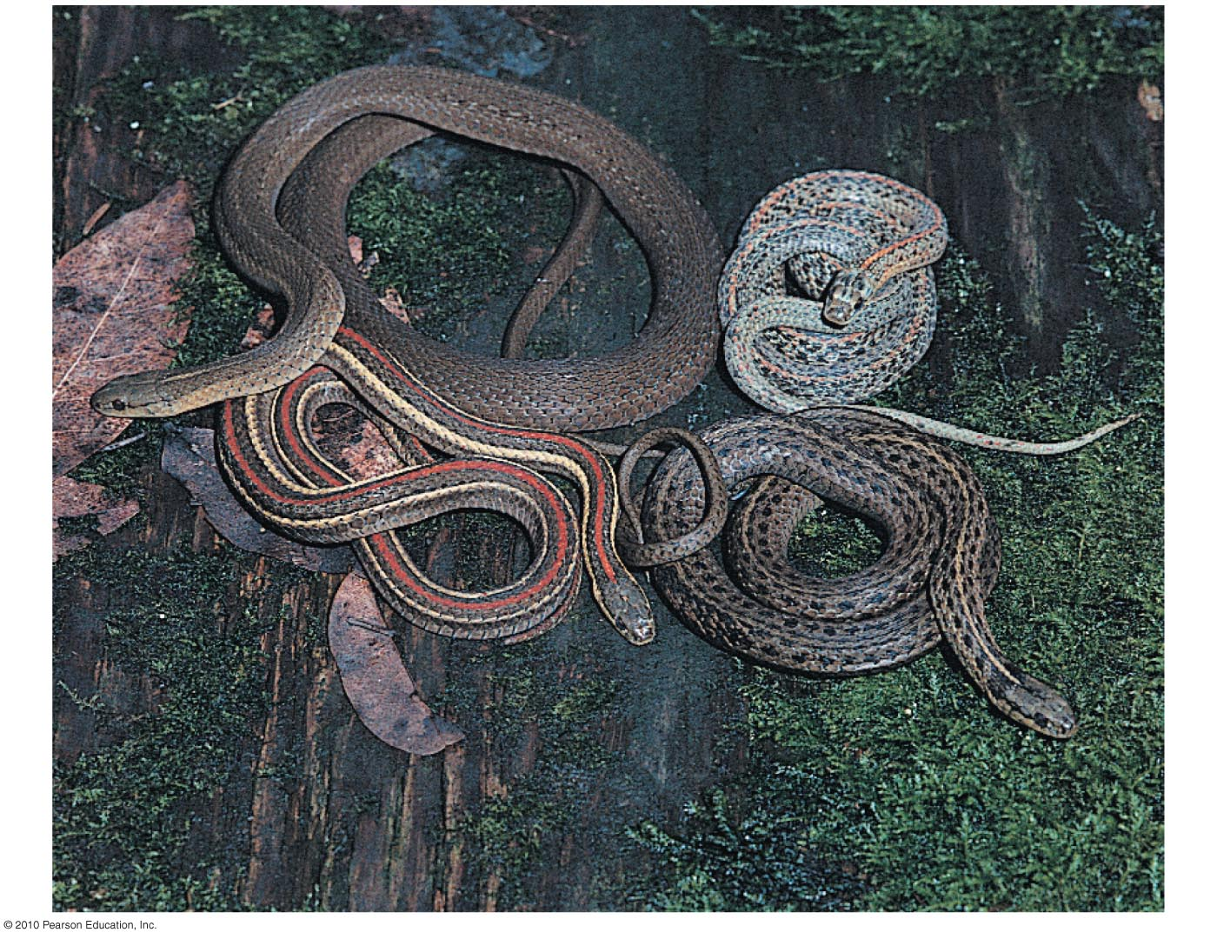
Variable traits in a population may be:
Polygenic, resulting from the combined effects of several genes or
Determined by a single gene
Polygenic traits tend to produce phenotypes that vary more or less continuously.
Single gene traits tend to produce only a few distinct phenotypes.
Notes:
Student Misconceptions and Concerns
1. Students may suggest that individuals evolve. As this chapter section clarifies, populations are the smallest units that can evolve. Individuals cannot have diversity from which to select. However, individuals can change during their lifetime in response to activities. Muscles can grow stronger because of use. However, these individual changes are not passed on to the next generation (after all, boys have been circumcised for thousands of years but are still born with a foreskin).
2. Another misperception is that evolution results from need. Challenge your students to explain how need and want have nothing to do with evolution (because neither need nor want can generate genetic variation!)
3. Students may think of mutations in a positive sense, as if they come as needed. Yet, mutations in key genes are the cause of cancer and other diseases. Only rarely does a mutation lead to a change that increases the chances for survival. However, these rare events can become significant if given enough time. (As the authors note: A random mutation is like a shot in the dark; it is not likely to improve a genome any more than shooting a bullet through the hood of a car is likely to improve engine performance.)
Teaching Tips
1. It might be interesting to discuss with students whether the Internet would have helped Mendel and Darwin. Is the Internet facilitating scientific communication? Has this technology created new problems in the process?
2. Try to find good, local examples of populations. If you live near a seashore, the many invertebrate populations (starfish, sea urchin, and kelp) would be great. Further inland we find somewhat isolated populations of fish and continuous and clumped populations of squirrels, separated by vast fields of corn, wheat, or soybeans! Bring the subject home with local examples.
3. No doubt about it, the Hardy-Weinberg equation is problematic for some students. Students should create a quick reference key to the definitions of the elements. Consider some practice problems varying the value of p and q.
4. Heterozygotes can form in two ways, the recessive from mom, the dominant from dad...or the reverse. This should serve to remind students that the 2pq portion of the equation represents the heterozygotes.
5. Another example that can be used for Hardy-Weinberg practice is cystic fibrosis. Cystic fibrosis strikes about one out of every 3300 Caucasian children. It results from the homozygous recessive condition. Thus, q² would equal 1/3300 = 0.000303 and q = the square root of 0.000303 = 0.0174. The frequency of carriers = 2pq = 2 x 0.0174 x 0.9826 = 0.0342 = 3.42%, about one in every 29 Caucasian adults. To bring the point home to your class, divide the number of Caucasian students in your class by 29 to estimate the number of students who are carriers. (Source of information is: Fertil. Steril. 2006 Jan 85(1): 135-8.)

Slide 34
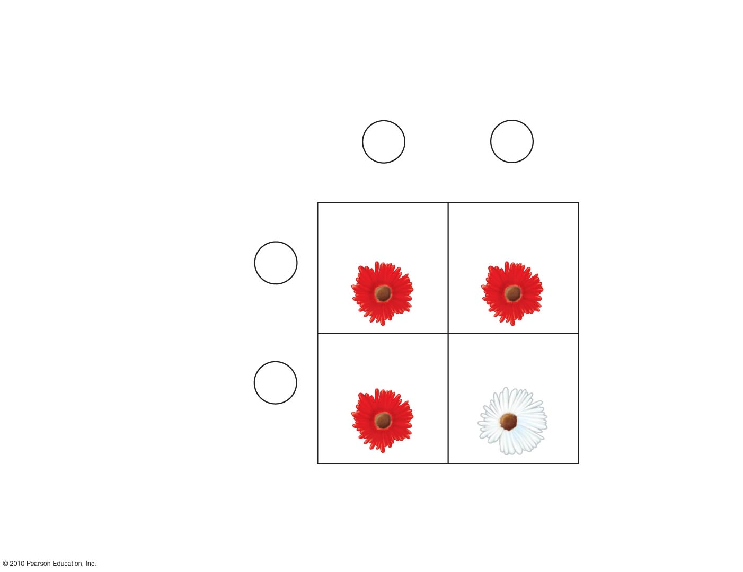
Allele frequencies
p = 0.8
(R)
q = 0.2
(r)
Eggs
R
r
p = 0.8
q = 0.2
RR
Rr
p² = 0.64
pq = 0.16
R
p = 0.8
Sperm
rR
rr
qp = 0.16
q² = 0.04
r
q = 0.2
Genotype frequencies
p² = 0.64
q² = 0.04
2pq = 0.32
(RR)
(Rr)
(rr)
Figure 13.20
Notes:
Figure 13.20 A mathematical swim in the gene pool

Slide 35
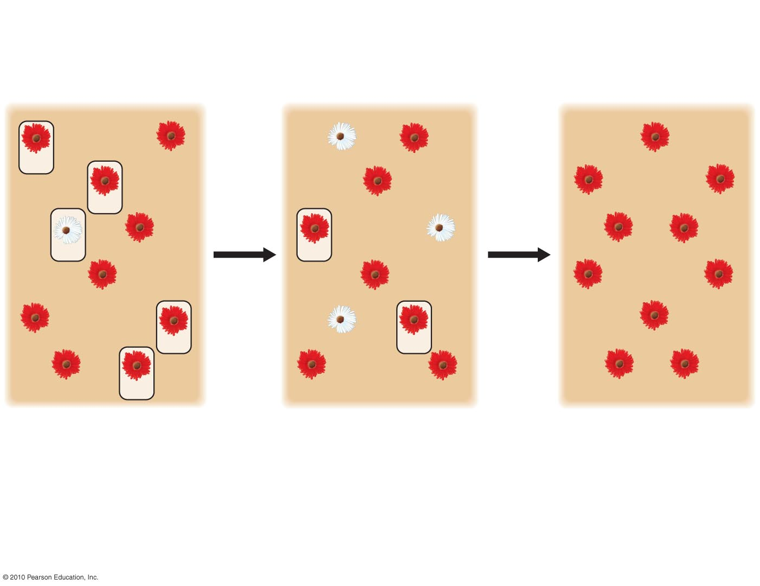
Genetic Drift
RR
RR
rr
RR
RR
Only 5 of
10 plants
leave
offspring
Only 2 of
10 plants
leave
offspring
Rr
Rr
RR
RR
rr
RR
RR
rr
RR
RR
Rr
Rr
RR
RR
RR
Rr
rr
RR
RR
RR
Rr
Rr
Rr
RR
RR
Generation 1
Generation 2
Generation 3
p (frequency of R) = 0.7
q (frequency of r) = 0.3
p = 0.5
q = 0.5
p = 1.0
q = 0.0
Figure 13.22-3
Notes:
Figure 13.22 Genetic drift (Step 3)

Slide 36
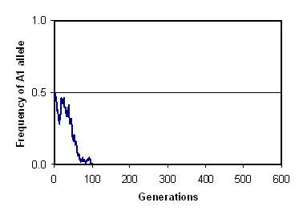
Interpreting Data
0
Only one run of the model is graphed. Note that the A1 allele went extinct after about 100 generations. Which of the following is most likely for additional trials?
A1 will always go extinct in fewer than 500 generations.
A1 will not go extinct in fewer than 500 generations.
A1 will go to either 1.0 or 0.0 in fewer than 500 generations.
Genetic drift is the change in the gene pool of a small population due to chance. This graph represents a computer model of the change in frequency of one allele (A1) (out of two at one locus) in a starting population of 100. All other Hardy-Weinberg conditions apply.
Notes:
Correct Answer: c

Slide 37
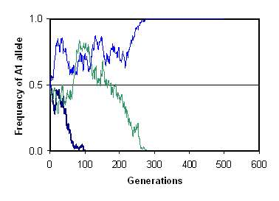
Interpreting Data
0
Here, three runs of the model are graphed. Which of the following is most likely?
About 50% of the time, A1 will go extinct in fewer than 500 generations.
About 67% of the time, A1 will go extinct in fewer than 500 generations.
About 67% of the time, A1 will go to a frequency of 100% in fewer than 500 generations.
Genetic drift is the change in the gene pool of a small population due to chance. This graph represents a computer model of the change in frequency of one allele (A1) (out of two at one locus) in a starting population of 100. All other Hardy-Weinberg conditions apply.
Notes:
Correct Answer: a

Slide 38
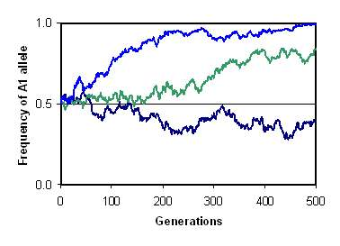
Interpreting Data
0
Here, three runs of the model are graphed for a larger population of 1,000. How does the larger population affect the rate of drift?
A1 allele will never become fixed at 1.0 or 0.0.
It takes more generations for the A1 allele to become fixed at 1.0 or 0.0.
The greater population size indicates that A1 must be the dominant allele.
This graph represents a computer model of the change in frequency of one allele (A1) (out of two at one locus) in a starting population of 1,000. All other Hardy-Weinberg conditions apply.
Notes:
Correct Answer: b

Slide 39
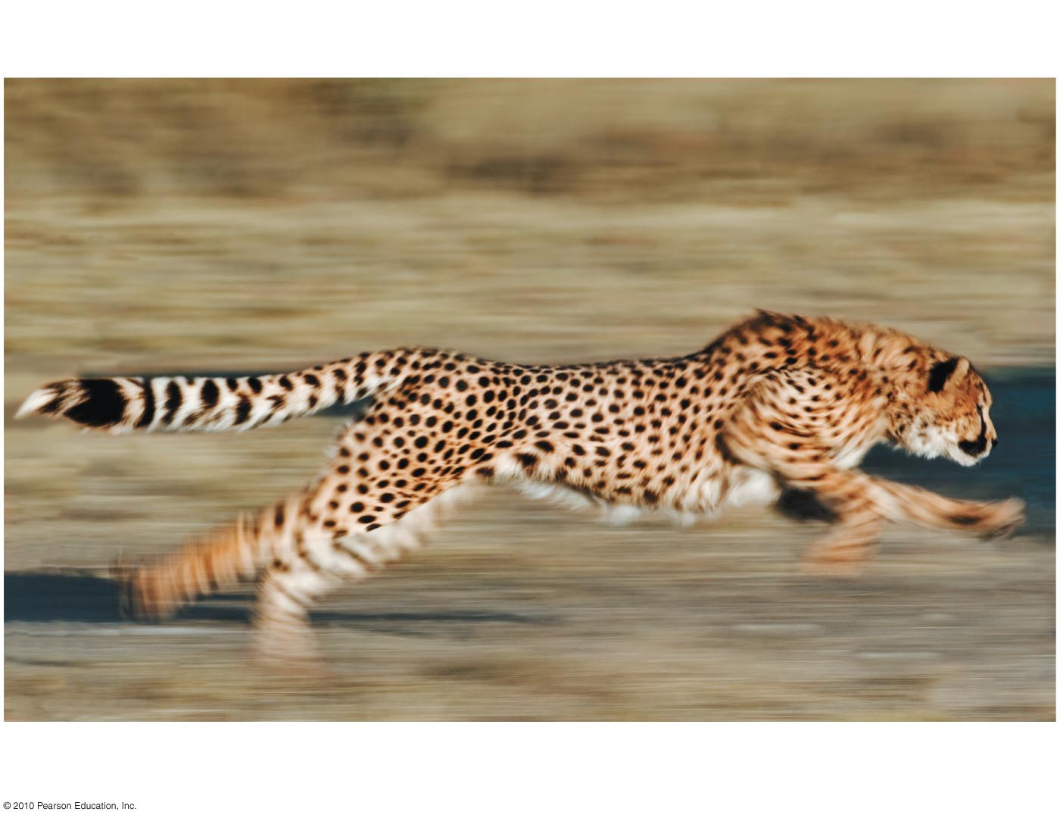
Bottlenecking in a population usually reduces genetic variation because at least some alleles are likely to be lost from the gene pool.
Cheetahs appear to have experienced at least two genetic bottlenecks in the past 10,000 years.
Notes:
Student Misconceptions and Concerns
1. The concept of a genetic bottleneck contributing to a loss of diversity can be difficult for some students to understand. Without an appreciation for population genetics, students might think that a recovery in sheer numbers of individuals is all that is needed. Yet, the loss of genetic diversity might doom a population eventually faced with widespread disease.
2. Sampling error can be difficult for some students to immediately understand. Have students work in pairs to flip a coin 10 times. For each pair, list the number of heads on the board as just a long list of numbers (no need to keep track of heads and tails). This can be done quickly as long as you have been sure to bring enough pennies. Now analyze the results. There should be considerable variation from the expected five. Now determine the average of all the groups, and the collective sample size. By pooling the results, and increasing the sample size, the means should be closer to five.
Teaching Tips
1. The loss of genetic diversity in a population because of the bottleneck effect is a significant problem in conservation. When a species is reduced to relatively few individuals, and then is brought back to abundance by extraordinary efforts, the species is not fully recovered. The lost genetic diversity may be a prerequisite for the long-term survival of the species. Consider challenging your students to identify modern endangered species that might suffer from a genetic bottleneck despite increasing numbers.
2. Students might best relate to the bias of the founder effect by this example. Just for the sake of explanation, consider that you and all the students present in today’s class are the only survivors of some global catastrophe. Would your class adequately represent the biological diversity of the current human population?
3. Challenge your students to explain why evolution primarily addresses only organisms that reproduce. Like people who vote, reproduction contributes to change. Moreover, like non-voters who influence opinions of voters, non-reproducing organisms can still influence the actions of those who do reproduce. Challenge your students to suggest how organisms that do not reproduce might influence the evolution of a species. (One such example is the benefit of a sibling helping to raise its nieces / nephews.)
4. Students are often surprised to learn that overweight human newborns can be as unhealthy as underweight newborns. Thus, stabilizing selection favors human birth weights clustered narrowly around a mean weight.
5. Consider challenging your students to distinguish between natural selection generally, sexual selection specifically, and artificial selection. One criterion for comparison is the nature of the selective environment. In natural selection, the interaction is between the organism and its immediate environment. In sexual selection, competition occurs within a species for access to mates. In artificial selection, humans act as the environment, favoring traits of human interest.
6. At the conclusion of this chapter information, it might be a good time to remind your students that most species that have ever lived are now extinct. Species do not have a mechanism to get what they need to survive. The natural variation inherited from the immediate ancestors and the new variations that emerge from mutations and genetic combinations are the raw materials for survival. No amount of need can influence the variety upon which selection must act. It is, therefore, quite possible that the variety in any generation is insufficient for survival. Periods of relatively fast environmental change may require traits insufficient for survival.

Slide 40
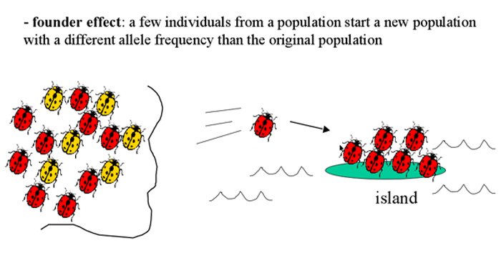
The Founder Effect
The founder effect is likely when a few individuals colonize an isolated habitat and represent genetic drift in a new colony. http://bcs.whfreeman.com/thelifewire/content/chp24/2402002.html.
The founder effect explains the relatively high frequency of certain inherited disorders among some small human populations.
http://youtu.be/Q6JEA2olNts
Notes:
Student Misconceptions and Concerns
1. The concept of a genetic bottleneck contributing to a loss of diversity can be difficult for some students to understand. Without an appreciation for population genetics, students might think that a recovery in sheer numbers of individuals is all that is needed. Yet, the loss of genetic diversity might doom a population eventually faced with widespread disease.
2. Sampling error can be difficult for some students to immediately understand. Have students work in pairs to flip a coin 10 times. For each pair, list the number of heads on the board as just a long list of numbers (no need to keep track of heads and tails). This can be done quickly as long as you have been sure to bring enough pennies. Now analyze the results. There should be considerable variation from the expected five. Now determine the average of all the groups, and the collective sample size. By pooling the results, and increasing the sample size, the means should be closer to five.
Teaching Tips
1. The loss of genetic diversity in a population because of the bottleneck effect is a significant problem in conservation. When a species is reduced to relatively few individuals, and then is brought back to abundance by extraordinary efforts, the species is not fully recovered. The lost genetic diversity may be a prerequisite for the long-term survival of the species. Consider challenging your students to identify modern endangered species that might suffer from a genetic bottleneck despite increasing numbers.
2. Students might best relate to the bias of the founder effect by this example. Just for the sake of explanation, consider that you and all the students present in today’s class are the only survivors of some global catastrophe. Would your class adequately represent the biological diversity of the current human population?
3. Challenge your students to explain why evolution primarily addresses only organisms that reproduce. Like people who vote, reproduction contributes to change. Moreover, like non-voters who influence opinions of voters, non-reproducing organisms can still influence the actions of those who do reproduce. Challenge your students to suggest how organisms that do not reproduce might influence the evolution of a species. (One such example is the benefit of a sibling helping to raise its nieces / nephews.)
4. Students are often surprised to learn that overweight human newborns can be as unhealthy as underweight newborns. Thus, stabilizing selection favors human birth weights clustered narrowly around a mean weight.
5. Consider challenging your students to distinguish between natural selection generally, sexual selection specifically, and artificial selection. One criterion for comparison is the nature of the selective environment. In natural selection, the interaction is between the organism and its immediate environment. In sexual selection, competition occurs within a species for access to mates. In artificial selection, humans act as the environment, favoring traits of human interest.
6. At the conclusion of this chapter information, it might be a good time to remind your students that most species that have ever lived are now extinct. Species do not have a mechanism to get what they need to survive. The natural variation inherited from the immediate ancestors and the new variations that emerge from mutations and genetic combinations are the raw materials for survival. No amount of need can influence the variety upon which selection must act. It is, therefore, quite possible that the variety in any generation is insufficient for survival. Periods of relatively fast environmental change may require traits insufficient for survival.

Slide 41
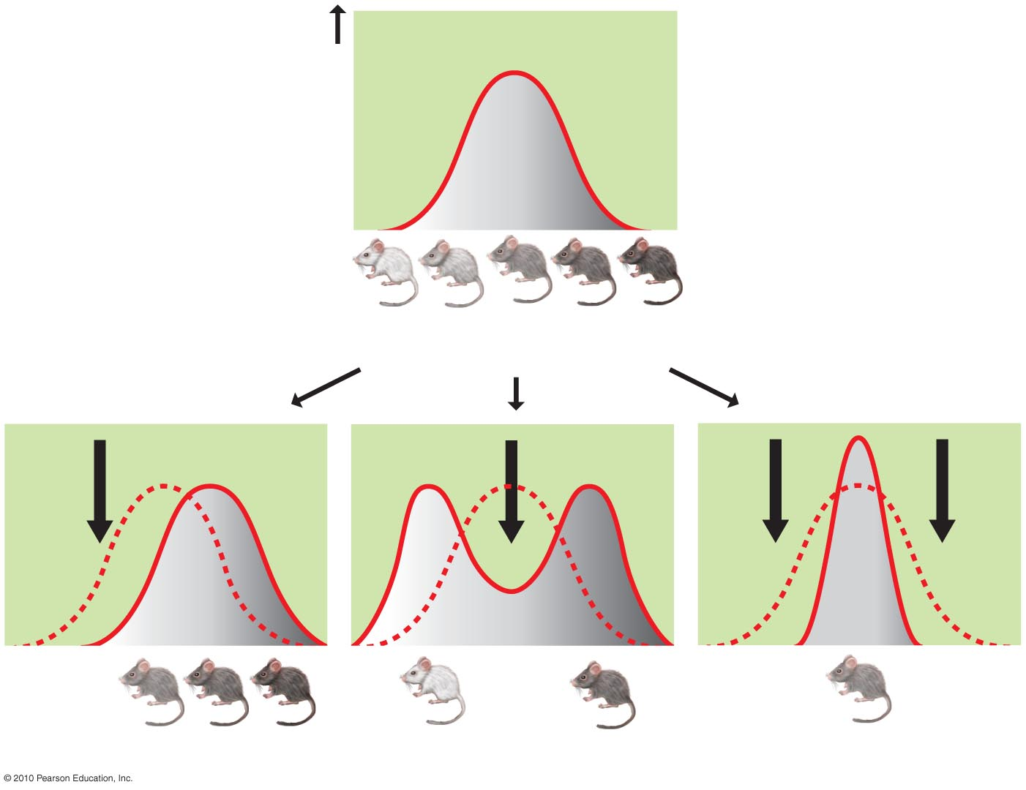
Three General Outcomes of Natural Selection
Stabilizing selection:
Favors intermediate phenotypes
Is the most common
Frequency
of individuals
Original
population
Evolved
population
Original
population
Phenotypes (fur color)
(a) Directional selection
(b) Disruptive selection
(c) Stabilizing selection
Figure 13.28
Notes:
Figure 13.28 Three general effects of natural selection on a phenotypic character

Slide 42
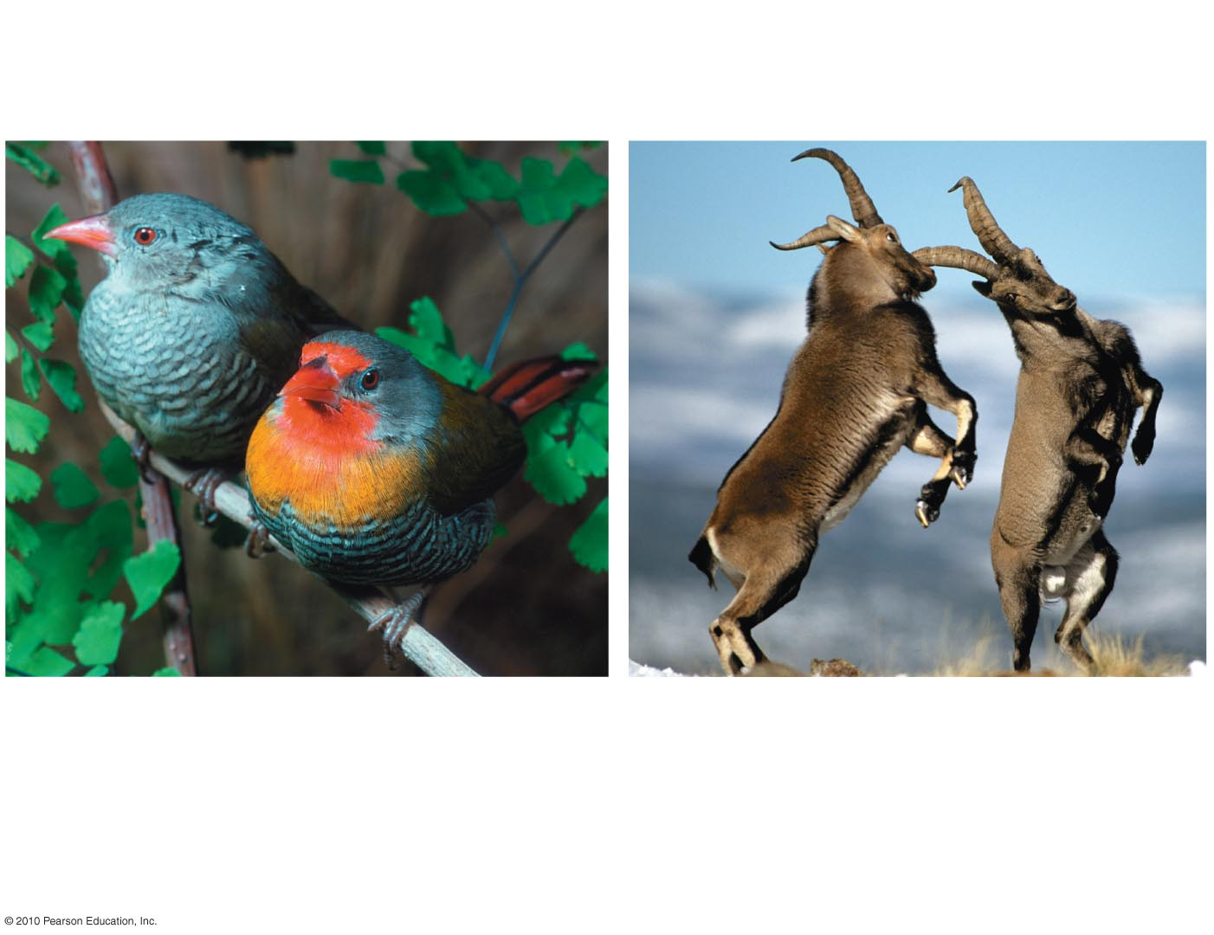
Sexual dimorphism is:
A distinction in appearance between males and females
Not directly associated with reproduction or survival
(a) Sexual dimorphism in
a finch species
(b) Competing for mates
Figure 13.29
Notes:
Figure 13.29 Sexual dimorphism

