Slide 1
Everything’s An Argument
Chapter 1

Slide 2
IS EVERYTHING AN Argument?
YES!!
Clothing
Foods
Groups you join
Unspoken arguments about who you are and what you value.

Slide 3
IS EVERYTHING AN Argument?
An argument can be any text:
Written
Spoken
Visual
Blunt & Aggressive
Change Opinion
Express your point of view
Subtle

Slide 4
Purposes of argument
To inform
To convince
To explore
To make decisions
To meditate or pray

Slide 5
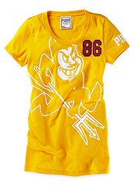
Not Just Words
Is this an Argument?
Arizona State t-shirt sold by Victoria’s Secret

Slide 6
Purposes of an argument
Many arguments are aimed at winning
Political candidates
Dueling lawyers in a court case
Academic

Slide 7
Purpose of argument
ARGUMENT
To use evidence and reason to discover some version of the truth.
Writers or speakers argue to discover some truth.
PERSUASION
To change a point of view or to move others from conviction to action
Writers persuade when they think they already know the truth.

Slide 8
Purpose of argument
Rogerian argument
Based on approaching audiences in nonthreatening ways
Find common ground
Establish trust among those who disagree about issues
Writers seek to understand perspectives of others for a win/win solution.

Slide 9
Types of arguments
Arguments to inform
Arguments to convince
Arguments to persuade
Arguments to explore
Arguments to make decisions
Arguments to meditate or pray
Academic arguments

Slide 10
Arguments to Inform
Tells the audience something they don’t know
(as simple as street signs)
Other informative arguments are more obviously designed to persuade
Example: political bumper stickers

Slide 11
Arguments to Convince
Used to convince readers rather than win out over opponents
Reports, white papers, and academic articles
Opponents’ viewpoints aren’t addressed directly, but they are always implied

Slide 12
Arguments to persuade
Move the audience enough to provoke action
Advertisements, political blogs and newspaper editorials
Use rhetoric to motive action, produce change, or win a point
Push the reader toward action

Slide 13
Arguments to explore
Urges the reader to take some form of exploration
No real “opponent”
Opponent could be the status quo

Slide 14
Arguments to make decisions
Aims to make good, sound decisions
Exploratory arguments may be to argue for a particular decision
Argue with your way though several alternatives in your mind, with friends, colleagues, parents
Look at pros and cons

Slide 15
Arguments to meditate or pray
Prayer or meditations on a theme
Writer is hoping to transform something in him or herself.
Stained glass window

Slide 16
Occasions for argument
Identify the public occasions that call for them
Rhetoric – art of persuasion
Aristotle based arguments based on issues of time
Past, future, and present
Classifications may overlap with others to a certain extent
Ex. Arguments about the past with implications for the future/arguments about the past with bearings on the present

Slide 17
Arguments about the past
Debates about the past are forensic arguments
Forensic arguments rely on evidence and testimony to recreate what can be known about events that have already occurred
Can be arguments about character (someone’s reputation in a historical context)

Slide 18
Arguments about the future
Deliberative arguments – what should happen in the future
Legislatures, congresses, and parliaments are called deliberative bodies
Establish policies for the future
Deliberative judgments often rely on prior forensic arguments b/c the past influences the future

Slide 19
Arguments about the present
Arguments about contemporary values
Beliefs and assumptions that are widely held within society
Called epideictic or ceremonial arguments b/c they are often heard in public
http://www.americanrhetoric.com/speeches/ronaldreaganfarewelladdress.html (9:42)

Slide 20
Kinds of argument
Consider stasis – the kinds of issues arguments address
Did something happen?
What is its nature?
What is the quality or cause?
What actions should be taken?
Explores a different aspect of a problem & uses different evidence or techniques to reach conclusions

Slide 21
Did something happen? Argument of fact
Involves a statement that can be proved or disproved with specific evidence or testimony
Simple to define
Arguments are subtle involving layers of complexity

Slide 22
What is the nature of the thing? Arguments of definition
Involves determining whether one known object or action belongs in a second category

Slide 23
What is the quality or cause of the thing? Arguments of evaluation and causality
Present criteria and then measuring individual people, ideas, or things against those standards
Both standards and the measurement can be explored argumentatively

Slide 24
What actions should be taken? Proposal arguments
Describe a problem so well that readers ask: What can we do?
Prove there is a problem
What actions should be taken?

Slide 25
Audiences for arguments
Audiences cross a full range of possibilities
Flesh and blood person
Friends in a social network
Ideal readers that you imagine for an editorial you write
As a writer you have an intended reader who exists in your own mind.

Slide 26
Audiences for arguments
As a writer, you want to think carefully about these real readers and to summon up what you do know about them, even if that knowledge is limited.

Slide 27
Audiences for arguments Considering contexts
Understand how context shapes and colors the perspectives readers bring to an argument
Think carefully about the contexts that surround your readers – and to place your topic in its context as well

Slide 28
Appealing to audience
3 ways to appeal to your audience
Pathos, ethos, and logos

Slide 29
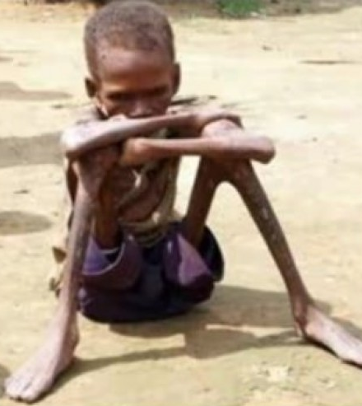
Emotional appeals: Pathos
People respond strongly to emotional appeals
Generates emotions – fear, anger, jealously, pity, love, etc.

Slide 30
Ethical Appeals: Ethos
Presentation of self
Is the writer credible?
Build credibility by emphasizing that you share values with your audience
Being fair and showing respect for audience and opponents
Visual items can make ethical appeals

Slide 31
Ethical appeal: ethos
Visual items can make ethical appeals
Authority
Respectability

Slide 32
Logical appeals: logos
Use of reasons and evidence
Facts, statistics, credible testimony, cogent examples
Just the facts Ma’am

Slide 33
Arguments and their rhetorical triangle
Arguments exist in a particular context
Influences how it can be shaped and how others will receive it
Rhetorical situation
A shorthand phrase for the entire set of concerns

