Slide 1
Chapter 2: Culture
Jennifer L. Fackler, M.A.

Slide 2
What Is Culture?

Slide 3
What Is Culture?
Culture - the values , beliefs, behavior, and material objects that, together, form a people’s way of life
  Influences:
    What we think, how we act, and what we own.
    Our goals, sense of justice, and personal feelings.
Material Culture - the tangible, physical things created by members of a society
  Ex: Books, Cell Phones, Others?
Nonmaterial Culture - the ideas created by members of a society
  Ex: Religion, Others?
Society – people who interact in a defined territory and share a culture

Slide 4
Culture Shock &
Operationalizing Culture
Culture Shock – personal disorientation when experiencing an unfamiliar way of life
  Examples?
How many cultures are there? How could we operationalize culture?
  Language
    200 in the U.S.
    7,000 Globally

Slide 5
Culture & Human Intelligence
3M Years Ago: Instinct → Culture
250K Years Ago: Rapidly Developing Culture
  Evidence: Tools & Cave Art
12k Years Ago: Birth of Civilization
  Permanent Settlements
  Creation of Specialized Occupations
  Fashioned the natural environment for themselves.
Ever since…
  Humans have made and remade their world in countless ways, resulting in our current cultural diversity.

Slide 6
Elements of Culture

Slide 7
Symbols
Symbol – anything that carries a particular meaning recognized by people who share a culture
  Examples?
  Human beings are unique because we sense our surrounding world but also give it meaning by transforming the elements of the world into symbols.
  We can create and manipulate symbols.
    Example: Winking – Interest, Understanding, Insult
  New symbols are created all the time.
    Example: Emoticons
  We usually take our culture’s symbols for granted.
    Example: Flag
  Symbolic meanings can vary both between and within cultures.
    Example: Confederate Flag

Slide 8
Language
Language – a system of symbols that allows people to communicate with one another
Key to cultural transmission, the process by which one generation passes culture to the next.
Language is what sets us apart from other creatures.
  Self-Conscious
  Aware of Our Limitations
  Aware of Our Mortality
  Able to Dream & Hope

Slide 9
Human Languages: A Variety of Symbols
Here the single English word “Read” is written in twelve of the hundreds of languages humans use to communicate with one another.

Slide 10
Language
Does language shape reality? Does someone who speaks Cherokee experience the world differently from those who think in English?
  Sapir-Whorf Thesis: people see and understand the world through the cultural lens of language.
    Each language has its own distinctive symbols that serve as building blocks of reality.
    Each language has words or expressions not found in any other symbolic system.
    All languages fuse symbols with distinctive emotions so that a single idea may “feel” different in different languages.
  Current thinking is that we fashion reality from our symbols, but evidence does not support the notion that language determines reality.

Slide 11
Values & Beliefs
Values – culturally defined standards that people use to decide what is desirable, good, and beautiful
  Serve as broad guidelines for social living.
  What people use to make choices about how to live.
  Abstract standards of goodness.
  Underlie beliefs.
  Example: Equal Opportunity; Others?
Beliefs – specific ideas that people hold to be true
  Particular matters that people consider true or false.
  Example: Woman Could be President; Others?
Few cultural values and beliefs are shared by everyone.

Slide 12
Values & Beliefs
Key Values of US Culture – What are they?
  Robin Williams (1970) – Central to Our Way of Life
    Equal Opportunity (vs. Equality)
    Achievement & Success
    Material Comfort
    Activity & Work
    Practicality & Efficiency
    Progress
    Science
    Democracy & Free Enterprise
    Freedom
    Racism & Group Superiority
What are some key cultural values elsewhere?

Slide 13
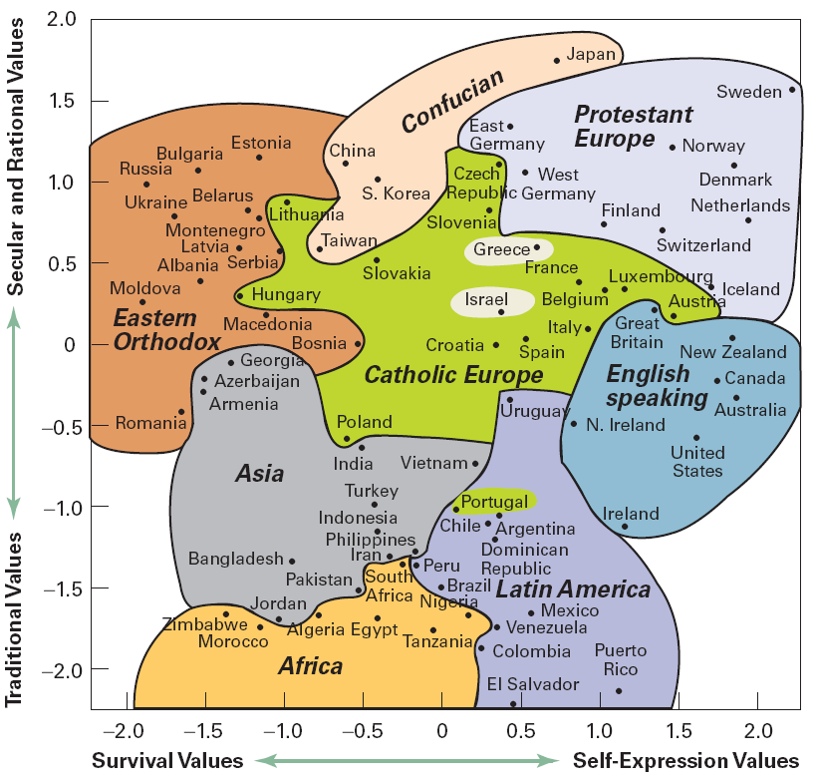
Cultural Values of
Selected Countries
A general global pattern is that higher-income countries tend to be secular-rational and favor self-expression. By contrast, the cultures of lower-income countries tend to be more traditional and concerned with economic survival. Each region of the world, however, has distinctive cultural patterns, including religious traditions, that affect values. Looking at the figure, what patterns can you see?
Source: Modernization, Cultural Change and Democracy by Ronald Inglehart and Christian Weizel, New York: Cambridge University Press, 2005.

Slide 14
Values & Beliefs
Values: Sometimes in Conflict
  Reflects cultural diversity.
  Sparks cultural change.
  Causes strain and often leads to awkward balancing acts in our beliefs.
    We usually learn to live with the contradictions.
Emerging Values
  Values change over time.
Values: A Global Perspective
  Values differ in high and low-income countries. How?
    Lower-Income: Survival, Tradition
    Higher-Income: Individual, Expression, Secular-Rational

Slide 15
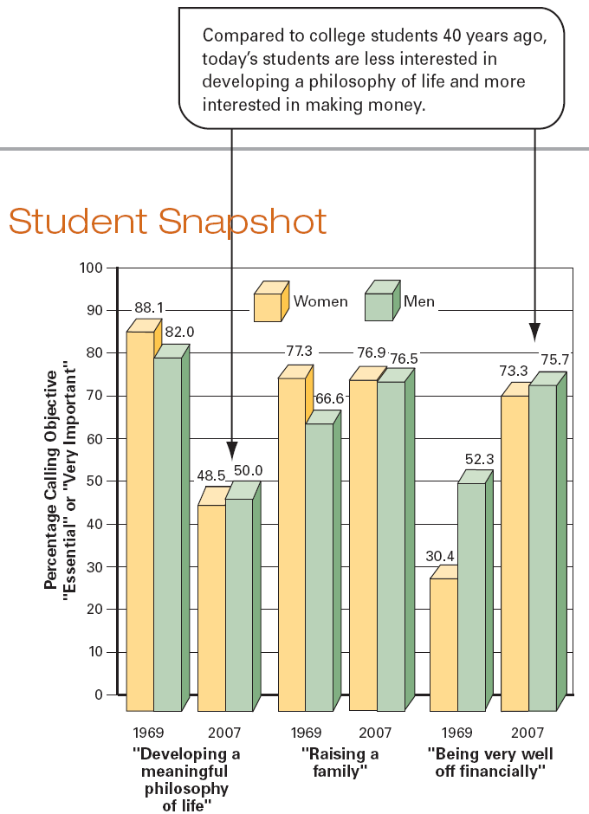
Life Objectives of First-Year
College Students, 1969-2007
Researchers have surveyed first-year college students every year since 1969. While attitudes about some things such as the importance of family have stayed about the same, attitudes about other life goals have changed dramatically.
Sources: Astin et al. (2002) and Pryor et al. (2005).

Slide 16
Norms
Norms – rules and expectations by which a society guides the behavior of its members
  Basic rules of everyday life.
  Make our dealings with others more orderly and predictable.
The most important norms in a culture apply everywhere and at all times.
  Example: Obedience from Young Children; Others?
Other norms depend on the situation.
  Example: Applaud After a Performance; Others?
Why are some norms more important than others? Who decides?
Sanctions – rewards or punishments that encourage conformity to cultural norms

Slide 17
Norms: Two Categorizations
Proscriptive vs. Prescriptive
  Proscriptive – states what we should not do
    Example: Avoid Casual Sex; Others?
  Prescriptive – states what we should do
    Example: Practice Safe Sex; Others?
Mores vs. Folkways
  Mores – norms that are widely observed and have great moral significance
    Right vs. Wrong
    Example: Adults should not have sex with children.
  Folkways – norms for routine or casual interaction
    Right vs. Rude
    Example: Men should wear ties to formal events.

Slide 18
Ideal & Real Culture
IMPORTANT! → Values and norms do not describe actual behavior so much as they suggest how we should behave.
Ideal culture (values and norms) always differs from real culture (what actually occurs).
Examples?
  Faithfulness in Marriage
    We SHOULD be faithful to our spouse (ideal culture).
    But many people cheat on their spouses (real culture).

Slide 19
Technology & Culture

Slide 20
Material Culture & Technology
Artifacts – a wide range of physical human creations; part of material culture
  Partly reflect underlying cultural values.
  Partly reflect a society’s level of technology.
  Examples: Chopsticks vs. Cutlery; Automobiles in America
Technology – knowledge that people use to make a way of life in their surroundings
  The more complex a society’s technology, the more its members are able to shape the world for themselves.
    Ex: Superhighways; Others?
  Both a blessing and a curse.
    Ex: Medicine vs. Violence; Others?
  Not equally distributed.
    Ex: The Digital Divide

Slide 21
Gerhard Lenski
Gerhard Lenski – described how societies changed over the past 10k years; focused on technology and how it shapes society; helps us understand the major differences among societies
  Sociocultural Evolution – changes that occur as a society gains new technology
    Simple Technology – little control over nature; can support just a small number of people
    Complex Technology – support hundreds of millions of people in far more affluent ways of life
    Inventing or Adopting New Technology → Societal Change
    ↑ Technology → Faster Change
    Do you agree or disagree? Examples?
  5 Types of Societies: H&G, H&P, A, I, P-I

Slide 22
Gerhard Lenski
Hunting & Gathering – 3M-200 Years Ago; use simple tools to hunt animals and gather vegetation
  Everyone spends most of their time searching for game & plants.
    Men Hunt & Women Gather - But both of the tasks were seen as equally important so the sexes had roughly the same social importance.
  Small societies comprised of several dozen people living in a nomadic, family-like group.
  No formal leaders.
  Egalitarian way of life.
  Vulnerable to the forces of nature due to limited technology.

Slide 23
Gerhard Lenski
Horticultural & Pastoral – Began ~10k Years Ago
  H – the use of hand tools to raise crops
    Formed Settlements
  P – the domestication of animals
    Nomadic, searching for grazing land.
  Populations expanded from dozens to hundreds.
  Greater Specialization Of Labor → More Socially Diverse → More Inequality
    Due to material surplus that required only certain members of society to be focused on getting food.

Slide 24
Gerhard Lenski
Agrarian – began ~5k years ago; large-scale cultivation using plows harnessed to animals or more powerful energy sources
  “Dawn of Civilization”
  Resided in permanent settlements.
  Expanded in size and population.
  Even greater specialization of labor.
    People had a greater range of life choices.
  Exhibit extreme social inequality (even more than present).

Slide 25
Gerhard Lenski
Industrial – started around 1775; the production of goods using advanced sources of energy to drive large machinery (steam engine)
  Drew people away from the home and reduced importance of family and tradition.
  Made the world seem smaller.
  Higher living standards for all.
  Greater Individualism and Personal Freedom

Slide 26
Gerhard Lenski
Postindustrial – term was coined in 1973; the production of information using computer technology
  Rather than producing things, produces ideas and information.
  Changes the skills that define a way of life.
  We now create symbolic culture on an unprecedented scale: new words, music, and images.
Do all 5 still exist somewhere in the world today? Examples?

Slide 27
Gerhard Lenski
Limits of Technology?
  Provides no quick-fix for social problems.
  Creates its own new problems.
  Gives us more personal freedom, but destroys our sense of community.
    Social Networking Sites?
  Can be used for both good and evil.
  Threatens the physical environment.

Slide 28
Cultural Diversity

Slide 29
High Culture & Popular Culture
High Culture – cultural patterns that distinguish a society’s elite
  Examples?
Popular Culture – cultural patterns that are widespread among a society’s population
  Mass media and celebrities have great importance in its spread.
  Examples?
Which is superior?
  Neither elites nor ordinaries share all the same tastes and interests.
  Does high culture receive praise because it is inherently better or because its supporters have more money, power, and prestige?
    Ex: Violin vs. Fiddle

Slide 30
Subcultures & Countercultures
Subculture – cultural patterns that set apart some segment of a society’s population
  Ex: Korean Americans, Yankees, Others?
  We participate in many subcultures without having much commitment to any of them.
  Involve both difference and hierarchy.
    Dominant or Mainstream? → Favored by powerful segments of the population.
  Source of variety, but also tension and sometimes violence.
    Ex: Religious Wars, Ethnic Cleansing
Counterculture – cultural patterns that strongly oppose those widely accepted within a society; specific type of subculture
  Ex: Hippies in the 1960s; Others?

Slide 31
Multiculturalism, Ethnocentrism & Cultural Relativism
What seems right and natural in one society can be seen as puzzling and even immoral in others.
Ethnocentrism – the practice of judging another culture by the standards of one’s own culture
  Necessary to be attached to your own way of life.
  But can generate misunderstanding and conflict.
Cultural Relativism – the practice of judging a culture by its own standards
  Requires openness.
  Gives rise to questions…
    If almost any kind of behavior is the norm somewhere, does that mean everything is equally right?
    How can we avoid imposing our own standards on others?
Multiculturalism – a perspective recognizing the cultural diversity of the US and promoting equal standing for all cultural traditions

Slide 32
The View from “Down Under”
North America should be “up” and South America “down,” or so we think. But because we live on a globe, “up” and “down” have no meaning at all. The reason this map of the Western Hemisphere looks wrong to us is not that it is geographically inaccurate; it simply violates our ethnocentric assumption that the United States should be “above” the rest of the Americas.

Slide 33
Cultural Change
Cultural Integration – the close relationships among various elements of a cultural system
  Change in one part of a culture usually sparks change in others.
    Example: Working Women → Delays Marriage Age & Raises Divorces
Cultural Lag – the fact that some cultural elements change more quickly than others, disrupting a cultural system
  Example: Genetic Advances → Law & Medicine
Three Causes of Cultural Change:
  Invention –continual process of creating new cultural elements
    Ex: Telephone, Airplane, Others?
  Discovery –recognizing and better understanding more fully something already in existence
    Ex: Planets, Herbs & Plants, Others?
  Diffusion –spread of cultural traits from 1 society to another; impact of globalization?
    Ex: Coins, Food, Others?

Slide 34
A Global Culture?
Today, more than ever, we can observe many of the same cultural practices the world over.
  Ex: Blue Jeans, Products & Brands, Others?
Why?
  Societies now have more contact with one another than ever before due to globalization.
    Global Economy → Flow of Goods
    Global Communication → Flow of Information
    Global Migration → Flow of People
These links make the cultures of the world more similar.
Limitations to this global-culture thesis:
  Flow is uneven with urban areas having many ties, rural areas having few ties, and world super powers (like the USA) having more influence.
  Assumes people everywhere can afford these goods, which is not the case.
  Cultural elements may be similar, but their meanings are not.
    Ex: Harry Potter Books in Tokyo vs. London; British Comedy; Foreign Films

Slide 35
Theoretical Analysis of Culture
Sociologists try to understand how culture helps us make sense of ourselves and the surrounding world.

Slide 36
Structural-Functional Analysis
Explains culture as a complex strategy for meeting human needs.
Values are the core of culture because they:
  Direct our lives.
  Give meaning to what we do.
  Bind people together (solidarity).
All cultural traits have functions that support the operation of society.
Seeks cultural universals, traits that are part of every known culture.
  Murdock (1945) identified dozens. Like what?
    Family – controls sexual reproduction and oversees the care of children
    Funeral Rites – to cope with the reality of death
    Jokes – safe means of releasing social tensions
Critical Review
  Largely ignores cultural diversity.
  Downplays the importance of change.

Slide 37
Social-Conflict Analysis
Stresses the link between culture and inequality.
Any cultural trait benefits some members of society at the expense of others.
Culture is shaped by a society’s system of economic production (Marx).
  Ties our cultural values of competitiveness and material success to our country’s capitalist economy, which benefits the wealthy elite.
    This is encourages us to view capitalism as “natural.”
Hope that eventually the strains of inequality will erupt into movements for social change.
  Ex: Civil Rights Movement, Women’s Movement
Critical Review
  Understates the ways that cultural patterns integrate members of society.

Slide 38
Symbolic-Interactionist Analysis
What do you think symbolic-interactionists say about culture?

Slide 39
Evolution & Culture: Sociobiology
Sociobiology – a theoretical approach that explores ways in which human biology affects how we create culture
Rests on Darwin’s Theory of Evolution and 4 Principles of Natural Selection → Survival of the Fittest
  All living things live to reproduce themselves.
  The blueprint for reproduction is in the genes.
  Some random variation in genes allows a species to “try out” new life patterns in a particular environment. The variation allows some organisms to survive better than others and pass on their advantageous genes to offspring.
  Over thousands of generations, the genetic patterns that promote reproduction survive and become dominant.
Bio-Logic: Sociobiologists claim that the large number of cultural universals reflects the fact that humans are members of a single biological species.
Critical Review
  Could revive biological arguments that claim genetic superiority.
  Minimal empirical support.

Slide 41
Culture & Human Freedom
Read page 65 in your textbook.

Slide 42
Culture: Constraint or Freedom?
As symbolic creatures, humans cannot live without culture.
But the capacity for culture does have some drawbacks.
  We are the only creatures that experience alienation.
  Culture is largely a matter of habit, which limits our choices and drives us to repeat troubling patterns. (Ex: Prejudice & Discrimination)
  Our society’s emphasis on competitive achievement isolates us from one another.
  Material things divert us from the security and satisfaction that come from close relationships and spiritual strength (false consciousness).
But culture also forces us to choose as we make and remake a world for ourselves.
  Cultural Diversity

Slide 43
Culturgram for the 90s
Customs & Courtesies
  Greetings
  Visiting
  Eating
  Gestures
The People
  General Attitudes
  Personal Appearance
  Population
  Language
  Religion
Lifestyle
  The Family
  Dating & Marriage
  Diet
  Business
  Recreation
  Activity:
  Can you fill these in for various cultures?

Slide 44
Discussion Questions
Do you think you can learn more about a people by studying their material or their nonmaterial culture? Why?
Why is culture a more effective strategy for survival than reliance on instinct?
How are core American values other than achievement and success reflected in childhood games?
How has the virtual culture impacted you?
What are the primary means by which society attempts to exert social control over its members?
Is a technologically more advanced society necessarily a superior one?
Do you think that teenagers constitute a distinct American subculture? Why?
Is cultural relativism always good? Under what circumstances do you feel that it is appropriate to condemn the practices of a culture other than your own?

Slide 45
Conclusion
Culture is made up of a variety of material and non-material elements.
Lenski identified the process of sociocultural evolution by which societies and cultures evolve as a result of technological innovation.
There are distinct groups within each culture known as subcultures and countercultures.
Cultures can and do change frequently.
The various sociological paradigms view culture quite differently.
Visual Summary on Pages 67-68
Review Questions on Page 69
Any questions?

