Slide 1
ITMT 1371 - Windows 7 Configuration Chapter 4 – Working with Disks and Devices

Slide 2
Working with Disks
Preparation:
Select partition type:
Master boot record (MBR)
GUID partition table (GPT)
Select disk type: Basic Disk vs. Dynamic Disk
Divide disk into partitions or volumes
File system type: FAT (File Allocation), FAT32, NTFS, exFAT

Slide 3
What is a Partition?
A partition is a contiguous space of storage on a physical or logical disk that functions as if it were a physically separate disk.
Partitions are visible to the system firmware and the installed operating systems.
Access to a partition is controlled by the system firmware before the system boots the operating system, and then by the operating system after it is started.
http://msdn.microsoft.com/en-us/windows/hardware/gg463525

Slide 4
Understanding Partition Styles
MASTER BOOT RECORD (MBR) | GUID PARTITION TABLE (GPT)
Supports up to four primary partitions or three primary partitions and one extended partition, with unlimited logical drives on the extended partition | Supports up to 128 primary partitions
Support volumes up to 2 terabytes in size | Support volumes up to 18 exabytes (1 exabyte = 1 billion gigabytes, or 2⁶⁰ bytes) in size
Data critical to platform operations is stored in hidden (un-partitioned) sector | Data critical to platform operation is stored in partitions rather than in hidden sectors
Replication and CRC are not features of MBR’s partition table | Replication and cyclical redundancy check (CRC) protection of the partition table provide increased reliability

Slide 5
Understanding Disk Types
Basic Disk Type
PRIMARY PARTITIONS | EXTENDED PARTITIONS
Function as if it is a physically separate disk and can host operating system | Extended partitions can not host an operating system
Can be marked as an active partition. You can have only one active partition per HD. | You can not mark an extended partitions as an active partition
Up to 4 primary partitions or 3 primary partition and one extended partition | Basic disk only contain one extended partitions, but an unlimited number of logical partitions
Each partition can be formatted and assigned a unique driver letter | Extended partitions can’t be formatted. However you can format the logical drives and assign unique driver letter for each of them.

Slide 6
Understanding Disk Types
Dynamic disk type:
One single partition that occupies the entire disk
Create unlimited volumes under the partition
Volume Types:
Simple volume
Spanned volume (JBOD)
Stripped volume (RAID-0)
Mirrored volume (RAID-1)
RAID-5 volume – Not supported
More detail about RAID: http://en.wikipedia.org/wiki/Standard_RAID_levels

Slide 7
Understanding File Systems
FAT:
16-bit or FAT16
Limit to 4GB partition
FAT32:
32-bit
Limit to 2 TB partition
File size limit to 4GB
Window 7 only can create up to 32GB partition

Slide 8
Understanding File Systems
exFAT:
Extended File Allocation Table or FAT64
Limit to 64 zettabyte in size (1 zettabyte = 1 billion terabyte)
Window 7 maximum size is 512 TB
NTFS (New Technology File System
Preferred file system for Window 7
Better security (encryption and permission)
http://en.wikipedia.org/wiki/NTFS

Slide 9
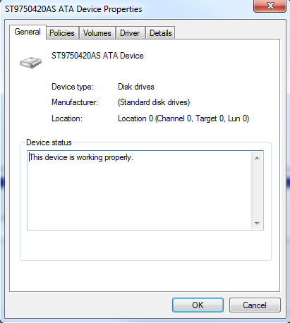
Using Disk Management Snap-In
Disk Management Views:
Disk List
Volume List
Graphic Views
Only display 2 views at
the same time
Physical Disk Properties
General
Volumes
Driver
Details

Slide 10
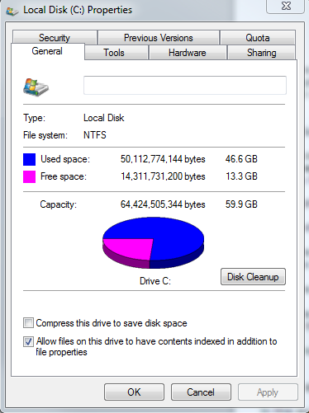
Using Disk Management Snap-In
Partition or Volume Properties
General
Tools
Hardware
Sharing
Security
Previous Versions
Quota

Slide 11
Using Disk Management Snap-In
Initializing disks.
Selecting a partition style
Converting basic disks to dynamic disks
Creating partitions and volumes
Extending, shrinking and deleting volumes
Formatting partitions and volumes
Assigning and changing driver letter and paths
Examining and managing physical disk properties

Slide 12
Using Disk Management Snap-In
Adding a New Disk
Changing the Partition Style
x86-based computer: MBR default
Converting basic disks to dynamic disks
Make sure that you have enough disk space
Do not convert to dynamic if computer is multi-booting
Can’t covert removable to dynamic disks
Can’t convert drives that use sector size greater than 512
To convert back to basic disk, you have to delete the dynamic volume

Slide 13
Using Disk Management Snap-In
Creating partitions and volumes
Format partition
File System
Allocation unit size (sector size)
Volume label
Quick format
Enable file and folder compression

Slide 14
Using Disk Management Snap-In
Extending, shrinking and deleting volumes
Require member of Backup Operator or Administrators group permission
Extend a partition on a basic disk
Extend a simple or spanned volume on a dynamic disk
Shrink disk partition or volume
Can’t shrink stripped volume
Can’t shrink FAT volume

Slide 15
Working with Disks
Using Diskpart.exe
Script mode:
Diskpart.exe /s scriptname
Console mode
Using Disk tools:
Disk Cleanup
Defragmenting Disks
Checking for Disk Errors

Slide 16
Working with VHDs
What is VHD?
VHD native boot:
Offline image updates
Image format standardization
Image deployment testing
Workstation configuration management

Slide 17
Working with VHDs
Creating a VHD
Using Disk Partition Snap-in
Using Disk Part
Attaching and Detaching VHDs
Booting from VHDs
bcdedit /copy {default} /d “vhs boot (locate)”
bcdedit /set {guid} device vhd=[locate]\filename.vhd
bcdedit /set {guid} osdevice vhd=[locate]\filename.vhd

Slide 18
Working with Devices and Drivers
Understanding Driver Complexity
Device driver is likely to be revised more often
The device driver is less likely to be included with the operating system
The device driver is more likely to cause compatibility or functionality problem

Slide 19
Working with Devices and Drivers
Create a Driver Update Policy
The latest is the greatest
Don’t fix if is not broken
Why manufacturers release new driver updates:
To address problems with the previous driver release(s)
To implement new feature
To enhance performance of the device

Slide 20
Working with Devices and Drivers
Understanding Driver Signing
Digital signature
Windows 7 alerts:
Windows can’t verify the publisher of this driver
The driver has been altered
Window cannot install this driver

Slide 21
Working with Devices and Drivers
Supplying Driver During Windows 7 Installation
Installs a generic driver
Leave the device without driver and complete the installation
Asking you to supply an alternate driver or failing that, halt
Update Drivers With Window Update

Slide 22
Working with Devices and Drivers
Using Device Manager
Enabling and Disabling Devices
Updating Drivers
Rolling back drivers
Troubleshooting drivers

Slide 23
Summary – Installing Windows 7
Partition Style, Disk Type
Using Disk Management and DiskPart.exe
Using Virtual Hard Disk (VHD)
Device Drivers

Slide 24
Knowledge Assessment
The file system included in Window 7 that is specifically designed for use on flash drives is called ______.
In Windows 7, the ______ file system is limited to volumes no larger than 32 GB.
The digital signature of a driver consist of a _________________ that is appended to the driver itself before publication
To extend or shrink a partition on a basic disk, you must be a member of the _______________ or ____________ group
There is no way to create a fourth primary partitions on a basic disk in Windows 7? True / False
All dynamic disk have only on partition on them? True / False
Disabling a device in Device Manager causes its device driver to be uninstalled? True / False
exFAT
FAT32
protected checksum
Backup Operator
Administrator

Slide 25
The end

