Slide 1
Chapter 5:
Learning

Slide 2
What is learning?
The cessation of thumb sucking by an infant.
The acquisition of language in children.
A computer program generates random opening moves for its first 100 chess games and tabulates the outcomes of those games. Starting with the 101st game, the computer uses those tabulations to influence its choice of opening moves.
A worm is placed in a T-maze. The left arm of the maze is brightly lit and dry; the right arm is dim and moist. On the first 10 trials, the worm turns right 7 times. On the next 10 trials, the worm turns right all 10 times.
Ethel stays up late the night before the October GRE administration and consumes large quantities of licit and illicit pharmacological agents. Her combined (verbal plus quantitative) score is 410. The night before the December GRE administration, she goes to bed early after a wholesome dinner and a glass of milk. Her score increases to 1210.
A lanky zinnia plant is pinched back and begins to grow denser foliage and flowers.
MYCIN is a computer program that does a rather good job of diagnosing human infections by consulting a large database of rules it has been given. If we add another rule to the database, has MYCIN learned something?
After pondering over a difficult puzzle for hours, Jane finally figures it out. From that point on, she can solve all similar puzzles in the time it takes her to read them.
After 30 years of smoking two packs a day, Zeb throws away his cigarettes and never smokes again.

Slide 3
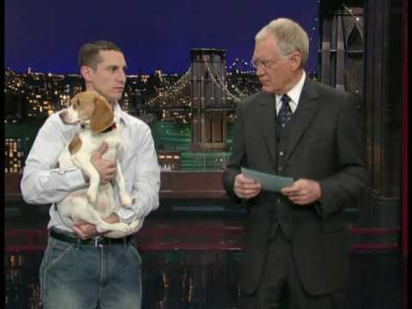
Adaptation to the Environment
Video: Letterman stupid pet tricks – playing dead (http://www.youtube.com/watch?v=DalB-CvO7Qc ) start at 30 secs.
Learning
any process through which experience at one time can alter an individual’s behavior at a future time

Slide 4
Learning
A relatively permanent change in
Behavior
Knowledge
Capability
Attitude
Acquired through experience
Cannot be attributed to illness, injury, or maturation
Infants do not ‘learn’ how to walk, as basic motor skills and maturation govern every species
Copyright © Allyn & Bacon 2008

Slide 5
Adaptation to the Environment
Conditioning
the process of learning the associations between environmental events and behavioral responses

Slide 6
Example
Relax
Visualize yourself on the beach.
It’s getting hotter, so you take a swim.
You get into deeper water and are enjoying cooling off from the heat...

Slide 7
Example cont.
http://www.youtube.com/watch?v=XLAYvjaGGqM
What was reaction?
Did your heartbeat increase?
Did you startle?
A seemingly neutral stimulus can evoke a response if paired with an unconditioned stimulus.

Slide 8
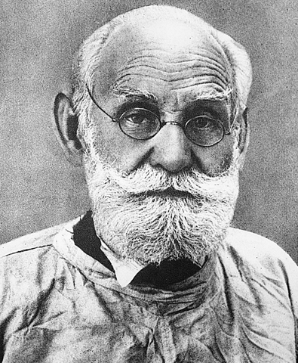
Ivan Pavlov (1849–1936)

Slide 9
Video clip - Pavlov
http://www.youtube.com/watch?v=CpoLxEN54ho

Slide 10
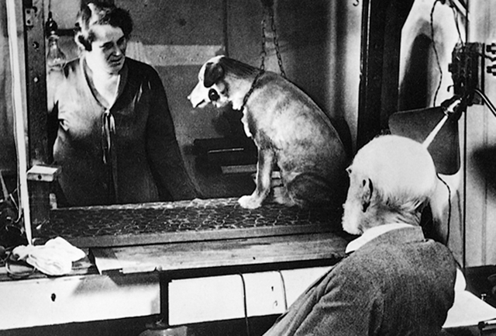
Pavlov’s Dogs
Digestive reflexes and salivation

Slide 11
Classical Conditioning
Pair a neutral stimulus with a response-producing stimulus until the neutral stimulus elicits the same response.
Stimulus doesn't produce a new behavior, but rather causes an existing behavior to occur

Slide 12
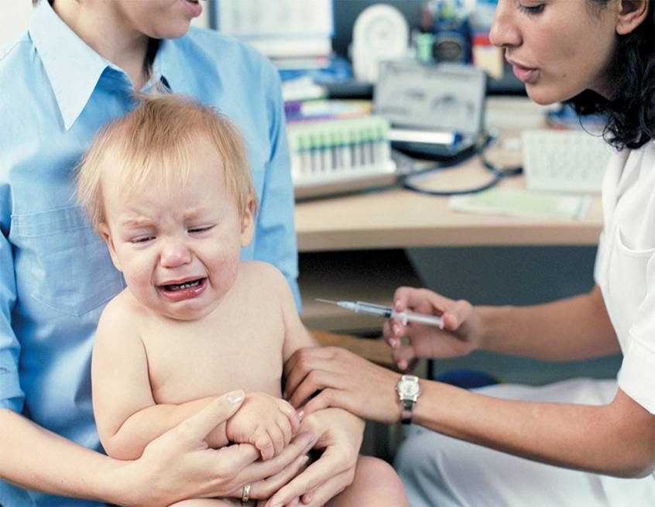
Classical Conditioning in Early Life: White Coats and Doctor Visits Most infants receive several vaccinations in their first few years of life. The painful injection (a UCS) elicits fear and distress (a UCR). After a few office visits, the clinic, nurse, or even the medical staff’s white lab coats can become a conditioned stimulus (CS) that elicits fear and distress—even in the absence of a painful injection.

Slide 13
Neutral Stimulus—Bell
Does not normally elicit a response or reflex action by itself
a bell ringing
a color
a furry object

Slide 14
Unconditioned Stimulus—Food
Always elicits a reflex action: an unconditioned response
food
blast of air
noise

Slide 15
Unconditioned Response—Salivation
A response to an unconditioned stimulus—naturally occurring
Salivation at smell of food
Eye blinks at blast of air
Startle reaction in babies

Slide 16
Conditioned Stimulus—Bell
The stimulus that was originally neutral becomes conditioned after it has been paired with the unconditioned stimulus
Will eventually elicit the unconditioned response by itself

Slide 17
Conditioned Response
The original unconditioned response becomes conditioned after it has been elicited by the neutral stimulus

Slide 18
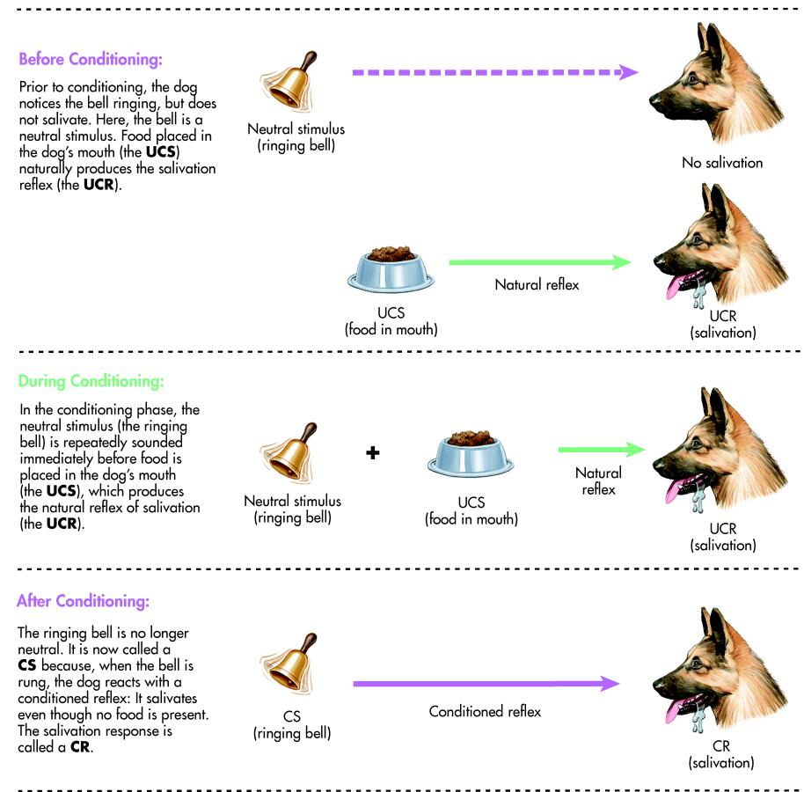

Slide 19
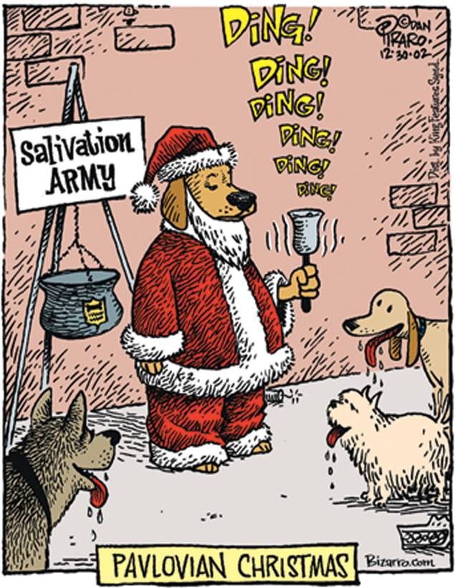

Slide 20
Activity
UCS stands for ________
In this demonstration, the UCS was the prospect of a ________
UCR stands for ________
In this demonstration, the UCR was my feeling of ________
CS stands for ________
All students learn to associate the order to “clear the desks” with a quiz. So the neutral stimulus _______ has become a CS.
CR stands for ________
In this demonstration, my feeling of ________was shown to be a conditioned response to the order to “clear your desks.”

Slide 21
Identify the UCS, UCR, Neutral Stimulus/CS, and CR
1. To discourage coyotes from attacking their sheep, ranchers feed the coyotes small pieces of mutton tainted with poison that, when ingested, cause the coyotes to experience extreme dizziness and nausea. Later, when the coyotes are placed in the pen with the sheep, the mere smell of the sheep causes the coyotes to run frantically away from their former prey.
2. As part of a new and intriguing line of research in behavioral medicine, researchers give mice saccharine-flavored water (a sweet substance that mice love) and then follow it up with an injection of a drug that weakens mice’s immune systems. Later, when these mice drank saccharine-flavored water, they showed signs of a weakened immune response. Research is currently underway to see if the reverse is possible (i.e., if conditioning can be used to increase immune functioning).
3. A passenger on an airplane was feeling very anxious about an important job interview the next morning, and as a result he was uneasy and nervous throughout the flight. Back at home weeks later, he is contemplating a holiday trip. Though he hadn’t previously been afraid to fly, he finds himself suddenly nervous about flying and decides to cancel his plans.
4. It’s no secret that people become unhappy when bad weather strikes, but what is surprising is that weather forecasters are consistently blamed for weather over which they obviously have no control. Weather forecasters around the country have been whacked by old ladies with umbrellas, pelted with snowballs, and even threatened with by people who mistakenly infer a causal relationship between the forecaster with subsequent foul weather patterns.
5. Why is it that automobile advertisements—especially those for sports cars—often feature beautiful young women? Because smart advertisers know (and research confirms) that new car ads that include an attractive female are rated by men as faster, more appealing, better-designed, and more desirable than similar ads that do not include an attractive female.

Slide 22
Identify the UCS, UCR, Neutral Stimulus/CS, and CR.
When you were still together, you and your ex used to love the same hit song by Blink 182. Now, when you hear that song, you feel really sad.
A fourth grade teacher who was strict and scary used to wear a strong, rose-scented perfume. The smell of roses now makes you very nervous.
One night when you bought a “Mighty Meal” combo at Burger Bazaar, you arrived home to find a burger, fries, colas, and three roaches in the bag. Now, even the sight of the Burger Bazaar logo makes you sick to your stomach.
You see a horror movie featuring many explicit and bloody murders that take place in London, England. Now, any picture of London tends to make you feel uneasy.
You have a crush on a fellow student who wears an expensive and elegant leather jacket. Anytime you see a person in a leather jacket, you think romantic thoughts about your crush.
You did really well in your psychology class and were praised by your instructor and parents. Now when you hang out in the psychology department at school, you tend to be in a very good mood.

Slide 23
Classical Conditioning and Ads

Slide 24
Classical Conditioning and Ads
http://www.youtube.com/watch?v=mgr3_w4b_0Y&feature=related - Pepsi 1984
http://www.youtube.com/watch?v=0w0mAcwJ3NE – Pepsi 1988
http://www.youtube.com/watch?v=mUZrrbgCdYc&feature=related - TMobile commercial

Slide 25
Classical Conditioning Phenomenon
Extinction
When the CS is presented without the UCS, the CR will gradually disappear
Spontaneous Recovery
The reappearance of a previously extinguished CR after a period of time without exposure to the CS is spontaneous recovery. So, extinction is NOT unlearning.
Notes:
Extinction- lack of reinforcement of the response and the resulting decline in response rate
-an operantly conditioned response declines in rate and eventually disappears if it no longer results in a reinforcer
ex: rats quit pressing levers if food pellets no longer appear
Extinction is not true “unlearning” of the response but rather a learned inhibition of responding
The mere passage of time following extinction can partially renew the conditioned reflex; called spontaneous recovery
Generalization-phenomenon in which , after conditioning, stimuli that resemble the conditioned stimulus will elicit the conditioned response even though they themselves were never paired with the unconditioned response.
Discrimination training can abolish generalization between two stimuli. By not linking the unconditioned stimulus to the neutral stimulus that has been generalized to, the animal will discriminate.

Slide 26
Phenomenon Cont.
Stimulus generalization
Stimuli that are similar to the original CS also elicit the CR even when not paired with the UCS.
Stimulus discrimination
When a particular CR is made to one stimulus but not to other, similar stimuli

Slide 28
Behaviorism
The attempt to understand observable activity in terms of observable stimuli and observable responses
John B. Watson (1913)
B. F. Skinner (1938)

Slide 29
John B. Watson
Defined psychology as the scientific study of behavior
All human behavior is a result of conditioning and learning
Neither talent, personality, nor intelligence was inherited
http://www.youtube.com/watch?v=KxKfpKQzow8&feature=PlayList&p=C2887F2E31246625&playnext=1&index=5

Slide 30
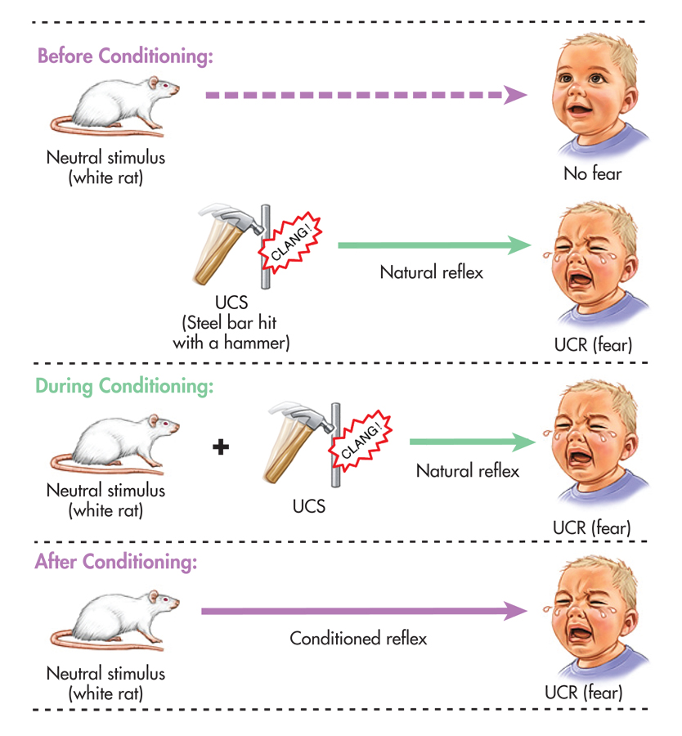

Slide 31
Classical Conditioning and Drug Use
Regular use may produce “placebo response” where user associates sight, smell, taste with the drug effect

Slide 32
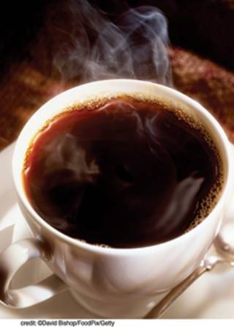
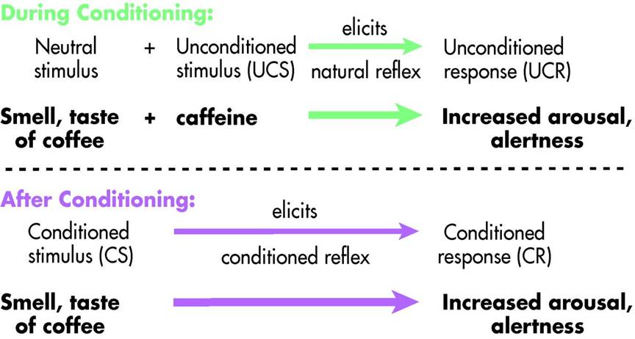
Figure 5.4 Classically Conditioned Drug Effects: Does Just the Smell of a Starbucks Cappuccino Perk You Up? If it does, classical conditioning is at work! Pavlov (1927) suggested that administering a drug could be viewed as a conditioning trial. Just like pairing the sound of a bell with the presentation of food, if specific environmental cues are repeatedly paired with a drug’s administration, they can become conditioned stimuli that eventually elicit the drug’s effect. For a regular coffee drinker, the sight, smell, and taste of freshly brewed coffee are the original neutral stimuli that, after being repeatedly paired with caffeine (the UCS), eventually become conditioned stimuli, producing the CS: increased arousal and alertness.

Slide 33
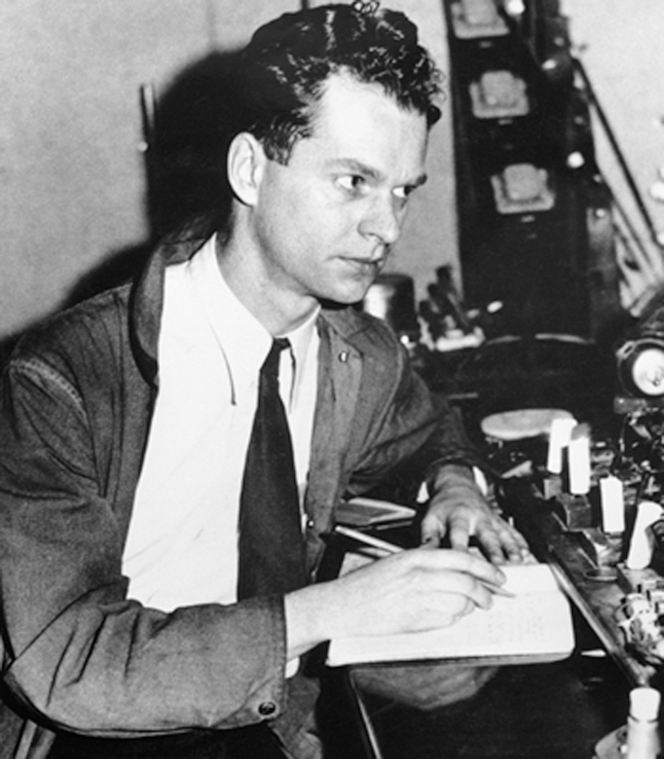
B. F. Skinner (1904–1990)

Slide 34
B. F. Skinner’s Operant Conditioning
Operant—voluntary response that acts on the environment to produce consequences

Slide 35
Operant Conditioning
Reinforcement—the occurrence of a stimulus following a response that increases the likelihood of the response being repeated

Slide 36
Positive and Negative Reinforcement
Positive Reinforcement—the addition of a reinforcing stimulus. Response is strengthened because something is added.
Negative Reinforcement—the removal of an aversive stimulus. Response is strengthened because something is removed.
http://www.youtube.com/watch?v=ns7ClJjf20M

Slide 37
Power of Positive Reinforcement
Record the number of
curved- and
straight-edged pieces
the volunteer picks up

Slide 39
Are rewards bad?
Rewards are ultimately an instrument of control
Can rewards undermine your interest in something?
http://abcnews.go.com/video/playerIndex?id=6427285

Slide 40
Is Praising Our Kids a Bad Thing?
http://www.youtube.com/watch?v=pDyochq2Q6w&feature=PlayList&p=86B1CB56EBF51DD3&index=3

Slide 41
Punishment
Presentation of a stimulus following a behavior that acts to decrease the likelihood that the behavior will be repeated

Slide 42
Punishment
The difference between punishment and negative reinforcement:
Punishment
Adds an unpleasant condition
A teen is grounded for not cleaning their room.
Negative reinforcement
An unpleasant condition is terminated or avoided
The probability of a desired response is increased by removing an unpleasant stimulus when the correct response is made
The teen is grounded until the room is clean.

Slide 43
Problems with Punishment
Does not teach or promote alternative, acceptable behavior
May produce undesirable results such as hostility, passivity, fear
Likely to be temporary
May model aggression

Slide 44
Videos
http://abcnews.go.com/video/playerIndex?id=3927858
http://abcnews.go.com/video/playerIndex?id=6132169

Slide 45
Making Punishment Effective
Punishment is necessary to stop destructive behavior.
Factors that influence the effectiveness of punishment: its timing, intensity, and the consistency of application
It is most effective when applied during the misbehavior or as soon afterward as possible
Interrupting the misbehavior diminishes its rewarding aspects.
The longer the delay between the response and the punishment, the less effective the punishment is in suppressing the response.
Don’t kick the dog today for what it did yesterday – it won’t connect the punishment with the misdeed.
If delay is necessary, the punishment should remind them of the incident and explain why it was inappropriate.

Slide 46
Making Punishment Effective
Punishment should be of the minimum severity necessary to suppress the problem behavior.
Unnecessarily severe punishment leads to adverse side effects.
Purpose of punishment is NOT to vent anger but to modify behavior.
Punishment meted out in anger is usually more intense than needed to bring about desired result.
If too mild, it will have no effect.
Gradually increasing the intensity of the punishment causes the perpetrator to adapt and the unwanted behavior will persist.
To suppress a behavior, the punishment must be more punishing than the misbehavior is rewarding.
A $200 ticket is more likely to suppress speeding than a $2 ticket.

Slide 47
Making Punishment Effective
It must be applied consistently.
Parents cannot ignore misbehavior one day and punish the same act the next day.
Both parents should react to the same misbehavior in the same way.
An undesired response will be suppressed more effectively when the probability of punishment is high.
Most people will not speed when a police car is in the rear-view mirror.

Slide 49
Punishment and Alternatives
1. Martin is an office manager in an insurance brokerage firm. He is aware that employees are stealing office supplies. He is watching each employee carefully, estimating the cost of the supplies that that employee is taking, and charging it against his or her paycheck every month.
2. The mother of a 3-year-old is angry because her child has developed a “potty mouth.” She screams at him when he uses naughty language. He cries when she does, but he keeps using these words anyway.
3. A teacher is frustrated because only about two-thirds of his fifth grade students manage to finish each week’s homework packet. He has started to assign extra weekend homework to the students who fail to hand in the packets on Friday morning. Most of this extra homework does not get done.
4. The father of a 14-year-old boy is concerned because his son has broken his weekend curfew for 3 weeks in a row. The boy comes home about 20 to 30 minutes past the designated time of 11 P.M. The father has grounded him for the remainder of the summer.
5. A babysitter wishes to stop the 6-year-old she watches from whining when she doesn’t get her way. The sitter sends the child to her room for 10 minutes whenever the child whines.

Slide 50
Operant Conditioning Terms
Shaping
Extinction
Spontaneous recovery
Discriminative stimuli
Schedules of reinforcement
Notes:
We are pulled as well as pushed by events in our environment. We do not just react to stimuli; we also behave in ways to produce or obtain certain environmental changes or stimuli.
Shaping- process in which successively closer approximations to the desired response are reinforced until the response finally occurs
Consequences- what happens after a response
positive reinforcement- the arrival of some stimulus following a response which makes the response more likely to occur; stimulus called
a positive reinforcer
negative reinforcement- the removal of some stimulus following a response which makes the response more likely to occur; stimulus called a negative reinforcer
punishment- opposite of reinforcement; the consequence of a response decreases the likelihood that the response will occur

Slide 51
Shaping Behavior
Shaping
Consists of gradually molding a desired behavior (response) by reinforcing any movement in the direction of the desired response
Gradually, responses are guided toward the ultimate goal
Learning a piano concerto is done by teacher praising your ability to
Read musical notes
Play individual notes
Play the notes continuously
Play one hand of notes according to the music
Play both hands according to the music
Play the concerto slowly
Play the concerto up to tempo
Play the concerto correctly

Slide 52
Video
http://www.youtube.com/watch?v=dhmONAl6Yiw&feature=PlayList&p=1753C578FD79D9A4&index=52student teaching dog through operant conditioning

Slide 53
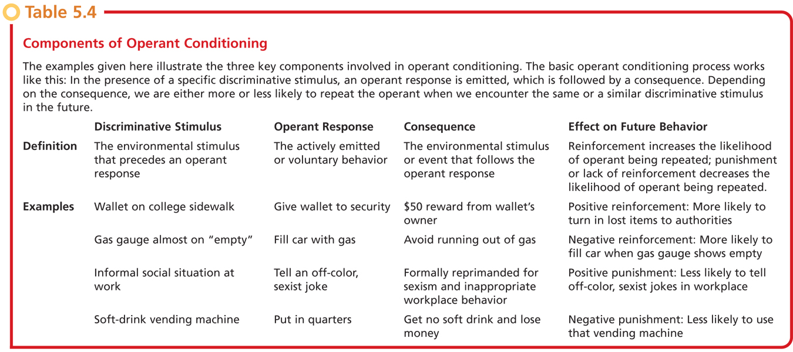
Discriminative Stimuli
Environmental cues that tell us when a particular response is likely to be reinforced

Slide 54
Behavior Modification
Application of learning principles to help people develop more effective or adaptive behaviors
Systematic use of reinforcement, shaping, and extinction increase the occurrence of desirable behaviors and decreases the incidence of undesirable behaviors

Slide 55
Activity
Look at the following problems as a behaviorist would. Suggest behavioral solutions for each.
Traffic! The problem of traffic gridlock in American cities continues to increase. Campaigns to encourage people to share a ride or take the bus have not been very successful. In one large city, commuters entering the city must cross one of several bridges to get to the area where office buildings and factories are concentrated. How could behavior modification be used to reduce the traffic congestion in the city?
The Homework Puzzle. An article published in The New York Times reported the results of a large-scale study on the benefits of homework for elementary school children. The study showed that the lowest-achieving children spent more time with homework than children with better grades. How can the longer time spent by the low-achieving children be explained? Why aren’t the children who spent more time with homework the ones who are making better grades?
Stars and Stickers. Should elementary school children receive material rewards for performance and cooperation? Imagine that you are a parent and that you have a child in the first grade. You have received a notice from the principal of the school that a program of tangible rewards (buttons, stickers, stars, bags of popcorn, cookies) is being considered. The notice compares tangible rewards for the children with the pay adults get for work. From what we know about behaviorism, is this a good idea? Explain why the extensive use of tangible rewards may backfire in this situation.

Slide 56
Reinforcement Schedules
Continuous—every correct response is reinforced; good way to get a low-frequency behavior to occur
Partial—only some correct responses are reinforced; good way to make a behavior resistant to extinction

Slide 57
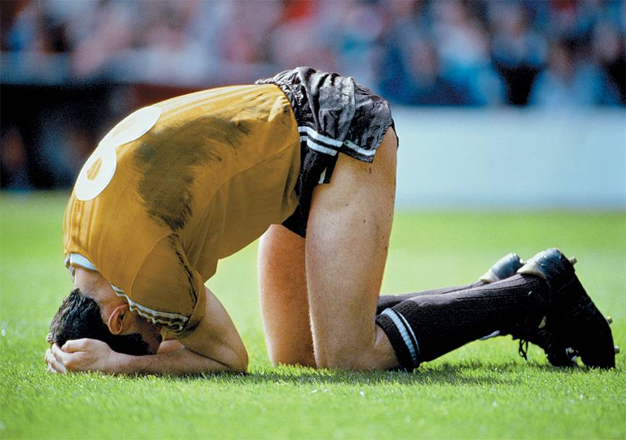
Learned Helplessness on the Field In humans, learned helplessness can be produced when negative events are perceived as uncontrollable. Even highly trained athletes can succumb to feelings of learned helplessness in the face of persistent defeats. Athletes who believe that they have no control over the factors that led to their loss or poor performance are less likely to believe that they can succeed in the future (Coffee & Rees, 2008). They’re also less likely to persist in the face of failure (LeFoll & others, 2008).

Slide 58
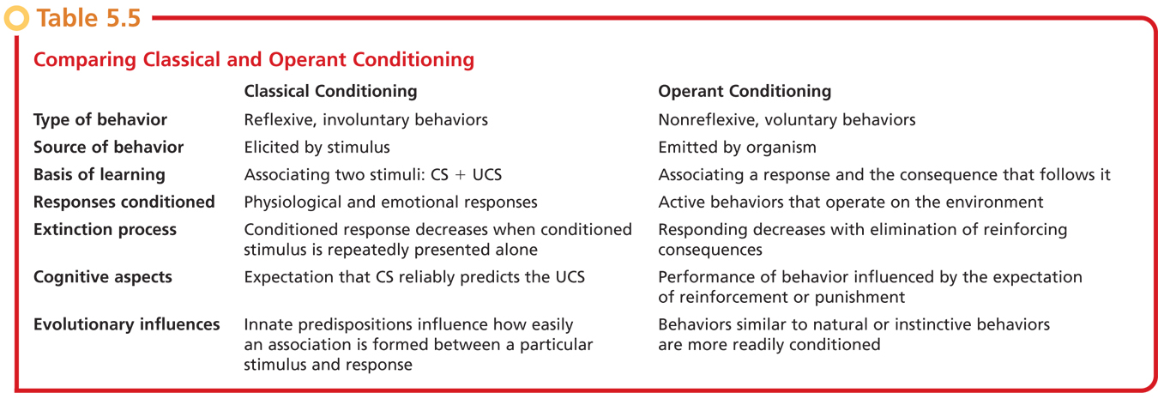
Classical Conditioning Versus Operant Conditioning

Slide 59
Activity
Classical vs. operant conditioning

Slide 60
Observation Learning
Observation
Modeling
Imitation
Albert Bandura and the Bobo doll study http://video.google.com/videoplay?docid=-4586465813762682933

Slide 61
Video
CD – Video games

Slide 62
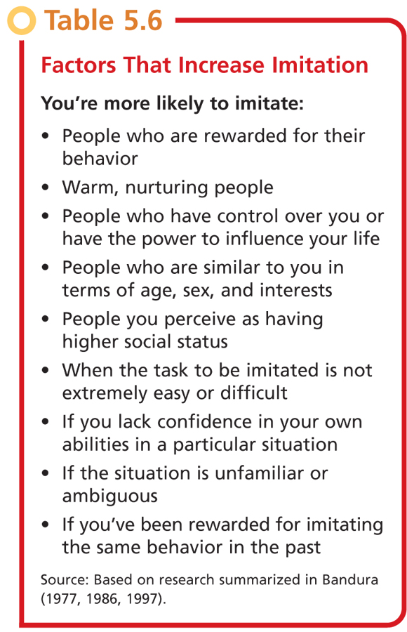

Slide 63
Famous Last Words???
Do as I say, not as I do.
This will teach you to hit your brother!
Why do you do that? You know you get in trouble for it.

Slide 64
Video
http://www.youtube.com/watch?v=X_s9pG5CWXM&feature=related

