Slide 1
Chapter 15: Equilibria in Solution of Weak Acids and Weak Bases
Most Weak Acids are Bronsted-Lowry Acids:
HC₂H₃O₂ + H₂O ↔ H₃O⁺ _{(aq)} + C₂H₃O₂⁻ _{(aq)}

Slide 2
Chapter 15: Acid Dissociation Constants (Ka)
HX ↔ H⁺ _{(aq)} + X⁻ _{(aq)}
Ka = [H⁺ ] [X⁻ ]/[HX]

Slide 3
Base Dissociation Constants (K_{b})
NH₃ + H₂O_{(l)} ↔ NH₄⁺_{(aq)} + OH⁻ _{(aq)}
K_{b} = [NH₄⁺] [OH⁻ ]/[NH₃ ]

Slide 4
Percent of Ionization of a Weak Acid
HC₂H₃O₂ + H₂O <-> H₃O⁺ _{(aq)} + C₂H₃O₂⁻ _{(aq)}
% = {[H⁺ ]/[weak acid]} 100

Slide 5
Sample Calculation
Calculate the [H⁺] in a 0.15 M solution of HC₂H₃O₂. Ka = 1.8E-5.
Calculate the percent of ionization for this weak acid.

Slide 6
Correction for Dissociation
1. Don’t have to correct for dissociation when the percent of ionization is 5% or less than 5%.
2. Ka or Kb = 1.0E-5
OMIT USE OF QUADRATIC FORMULA!

Slide 7
Correction for Dissociation
3. If Ka/Kb = 1.0E-4, first calculate percent of ionization not correcting for dissociation.
4. If Ka/Kb value is large then 1.0E-4, must use quadratic formula.

Slide 8
Problem
The K_{a} value for Benzoic Acid (HC₇H₅O₂) is 6.3E-5. Calculate the equilibrium concentration of H₃O⁺, C₇H₅O₂⁻, and HC₇H₅O₂

Slide 9
Percent of Ionization of a Weak Base
NH₃ + H₂O_{(l)} ↔ NH₄⁺_{(aq)} + OH⁻ _{(aq)}
% = { [ OH⁻ ]/[weak base] } 100

Slide 10
Chang: Problem 15.47-B
Calculate the percent ionization for Benzoic Acid having the following concentration. Ka= 6.5E-5.
(b) 0.00020 M

Slide 11
Problem
A solution of acetic acid has a pH of 2.54. What is the concentration of acetic acid (HC₂H₃O₂) in this solution.
Ka = 1.8E-5

Slide 12
Chang: Problem 15.45, Page 688
The pH of an acidic solution is 6.20. Calculate the Ka for the acid. The initial acid concentration is 0.010 M.

Slide 13
Problem 15.48: Page 704
Calculate the percent of ionization of Hydrofluoric Acid at the following concentrations: Ka = 7.1E-4
(a) 0.60 M
(b) 0.0046 M
(c) 0.00028M

Slide 14
Problem
Pyridine, C₅H₅N, is a bad smelling liquid that is a weak base in water. What is the pH of a 0.20 M aqueous solution of this compound.
Kb = 1.5E-9

Slide 15
Chang: Problem 15.54, page 689
The pH of a 0.30 M solution of a weak base is 10.66. What is the Kb of the base.

Slide 16
Chapter 15: Conjugate acid-base pairs
HC₂H₃O₂ ↔ H⁺_{(aq)} + C₂H₃O₂⁻ _{(aq)}
C₂H₃O₂⁻ _{(aq)} H₂O ↔ HC₂H₃O₂+ OH⁻_{(aq)}
HC₂H₃O₂ + C₂H₃O₂⁻ _{(aq)} + H₂O ↔ H⁺_{(aq)} + C₂H₃O₂⁻ _{(aq)} + HC₂H₃O₂+ OH⁻(aq)
Summary: H₂O ↔ H⁺_{(aq)} + OH⁻_{(aq)}

Slide 17
Chapter 15: Conjugate acid-base pairs
(K_{a}) (K_{b}) = K_{w}
Ka for HC₂H₃O₂ =1.8E-5. Calculate Kb for C₂H₃O₂⁻

Slide 18
Chapter 15: Conjugate acid-base pairs
H₂S ↔ H⁺ + HS⁻
Ka = 5.7E-8
HS⁻ + H₂O ↔ H₂S + OH⁻
Calculate Kb for H₂S ↔ H⁺ + HS⁻
Ka = 5.7E-8

Slide 19
Chapter 15: Hydrolysis
Salt → Cation _{(aq)} + Anion _{(aq)}
Cation/Anion + H₂O ↔ H⁺ _{(aq)}/OH⁻ _{(aq)}

Slide 20
Hydrolysis Equations
C₂H₃O₂⁻ + H₂O ↔ HC₂H₃O_{2(aq)} + OH⁻_{(aq)}
Fe²⁺_{(aq)}+H₂O_{(l)}↔ Fe[H₂O)(OH)] ⁺_{(aq)}+ H⁺ _{(aq)}
NH₄⁺_{(aq)} + H₂O ↔ :NH_{3(aq)} + H⁺ _{(aq)}

Slide 21
Hydrolysis Rules
1. Acidic pH
Transition Metal Cations
Polyatomic Cations
NH₄⁺_{(aq)} + H₂O ↔ :NH_{3(aq)} + H⁺ _{(aq)}
Fe²⁺_{(aq)}+H₂O_{(l)}↔ Fe[H₂O)(OH)] ⁺_{(aq)}+ H⁺ _{(aq)}

Slide 22
Hydrolysis Rules
2. Basic pH
Polyatomic anions other than NO₃⁻
C₂H₃O₂⁻ + H₂O ↔ HC₂H₃O₂ + OH⁻

Slide 23
Hydrolysis Rules
2. Basic pH
Polyatomic anions other than NO₃⁻
C₂H₃O₂⁻ + H₂O ↔ HC₂H₃O₂ + OH⁻

Slide 24
Hydrolysis Rules
4. Will cause hydrolysis. Can’t project pH.
NH₄C₂H₃O₂

Slide 25
Problem 15.48: Page 704
Calculate the percent of ionization of Hydrofluoric Acid at the following concentrations: Ka = 7.1E-4
(a) 0.60 M
(b) 0.0046 M
(c) 0.00028M

Slide 26
Ions that Do Not Cause Hydrolysis
Cations from I-A and II-A
Anions from VII-A
NO₃⁻

Slide 27
Problem 15.76: Page 15.76
Predict whether the following solutions are acidic, basic, or nearly neutral: (a) NaBr; (b) K₂SO₃; (c ) NH₄NO₂; (d) Cr(NO₃)₃

Slide 28
Chapter 15: Polyprotic Acids
H₂CO₃ ↔ H⁺ + HCO₃⁻
Ka₁= 4.3E-7
HCO₃⁻ ↔ H⁺ + CO₃²⁻
Ka₂ = 4.7E-11

Slide 29
Problem
Trisodium phosphate (Na₃PO₄) is available in hardware stores as TSP and is used as a cleaning agent. The label on a box of TSP warns that the substance is very basic (caustic or alkaline). What is the pH of a solution containing 50.0 grams of TSP in a liter of solution?
Ka for HPO₄²⁻ = 4.8E-13

Slide 30
Molecular Structure and Ka Values
Ka Values
Polarity of Bond
Electronegativity Difference

Slide 31
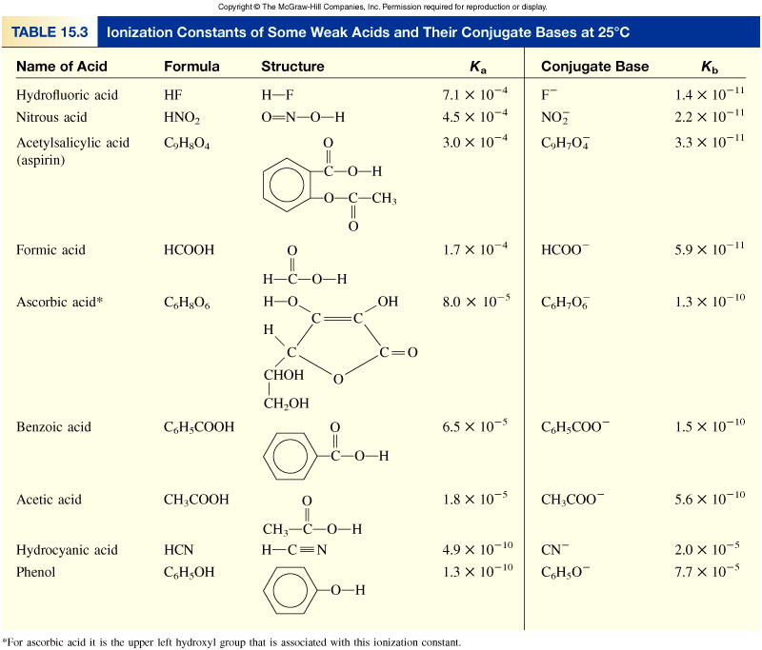
Table 15.3

Slide 32
Molecular Structure and Kb Values
Kb Values
Availability of Pair Electrons
Electronegativity of Attached atoms

Slide 33
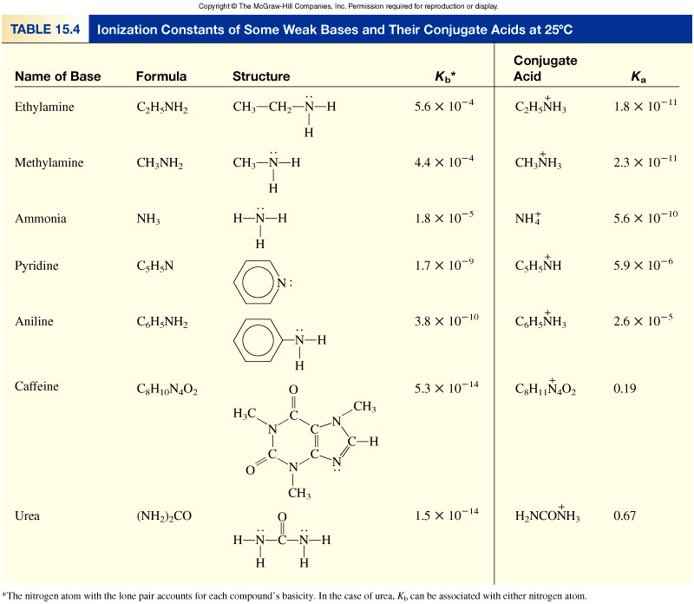
Table 15.4

