Slide 1
Allergic Purpura
(HENOCH-SCHÖNLEIN PURPURA)
BIOL1406
Professor Nesterovitch
Min Wang
Dec/3/2012

Slide 2
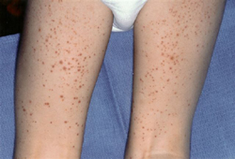
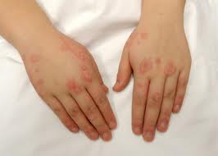
HENOCH-SCHÖNLEIN PURPURA

Slide 3
DEFINITION
HSP is a small-vessel vasculitis characterized by purpura, arthritis, abdominal pain, and hematuria.
It is the most common cause of non-thrombocytopenic purpura in children

Slide 4
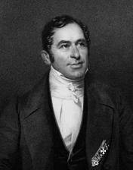
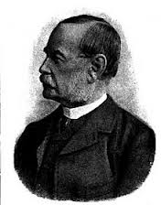
BACKGROUND
Henoch-Schonlein Purpura is named after the two doctors who first described it. It is also called Anaphylactoid Purpura (AP).
Johann Schönlein
Edouard Henoch

Slide 5
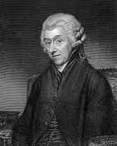
HISTORY
First described in 1801 by William Heberden, a physician in London, who wrote about a case of a 5 year old boy with hematuria, abdominal pain, joint pains and a skin rash.
William Heberden

Slide 6
HISTORY
In 1837, Johann Schönlein and later in 1874, Edouard Henoch described multiple case reports of similar cases. They also showed an association of an upper respiratory infection preceding development of symptoms.

Slide 7
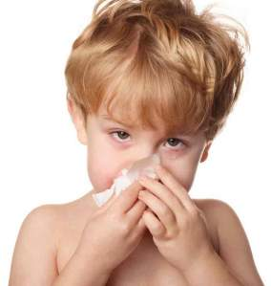
Epidemiology
The etiology of HSP is unknown, but it typically follows as upper respiratory tract infection.

Slide 8
Epidemiology
It used to account for about 1% of the admissions to hospital but changes in the medical practice have reduced the frequency to about 0.6%.

Slide 9
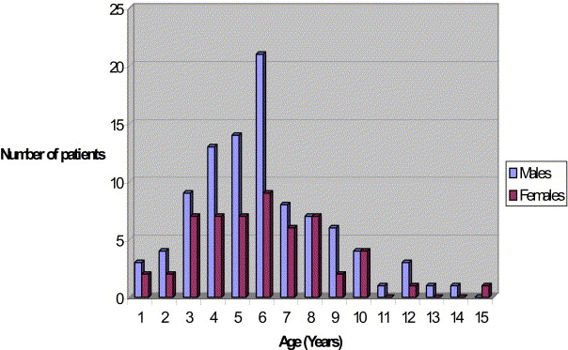
Epidemiology
It is more frequent in children more than adult, and mostly occurs between the ages of 2-8 years.
Trapani, S., A. Micheli, et al. (2005). "Henoch Schonlein Purpura in Childhood: Epidemiological and Clinical Analysis of 150 Cases Over a 5-year Period and Review of Literature." Seminars in Arthritis and Rheumatism 35(3): 143-153.

Slide 10
Epidemiology
Males are affected twice as frequently as females.
And the overall incidence is estimated to be 9/100000 population

Slide 11
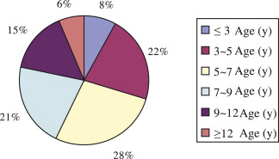
Epidemiology
50% < 5 years & 75% < 10 years
Trapani, S., A. Micheli, et al. (2005). "Henoch Schonlein Purpura in Childhood: Epidemiological and Clinical Analysis of 150 Cases Over a 5-year Period and Review of Literature." Seminars in Arthritis and Rheumatism 35(3): 143-153.
Notes:
HSP seemed to follow an upper respiratory tract infection and in one of study of 219
patients a potential eliciting factor mostly infectious was identified in 37% of cases

Slide 12
Epidemiology
Peaks in Winter and Spring
Commoner in Boys (2:1)
Rare in Afro/Caribbeans
Roberts PF, Waller TA, et al. (2007) "Henoch-Schönlein purpura: a review article.” South Medical Journal. 100(8):821-4.
Notes:
HSP seemed to follow an upper respiratory tract infection and in one of study of 219
patients a potential eliciting factor mostly infectious was identified in 37% of cases

Slide 13
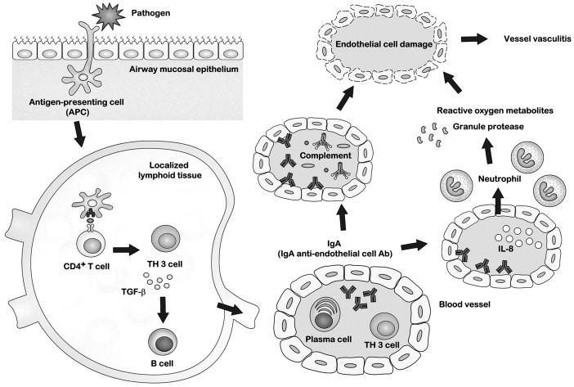
Pathology
Specific pathogenesis is not well known.
  Genetic.
  Cytokines are increased in active disease.
  This illness is considered by histopathology to be an IgA mediated vasculitis of small vessels.
Yang YH, Chuang YH et al. (2008) “The immunobiology of Henoch-Schönlein purpura.” Autoimmun ity Reviews. 7(3):179-84.

Slide 14
Pathophysiology
  HSP and IgA nephropathy are related disorders.
  HSP affects mostly children and involves the skin and connective tissues, gastrointestinal tract, joints, and scrotum as well as the kidneys.
Roberts PF, Waller TA, et al. (2007) "Henoch-Schönlein purpura: a review article.” South Medical Journal. 100(8):821-4.

Slide 15
FACTS
HSP is a systemic vasculitic syndrome, also a benign self-limited disorder.
90% of cases reported in children
Male : Female = 2:1
Fewer than 5% of cases cause chronic symptoms.
Renal disease is more severe in adults

Slide 16


CAUSES
Pathogenesis is not yet clear.
Food allergies (eggs, milk, beans, etc.)

Slide 17
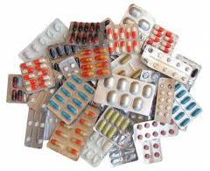
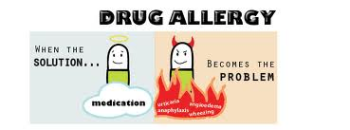
CAUSES
Drugs (aspirin, antibiotics, etc.)

Slide 18
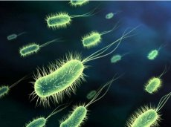
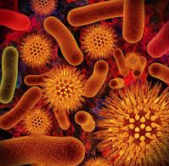
CAUSES
Micro-organisms (bacteria, viruses, parasites, etc.) infection

Slide 19

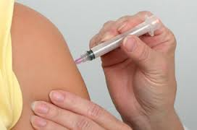
CAUSES
Insect bites, vaccination and others

Slide 20
SYMPTOMS (Skin Manifestations)
Rash (95-100%), especially involving the legs, may not be present on initial presentation
  Beginning as pinkish maculopapules that initially blanches on pressure.
  Then progress petechiae or purpura which are characterized clinically as palpable pupura that evolve from red to purple rusty brown before they eventually fade.

Slide 21
SYMPTOMS (Rash)
  The lesions tend to occur in crops lasting from 3-10 days and may appear at intervals that vary from a few days to as long as 3-4 months.
  In fewer than 10% of children, recurrence of the rash may not end until as late as a year and rarely several years after the initial episode

Slide 22
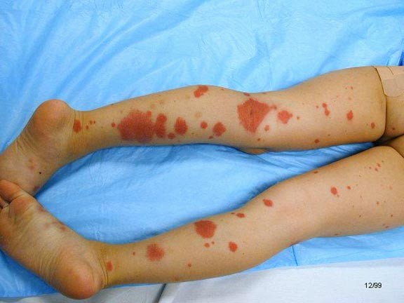

Slide 23
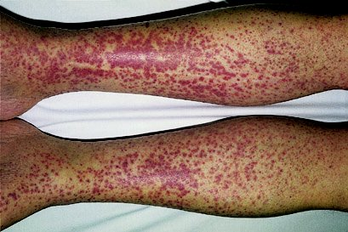

Slide 24
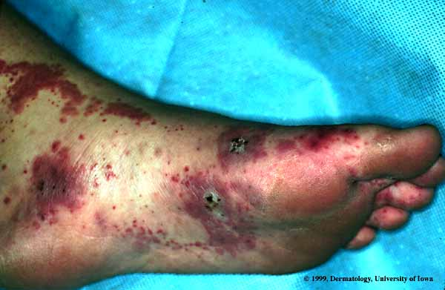

Slide 25
SYMPTOMS (Skin Manifestations)
Lower limb and buttocks
Extensor surfaces, symmetrical
  Erythematous Macules(red)
  Purple, non-blanching, urticarial non-pruritic, purpuric papules
  Confluent
Associated hand/feet edema
Swelling of scalp, ears

Slide 26
SYMPTOMS (Joints Manifestations)
Joint pain (60-80%), especially involving knees and ankles
  Arithritis is usually localized to the knees and ankles and appears to be concomitant with edema.
  The effusion are serous, not hemorrhagic, in nature and resolve after few days without residual deformity or articular damage.
  They may recur during a subsequent reactive phase of the disease

Slide 27
SYMPTOMS (Joints Manifestations)
Arthralgia and periarticular oedema ~66%
May precede rash & joint pain
Self limiting
No synovial effusions
  Knees
  Ankles
  Elbows
  Wrists

Slide 28
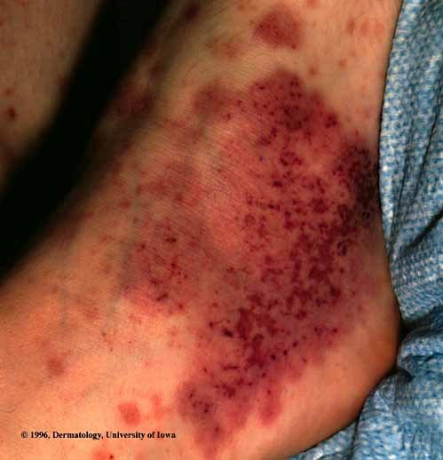

Slide 29
SYMPTOMS (Gastrointestinal Manifestations)
Abdominal pain and vomiting (85%)
More than half of children with repeated abdominal pain,
May be associated with vomiting, hematemesis rare
Some Children have black stools or blood in the stool, diarrhea or constipation
Occasionally intussusception, intestinal obstruction or intestinal perforation

Slide 30
SYMPTOMS (Renal Manifestations)
  in up to 30% -60% of patients in the course of 1-8 weeks.
  Usually more rapidly progressive in adults. Rare in children.
  May present with hematuria.
  Usually resolve spontaneously.

Slide 31
SYMPTOMS (others)
  Food hypersensitivity
  Cold exposure
  Autosomal recessive Chronic granulomatous disease
  Myelodysplastic syndrome
  Small cell lung cancer
  Breast cancer

Slide 32
SUMMARY OF MAIN SYMPTOMS
Rash: rashes are most common on the buttocks, abdomen and legs.
Joint pain and swelling, especially in the knees and ankles.
Abdominal pain, along with blood in the urine etc.
Kidney failure.

Slide 33
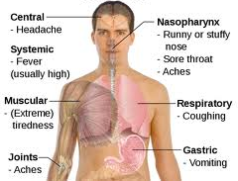
MEDICATIONS
Usually self-limiting (1-6 weeks)

Slide 34
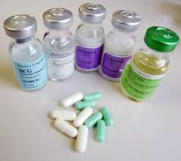
MEDICATIONS
Steroids:
  may decrease tissue edema, may aid in arthralgias and some abdominal pain
  Has not been shown to be beneficial in kidney disease or dermal manifestations
  Does not lessen chance of recurrence
  Does not shorten duration of disease

Slide 35
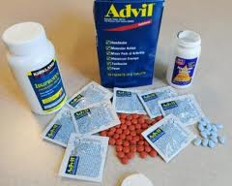
MEDICATIONS
Nonsteroidal anti-inflammatory drugs (NSAIDs) may help joint pain and do not worsen the purpura. However, NSAIDs should be used cautiously in patients with renal insufficiency.

Slide 36
COMMENT DRUGS
Vancomycin
Streptokinase
Ranitidine
Cefuroxime
Diclofenac
Enalapril
Captopril

Slide 37
TREATEMENT
There is no cure for this disease.
General treatment
Actively looking for and removal of pathogenic factors
Bed rest
Plenty of fluids

Slide 38
Prognosis
HSP is generally a benign disease with an excellent prognosis.
More than 80% of patients have a single isolated episode lasting a few weeks.
Approximately 10-20% of patients have recurrences.
Fewer than 5% of patients develop chronic HSP.
Abdominal pain resolves spontaneously within 72 hours in most patients.

Slide 39
References
Trapani, S., A. Micheli, et al. (2005). "Henoch Schonlein Purpura in Childhood: Epidemiological and Clinical Analysis of 150 Cases Over a 5-year Period and Review of Literature." Seminars in Arthritis and Rheumatism 35(3): 143-153.
Roberts PF, Waller TA, et al. (2007) "Henoch-Schönlein purpura: a review article.” South Medical Journal. 100(8):821-4.
Yang YH, Chuang YH et al. (2008) "The immunobiology of Henoch-Schönlein purpura." Autoimmun ity Reviews. 7(3):179-84.
Dennis K, Braunwald E, (2005) "Harrison’s Principles of Internal Medicine." New York: McGraw-Hill, 16th edition, eds.
Lawrence T, and McPhee S, (2006) "Current Medical Diagnosis and Treatment." New York: McGraw-Hill, 45th edition, eds.

Slide 40

Thank you!

