Slide 1
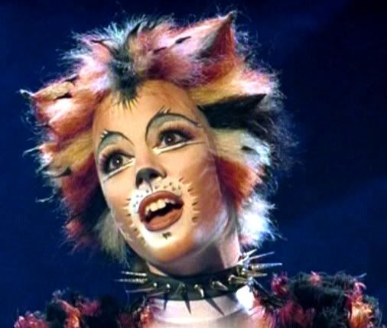
Stage Makeup

Slide 2
Stage Makeup
is used to enhance the portrayal of an actor’s character whether it is “straight” makeup (corrective) or character makeup

Slide 3
Makeup The application of cosmetics to the face and body to help give the appearance of different ages, special facial features of ethnic origins, environment and nonhuman characters. Makeup functions to help the performer personify and embody a character.
Stage Makeup
is used to enhance the portrayal of an actor’s character whether it is “straight” makeup (corrective) or character makeup

Slide 4
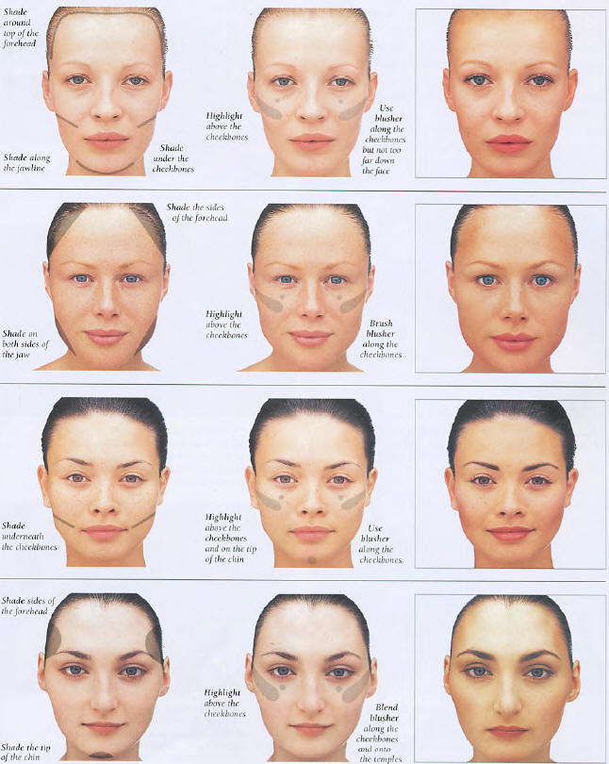
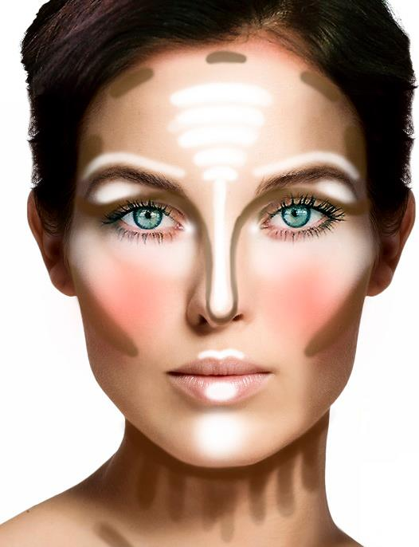
Corrective Stage Makeup
Intro
Exercise
Visuals
Handout
Chart Exercise
Project

Slide 5
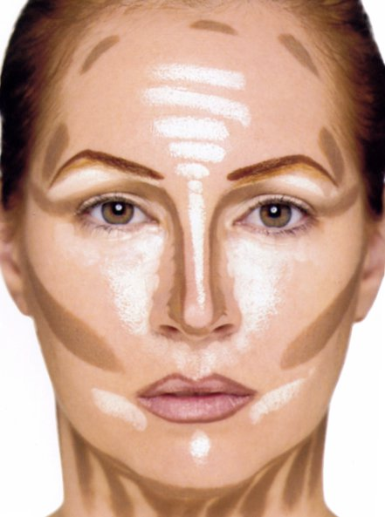
Corrective Stage Makeup
The art of creating the appearance of perceived shapes, texture and color on the face by using the artistic concept of perspective drawing which is based, in part, on the affects of light on surfaces.
Project One Tutorial

Slide 6
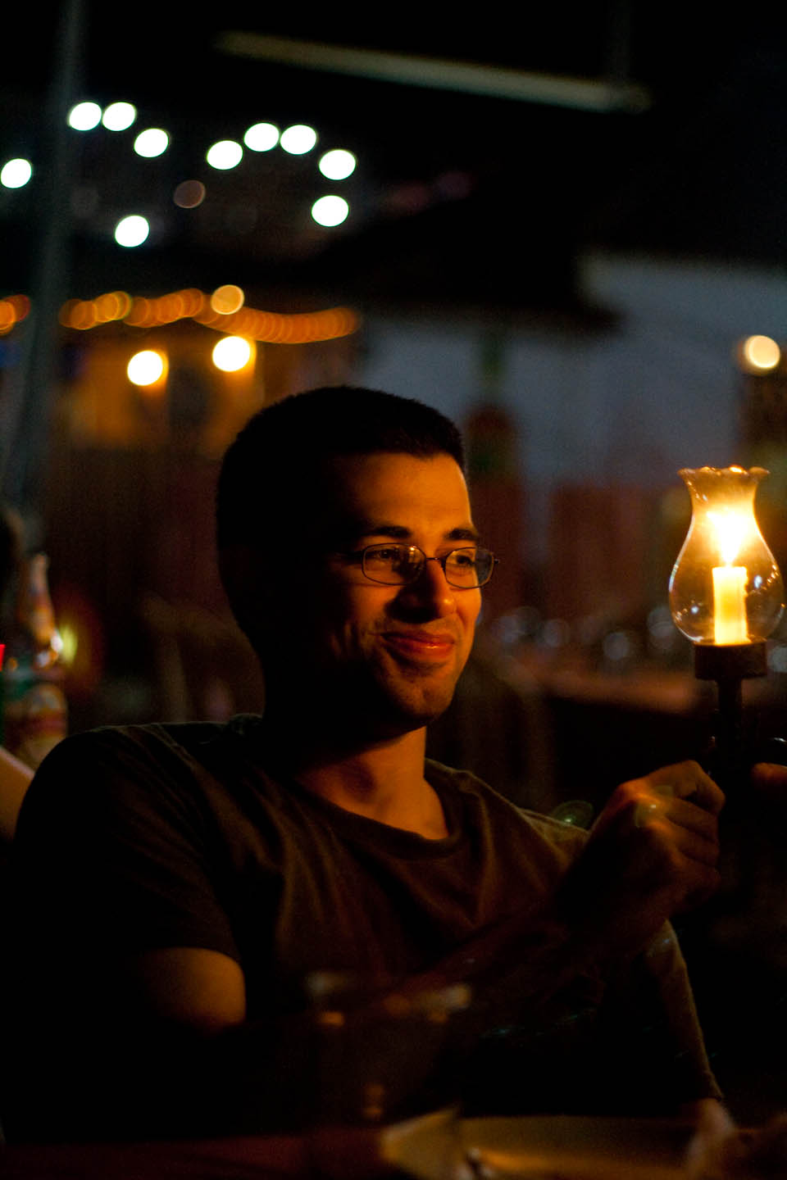
Light illuminates
and therefore
shapes what we see
What happens to his face when you move his light source around?
How do you know what part of his face is protruding closer to you and what part is more recessed?

Slide 7
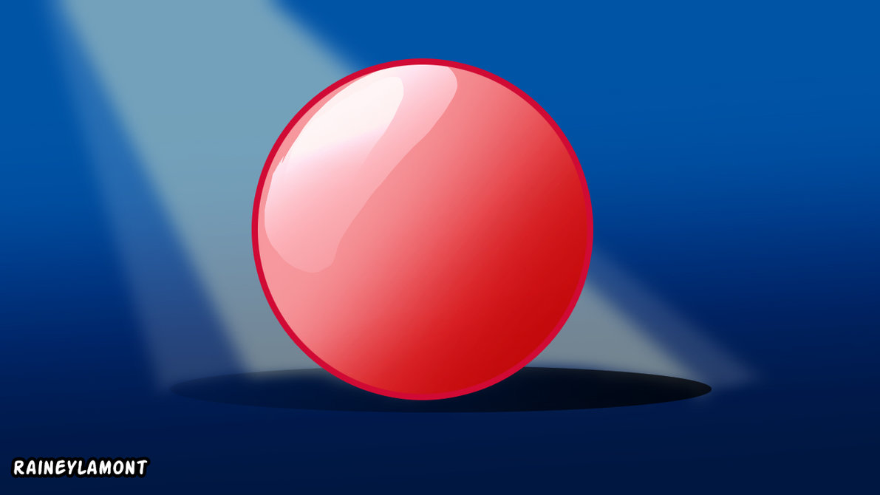
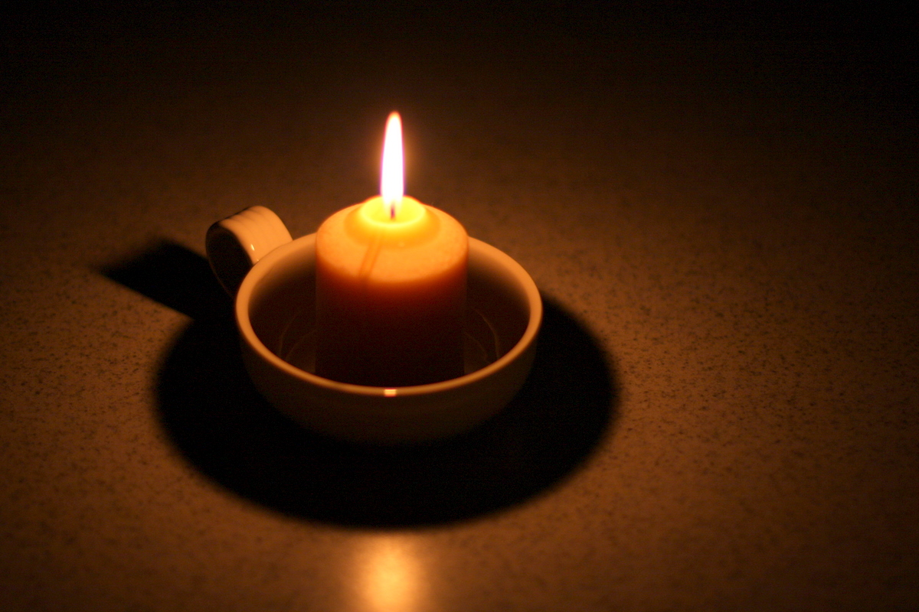
Are they flat circles or three dimensional?
How do you know?
What does the highlighted and shaded areas tell you about
the shape?
what part is closest to you?
what part is recessed or farther away from you?
Compare the two spheres
Describe the
three dimensional shape of this object

Slide 8
How does light give dimension to a figure? How can we replicate a particular shape on a flat surface (painting or drawing)? How can we enhance or change the appearance of the shape of a three dimensional figure?
Light affects color, texture and shape of objects

Slide 9
Contouring with HIGHLIGHTS and SHADOWS for Stage Makeup Corrective Old Age Animal Victim Monster Gender Change Creating a Likeness Cultural Period Stress
Since the appearance of HIGHLIGHTS and SHADOWS affect what we perceive as the structure of an object, we can use makeup to represent highlights and shadows on the face to contour it to the look we want the audience to see
.

Slide 10
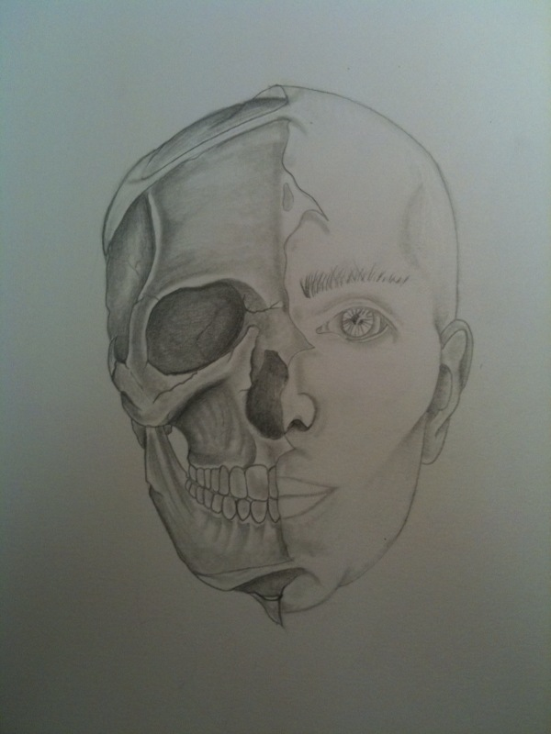
Contouring the face based on
natural skeleton shape to
corrective or character shape

Slide 11
HIGHLIGHTING adds dimension to the face by emphasizing the natural raised parts of the face that enhances your look (for corrective makeup) or creates the illusion of a character (for character makeup)
HIGHLIGHTS
are light colored creams or powders used in stage makeup to brighten an area of the skin.
Depending on the type of edge required (sharp or gradual), the highlight is blended next to a shadowed area.
.
As shown on the face chart to the left as white areas:
Forehead
Bridge of the nose
Lip arches and lower lip
Cheekbones
Chin

Slide 12
SHADOWING adds dimension to facial features and is applied to the natural hollows of the face to either enhance your look (for corrective makeup) or create the illusion of a character (for character makeup)
SHADOWS
Are dark colored
creams or powders used in stage makeup to give the impression of a shadowed or recessed area of the skin.
Depending on the type of edge required (sharp or gradual), the shadow is blended next to a highlighted area.
.
As shown on the face chart to the left as dark areas:
Below cheekbones
Sides of nose
Hollow of lip
Below lip
Sides of forehead and temple area
Below jawline

Slide 13
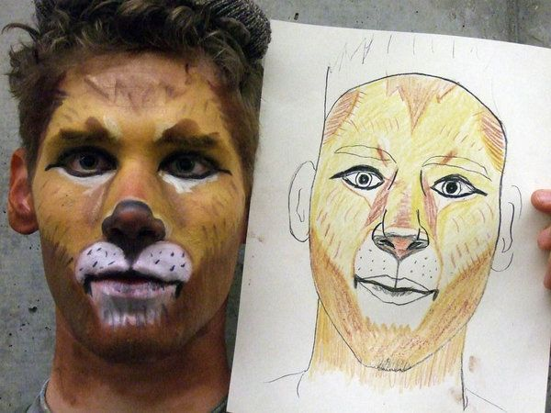
Makeup Charts
Used to design the makeup and then used to re-create the image on the actor’s face for every performance.

Slide 14
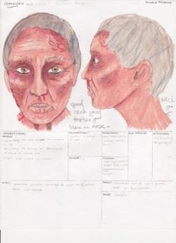
Makeup Chart
A tool of the makeup artist to design how makeup foundation, highlights, shadows, prosthetics, bald caps, hair/wigs and other makeup techniques will be applied to an actor’s face to create a character look

Slide 15
Front and side view of character makeup charts

Slide 16
Straight Corrective Makeup
For MEN and WOMEN

Slide 17
Straight Corrective Makeup
For
MEN
and
WOMEN

Slide 18
Straight Corrective Makeup
For
MEN
and
WOMEN

