Slide 1
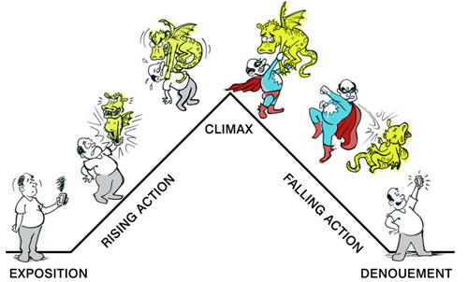
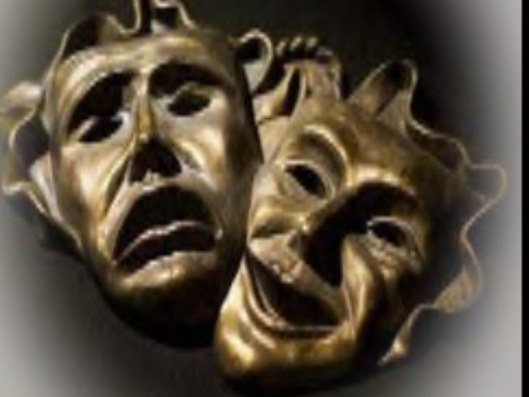
Dramatic Structure and Dramatic characters
Chapter 7

Slide 2
Characteristics of Dramatic Structure
Dramatic Forms
Climactic
Episodic
Combination of Climactic and Episodic
Disconnected Episodes
Based on Ritualistic Pattern
Musical Theatre Structure

Slide 3
Climactic Structure
The Plot Begins Late in the Story
Exposition - Must first establish the background or setting of the play. It is information necessary for an understanding of the story but not covered by the action onstage; events or knowledge from the past, or occurring outside the play, which must be introduced so that the audience can understand the characters or plot.
Running Action - All the roads of the past move toward a central crucial intersection in the present.
Climax – The crucial convergence of
crossroads. The highpoint in the
development of a dramatic plot.

Slide 4
Climactic Structure
The Plot Begins Late in the Story
Falling Action – After the climax, the road to a resolution that is a consequence of the climax.
Denouement –The final resolution to the plot.
Cliff hanger – Climax at the end of the plot that leaves the audience “hanging”.
Scenes, Locales and Characters Are Limited
Started out much like Greek theatre and moved to five acts, then three acts and down to two acts.
Today, long one-act plays with no
intermission are frequently presented.
Notes:
Greek Theatre climatic drama typically limited the number of long segments or acts to generally five episodes separated by choral interludes.
The French neoclassicists used five acts.
19th and 20th centuries used three acts.
Today, the norm is two acts.
Today, the long one-acts are also popular.

Slide 5
Climactic Structure
The Plot Begins Late in the Story
Construction Is Tight
Cause and Effect Relationship
Well-made plays – Type of play popular in the 19th century and early 20th century that combines apparent plausibility of incident and surface realism with a tightly constructed, highly causal, and contrived plot.
Deus ex machina – Literally, “god from a machine”, a resolution device in classic Greek drama, hence, intervention of supernatural forces—usually at the last moment—to save the action from its logical conclusion. In modern drama,
an arbitrary and coincidental solution or
in melodrama, a “hero comes to
save the day”.
Notes:
Deus ex machina – referring to Greek theatre when gods were brought down from the top of the stage house at the end of a play to resolve the action. The term has since become used to describe any outside intervention at the end of a play to bring the play to a close.

Slide 6
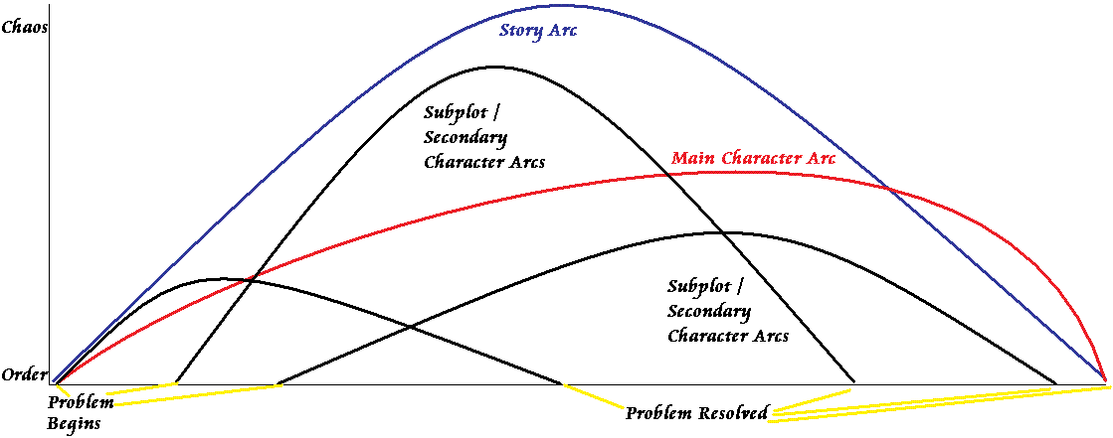
Episodic Structure
The Plot Begins Early in the Story
Less Cause and Effect Relationships
Plot or action usually begins early in the play
The forces are centrifugal, moving out to embrace additional elements
Shakespearian plays are excellent examples of
episodic structure
People, Places and Events Proliferate
Covers an extensive period of time
Long scenes alternate
with shorter ones
Use of many characters

Slide 7
Episodic Structure
The Plot Begins Early in the Story
There may be a parallel plot or subplot
A secondary plot that reinforces or runs parallel to the major plot in an episodic play.
Scenes can move back and forth through time
(not necessarily cause and effect).
Scenes can move from place to place.

Slide 8
Episodic Structure
The Plot Begins Early in the Story
Scenes can alternate from one group of characters
to another group.
Many current movies/TV shows
use parallel or subplots such as
“Game of Thrones”
and many others
Juxtaposition and contrast occur
Comic scenes can alternate with
serious scenes
The overall effect is cumulative

Slide 9
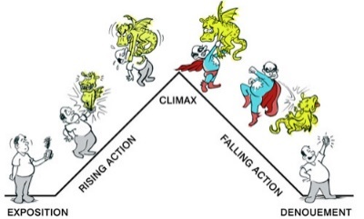
Climactic
Episodic
Plot begins late
Covers short space of time
Contains a few long scenes in generally three acts
Restricted locale
Limited number of characters (6-8)
Plot is linear with few, if any, subplots or counterplots
Line of action proceeds in a cause-and-effect chain
The characters and events are closely linked in a sequential, logical and almost inevitable development
Plot begins early
Covers long space of time
Contains many short scenes or combination of short and long scenes
Ranges over many places
Many characters (several dozen)
Several threads of action such as two parallel plots or comic relief inside a serious play
Scenes are juxtaposed to one another
Notes:
A example of juxtaposed scenes is where an event may result from several causes; or it may have not apparent cause; but arises in a network or web of circumstances.

Slide 10
Combination of Climactic and Episodic Form
Rituals as Dramatic Structure
Serial Structure as in a “musical revue”
Rituals are generally ceremonial events, often religious, which take place in a prescribed sequence.
Avant-garde theatre often uses this form of structure
Patterns as dramatic structure as in “Waiting for Godot”
Notes:
A example of juxtaposed scenes is where an event may result from several causes; or it may have not apparent cause; but arises in a network or web of circumstances.

Slide 11
Structure in Experimental and Avant-Garde Theatre
Special Structures
Emphasis on nonverbal theatre
Gestures, body movements and sounds tell the story
Reliance on improvisation or a scenario developed by performers and the director to tell the story, rather than a written text
Interest in ritual and ceremony
Stress on the importance of the physical environment of the theatre, including the spatial relationship of the performers to the audience
Notes:
These are avant-garde theatres which in French means “advance guard in a military formation”. The term has come to mean an intellectual or artistic movement in any age that breaks with tradition and therefore means ahead of its time.

Slide 12
Structure in Experimental and Avant-Garde Theatre
Segments and Tableaux as Structure
A Tableau (tableaux-plural) in theatre is a static scene onstage featuring performers in costume depicting a scene that tells a story. Using the idea of frames in a movie film, the director uses these live 3-dimensional picture frames to tell a story moving from one frame to the next, almost like the silent pictures did with rapid jerky moves.
Notes:
These are avant-garde theatres which in French means “advance guard in a military formation”. The term has come to mean an intellectual or artistic movement in any age that breaks with tradition and therefore means ahead of its time.

Slide 13
Structure in Musical Theatre
Alternation and Juxtaposition
Musical numbers alternate with spoken scenes
Solos and duets alternate with choral numbers
Singing alternates with dance numbers
Sometimes comic songs and scenes alternate with serious ones
Notes:
These are avant-garde theatres which in French means “advance guard in a military formation”. The term has come to mean an intellectual or artistic movement in any age that breaks with tradition and therefore means ahead of its time.

Slide 14
Dramatic Characters
Extraordinary Characters
Historical Characters of Early Theatre –
Kings and Queens, larger than life or “unique”
as opposed to “ordinary” people
Comic Characters – Can also be extreme
Notes:
These are avant-garde theatres which in French means “advance guard in a military formation”. The term has come to mean an intellectual or artistic movement in any age that breaks with tradition and therefore means ahead of its time.

Slide 15
Dramatic Characters
Representative or Quintessential Characters
Ordinary characters that embody or represent
an entire group of people
Stock Characters
Two dimensional, stereotypical characters
Commedia dell’arte – Form of comic theatre originating in Italy in the 16th century in which dialogue was improvised around a scenario involving a set of stock characters, each with a traditional costume, name and often mask
Notes:
These are avant-garde theatres which in French means “advance guard in a military formation”. The term has come to mean an intellectual or artistic movement in any age that breaks with tradition and therefore means ahead of its time.

Slide 16
Dramatic Characters
Characters with a Dominant Trait
Similar to stock characters but which possessed a singular “dominant trait”
Minor Characters
Characters in all types of plays who play a small part in the overall action of the play
Narrator or Chorus
An individual or group of individuals who speak or sing “directly to” the audience, sometimes pursuing a dramatic persona
Nonhuman Characters
Notes:
These are avant-garde theatres which in French means “advance guard in a military formation”. The term has come to mean an intellectual or artistic movement in any age that breaks with tradition and therefore means ahead of its time.

Slide 17
Dramatic Characters
Juxtaposition of Character Types
Protagonist
Principal character in a play, the one whom the drama is about
Antagonist
Opponent of protagonist in a drama
Orchestration of Characters
Notes:
These are avant-garde theatres which in French means “advance guard in a military formation”. The term has come to mean an intellectual or artistic movement in any age that breaks with tradition and therefore means ahead of its time.

