Slide 1
The Background and Expectations of the Audience

Slide 2
What an Audience brings to the Theatrical Performance
Their knowledge and personal memories
Their awareness of the social, political and philosophical world in which the play was written or produced– the link between theatre and society
Their knowledge about the play and playwright
Their personal expectations concerning the event: what they anticipate will happen at a performance

Slide 3
A closer look at what the audience brings
Background of individual spectators
Background information on the play or playwright
Background of the period
Theatre and Society
Does theatre affect or reflect society?

Slide 4
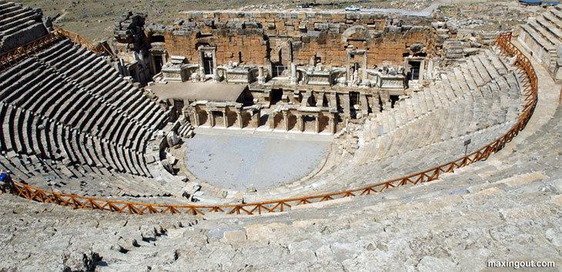
Greek Theatre and Culture
Standard forms of drama emerged
Only five scenes to a play interspersed with Chorus
Drama took place in one locale,
preferably a palace,
in a short span of time
Blood and guts were not shown on the stage
Female characters
were played by young men

Slide 5
Typical Greek Theatre
Sophocles’ Antigone would have been performed here

Slide 6
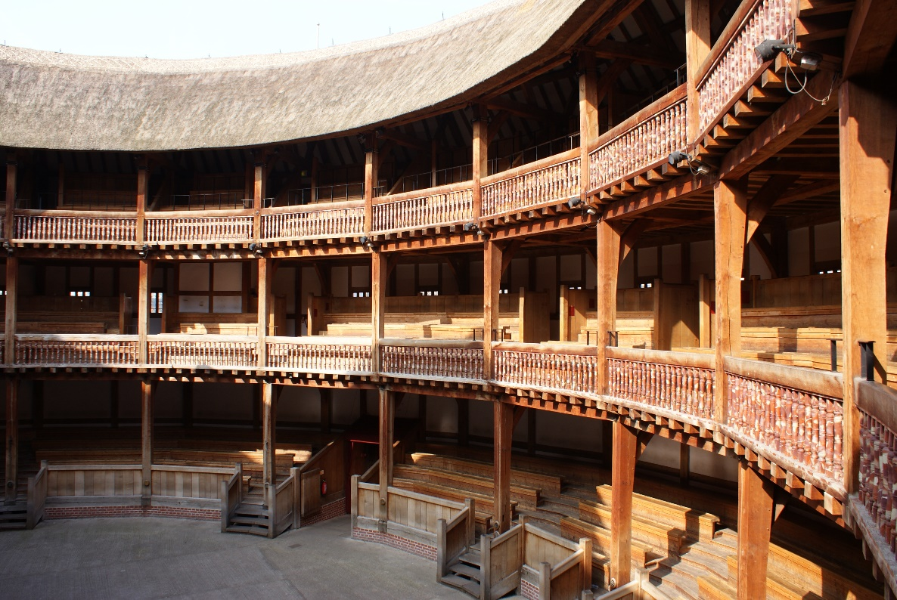
Elizabethan Theatre and Culture
The Globe Theatre where
Shakespeare performed his plays
Female characters
continued to be played by young men

Slide 7
Shakespeare’s Globe Theatre *Opened in 1599 and owned by actors who were also shareholders in the Lord Chamberlain's Men (Shakespeare was one of the actors with a smaller share than others.)

Slide 8
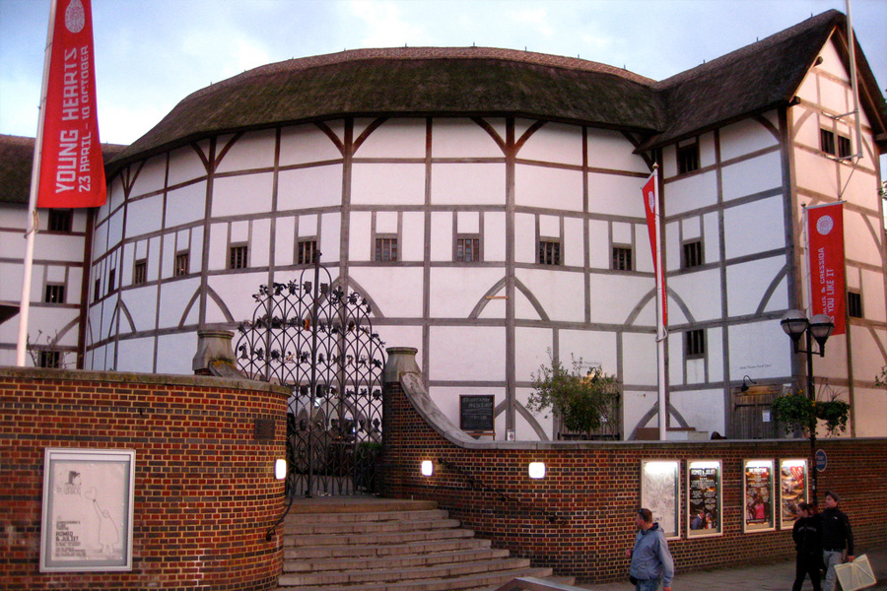
Shakespeare’s Globe Theatre

Slide 9
Elizabethen Theatre *Opened in 1587, 12 years before the Globe opened *First purpose-built playhouse to stage Shakespeare’s plays
The Rose Theatre

Slide 10
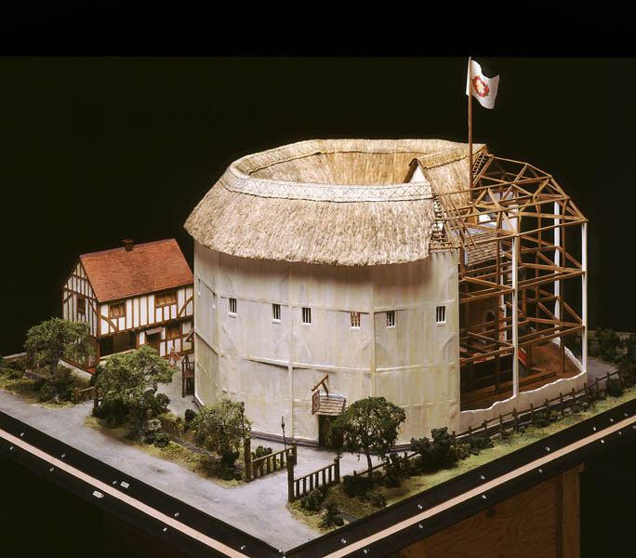
The Rose Theatre

Slide 11
Greek vs. Elizabethan Theatre and Culture
Greeks and Elizabethans demonstrated a strong link between their theatre and their society
Classical Greeks
Elizabethan Age
Society’s sense of balance
& order
Pericles in Athens during the
Golden Age of Greece
Politics, art, architecture
& theatre thrived together
Promoted ideals of beauty,
order, symmetry & moderation
with pride in human achievement
Society in an age of exploration
Queen Elizabeth I conquered
the Spanish Armada
England expanded confidently
on all fronts
Evolved from Medieval Drama

Slide 12
Greek vs. Elizabethan Theatre and Culture
Greeks and Elizabethans demonstrated a strong link between their theatre and their society
Classical Greeks
Elizabethan Age
Only five (5) scenes in
one play
Choral sections for musical
narration and comments
Only one locale, usually
in front of a palace
Short time span
Balance and order but not
showing violence on stage
Shift rapidly between
many locations
Shift rapidly between
time periods
Expansive in numbers of
characters & action in a play
Easily shows violence on stage
Expansiveness & sense of
adventure mirrors the period

Slide 13
Modern Theatre and Culture
Link between theatre and society
Heterogeneous
People of different races, religions, sexual orientations and
national backgrounds living side by side
Swift global communication
Television, computers, Internet, text messaging, social media such as Facebook and Twitter. Instantaneous communication and awareness of cultures around the world
Fragmentation of traditional institutions and ideas
Organized religion, the family, marriage, evolution theory, economics, psychology, science and relativity
Changes in viewpoints and discoveries
Life appears less unified & ordered affected by world wars, the Holocaust, Vietnam & other wars, terrorism & natural disasters

Slide 14
Modern Theatre and Culture
Link between theatre and society
Modern global & historical developments reflect Modern Theatre making modern theatrical productions
Inclusive (both men and women actors), fragmented and eclectic (made up of a select group of varying sources based on likes and dislikes), embracing different styles and traditions.
Many cultures are reflected from around the world
Wide range of styles from the darkest tragedies to the lightest comedies to the highly experimental
Created by dramatists who write on many subjects and in many diverse styles
Eclectic means not following any one system, as of philosophy, medicine, etc. but selecting and using what are considered the best of all systems.
Notes:
Eclectic MEANS not following any one system, as of philosophy, medicine, etc., but selecting and using what are considered the best elements of all systems.

Slide 15
Expectations: The Variety of Experiences in Modern Theatre
Why do you go to the theatre or watch a movie?
To escape, for adventure, to be moved, to learn, to be stimulated, or challenged intellectually or emotionally
Modern diversity in theatre reflects the overall diversity in contemporary life
Broadway and Touring Theatre
Resident Professional Theatre
Alternative Theatre: Off-Broadway and Elsewhere
Young People’s Children’s Theatre
College and University Theatre
Community and Amateur Theatre
Notes:
Broadway & Touring- oldest U.S. theatres and in larger theatres in the Times Square district of New York City, professional theatre and productions sent on tours are replicas of the Broadway production.
Resident Professional or Regional Theatre- high quality professionals and diverse in styles are resident in areas in U.S. and some Shakespearian Summer Festivals
Alternative Off-Broadway-Began in 1950’s and were smaller and less costly than Broadway and offered more alternative or nontraditional professional plays. Also cabaret and dinner theatres.
Children’s theatre or theatre for youth- Professionals who perform for children but can be produced by semi-professionals, improvisational groups, amateur and educational groups. Most often performed as musicals.
College- sometimes the only form of theatre in a location, sometimes brings in professionals to work with students of the theatre. Several size theatres for large, small and black box theatre productions
Community and amateur- Some have professional training and others or just lovers of the theatre

Slide 16
The Critic, the Reviewer and the Blogger
The Critic
One who observes and analyzes theatre with extensive explanation
Highly knowledgeable and sensitive to theatrical art and techniques
The Reviewer
One who observes and reports on what has occurred in the theatre production. Tells briefly what the theatre event is about for a television or newspaper type of audience
The Blogger
One who observes and gives their opinions with or without theatrical knowledge

Slide 17
The Critic’s Tasks
Understand exactly what is being presented, including the intentions of the playwright and the director
Analyze the play, the acting, and the direction of the play, as well as technical elements such as scenery, lighting, costumes and makeup
Evaluate the presentation as to its worth and purpose

Slide 18
How to Properly Critique A Theatrical Production
Gain knowledge of theatre history
Understand techniques particular to actors, directors, designers and theatrical technicians
Be familiar with plays written in various styles and modes as well as particular playwrights’ styles/purposes
Understand the time period of the play and when the play was written
Be able to relate what is happening in theatre to other art forms and to society in general.

Slide 19
The Purpose of Criticism in Theatre
Benefits for an audience
Audience must distinguish between fact and opinion
Audience can learn about the background of a play to get a better understanding about it when they view it first-hand
Audience must make up their own mind apart from critics but can use critics to better understand the performing arts
Critical Criteria
What is being attempted?
Have the intentions been achieved?
Was the attempt worthwhile?
Notes:
What is the play and the production attempting to do? Tragedy, comedy and etc.
How well have the intentions of the creator been carried out?
Did the audience get anything out of it?

Slide 20
The Dramaturg or Literary Manager
The Dramaturg or Literary Manager
One on the staff of a theatre who consults with and advises authors and directors as well as writes program notes and edits scripts.
New in the U.S. but prevalent in Europe for a long time
Researcher
Marketer
Prepares educational materials for students and teachers
Notes:
Check out the summary notes on pages 42 and 43

Slide 21
Chapter 2 Discussion/Forum:
Express your opinion and give reasons of why you might think society affects the theatre or rather the theatre affects society.

