Slide 1
Introduction to theatre
DRAMA 1310
Welcome

Slide 2
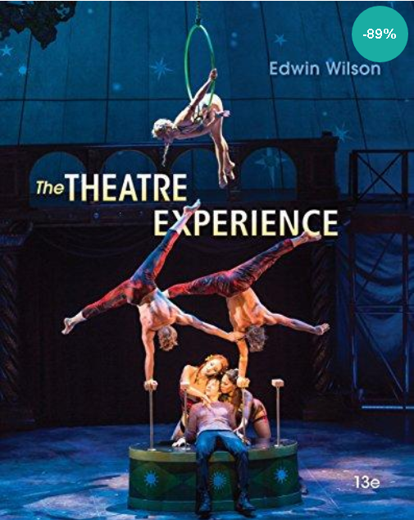
welcome

Slide 3
Overview of course
We will follow the basic outline of the syllabus
Read the syllabus and take the Quiz #1 on it next Saturday.
You will need to look over the pre-approved list of plays to attend
Be prepared to write a critique on each play. The rubrics that will be used to grade the critiques are on the Learning Web and the instructions on how to write a critique are also included.
You must turn in to me a written statement determining which three plays you will attend or have attended and will critique by September 21. You are free to change your mind but you must plan which three plays you will see and when by September 21.
The due dates for turning in the actual written critiques are: Critique #1 = Nov. 02; Critique #2 = Nov. 23; and Critique #3 = Dec. 14

Slide 4
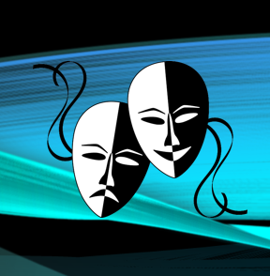
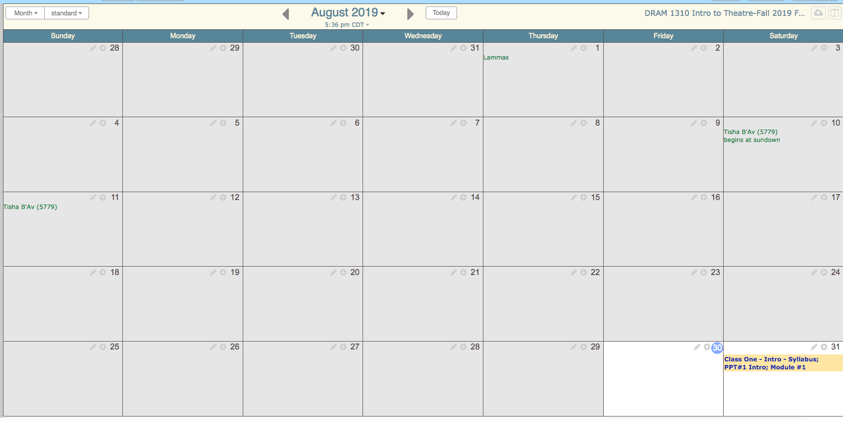
Drama 1310 Calendar
for Fall On Campus 2019

Slide 5
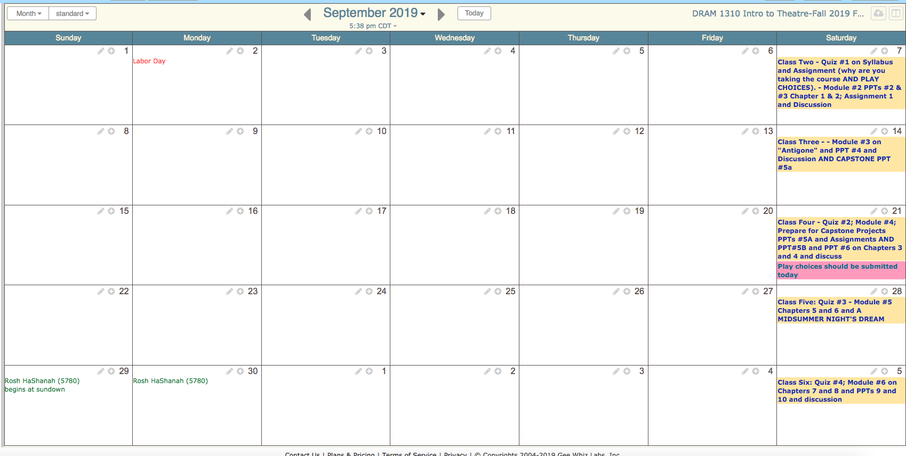
Drama 1310 Calendar
for Fall On Campus 2019

Slide 6
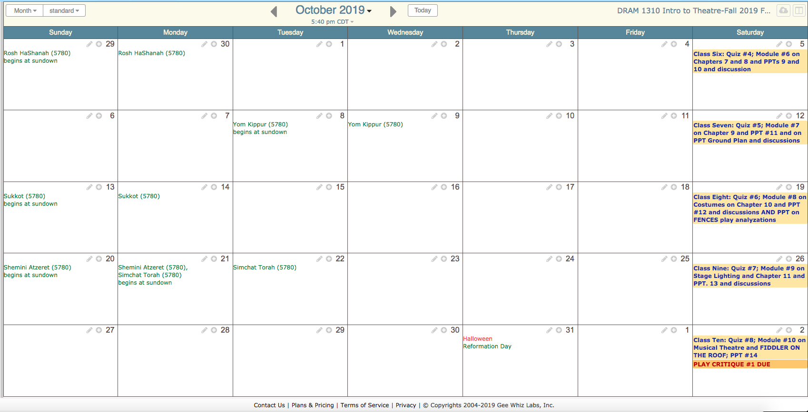
Drama 1310 Calendar
for Fall On Campus 2019

Slide 7
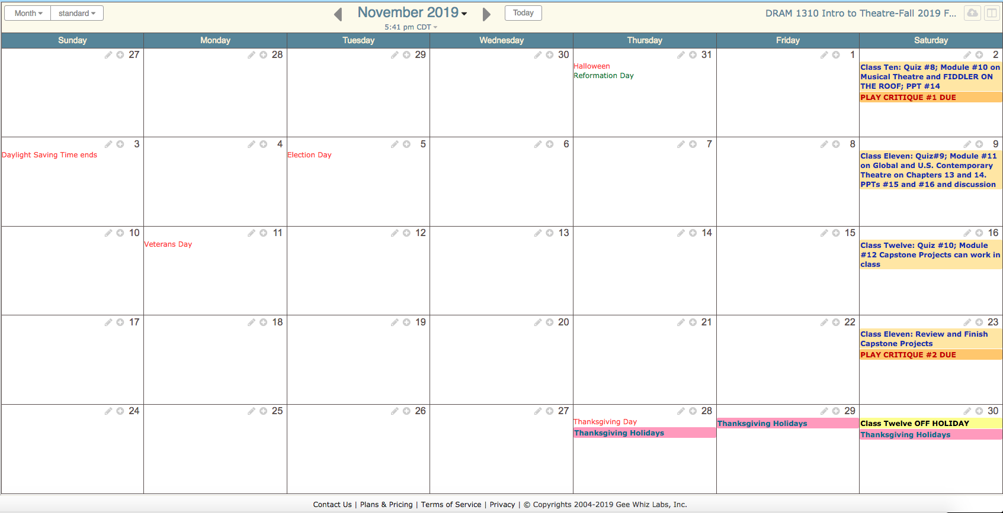
Drama 1310 Calendar
for Fall On Campus 2019

Slide 8
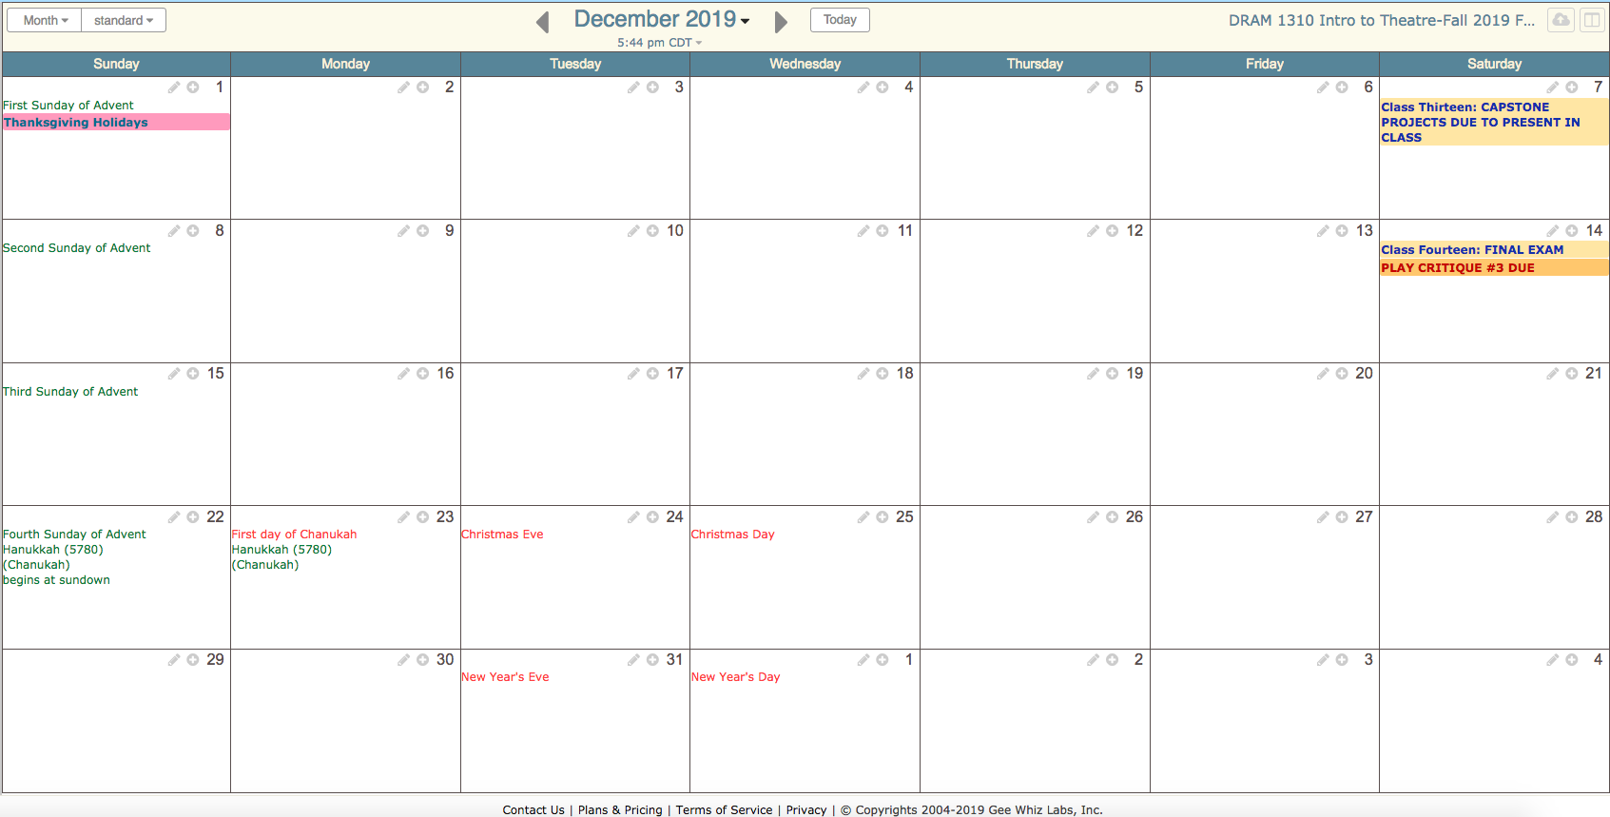
Drama 1310 Calendar
for Fall On Campus 2019

Slide 9
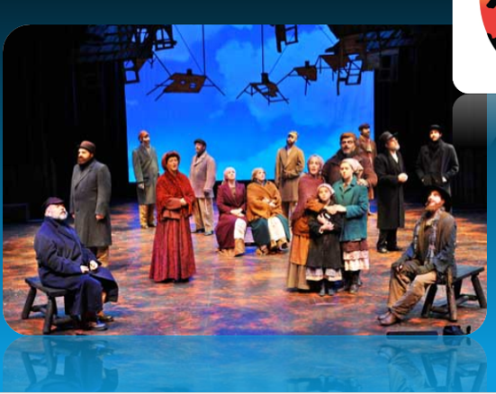
Plays to analyze in class
OVERVIEW OF COURSE
We will read and watch 4 plays to analyze in class for group discussion.
We will learn the “Role of the Chorus” in Greek Theatre
The class will be divided into groups to work on final capstone projects that will be presented to the class and an adlib performance of a theatrical scene
We will incorporate teamwork through
Group Assignments
Group Discussions/Forums
2 Final Capstone Projects
We will have individual assignments, 10 quizzes and a comprehensive Final Exam.

Slide 10
Group capstone projects
Group Project #1:
Choose a scene from an approved play to design and present the different aspects of theatre production for the scene. Present to the class your final renderings and other design work. As a group explain how you analyzed the play and how you came up with your designs (Set design, costume design, lighting design, sound design and etc.).
Group Project #2:
From the chosen approved scene from your play for your group, assign responsibilities for jobs such as director, actors for characters, prop person, stage manager and other LIVE production aspects of the performance of the scene which may include lights and sound. Perform the scene for the class and be prepared to analyze your group and the other class groups’ performances from an audience/critic’s point of view.

Slide 11
Next steps
Session One
Read your syllabus and prepare to take Quiz #1 on the syllabus
Read and listen to the Introduction to Theatre PowerPoint (this PowerPoint)
Read through the documents on the approved play list to attend and write critiques, the rubric for writing critiques, and the explanation on how to write a critique
Read the instructions on the two Final Capstone Group Projects
IN CLASS ACTIVITY
1. Introduce yourself to the class with your name and a little background about you. What is your major and what are you looking forward to learning in the class?
2. William Shakespeare once said in a play "All the world's a stage". Give your opinion about this. What do you think he meant and do you believe it to be true or not. Why or why not and give examples for your reasoning.

