Slide 1
Contemporary Theatre in the United States
Chapter 14

Slide 2
National Endowment for the Arts, A History 1965-2008, Bauerlein,M.; Grantham, E.
“Created by the Congress of the United States
And President Lyndon B. Johnson in 1965,
the NEA…(was intended) to embody a hope.
The NEA was established to nurture American
creativity, to elevate the nation’s culture, and to sustain and
preserve the country’s many artistic traditions. The Arts Endowment’s mission was clear—to spread this artistic prosperity throughout the land, from the dense neighborhoods of our largest cities to the vast rural spaces, so that every citizen might enjoy America’s great cultural legacy.”
There has never been a tradition of
government support for the arts in the U.S.
which is in contrast to Britain and many other countries in continental Europe.

Slide 3
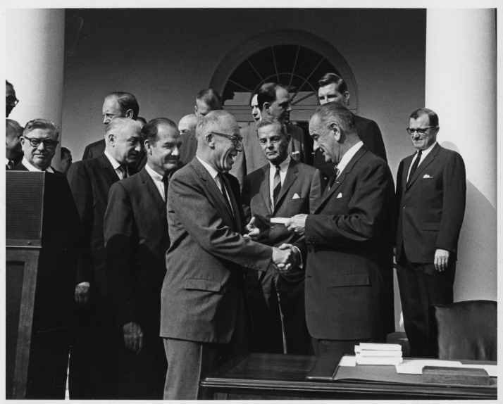
President Johnson & W.V. Congressman Hechler shake hands Sept. 29, 1965 at the Rose Garden signing ceremony for legislation creating the National Endowment for the Humanities and for the Arts.
Budget in 1992
$175 million
Budget in 1997
$99 million
Budget in 2007
$120 million with inflation, same as in 1997
Budget in 2012
$146 million still not at the level of 1992

Slide 4
Current U.S. theatre consists of a conglomerate of styles reflecting the complexity of today’s life in our society.
Multicultural
Variety of levels of professional/nonprofessional theatres
Wide range of economic status of theatres/budgets
Equity and non-Equity theatres (unions)
Represent a variety of political and social issues
Full range of categories of plays from classical to avant-garde
Generally introduced to children at an early age
Widespread to all parts of the country in metropolitan, city, town and rural areas
All strands of theatre exist simultaneously

Slide 5
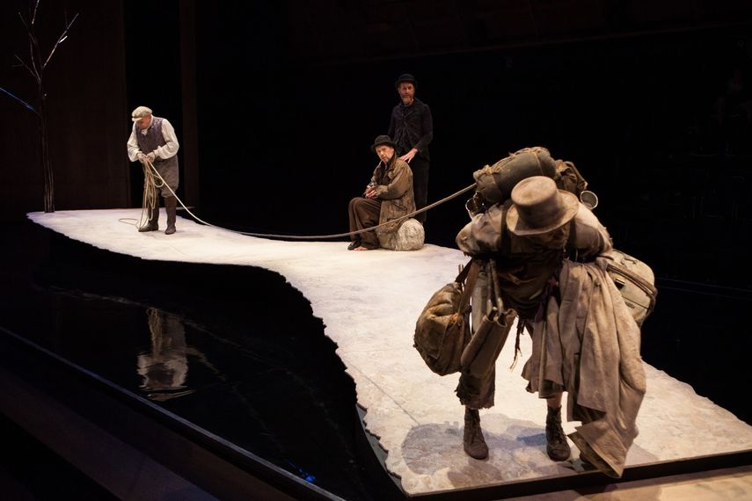
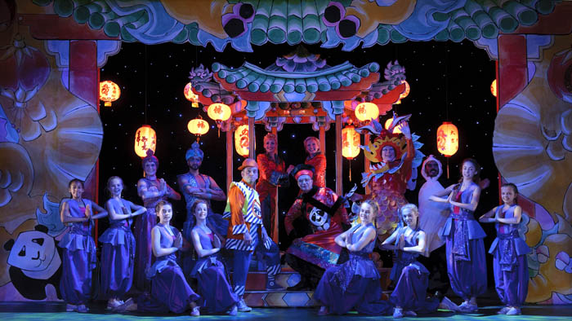
Nontraditional, Alternative Theatre in the U.S.
Second half of 20th century and full-blown in the 21st century
Avant-garde, Experimental, Postmodernistic
Futurism, Expressionism, Surrealism
Happenings, Multi-media, Environmental Theatre

Slide 6
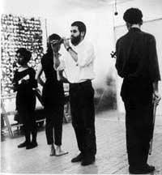
United States
Happenings, Multimedia
and Environmental Theatre
Happenings:
Non-literary theatrical events, developed in the 1960’s, in which the script is replaced with a scenario which provides for chance occurrences, and are performed (often only once) in such places as parks and street corners.

Slide 7
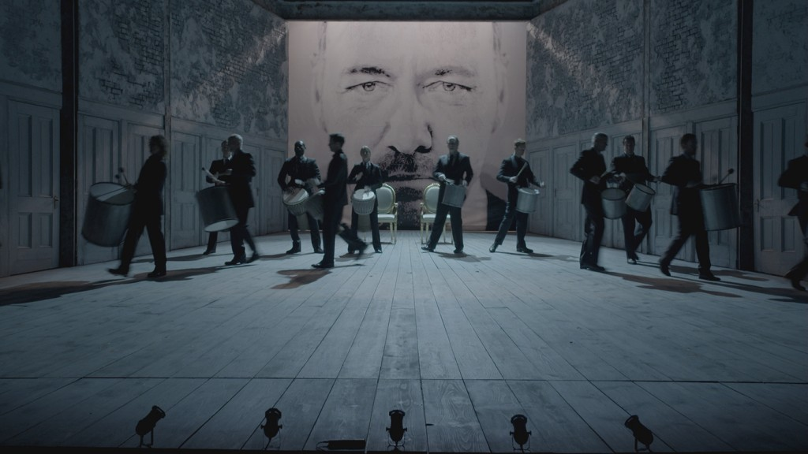
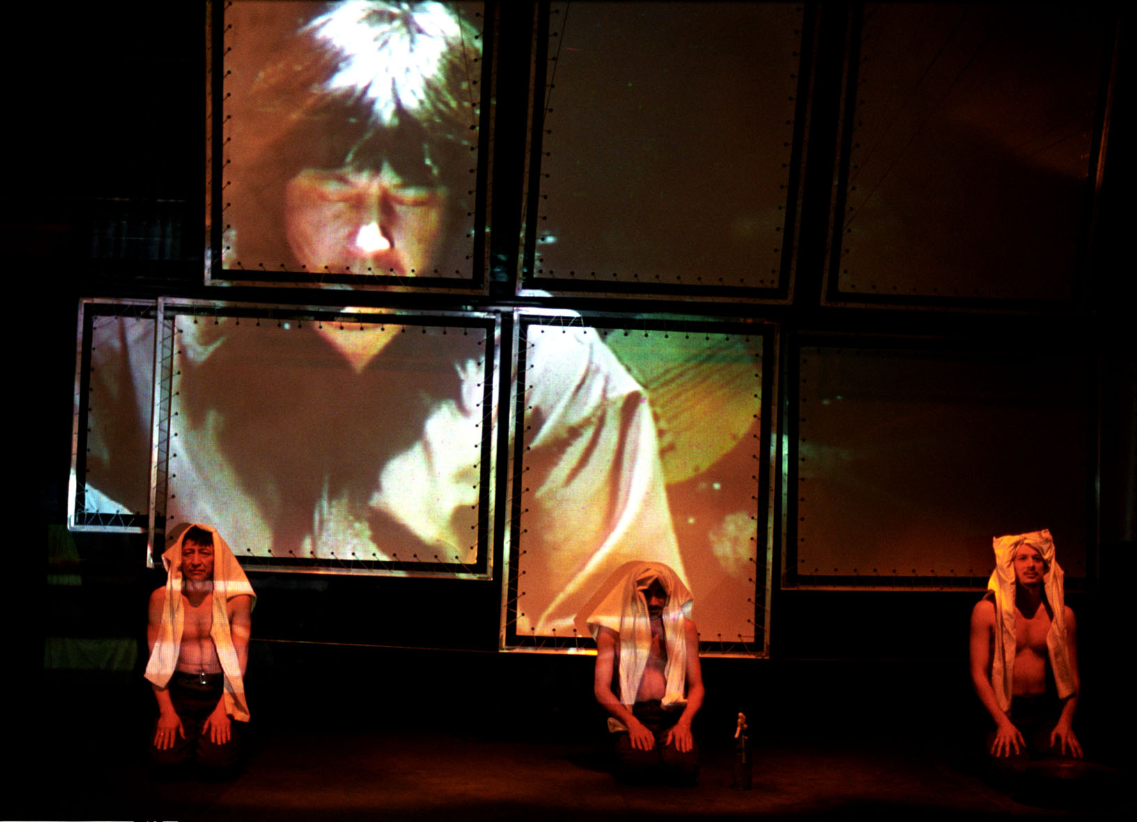
United States
Happenings, Multimedia
and Environmental Theatre
Multimedia:
Use of electronic media, such as slides, films, videotapes and computer generated art in LIVE theatrical productions.

Slide 8
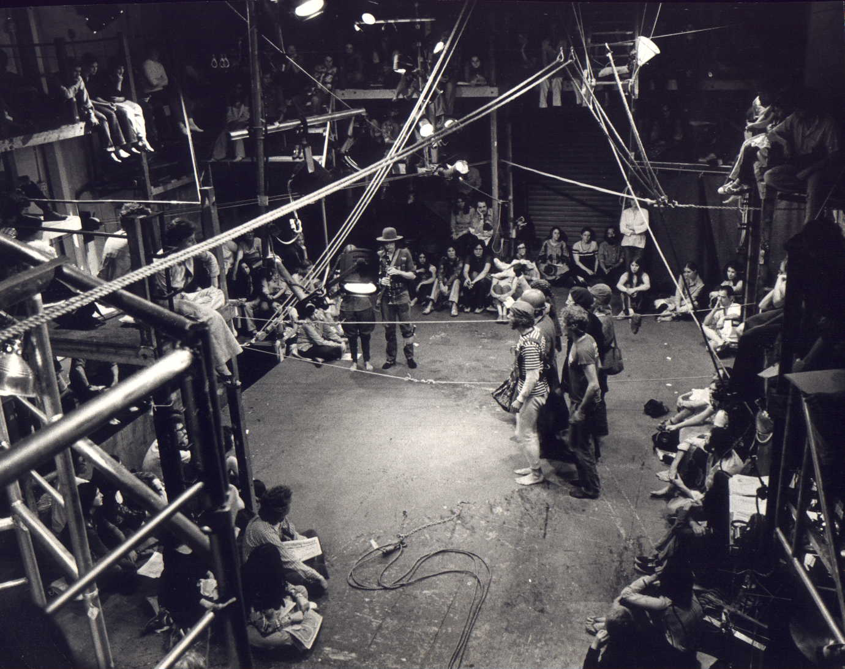
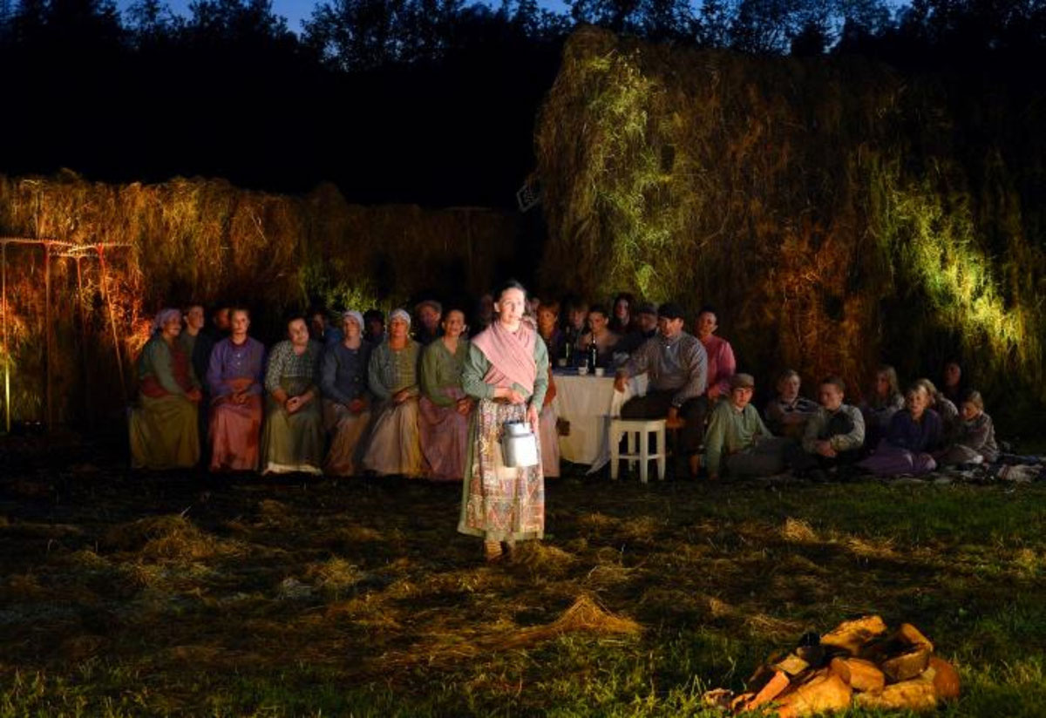
United States
Happenings, Multimedia
and Environmental Theatre
Environmental:
A type of theatre made popular in the 1960’s, which attempts to eliminate the disctinction between audience & acting space & which emphasizes a multiple focus for the audience rather than a single focus.

Slide 9
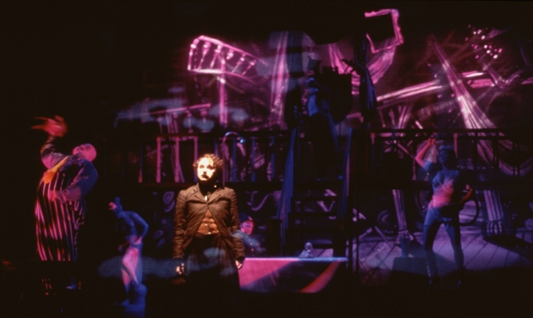
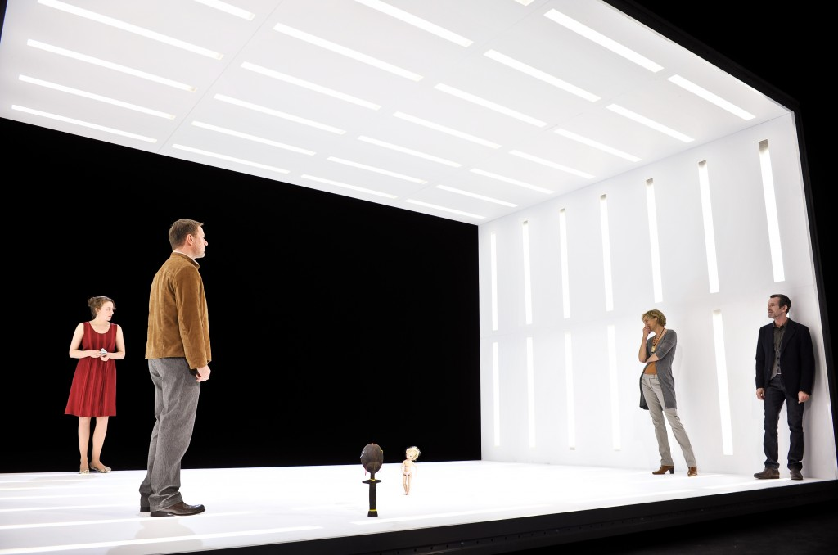
United States
Postmodernism
Postmodernism:
Theory that division of art works into modernists categories, such as realism & departures of realism, is artificial. Postmodernist works mix realistic and nonrealistic elements as well as techniques from popular & traditional art.

Slide 10
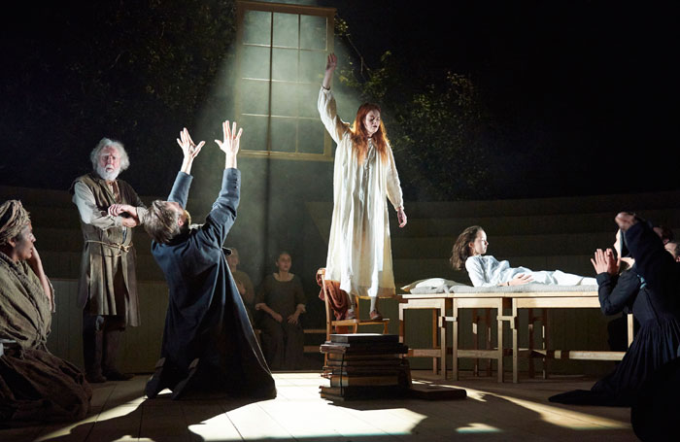
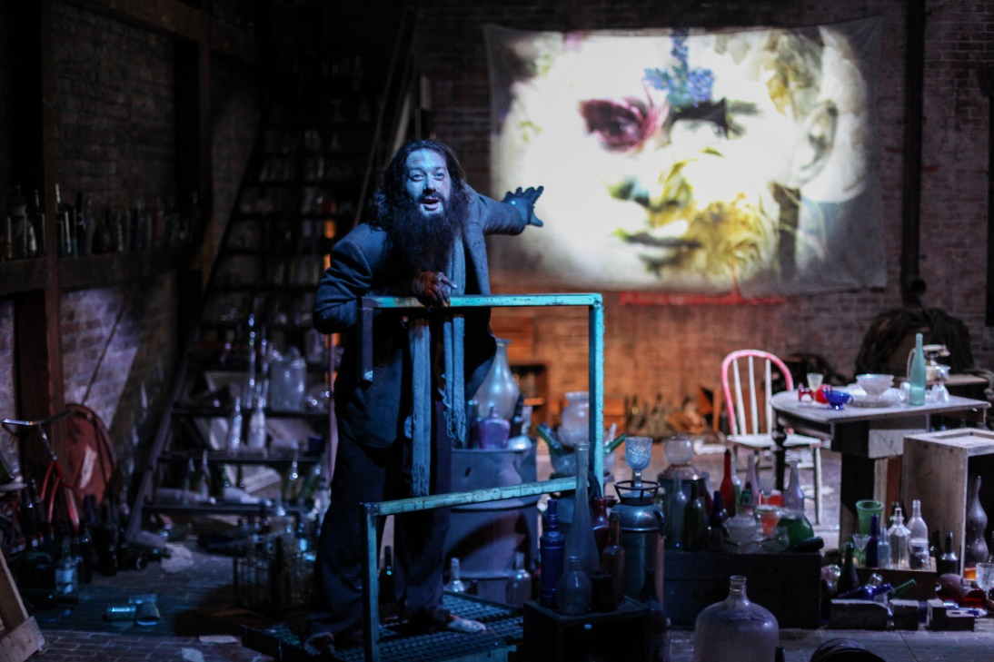
United States
Traditional &
Nontraditional
Traditional with Originality:
Tennessee Williams, Arthur Miller, Edward Albee, Sam Shepard, David Mamet, Horton Foote & many more wrote about the American family and the demise of the American dream & often blurred the distinction between realism & abstraction.

Slide 11
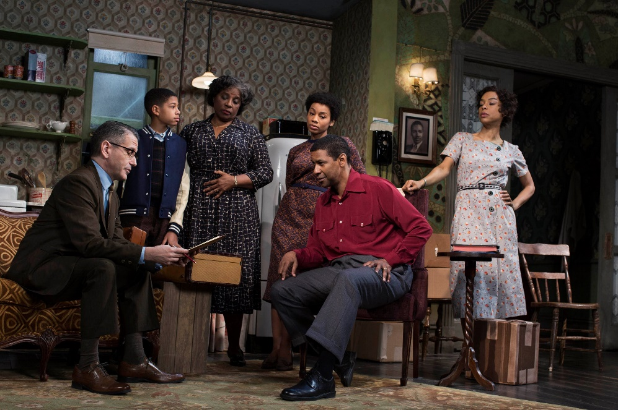
United States
Theatre of Diversity
African Grove Theatre in New York
(1820-1827) Classics/Shakespeare
Black Musicals by Bob Cole & William Johnson (Early 1900’s)
The Lafayette Players
produced 250 plays (1914– the Depression)
The Federal Theatre Project created a new generation of artists to develop in the 1940’s & 50’s
Lloyd Richards became first African American director on Broadway & head of the Yale School of Drama
African American Theatre:
Also referred to as
Black Theatre.
Has a long history from classical actors to remnants
of African & Caribbean theatre.

Slide 12
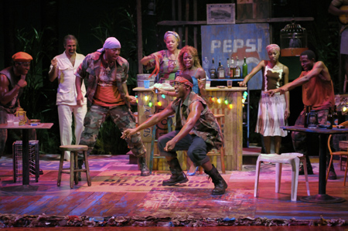
United States
Theatre of Diversity
1960’s to ‘90’s
Outpouring of African American
Theatre reflecting the struggle for
civil rights
The Black Theater Alliance
Listed 125 producing groups in the U.S.
The Negro Ensemble Company (1967)
Holds contemporary record for continuous productions
The 1970’s & Beyond
African Americans widely populated the New York
Broadway stage.
The 2008 Pulitzer Prize winner for the play Ruined is Lynn Nottage
African American Theatre:
Also referred to as
Black Theatre.
Has a long history from classical actors to remnants
of African & Caribbean theatre.

Slide 13
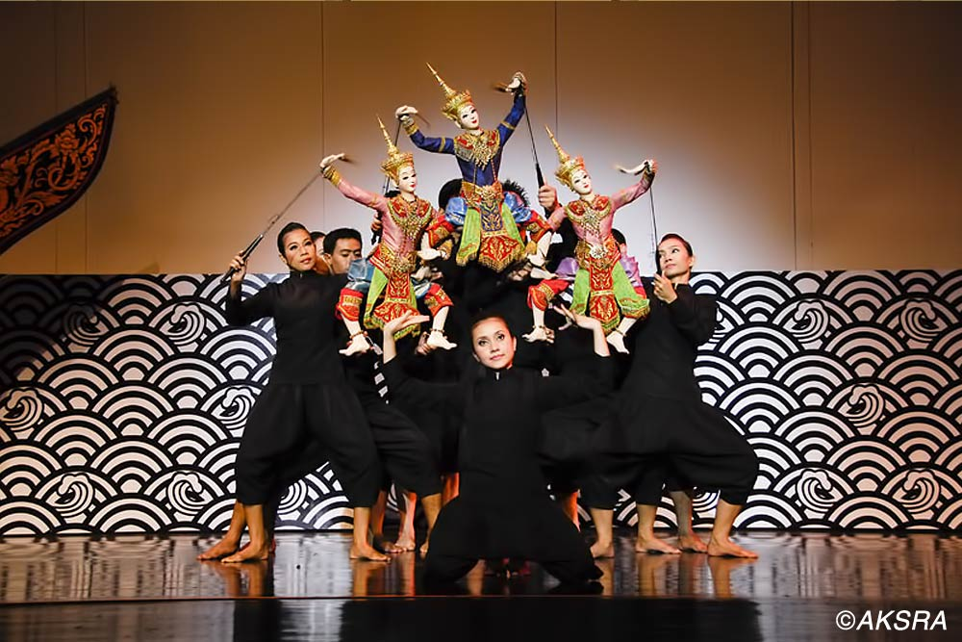
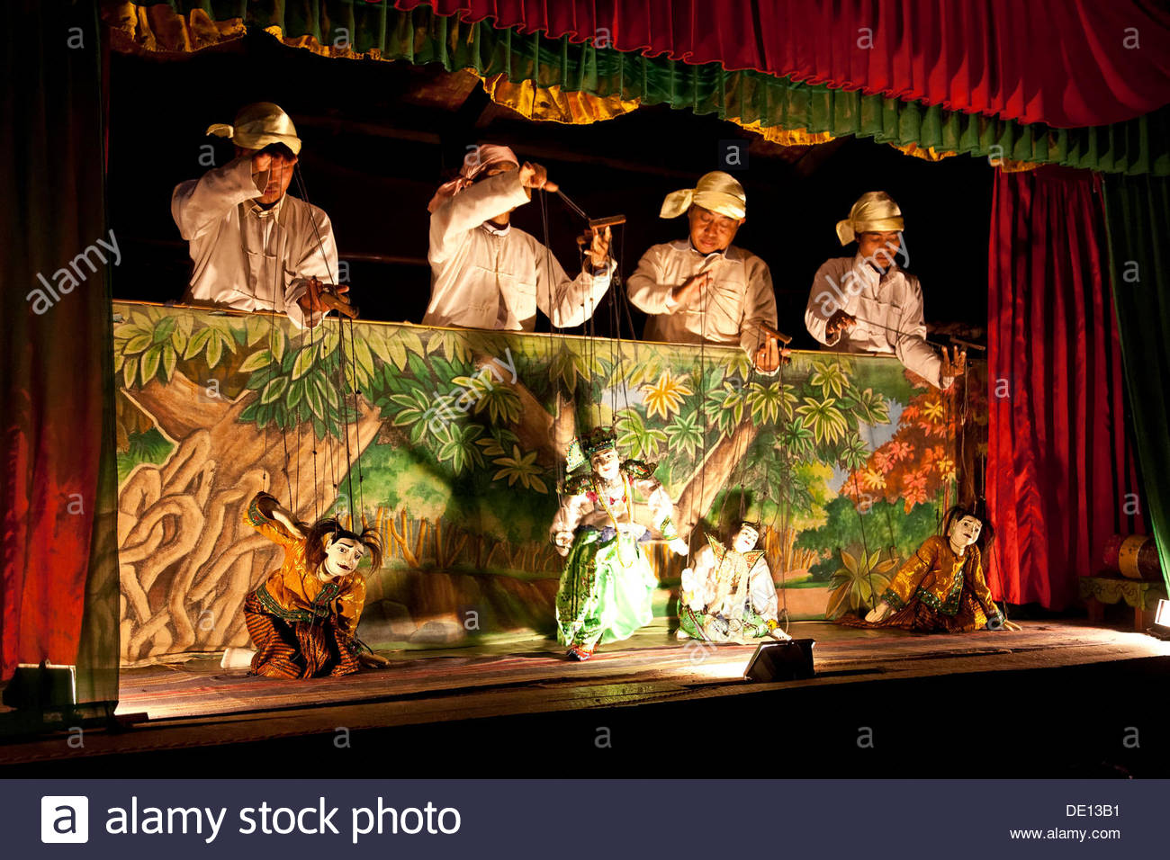
United States
Asian American Theatre
The 1850’s saw many puppet shows, acrobatic acts, and traditional operas imported from China to California.
With the background of Asian theatrical traditions of the Indian, Chinese and Japanese art, Asian American Theatre was influenced by mime, dance, music, puppetry, acting and philosophical, religious text.

Slide 14
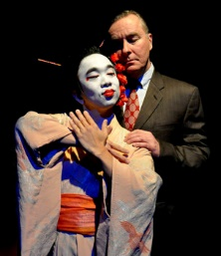
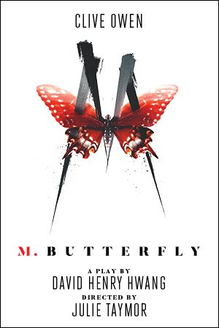
United States
Asian American Theatre
The East West Players
in Los Angeles (1965)
The Asian Exclusion Act
in Seattle & The Asian- American Theatre Workshop in San Francisco (1973)
Asian American playwrights:
Philip Kan Gotanda
(1970’s – present)
The American Conservatory Theatre presented his 2007
After the War.
David Henry Hwang wrote
M. Butterfly in 1988
for Broadway.
Plus many more
Asian American theatrical
artists have emerged.

Slide 15
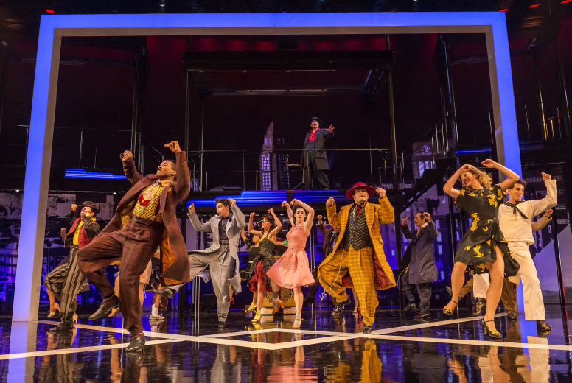
United States
Latino-Latina
American Theatre
Contemporary Hispanic Theatre
3 Categories:
Chicano theatre
Cuban American theatre
Puerto Rican or Nuyorican theatre
All address the experiences of Hispanics
living in the U.S., sometimes written in
Spanish but usually performed
in English.
Chicano Theatre:
El Teatro Campesino (farmworkers’ theatre)
Luiz Valdez
wrote agitprop plays
such as Zoot Suit
(1978) for Broadway

Slide 16
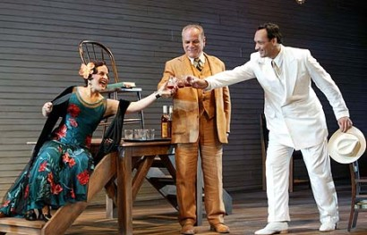
United States
Latino-Latina
American Theatre
Contemporary Hispanic Theatre
3 Categories:
Chicano theatre
Cuban American theatre
Puerto Rican or Nuyorican theatre
All address the experiences of Hispanics
living in the U.S., sometimes written in
Spanish but usually performed
in English.
Cuban American Theatre:
Federal Theatre Project
in Florida was the catalyst for 14 Cuban American productions
Eduardo Machado & Nilo Cruz won Pulitzer Prize in 2003 for Anna in the Tropics

Slide 17
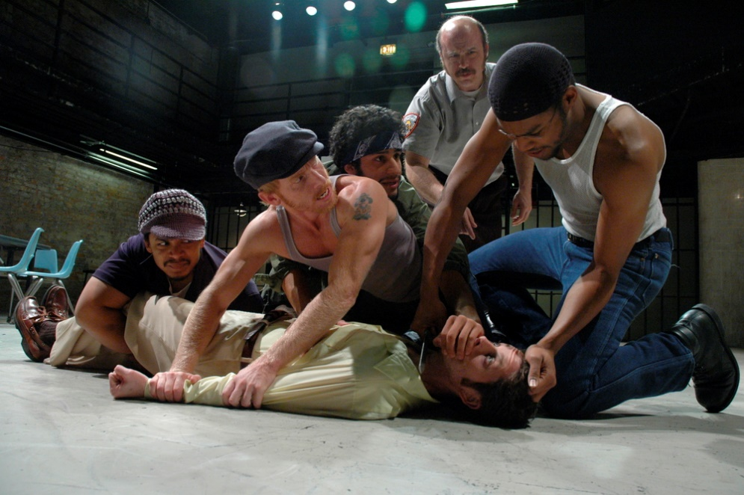
United States
Latino-Latina
American Theatre
Contemporary Hispanic Theatre
3 Categories:
Chicano theatre
Cuban American theatre
Puerto Rican or Nuyorican theatre
All address the experiences of Hispanics
living in the U.S., sometimes written in
Spanish but usually performed
in English.
Nuyorican or Puerto Rican American Theatre:
Mostly in New York but many theatre groups both led by Latinos and Latinas.
An ex-convict, Miguel Pinero won awards for his
Short Eyes,
a harshly
realistic portrait
of prison life.

Slide 18
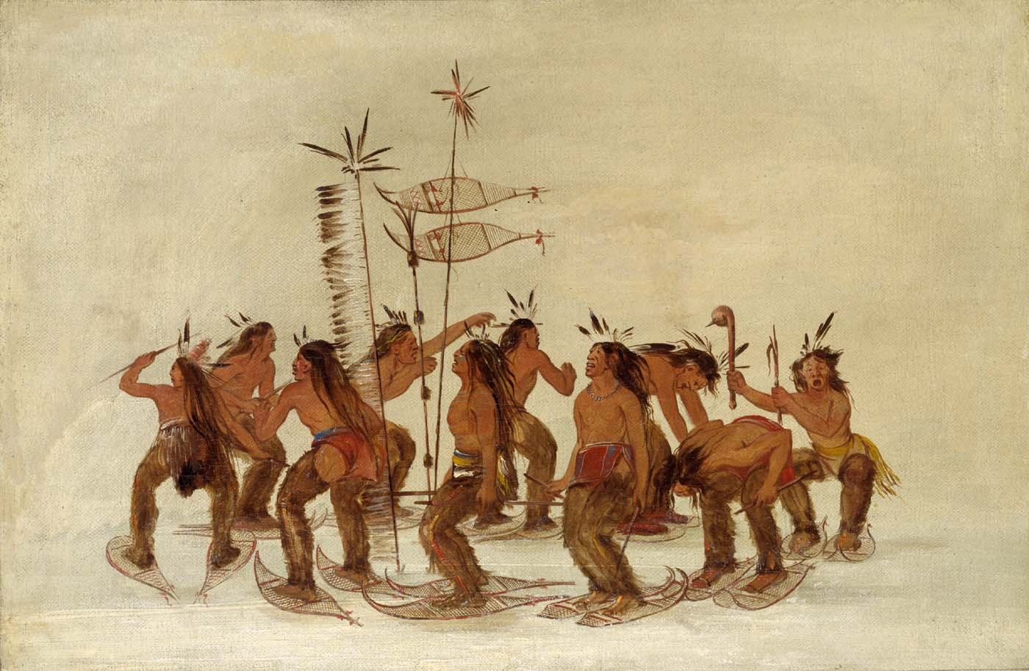
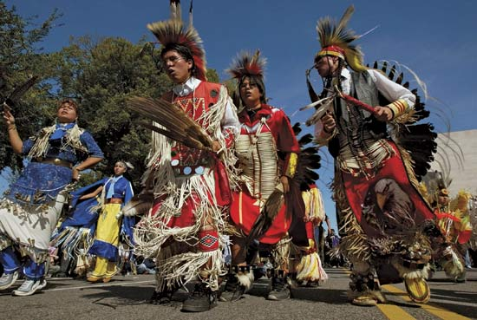
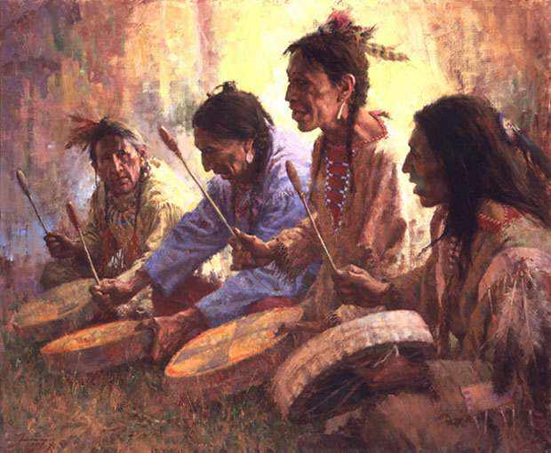
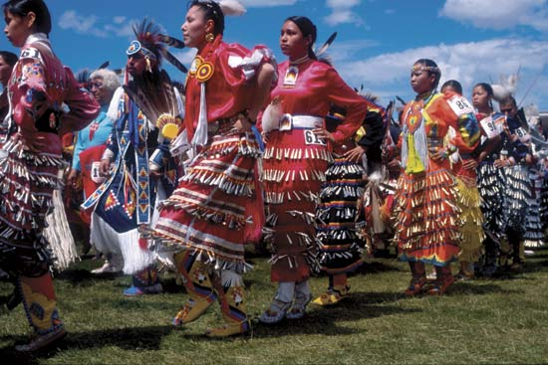
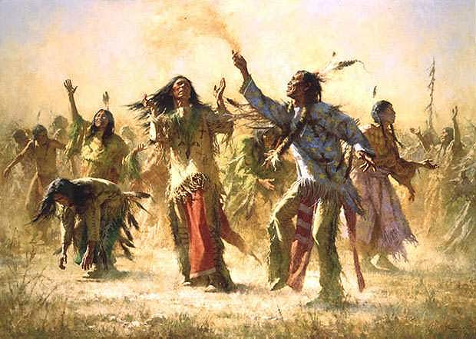
Forced to go Underground
in the 19th Century
The legacy of rituals & ceremonies that had strong theatrical components began to get lost when the U.S. government outlawed them.
United States
Native American Theatre
Native American Traditions:
Ancient rituals and ceremonies that involved everyone. Unique because there was no separation between audience & performer.

Slide 19
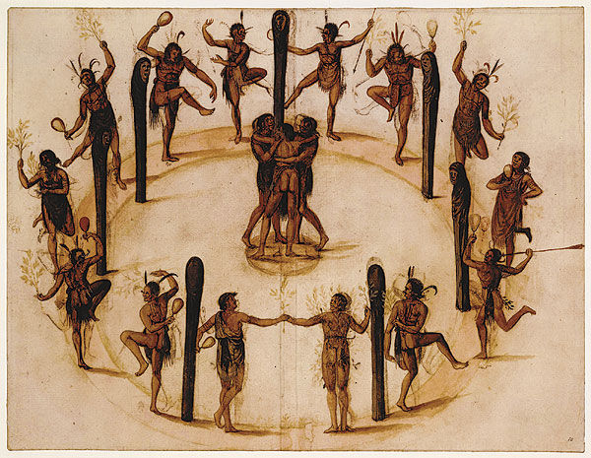
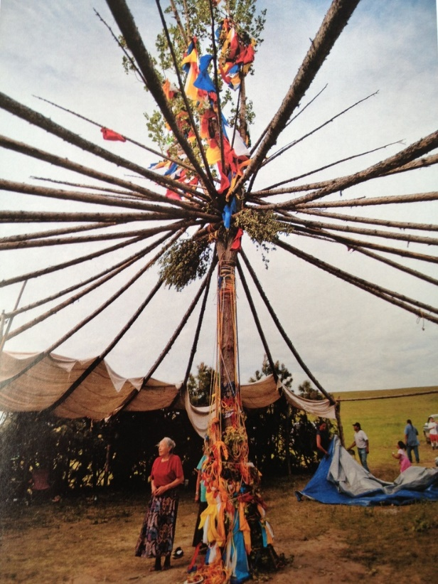
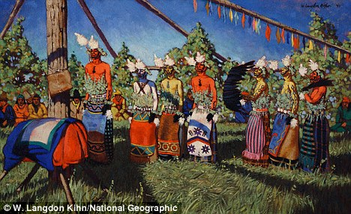
The American Indian Religious Freedom Act of 1972
Legalized once again certain ceremonies like the sun dance.
United States
Native American Theatre
Native American Traditions:
Increased awareness
of the Native American ceremonial
culture contributed to
the emergence of modern
Native American Theatre.

Slide 20
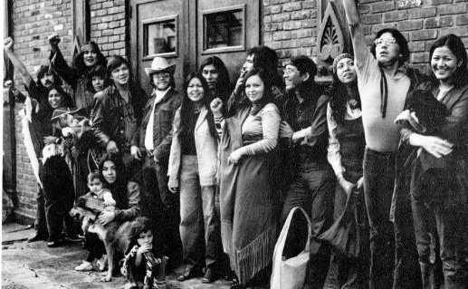
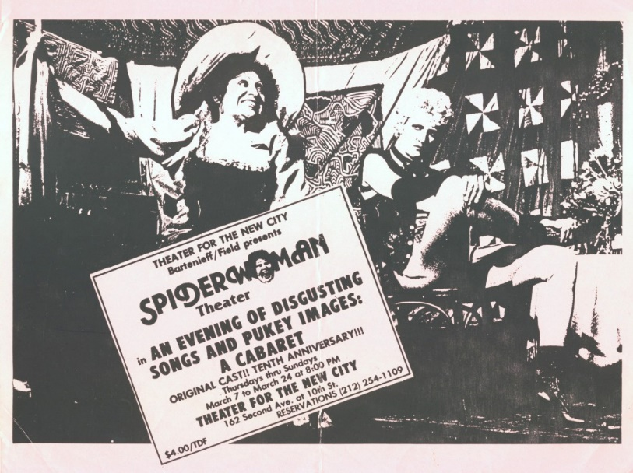
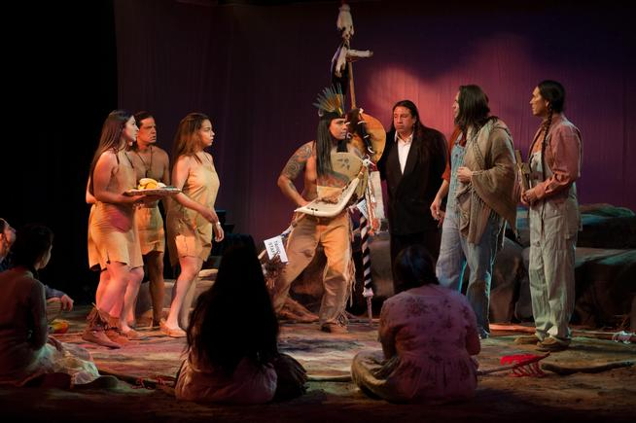
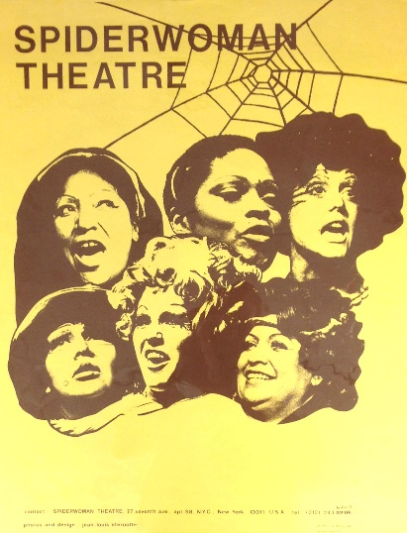
United States
Native American Theatre
Native American Traditions:
Two groups led the way
Spiderwoman Theatre
Both Native American and Feminist
Native American Theatre Ensemble

Slide 21
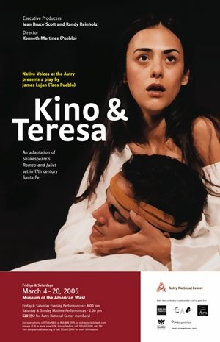
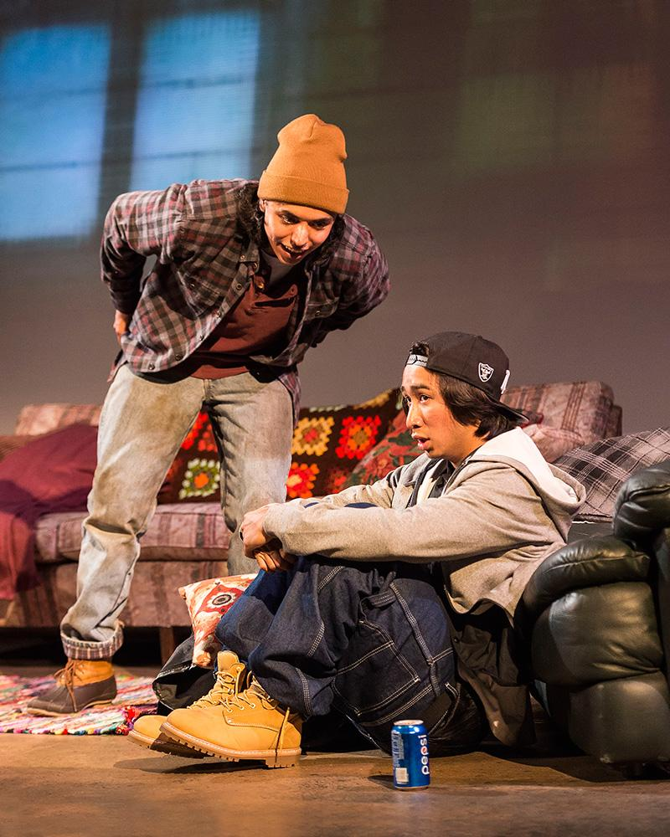
United States
Native American Theatre
Modern Native American
Theatre Group
Native Voices
Resident production group at the Autry Museum
Los Angeles, CA
Native American Traditions:
They Don’t Talk Back Written by Frank Henry Kaash Katasse (Tlingit) Directed by Randy Reinholz (Choctaw) March 2–20, 2016

Slide 22
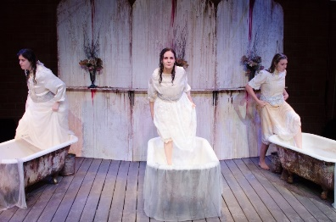
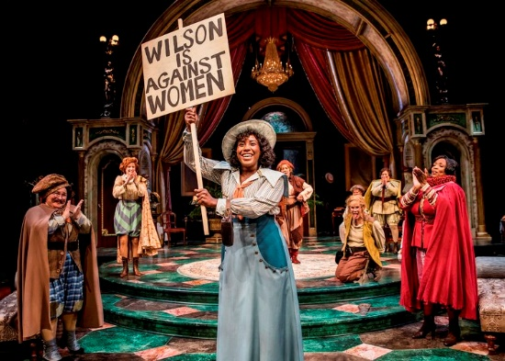
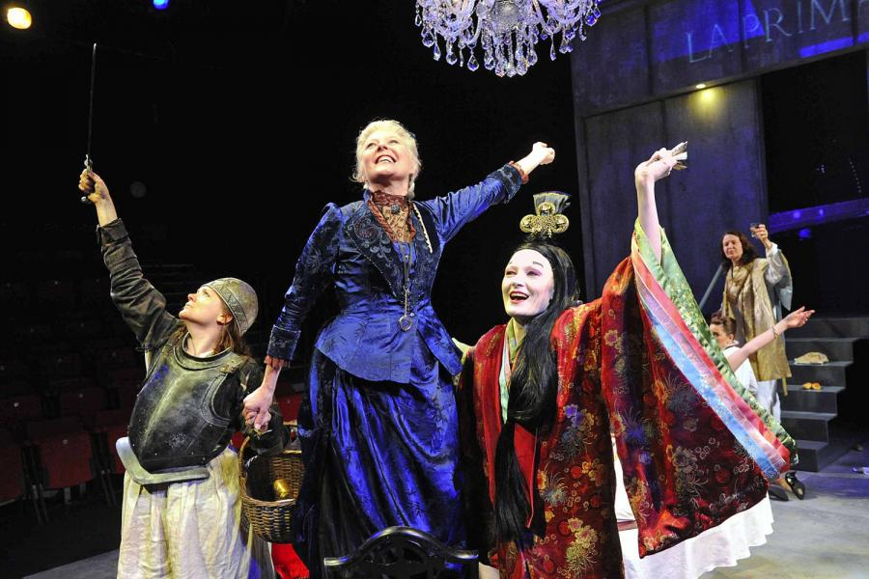
United States
Feminist Theatre and
Playwrights
More than 100 feminist theatrical companies have been founded in the U.S.
It’s Alright to Be a Woman Theatre
In New York was on one of the first groups to translate consciousness raising to stage performance.

Slide 23
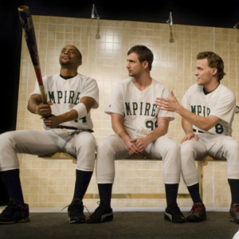
Take Me Out
by Richard Greenberg
won a Tony award in 2003
United States
Gay and Lesbian Theatre
The late 1960’s began
a movement toward gay issues that stirred playwrights to
address onstage.
The AIDS crisis also moved playwrights to write emotional plays in the 1980’s

Slide 24
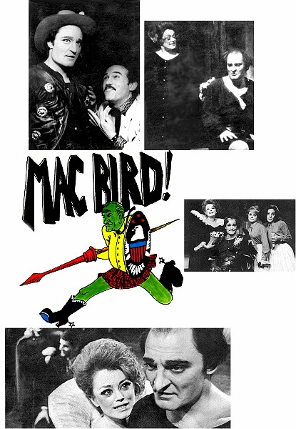
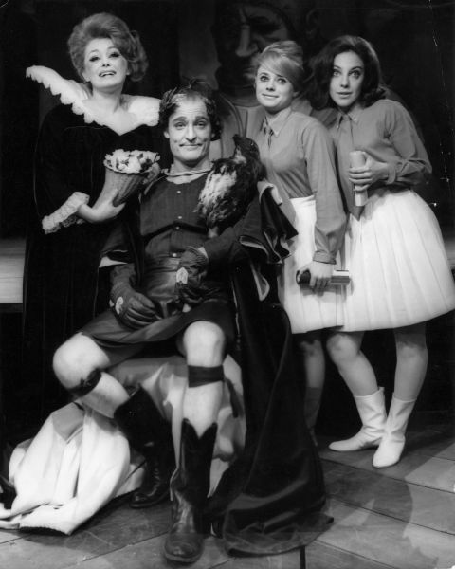
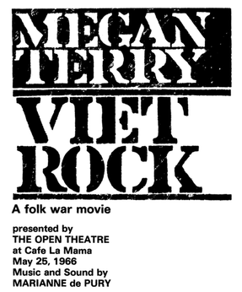
United States
Political Theatre
A marked increase in political drama was experienced during
the Viet Nam period
of U.S. history
Interspersed with other types of plays are the strongly political plays

Slide 25
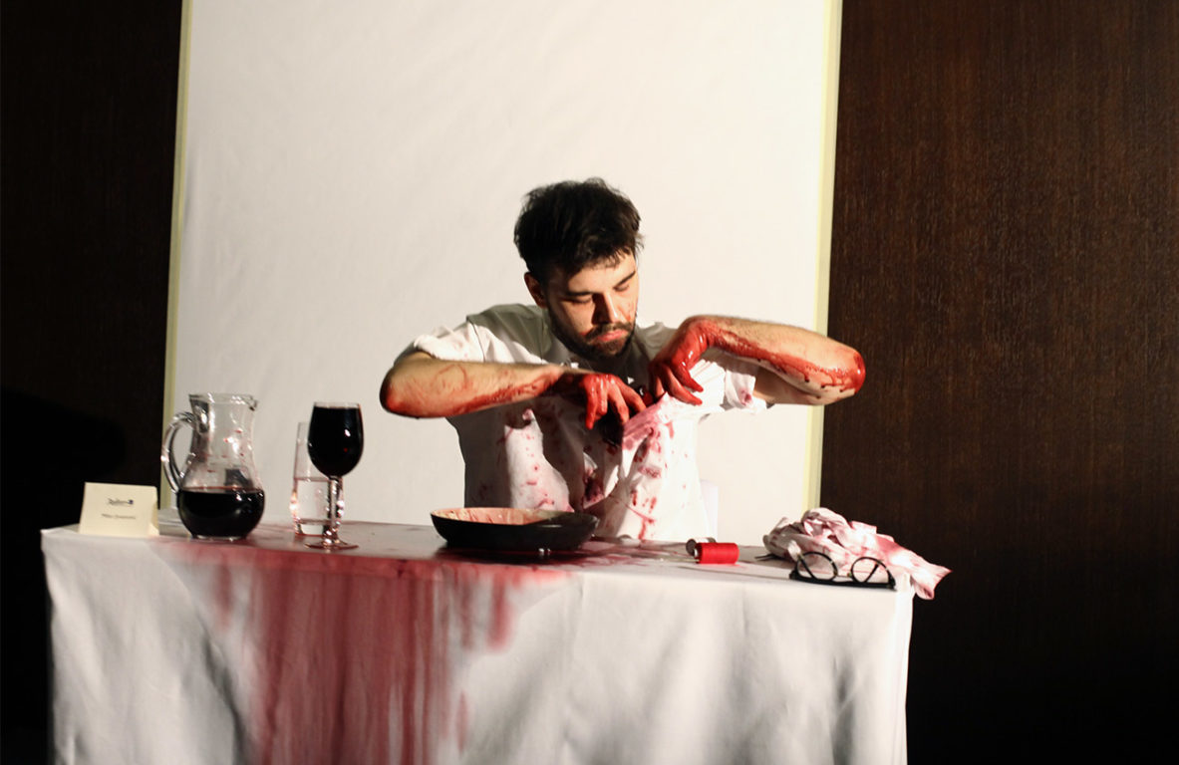
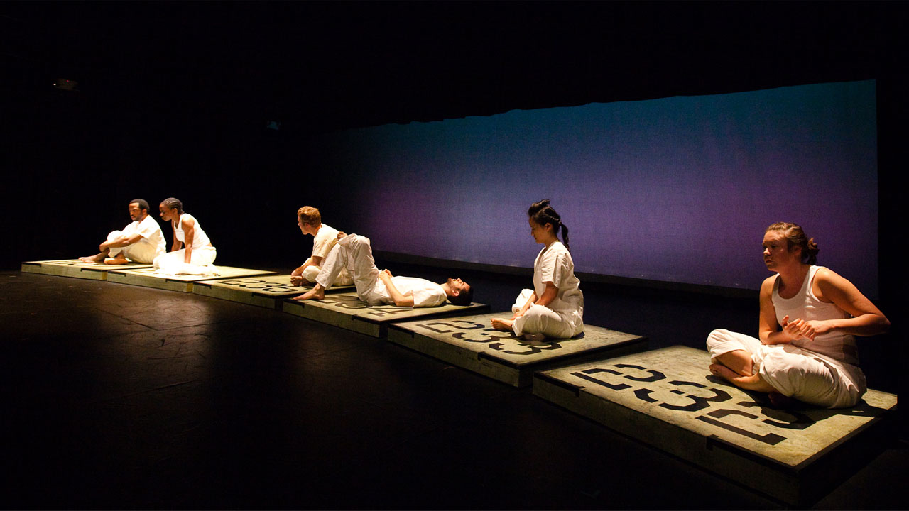
United States
Performance Art
Performance Art is
experimental
theatre that Initially
incorporated
elements of dance and visual arts into
performance. Since performance art often is based on the vision of an individual performer or director rather than playwright, the autobiographical monologue and solo performance have become popular performance art forms.

Slide 26
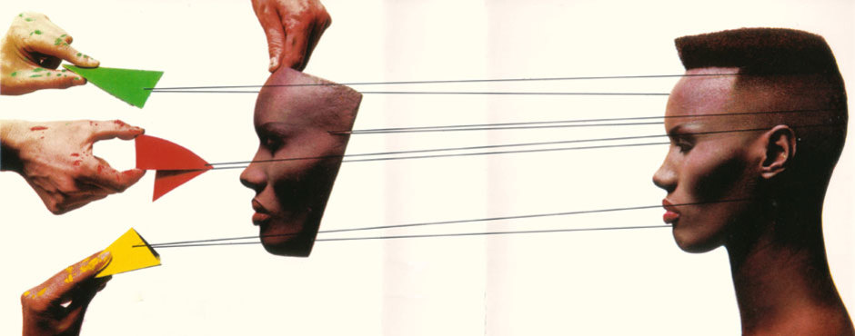
United States
Performing Art
Antecedents were:
Clowning, vaudeville, stand-up comedy
1970’s emphasis was on visual and ritualistic aspects of performing
Individual artists performing one-man shows of various types in mime, storytelling and other art forms
Monologists depicting an array of characters to emphasize a point

Slide 27
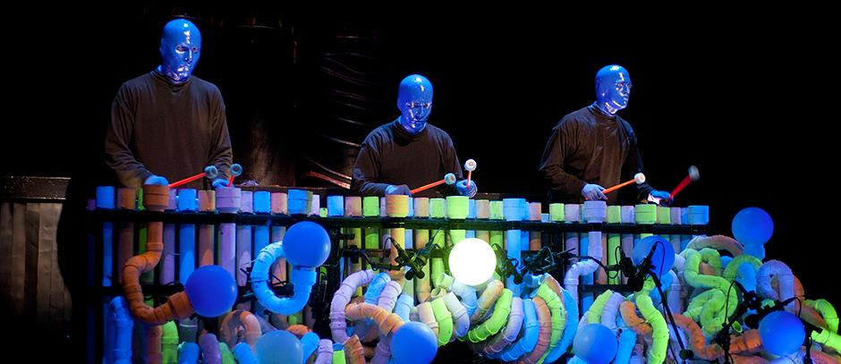
United States
Performing Art
Some ensemble work such as the Blue Man Group

Slide 28
Today’s Theatre:
Global, Eclectic, Diverse
United States
Theatre
What about the future of theatre?
Diverse, experimental, fragmented reflecting its environment
Advances in modern technology will enhance the theatre experience with mix media
The theatre of the future will be an extension of the theatre of the past with revivals and more
Theatre will always be performed by people for people to deal with the hopes, fears, agonies and joys of the human race.

Slide 29
Final Exercises
Explain the differences between
#20 - American theatre to other countries
#21 – Avant-garde vs. traditional theatre
#22 – A one-man show to other forms of theatre
#23 – How could “Fences” or another political play impact an audience and why?
#24 – Where do you think theatre will go from here and why?

