Slide 1
Scenery
Chapter 9

Slide 2
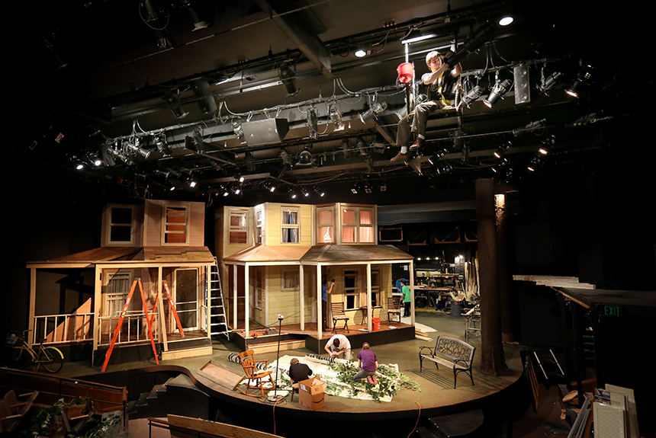
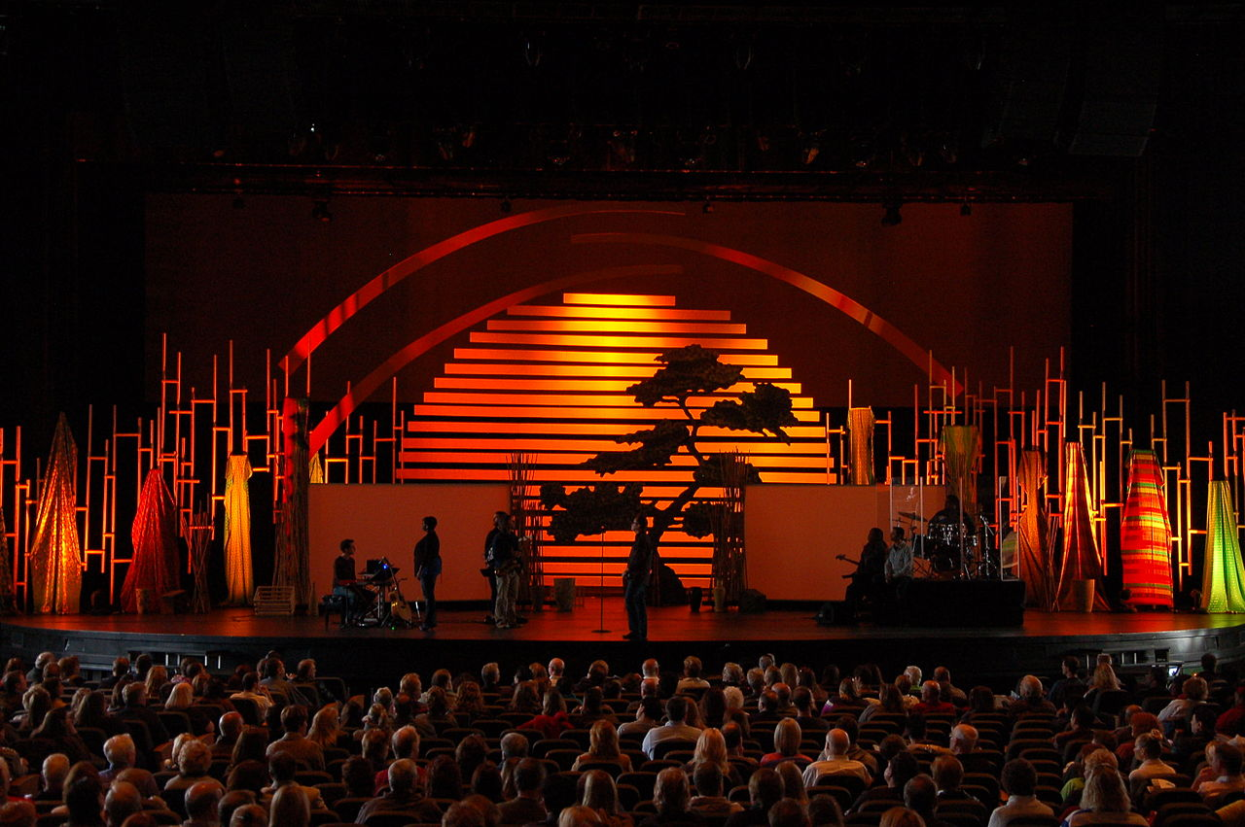
Scenery
The Audience’s View
The atmosphere the audience sees and feels around them begins “setting the stage” for the play performance even before the play begins.

Slide 3
Scenery
The Scene Designer
The Scene Designer
creates the visual world in which a play unfolds.
In addition to working with the Director and Playwright,
the Scene Designer also collaborates with other designers and technicians:
Lighting Designer, electricians and crew
Costume Designer, seamstresses and crew
Sound Designer and crew

Slide 4
Scenery
The Scene Designer
The Scene Designer
helps create the realistic or fantasy style of the play.
The Scene Designer indicates through his/her design the kind of world the play is set in:
Outdoors, Indoors (locale)
Afluent or humble
Time period (past, present, future, timeless)
Seamlessly move through time and locale

Slide 5
Scenery
The Scene Designer
The Scene Designer
must be concerned with:
The practical, as well as the aesthetic concern of the Director & Playwright:
How a door opens and closes
How to make sturdy a flight of stairs
Where lights should be placed safely and which kind of light to used that fits the voltage set for the facility
How much material to “build” a costume and what it takes to make it wearable and functional for an actor/ress
Understand the acoustics of the “room” and how to create the appropriate sound electronically to the audience

Slide 6
Scenery
The Scene Designer
The Scene Designer
must understand symbolism on stage:
Such as:
A single item onstage may suggest an entire room
A bookcase (library or professor’s office)
A stained-glass window (church or synagogue)
A flooded stage with bright, warm yellow/orange light (a cheerful,
sunny day)
A single shaft of pale blue light (moonlight or eerie graveyard scene at night)

Slide 7
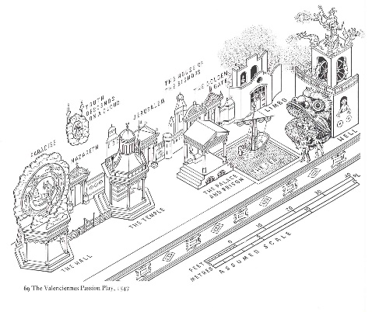
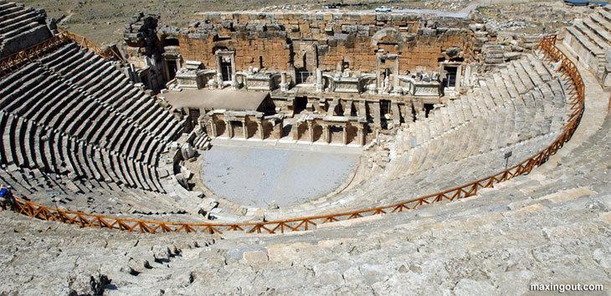
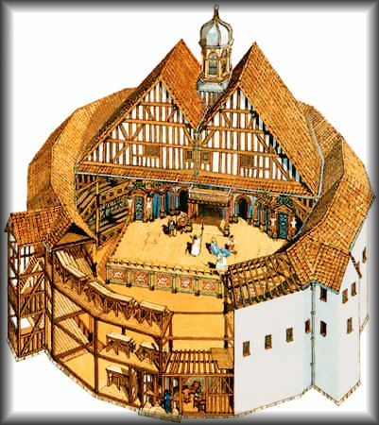
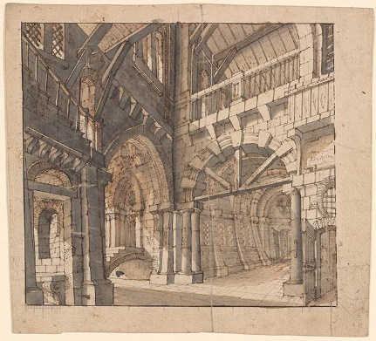
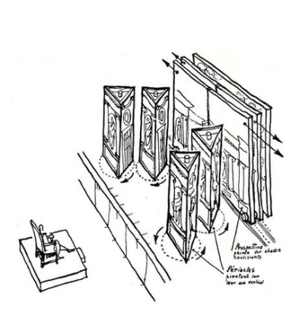
Scenery
Stage Design History
Earliest stages of western and
Asian theatre used little stage scenery
Progression of stage scenery to today:
Greek (facade of stage house usually represented a palace)
Medieval (mansions “wagons” set up in town squares)
Elizabethan/Spanish Renaissance (no scenery as in Greek
theatre but used a small amount of simple set pieces for furniture)
Italy and later France and England (proscenium stage with designers such as the Bibiena family brought perspective drawings and mechanical scene changes to the stage)

Slide 8
Scenery
Stage Design History
Scenic Design Today
From Italian proscenium style, elaborate scenery to today’s many faceted theatrical onstage experience of scenery:
Since the Italian infusion of elaborate scenery, theatre has experienced a combination of improved stage machinery—the means by which scenery is shifted—and increasing realism in depicting scenes. This growing emphasis on mechanization, technology and realism has been the basis of much modern stage scenery.

Slide 9
Scenery
Scene Design Today
Scene Design is more than mere
reproduction of a scene in “real life”;
it is a representation of life—
it merely resembles life.
In the case of a fantasy, it merely suggests the fantastical world of the play.

Slide 10
Scenery
Scene Design Today
The Scene Designer’s Objectives:
Help the tone and style of the production
Establish the locale and period in which the play takes place
Develop a design concept consistent with the director’s concept.
Provide a central image or metaphor, where appropriate
Ensure that scenery is coordinated with other production elements
Solve practical design problems

Slide 11
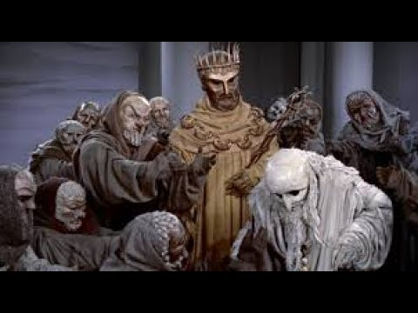
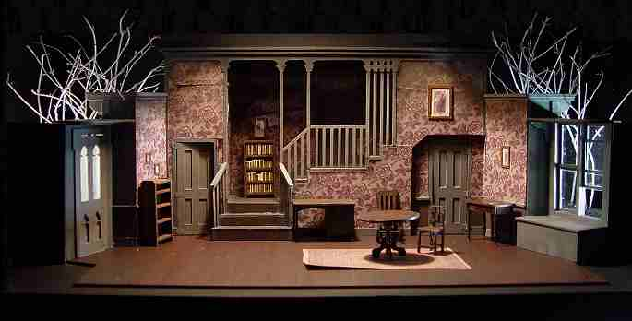
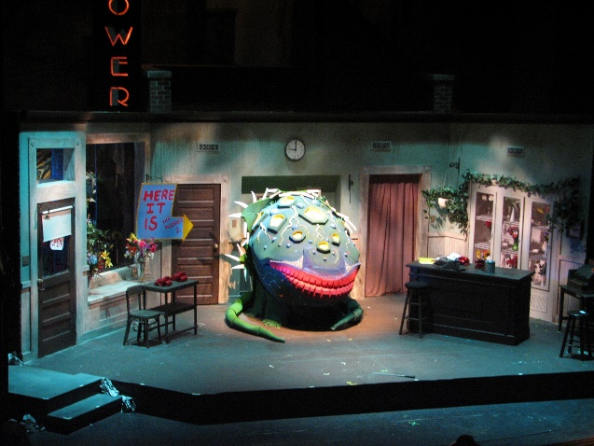
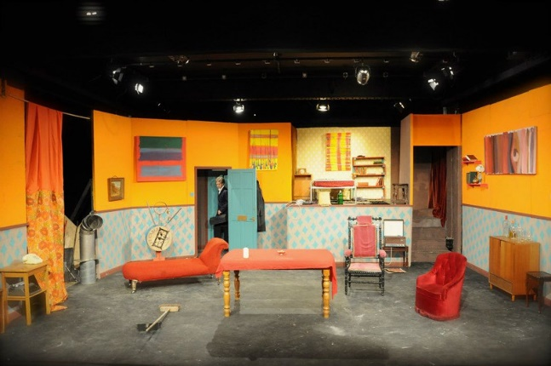
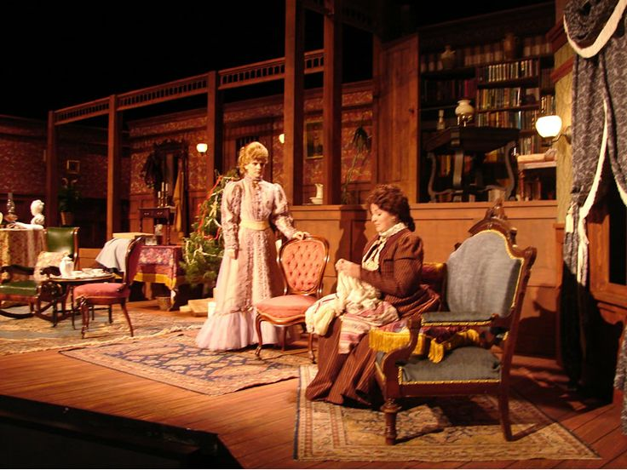
Scenery
Scene Design Today
Establishing Tone and Style:
Style
Modern Realistic as everyday life
Traditional Tragedy with verse rather than prose
Slapstick Farce involving comic, exaggerated scenery
Tone
Characters are fighting against emotional forces within themselves (use of unrealistic scenery or costume)
Characters are the same as in “real life” (use of realistic scenery and costume)

Slide 12
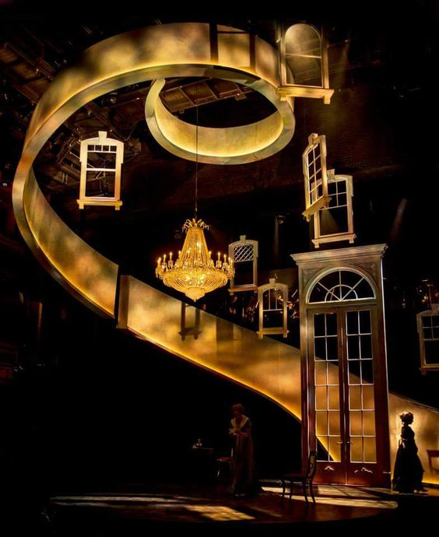
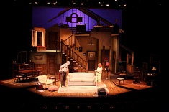
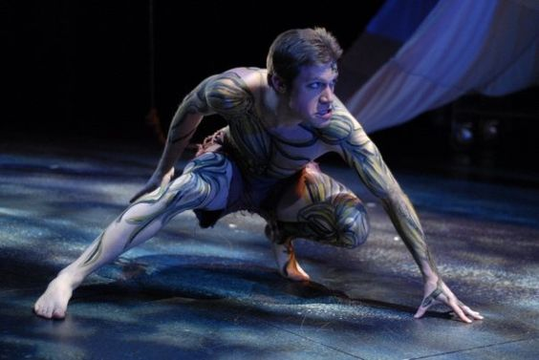
Scenery
Scene Design Today
Realism vs. Nonrealism:
Realism
Everything connected with a production conforms to our observation of the world around us. Broadly, an attempt to present onstage people, places and events corresponding to those in everyday life.
Nonrealism
“Departures from realism” which are all types of theatre that depart from observable reality such as a musical; a play with “fantastic characters” such as witches, ghosts, death, talking animals, etc.; a play with soliloquies or use poetic verse to communicate.

Slide 13
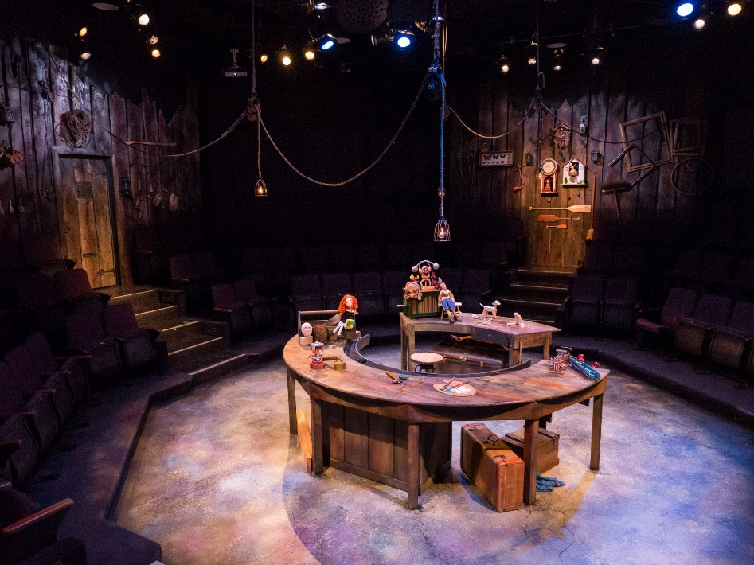
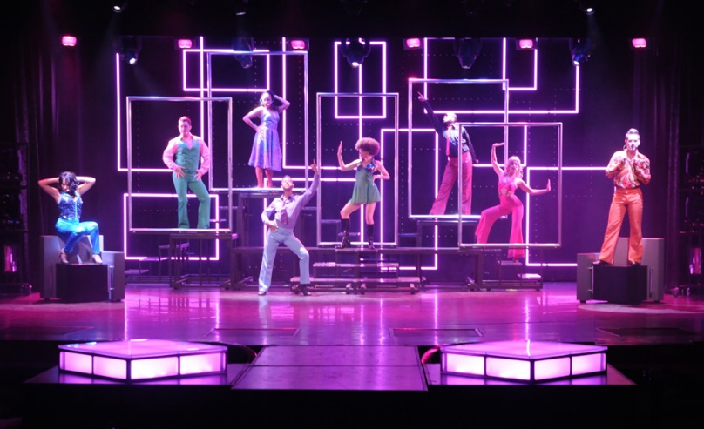
Scenery
Scene Design Today
Establish Locale and Period:
Set Pieces
Can tell us time and place
Old radio or phone
Spaceship or futuristic land pieces
Can tell us about the characters
Sloppy or lazy vs. neat and tidy
Upper class or middle or lower class (in control of surroundings or not)
Whether cold, hot or kind of temperature and conditions of the environment of the characters

Slide 14
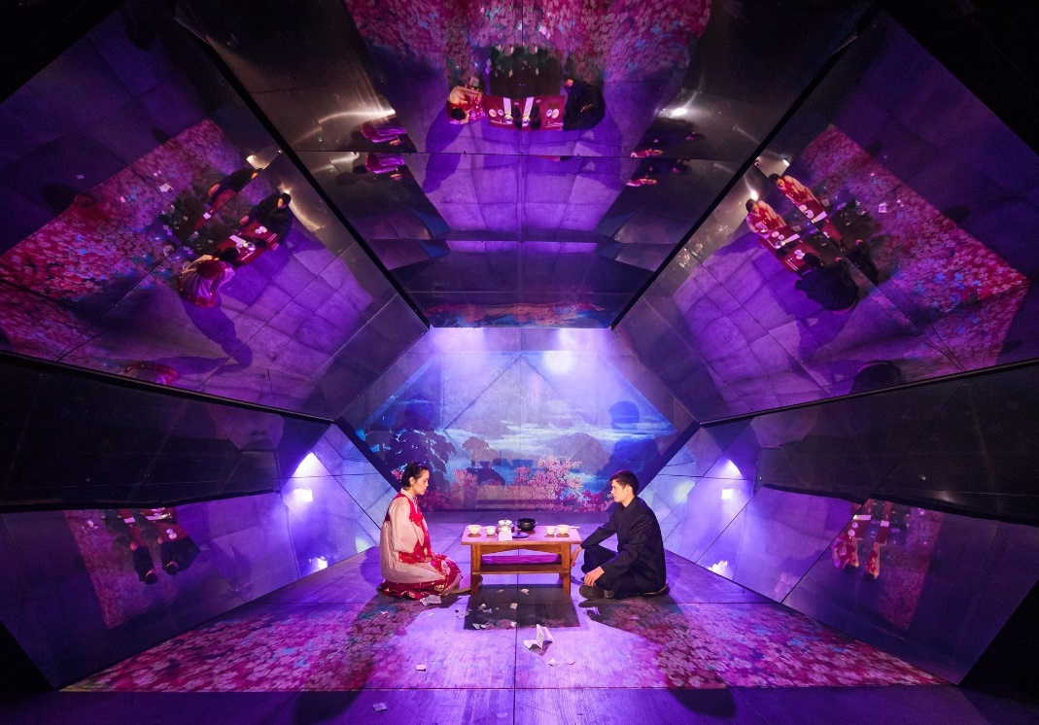
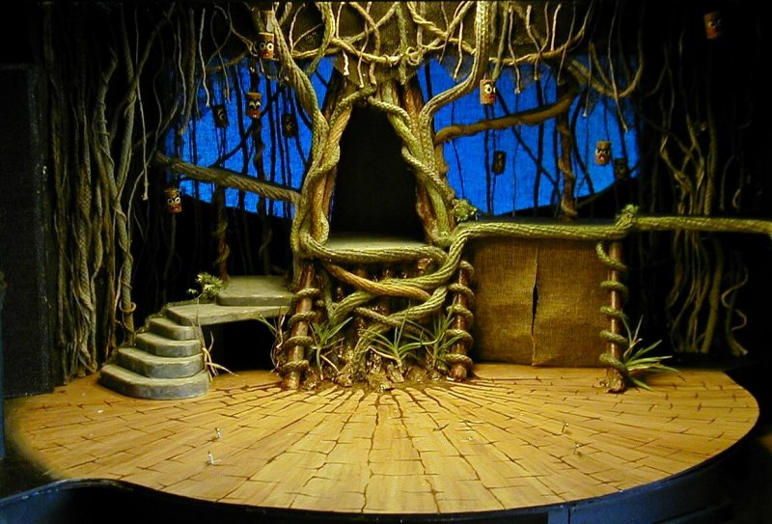
Scenery
Scene Design Today
Developing a Design Concept:
Enhance the director’s concept
of the play.
Use scenery to pull together the
“spine” of the play.
Spine: The “through-line” or general action, feeling or emotion that runs through a play
from beginning to end
Notes:
Mia Chung’s new play You For Me For You, and “The Tempest”

Slide 15
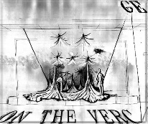
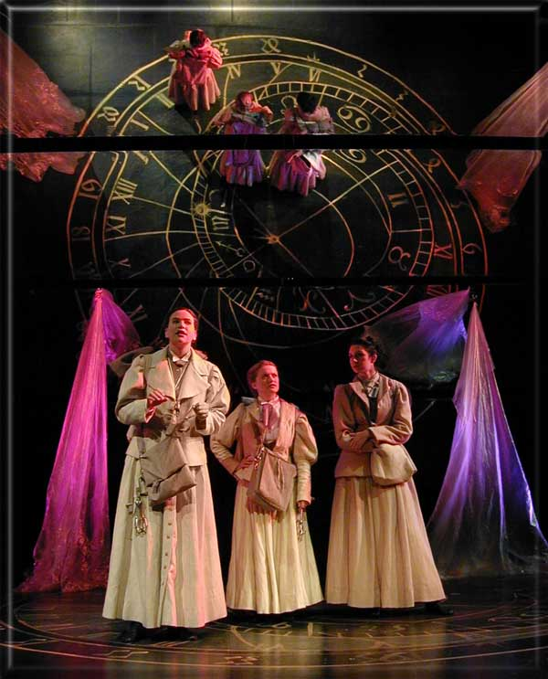
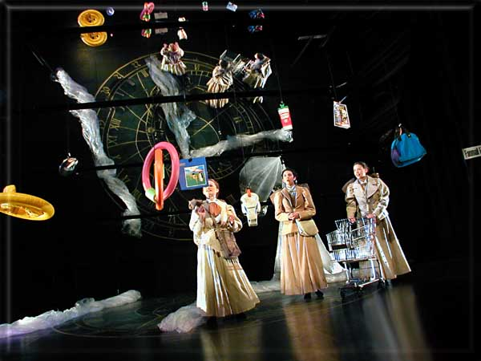
Scenery
Scene Design Today
Providing a Central Image or Metaphor:
Similar to concept, using elements of scene design such as lines, shapes and colors to enhance the concept of the play.

Slide 16
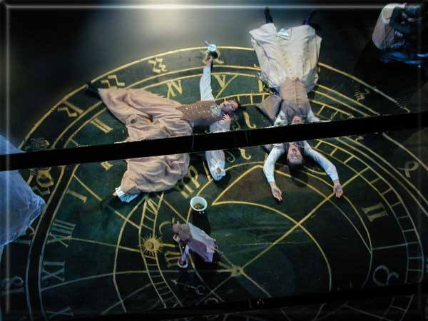
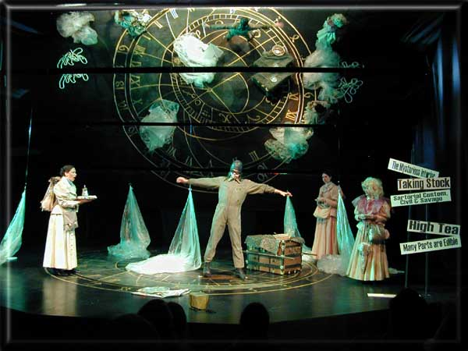
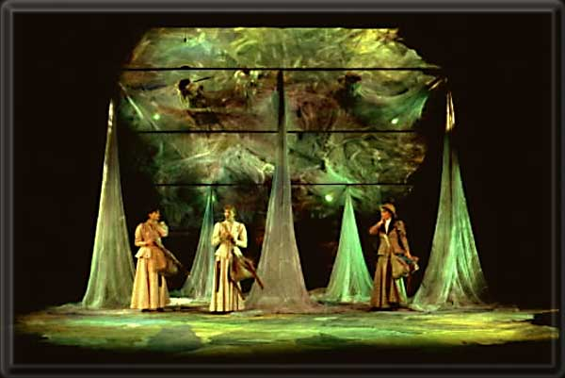
Scenery
Scene Design Today
Providing a
Central Image
or Metaphor:
Similar to concept, using elements of scene design such as lines, shapes and colors to enhance the concept of the play.

Slide 17
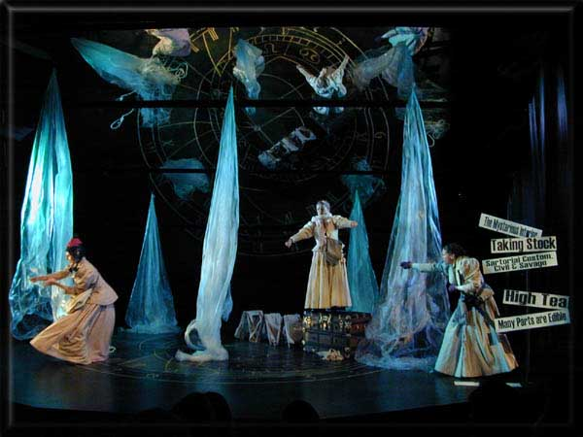
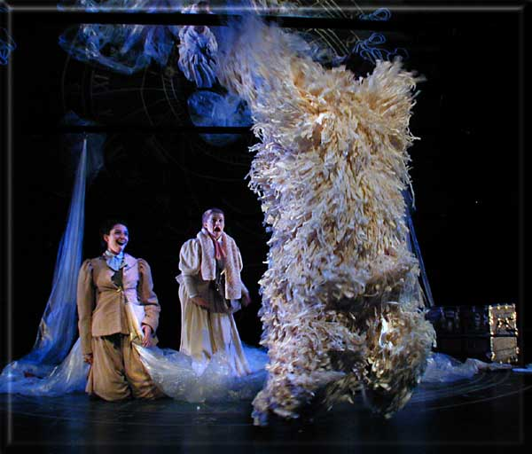
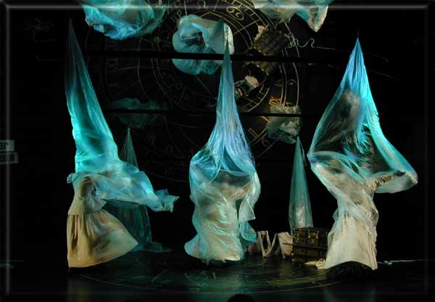
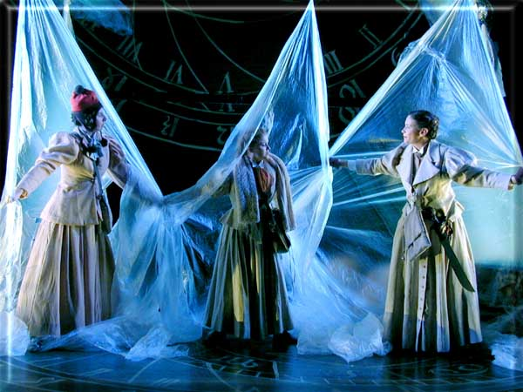
Scenery
Scene Design Today
Providing a
Central Image
or Metaphor:
Similar to concept, using elements of
scene design such
as lines, shapes and
colors to enhance
the concept of the play.

Slide 18
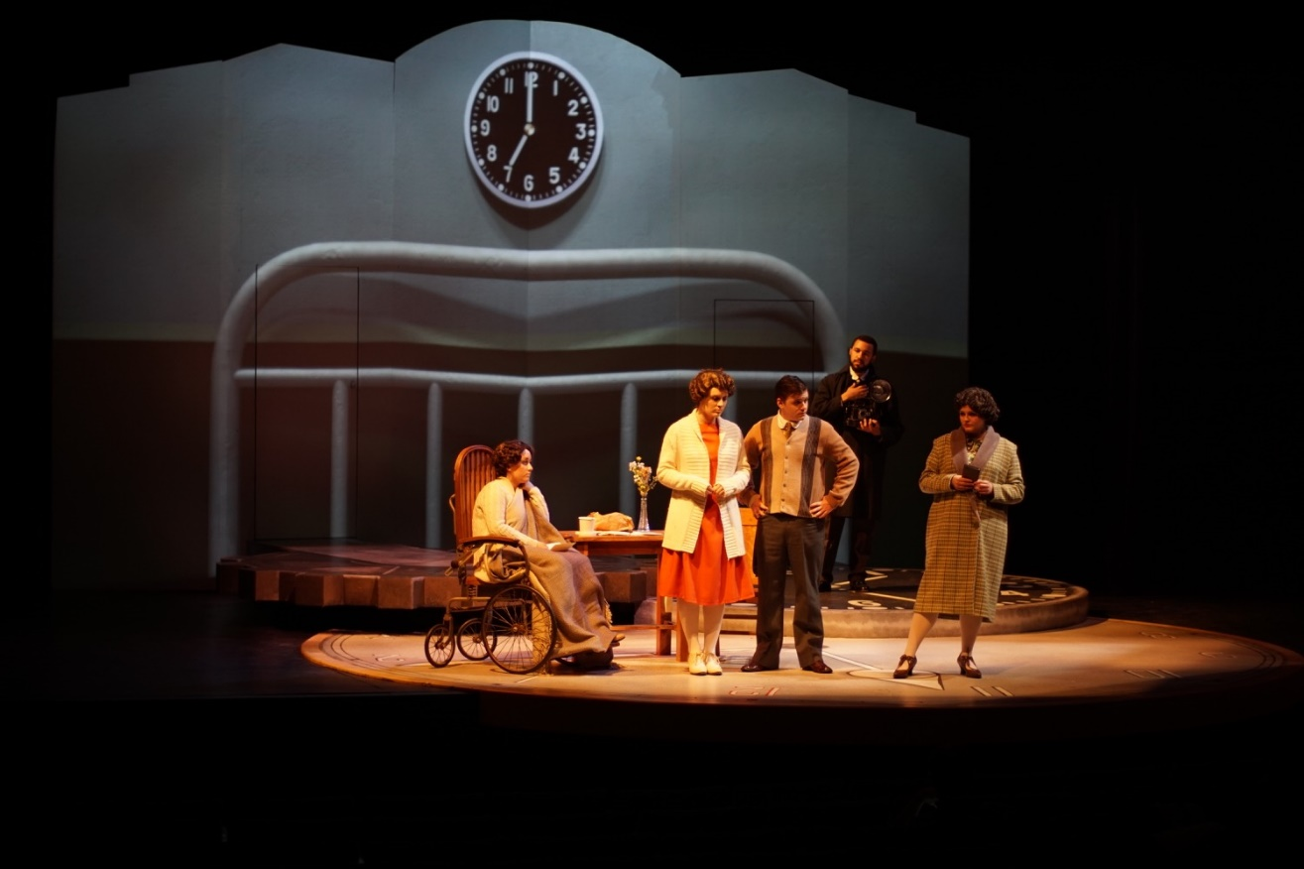
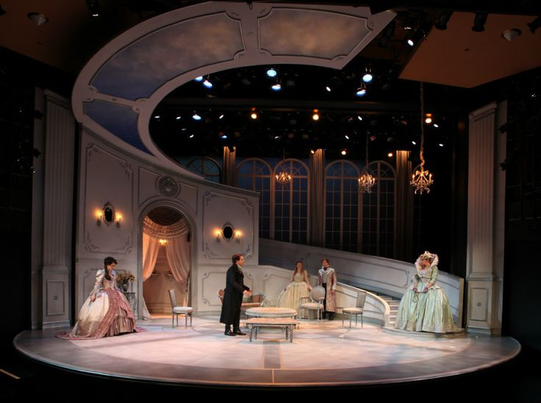
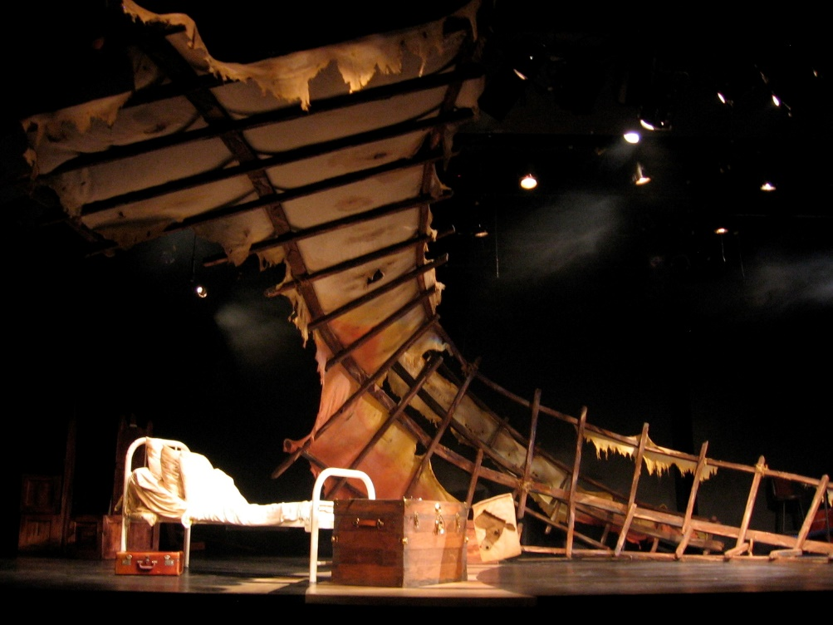
Scenery
Scene Design Today
Providing a
Central Image
or Metaphor:
Similar to concept,
using elements of
scene design
such as
lines, shapes & colors
to enhance
the concept
of the play.

Slide 19
Scenery
Scene Design Today
Coordinating Scenery with the Whole:
The scenery should be consistent with the playwright’s intent and the director’s concept.
The setting should contribute to the overall effect of a production; not contradict it or confuse the audience.

Slide 20
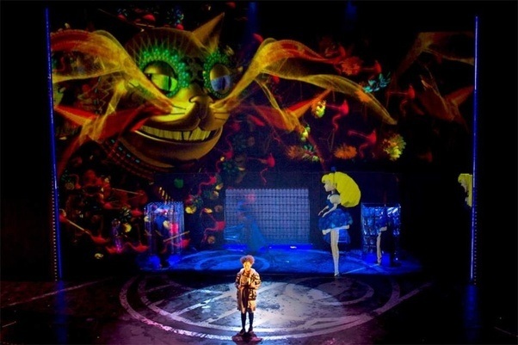
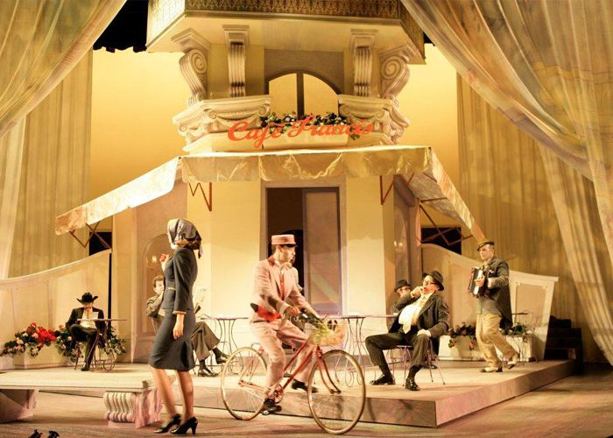
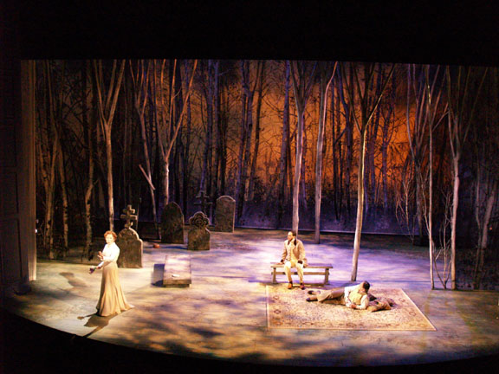
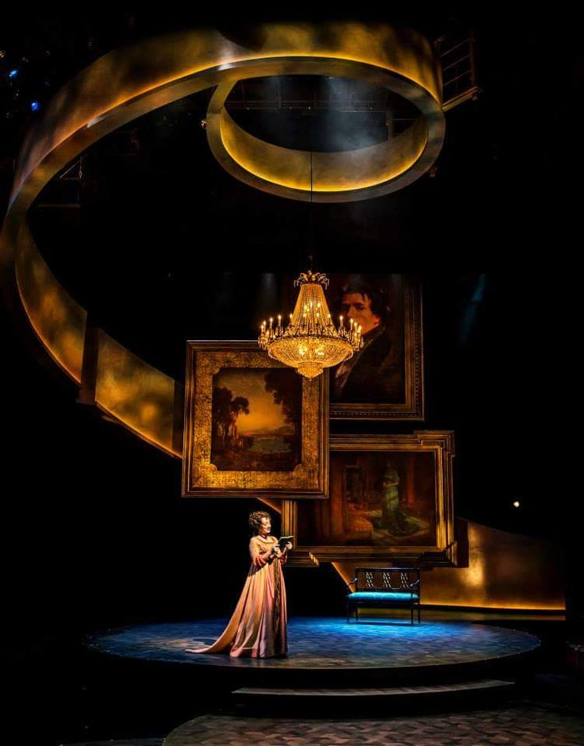
Scenery
Solving Practical
Design Problem
Five Elements of Design:
1. Line-The outline or silhouette of elements onstage
Ex. Predominately curved lines vs. sharply angular lines
Scene Design Today

Slide 21
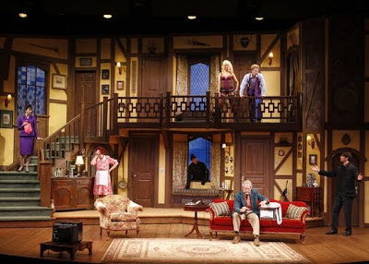
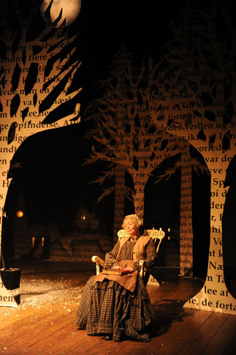
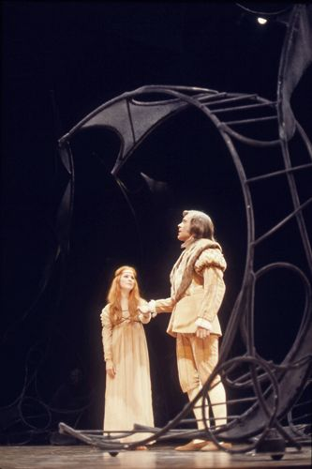
Scenery
Solving Practical
Design Problem
Five Elements of Design:
2. Mass-The overall bulk or weight of scenic elements
Ex. A series of high, heavy platforms or fortress walls vs.
a bare stage or a stage with only a single tree on it
Scene Design Today

Slide 22
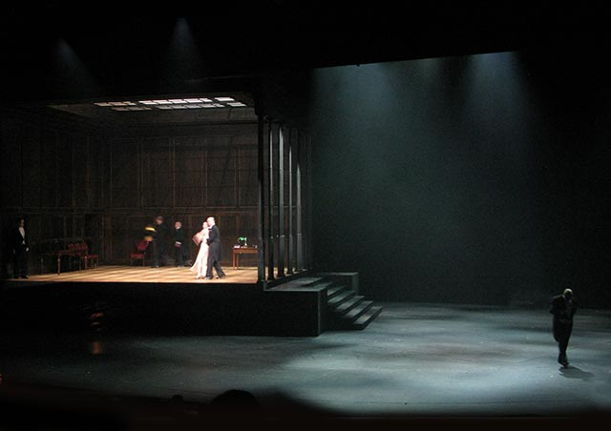
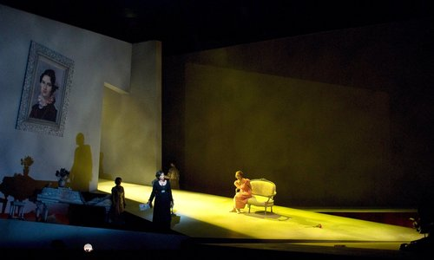
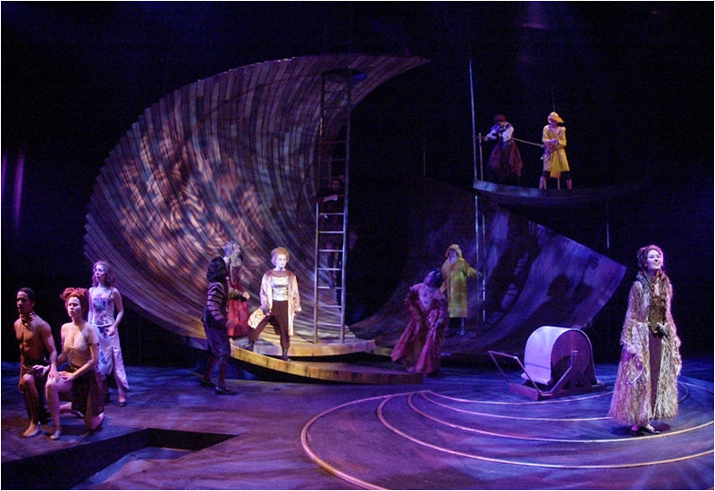
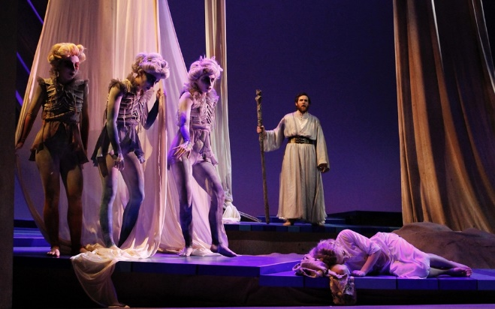
Scenery
Solving Practical
Design Problem
Five Elements of Design:
3. Composition-The balance and arrangement of elements, the way
elements are arranged
Ex. Mostly to one side of the stage, in a vertical or horizontal
configuration, or equally distributed onstage
Scene Design Today

Slide 23
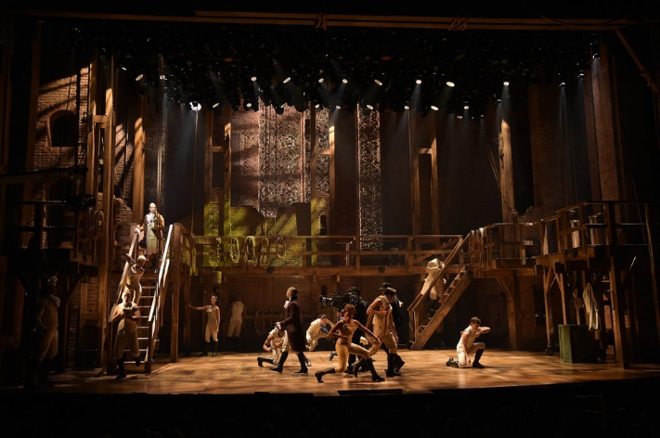
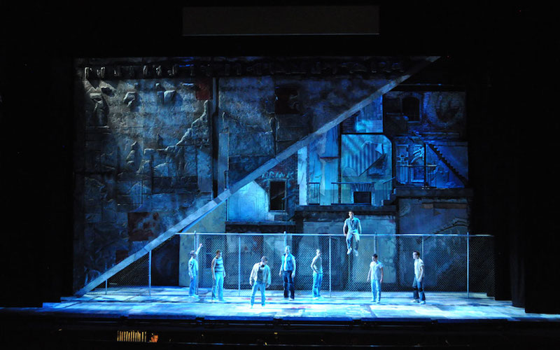
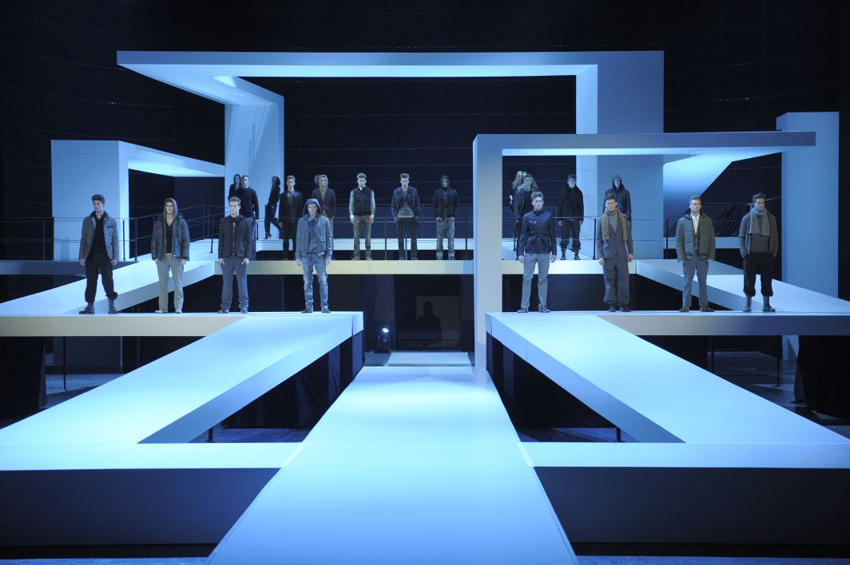
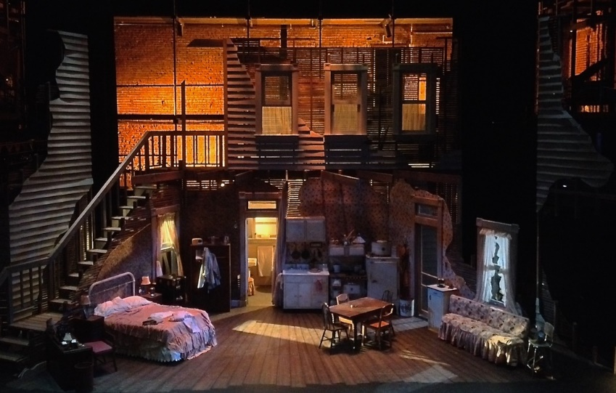
Scenery
Solving Practical
Design Problem
Five Elements of Design:
4. Texture-The “feel” projected by surfaces and fabrics
Ex. The slickness of chrome or glass vs. the roughness of brick or burlap
Scene Design Today

Slide 24
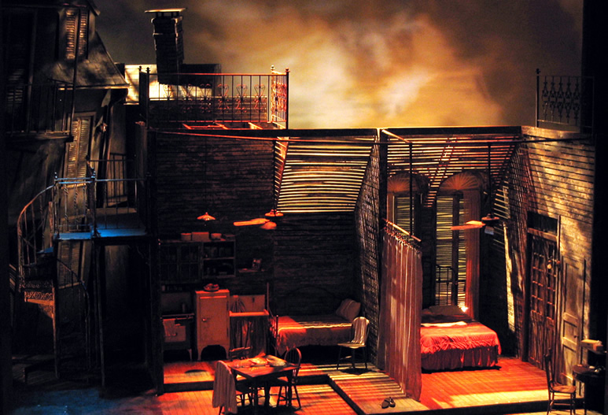
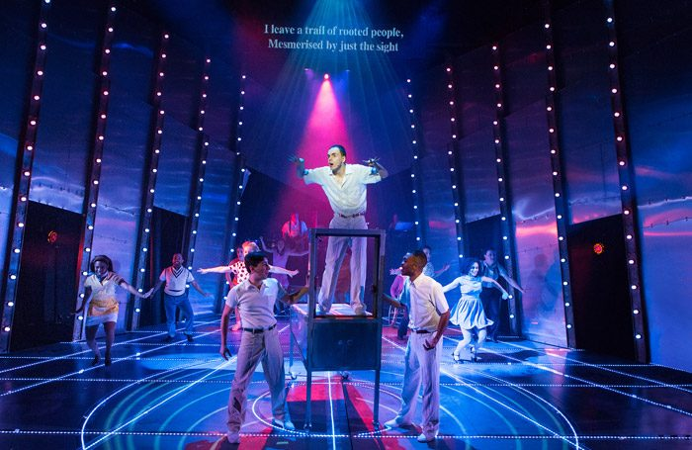
Scenery
Solving Practical
Design Problem
Five Elements of Design:
5. Color-The shadings and contrasts of color combinations
Ex. Warm and “cozy” are usually in the red to yellow range and
“cool and sterile” are usually in the purple to blue range
Scene Design Today

Slide 25
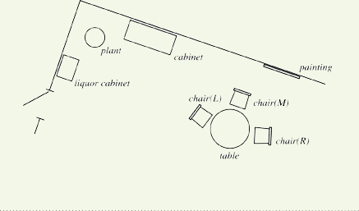
Scenery
Elements of Scene Design
Physical Layout of the Playing Area:
A Ground Plan

Slide 26
Scenery
Elements of Scene Design
Physical Layout of the Playing Area:
A Ground Plan must:
Fit into theatre space
Make room for actors to move on and off stage
If an actor exits one side of the stage and enters another on the other side of the stage, he/she must have space (without obstacles) to get there
Make room for actors to change costumes quickly
Make room for actors to move around on stage, particularly if they need extra space for fighting or dancing and etc.

Slide 27
Scenery
Elements of Scene Design
Physical Layout of the Playing Area:
A Ground Plan
Is a floor plan outlining the various levels on the stage and indicating the placement of all scenery, furniture, doors, windows and etc. It is an architectural blueprint of the ground floor of the stage that not only indicates the placement of furniture, doors and windows, but also the various levels of the stage, as well as the walls of rooms, platforms and etc.

Slide 28
Scenery
Elements of Scene Design
Stage Right-Right side of stage from actor’s point of view
Stage Left-Left side of stage from actor’s point of view
Downstage-Front of the stage toward the audience
Upstage-At or toward the back of the stage, away from the front edge of the stage, away from the audience

Slide 29
Scenery
Materials and Devices of Scene Design
Turntable-A circle set into the floor which is rotated mechanically or electronically to bring one set into view as another disappears

Slide 30
Scenery
Materials and Devices of Scene Design
Wagon-Low
platform mounted
on wheels or
casters by means
of which scenery
is moved on and offstage

Slide 31
Scenery
Materials and Devices of Scene Design
Fly loft-Space above the stage where scenery may be lifted out of sight by ropes & pulleys

Slide 32
Scenery
Materials and Devices of Scene Design
Fly loft-Space above the stage where scenery may be lifted out of sight by ropes & pulleys

Slide 33
Scenery
Materials and Devices of Scene Design
Flat-A scenic unit consisting of canvas stretched on a wooden frame often used with similar units to create a set

Slide 34
Scenery
Materials and Devices of Scene Design
Flat-A scenic unit consisting of canvas stretched on a wooden frame often used with similar units to create a set

Slide 35
Scenery
Materials and Devices of Scene Design
Flat-A scenic unit consisting of canvas stretched on a wooden frame often used with similar units to create a set

Slide 36
Scenery
Materials and Devices of Scene Design
Special Scenic Effects: The Scrim-Thin open-weave fabric which is nearly transparent when lit from behind and opaque when lit from the front

Slide 37
Scenery
Materials and Devices of Scene Design
Special Scenic Effects: Screen Projection-A picture or drawing is projected on a screen from in front or from behind.

Slide 38
Scenery
Materials and Devices of Scene Design
Special Scenic Effects: Prop-Properties; objects that are used by performers onstage or are necessary to complete a set

Slide 39
Scenery
The Process of Scene Design: Steps in the Design
Read the script
May make a few rough sketches
Designer and Director meet to exchange ideas
Materials and Devices of Scene Design
4. Designer develops preliminary thumbnail sketches
Sketches, drawings, models and etc. are developed to
work with director

Slide 40
Scenery
The Process of Scene Design: Steps in the Design
5. After the Designer and Director agree on a design, the Designer makes a more complete sketch, usually in color called a Rendering
Materials and Devices of Scene Design

Slide 41
Scenery
The Process of Scene Design: Steps in the Design
6. The Designer creates two types of models
1. Usually all
white showing location of
platforms & walls
2. Completed, finished model in
full color with
details
Materials and Devices of Scene Design

Slide 42
Scenery
The Process of Scene Design:
Computer Assisted Design (CAD)
Materials and Devices of Scene Design

Slide 43
Scenery
The Process of Scene Design:
Computer Assisted Design (CAD)
Materials and Devices of Scene Design

Slide 44
Scenery
The Scene Designer’s Collaborators and the Production Process
Collaboration is the key
Technical Director- Staff member responsible for scheduling, construction, and installation of all equipment; he or she is responsible for guaranteeing that designs are executed according to the designer’s specifications.
Property Designer- creates and executes all props including special effects props.
Scenic Charge Artists or Paint Charge Artists- Build and paint sets
Design Assistants or Scene Designer- Create “designer/front elevations
(Drawings that show all exact scenic details from the point of view of the audience

Slide 45
Scenery
The Scene Designer’s Collaborators and the Production Process
Collaboration is the key
The Property Designer ‘s areas:
Functional props used by actors
Set dressings to fill out the visual stage reality
Technical Rehearsals:
Stage Manager plays leadership role
Collaborates with all technical crew
Sometimes a Scene Designer is also involved with creating a “total environment” for the audience by designing the way the audience is situated around or next to the actors and other aspects of the whole environment experience of the audience.

