Slide 1
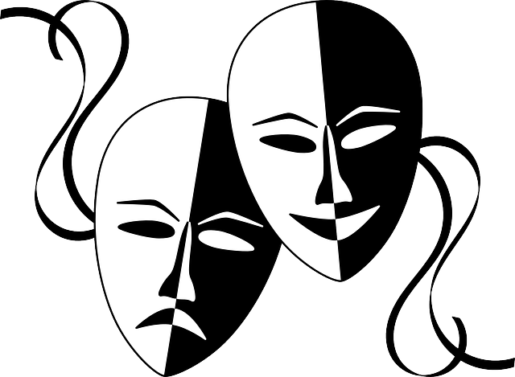
Theatre Spaces:
The Audience Views the Stage

Slide 2
Creating the Environment
Theatre Spaces
Proscenium Stage / Fourth Wall
Arena / Circle Stage / Theatre-in-the-Round
Thrust Stage
Black Box
Created & Found Spaces
Notes:
Proscenium-Arch or frame surrounding the stage opening in a box or picture stage (frame)
Arena – Stage entirely surrounded by the audience. Also known as Circle Theatre or theatre-in-the-round
Thrust Stage- Stage space that thrusts into the audience space; a stage surrounded on three sides by audience seating
Black Box – A theatre space that is open, flexible and adaptable, usually without fixed seating. The stage/audience configuration can be rearranged to suit the individual requirements of a given production, making it both economical and particularly well suited to experimental work.
Fourth Wall – Convention, in a proscenium-arch theatre, that the audience is looking into a room through an invisible fourth wall

Slide 3
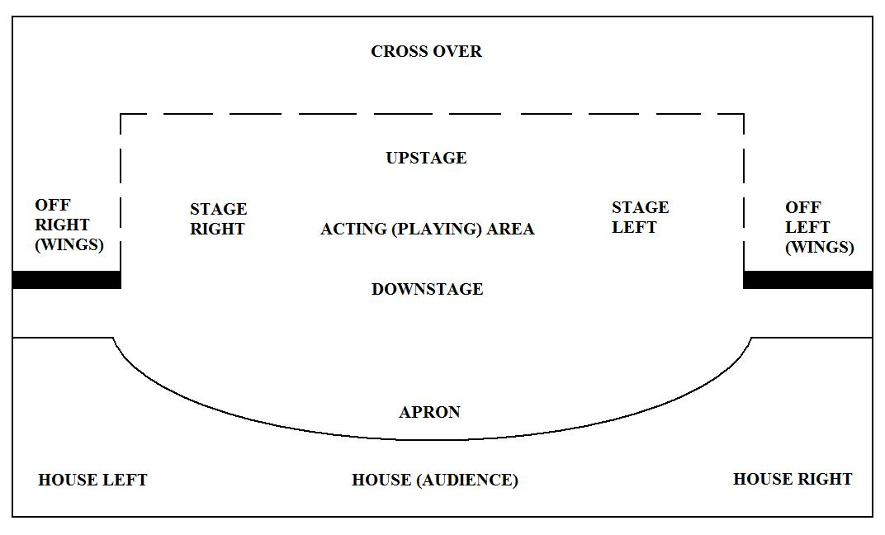
Creating the Environment
The Proscenium Stage
ORCHISTRA PIT

Slide 4
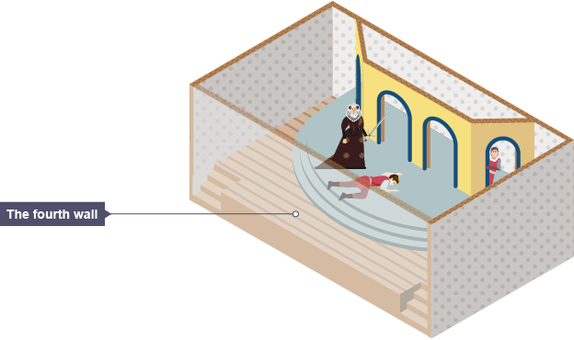
Creating the Environment
The Invisible
Fourth Wall
of
Proscenium Theatre

Slide 5
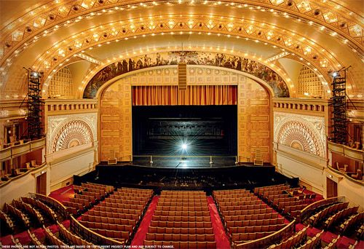
Creating the Environment
Proscenium stage:
Picture Frame Stage

Slide 6
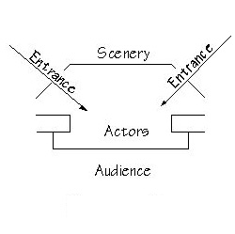
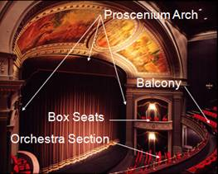
Creating the Environment
The Proscenium Stage:
Actors’ Entrances and Audience’ Special Seats

Slide 7
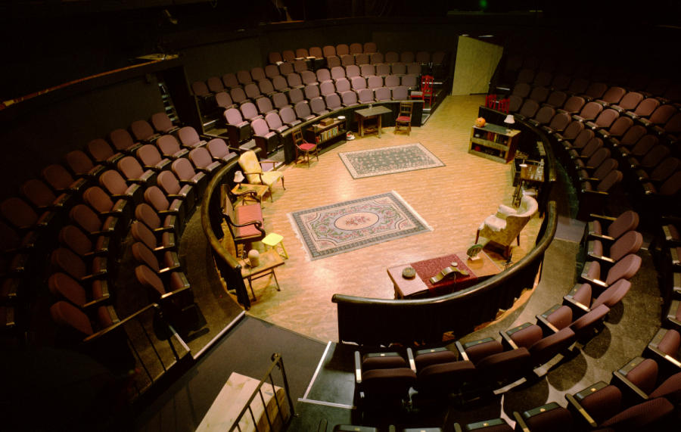
Creating the Environment
The Arena Stage:
Theatre-in-the-Round
Circle Theatre

Slide 8
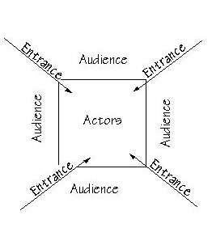
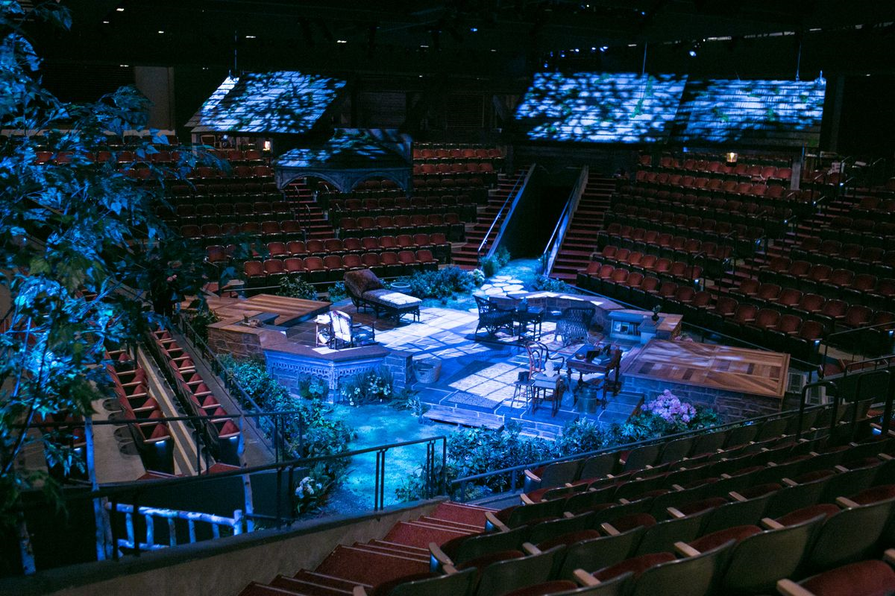
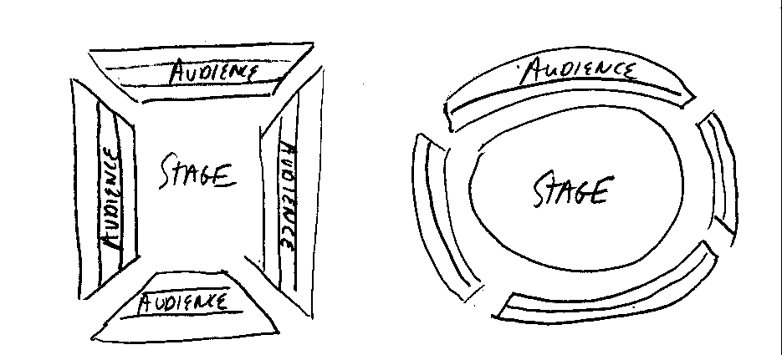
Creating the Environment
The Arena Theatre Actor Entrances & Exits

Slide 9
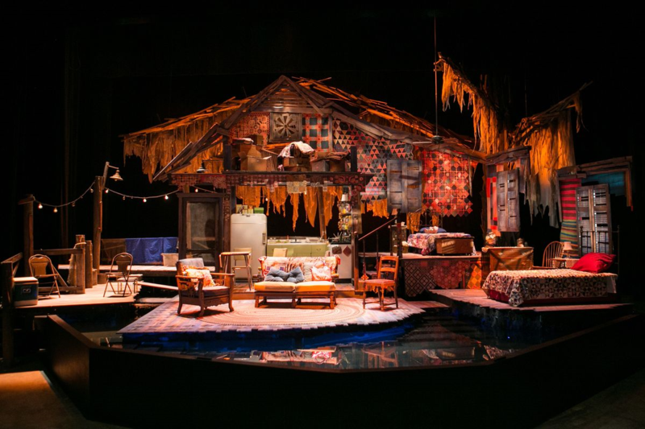
Creating the Environment
Arena Theatre Scenery
can have a “see-through” effect
in order to help the audience
on all four sides
see the action on the stage

Slide 10
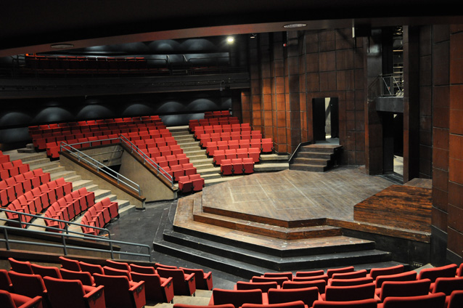
Creating the Environment
The Thrust Stage:
Juts into the “house”
of the audience

Slide 11
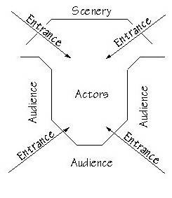
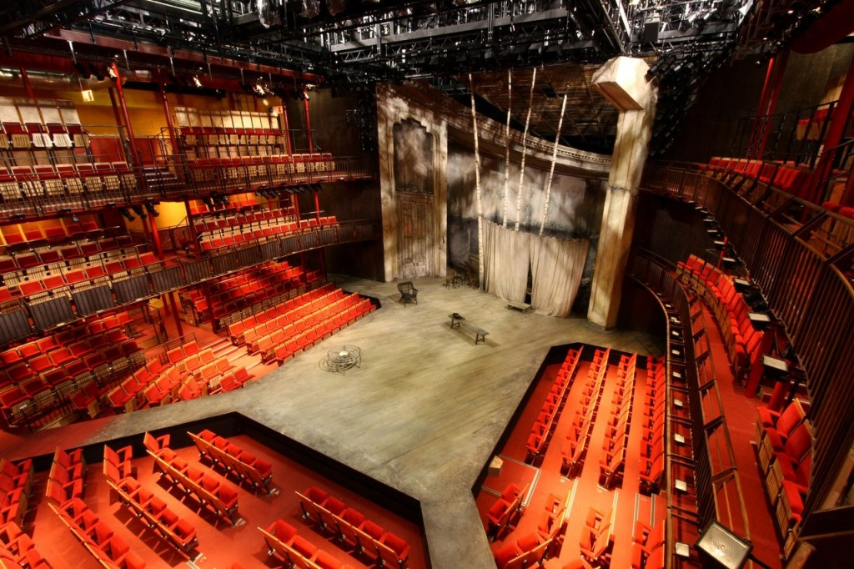
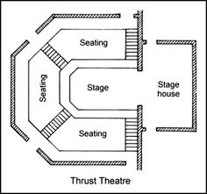
Creating the Environment
Thrust Stage allows four entrances for actors like the arena stage

Slide 12
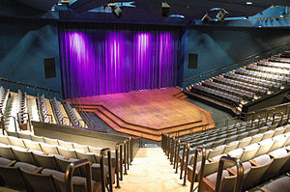
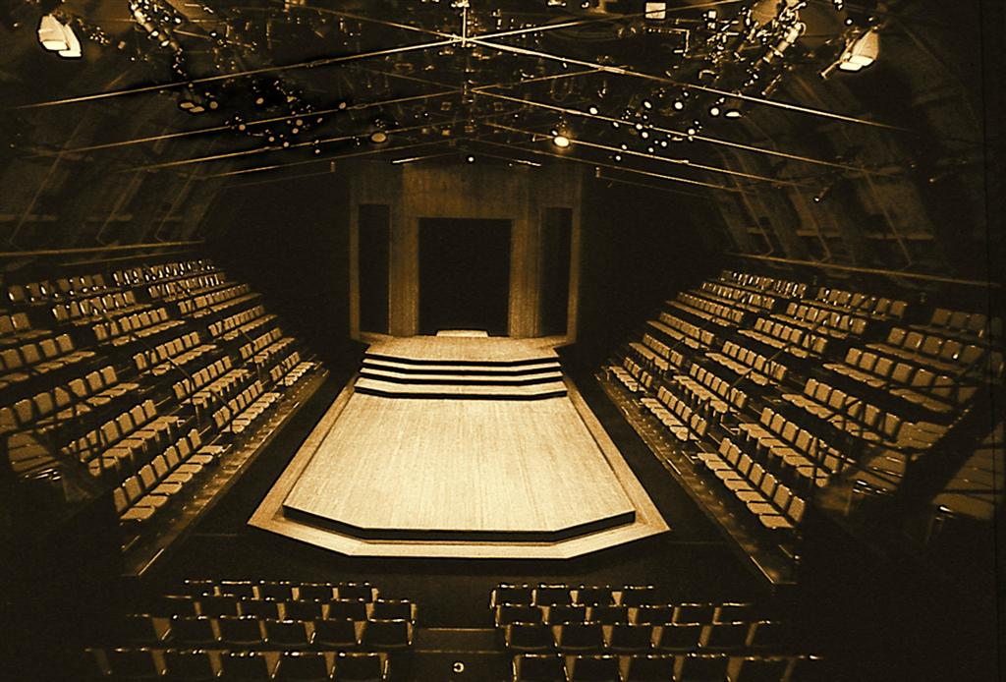
Creating the Environment
Thrust Stage is more versatile
than either
Proscenium or Arena

Slide 13
Creating the Environment
The Black Box Stage
is the most versatile
of all stages

Slide 14
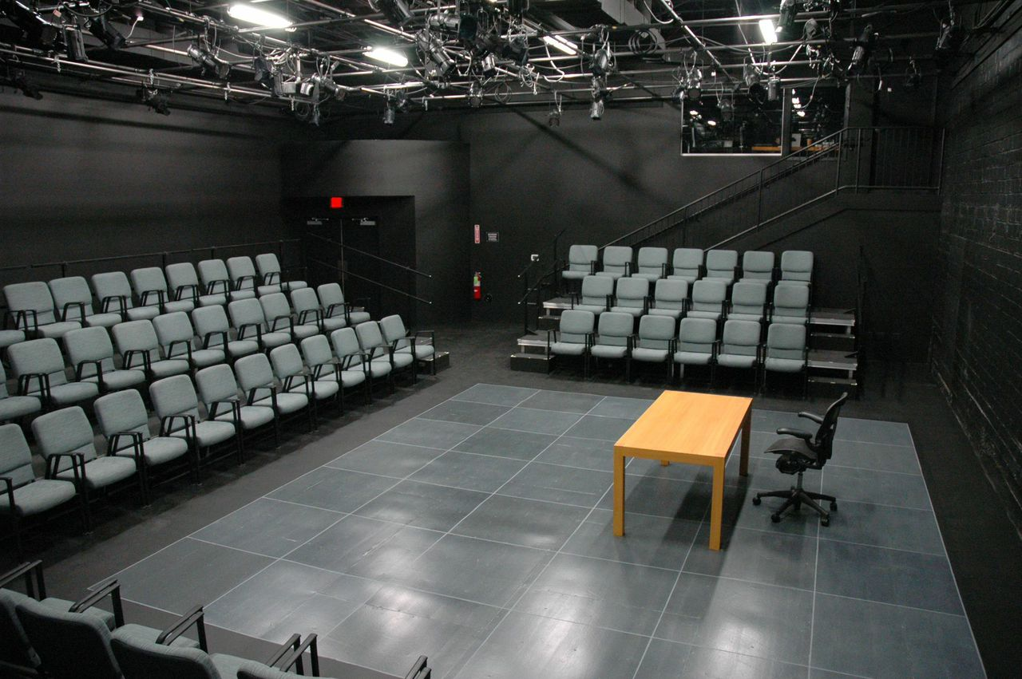
Creating the Environment
The Black Box stage
is adaptable to most
theatrical productions,
except for
large musicals.
It is especially suited to
Experimental theatre.

Slide 15
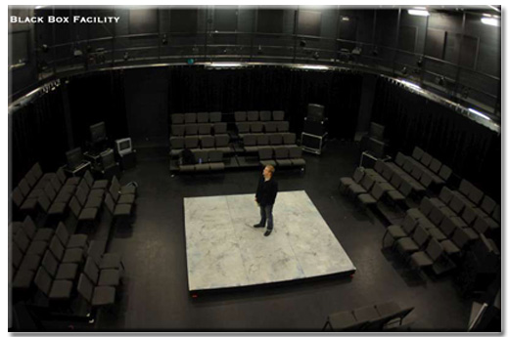
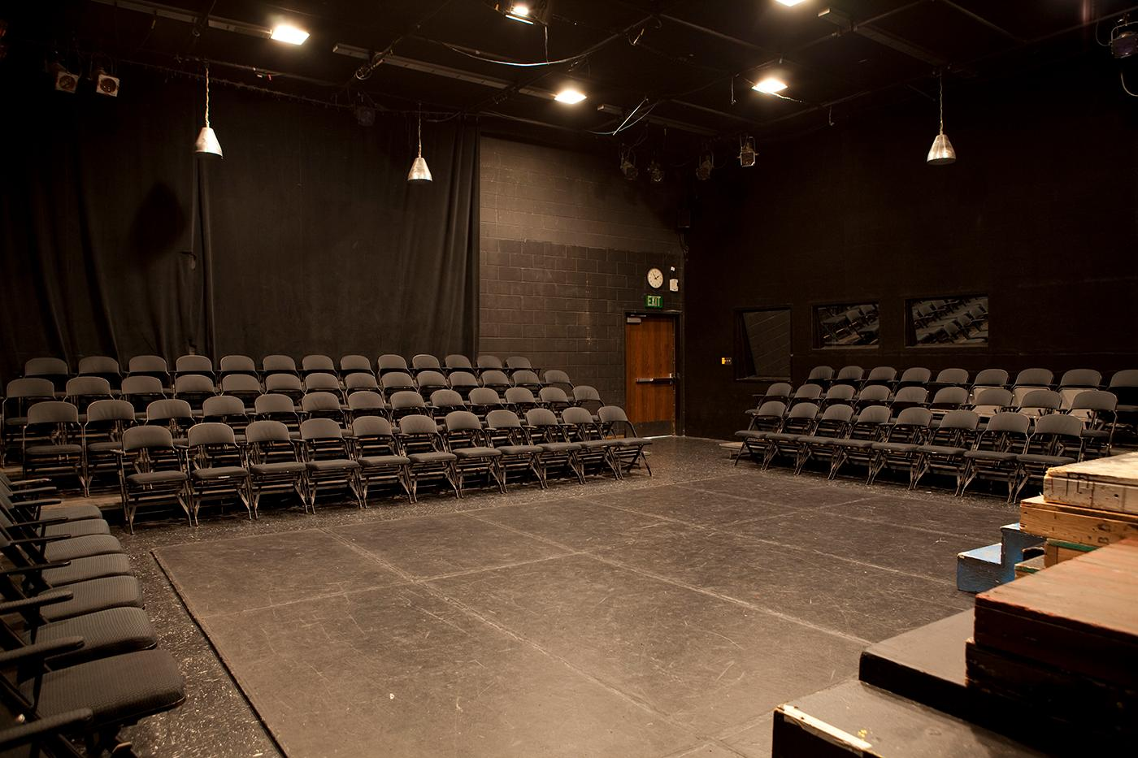
Creating the Environment
The Versatility & Economics of the Black Box
Arena
Thrust
Proscenium

Slide 16
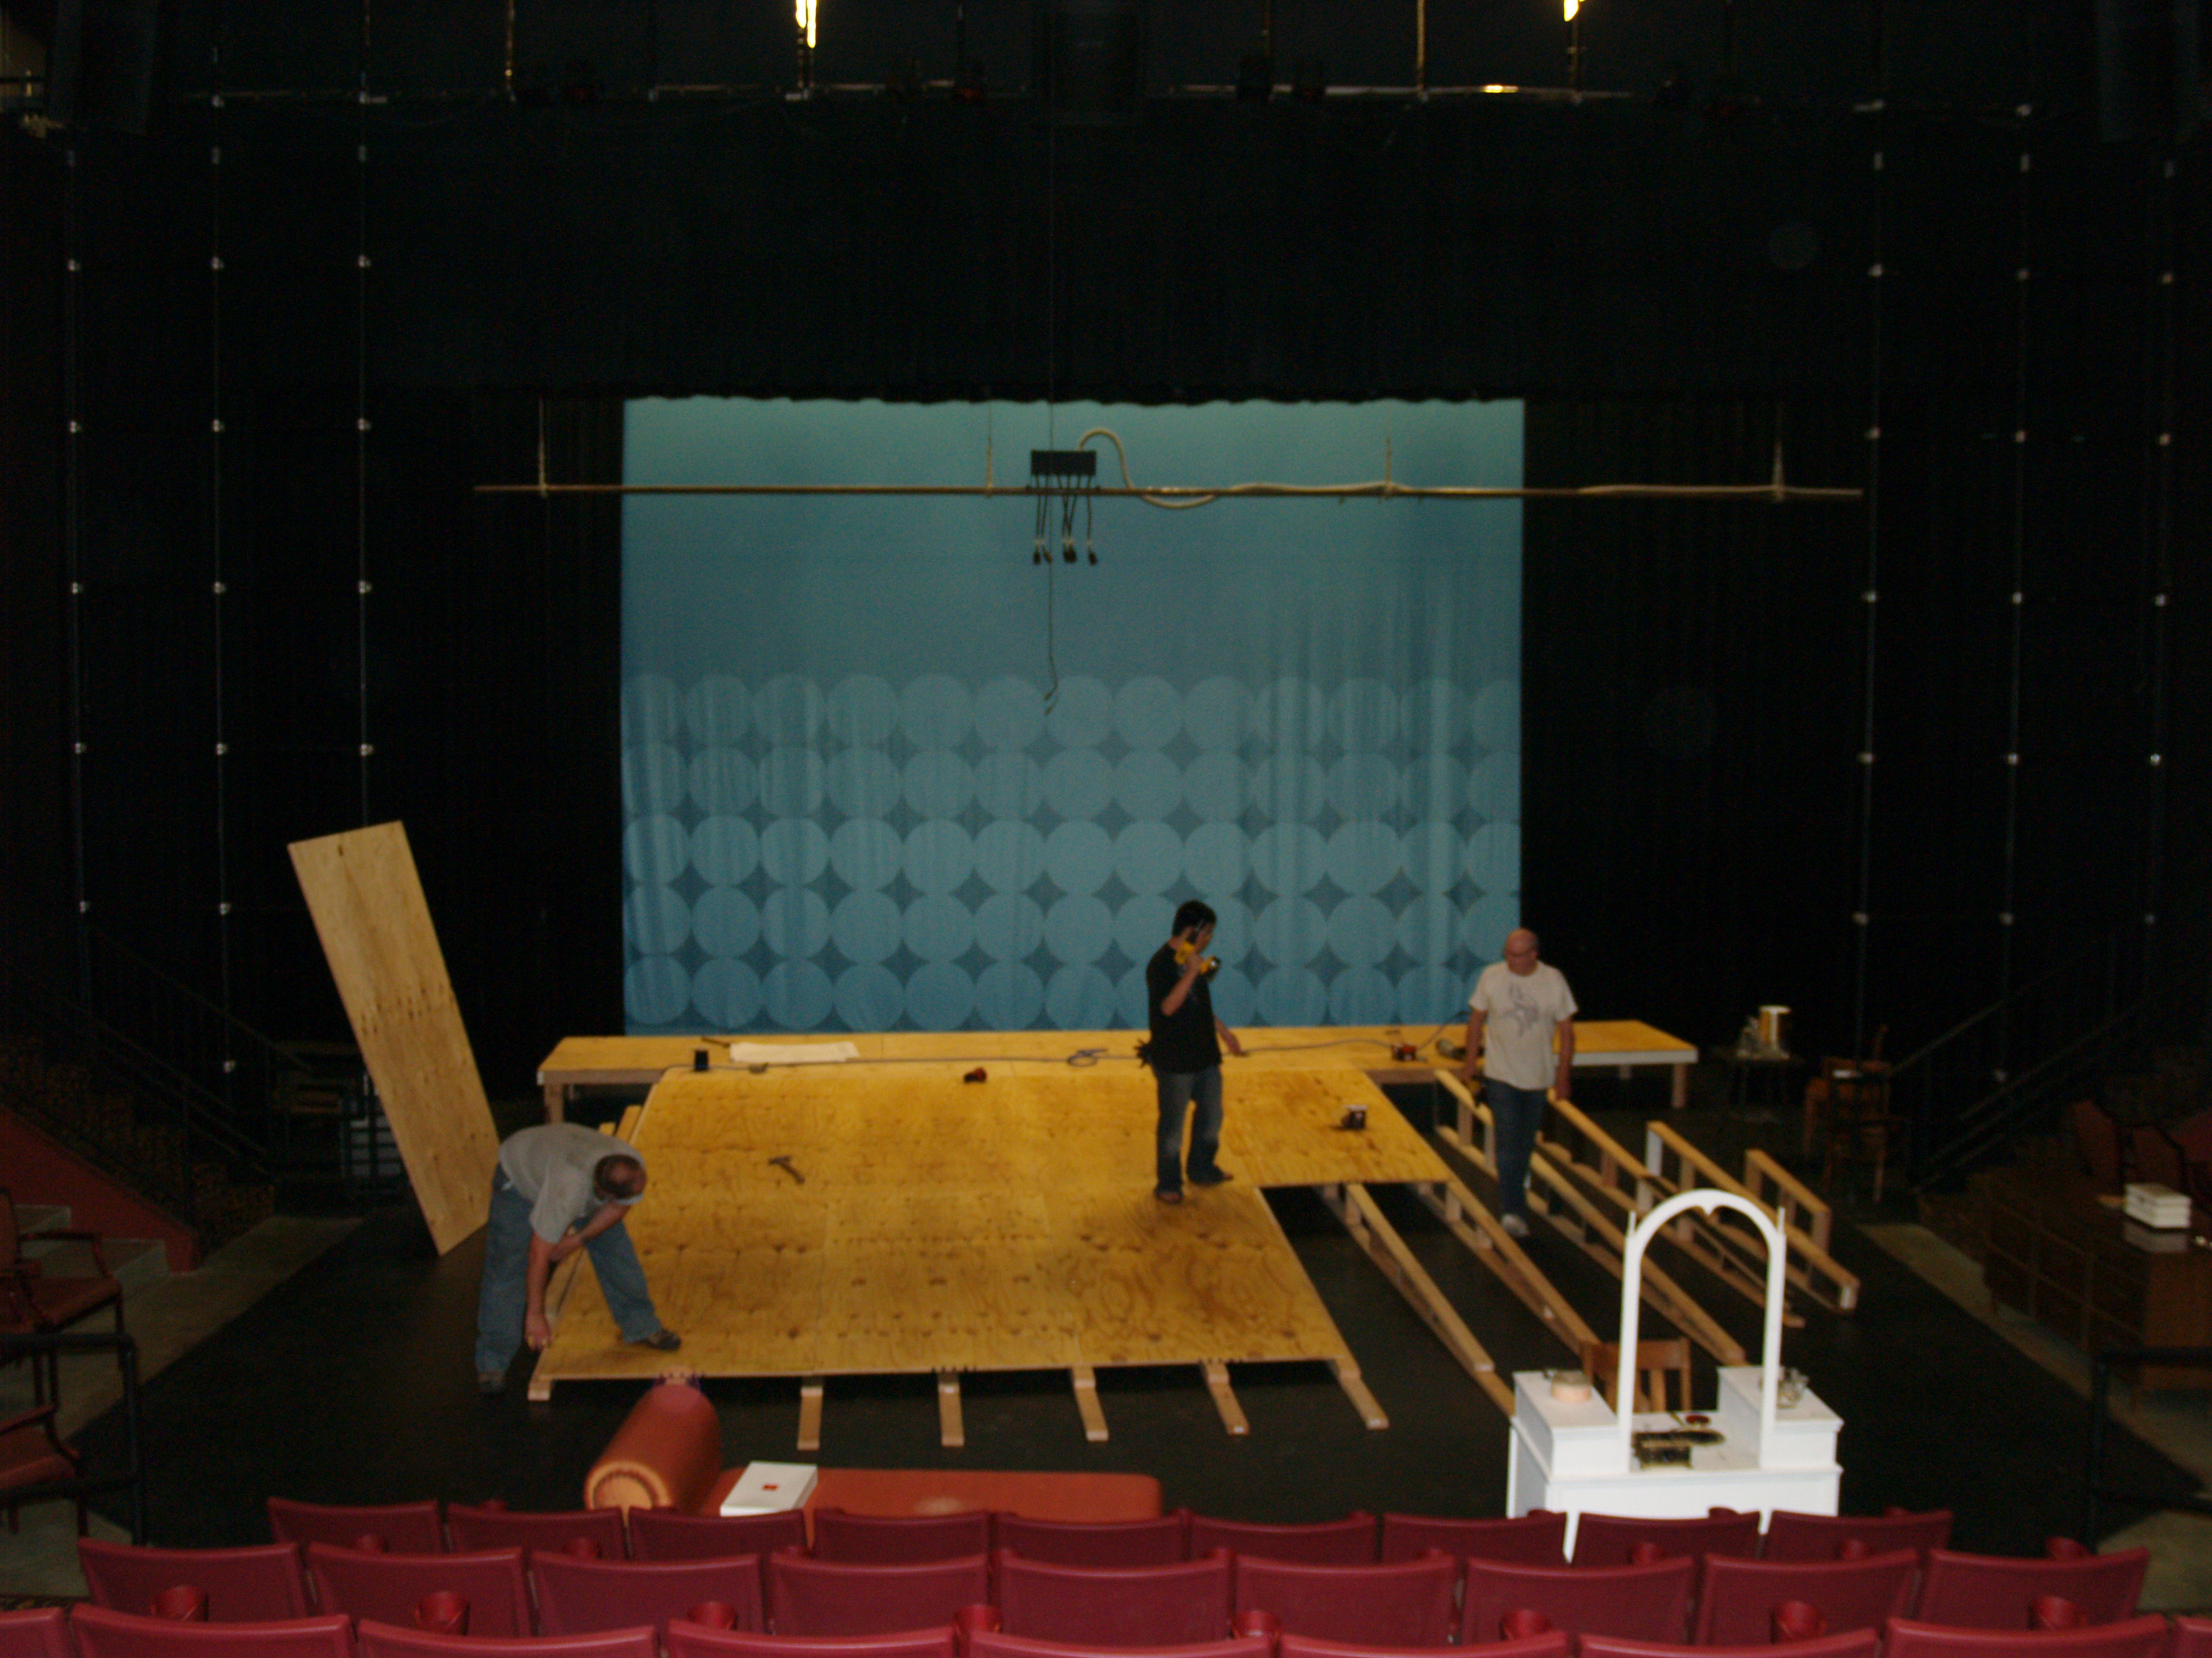
Creating the Environment

Slide 17
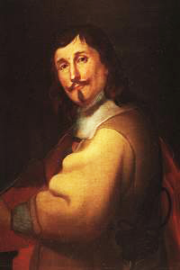
Creating the Environment
Giacomo Torelli (1608-1678)
An Italian stage designer,
engineer & architect.
Noted for creating machinery for
spectacular scene changes &
special effects.
He invented the revolving stage &
the chariot-and-pole system for changing scenery.

Slide 18
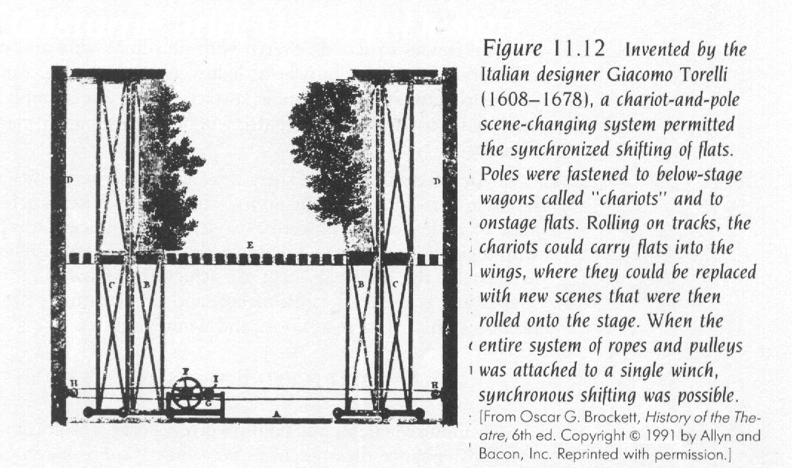
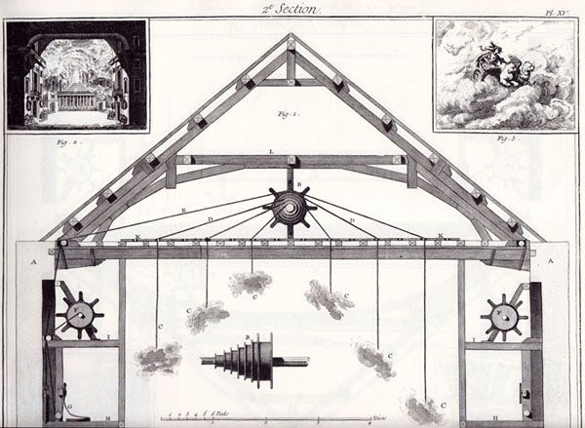
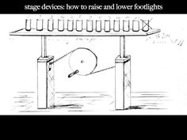
Creating the Environment

Slide 19
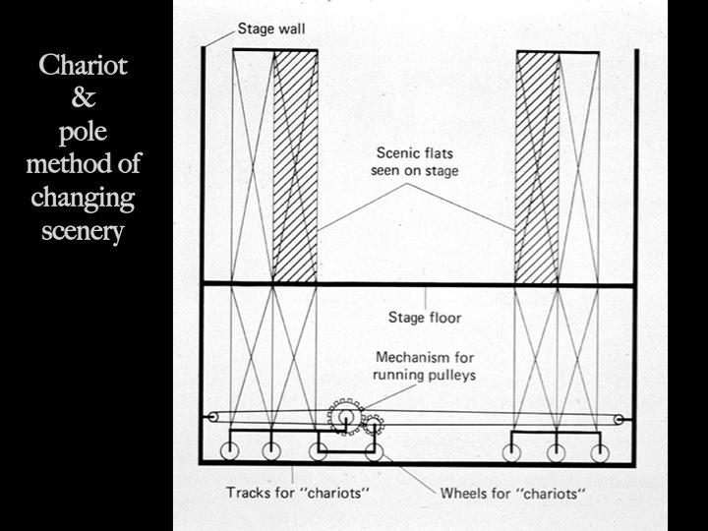
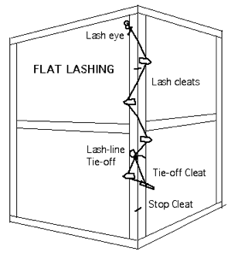
Creating the Environment

Slide 20
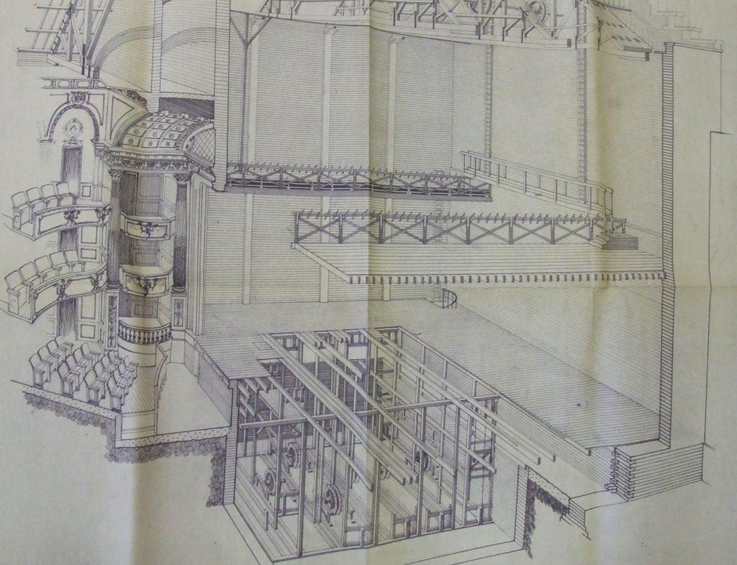
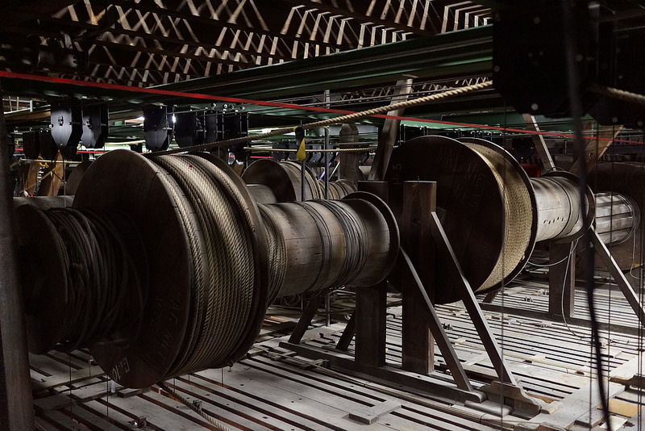
Creating the Environment

Slide 21
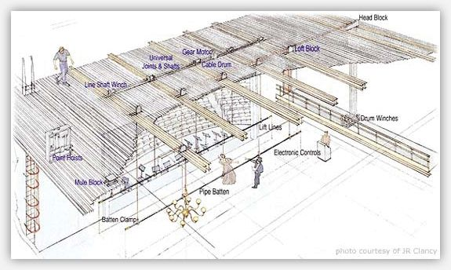
Creating the Environment

Slide 22
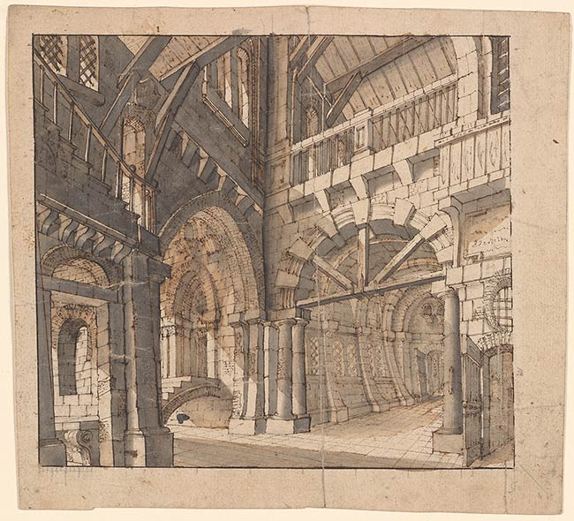
Creating the Environment

Slide 23
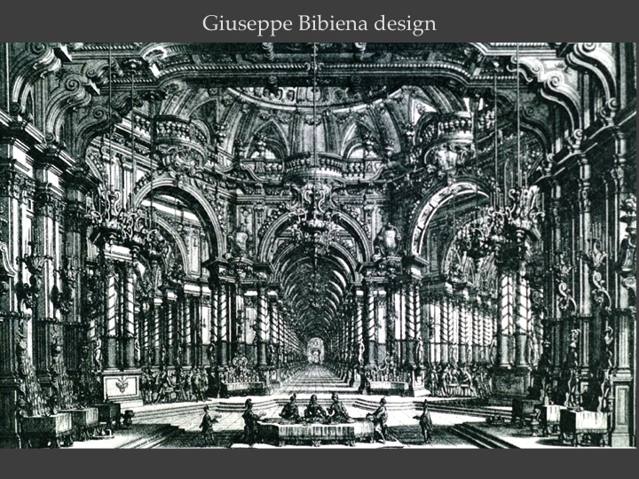
Creating the Environment
The Bibiena family designed large backdrops
in perspective
to give depth to the scenery

Slide 24
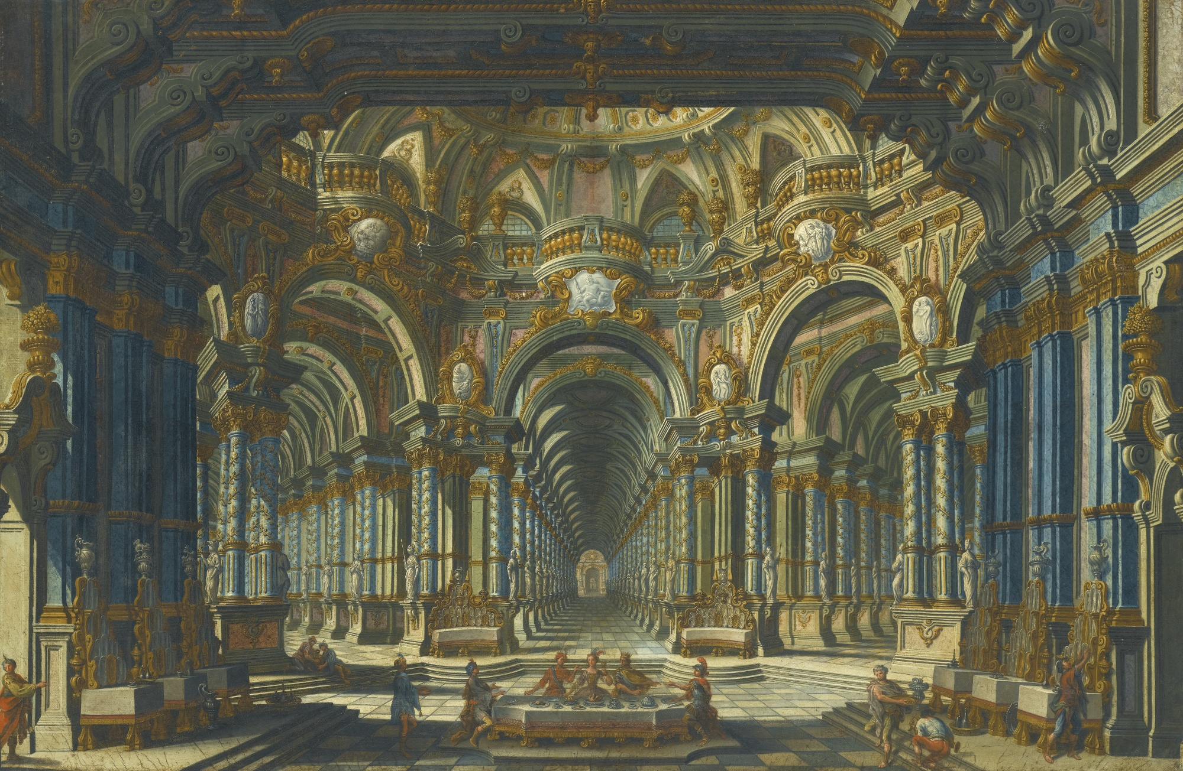
Creating the Environment
This allowed for
Intricate designs that gave a more realistic feel to the background for the actors and audience to imagine

Slide 25
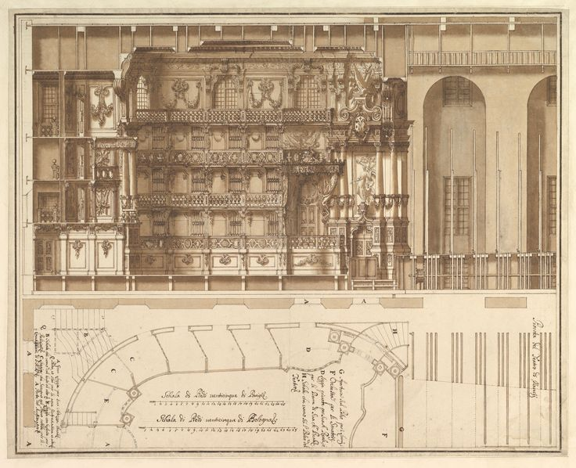
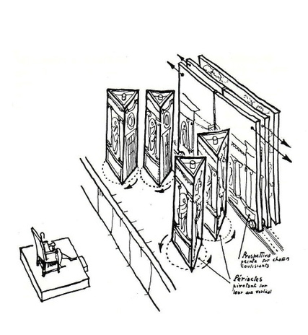
Creating the Environment
Sliding Straight Flats
Pivoting Triangle Flats

Slide 26
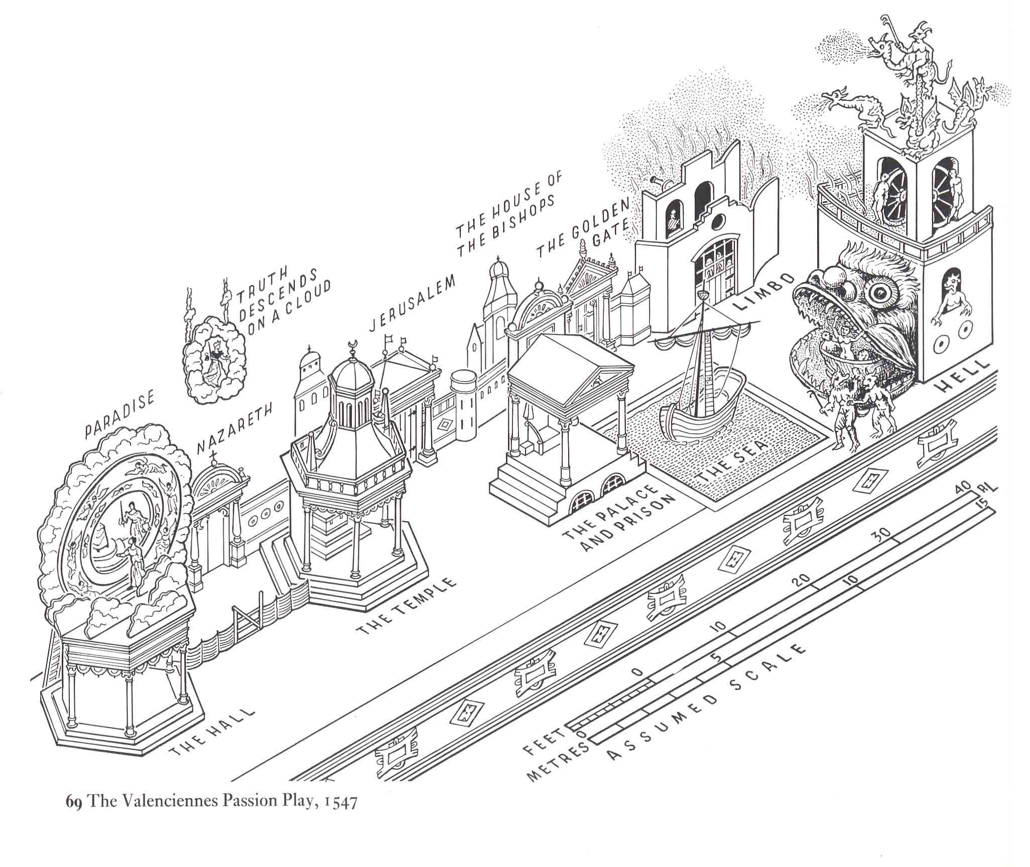
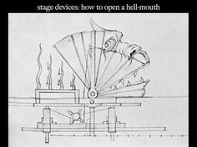
Creating the Environment
Medieval Theatre and Passion Plays

Slide 27
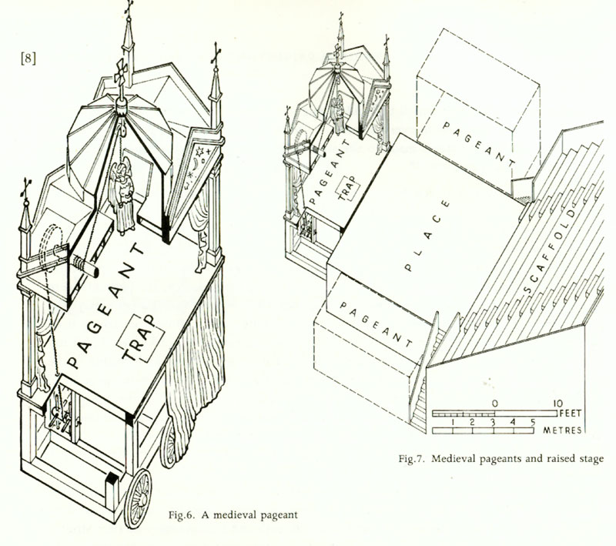
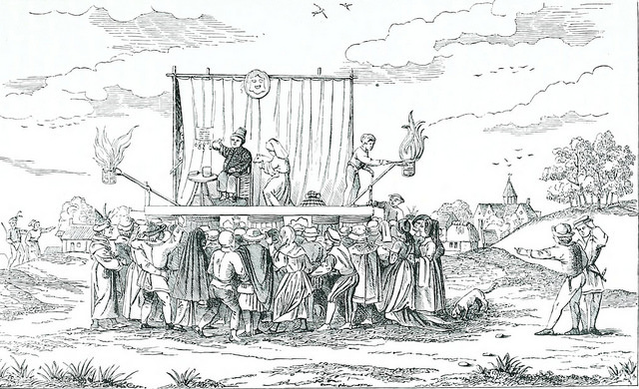
Creating the Environment
The Elevated or
Platform Stage
Provided space for
Trap Doors

Slide 28
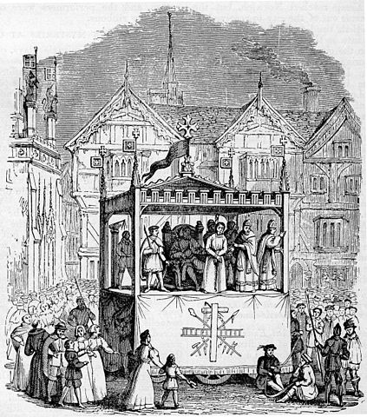
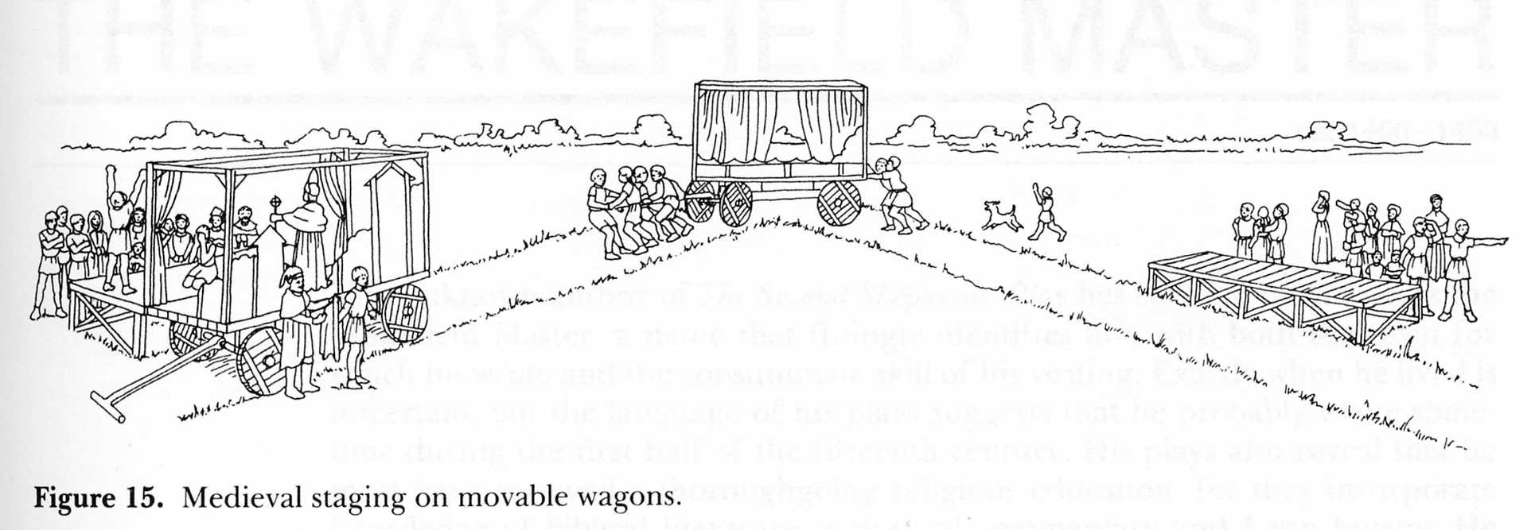
Creating the Environment
From the
Elevated or Platform Stage
to
The Wagon Stage

Slide 29
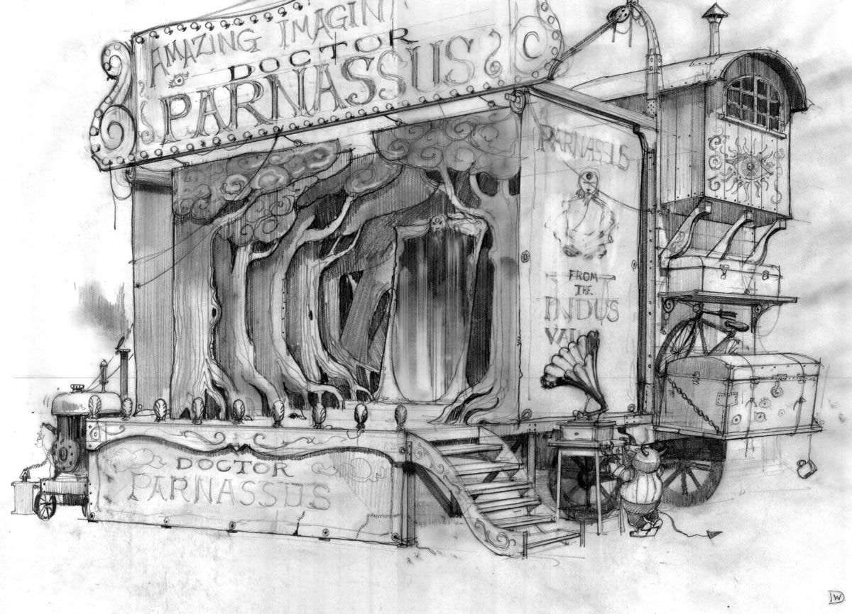
Creating the Environment
This tradition carried on for many years and across continents

Slide 30
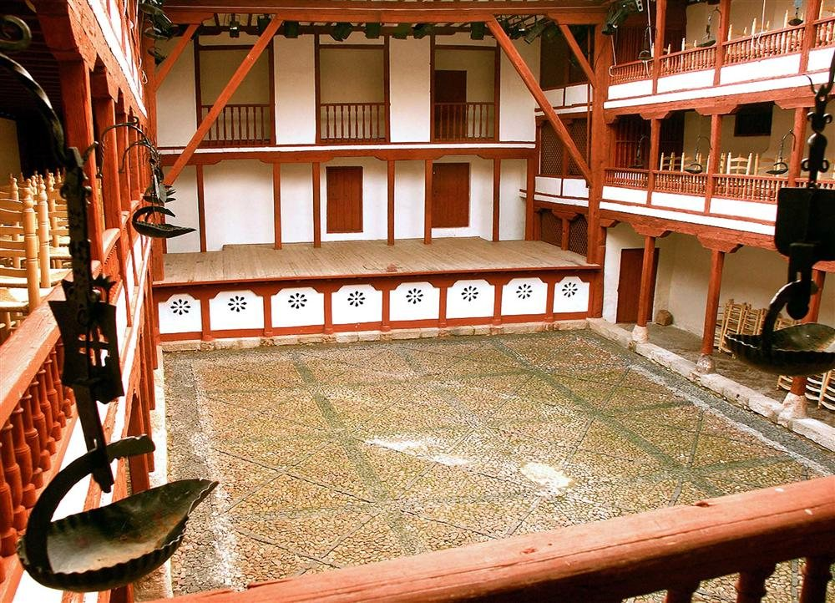
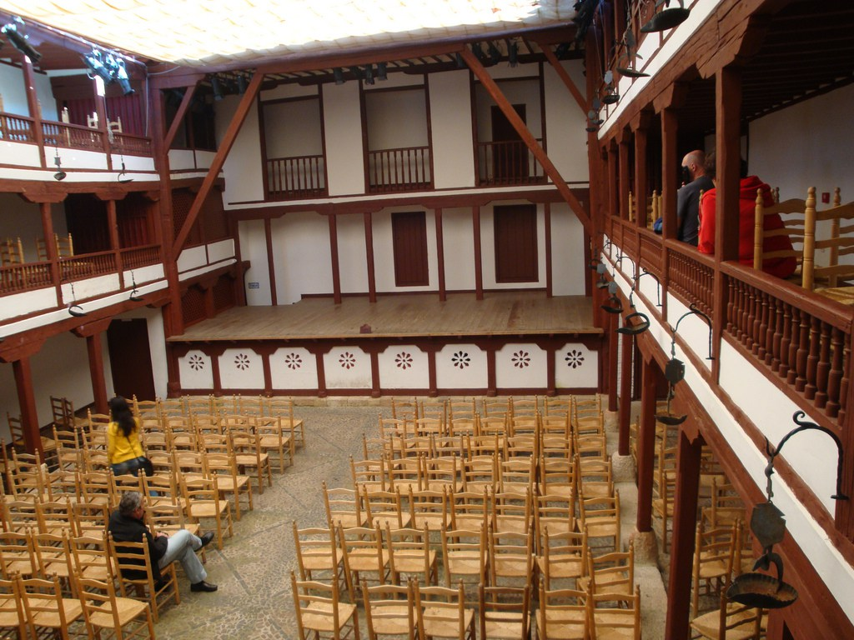
Creating the Environment
The Corral Stage
was prominent
during the
Spanish Golden Age usually located
in the courtyard
of a series of
adjoining buildings

Slide 31
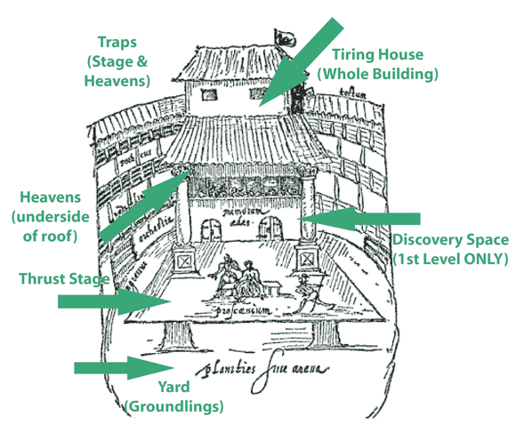
Creating the Environment

Slide 32
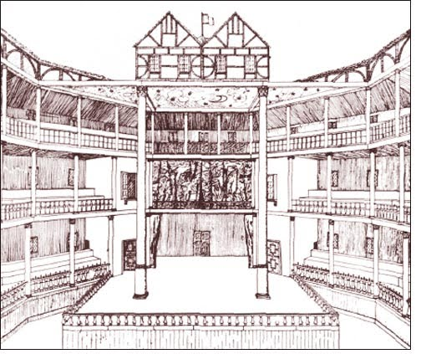
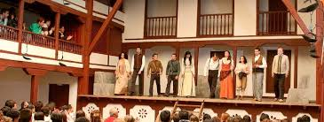
Creating the Environment
Spanish Corral Theatre
Elizabethan Theatre

Slide 33
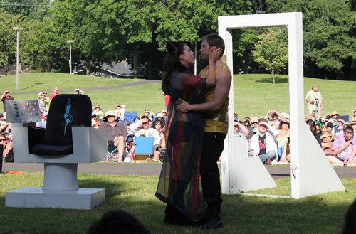
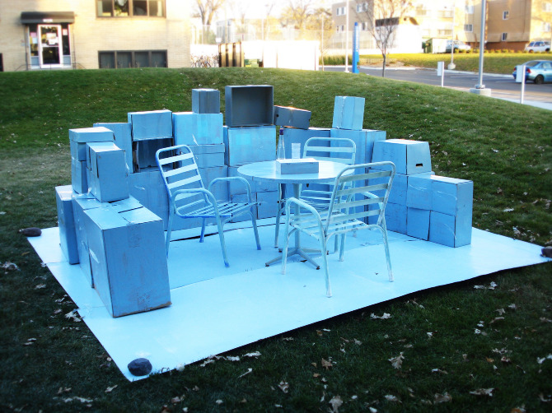
Creating the Environment
Created Space
Found Space

Slide 34
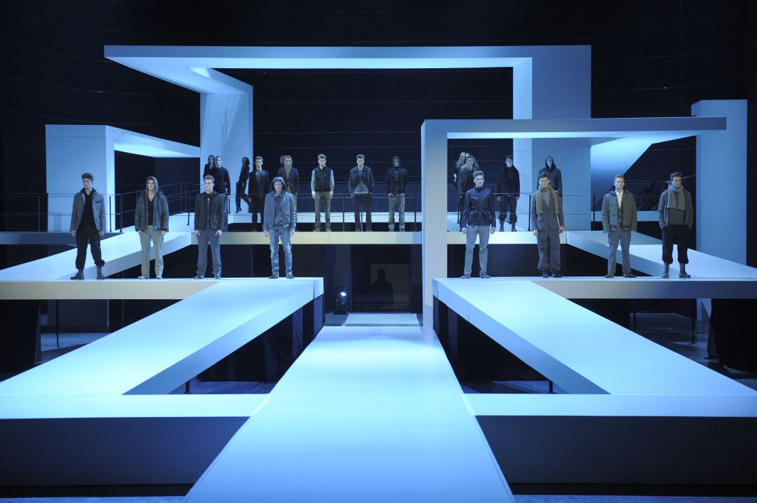
Creating the Environment
Experimental Theatre
Found Space
Created Space
Notes:
Non-theatre buildings
Adapted spaces
Street theatre
Multifocus environments

