Slide 1
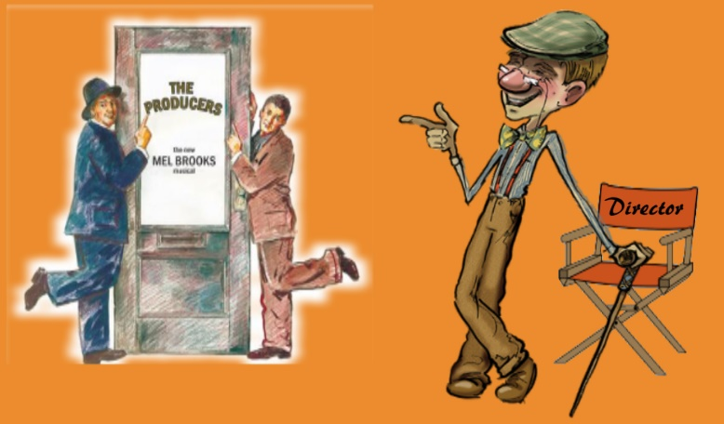
The Director and the Producer
Chapter 5

Slide 2
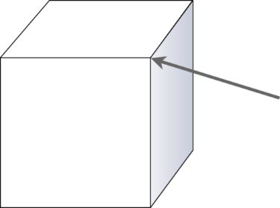
The Director
The Director is the eye of the audience.
The Director shapes a production for an audience.

Slide 3
The Traditional Director
Three Approaches to Directing:
Traditional – The text-based method
Auteur – Author Directors who put their own message into the script
Postmodern – Began in late 19th century with directing that broke long held taboos (avant-garde, experimental & others)
“The Director and the Script”

Slide 4
The Script is the basis for the production
and message to the audience.
Choosing a script
Spine of a script
Style of the production
The “Directorial Concept”
The Director and the Dramaturg

Slide 5
The Director Task #1
What is the Spine?
The Spine of a play is the main action determined by the goal or primary objective of the characters in the play, collectively and individually.
The Spine is also known as the through-line or center point of the play action.

Slide 6
The Spine of the Play
Defining the spine of a play for a director provides him/her the identity of
the nerve center of the play.
“Antigone” – which angle should a director choose
Heroism and bravery of Antigone
The dilemma of a leader
A woman’s plight in life during the time period
What to emphasize?
Notes:
What could be the spine of the play for “A Midsummer Night’s Dream”?

Slide 7
The Director The Style of the Production Task #2
The Director chooses the way in which a play is presented.
Realism
Naturalism-Attempts to put on stage exact copies of everyday life; sometimes also called “slice of life”
Heightened Realism-Also called “selective realism” where actors perform with suggestions of furniture or skeletal scenery while acting as if in real life
Notes:
Naturalism – real furniture and etc. “Fences” or “A Streetcar Named Desire”
Heightened Realism – suggestions of furniture but actors performing like real life… “War Horse”

Slide 8
The Director The Style of the Production Task #2
The Director chooses the way in which a play is presented.
Nonrealism
Allegory-The symbolic representation of abstract themes through characters, action and other concrete elements of a play
Expressionism-The attempt in drama to depict the subjective state of a character or group of characters through quiet nonrealistic techniques as distortion, striking images, and poetic language
Notes:
Allegory – Example are Morality Plays in Medieval times in which characters personify ideas in order to teach. ”Everyman”, the medieval play, has characters named “Good Deeds”, “Fellowship”, and “Worldly Goods”. Also the play, “The Crucible” by Arthur Miller written during the 1950’s, is a play that depicts the “witch hunt” of American citizens as communists and uses the Salem “witch hunts” to make a point.
Expressionism – It gives an outward expression to inner feelings. In the play “The Adding Machine”, the main character named “Mr. Zero, is fired from a job and his feelings are conveyed through the room feeling like it is turning around on him and sirens are contorting his sense of stability.

Slide 9
The Director The Style of the Production Task #2
The Director chooses the way in which a play is presented.
Style in a play can be depicted in several ways:
The look of the scenery and lights
The way performers speak
The costumes and props
The rhythm and pace of the play

Slide 10
The Director The Style of the Production Task #2
The Director chooses the way in which a play is presented.
2 Essential elements of using style to a traditional director:
The style should be appropriate to the play, honoring the playwright’s intent
The style should be consistent throughout every aspect of the production

Slide 11
The Directorial Concept
Concept and Period
The Director can choose to change the period of the play if it stays true to the essence of the play.
Concept and Central Image
The Director can choose to use a central controlling image or metaphor to convey the essence of the play that is in line with the intent of the playwright.
Notes:
Shakespearian and Greek plays are often changed into different time periods to reflect the director’s concept of the play to his/her audience. (Recent Julius Ceasar play in New York depicted it in present day.)
Shakespeare’s Hamlet where the main character feels trapped in a web of his own creation could be imagery shown as the scenery and lights giving off a feeling of Hamlet inside a spider web. Also, I did A Streetcar Named Desire where
the two main characters from different backgrounds and using their own imaginations of life and the world were depicted in two types of scenery clashing to bring out the imagery even more.

Slide 12
The Directorial Concept
Concept and Purpose
The best concept of a play is one that remains true to the spirit and meaning of the script.
Gimmickry in a play takes away from its purpose and meaning.

Slide 13
The Director and the Dramaturg
Dramaturg Duties are invaluable to Directors
Discover promising new plays
Helping playwrights develop their scripts
Identify plays from the past that should be brought to life
Prepare material for teachers and their students
Writes articles about the play and performances
Marketing the play performance

Slide 14
The Auteur Director
Three Approaches to Directing:
Traditional – The text-based method
Auteur – Author Directors who put their own message into the script
Postmodern – Began in late 19th century with directing that broke long held taboos (avant-garde, experimental & others)
“Author Directors”

Slide 15
The Director authors his/her own script to the production of the play.
Generally the script is non-existent
The director stages the actors and moves them to act and to create a script based on the director’s point of view (usually avant-garde).
Vsevolod Meyerhold (1874-1940) developed a kind of theatre in which he controlled all the elements (including using a script to springboard into a new creation of his own script).
Notes:
He used actors in many different ways such as circus acrobat performers and robots.

Slide 16
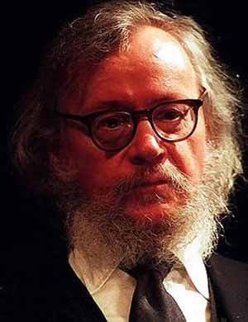
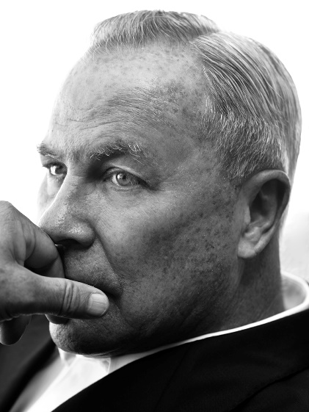
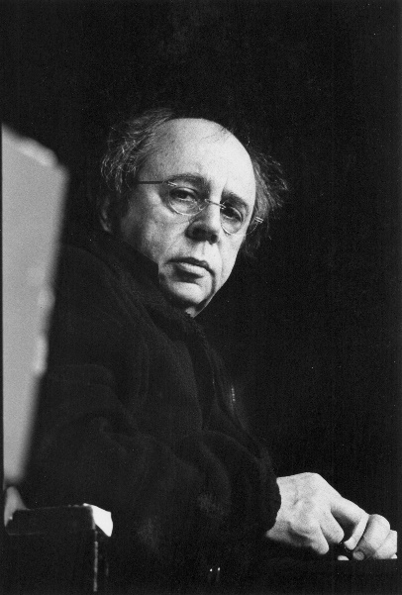
The Director Auteur “Author”
Following Meyerhold’s footsteps
were other avant-garde auteur directors
Jerzy Grotowski
Richard Foreman
Robert Wilson

Slide 17
The Postmodern Director
Three Approaches to Directing:
Traditional – The text-based method
Auteur – Author Directors who put their own message into the script
Postmodern – Began in late 19th century with directing that broke long held taboos (avant-garde, experimental & others)
“The Taboo/Experimental Director”

Slide 18
The Postmodern Directors’ subject matter included explicit sexual content, social diseases, the subjugation of women, and the hypocrisy of some religious figures.
Deconstruction of scripts where text could be altered, deleted, re-arranged or taken out of context
Abandonment of narrative or linear structure of the play
Unfamiliar, cross-gender, multicultural casting
Notes:
Replaced traditional structure of a play with the use of segments, tableaux and other non-sequential structures of a play.
King Lear played by a female on a ranch leaving fortune to the “good ole boys”.

Slide 19
The Director and the Production The Physical Production
The Director must work with the designers of the play.
The Director confers with the costume, scene, lighting and sound designers to give visual shape and substance to the director’s concept.

Slide 20
The Director’s work with the Performers
The Director casts the play.
The Director supervises all rehearsals.
The Director blocks the actors.
Blocking: Pattern and arrangement of performers’ movements onstage with respect to each other and to the stage space set by the director.

Slide 21
The Director’s work with the Performers
Casting
Casting is fitting performers into the roles of the play.
Typecasting-the performer closely resembles the characteristics of the role of the character in the play
Casting against type-used for comic or satiric purposes
Audition for a play-actors try-out for a role in the play
Historically, acting companies or guilds were formed which
avoided the need to have actors audition for a role in the play
as is regularly practiced today, except for some famous “stars”

Slide 22
The Director’s work with the Performers
Rehearsals
“Practice makes perfect”
The Director guides, shapes and supervises the practice and movement and rhythm of the performers and scenery. He/she motivates and molds the actors into who he/she believes the characters should be. The director envisions and blocks the action of the characters based on his/her interpretation of how the characters relate to each other and to the theatre space. He/she moves the actors to work as an ensemble.

Slide 23
The Director’s work with the Performers
Rehearsals
Generally, rehearsals begin with the director, actors; and sometimes designers (if a musical, the composer or conductor) sitting around each other. The actors read their parts in character to get a flavor of the play.
The director explains his/her point of view of the play and characters. He/she conveys his/her concept and spine of both the play and some major characters.
The script is broken down into segments or scenes and the director instructs the actors and crew on the rehearsal schedule (what will be practiced or needed when)
The director will set the time of when the actors will be “off book”
and can no longer call for a “line”.

Slide 24
The Director’s work with the Performers
The Director as the Audience’s Eye
The Director stands in for the audience before the play is publically performed.
Placing “characters” in certain physical relationship to each other and inside the theatre space can form a “picture” for the audience to use to relate to the play.
The “movie” director has even more control over what the audience sees.
Notes:
Sometimes an actor doesn’t realize that the audience cannot see important movements or facial expressions performed by the actor. This where the director helps the actor understand what the audience sees and hears from their point of view.

Slide 25
The Director’s work with the Performers
Movement, Pace and Rhythm
The Director gives shape and structure to a play through
Space
Time (movement, pace and rhythm)
Pick up the cues
Movement and rhythm of actors on stage
(Does it fit the mood of the play and does it keep the audience interested)

Slide 26
The Director’s work with the Performers
Technical Rehearsal
The performers are onstage in their costumes with the scenery, lighting, sound and sound effects.
The tech crew spots the cues for their technical performance and rehearses scene changes, costume and makeup changes/adjustments, props placement/movement and etc.
Complete “run-throughs” are rehearsed and adjusted.

Slide 27
The Director’s work with the Performers
Dress Rehearsal
The dress rehearsal is the first full performances before performances for the public.
It is designed to pretend there is an audience watching, therefore there are no stops or “fixes” during the performances.
It’s time to find out what works and doesn’t.
“The play must go on” LIVE before an audience no matter what happens, so the actors and crew must rehearse how to adjust “on their feet” when something doesn’t go as expected.

Slide 28
The Director’s work with the Performers
Previews
Previews are tryout performances of a production
before an audience, preceding
the official “opening” performance.
Previews are used to test the performer-audience relationship which is crucial in a theatrical performance of a play.

Slide 29
The Producer or Managing Director
The Producer-
In American usage, the person responsible for the business side of production, including raising the necessary money.
In British usage, a producer for many years was the equivalent of the American director.
The Managing Director-
In non-profit theatre organizations, the individual who controls resources and expenditures.

Slide 30
The Producer or Managing Director
The Commercial Producer
Raise money to finance the production
Secure rights to the script
Deal with the agents for the playwright, director and performers
Hire the director, performers, designers and stage crew
Deal with theatrical unions
Rent theatre space (if needed)
Supervise the box office, auditorium and business office
Supervise the advertising
Oversee the budget and week-to-week financial management of the production

Slide 31
The Producer or Managing Director
Noncommerical Theatres
Adminstrative organization of a non-profit theatre
Board of Directors
Artistic Director
Executive or Managing Director
Responsibilities of a noncommercial managing director
Maintenance of the theatre building
Keeps productions under budget, balancing artistic and financial needs
Responsible for publicity
Maintains box office, programs for productions, secures ushers for “front of the house” and other details

