Slide 1
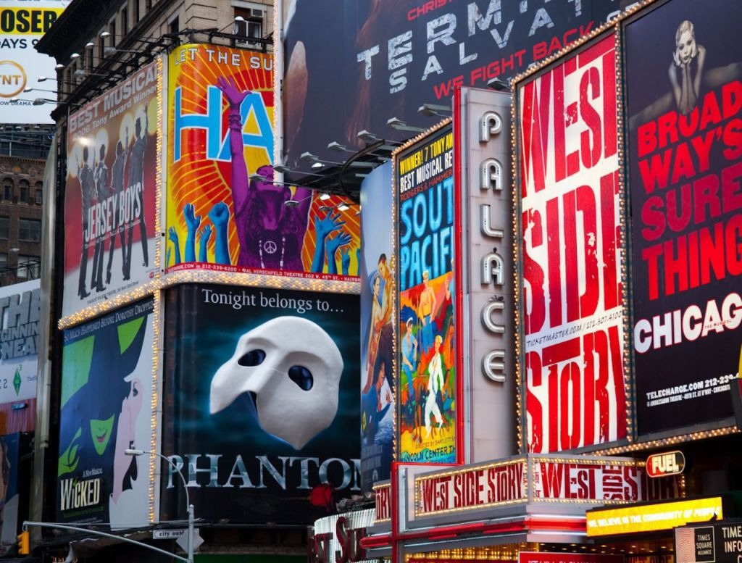
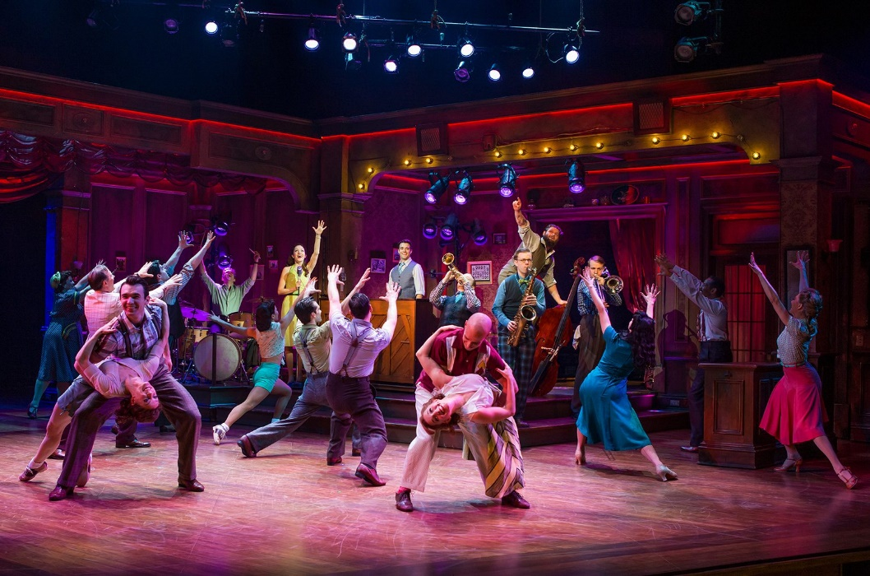
The Theatre today Chapter 12 Musical Theatre
Largely a product of
U.S. American talent and creativity

Slide 2
The appeal of music and dance
Dramatic Productions
Have included music and dance throughout the ages
Drama, music and dance are all three performing arts
Singing and dancing have wide popular appeal
Drama, poetry, song and dance elevate ones emotions

Slide 3
opera a drama set entirely to music
Began in Florence, Italy around 1600
Became widespread throughout Europe and England between 1600-1900

Slide 4
opera terminology developed… Traits of opera
Arias – Strong melodic solos
Recitatives – Transitional sections between arias
Duets, Trios, Quartets and Choruses – groups of singers in harmony
Operatic stories used: Mythology, history, and contemporary fictional and real events
Opera buffa – Comic opera as opposed to serious opera
Famous composers, singers other figures of opera were: Allesandro Scarlatti, Wolfgang Amadeus Mozart, Richard Wagner, Giuseppe Verdi and Giacomo Puccini
Notes:
[res-i-tuh-teev]

Slide 5
Types of musical theatre Terms
Musical Theatre
A type of theatre that integrates songs, spoken dialogue, acting and dance. The story and emotions are underscored and enhanced by the music and dance which are fully integrated into the plot.
Types of Musical Theatre are:
Opera, operetta, musical comedy, musical theatre, and revue

Slide 6
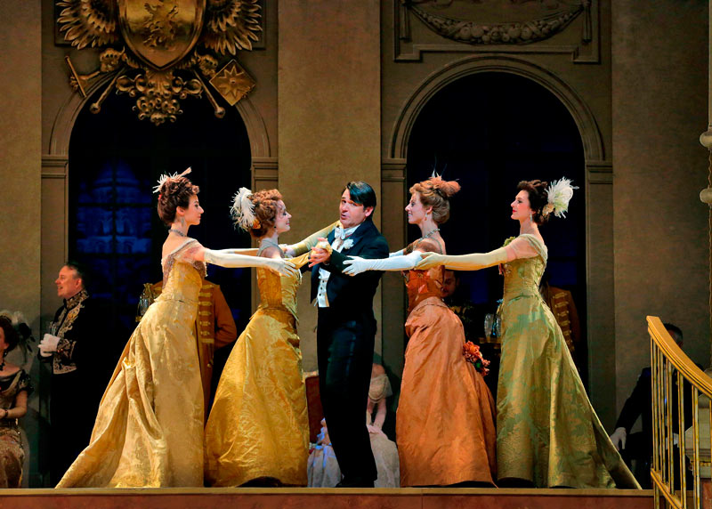
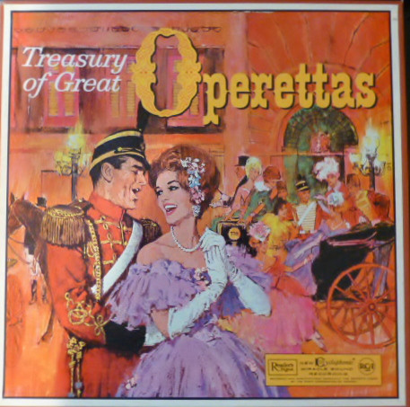
Operettas
Similar to operas but not entirely
set to music. Certain portions are
spoken, as in regular drama.
Generally features a romantic story set in a far off locale with an air of unreality and make-believe away from everyday life.

Slide 7
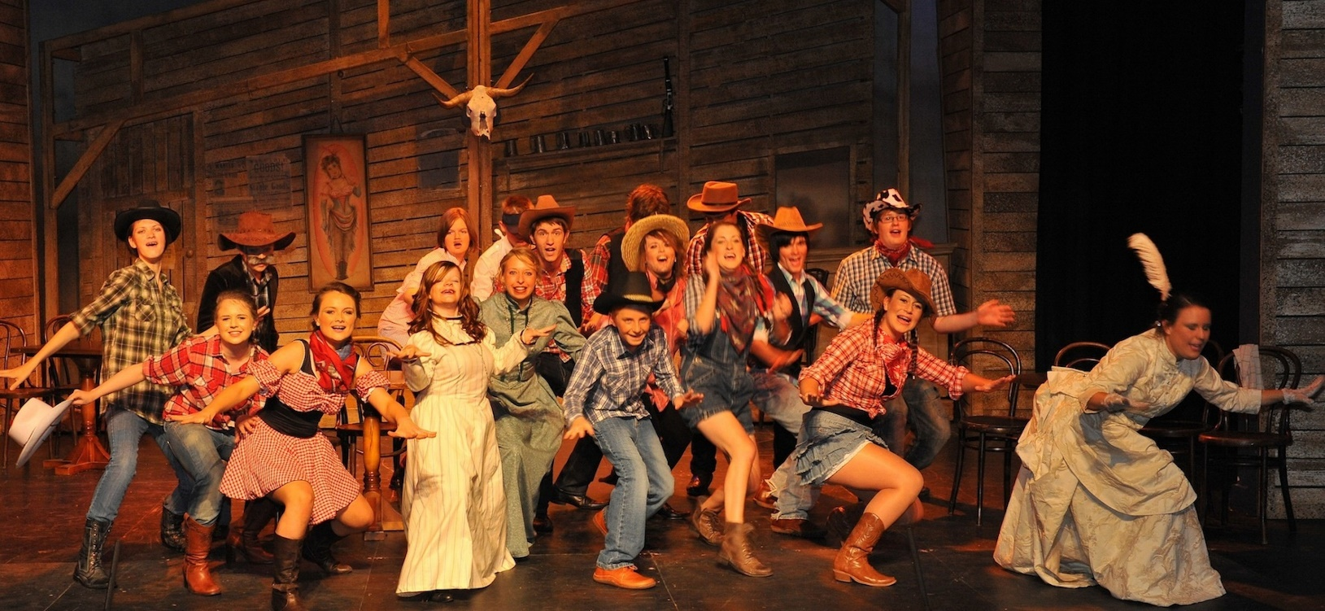
Musical comedy
Emerged in the U.S. in the early 20th century that featured a light, comic story interspersed with popular music. It differed from operetta because it related to contemporary people and events which made it seem closer to real life than the fanciful operetta.

Slide 8
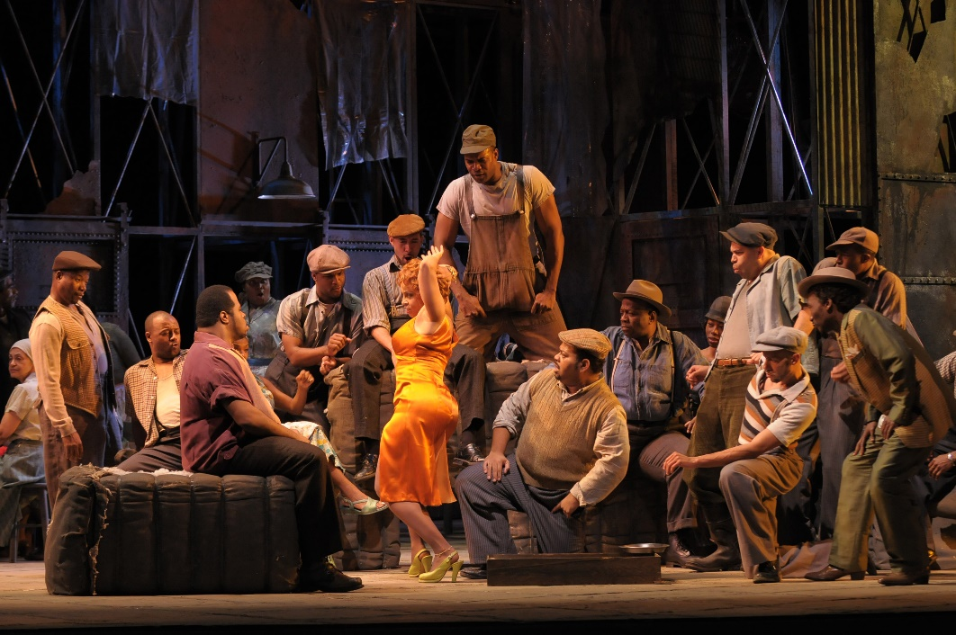
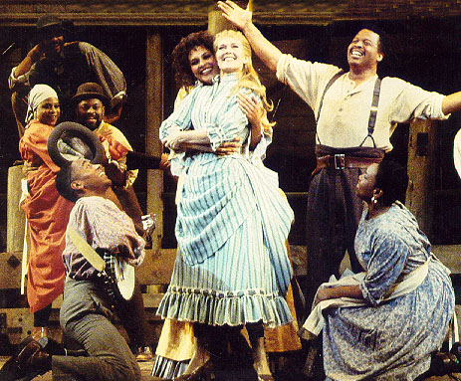
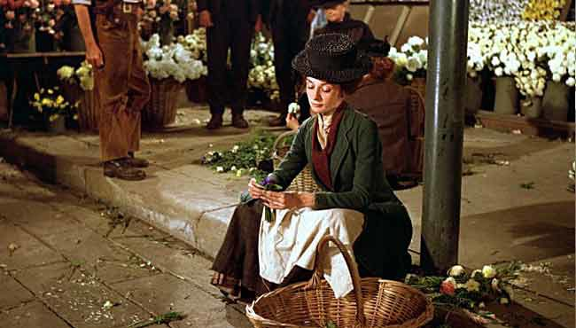
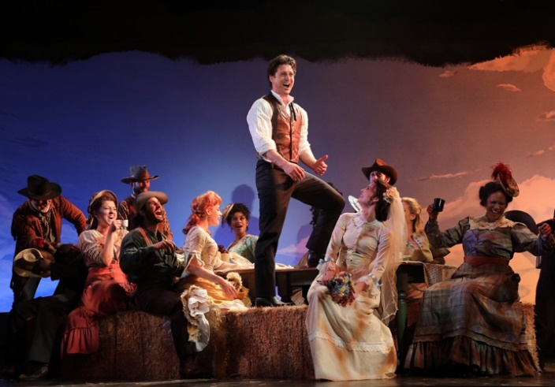
Musical or Musical Theatre
Evolved out of operetta and musical comedy. This combination used the techniques of operettas but were more serious in their storyline. They related more to real life than either of its predecessors.

Slide 9
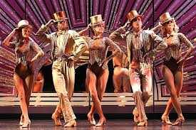
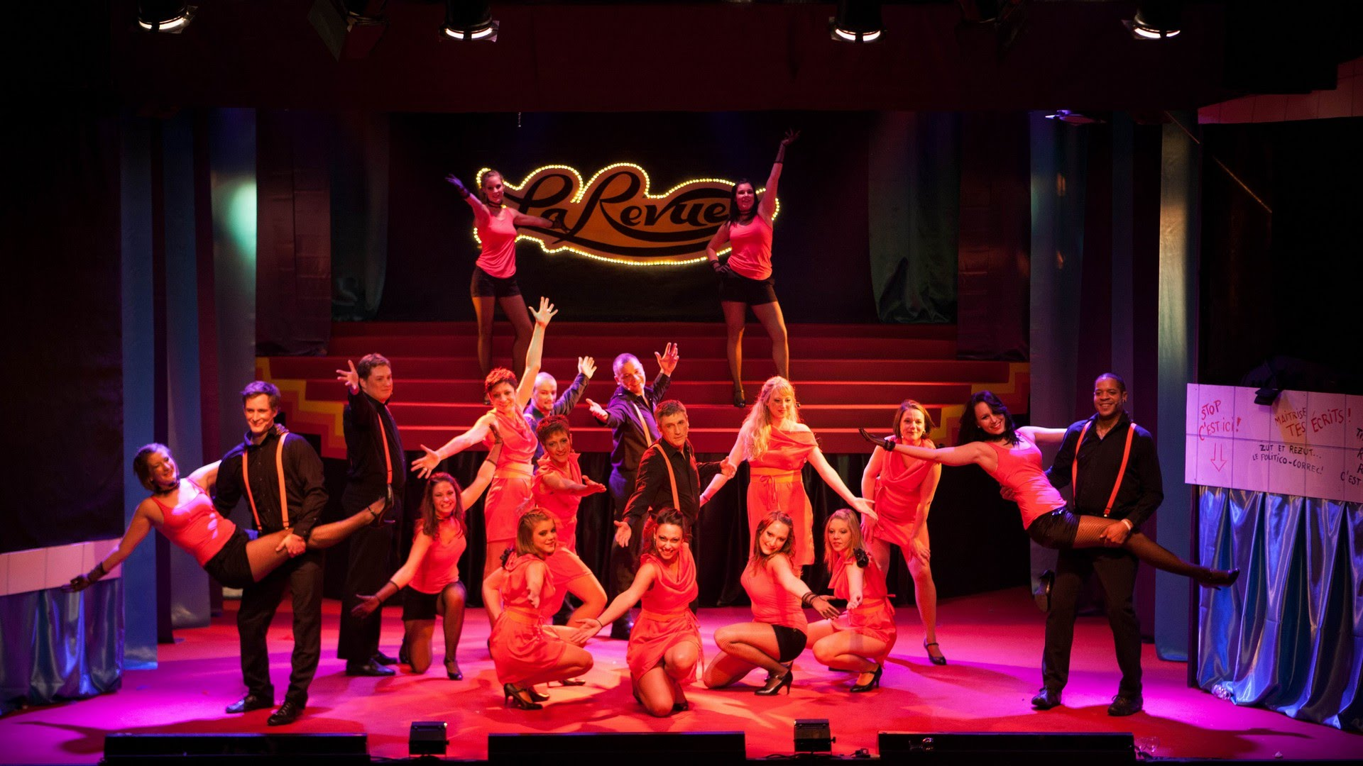
The Revue
A show in which sketches and vignettes alternate with musical numbers. There is no single storyline that carries through from beginning to end (modern day “Saturday Night Live”).
Notes:
Scenes and songs stand alone and may have very little relationship to each other, although they often have a common theme or may be written by the same composer or lyricist.

Slide 10
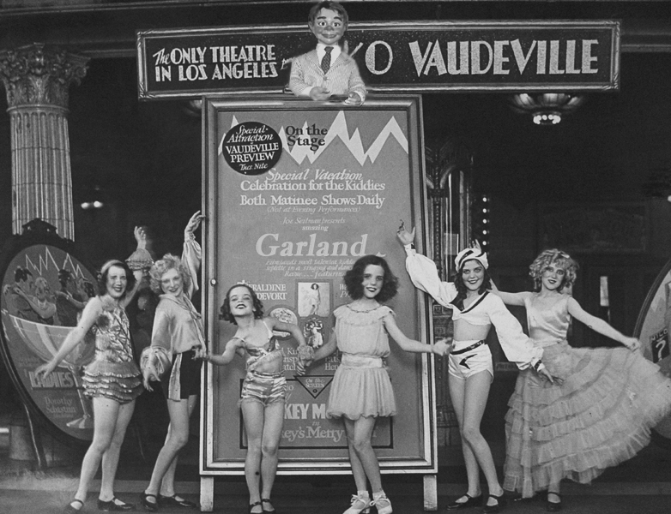
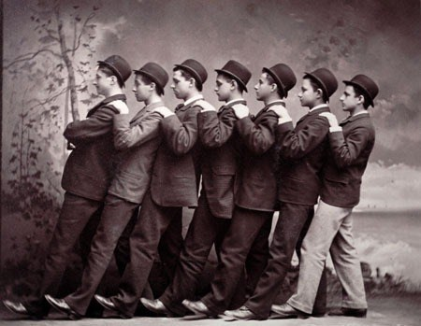
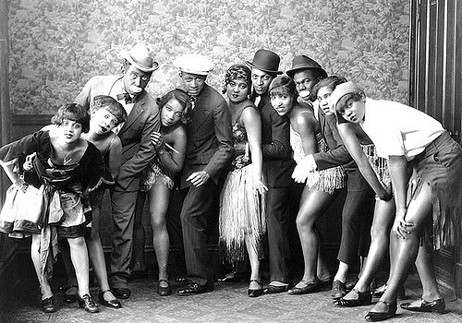
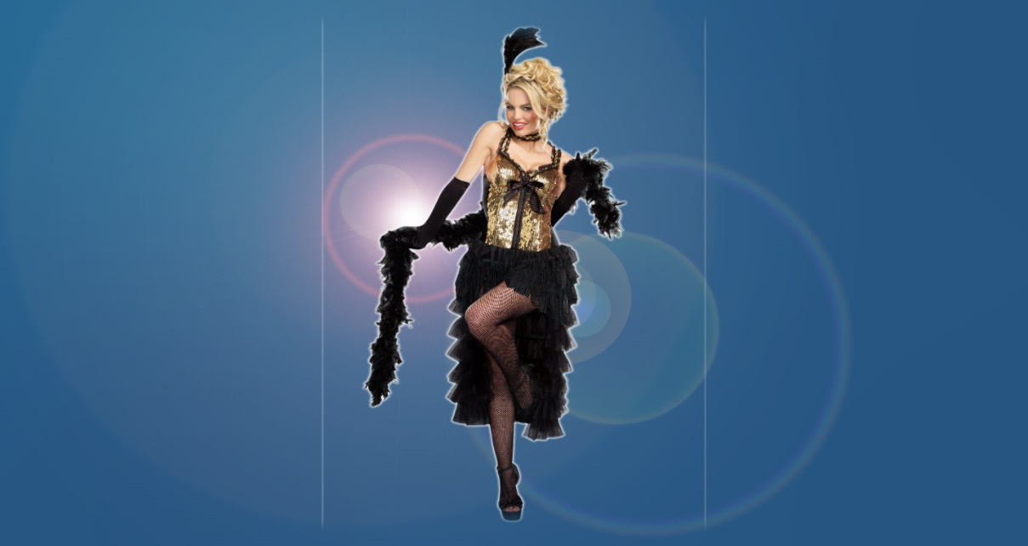
The American musical
Minstrel Show
Vaudeville
Vaudeville
Vaudeville
Antecedents
Vaudeville-A series of variety acts i.e. music, sketches, juggling and animal acts
Burlesque-At first featured dramatic sketches and songs that satirized other theatrical forms; but later became “risqué girlie shows”
Minstrel shows-A variety show that featured white performers wearing blackface makeup
Burlesque
Notes:
Scenes and songs stand alone and may have very little relationship to each other, although they often have a common theme or may be written by the same composer or lyricist.

Slide 11
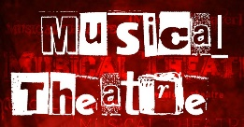
The American musical
Book- The storyline and dialogue of a musical
Lyricist- The author of the lyrics of the songs in the musical

Slide 12
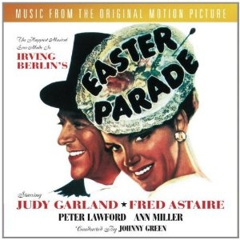
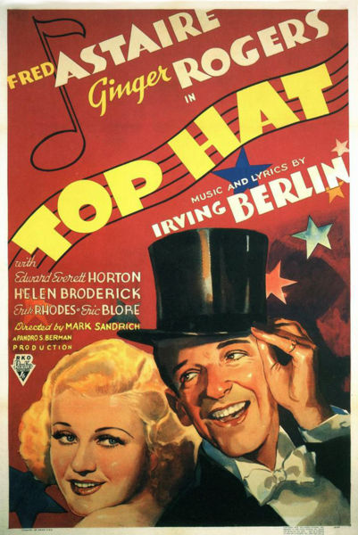
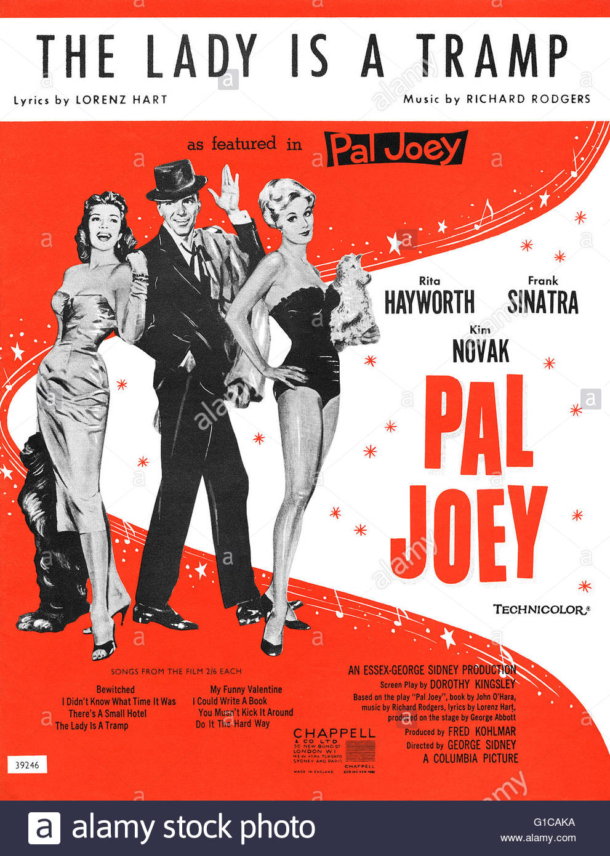
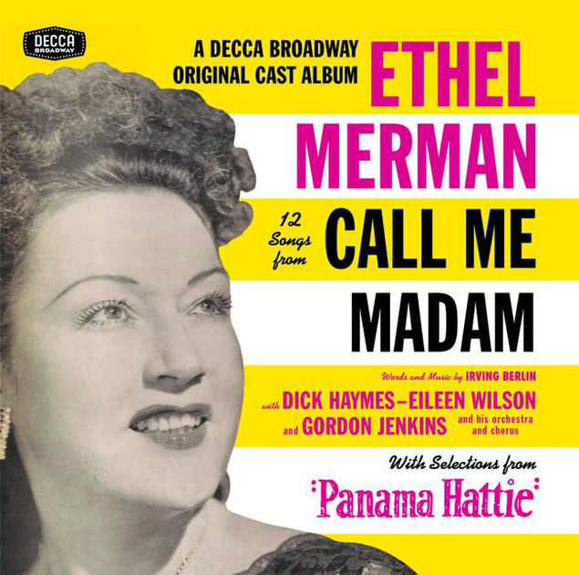
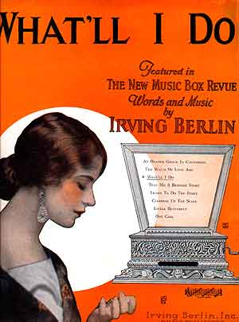
The 1920’s and 1930’s: musical comedies
Around WWI, native American musicals began to emerge written by exceptional composers and lyricists. The melodies became known as standards because they were so popular that they were played on the radio, TV and available on recordings.

Slide 13
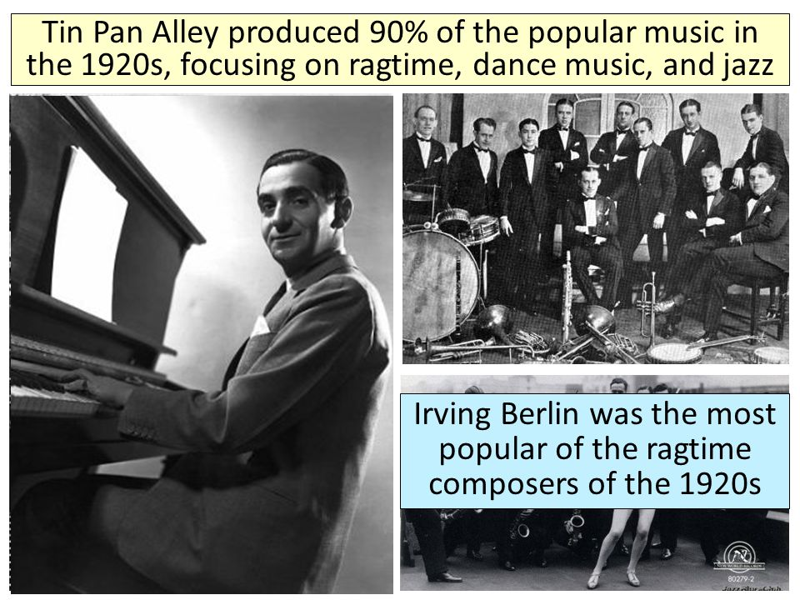
The 1920’s and 1930’s: musical comedies
Melodies ranged from the sprightly to the haunting and featured surprising modulations and developments in the melodic line. Lyrics were just as exceptional and brought the story home to the everyday person.
Famous composers were
Irving Berlin, Jerome Kern, George Gershwin, Cole Porter & Richard Rodgers
Famous lyricists were
Ira Gershwin, Lorenz Hart, Irving Berlin and Cole Porter

Slide 14
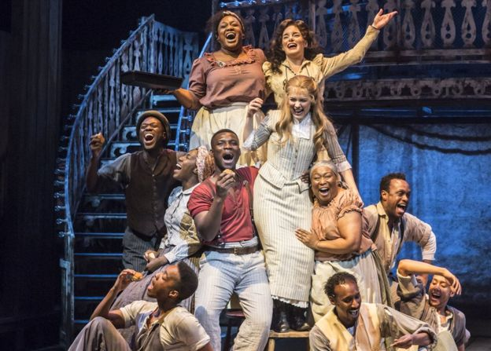
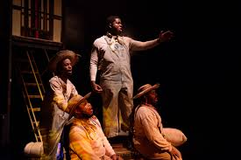
Showboat A Landmark Musical
Composed by Jerome Kern, book & lyrics by Oscar Hammerstein II in 1927 introduced for the first time onstage problems facing African Americans, a romance between a white man and black woman, the chorus line of dancers was eliminated, it was based on a novel about U.S. American everyday life, it was a serious story rather than a comedy, and a subplot was introduced in this musical. In addition, the popular songs were more closely integrated with the storyline and script.

Slide 15
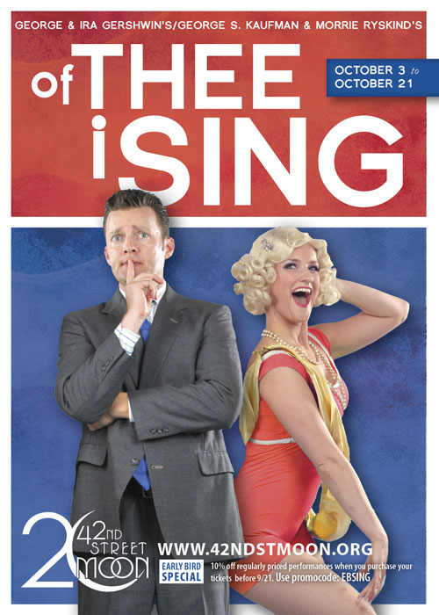
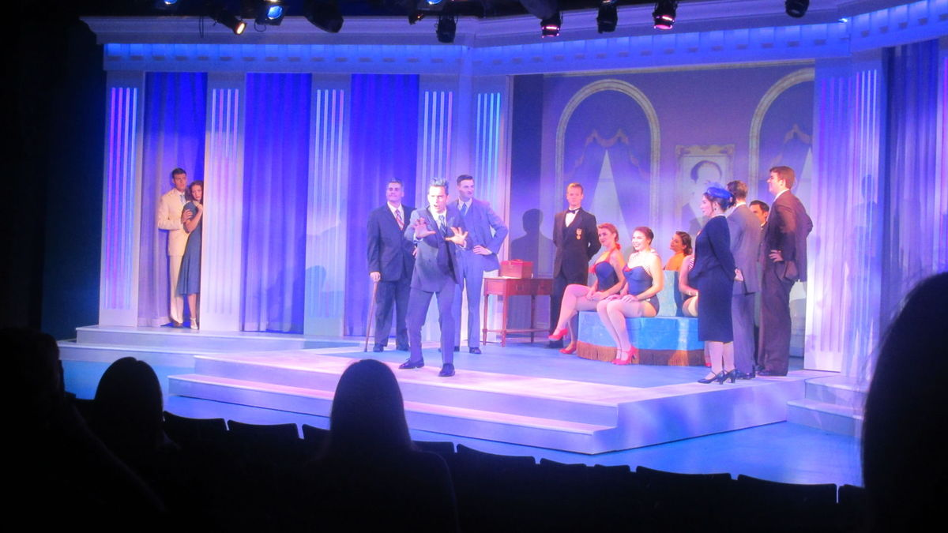
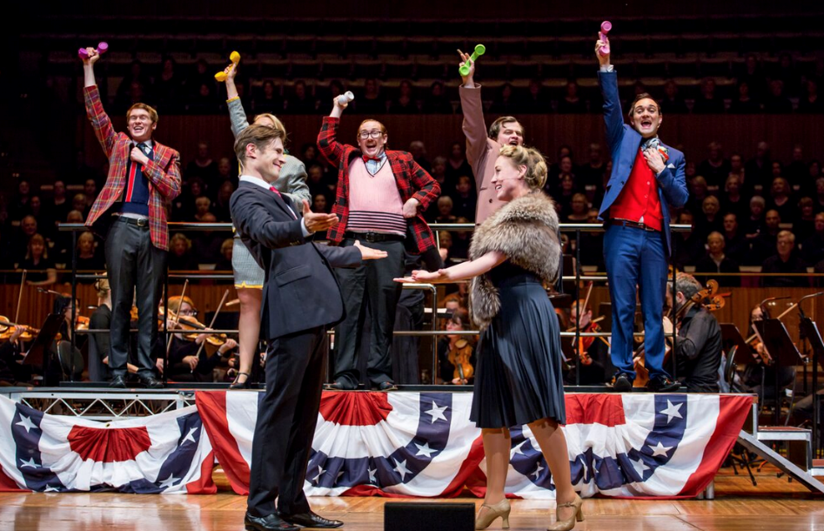
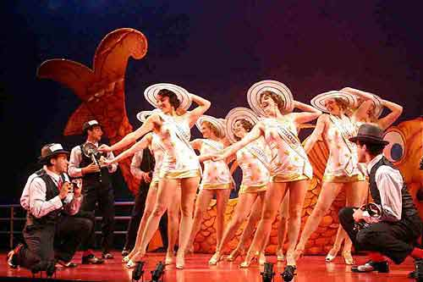
of thee I sing first Pulitzer prize Musical
Music and lyrics by George and Ira Gershwin in 1931 was a satire on political and cultural institutions such as presidential elections and Miss America contests.

Slide 16
porgy and bess serious Musical with timeless music
Music by George Gershwin,
book by DuBose Heyward,
lyrics by Heyward & Ira Gershwin in 1935
had a powerful realistic storyline set in “Catfish Row”, a black community in Charleston, SC, where Porgy, a crippled man, falls in love with Bess, who “belongs” to someone else. “Summertime” and “It Ain’t Necessarily So” are two famous songs that have lasted over the years.

Slide 17
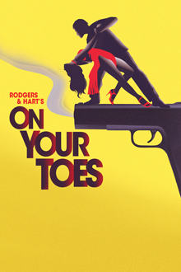
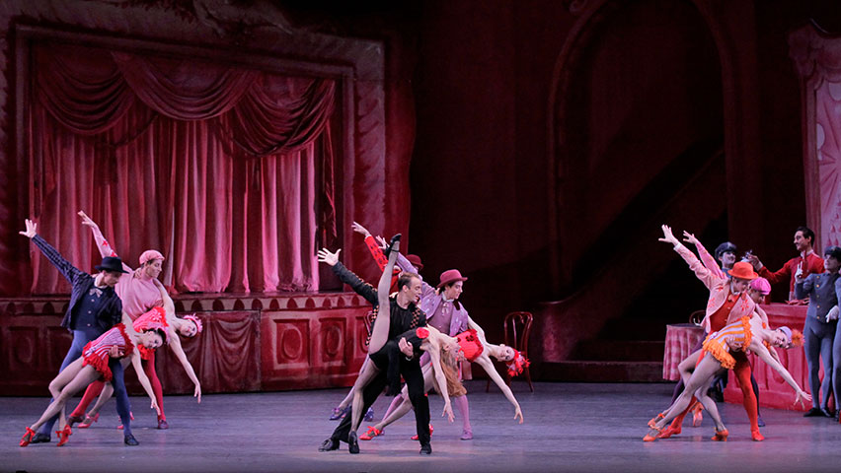
on your toes introduced serious dance to musicals
Music by Rodgers & Hart, Co-author of book was George Abbott in 1936
about a Russian ballet company being persuaded to present a modern ballet.
Abbott then introduced
“Slaughter On Tenth Avenue” as a fast-paced
serious dance musical.

Slide 18
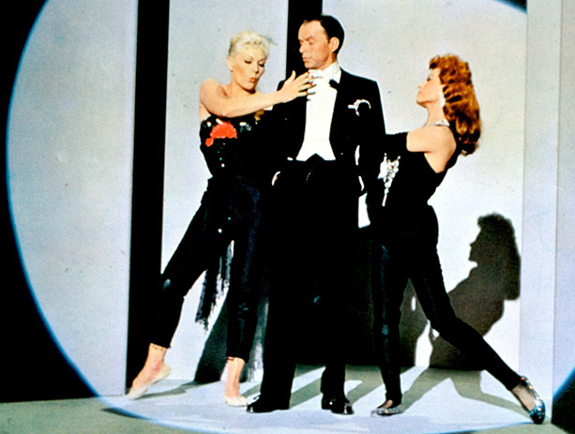
pal joey introduced the hero as a heel
Music by Rodgers & Hart in 1940
about a nightclub singer who
takes advantage of a woman to
get ahead. The presentation of an anti-hero as a leading character was a further step in the development of American musical theatre which emerged full-blown in the 1940’s and 1950’s.

Slide 19
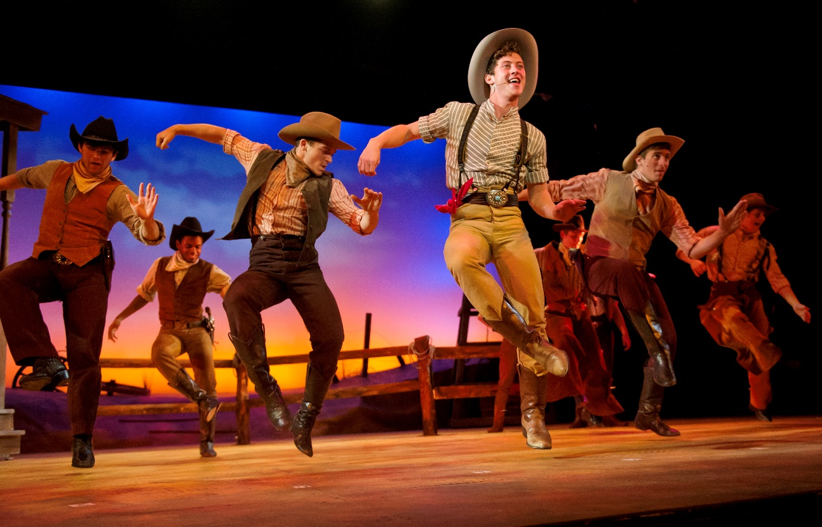
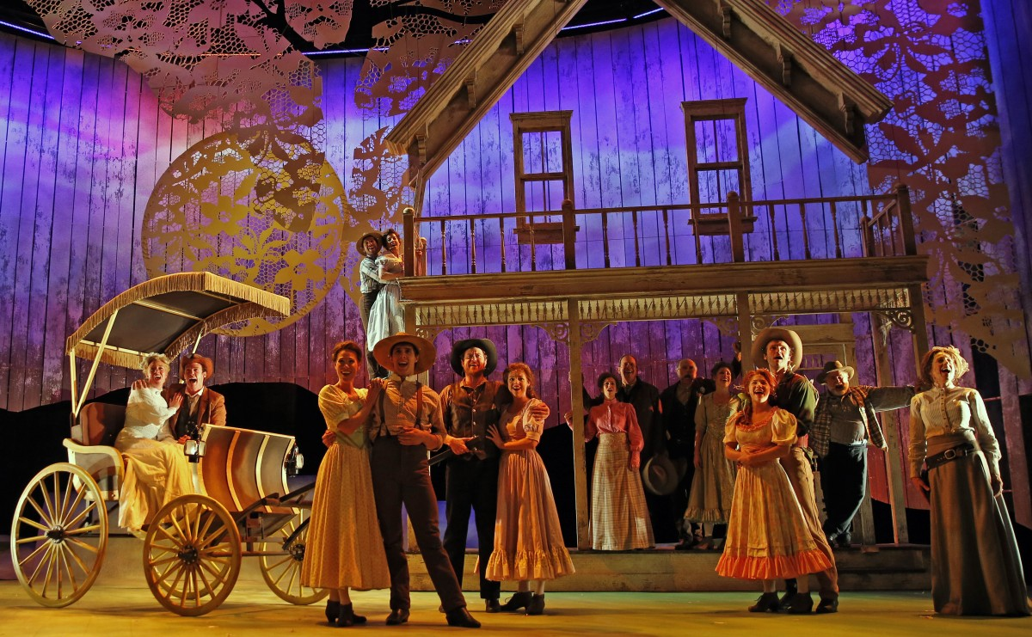
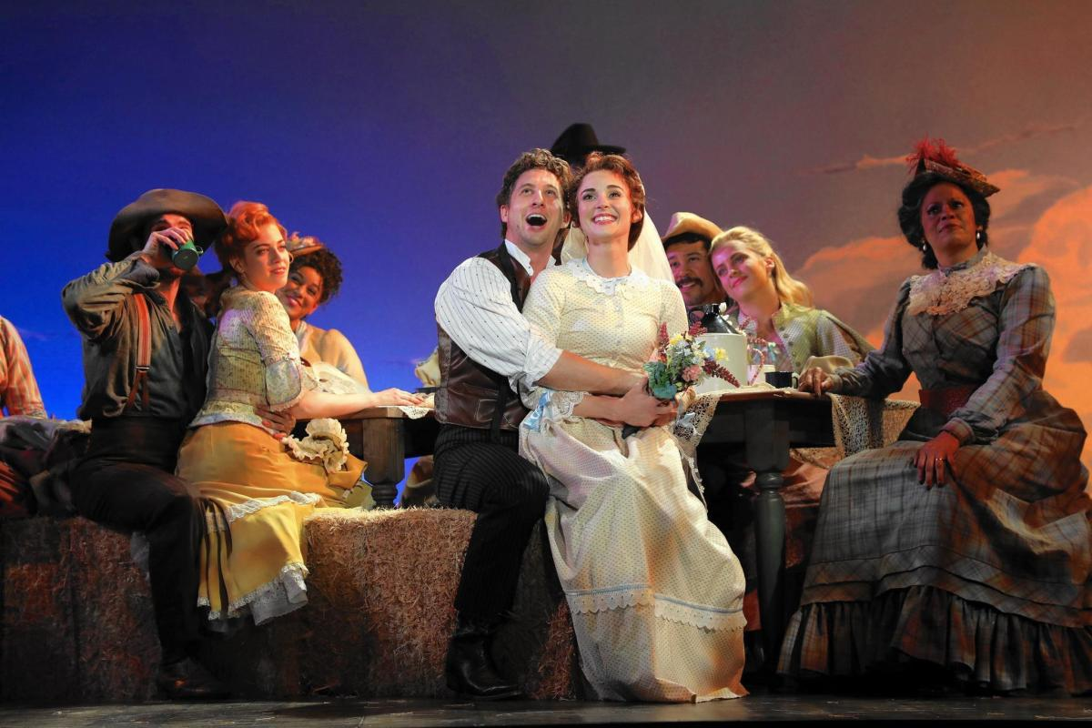
musical theatre of the 1940’s and 1950’s
In 1943 Oklahoma heralded the Golden Era of American book musicals & brought together for the first time the infamous team of Richard Rodgers & Oscar Hammerstein II

Slide 20
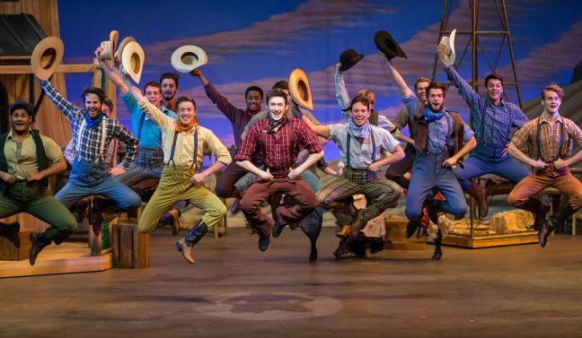
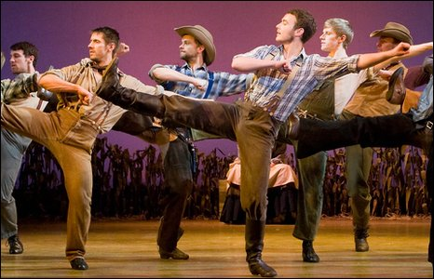
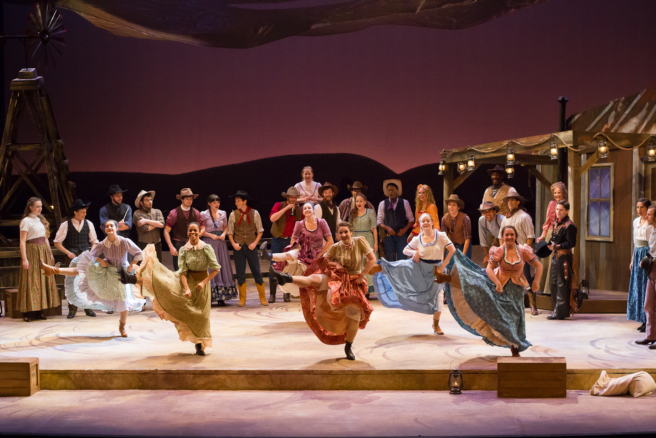
oklahoma! Rodgers & Hammerstein (1943)
Agnes de Mille (1905-1995) A classical ballet choreographer introduced ballet as a crucial element that carried the story forward & became part of the fabric of the musical.

Slide 21
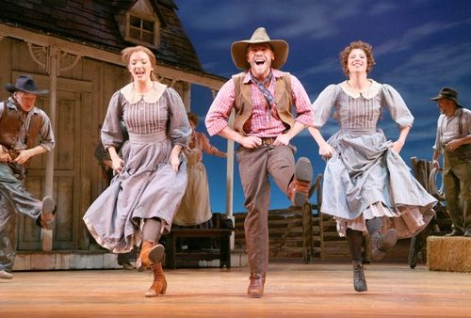
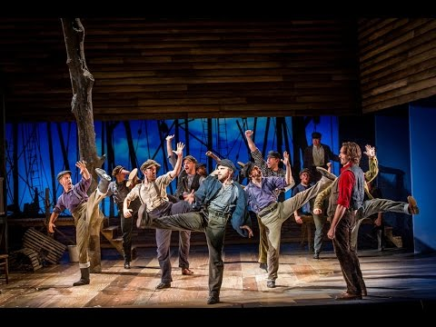
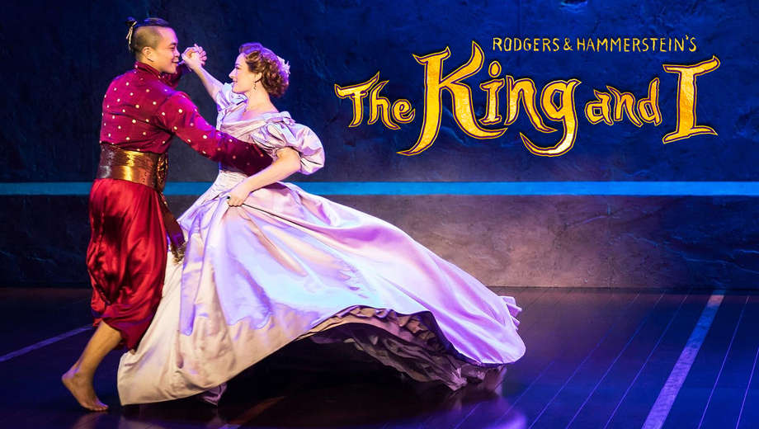
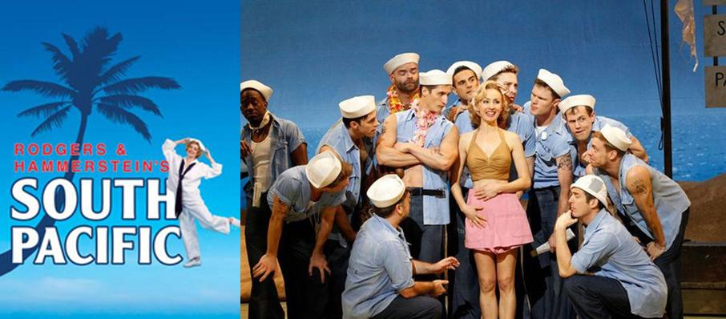
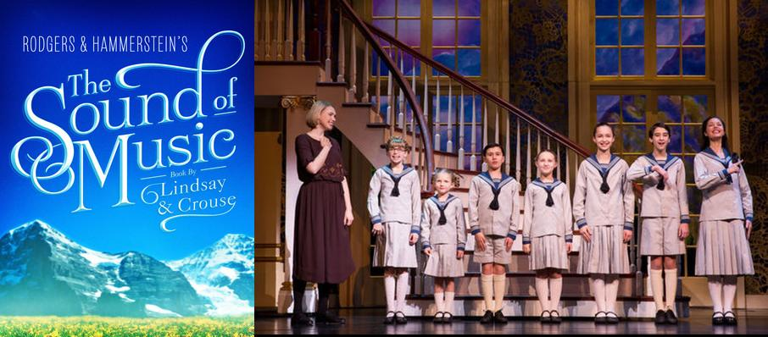
oklahoma! Rodgers & Hammerstein (1943)
After Oklahoma! , American musicals could tackle any subject,
serious as well as frivolous, and present it as an integrated art form with acting, dancing and singing masterfully intertwined.
For Rodgers & Hammerstein, Oklahoma!
was the first in a long line of
successful musicals that included…
Carousel (1945)
(1949)
(1959)
(1951)

Slide 22
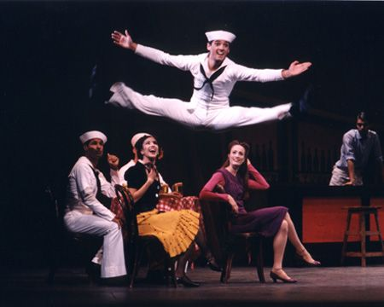
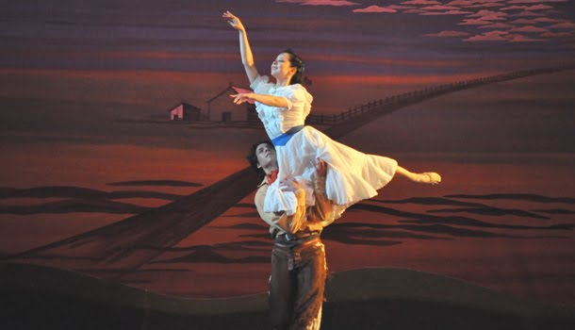
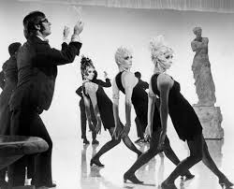
Choreography in musical theatre encompassed many dance forms from classical pirouettes to muscular leaps and rapid-fire tap dancing
Jerome Robins’ (1918-1999)
Energetic athleticism
Bob Fosse’s (1927-1987)
Sharp, angular, eccentric moves
Agnes de Mille’s (1905-1995) Classical lifts and turns

Slide 23
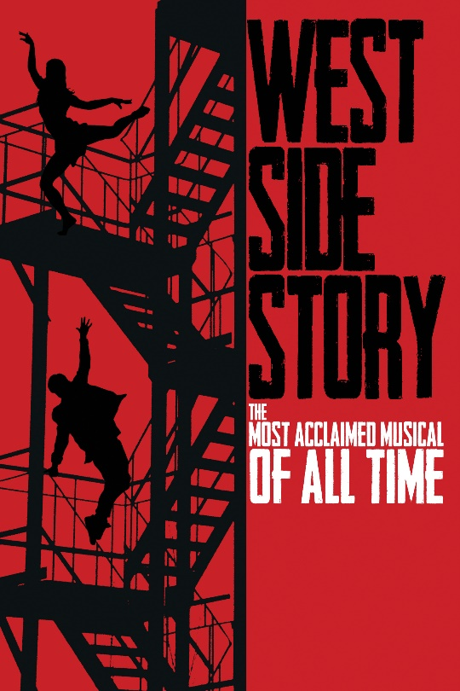
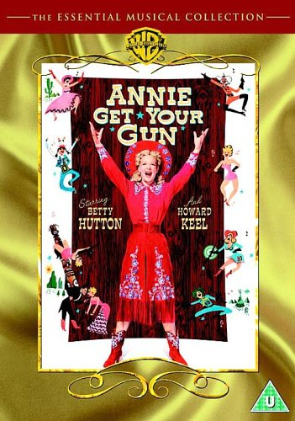
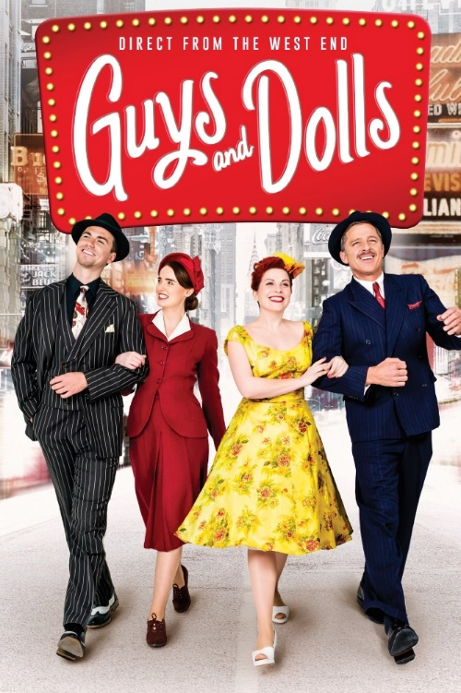
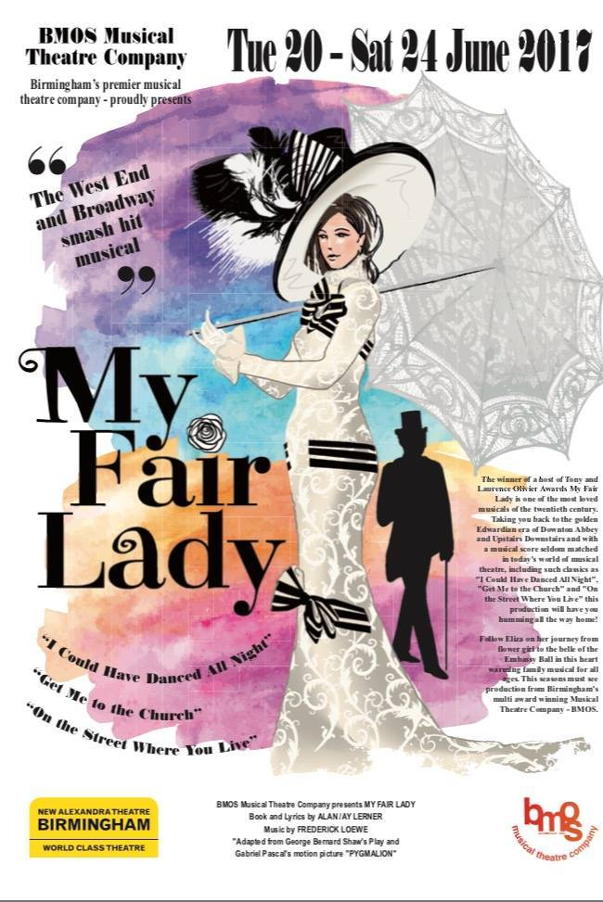
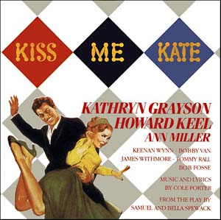
an outpouring of first-rate musicals in the 1940’s and 1950’s
1950
1957
1946
1956
1948
Notes:
Annie Get Your Gun-Life of Annie Oakley; Kiss Me Kate-Story of a theatre company putting on a version of Shakespeare’s Taming of the Shrew; My Fair Lady- A musical version of George Bernard Shaw’s Pygmalion; West Side Story- A modern musical version of Romeo and Juliet

Slide 24
musicals from the 1960’s through the 1980’s
1964
Many believe that the last musical of the Golden Era of book musicals is Fiddler On the Roof with music by Jerry Bock ( b.1928), lyrics by Sheldon Harnick (b.1924), and book by Joseph Stein (1912-2010).
Notes:
Annie Get Your Gun-Life of Annie Oakley; Kiss Me Kate-Story of a theatre company putting on a version of Shakespeare’s Taming of the Shrew; My Fair Lady- A musical version of George Bernard Shaw’s Pygmalion; West Side Story- A modern musical version of Romeo and Juliet

Slide 25
Fiddler on the roof
A story about a Jewish family
whose father tries to uphold the
traditions of the past in a small village in Russia.
It is in Anatevka, where the Jewish community faces
persecution and organized massacre or genocide.
Notes:
Annie Get Your Gun-Life of Annie Oakley; Kiss Me Kate-Story of a theatre company putting on a version of Shakespeare’s Taming of the Shrew; My Fair Lady- A musical version of George Bernard Shaw’s Pygmalion; West Side Story- A modern musical version of Romeo and Juliet

Slide 26
changes in American musicals
In 1967 a new musical began
a new trend of a celebration of the informal, anti-establishment lifestyle of young people in the 1960’s called HAIR. It had no real story line and represented a radical departure from the book musicals that had dominated the scene for the previous 25 years. After HAIR, musicals became increasingly fragmented with few but notable exceptions.
Notes:
Annie Get Your Gun-Life of Annie Oakley; Kiss Me Kate-Story of a theatre company putting on a version of Shakespeare’s Taming of the Shrew; My Fair Lady- A musical version of George Bernard Shaw’s Pygmalion; West Side Story- A modern musical version of Romeo and Juliet

Slide 27
changes in American musicals
In place of book musicals, other approaches were explored.
Concept Musical- A musical that is build around an idea or
a theme rather than a story.
Follies (1971) by Stephen Sondheim and Harold Prince-Paid tribute to the stars and music of a bygone era but also underscored a negative affect of passing years in terms of nostalgia & self-delusion.
Assassins (1990) by Sondheim and Prince-An examination in songs and scenes of the motives and delusions of people who murdered American presidents.
A Little Night Magic (1973) and Sweeney Todd, the Demon Barber of Fleet Street (1979) by Sondheim-were more traditional in style.
Notes:
Annie Get Your Gun-Life of Annie Oakley; Kiss Me Kate-Story of a theatre company putting on a version of Shakespeare’s Taming of the Shrew; My Fair Lady- A musical version of George Bernard Shaw’s Pygmalion; West Side Story- A modern musical version of Romeo and Juliet

Slide 28
Occasional breaking of fresh ground by combining the old with the new
Represented the idea that choreographers were becoming directors and
putting their own vision onto the musical stage.
Notes:
Annie Get Your Gun-Life of Annie Oakley; Kiss Me Kate-Story of a theatre company putting on a version of Shakespeare’s Taming of the Shrew; My Fair Lady- A musical version of George Bernard Shaw’s Pygmalion; West Side Story- A modern musical version of Romeo and Juliet

Slide 29
Another trend of the 1970’s and 1980’s was the emergence of British musicals
Notes:
Annie Get Your Gun-Life of Annie Oakley; Kiss Me Kate-Story of a theatre company putting on a version of Shakespeare’s Taming of the Shrew; My Fair Lady- A musical version of George Bernard Shaw’s Pygmalion; West Side Story- A modern musical version of Romeo and Juliet

Slide 30
Musicals from 1990 to the present
4 Trends are Discernable
Revival of past musical successes
Appearance of fresh, off-beat musicals
Musicals based on films
Jukebox musicals
Some new contemporary musicals have favored the book musicals of the past style, but musicals are here to stay as is evident in the continued success of Broadway
Notes:
Annie Get Your Gun-Life of Annie Oakley; Kiss Me Kate-Story of a theatre company putting on a version of Shakespeare’s Taming of the Shrew; My Fair Lady- A musical version of George Bernard Shaw’s Pygmalion; West Side Story- A modern musical version of Romeo and Juliet

Slide 31
Scenes from Fiddler on the roof
What makes this musical set apart from many others?

Slide 32
Chapter 12 exercises
Exercise #18
What is the spine of the play Fiddler?
Explain the type of musical it is and why?
Exercise #19
What are the five types of musical theatre
and give examples. What type would you enjoy the most and why?

