Slide 1
Fashion History
Chapters 11 – 14
Directoire & Empire Periods
Romantic Period
Crinoline Period
Bustle Period

Slide 2
The Directoire & Empire Period
1790-1820
Chapter 11

Slide 3
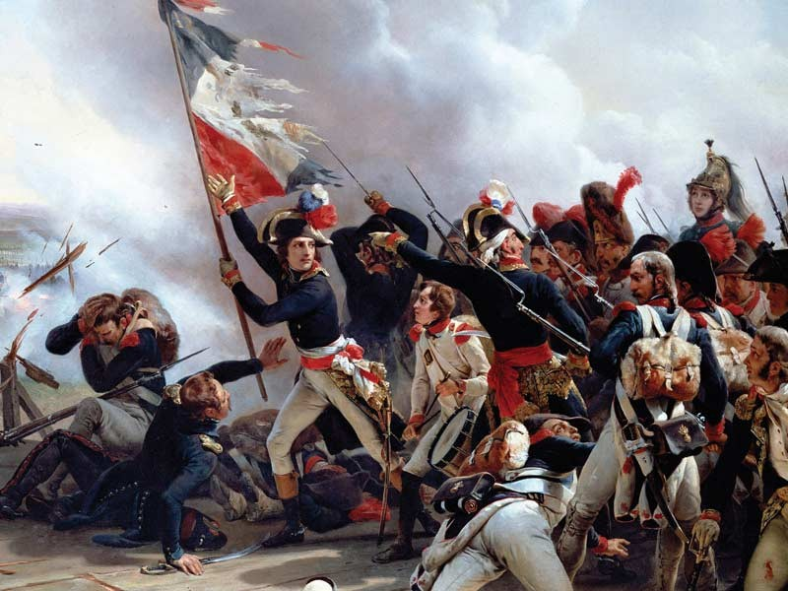
The Directoire & Empire Period
The Directoire period (1790 – 1800) includes the French Revolution and the establishment of the Directory (Directoire in French), a government by a five man executive body.
The Empire period followed, coinciding generally with the period during which Napoleon Bonaparte was head of state in France. The name of the period derives from the name of this era, the Napoleonic Empire.
The silhouette of fashions for women during the revolution didn’t change significantly from those of the pre-revolutionary periods.
Men’s costumes took on a number of symbolic meanings. The most obvious and most visible symbols of the Revolution were the bonnet rouge (red cap of liberty) and the sans culottes.
Culottes – The French word for “knee breeches”

Slide 4
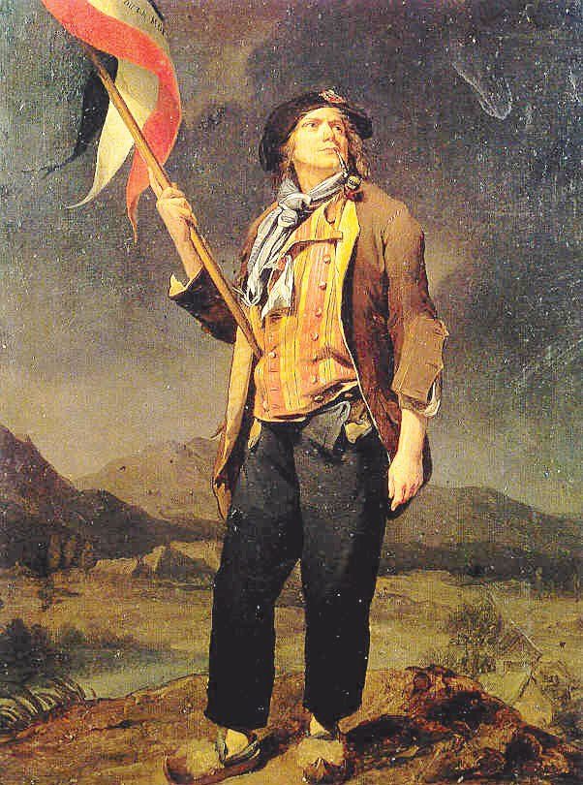
The Directoire & Empire Period
Idealized sans-culotte by Louis-Léopold Boilly (1761–1845).
For many generations, men of the laboring classes wore trousers, while the nobility/affluent wore knee breeches. Working class men, who supported the Revolution, wore trousers – hence the name “sans culottes”or “without knee breeches.
Other elements of sans culotte dress included the carmagnole (kar-man-yole), a short woolen cloth jacket of a dark color. It was hip length with fullness at the back, cut rather like a smock. (See Figure 11.2)

Slide 5
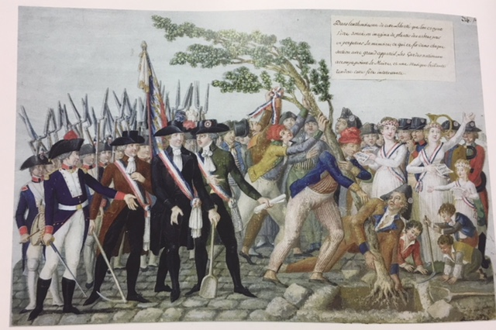
The Directoire & Empire Period

Slide 6
The Directoire & Empire Period
Marveilleuses (mere-vay-use) – The Marvelous Ones, were women who affected the most extreme of the Directorie Styles, with long flowing trains, sheer fabrics, extreme necklines cut in some extreme cases to the waistline, and huge exaggerated jockeylike caps.
Men, known as Incroyables (incredibles) wore waistcoats of loose fit at the shoulders, excessively tight breeches, and cravats (neckties) and collars that covered so much of their chins that it’s a wonder if they could be heard when they spoke.

Slide 7
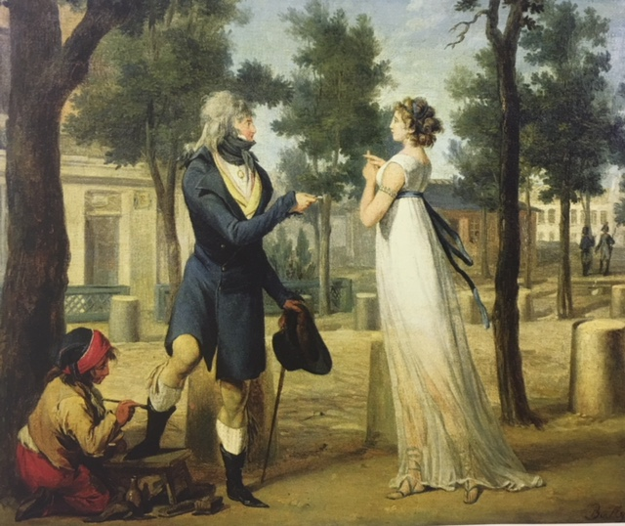
The Directoire & Empire Period

Slide 8
French Revolution 1789
Fashion was based on ancient Greek forms that had low round necklines and a high waist.
The dresses fell straight to the floor.
They were made of soft clinging fabrics like linen or muslin.
c.1790
c.1790
c.1790
c.1800

Slide 9
The Directoire Period Costume For Women
Pantalettes
Chemise
Corset
Petticoat

Slide 10
The Empire Period Costume For Women
The high waisted, relatively straight silhouette of c.1800 to 1820 came to be known as the empire line

Slide 11
The Empire Period Costume For Women
While the empire silhouette continued to dominate, a variety of sleeve and neckline styles could be seen.

Slide 12
The Empire Period Costume For Men
When compared to the 18th Century, men’s dress of the Empire Period was subdued in color and lacked decoration.
Gradually trousers replaced knee breeches for day and evening

Slide 13
The Empire Period Costume For Men
The visible elements of men’s dress were his trousers, shirt , vest, and coat.
Pantaloons
Trousers, called pantaloons when very tightly fitted, often had straps that fit under the instep to keep them from riding up.

Slide 14
The Directoire & Empire Period
Napoleon’s Wardrobe list –Page 312
Evidence of Costume – quite a few garments were found from this period were available for study.
Hairstyles and Headdress – Page 318
Accessories – Page 319

Slide 15
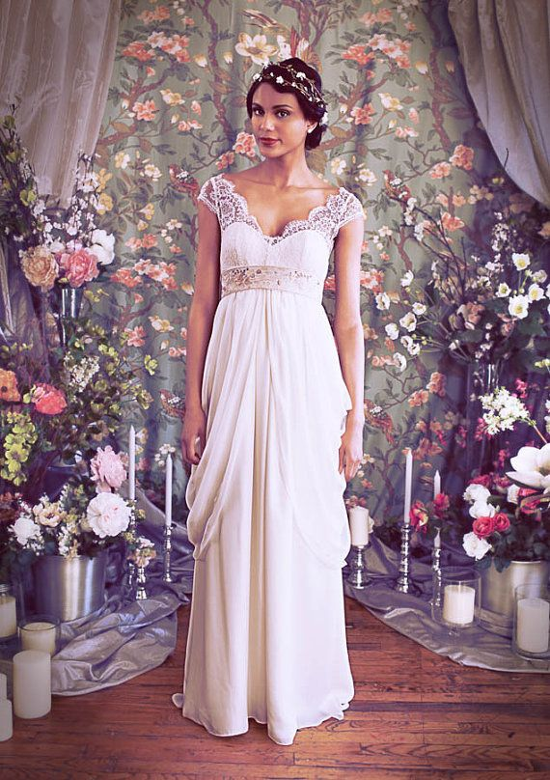
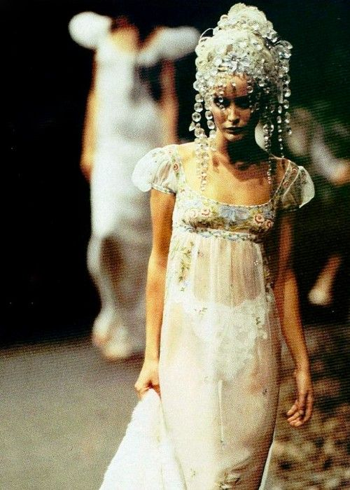
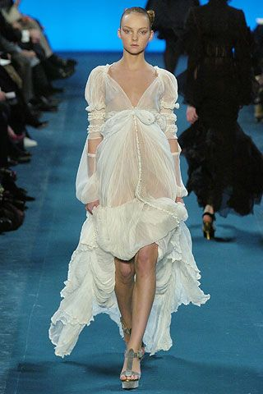
The Directoire & Empire Period Modern Influences

Slide 16
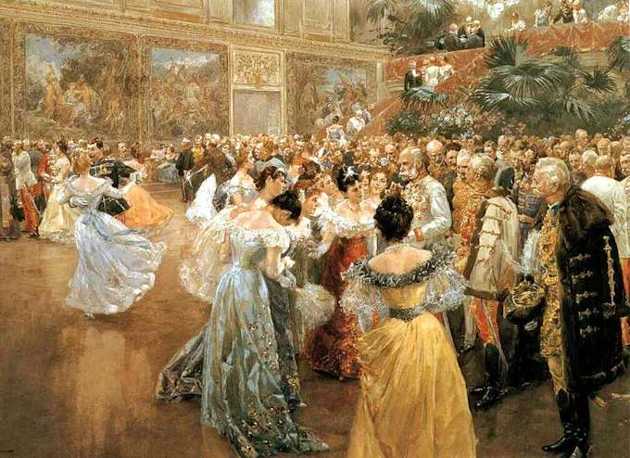
The Romantic Period
1820-1840
Chapter 12

Slide 17
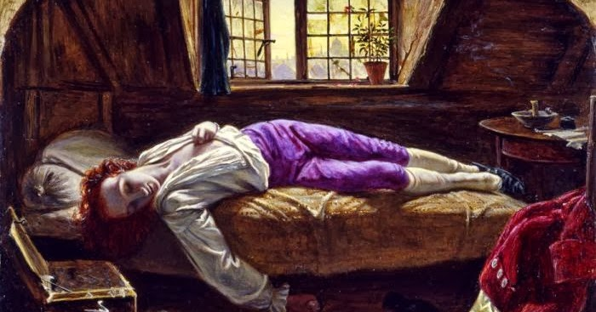
The Romantic Period
The term Romantic is applied to literature, music, arts, and dress from 1820-1840.
The emphasis was on emotion sentiment and feeling.
The Death of Chatterton by Henry Wallis, 1856.

Slide 18
The Romantic Period
With Industrialization and location of business in workplaces away from home, women’s roles were increasingly confined to the home.
Well to do women were severely limited in their activities. The home was the center of entertainment and well-to-do women served as hostesses for their husbands. For this role, they required a substantial wardrobe of fashionable clothes. Clothes limited movement.
Women from working class families and rural areas, and women pioneers wore garments that were less hampering and more practical.
Advances in producing textiles was now well established. The variety of ready-made clothing for men continued to expand, but women could buy few ready made garments other than corsets and cloaks.

Slide 19
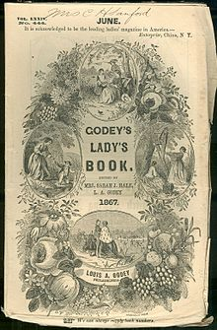
The Romantic Period
Sources of Evidence About Costume
- American Women’s magazines
- Godey’s Lady Book and Peterson’s Magazine began publication in 1830 and 1842 respectively.

Slide 20
The Romantic Period Costume For Women
Drawers
Chemise
Corset
A number of full starched petticoats
Corset Cover Or Camisole

Slide 21
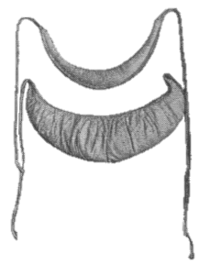
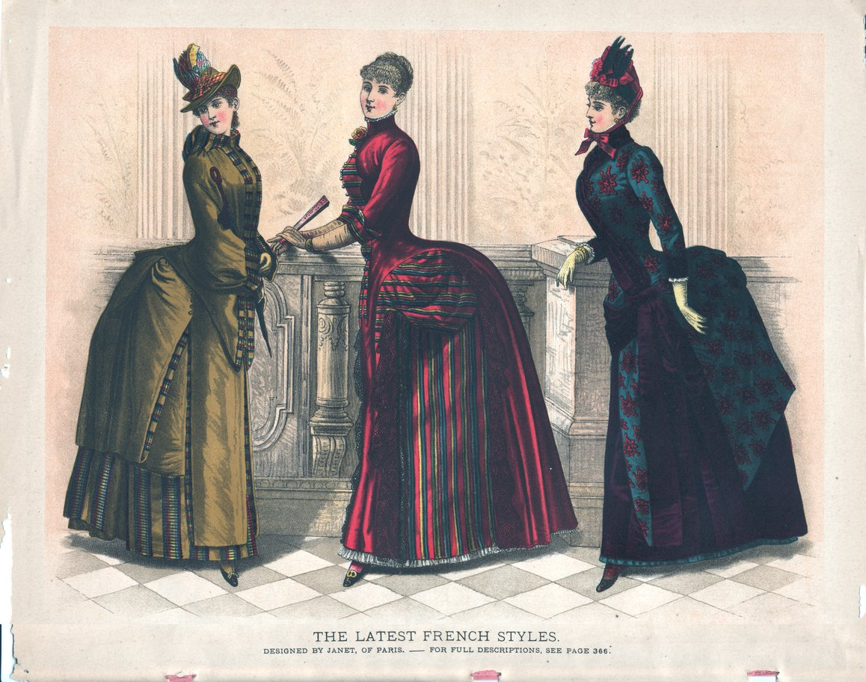
The Romantic Period Costume For Women
Bustles – small down-or cotton-filled pads that tied around the waist at the back, held out in skirts in the back.

Slide 22
The Romantic Period Costume For Women
Dresses were frequently identified in fashion magazines according to the time of day or activity for which they were intended.
Morning Dresses – informal – made of lingerie type fabrics
Day Dresses, Promenade or Walking Dresses and Carriage Dresses.

Slide 23
The Romantic Period Costume For Women
Sleeves were diverse
Puffed at the shoulder then attached to a long sleeve, which was fitted to the wrist.
Marie Sleeve – full to wrist, but tied in at intervals with ribbons or bands (Figure 12.8 – page. 334)
Demi-gigot – full from shoulder to elbow then fitted from elbow to wrist (Figure 12.6 – page 333)
Gigot – Leg-of-mutton sleeves – full at the shoulder, gradually decreasing in size to wrist where they ended in a fitted cuff.

Slide 24
The Romantic Period Costume For Women
Imbecile or idiot sleeves were extremely full from shoulder to wrist where they gathered into a cuff.
Skirts were lifted from the ground, showing the feet and ankles.
Pelerines were especially popular; they were wide cape like collar that extended over the shoulders and across the bust.

Slide 25
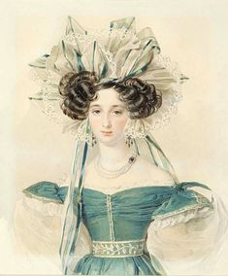
The Romantic Period Costume For Women
Hairstyles and Headdress – Page 337
Turban
Hat
Bonnet
Different Hairstyles

Slide 26
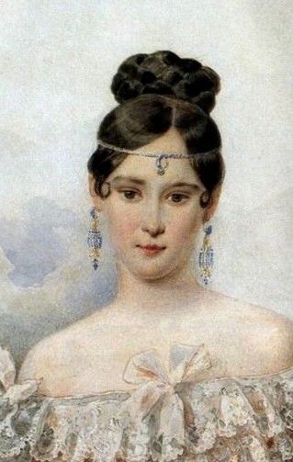
The Romantic Period
Accessories (Page 12. 2)
Chatelaine – ornamental cluster of small tools worn hanging from the waist
Women’s Gloves (mitt, or mitten made of black silk net)
Beaded handbags
Parasol
Top Hats
Cravats
Shoes – flat heel with squared toe, low-heeled laced boot, boot with an elastic inset gusset – also called a Congress Boot

Slide 27
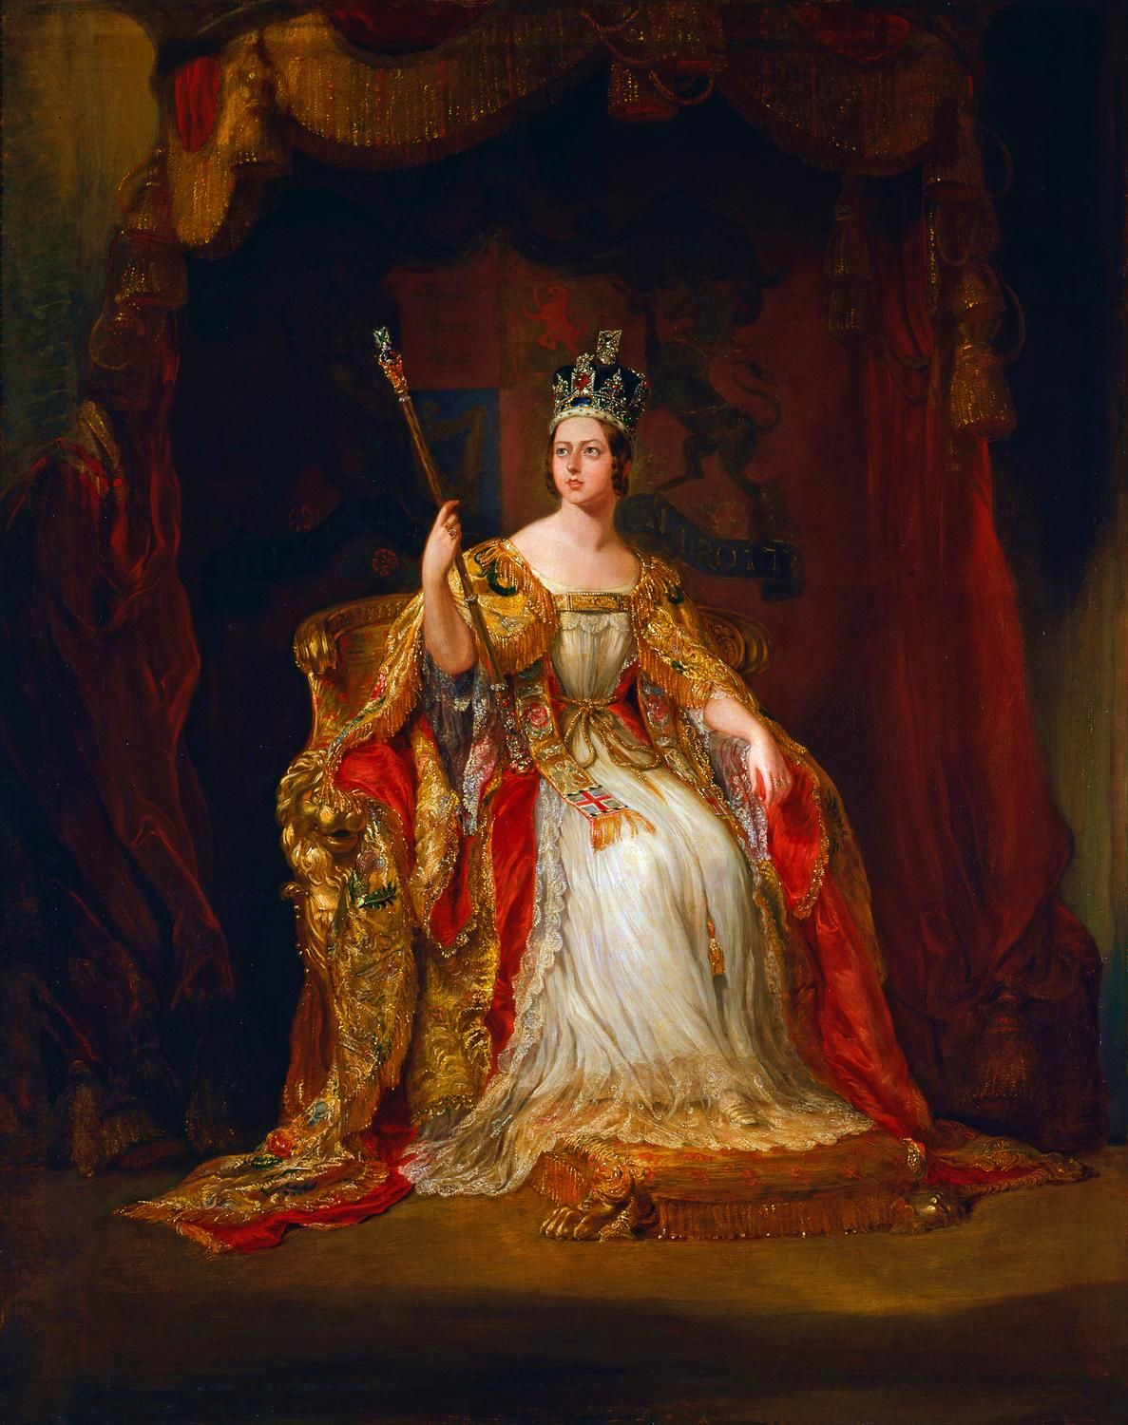
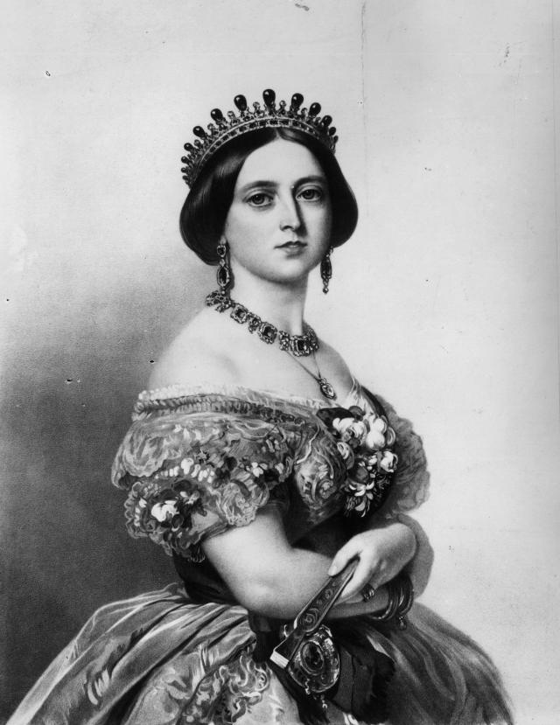
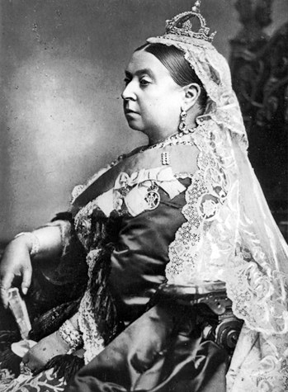
The Romantic Period
Queen Victoria came to throne in 1837 at the age of 18 and ruled Great Britain and the empire until her death in 1901.
She had such a strong influence that her name was often used to describe most of the 19th century, which we call “the Victorian Age.”

Slide 28
The Romantic Period
The 1840’s marked the beginning of photographic portraits.
Louis Daguerre of France was famous for being the father of photography made it fashionable for people to come and sit for their portraits.

Slide 29
The Romantic Period Costume For Men
The top hat was the predominant headwear for men during the day and evening
Elements of men’s clothing continued to be under drawers, shirts, waistcoats, trousers, and coats.
The name “trousers” gradually superseded the term “pantaloons”.

Slide 30
The Romantic Period Costume For Men
COATS
Newmarket
Greatcoat
Box Coat
Paletot
Chesterfield
Mackintosh

Slide 31
The Romantic Period
https://www.youtube.com/watch?v=puQfI4eXGoE

Slide 32
Chapter 13 The Crinoline Period
1850-1869

Slide 33
Charles Worth
The House of Worth, is the 1st French couture house that opens in 1858
Charles Worth who was British-born, began the high fashion dressmaking that became know as the haute couture.
He dressed the most respectable and most notorious women of the time.
https://www.youtube.com/watch?v=d3O3zvtwG24

Slide 34
The Crinoline Period
The style lines for women’s dress at the beginning of the crinoline period were like those of the late Romantic Period.
The innovation of the cage crinoline or hoopskirt c. 1857 contributed to the continuing popularity of very wide skirts.
The term crinoline took on a new definition in the 1850s that it has retained to this day. Crinoline was a stiff fabric used in petticoats to hold out skirts. When hoop skirts were introduced, people took to calling them cage crinolines, then shortened to crinoline. Today, the term crinoline is applied to any stiff petticoat.

Slide 35
The Crinoline Period Costume For Women
Drawers
Chemise
Corset
Corset Cover Or Camisole
Cage Crinoline Hoop Skirt
One petticoat
Undergarments

Slide 36
The Crinoline Period
Costume For Women
Armhole seams were placed below the natural shoulder on the upper part of the arm. This is called a dropped shoulder line.
Daytime dresses had high necks
Evening dresses had low, often off-the-shoulder necklines

Slide 37
The Crinoline Period Costume For Men
Under Drawers
Shirt
Trousers
Vest

Slide 38
The Crinoline Period Costume For Men
Men could choose from several different jacket types:
Dress or tailcoat for formal and evening wear
Frock coat for daytime
Sack jacket for less formal occasions *

Slide 39
Chapter 14
The Bustle Period And The Nineties 1870-1900
The bustle period describes the time in which the bustle was popular.
This was from 1870- 1890.
The bustle is the device that provided shaping for a skirt silhouette with extreme back fullness.

Slide 40
Ready To Wear Clothing
By 1910 every article of clothing for women could be purchased at a store.
What changes made this possible?
The entry of women in the workforce decreased the time they had to make clothing.
This created a demand to purchase clothing.
Wide use of sewing machines
Development of sized paper patterns
Technology allowing the cutting of many garment pieces at the same time.
Wolf Model 2279 used a thin vertical blade action to cut three thicknesses of cloth.”²

Slide 41
Costume For Women
The Bustle Period
The primary element of this time period was the bustle, a structure to support a skirt with a full back.
In the twenty years that bustles were in fashion, three different shapes of bustles were worn.
The second bustle type (c. 1878-1883) was called a sheath or cuirass bodice, which dropped fullness to below the back of the knees.
The final bustle type (c. 1883 – 1890) was rigid and shelf-like and rarely had a train
The earliest bustles (1870-1878) was created by manipulating the full skirt in a waterfall-like effect, often with a train.

Slide 42
The Nineties
1890’s
Costume For Women
Back fullness diminished Sleeves grew larger
Skirts were more circular
The hour-glass shape silhouette came into fashion
Leg-Of-Mutton Sleeves

Slide 43
The Bustle Period And The Nineties Costume For Men
Men could choose from more types of jackets.
Generally the type of jacket worn was related to the formality of the occasion.

Slide 44
The Bustle Period And The Nineties Costume For Men
An innovation in evening wear was the tuxedo, made with a sack jacket and first worn in the 1880s.

Slide 45
The Bustle Period And The Nineties Costume For Men
Derby
Top Hats
Fedora
Straw Boater

Slide 46
The Bustle Period And The Nineties Costume For Men
Collars
Pince Nez
Ties and Ascots
Gloves
Walking Sticks

Slide 47
The Bustle Period And The Nineties 1870-1900
https://www.youtube.com/watch?v=QDZ4xX7JSos

