Slide 1
Fashion History
Chapter 17
The New Look
1947-­‐1960

Slide 2
Frozen Fashion
Fashions had been effectively frozen since the war years
WWII (1939-­‐1945)
Characteristics of women’s clothing were” Ridged manly square shoulder lines
During these years in
Britain and the US people had to manage with restricted amounts of clothing.
1940
1944

Slide 3
Dior Collection
Spring 1947
The wartime styles departed soon after the showing of the Christian Dior Collection in spring, 1947.

Slide 4
The New Look
In 1947 after WWII Parisian Fashion designers turned in a dramatic new direction that the fashion press labeled “The New Look”

Slide 5
CHARACTERISTICS OF THE NEW LOOK
Feminine
Soft gentle rounded shoulder line Small waist (wasp-­‐waisted silhouette)
A billowing skirt
Generous use of luxurious fabrics
This type of style dominated until the mid 1950’s.
1942
1947

Slide 6
https://www.youtube.com/watch?v=eYjE48Pj8fg

Slide 7
Outerwear

Slide 8
Hair and Headdress
1947-­‐1960

Slide 9
FOOTWEAR
1947-­‐1960

Slide 10
COSTUME FOR MEN
1947-­‐1960
Continental cut of the late 1950s
Bold Look
Grey Flannel Suit

Slide 11
Hair and headdress
1947-­‐1960
Fedora
Alpine
Driving Cap
Pork Pie
D.A. or Duck Tail Hairstyle

Slide 12
Footwear
1947-­‐1960
Oxford
Blue Suede Loafers
White Buckskin
Leisure Shoes
Penny Loafers

Slide 13
Poodle skirt
FADS
Fads are styles with
intense popularity worn by a large number of people for a very short time
Among the fads for adolescent girls were poodle skirts made of felt with appliquéd poodles

Slide 14
A subculture is a group of people within
a culture that differentiates themselves from the larger culture to which they belong.
A style tribe or fashion tribe is a group of people that dress in a distinctive style to show their membership in this group.

Slide 15
Subculture
beatniks
Against the conventional lifestyles and fashions of the time, there were non-­‐ conformists, such s the beatniks
It started as a literary movement that included many writers and they adopted certain habits of dress and grooming.
Such as beard, ponytails, dirty sneakers, and peasant blouses.
They adopted black clothes especially turtlenecks and berets for men and leotards, tights and ballet slippers for women.

Slide 16
Subculture
Subculture
Teddy boys
In Britain, there were the Teddy Boys.
They represented signs of rebellion that were to grow in the next decade.
They created the first independent fashion for young people.

Slide 17
Style Tribe
https://www.youtube.com/watch?v=InUZTmNhqmQ

Slide 18
Subculture
Subculture
Harajuku /Decora
https://www.youtube.com/watch?v=WblNctc3ys0

Slide 19
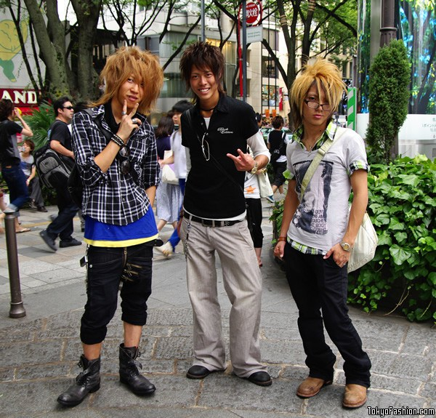
Subculture
NO HOMEWORK !
Please do a minimum one page (a least 3 paragraphs) write up on a fashion subculture – including at least one visual and be prepared to discuss in class on next Thursday.

Slide 20
Fashion History
Chapter 18
The Sixties and Seventies
1960-­‐1 980

Slide 21
Transformation in fashion
By 1960 a change was evident as fashion moved away from “New Look” styles to a contrasting style.

Slide 22
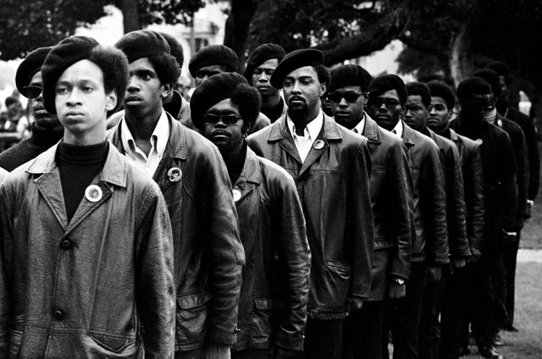
Social Protests
Civil rights Movement and Black Power
Anti War and Anti establishment
The feminist movement
The environmental movement

Slide 23
Groups of mostly young people who had the same interests and wore the same kinds of clothing were called style tribes by author Ted Polhemus.
Style Tribes
Mods Hippies
Anti War Youth Punks
Mods

Slide 24
Style tribes
Hippies

Slide 25
Style tribes
Anti war youth

Slide 26
Style tribes
punks

Slide 27
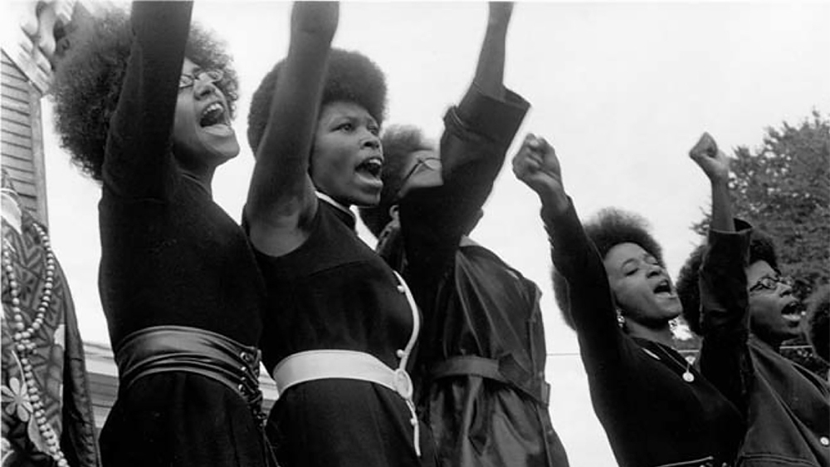
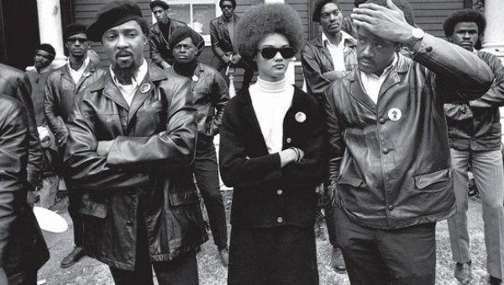
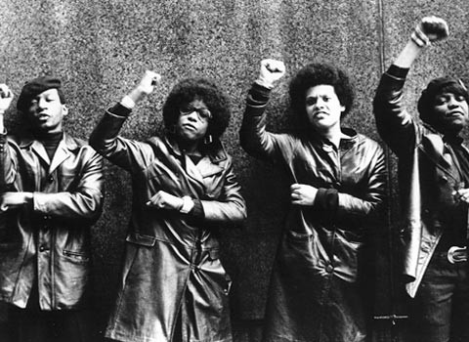
Style tribes
Black Panthers

Slide 28
Op Art & Pop art
Art movements that influenced
I ifashion included Op Art and Pop Art.
Op art, also known as optical art, it is a style of visual art that makes use
of optical illusions.
c. 1960s "Andy Warhol" Campbell's Soup Paper Dress

Slide 29
Costume for women
1960-­‐1970
Although women did not want to cover their legs with skirts, pants and pant-­‐suits were important components of most women’s wardrobes from the late 1960s on.
By 1964 there was an easy unfitted silhouette and gradually the skirts became shorter and shorter. The term mini skirts and micro mini was applied to these short skirts.

Slide 30
1960’s Fashion
https://www.youtube.com/watch?v=aCYfPzNkmtk

Slide 31
Costume For Women
1970-­‐1980
By the early 1970’s most skirts tended to be mini in length.
In 1972 Diane Von Furstenberg came out with the wrap dress
https://www.youtube.com/watch?v=iXxFFkTx7sA

Slide 32
Hip huggers had wide flaring or bell bottom legs.
Hot Pants are very short pants
Pants gained acceptance not only for leisure but also for all occasions.
Blue jeans were
first adopted by the hippies and then picked up by the young and were adopted in mainstream fashion and by the 1970’s were being worn by all ages.

Slide 33
Hair and headdress
1960-­‐1980
1960s
1960s
1960s
Early 1970s
1970s
1960s
1963
1976
1975-1980

Slide 34
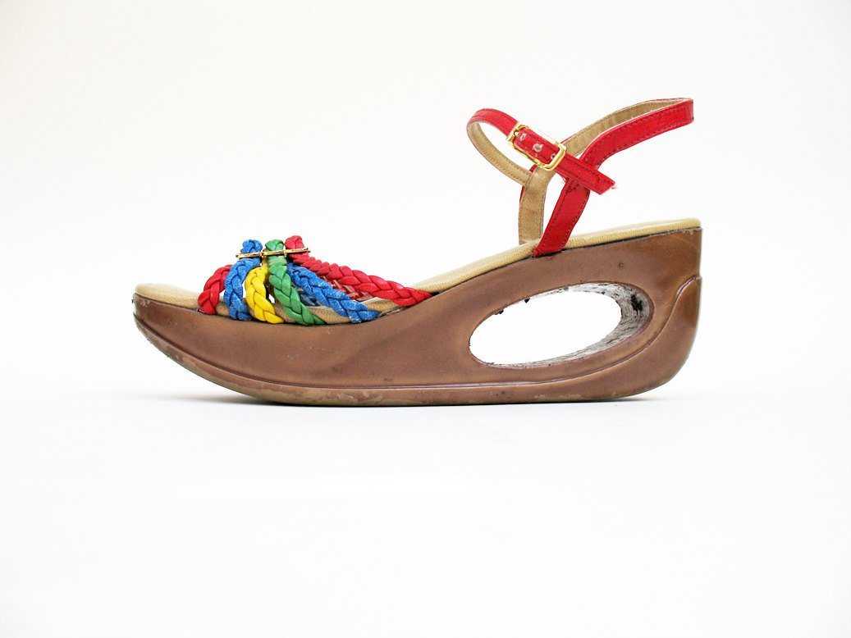
Footwear 1960-­‐1980

Slide 35
Costume For Men
By the mid 1960’s continental suits were being replaced by the mod suits
As mod fashions appeared, men’s suits moved from conservative styles to mod-­‐ inKluenced styles.

Slide 36
COSTUME FOR MEN
With the social revolution came greater freedom of choice in clothes for men.
Esquire magazine called it the Peacock Revolution.
The peacock revolution had a major impact on
tuxedos, which were cut with more body shaping and a wide range of colors.
Burgundy, green and brown were especially popular.
The “disco look” became popular with the three-­‐ piece suit for men

Slide 37
Costume for men
Leisure Suit
Turtle Neck

Slide 38
Fashion History
Chapter 19
The Eighties, The nineties, and the ₂₁
st
century
1980-­ 2000

Slide 39
The Eighties, The nineties, and the 21st century 1980-­‐2008
New methods were developed for selling fashion through television, mail order, and the Internet.

Slide 40
Costume for women
1980-­‐1990
Hair was big, heels were big, jewelry was big and shoulders were big
Shoulder pads were added to everything from daytime dresses to sweaters for casual wear and evening dresses.
Short skirts and mini skirts reappeared in the 1980’s
Many dresses, skirts, and pants were fi itted tight until the early 1990’s
Jeans are a part of every day costume
French designers began power-­‐dressing women with slim skirts and huge shoulders,

Slide 41
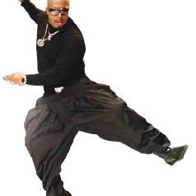
Costume for men
1980-­‐1990
With the help of Italian designers men’s suit silhouette underwent a change.
The suits had wide shoulders with an easy fit
Shirts had bright and whacky prints Parachute pants also became popular
https://www.youtube.com/watch?v=otCpCn0l4Wo

Slide 42
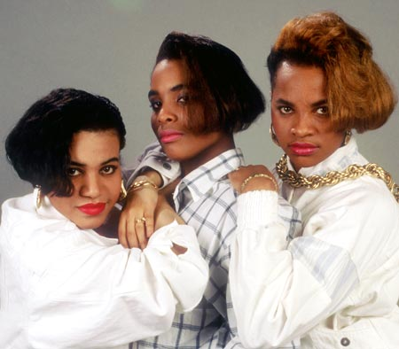
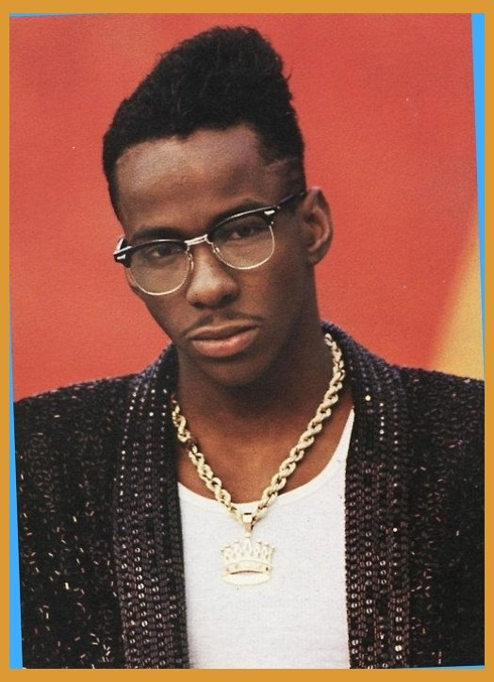
Hair and Headdress 1980’s

Slide 43
The 80’s
https://www.youtube.com/watch?v=M0KeMR1wboA

Slide 44
1990’s
In contrast to the elaborate F lashy style in the 1980’s; the 1990’s brought a minimalist approach to fashion.
There was a larger trend in the adoption of tattoos, body piercings other than ear piercing.
Most of the fashion trends of the 1990s were based around the casual style, such as blue jeans and the T-­‐shirt.

Slide 45
Style tribes 1990’s
Grunge
Hip Hop
Goth
Hippie
Punk

Slide 46
Costume for women
1990’s
Neon Colors
Shoulder lines became smaller and natural.
Leggings and Exercise wear was adopted into everyday wear for example:
leotards worn as tops were popular
Tops that revealed the midriff, which was called “crop tops”, were popular
Hippie look: revival of 1960s fashion from 1993 onwards, including hippie-­‐style floral dresses, turtleneck shirts, lace blouses, and Gypsy tops’
By the mid 90’s pants and jeans had become wider and looser

Slide 47
Costume for women
1990’s

Slide 48
Costume for men

Slide 49
Costume for men
1990’s
The early nineties men wore a loose fitting slacks suits
In the late 1990’s more structured lines in suits were apparent for men.
Some Italian suits had stretch fibers added in to maintain a line that was closer to the body.

Slide 50
Hair and headdress for men 1990’s

Slide 51
The 90’s
https://www.youtube.com/watch?v=y7De4CC3qLY

Slide 52
https://www.cnn.com/videos/tv/2019/01/11/lead-kate-bennet-dnt-american-style-jake-tapper.cnn/video/playlists/american-style/

Slide 53
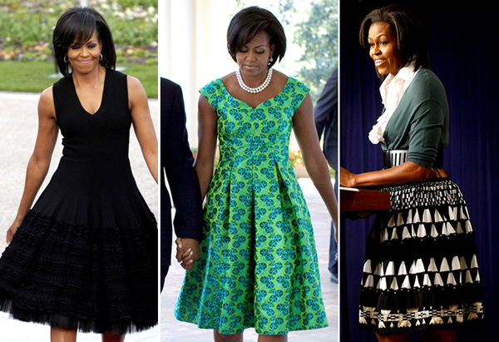
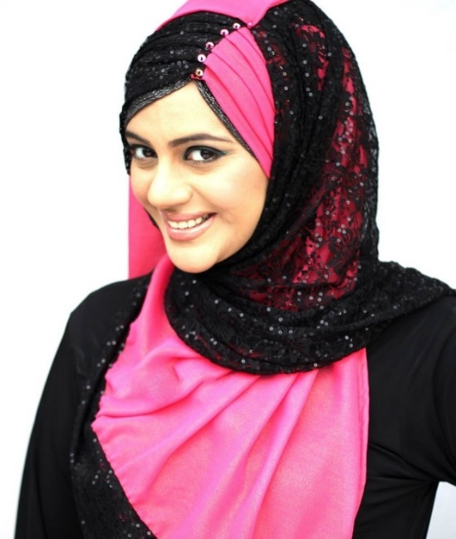
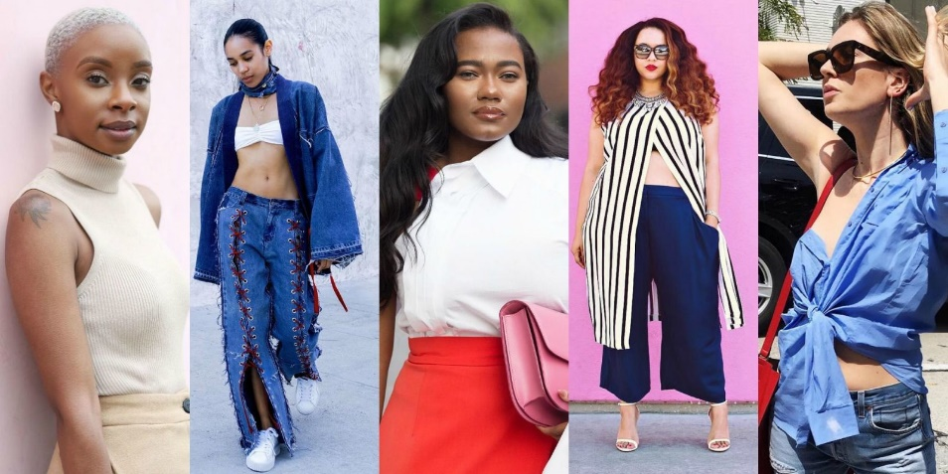
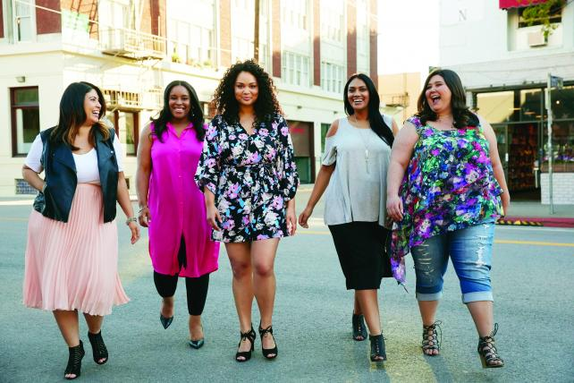
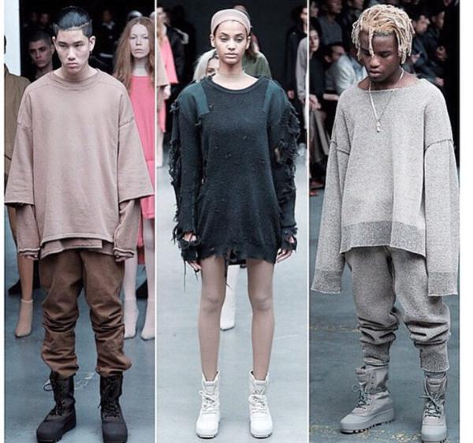
The New Millennium
Street Style
Social Media
Cultural Influences
Economy
Politics
Fast Fashion

