Slide 1
The Clothes Make the Man, the Woman and The Slave

Slide 2
The Clothes Make the Man, the Woman and The Slave
People wear clothing to protect their bodies against nature, to define their social roles, and to express their personalities. But what happens when a person is forced to wear clothing chosen by another? The images and text below show some of the ways that slaveholders used clothing to manipulate the gender identities of black men and women in order to sustain the institution of slavery. They also demonstrate some of the ways in which slaves used clothing both to survive their captivity and to rebel against it.

Slide 3
The Clothes Make the Man, the Woman and The Slave
Gender Specific Clothing
The Power of a Uniform
Clothing for Slave Children
Dress That Oppressed and Clothing That Liberated
Nudity and the Captive Body
Slave Women and the Headwrap

Slide 4
The Clothes Make the Man, the Woman and The Slave
In 1797, George Washington wrote to farm manager James Anderson in regards to clothing his slaves that, "It has always been my aim to feed & cloath them well...- in return, I expect such labour as they ought to render." Despite Washington's assurances, clothing issued to the slaves was minimal, plain, and often coarse. Some textiles were imported and crafted into clothing for slaves at Mount Vernon, while other garments were ordered ready-made in large quantities.
https://www.mountvernon.org/library/digitalhistory/digital-encyclopedia/article/slave-clothing/

Slide 5
Gender Specific Clothing
Adult male and female slaves usually dressed in clothing deemed gender appropriate by white society. Thus, men were given pants, women dresses. In the winter, masters generally distributed extra clothing to their slaves. These supplemental items, and others constructed by the slaves themselves, were also different for men and women. For instance, under their skirts women often made and wore pantalets, pant-like items that reached just above the knee. While men were given knee-length coats to wear during the colder seasons, women received heavy wraps, which they wore as shawls. The picture below, though taken after Emancipation, shows a black man and woman in the gender distinct clothing that they would have worn as slaves.

Slide 6
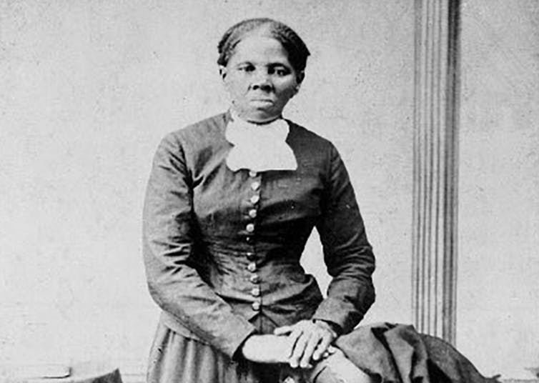
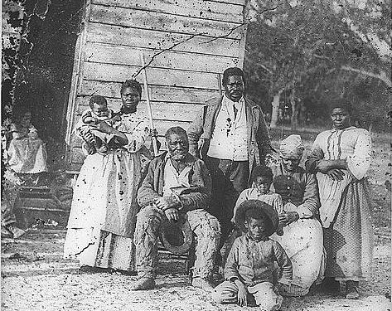
Gender Specific Clothing

Slide 7
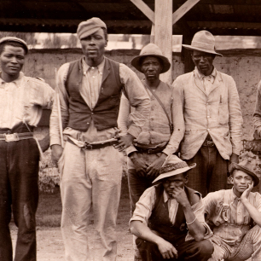
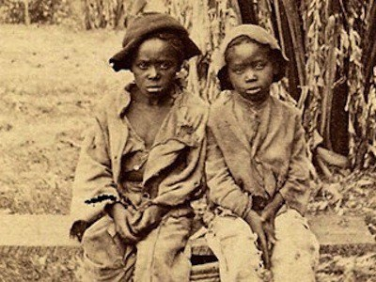
Gender Specific Clothing

Slide 8
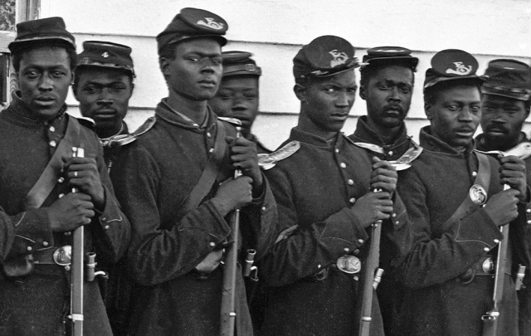
The Power of a Uniform

Slide 9
The Power of a Uniform
Many planters used a philosophy of paternalism to justify slavery. They imagined themselves as the fathers of slaves who needed to be cared for and guided. This way of thinking not only validated the master's ownership of slaves, but also his punishment of those in his custody. It was a system that disempowered all slaves, men and women, relegating them to the status of children. Enslaved men who escaped to union lines and became soldiers gained a renewed sense of power. For the first time, they put on uniforms in wage earning jobs and were permitted to carry firearms. One ex-slave described the experience in this way: "After the war started, I ran off and joined the army ... I was sent to Tullahoma for training. This was the biggest thing that ever happened in my life. I felt like a man, with a uniform on and a gun in my hand ..." This slave's identity as an adult male was restored by his position as a soldier in the fight against slavery and was symbolized by his attire.

Slide 10
Clothing for Slave Children
Slave children were often given minimal amounts of clothing. On some farms, they went entirely naked. Mattie Curtis, who was enslaved in North Carolina, remembered in an interview years later: "I went as naked as Yo' han' till I was fourteen years old. I was naked like that when my nature come to me. Marse Whitfield aren't carin', but atter dat mammy tol' him dat I had ter have clothes." As Mattie's memory suggests, changes in the dress of slaves often occurred at the onset of adolescence. For boys, this usually meant trading in long dress-like shirts, similar to those worn by the children pictured below, for pants. Fountain Hughes, formerly a slave, recalled: " ... you wore a dress like a woman till I was ... ten, twelve, thirteen years old."

Slide 11
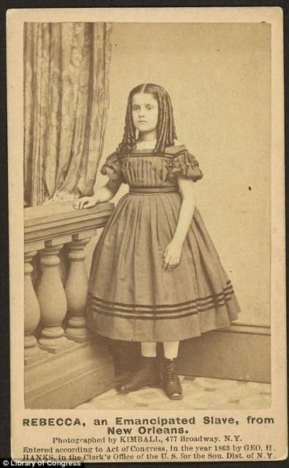
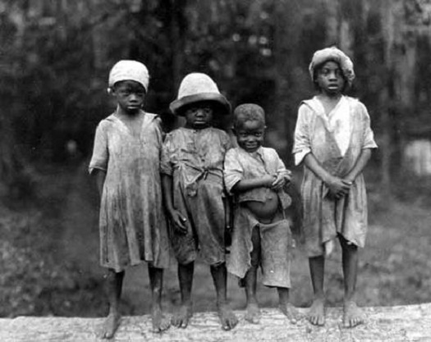
Clothing for Slave Children

Slide 12
Dress That Oppressed and Clothing That Liberated

Slide 13
Dress That Oppressed and Clothing That Liberated
Slave owners manipulated clothing in a variety of ways to oppress their slaves. Female slaves sometimes expressed resentment about dresses that were plain, coarse, and un-feminine. Evidence suggests that dances, attendance at church, and other social gatherings were events for which slave women often put on their fancier dresses and primped themselves in imitation of their mistresses, hoping to attract the attentions of young men. Former slave, Rosa Maddox, declared that good clothes were the reason that she "had lots of beaus." Masters knew that one way of punishing female slaves was to attack their identity as women. Records indicate that at least one master punished a captured female runaway by forcing her to wear attire designed for men. Harriet Jacobs' owner, Dr. Norcum, took a similar approach. Enraged by Harriet's affair with another man, he cut off her long hair, a traditional marker of feminine beauty.

Slide 14
Dress That Oppressed and Clothing That Liberated
Slave women also manipulated clothing, however, and were known to use male garments to their benefit. In the fields, some women made leggings similar to pant legs to protect their calves. Other women employed men's clothing for less practical, more daring ends. Harriet Jacobs fled from the home of Dr. Norcum wearing a sailor's suit, and Ellen Craft, a light skinned black woman escaped captivity disguised as a white man. Posing as her servant, Ellen's husband, William, also achieved freedom.

Slide 15
Nudity and the Captive Body

Slide 16
Nudity and the Captive Body
William Blake's image of a black woman being whipped was created for a book about slavery in Surinam. However, the vision it presents is significant for North American slavery as well. In their efforts to assert control, masters not only dressed their slaves, but also undressed them. Slaves were stripped for inspection on the auction block and often provided with insufficient clothing while working in the fields. Whipping, a common form of slave punishment, demanded the removal of clothing. For the female slave, this generally meant disrobing down to the waist. Although her state of half dress allowed the woman some modesty, it also exposed her naked breasts to all eyes. This sight reinforced white perceptions associating sexuality with the "uncivilized" black female. At the same time, the slave's body, uncovered and vulnerable, could provoke the desire of onlookers, increasing the chances of the woman being sexually assaulted as well.

Slide 17
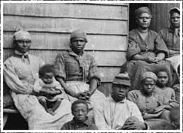
Slave Women and the Headwrap

Slide 18
Slave Women and the Headwrap

Slide 19
Slave Women and the Headwrap
Originally the head-wrap, or turban, was worn by both enslaved men and women. In time, however, it became almost exclusively a female accessory. In the photograph above, the women wear head-wraps, while the men wear hats. For their white European masters, the slaves' head-wraps were signs of poverty and subordination. Accounts of clothing distribution show that masters sometimes allotted extra handkerchiefs to their female slaves, ostensibly to be used as head coverings. In fact, in certain areas of the South, legislation appeared that required black women to wear their hair bound up in this manner.

Slide 20
Slave Women and the Headwrap
The head-wrap, however, was more than a badge of enslavement imposed on female slaves by their owners. Embellishment of the head and hair was a central component of dress in various parts of Africa, particularly in West Africa. From the time European fabrics were made available to them, African women wore head-wraps similar to those worn by their enslaved counterparts in America. For these women, the wrap, which varied in form from region to region, signified communal identity. At the same time, the particular appearance of an individual head-wrap was an expression of personal identity.

Slide 21
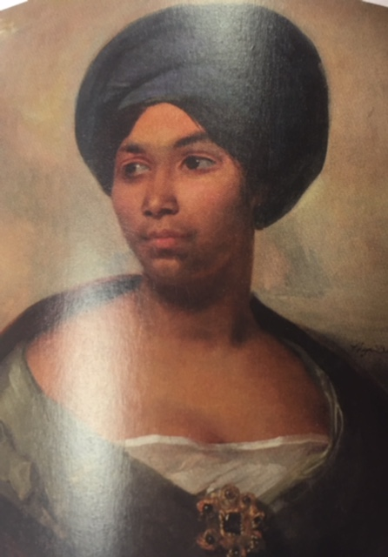
Slave Women and the Headwrap
In America, the head-wrap was a utilitarian item, which kept the slave's hair protected from the elements in which she worked and helped to curb the spread of lice. Yet, as in Africa, the head-wrap also created community -- as an item shared by female slaves -- and individuality, as a thing unique to the wearer. Cassandra Stancil, enslaved in her youth, insisted that she never asked another woman how to tie her head-scarf. "I always figured I could do it," she said, "I could try and experiment and if not get that, get something that I liked." The head-wrap was an object of oppression from one vantage point. But from the other, the perspective of the slave community, it was a vehicle of empowerment and a memento of freedom.

Slide 22
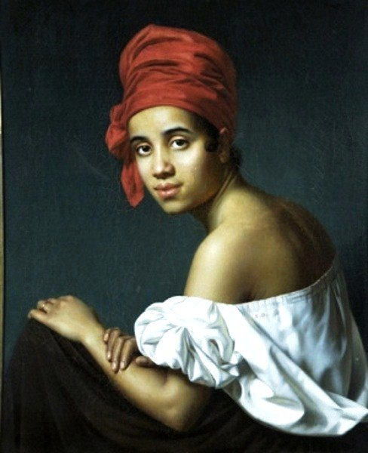
Tignon Laws
Tignon Law – A rule that prohibited black women from displaying their hair.
Tignon – a headwrap
Worn by free and slave Creole women of African ancestry in the mid 1700’s.
This Sumptuary Law was enacted by Governor Esteban Rodriguez Miro to regulate the appearance and style of dress for people of color.

Slide 23
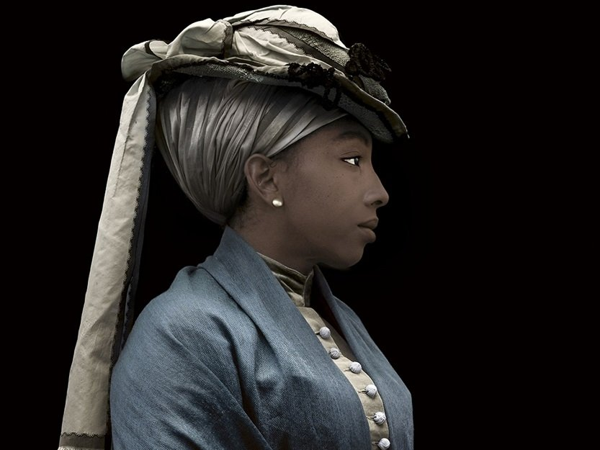
Tignon Laws
It was said that black women’s features often attracted male, white, French, and Spanish suitors and their beauty was a perceived threat to white women.
The Tignon Law was a tactic used to combat these men engaging in affairs with Creole women.
Black women abided by the law and took it and turned it into fashion.
The women used unique colors, jewels, ribbons and wrapping techniques.
Tignon laws went out of effect in the 1800s, but black and other women worldwide continue to use them worldwide as wardrobe staples to pay homage to their culture and/or religions.

Slide 24
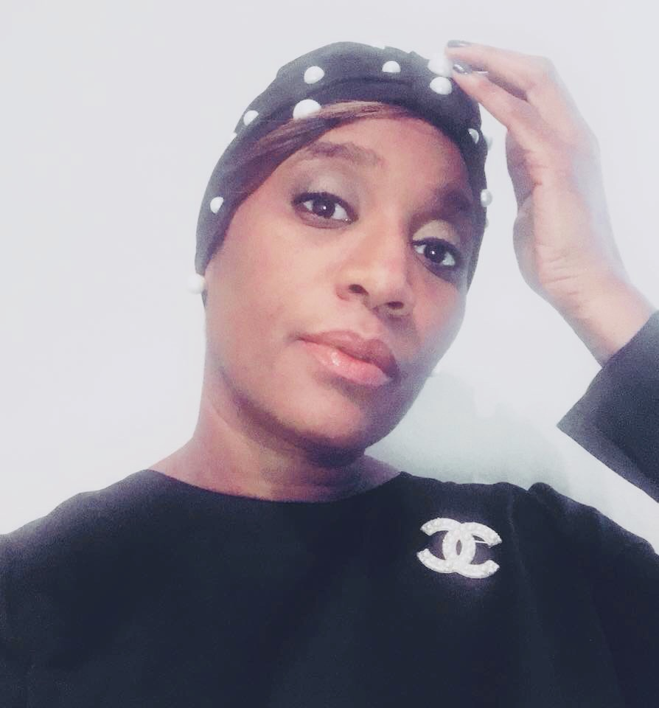
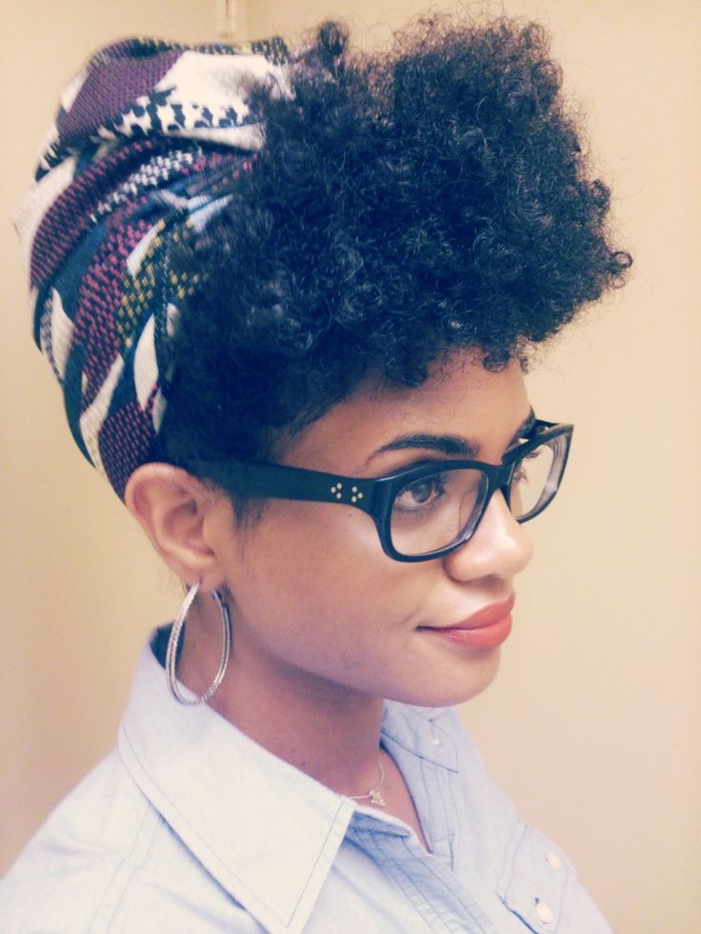
Slave Women and the Headwrap

