Slide 1
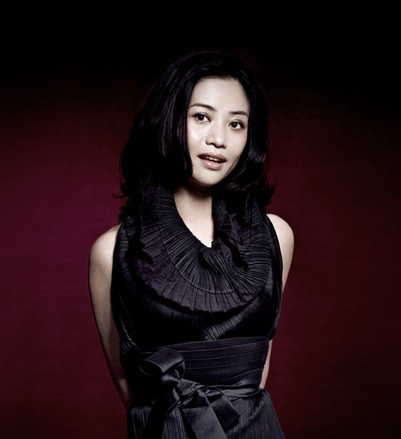
Designer Spotlight Guo Pei

Slide 2
Guo Pei
Chinese Fashion Designer – Born in Beijing in 1967
Started sewing at age two
Studied Fashion Design at Beijing School of Industrial Fashion Design
Three years after graduating, she became the chief designer at one of Beijing’s independently owned clothing companies
1997, she launched her own label and atelier, Rose Studio
2nd born and raised Asian designer to be invited to be a member of the Chambre Sydicale de la Haute Couture

Slide 3
Chambre Syndicale De La Couture
It is the regulating commission that determines which fashion design houses are eligible to be true haute couture houses. Within the Fédération the Syndicale is a body that promotes, educates, represents, defends, deals with social and working benefits and advises its members in all relations between labor and management, including great names of the Paris couture world. The Syndicale also deals with piracy of styles, foreign relations and organization and coordination of the fashion collection timetables. They also institute some collective international advertising for the French fashion industry.

Slide 4
Chambre Syndicale De La Couture
According to Chambre Syndicale De La Couture rules, to classify as a couture house a couturier must produce 50 new and original designs of day and evening wear for each collection. They must show 2 collections a year. They must employ a minimum of at least twenty full-time technical people in at least one atelier or workshop.
Because of the strict regulations by the Chambre only a few design houses can use the exclusive Haute Couture label. The current number of couture classification houses are entitled to free advertising on state run French television.
Private buyers form only a fraction of the sales of a couture house. Manufacturers attend collections to buy models, toile patterns or to seek inspiration. Bi-annually in January and July buyers and world press flock to Paris for the spring/summer and fall/winter Haute Couture and Ready To Wear/Prêt-à-Porter collections. The Fédération Françoise oversees the smooth running of organizing the buyers and press with the Chambre Syndicale.

Slide 5
Guo Pei
Her aesthetic borrows heavily from the traditional Chinese imperial court designs
Her designs use a lot of fur, silk, and embroidery work
Pei has worked as a costume designer on films and also did work on costumes worn at the 2008 Summer Olympics
In 2008, she conceived a canary yellow floor length dress with a large circular train, edged with yellow colored fur and embroidered with silver floral patterns. It took approximately 50,000 hours over the course of 2 years for her design team to create and it weighed 55 lbs.
Singer Rihanna came across the gown online when she was researching what to wear to the 2015 Met Gala in New York City

Slide 6
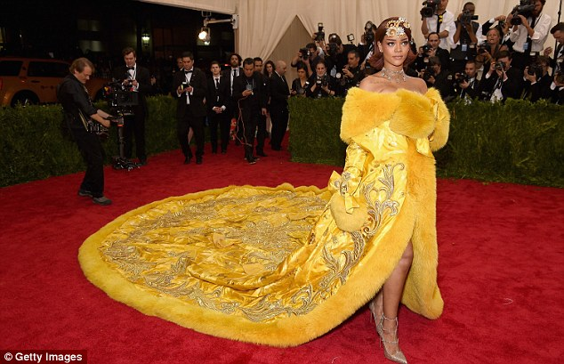
Guo Pei

Slide 7
Guo Pei
In 2016, she was also named one of TIME magazine’s 100 Most Influential People and one of the Business of Fashion's 500 most influential people shaping the global fashion industry.
Today, she employs nearly 500 skilled artisans dedicated to producing her stunning creations, some of which can take thousands of hours and up to two years to complete.
She has a new studio on the prestigious Rue Saint Honoré in Paris, and has launched her own eponymous brand, Guo Pei

Slide 8
Guo Pei
https://www.youtube.com/watch?v=_pJTNQSvbcI
https://www.youtube.com/watch?v=MIbCxM6EiPo

Slide 9
Guo Pei
https://www.youtube.com/watch?v=C_E4j0T59Jc
https://www.youtube.com/watch?v=a1ew-tsk8KA

