Slide 1
Don’t forget to call grandpa!
By: Angie, Susan, Ashley, Christian, and Sarah, RubIannys, Carmen

Slide 2
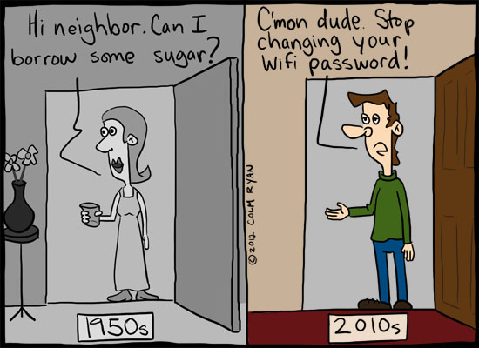
1930s
1930-2014
Between our grandparents ‘ day and age and now we are lacking the basic principles they lived by.

Slide 3

Basic principles
Communication and Social Skills
Religion
Family Life
Family Traditions
Respect
These beliefs and misunderstandings hinder the interpersonal communication process because these five concepts suspend the ability to gain any relationship.

Slide 4
Technology
Sarah

Slide 5


Slide 6
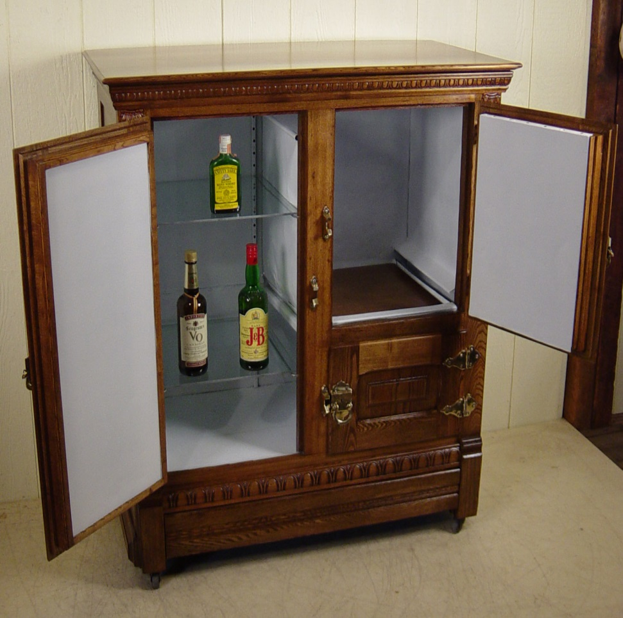
Then versus now
A fridge [or icebox] consisted of a small, two-door, wooden cabinet
Clothing was hand-washed and hung to dry in the backyard
Family meals took place without the interference of phones
Parents could not get ahold of their children as easily

Slide 7


Slide 8
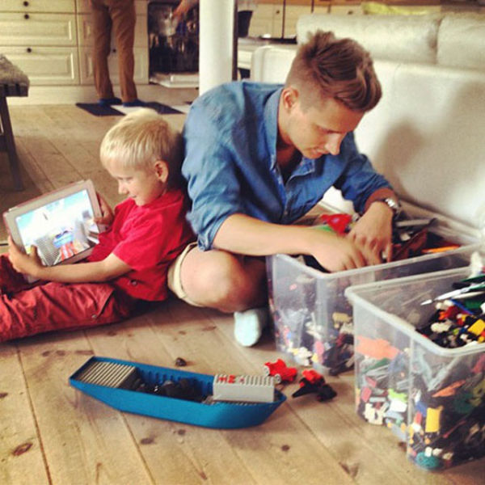
Then versus now
Children have no imagination
Everything is available at the click of a button
According to a Pew Internet Study, children’s attention span in 2004 was 12 minutes. In 2014, it is 5 minutes

Slide 9
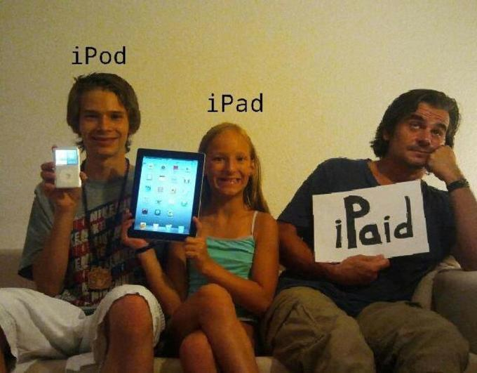
“I fear the day that technology will surpass our human interaction. The world will have a generation of idiots.”
- Albert Einstein

Slide 10
Religion
Rubiannys

Slide 11

Introduction
Religion has remained vibrant and vital. New issues and interest have emerged, but religions role in society remains intact. However, we believe that what distinguishes past generations with this one is diversity and development.

Slide 12

Introduction
Nearly 6 out of 10 Americans pray one or more times each day
However, belief in God has slipped and a growing number of Americans are finding themselves questioning God’s certainty
With modernization and better education, religious beliefs and behaviors across countries tend to decline

Slide 13
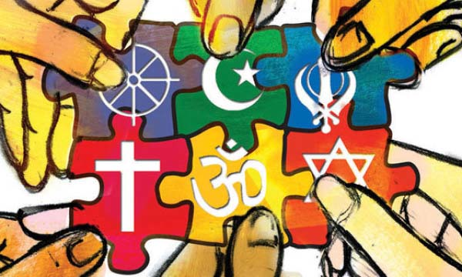
The Beginning
Religion had humble beginnings, but as Rome fell and we entered the dark ages, Christianity became a very powerful force
People needed hope in something greater and a life beyond this one and Christianity’s message gave people something to believe in

Slide 14

RELIGION:
then and now
The biggest difference one would need to point out is that religion is considered today to be little more than someone's personal, spiritual beliefs - nothing is gained or granted in the West from being one religion or another. Christians simply maintain their own faith and congregate together, Jews go to their temples, Muslims pray in their Mosques, but there's no political acceptance or endorsement for any of these religions.

Slide 15
What made Religion so strong back then?
Medicine and treatment were no longer available
There was no law of the land to keep the lords in check
The uncertainty of the soul after death
The Unifying force?
Religion did not serve as a personal, spiritual beacon, but something of a guild, a union, or a society of which everyone could lean on one another for support

Slide 16

Development and science
WHAT IS THE PRICE?

Slide 17


The price
In the past, the majority of the people had no formal education but, things have changed drastically.
Knowledge of science and technology gave our traditional way of life a big setback. Belief in superstitions has almost vanished. Faith in religions also has also been shaken.

Slide 18
The price
Earlier, most people were involved in agriculture and fishing. Most of these people were illiterate with a blind faith in God. They did not have the courage to argue on issues relating to religion.
With changing times, people got the opportunity of interacting with each other, in person or through television and analyzing everything, religious or otherwise.

Slide 19
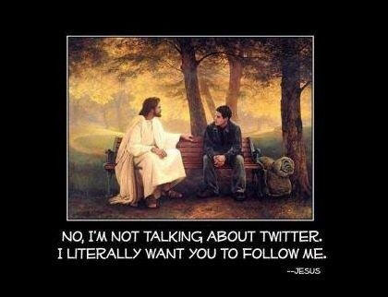
The matter of religion
With the belief in technology, the bond with religion is growing weaker and as we stray we are losing the importance of values
Regardless of which religion, they all teach the value of love, sacrifice, and brotherhood

Slide 20
Family Life: then and Now
Christian

Slide 21
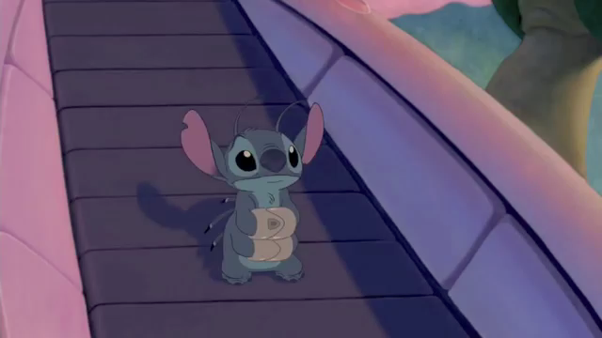
“New research about an old institution challenges the conventional wisdom that the family today is worse off than in the past.” - Stephanie Coontz

Slide 22
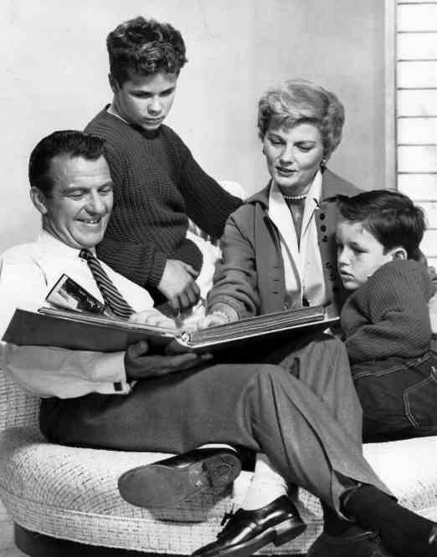
1950’s television series called “Leave it to Beaver” shows the idealized suburban family of the mid 20th century.

Slide 23
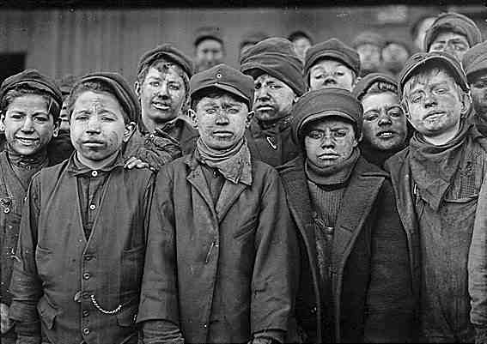
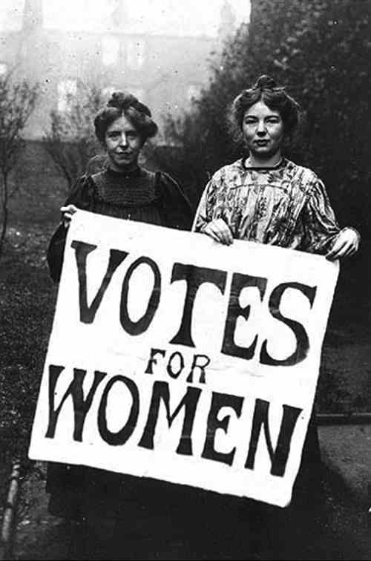
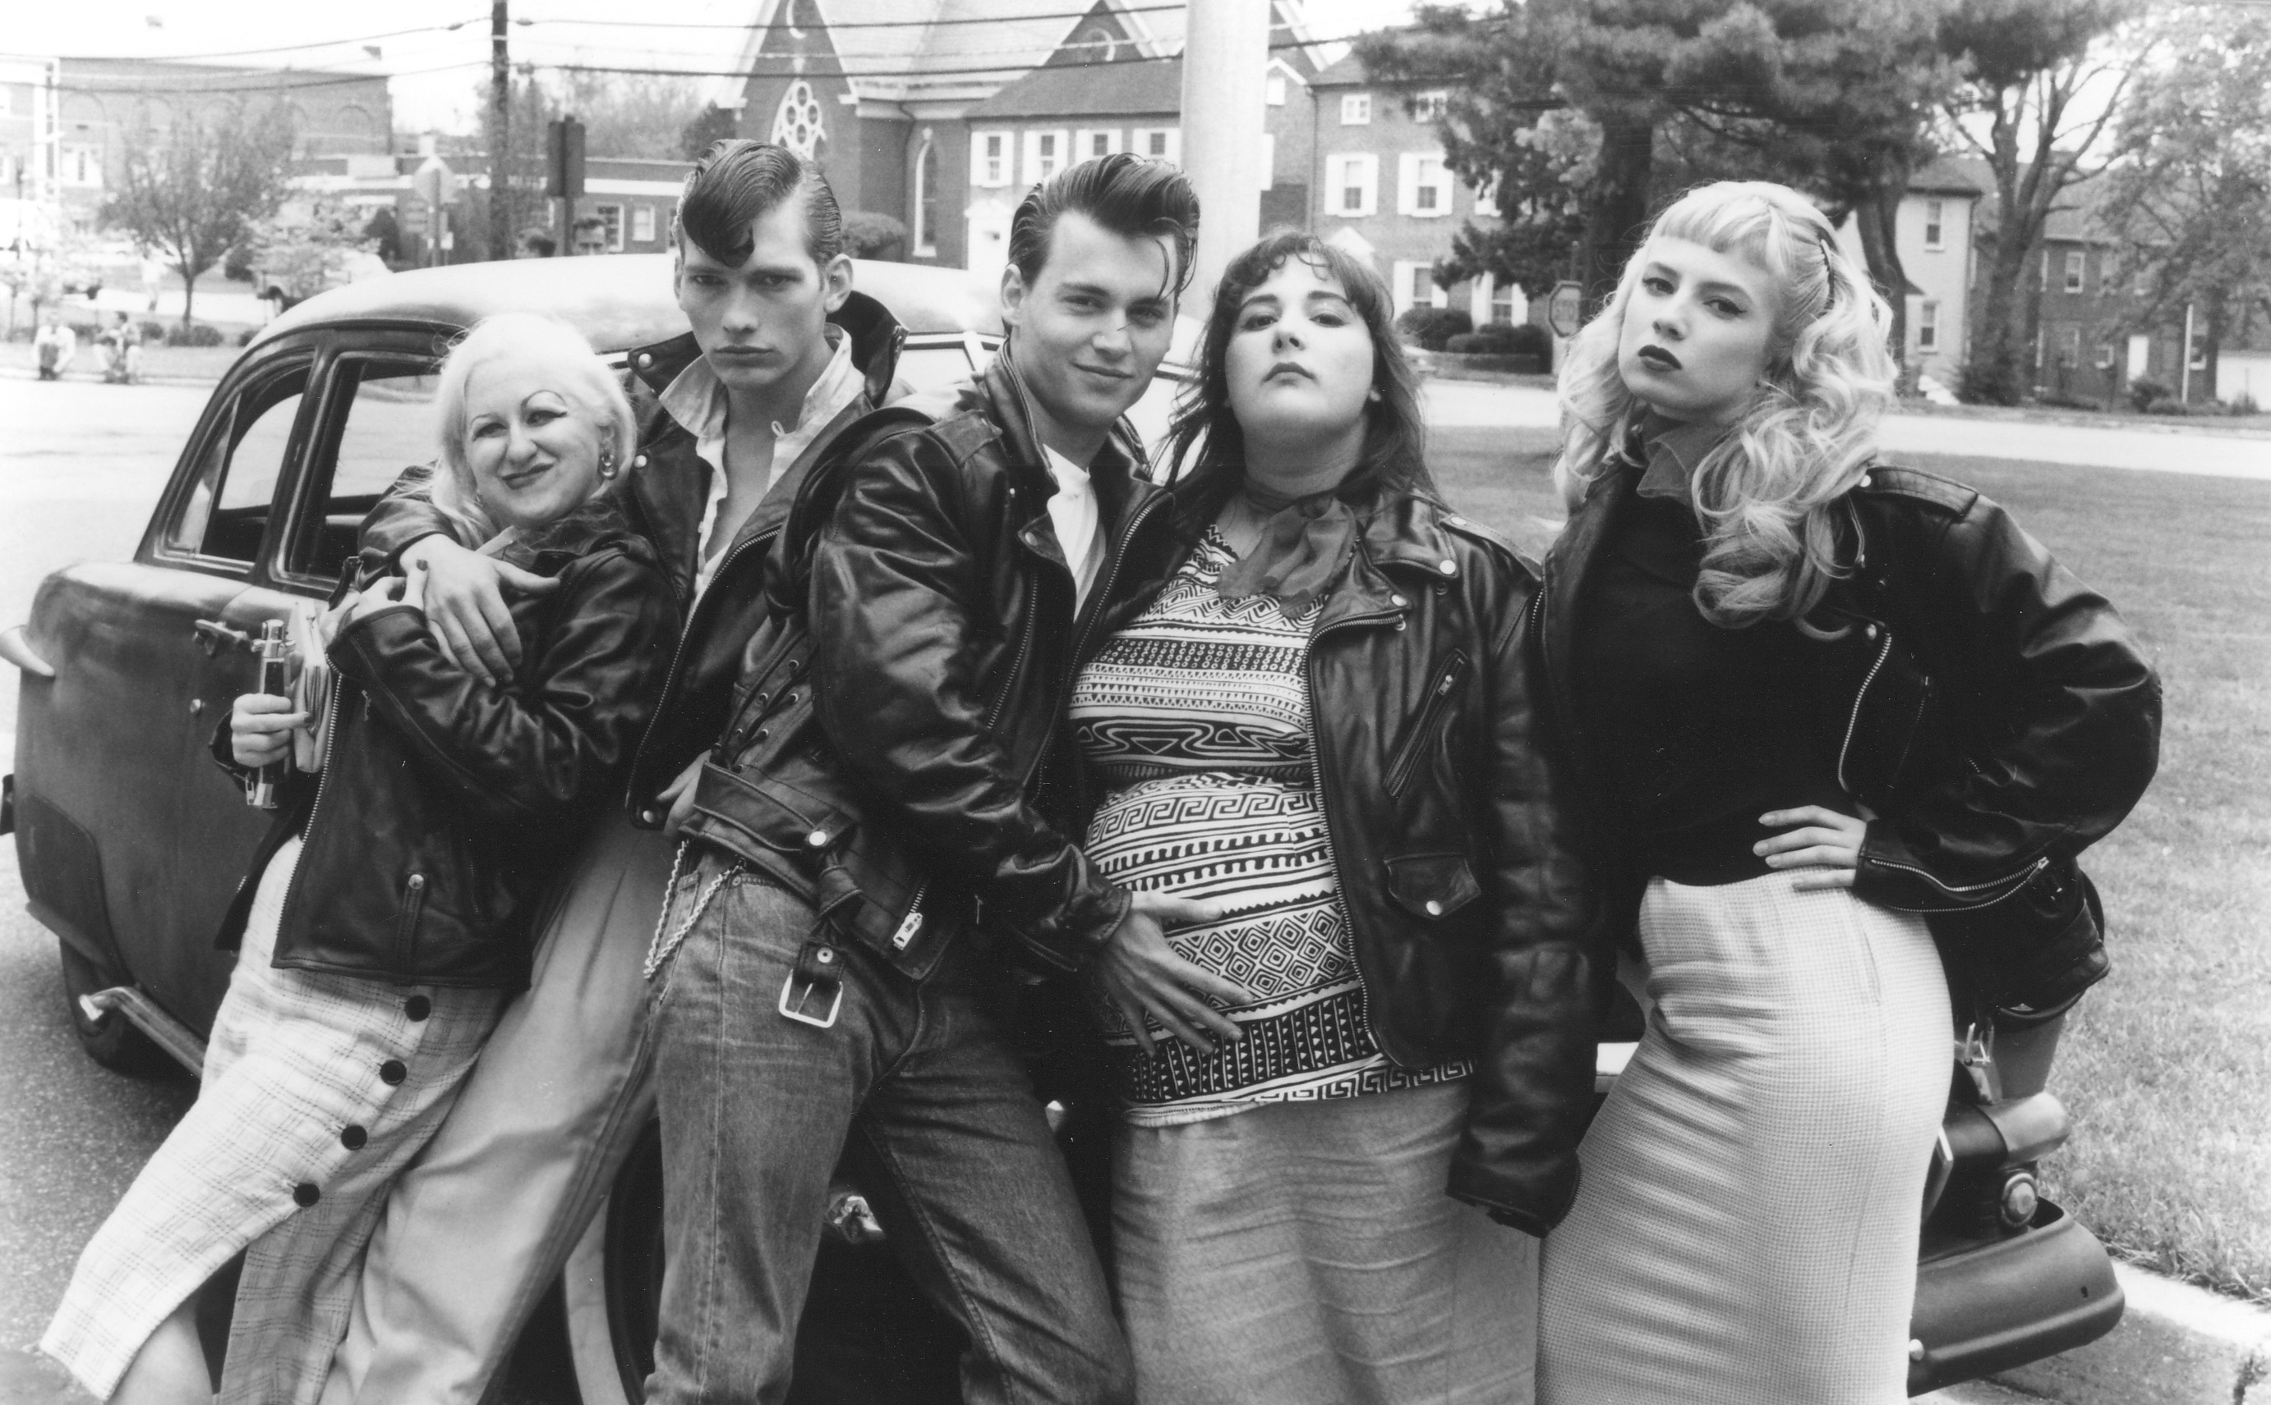
2B
Parens Patriae
Binet’s IQ Test
Child Welfare specialist, social workers, and private psychologists
1A
3C
1836 – First Child Labor Law
1936 – Federal Purchase Law
1938 – Minimum Age
1963 – Equal Pay Act
2006 – “Partial Birth”
2009 – “Fair Pay Restoration Act”

Slide 24
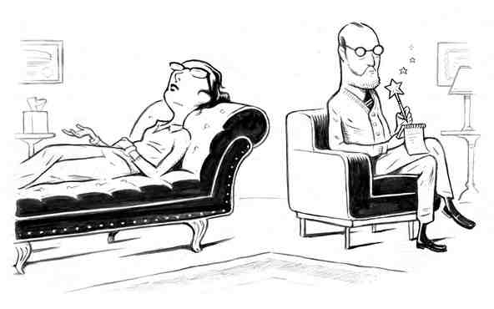
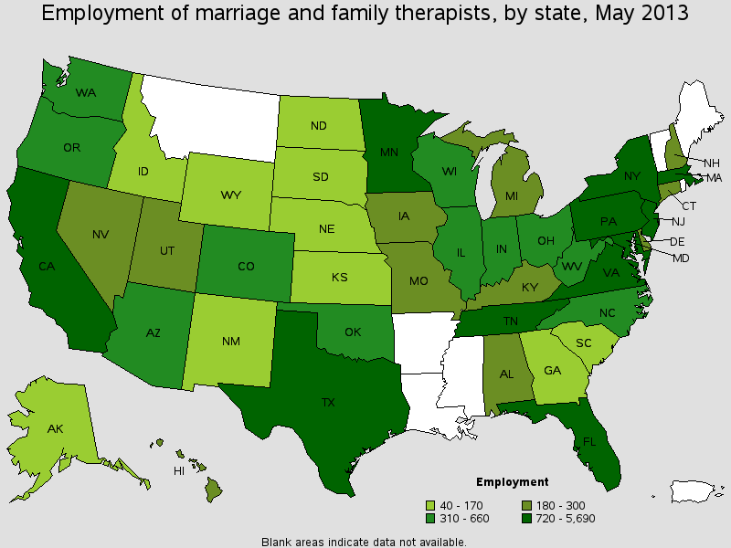
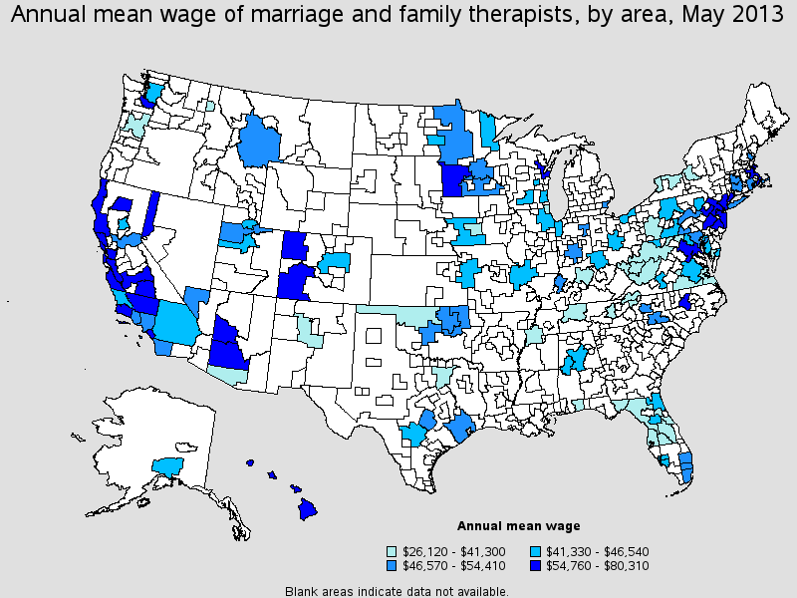
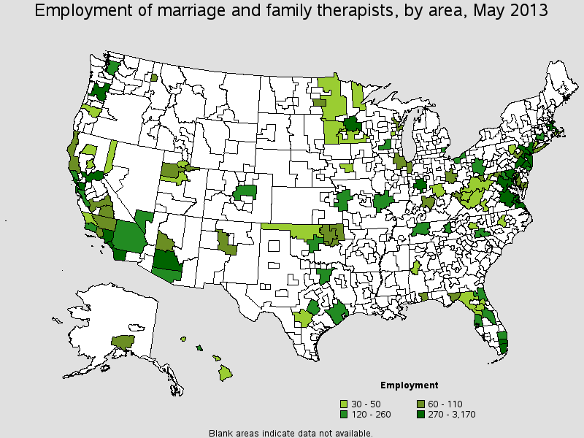

Slide 25
Family Gatherings
Ashley

Slide 26
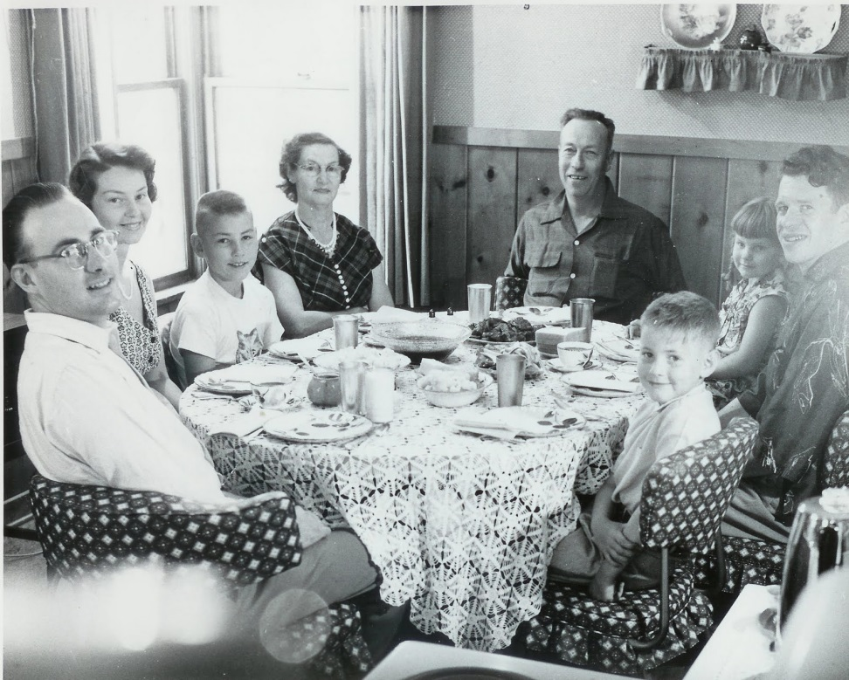
1920’s – 1970’s
At family gatherings like birthday parties and holidays the families would have different tables for the adults and for the children due to conversations
Women started working during this time so they didn’t have enough time to cook and clean for family holiday gatherings
Families were close, they were having casual meet ups once a week; usually on Sundays after church

Slide 27
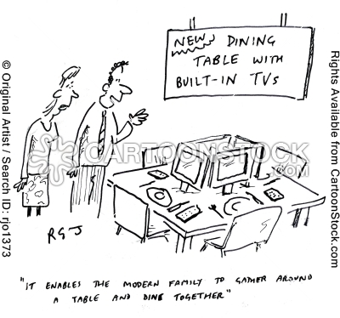
1980 - 1990
Most of the families were drifting apart; they were becoming more independent and more into technology
Immediate families weren’t close but they still had “family time”

Slide 28
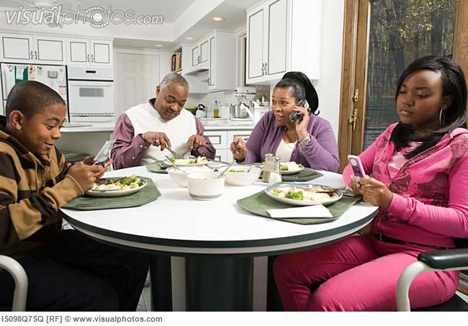
2000 - Now
Families don’t get together as much as they did. Some families are very distant from each other and don’t communicate a lot
If families do get together for a holiday or some kind of family event they don’t stay long. They usually leave after two to four hours
Some families don’t even know most of their relatives

Slide 29
Respect and discipline
Angie and Susan

Slide 30
Social Behavior and Etiquette
When looking Back at the men and women of the early 1900’s we can obviously see the change in social behavior and etiquette from then and now.
So much has been socially modified throughout the course of time. Such as:
  Core Values
  Attributes

Slide 31
Core Values
1900’s – 1950’s
1980’s - Now
Traditionalist
  Discipline
  Patience
  Responsibility
  Duty before pleasure
  Quality
  Family focus
Millennials
  Tolerant
  “I Want It NOW!” attitude
  Sociable
  Extreme fun
  Quantity
  Friendly scheduled, but structured lives; kids with schedules

Slide 32

“I want it NOW!”

Slide 33
Quality versus Quantity

Slide 34
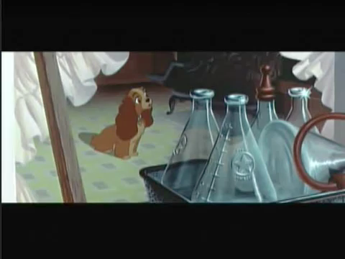

Slide 35
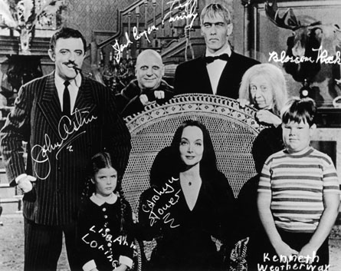
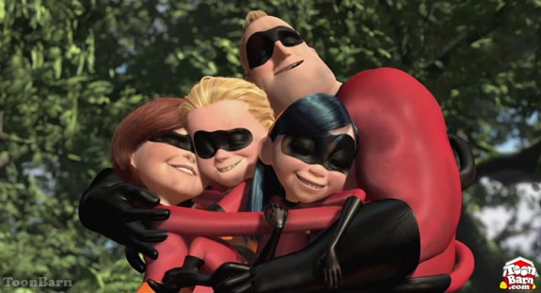
Family Moments
Meal times
Outings at the park
Listening to shows on radio
Study time
Play time/ Togetherness

Slide 36

Busy Lives
Eating when and where you can
Scheduled play dates with friends
A television in EVERY ROOM
Individual study time at your leisure
Scheduling family time

Slide 37
Attributes
1900’s – 1950’s
1980’s - Now
Traditionalists
  Trust in hierarchy and authority
  Honor
  Loyalty
  Strong work ethic
  Sacrifice
Millennials
  Very patriotic (shaped by 9/11) /Political Savvy
  Self-absorbed/strong sense of entitlement
  Loyalty of self over peers; “Me First” attitude
  Respect given for competency no title / Strong sense of entitlement
  Eager to spend money

Slide 38



Loyalty:
A strong feeling of support or allegiance

Slide 39
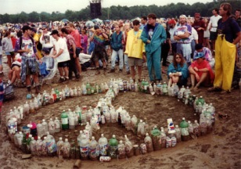
Vietnam War and Peace Movement

Slide 40
If we don’t take control of these changes, what will come of future generations?

Slide 41
Works cited
Sarah:
http://www.pbs.org/wgbh/aso/thenandnow/tech.html
http://psychminds.com/is-the-internet-destroying-our-attentions-span/
Christian:
www.continuetolearn.ulowa.edu
www.bls.gov
Infoplease.com
Historyforensicpsych.umwbloss.ors.
Ashley:
Rubi:
Susan and Angie:

