Slide 1
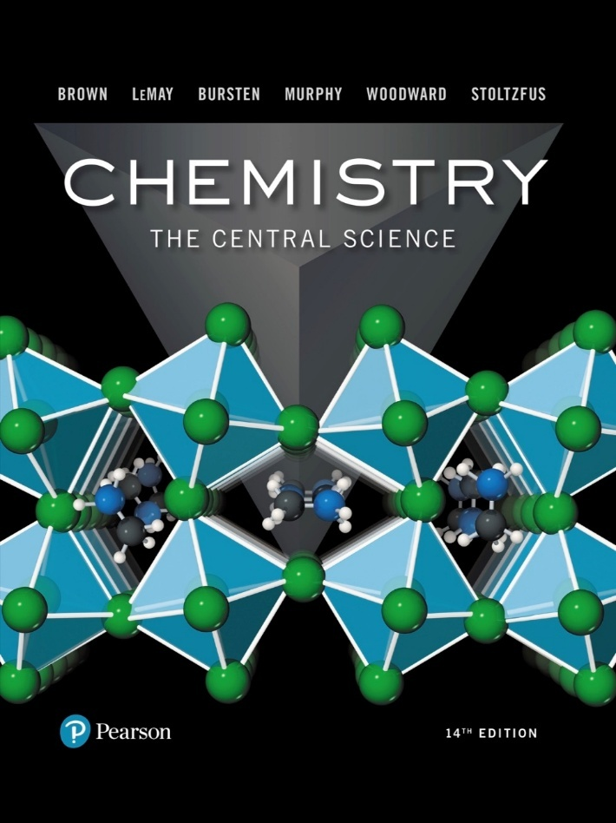
Chemistry: The Central Science
Fourteenth Edition
Chapter 7
Periodic Properties of the Elements
Copyright © 2018, 2015, 2012 Pearson Education, Inc. All Rights Reserved
Notes:
If this PowerPoint presentation contains mathematical equations, you may need to check that your computer has the following installed:
1) MathType Plugin
2) Math Player (free versions available)
3) NVDA Reader (free versions available)

Slide 2
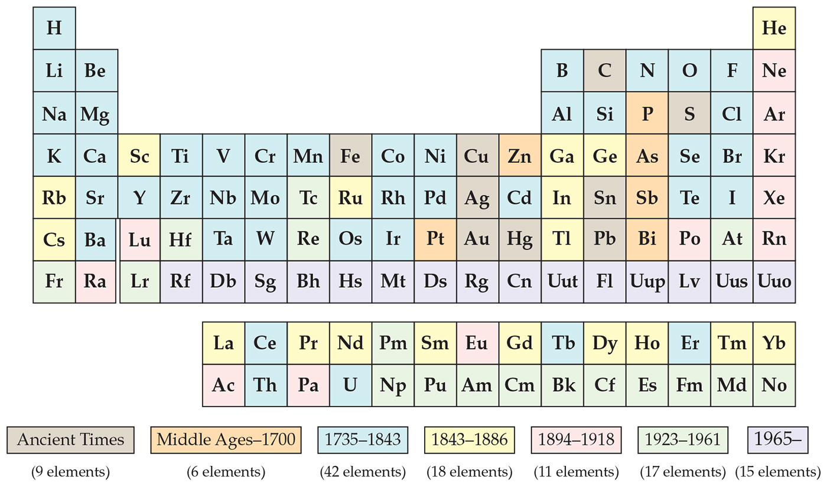
Development of the Periodic Table
Dmitri Mendeleev and Lothar Meyer independently came to the same conclusion about how elements should be grouped.

Slide 3
Mendeleev and the Periodic Table
Table 7.1 Comparison of the Properties of Eka-Silicon Predicted by Mendeleev with the Observed Properties of Germanium
Property | Mendeleev’s Predictions for Eka-Silicon (made in 1871) | Observed Properties of Germanium (discovered in 1886)
Atomic weight | 72 | 72.59
Density (gram per centimeter cubed) | 5.5 | 5.35
Specific heat (joule per gram - kelvin) | 0.305 | 0.309
Melting point (°C) | High | 947
Color | Dark gray | Grayish white
Formula of oxide | XO₂ | GeO₂
Density of oxide (gram per centimeter cubed) | 4.7 | 4.70
Formula of chloride | XCl₄ | GeCl₄
Boiling point of chloride (°C) | A little under 100 | 84
Chemists mostly credit Mendeleev because he also used chemical properties to organize the table and predicted some missing elements and their expected properties, including germanium.

Slide 4
Atomic Number
Mendeleev’s table was based on atomic masses. It was the most fundamental property of elements known at the time.
About 35 years later, the nuclear atom was discovered by Ernest Rutherford.
Henry Moseley developed the concept of atomic number experimentally. The number of protons was considered the basis for the periodic property of elements.

Slide 5
Periodicity
Periodicity is the repetitive pattern of a property for elements based on atomic number.
The following properties are discussed in this chapter:
Sizes of atoms and ions
Ionization energy
Electron affinity
Some group chemical property trends
First, we will discuss a fundamental property that leads to may of the trends, effective nuclear charge.

Slide 6
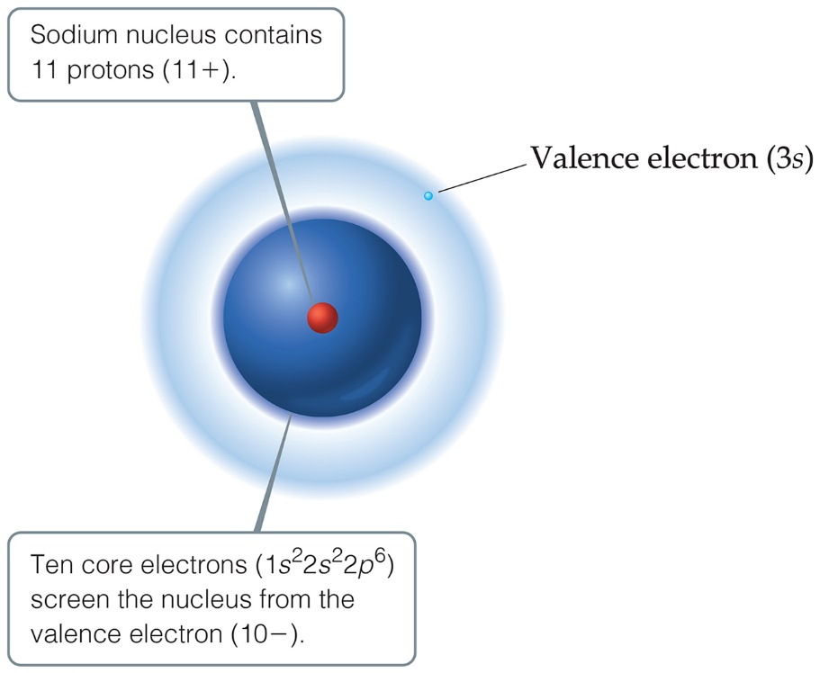
Effective Nuclear Charge (1 of 2)
Many properties depend on attractions between valence electrons and the nucleus.
Electrons are both attracted to the nucleus and repelled by other electrons.
The forces an electron experiences depend on both factors.

Slide 7
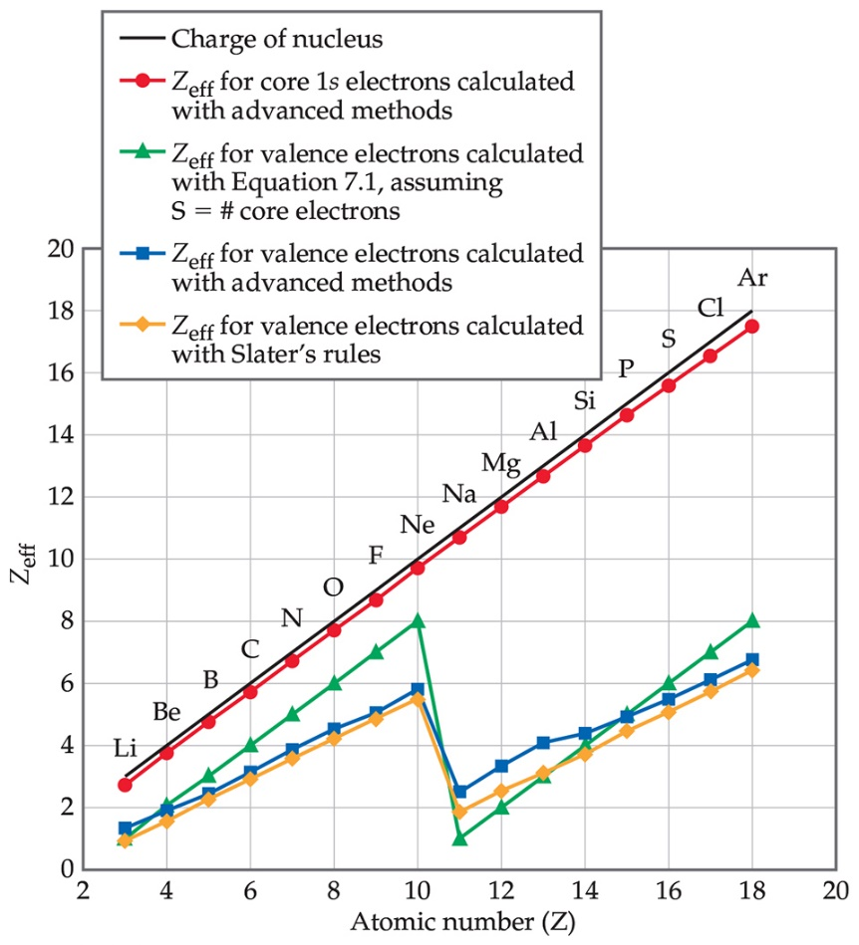
Effective Nuclear Charge (2 of 2)
The effective nuclear charge, Z_{eff}, is found this way:
Z_{eff} = Z − S
where Z is the atomic number and S is a screening constant, usually close to the number of inner electrons.
Effective nuclear charge is a periodic property:
It increases across a period.
It increases slightly down a group.

Slide 8
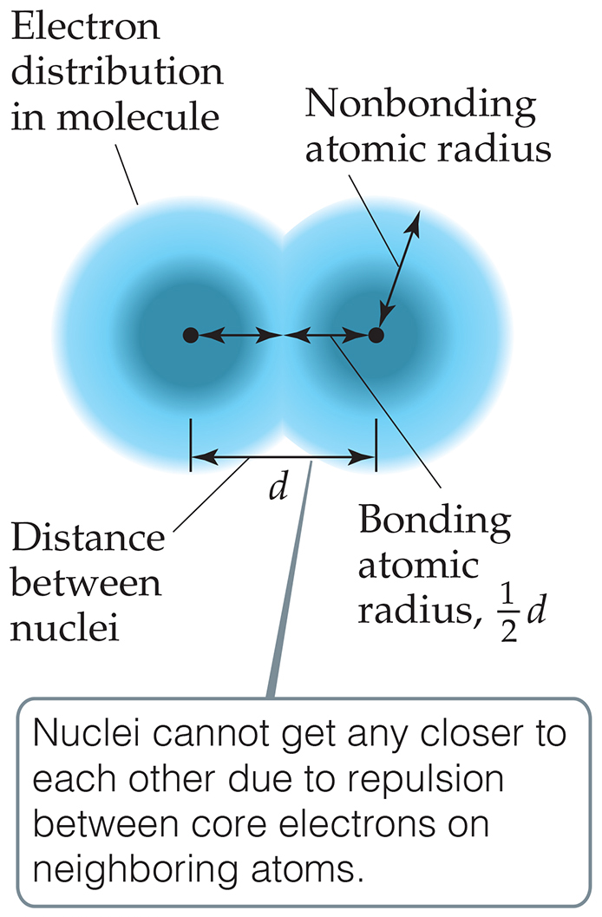
What Is the Size of an Atom?
The nonbonding atomic radius, or van der Waals radius, is half of the shortest distance separating two nuclei during a collision of atoms.
The bonding atomic radius, or covalent radius, is half the distance between nuclei in a bond.

Slide 9
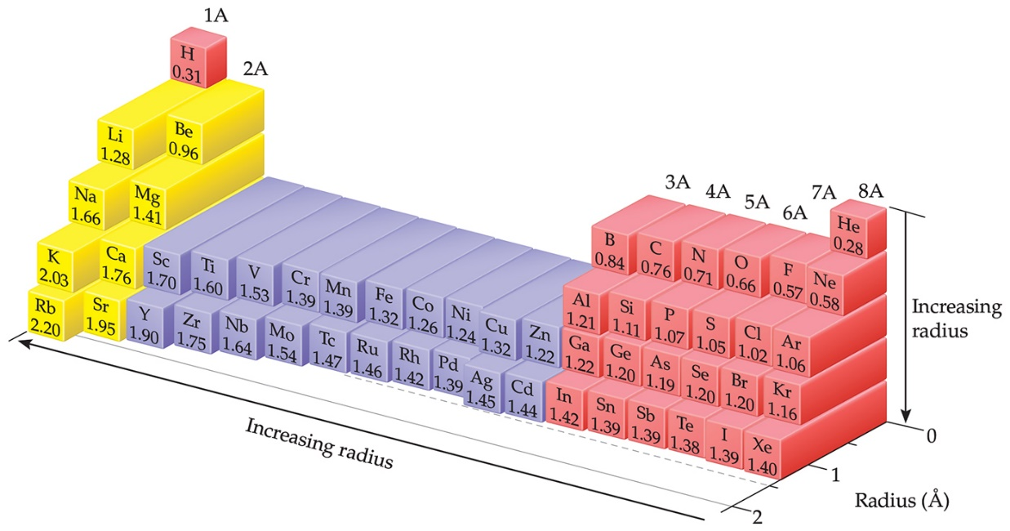
Sizes of Atoms
This figure shows the trend in bonding atomic radius.
The bonding atomic radius tends to
decrease from left to right across a period (Z_{eff} ↑).
increase from top to bottom of a group (n ↑).

Slide 10
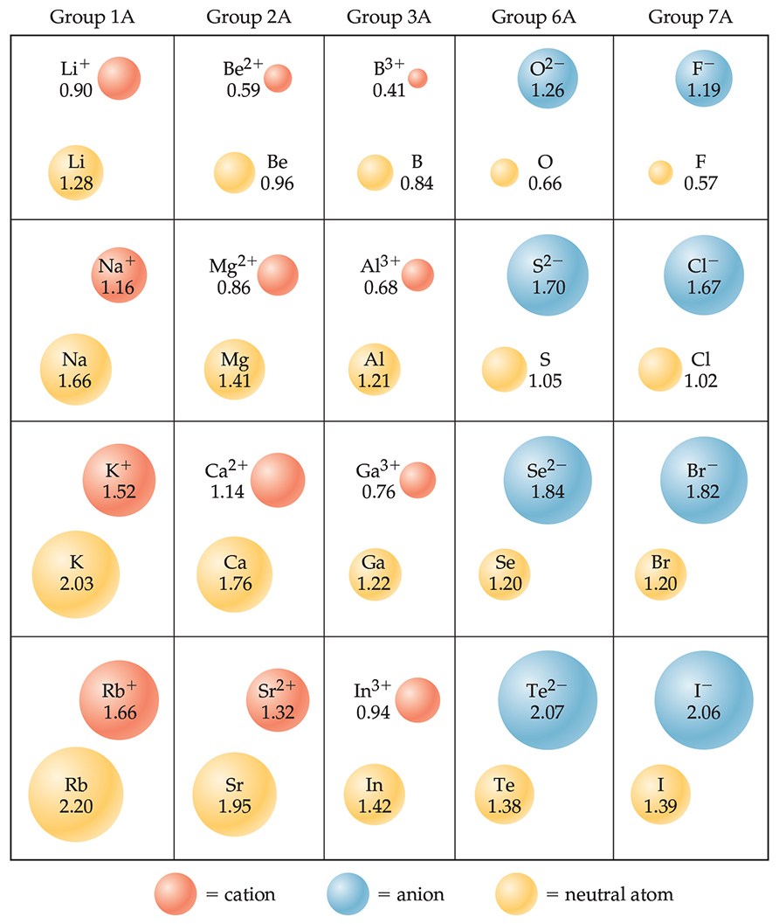
Sizes of Ions (1 of 2)
Determined by interatomic distances in ionic compounds
Ionic size depends on
the nuclear charge.
the number of electrons.
the orbitals in which electrons reside.

Slide 11
Sizes of Ions (2 of 2)
Cations are smaller than their parent atoms:
The outermost electron is removed and repulsions between electrons are reduced.
Anions are larger than their parent atoms:
Electrons are added and repulsions between electrons are increased.

Slide 12
Size of Ions—Isoelectronic Series
In an isoelectronic series, ions have the same number of electrons.
Ionic size decreases with an increasing nuclear charge.
An isoelectronic series (10 electrons)
Note increasing nuclear charge with decreasing ionic radius as atomic number increases
Increasing nuclear charge →
Decreasing ionic radius →

Slide 13
Ionization Energy (I)
The ionization energy is the minimum energy required to remove an electron from the ground state of a gaseous atom or ion.
The first ionization energy is that energy required to remove the first electron.
The second ionization energy is that energy required to remove the second electron.
Note: The higher the ionization energy, the more difficult it is to remove an electron!

Slide 14
Ionization Energy
It requires more energy to remove each successive electron.
When all valence electrons have been removed, it takes a great deal more energy to remove the next electron (a core electron).
Table 7.2 Successive Values of Ionization Energies, I, for the Elements Sodium through Argon (kJ/m o l)

Slide 15
Periodic Trends in First Ionization Energy (I₁)
I₁ generally increases across a period.
I₁ generally decreases down a group.
The s- and p-block elements show a larger range of values for I₁. (The d-block generally increases slowly across the period; the f-block elements show only small variations.)

Slide 16
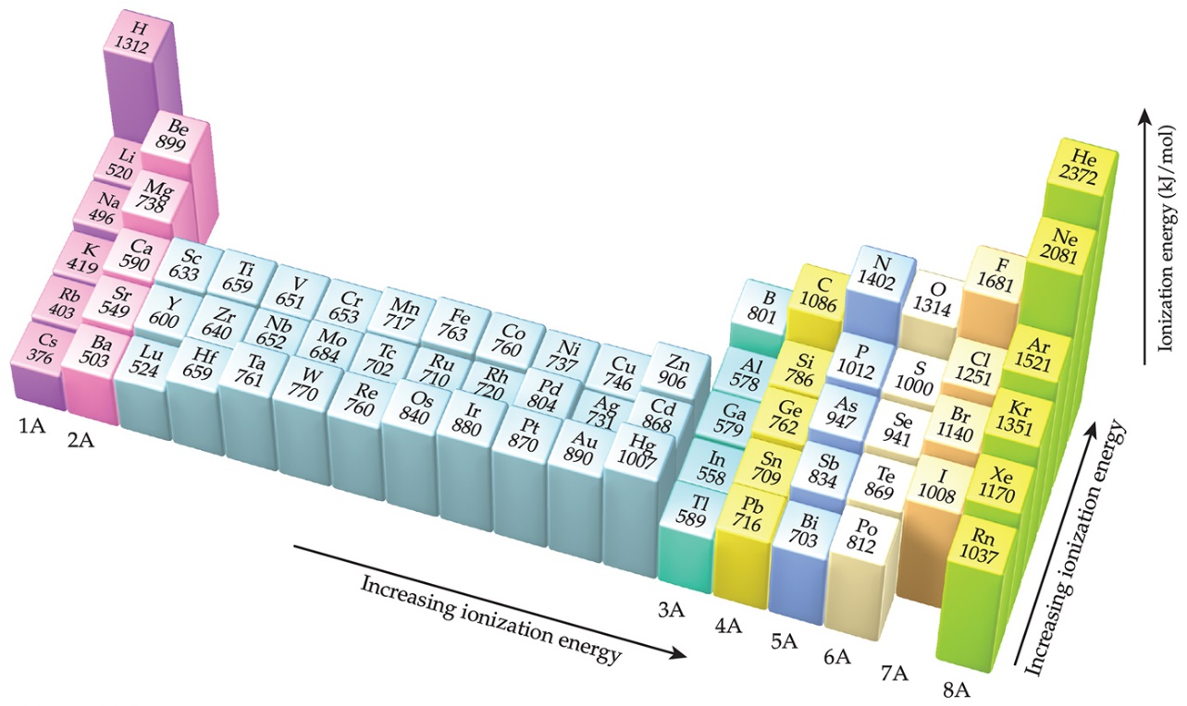
Factors That Influence Ionization Energy
Smaller atoms have higher I values.
I values depend on effective nuclear charge and average distance of the electron from the nucleus.

Slide 17
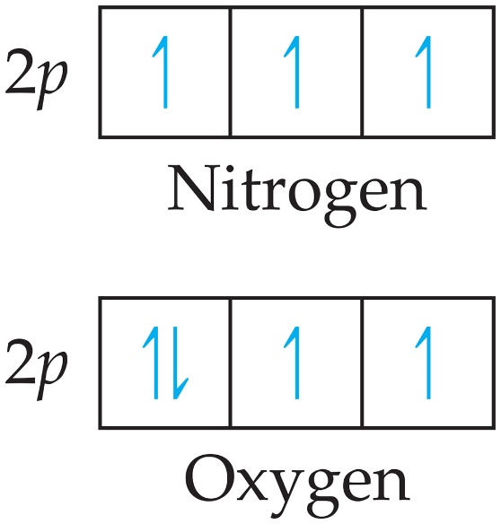
Irregularities in the General Trend
The trend is not followed when the added valence electron in the next element
enters a new sublevel (higher energy sublevel);
is the first electron to pair in one orbital of the sublevel (electron repulsions lower energy).

Slide 18
Electron Configurations of Ions
Cations: The electrons are lost from the highest energy level (n value).
(losing a 2s electron).
(losing two 4s electrons).
Anions: The electron configurations are filled to
for example,
is
(gaining one electron in
2p).

Slide 19
Electron Affinity
Electron affinity is the energy change accompanying the addition of an electron to a gaseous atom:
It is typically exothermic, so, for most elements, it is negative!

Slide 20
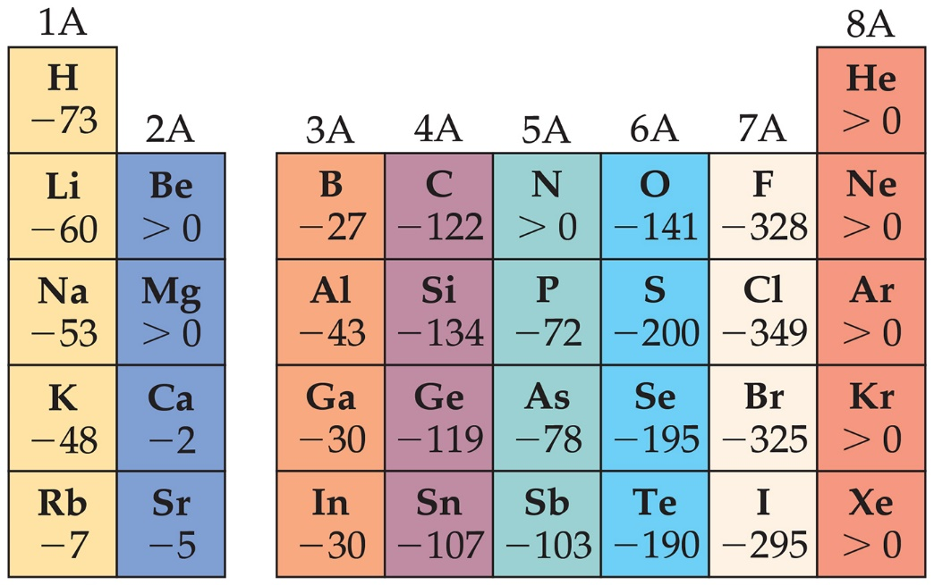
General Trend in Electron Affinity
Not much change in a group.
Across a period, it generally increases. Three notable exceptions include the following:
Group 2A: s sublevel is full!
Group 5A: p sublevel is half-full!
Group 8A: p sublevel is full!
*Note: The electron affinity for many of these elements is
positive

Slide 21
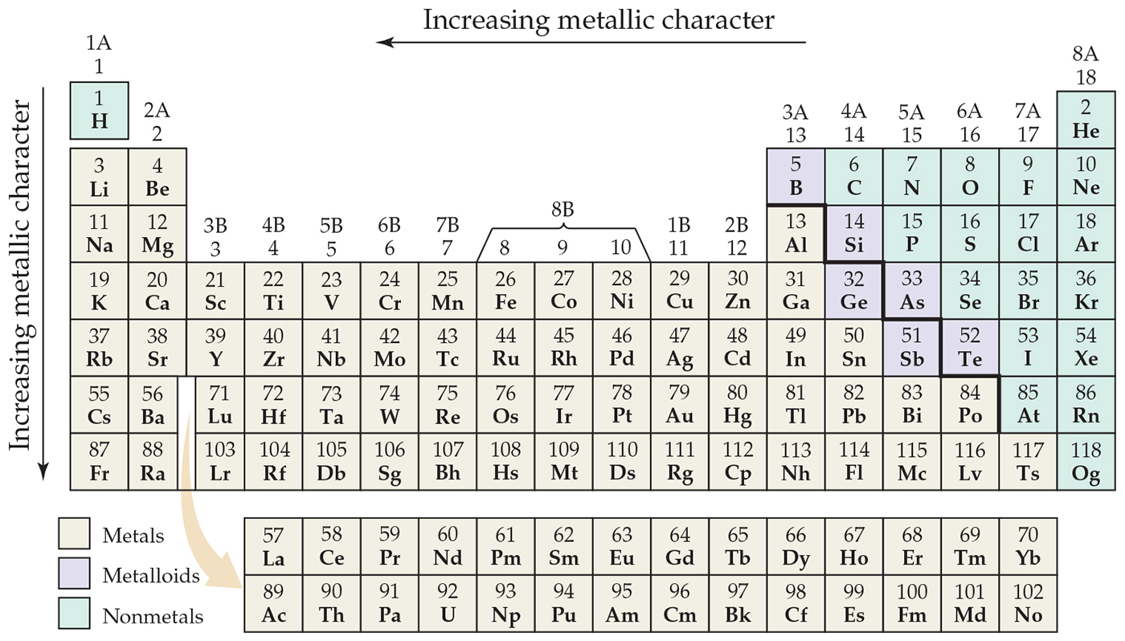
Metal, Nonmetals, and Metalloids

Slide 22
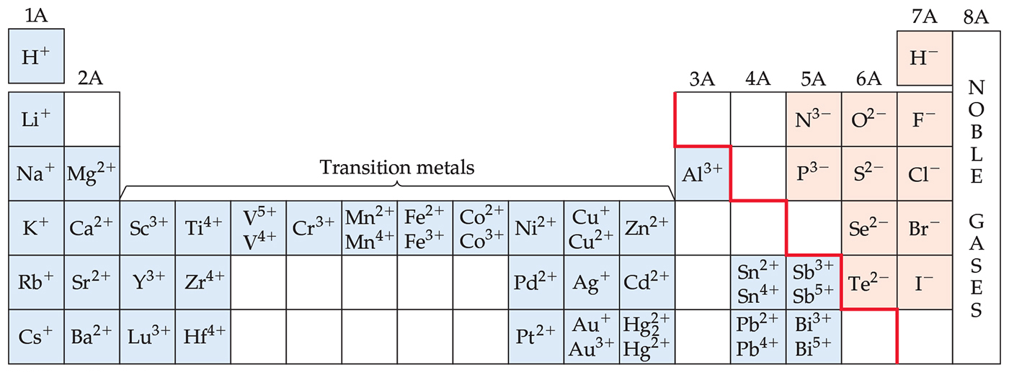
Metals Differ from Nonmetals
Metals tend to form cations.
Nonmetals tend to form anions.
Note the special property of hydrogen.

Slide 23
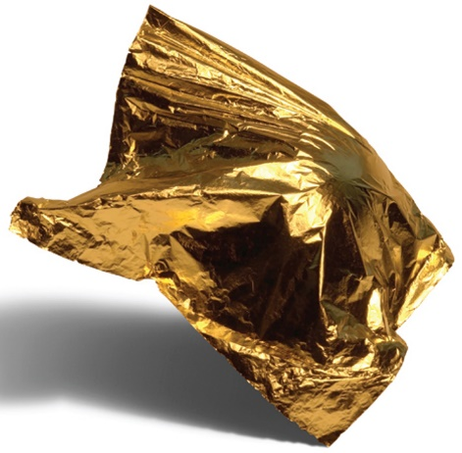
Metals
Most of the elements in nature are metals.
Properties of metals:
Shiny luster
Conduct heat and electricity
Malleable and ductile
Solids at room temperature (except mercury)
Low ionization energies/form cations easily

Slide 24
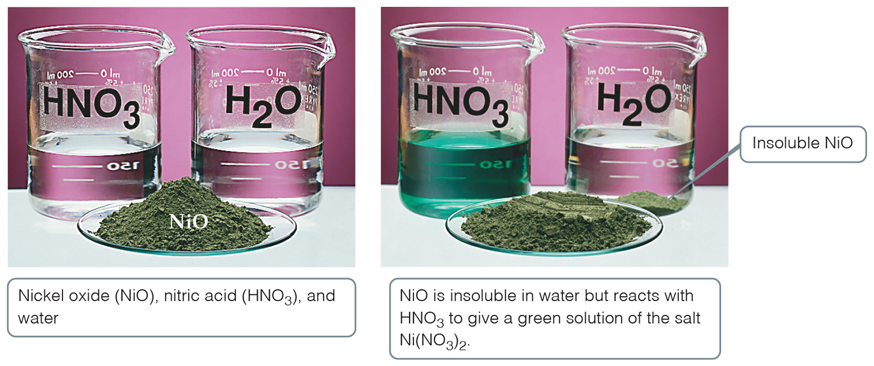
Metal Chemistry
Compounds formed between metals and nonmetals tend to be ionic.
Metal oxides tend to be basic and react with acids.

Slide 25
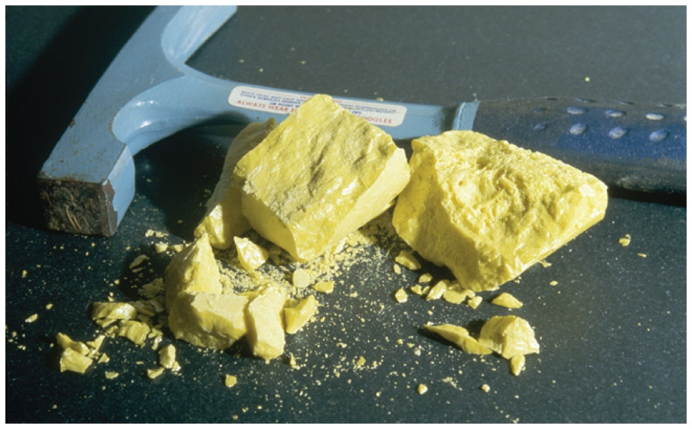
Nonmetals
Nonmetals are found on the right hand side of the periodic table.
Properties of nonmetals include the following:
Solid, liquid, or gas (depends on element)
Solids are dull, brittle, poor conductors
Large negative electron affinity, so they form anions readily

Slide 26
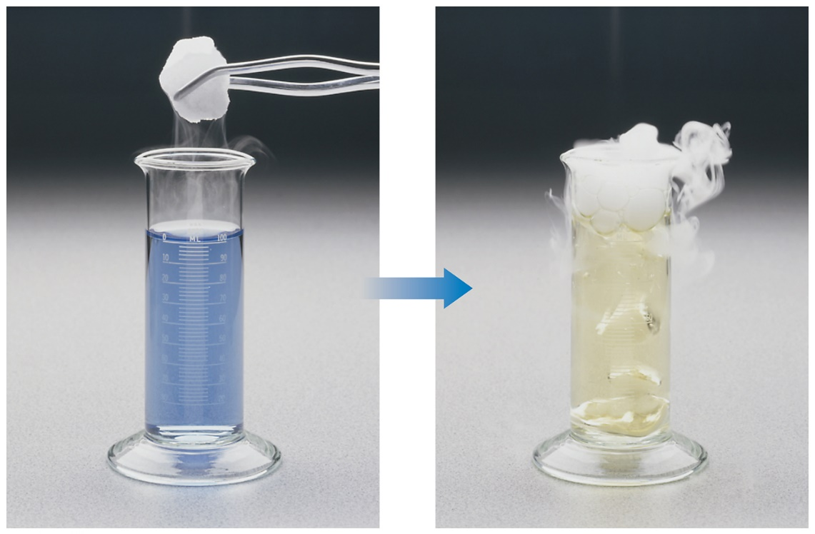
Nonmetal Chemistry
Substances containing only nonmetals are molecular compounds.
Most nonmetal oxides are acidic.

Slide 27
Recap of a Comparison of the Properties of Metals and Nonmetals
Table 7.3 Characteristic Properties of Metals and Nonmetals
Metals | Nonmetals
Have a shiny luster; various colors, although most are silvery | Do not have a luster; various colors
Solids are malleable and ductile | Solids are usually brittle; some are hard, and some are soft
Good conductors of heat and electricity | Poor conductors of heat and electricity
Most metal oxides are ionic solids that are basic | Most nonmetal oxides are molecular substances that form acidic solutions
Tend to form cations in aqueous solution | Tend to form anions or oxyanions in aqueous solution

Slide 28
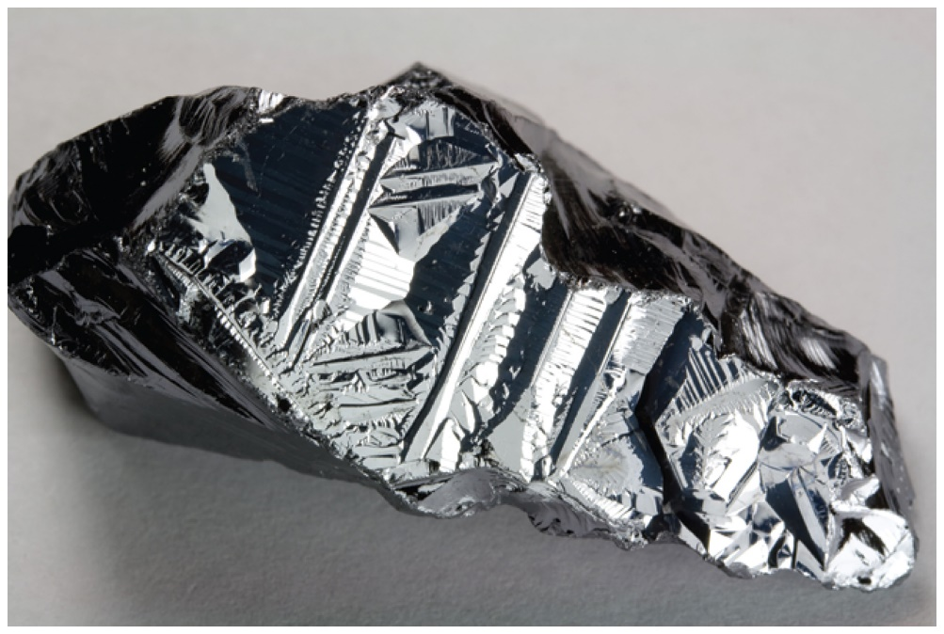
Metalloids
Metalloids have some characteristics of metals and some of nonmetals.
Several metalloids are electrical semiconductors (computer chips).

Slide 29
Group Trends
Elements in a group have similar properties.
Trends also exist within groups.
Groups compared:
Group 1A: the alkali metals
Group 2A: the alkaline earth metals
Group 6A: the oxygen group
Group 7A: the halogens
Group 8A: the noble gases
Why hydrogen is a nonmetal

Slide 30
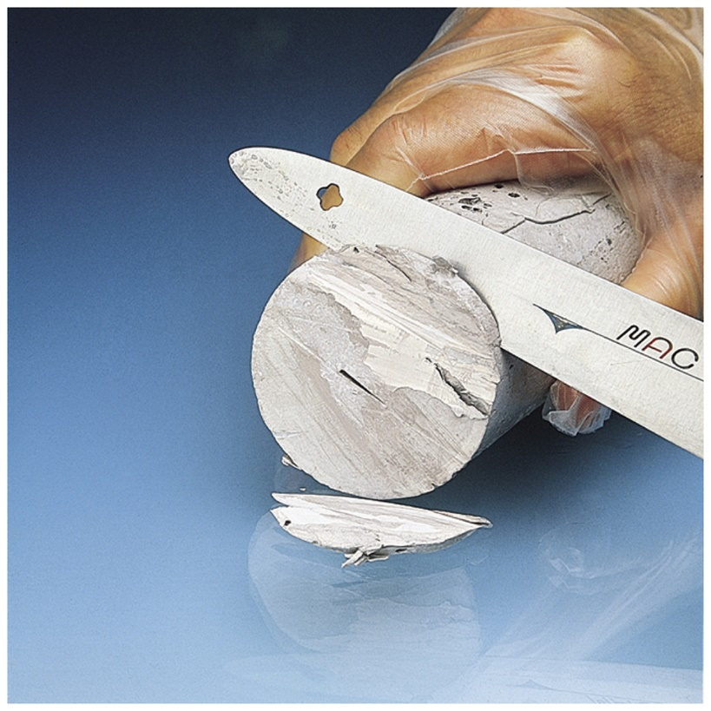
Alkali Metals
Alkali metals are soft, metallic solids.
They are found only in compounds in nature, not in their elemental forms.
Typical metallic properties (luster, conductivity) are seen in them.

Slide 31
Alkali Metal Properties
They have low densities and melting points.
They also have low ionization energies.
Table 7.4 Some Properties of the Alkali Metals
Element | Electron Configuration | Melting Point (°C) | Density gram per cubic centimeter | Atomic Radius (Å) | I₁ (kJ /mol)
Lithium | Electron, left bracket, H e, right bracket, 2 s 1. | 181 | 0.53 | 1.28 | 520
Sodium | Electron, left bracket, N e, right bracket, 3 s 1. | 98 | 0.97 | 1.66 | 496
Potassium | Electron, left bracket, Ay r, right bracket, 4 s 1. | 63 | 0.86 | 2.03 | 419
Rubidium | Electron, left bracket, K r, right bracket, 5 s 1. | 39 | 1.53 | 2.20 | 403
Cesium | Electron, left bracket, X e, right bracket, 6 s 1. | 28 | 1.88 | 2.44 | 376

Slide 32
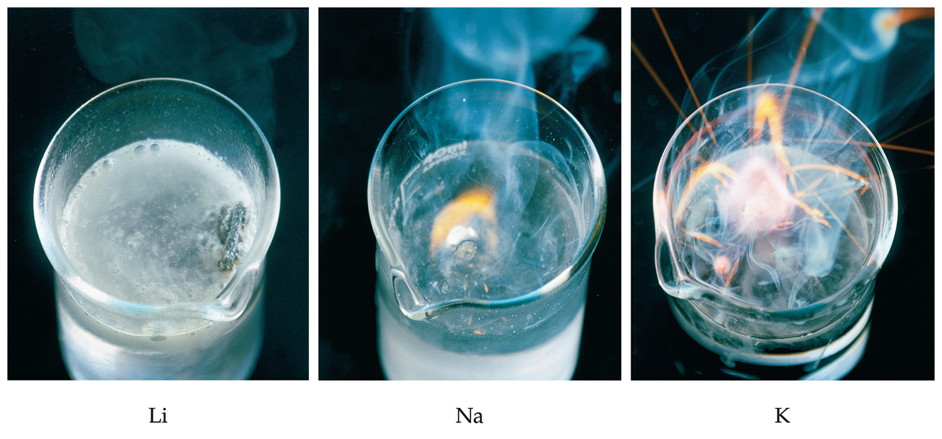
Alkali Metal Chemistry
Their reactions with water are famously exothermic.

Slide 33
Differences in Alkali Metal Chemistry
Lithium reacts with oxygen to make an oxide:
Sodium reacts with oxygen to form a peroxide:
K, Rb, and Cs also form superoxides:

Slide 34
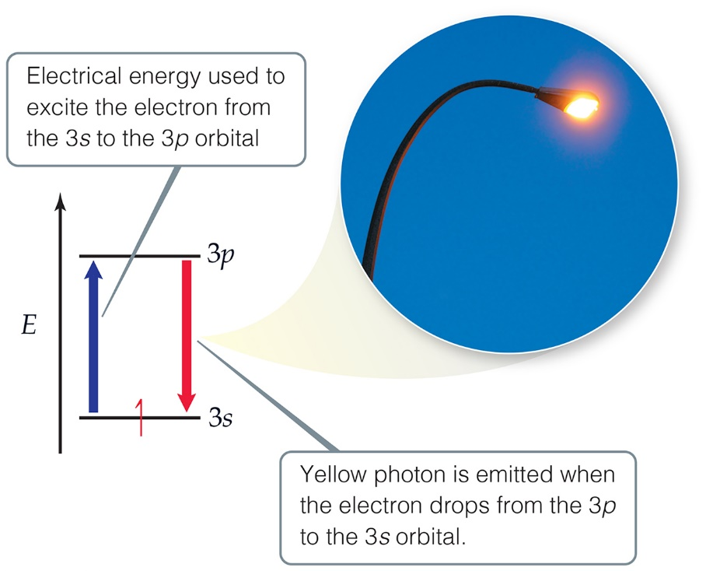
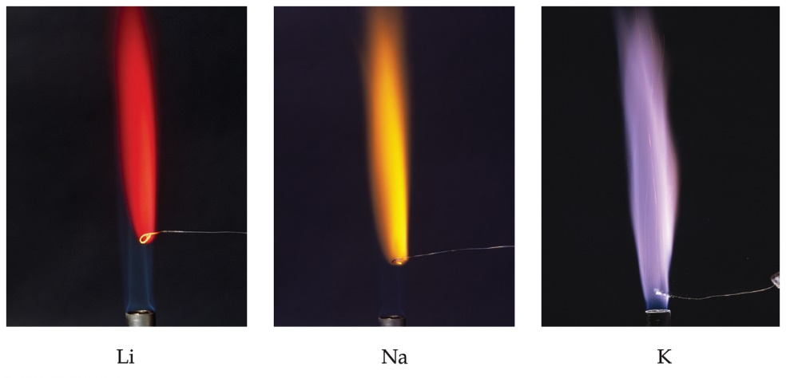
Flame Tests
Qualitative tests for alkali metals include their characteristic colors in flames.
These are caused by electronic transitions.

Slide 35
Alkaline Earth Metals (1 of 2)
Table 7.5 Some Properties of the Alkaline Earth Metals
Element | Electron Configuration | Melting Point (°C) | Density gram per cubic centimeter | Atomic Radius (Å) | I₁ (kJ /mol)
Beryllium | Electron, left bracket, H e, right bracket, 2 s 2. | 1287 | 1.85 | 0.96 | 899
Magnesium | Electron, left bracket, N e, right bracket, 3 s 2. | 650 | 1.74 | 1.41 | 738
Calcium | Electron, left bracket, Ay r, right bracket, 4 s 2. | 842 | 1.55 | 1.76 | 590
Strontium | Electron, left bracket, K r, right bracket, 5 s 2. | 777 | 2.63 | 1.95 | 549
Barium | Electron, left bracket, X e, right bracket, 6 s 2 | 727 | 3.51 | 2.15 | 503
Alkaline earth metals have higher densities and melting points than alkali metals.
Their ionization energies are low, but not as low as those of alkali metals.
They readily form +2 cations, losing the 2 valence electrons.

Slide 36
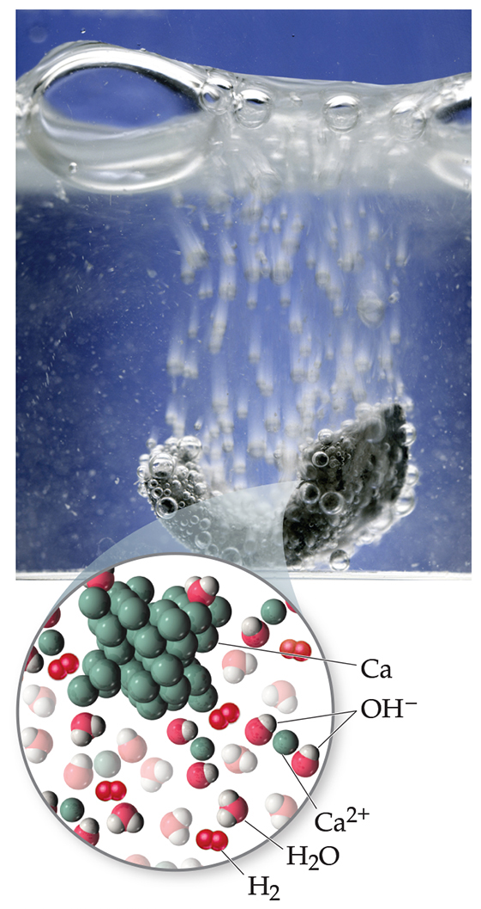
Alkaline Earth Metals (2 of 2)
Beryllium does not react with water, and magnesium reacts only with steam, but the other alkaline earth metals react readily with water.
Reactivity tends to increase as you go down the group.

Slide 37
Group 6A—Increasing in Metallic Character down the Group
Table 7.6 Some Properties of the Group 6A Elements
Oxygen, sulfur, and selenium are nonmetals.
Tellurium is a metalloid.
The radioactive polonium is a metal.
Trend: Oxygen is more likely to form –2 anion; polonium is most likely to have a positive charge.

Slide 38
Allotropes of Oxygen
Oxygen can exist as two different elemental forms:
Oxygen gas, O₂ (technically called dioxygen)
Ozone gas, O₃

Slide 39
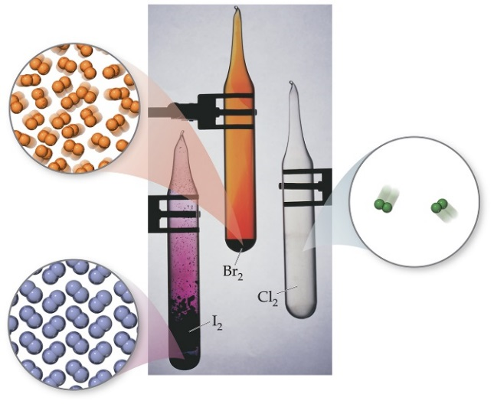
Group 7A—Halogens
Table 7.7 Some Properties of the Halogens
The halogens are typical nonmetals.
They have highly negative electron affinities, so they exist as anions in nature.
They react directly with metals to form metal halides.

Slide 40
Group 8A—Noble Gases
Table 7.8 Some Properties of the Noble Gases
*Only the heaviest of the noble-gas elements form chemical compounds. Thus, the atomic radii for the lighter noble-gas elements are estimated values.
The noble gases have very large ionization energies.
Their electron affinities are positive (can’t form stable anions).
Therefore, they are relatively unreactive.
They are found as monatomic gases.

Slide 41
Hydrogen
Is 1s¹ a metallic electron configuration like the other ns¹ elements?
We do think of acid compounds, like HCl, as having
however they are really covalent in nature.
When reacting with metals, hydride anions
form.

Slide 42
Copyright

