Slide 1
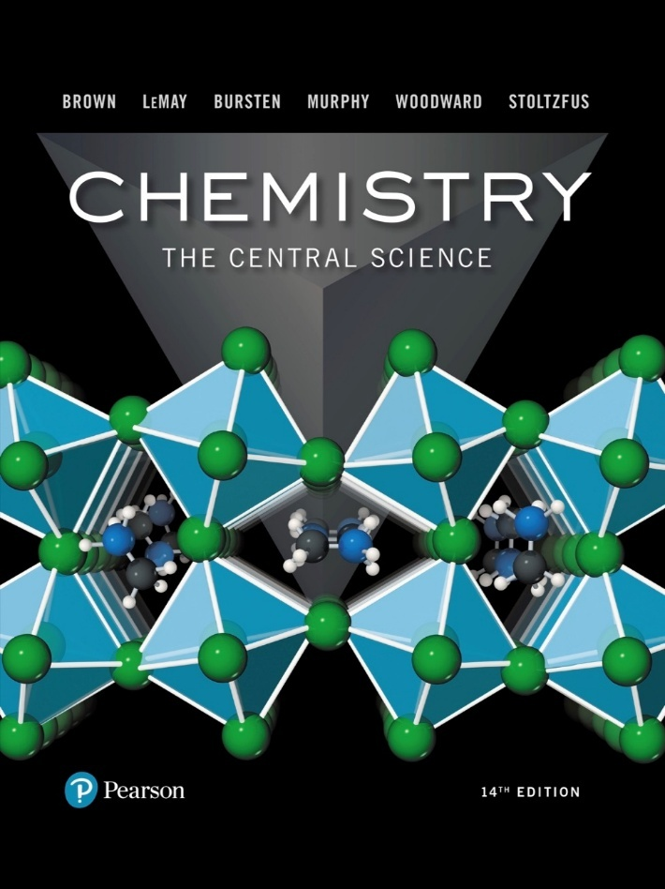
Chemistry: The Central Science
Fourteenth Edition
Chapter 5
Thermochemistry
Copyright © 2018, 2015, 2012 Pearson Education, Inc. All Rights Reserved
Notes:
If this PowerPoint presentation contains mathematical equations, you may need to check that your computer has the following installed:
1) MathType Plugin
2) Math Player (free versions available)
3) NVDA Reader (free versions available)

Slide 2
Energy
From Chapter 1, energy is the ability to do work or transfer heat.
This chapter is about thermodynamics, which is the study of energy and its transformations.
Specifically, thermochemistry is the study of chemical reactions and the energy changes that involve heat.

Slide 3
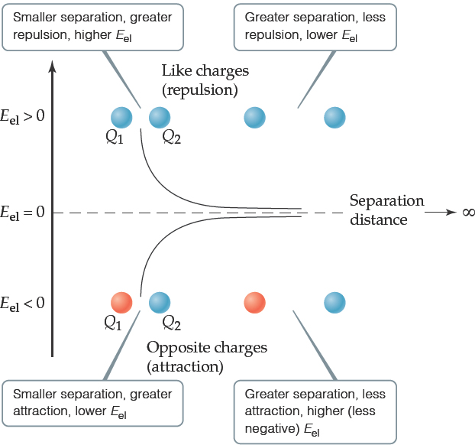
Chemical Energy Is Mainly Potential Energy
The most important form of potential energy in molecules is electrostatic potential energy, E_{el}:
Reminder: the unit of energy commonly used is the Joule:

Slide 4
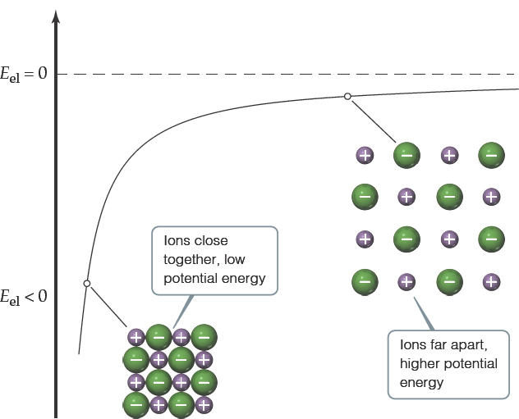
Attraction Between Ions
Electrostatic attraction is seen between oppositely charged ions.
Energy is released when chemical bonds are formed; energy is consumed when chemical bonds are broken.

Slide 5
First Law of Thermodynamics
Energy can be converted from one form to another, but it is neither created nor destroyed.
To heat your home, chemical energy needs to be converted to heat.
Sunlight is converted to chemical energy in green plants.
There are many more examples of conversion of energy.

Slide 6
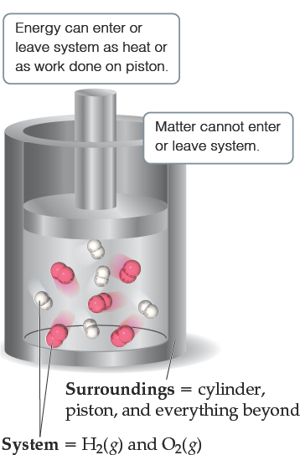
Definitions: System and Surroundings
The portion of the universe that we single out to study is called the system (here, the hydrogen and oxygen molecules).
The surroundings are everything else (here, the cylinder, piston and everything beyond).

Slide 7
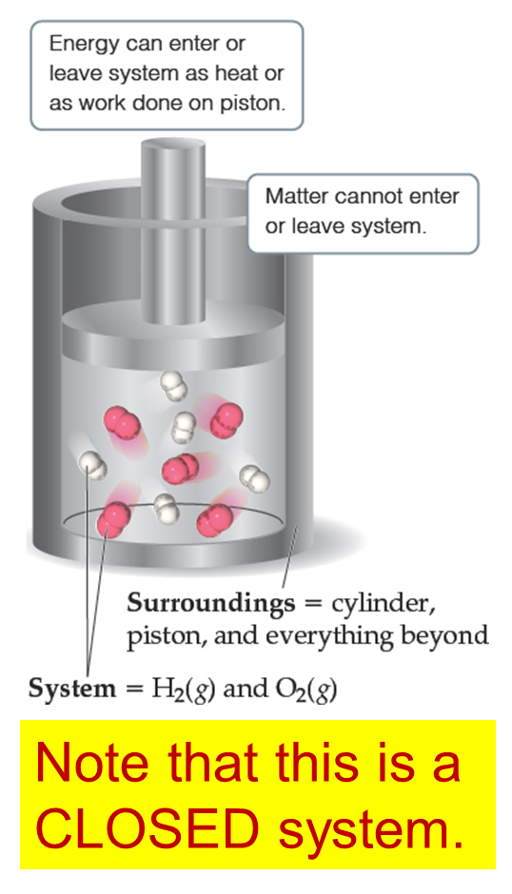
Types of Systems
Open System: a region of the universe being studied that can exchange heat and mass with its surroundings.
Closed System: a region of the universe being studied that can only exchange heat with its surroundings (not mass)
Isolated System: a region of the universe that can not exchange heat or mass with its surroundings

Slide 8
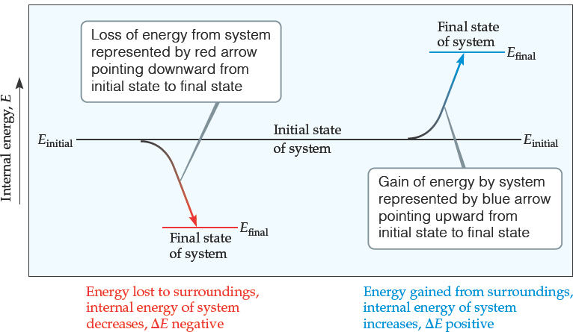
Internal Energy (1 of 2)
The internal energy of a system is the sum of all kinetic and potential energies of all components of the system; we use E to represent it.
We generally don’t know E, only how it changes

Slide 9
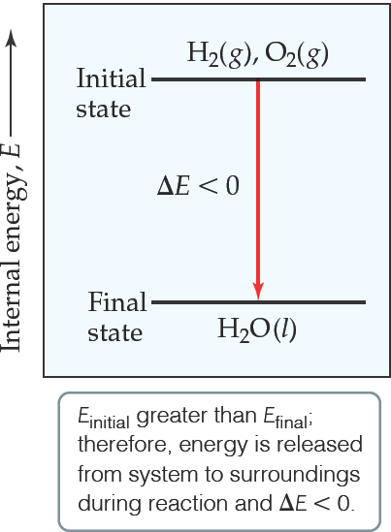
Internal Energy (2 of 2)
By definition, the change in internal energy,
is the final energy of the system minus the initial energy of the system:

Slide 10
Changes in Internal Energy (1 of 2)
the system absorbed energy from the surroundings.

Slide 11
Changes in Internal Energy (2 of 2)
the system released energy to the surroundings.

Slide 12
Thermodynamic Quantities Have Three Parts
A number
A unit
A sign
Note about the sign:
A positive
results when the system gains energy from the surroundings.
A negative
results when the system loses energy to the surroundings.

Slide 13
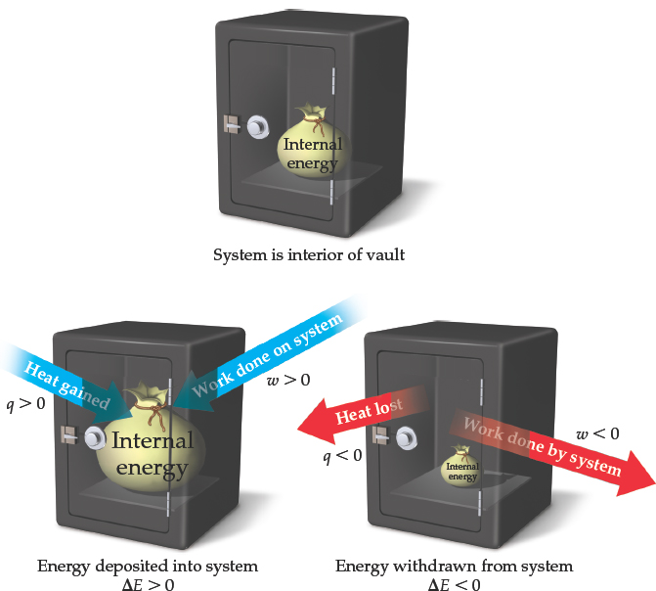
Changes in Internal Energy
When energy is exchanged between the system and the surroundings, it is exchanged as either heat (q) or work (w).
That is,

Slide 14
ΔE, Q, W, and Their Signs
Table 5.1 Sign Conventions for q, w, and E
For q | + means system gains heat | − means system loses heat
For w | + means work done on system | − means work done by system
For E | + means net gain of energy by system | − means net loss of energy by system

Slide 15
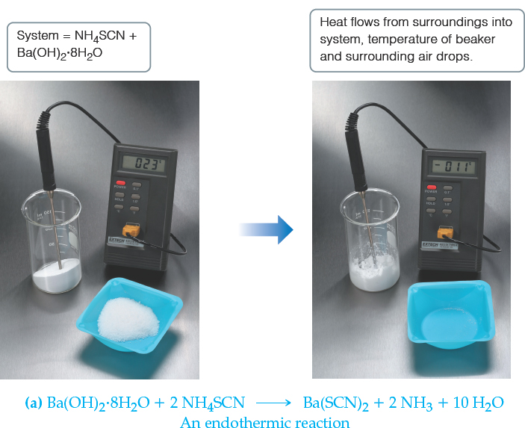
Exchange of Heat Between System and Surroundings (1 of 2)
When heat is absorbed by the system from the surroundings, the process is endothermic.

Slide 16
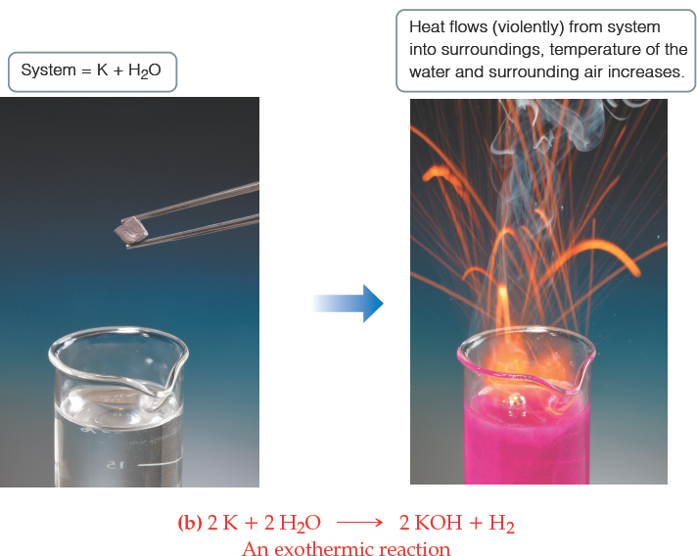
Exchange of Heat Between System and Surroundings (2 of 2)
When heat is released by the system into the surroundings, the process is exothermic.

Slide 17
State Functions (1 of 3)
Usually we have no way of knowing the internal energy of a system; finding that value is simply too complex a problem.
However, we do know that the internal energy of a system is independent of the path by which the system achieved that state.
In the system below, the water could have reached room temperature from either direction.

Slide 18
State Functions (2 of 3)
Therefore, internal energy is a state function.
It depends only on the present state of the system, not on the path by which the system arrived at that state.
And so,

Slide 19
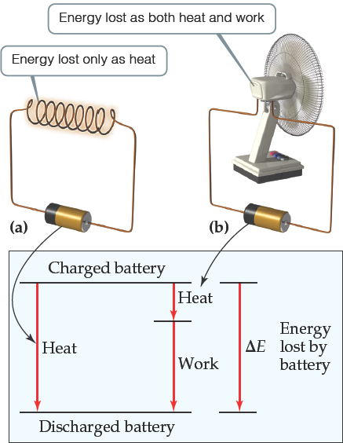
State Functions (3 of 3)
However, q and w are not state functions.
Whether the battery is shorted out or is discharged by running the fan, its
is the same, but q and w are different in the two cases.

Slide 20
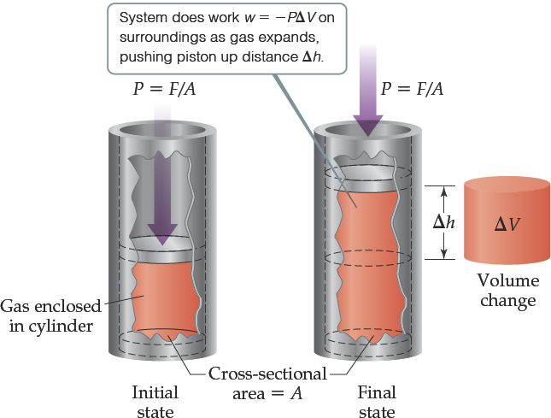
Work (1 of 2)
Usually the only work done by chemical or physical change is the mechanical work associated with a change in volume of gas.

Slide 21
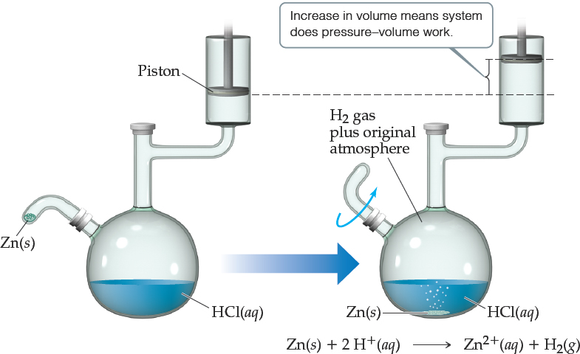
Work (2 of 2)
We can measure the work done by the gas if the reaction is done in a vessel that has been fitted with a piston:
The work is negative because it is work done by the system.

Slide 22
Enthalpy (1 of 3)
If a process takes place at constant pressure (and we usually work at atmospheric pressure) and the only work done is this pressure–volume work, we can account for heat flow during the process by measuring the enthalpy (H) of the system.
Enthalpy is the internal energy plus the product of pressure and volume:

Slide 23
Enthalpy (2 of 3)
When the system changes at constant pressure, the change in enthalpy,
This can be written

Slide 24
Enthalpy (3 of 3)
we can substitute these into the enthalpy expression:
Since
So, at constant pressure, the change in enthalpy is the heat gained or lost.

Slide 25
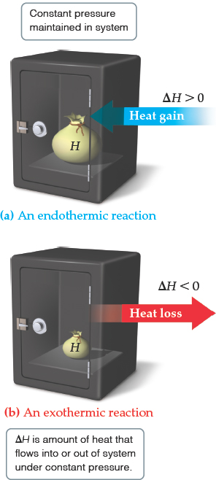
Endothermic and Exothermic
A process is endothermic when
A process is exothermic when

Slide 26
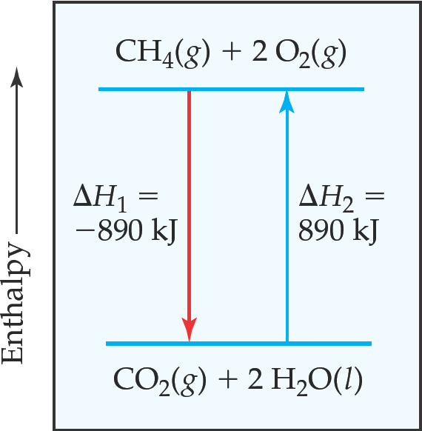
Enthalpy of Reaction (1 of 2)
The change in enthalpy,
is the enthalpy of the products minus the enthalpy of the reactants:

Slide 27
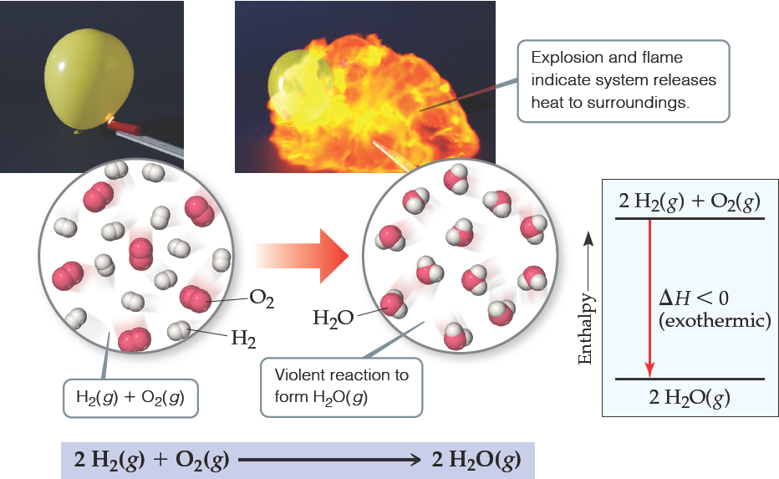
Enthalpy of Reaction (2 of 2)
This quantity,
is called the enthalpy of reaction, or the heat of reaction.

Slide 28
The Truth About Enthalpy
Enthalpy is an extensive property.
The enthalpy change for a reaction is equal in magnitude, but opposite in sign, to
for the reverse reaction.
The enthalpy change for a reaction depends on the states of the reactants and the products.

Slide 29
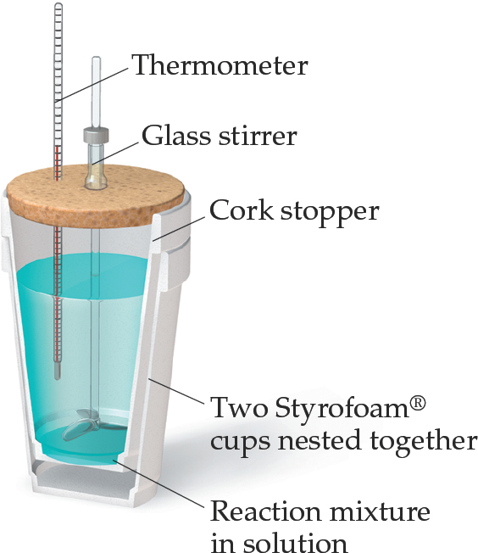
Calorimetry
Since we cannot know the exact enthalpy of the reactants and products, we measure
through calorimetry, the measurement of heat flow.
The instrument used to measure heat flow is called a calorimeter.

Slide 30
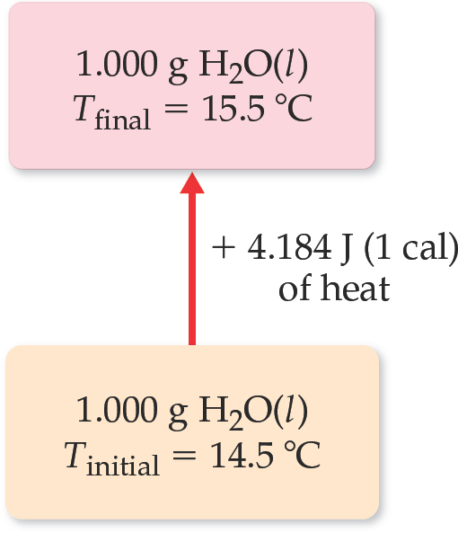
Heat Capacity and Specific Heat
The amount of energy required to raise the temperature of a substance by 1 K (1 degree Celsius) is its heat capacity. If the amount of the substance heated is one gram, it is the specific heat. If the amount is one mole, it is the molar heat capacity.
Table 5.2 Specific Heats of Some Substances at 298 K
Elements | Blank | Compounds | Blank
Substance | Specific Heat (J/g-K) | Substance | Specific Heat (J/g-K)
N₂(g) | 1.04 | H₂O(l) | 4.18
Al(g) | 0.90 | CH₄(g) | 2.20
Fe(s) | 0.45 | CO₂(g) | 0.84
Hg(l) | 0.14 | CaCO₃(s) | 0.82

Slide 31
Constant Pressure Calorimetry
By carrying out a reaction in aqueous solution in a simple calorimeter, the heat change for the system can be found by measuring the heat change for the water in the calorimeter.
The specific heat for water is 4.184 J/g∙K. We use this value for dilute solutions.
We can calculate ΔH for the reaction with this equation:

Slide 32
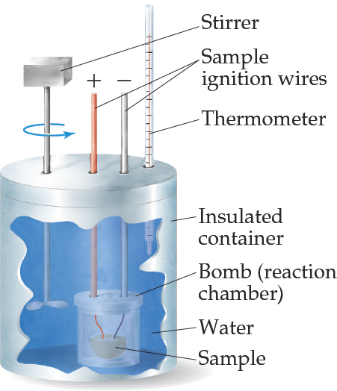
Bomb Calorimetry (1 of 2)
Reactions can be carried out in a sealed “bomb” such as this one.
The heat absorbed (or released) by the water is a very good approximation of the enthalpy change for the reaction.

Slide 33
Bomb Calorimetry (2 of 2)
Because the volume in the bomb calorimeter is constant, what is measured is really the change in internal energy,
For most reactions, the difference is very small.

Slide 34
Hess’s Law (1 of 2)
ΔH is well known for many reactions, and it is inconvenient to measure ΔH for every reaction in which we are interested.
However, we can calculate ΔH using published ΔH values and the properties of enthalpy.

Slide 35
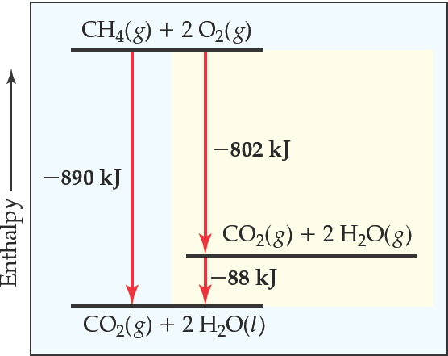
Hess’s Law (2 of 2)
Hess’s law: If a reaction is carried out in a series of steps, ΔH for the overall reaction equals the sum of the enthalpy changes for the individual steps.
Because H is a state function, for a particular set of reactants and products, ΔH is the same whether the reaction takes place in one step or in a series of steps.

Slide 36
Enthalpies of Formation
An enthalpy of formation, ΔH_{f}, is defined as the enthalpy change for the reaction in which a compound is made from its constituent elements in their elemental forms.

Slide 37
Standard Enthalpies of Formation (1 of 2)
Standard enthalpies of formation, ΔH_{f}°, are measured under standard conditions (25 °C and 1.00 atm pressure).

Slide 38
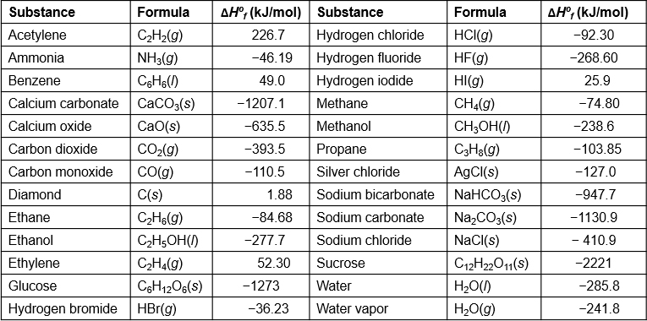
Standard Enthalpies of Formation (2 of 2)
Table 5.3 Standard Enthalpies of Formation,

Slide 39
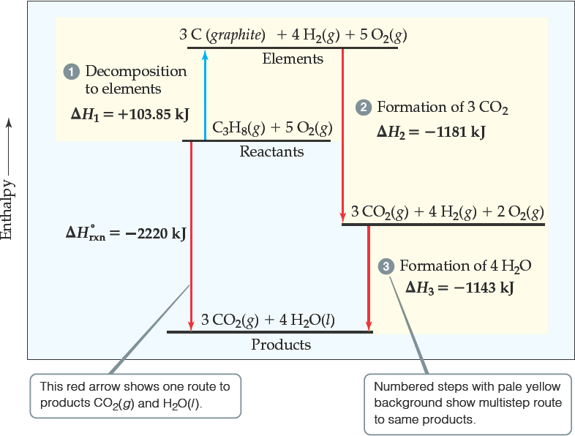
Calculation of ΔH (1 of 6)
Imagine this as occurring in three steps:
Decomposition of propane to the elements:

Slide 40
Calculation of ΔH (2 of 6)
Imagine this as occurring in three steps:
Formation of CO₂:

Slide 41
Calculation of ΔH (3 of 6)
Imagine this as occurring in three steps:
Formation of H₂O:

Slide 42
Calculation of ΔH (4 of 6)
So, all steps look like this:

Slide 43
Calculation of ΔH (5 of 6)
The sum of these equations is the overall equation!

Slide 44
Calculation of ΔH (6 of 6)
We can use Hess’s law in this way:
where n and m are the stoichiometric coefficients.

Slide 45
Calculation of ΔH Using Values from the Standard Enthalpy Table

Slide 46
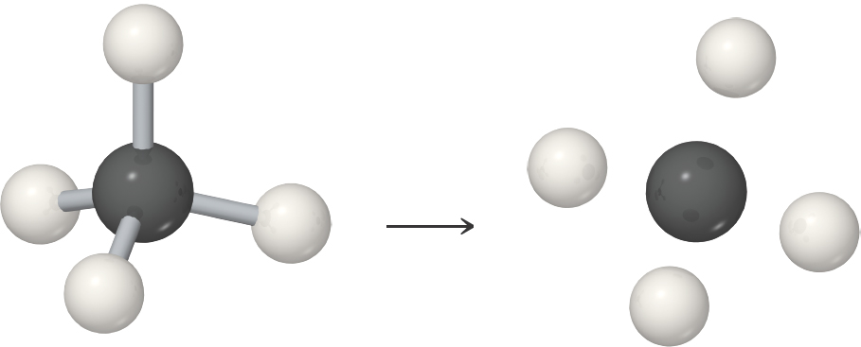
Bond Enthalpy (1 of 3)
The enthalpy associated with breaking one mole of a particular bond in a gaseous substance.

Slide 47
Bond Enthalpy (2 of 3)
The bond enthalpy is always positive because energy is required to break chemical bonds.
Energy is always released when a bond forms between gaseous fragments.
The greater the bond enthalpy, the stronger the bond.

Slide 48
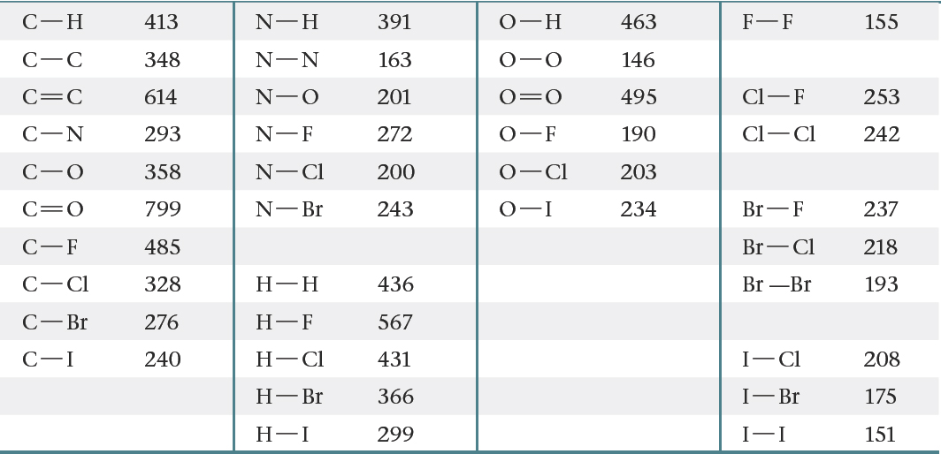
Bond Enthalpy (3 of 3)
Table 5.4 Average Bond Enthalpies (kJ/mol)

Slide 49
Bond Enthalpies and Enthalpy of Reaction (1 of 2)
Add bond energy for all bonds made (+)
Subtract bond energy for all bonds broken (−)
The result is an estimate of ΔH.

Slide 50
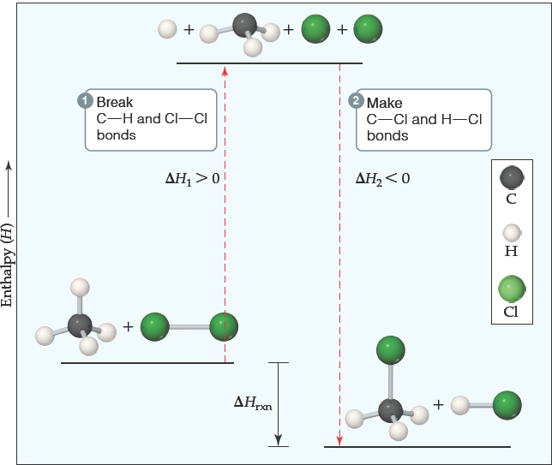
Bond Enthalpies and Enthalpy of Reaction (2 of 2)
So, we can predict whether a chemical reaction will be endothermic or exothermic using bond energies.

Slide 51
Energy in Foods (1 of 3)
The energy released when one gram of food is combusted is its fuel value.
Table 5.5 Compositions and Fuel Values of Some Common Foods
Blank | Blank | Approximate Composition (% by Mass) | Blank | Fuel Value | Blank
Blank | Carbohydrate | Fat | Protein | K J/g | kcal/g(C a l/g)
Carbohydrate | 100 | — | — | 17 | 4
Fat | — | 100 | — | 38 | 9
Protein | — | — | 100 | 17 | 4
Apples | 13 | 0.5 | 0.4 | 2.5 | 0.59
Beerª | 1.2 | — | 0.3 | 1.8 | 0.42
Bread | 52 | 3 | 9 | 12 | 2.8

Slide 52
Energy in Foods (2 of 3)
[Table 5.5 Continued]
Blank | Blank | Approximate Composition (% by Mass) | Blank | Fuel Value | Blank
Blank | Carbohydrate | Fat | Protein | k J/g | kcal/g(C a l/g)
Cheese | 4 | 37 | 28 | 20 | 4.7
Eggs | 0.7 | 10 | 13 | 6.0 | 1.4
Fudge | 81 | 11 | 2 | 18 | 4.4
Green beans | 7.0 | — | 1.9 | 1.5 | 0.38
Hamburger | — | 30 | 22 | 15 | 3.6
Milk (whole) | 5.0 | 4.0 | 3.3 | 3.0 | 0.74
Peanuts | 22 | 39 | 26 | 23 | 5.5
ªBeer typically contains 3.5% ethanol, which has fuel value.

Slide 53
Energy in Foods (3 of 3)
Most of the energy in foods comes from carbohydrates, fats, and proteins.
Carbohydrates (17 kJ/g):
Fats (38 kJ/g):
Proteins produce 17 kJ/g (same as carbohydrates): Their chemical reaction in the body is not the same as in a calorimeter.

Slide 54
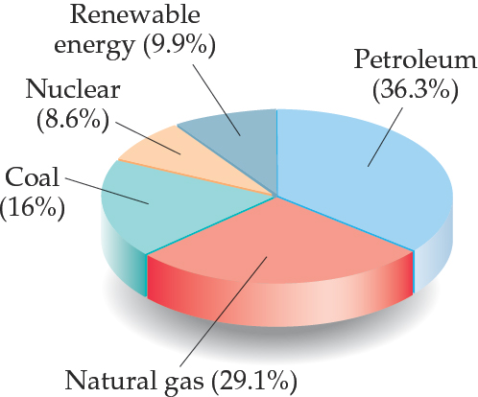
Energy in Fuels (1 of 2)
The vast majority of the energy consumed in this country comes from fossil fuels.

Slide 55
Energy in Fuels (2 of 2)
Table 5.6 Fuel Values and Compositions of Some Common Fuels
Blank | Blank | Approximate Elemental Composition (Mass %) | Blank | Blank
Blank | C | H | O | Fuel Value (kJ/g)
Wood (pine) | 50 | 6 | 44 | 18
Anthracite coal (Pennsylvania) | 82 | 1 | 2 | 31
Bituminous coal (Pennsylvania) | 77 | 5 | 7 | 32
Charcoal | 100 | 0 | 0 | 34
Crude oil (Texas) | 85 | 12 | 0 | 45
Gasoline | 85 | 15 | 0 | 48
Natural gas | 70 | 23 | 0 | 49
Hydrogen | 0 | 100 | 0 | 142

Slide 56
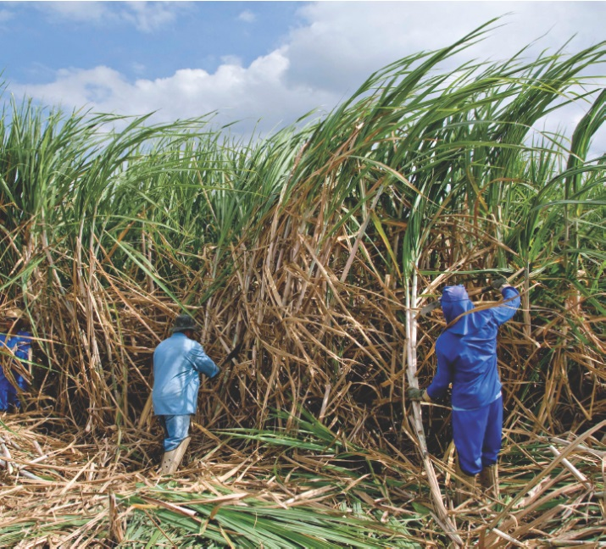
Other Energy Sources
Nuclear fission produces 8.6% of the U.S. energy needs.
Renewable energy sources, like solar, wind, geothermal, hydroelectric, and biomass sources produce 9.9% of the U.S. energy needs.

Slide 57
Copyright

