Slide 1
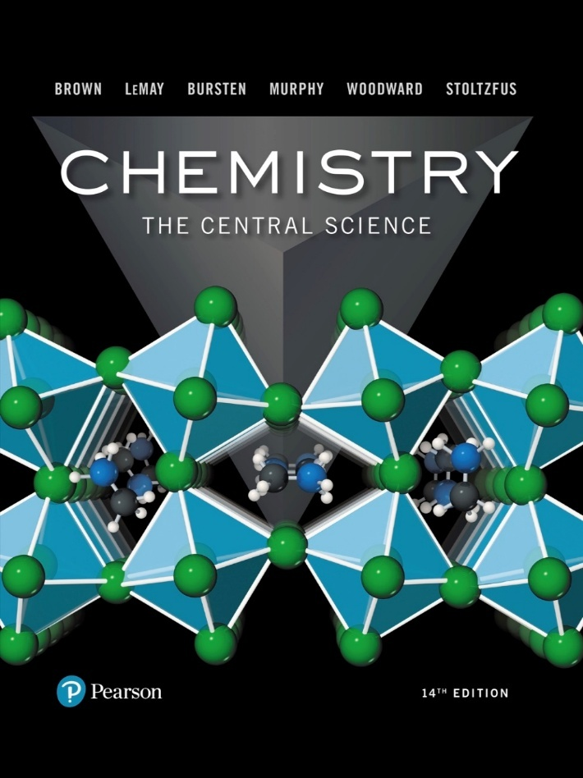
Chemistry: The Central Science
Fourteenth Edition
Chapter 1
Introduction: Matter, Energy, and Measurement
Copyright © 2018, 2015, 2012 Pearson Education, Inc. All Rights Reserved
Notes:
If this PowerPoint presentation contains mathematical equations, you may need to check that your computer has the following installed:
1) MathType Plugin
2) Math Player (free versions available)
3) NVDA Reader (free versions available)

Slide 2
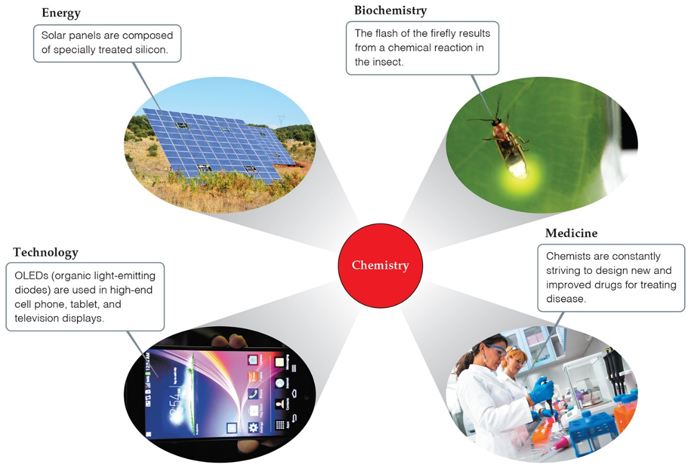
Chemistry
Chemistry is the study of matter, its properties, and the changes it undergoes.
It is central to our fundamental understanding of many science-related fields.

Slide 3
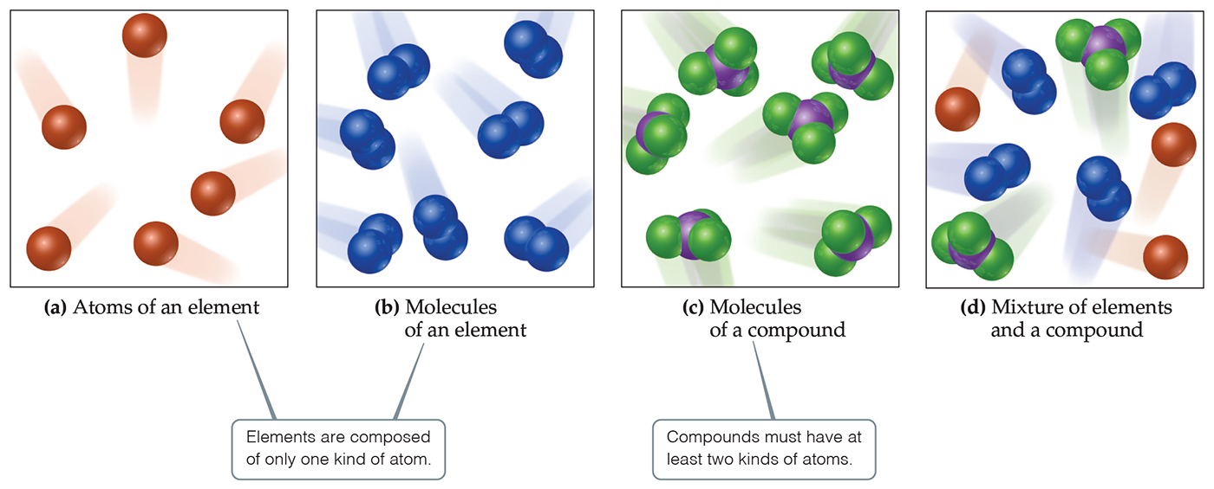
Matter
Matter is anything that has mass and takes up space.

Slide 4
Methods of Classification
State of Matter
Composition of Matter

Slide 5
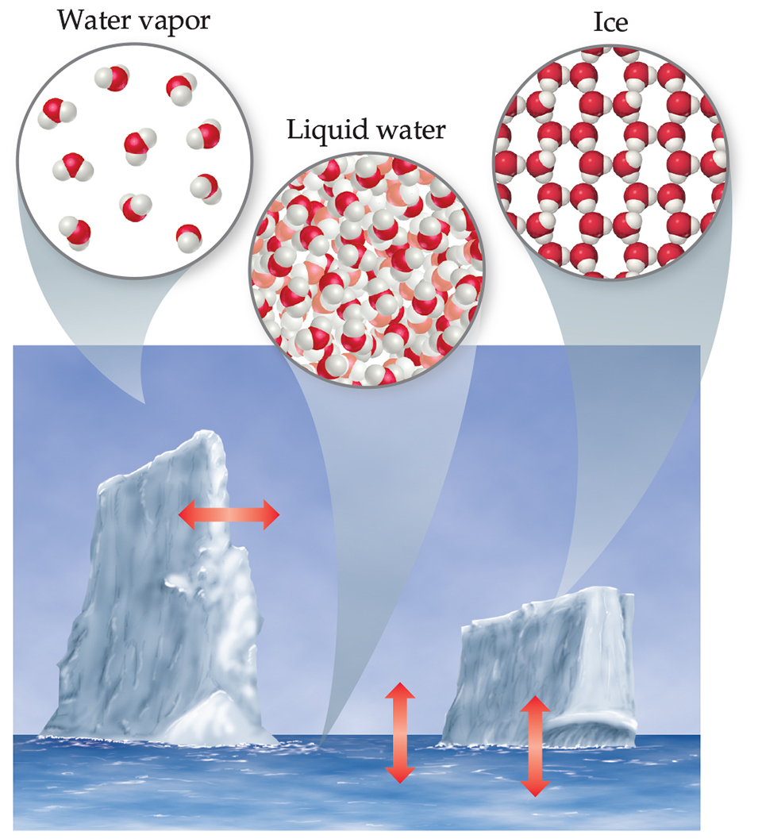
States of Matter
The three states of matter are
solid.
liquid.
gas.
In this figure, those states are ice, liquid water, and water vapor.

Slide 6
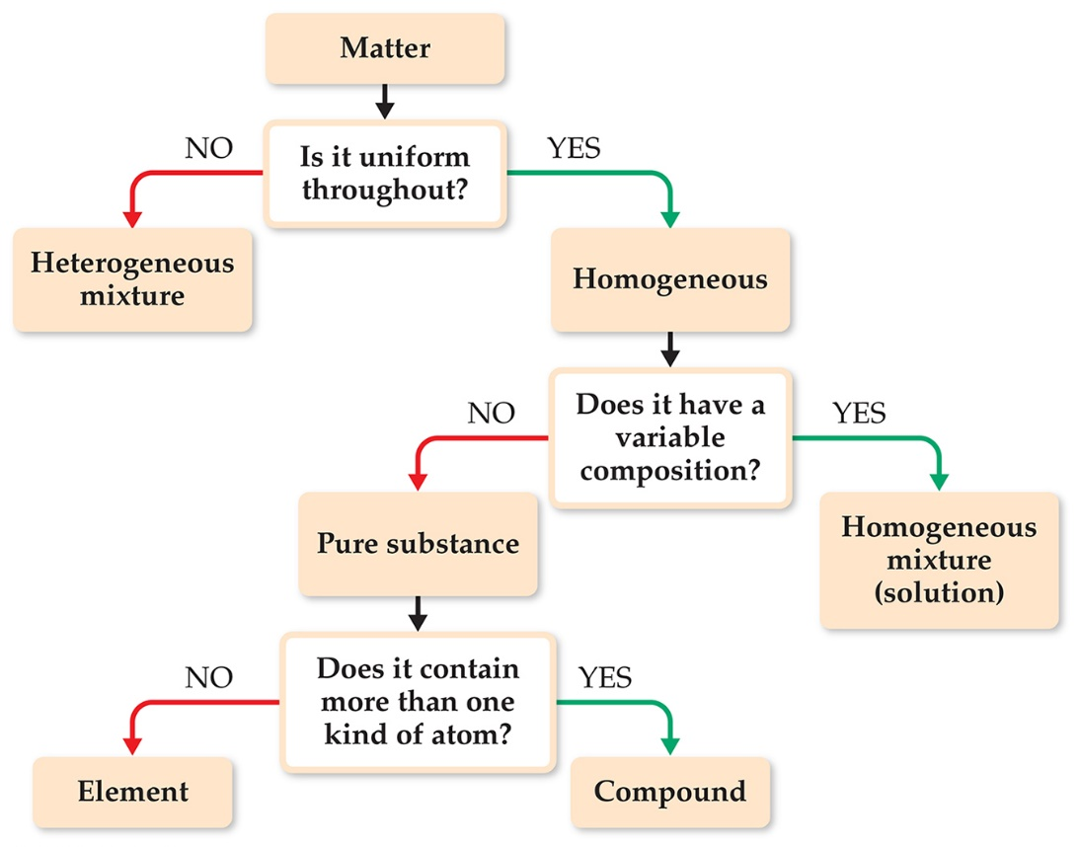
Classification of Matter Based on Composition (1 of 2)
If you follow this scheme, you can determine how to classify any type of matter.
Homogeneous mixture
Heterogeneous mixture
Element
Compound

Slide 7
Classification of Matter—Substances
A substance has distinct properties and a composition that does not vary from sample to sample.
The two types of substances are elements and compounds.
An element is a substance which can not be decomposed to simpler substances.
A compound is a substance which can be decomposed to simpler substances because it is made up of more than one element.

Slide 8
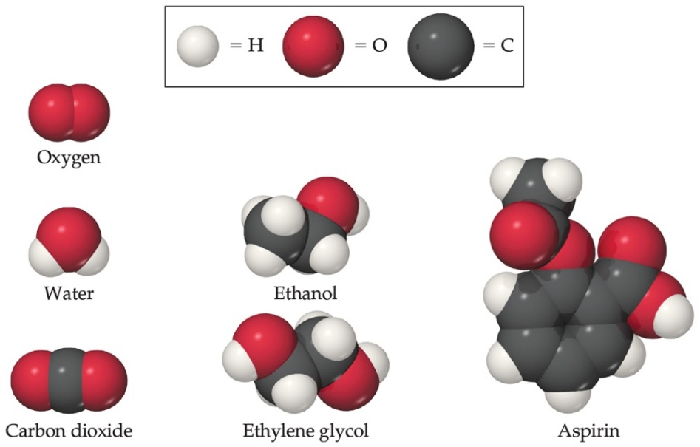
Classification of Matter Based on Composition (2 of 2)
Atoms are the building blocks of matter.
Each element is made of a unique kind of atom, but can be made of more than one atom of that kind.
A compound is made of atoms from two or more different elements.
Note: Balls of different colors are used to represent atoms of different elements. Attached balls represent connections between atoms that are seen in nature. These groups of atoms are called molecules.

Slide 9
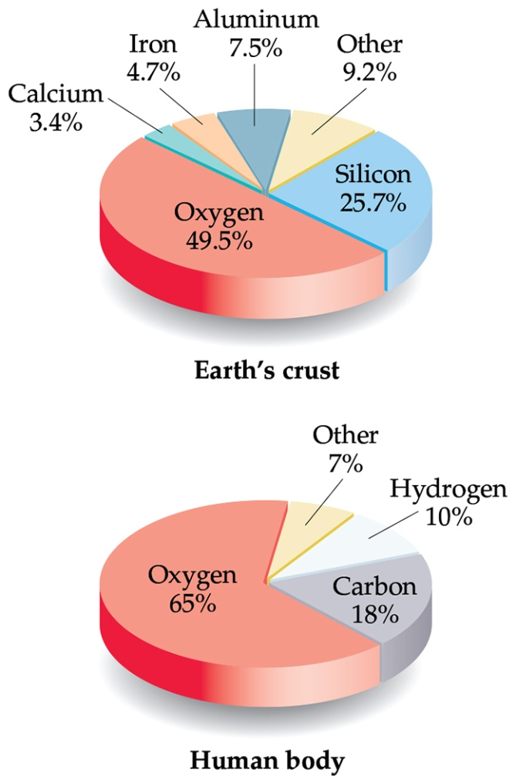
Elements and Composition
There are currently 118 named elements.
Only five elements make up 90% of the Earth’s crust by mass.
Only three elements make up 90% of the human body by mass!
Note the importance of oxygen!

Slide 10
Representing Elements
Table 1.1 Some Common Elements and Their Symbols
Carbon | C | Aluminum | A l | Copper | C u (from cuprum)
Fluorine | F | Bromine | B r | Iron | F e (from ferrum)
Hydrogen | H | Calcium | C a | Lead | P b (from plumbum)
Iodine | I | Chlorine | C l | Mercury | H g (from hydrargyrum)
Nitrogen | N | Helium | H e | Potassium | K (from kalium)
Oxygen | O | Lithium | L i | Silver | A g (from argentum)
Phosphorus | P | Magnesium | M g | Sodium | Na (from natrium)
Sulfur | S | Silicon | S i | Tin | S n (from stannum)
Chemists usually represent elements as symbols.
Symbols are one or two letters; the first is always capitalized.
Some elements are based on Latin, Greek, or other foreign language names.

Slide 11
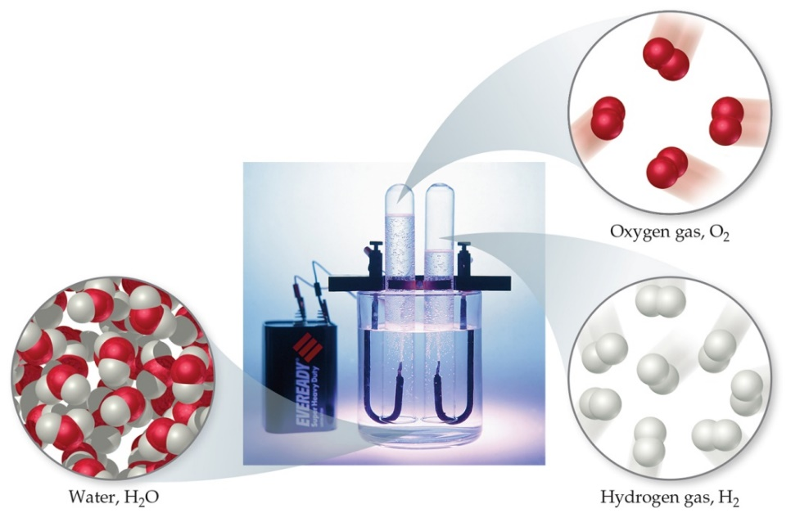
Compounds and Composition
Compounds have a definite composition. That means that the relative number of atoms of each element in the compound is the same in any sample.
This is The Law of Constant Composition (or The Law of Definite Proportions).

Slide 12
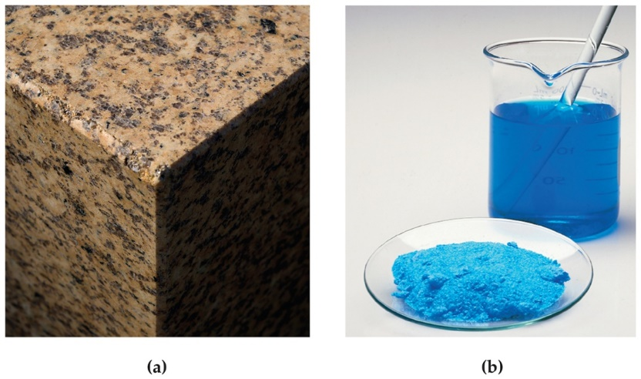
Classification of Matter—Mixtures
Mixtures exhibit the properties of the substances that make them.
Mixtures can vary in composition throughout a sample (heterogeneous) or can have the same composition throughout the sample (homogeneous).
A homogeneous mixture is also called a solution.

Slide 13
Two Types of Properties
Physical properties
Chemical properties

Slide 14
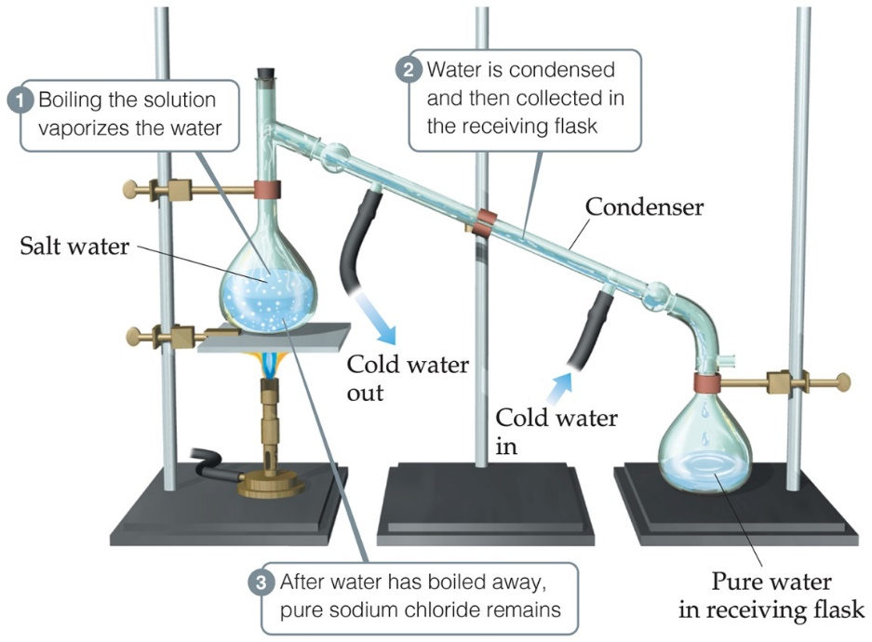
Physical Properties
Physical properties can be observed without changing a substance into another substance.
Some examples include color, odor, density, melting point, boiling point, and hardness.

Slide 15
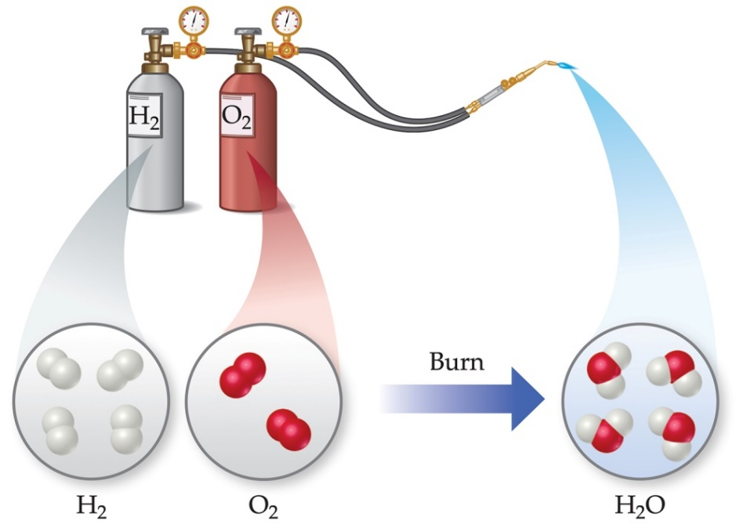
Chemical Properties
Chemical properties can only be observed when a substance is changed into another substance.
One common chemical property is flammability, or the ability to burn in oxygen.

Slide 16
Types of Properties
Intensive properties are independent of the amount of the substance that is present.
Examples include density, boiling point, or color.
These are important for identifying a substance.
Extensive properties depend upon the amount of the substance present.
Examples include mass, volume, or energy.

Slide 17
Types of Changes
Physical changes are changes in matter that do not change the composition of a substance.
Examples include changes of state, temperature, and volume.
Chemical changes result in new substances.
Examples include combustion, oxidation, and decomposition.

Slide 18
Changes in State of Matter
Converting between the three states of matter is a physical change.
When ice melts or water evaporates, there are still 2 H atoms and 1 O atom in each molecule.

Slide 19
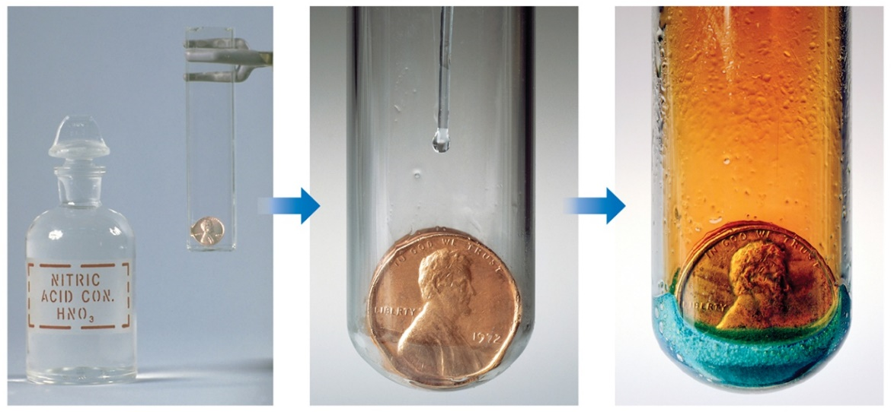
Chemical Reactions (Chemical Change)
In the course of a chemical reaction, the reacting substances are converted to new substances. Here, the copper penny reacts with nitric acid; it gives a blue solution of copper(II) nitrate and a brown gas called nitrogen dioxide.
Note: Physical properties, like color, often helps us See that chemical change has occurred.

Slide 20
Separating Mixtures
Mixtures can be separated based on physical properties of the components of the mixture. Some methods used are
filtration
distillation
chromatography

Slide 21
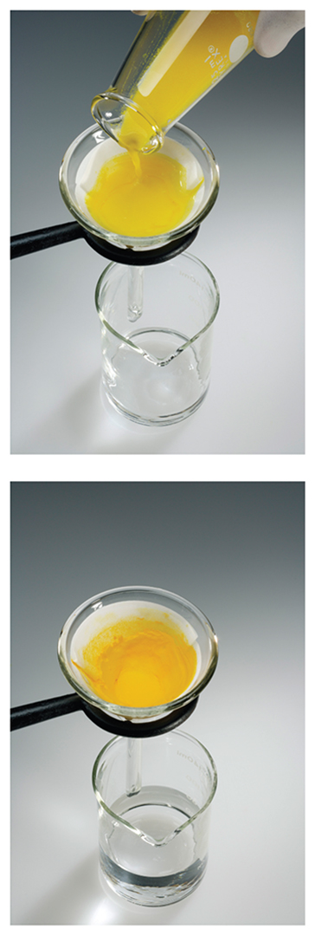
Filtration
In filtration, solid substances are separated from liquids and solutions.

Slide 22
Distillation
Distillation uses differences in the boiling points of substances to separate a homogeneous mixture into its components.

Slide 23
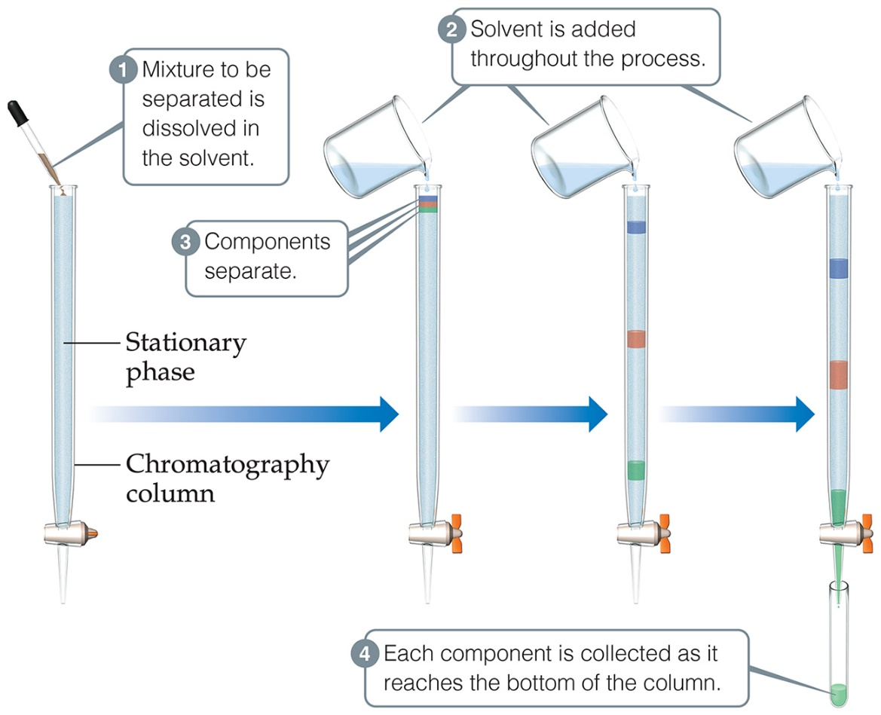
Chromatography
This technique separates substances on the basis of differences in the ability of substances to adhere to the solid surface, in this case, dyes to paper.

Slide 24
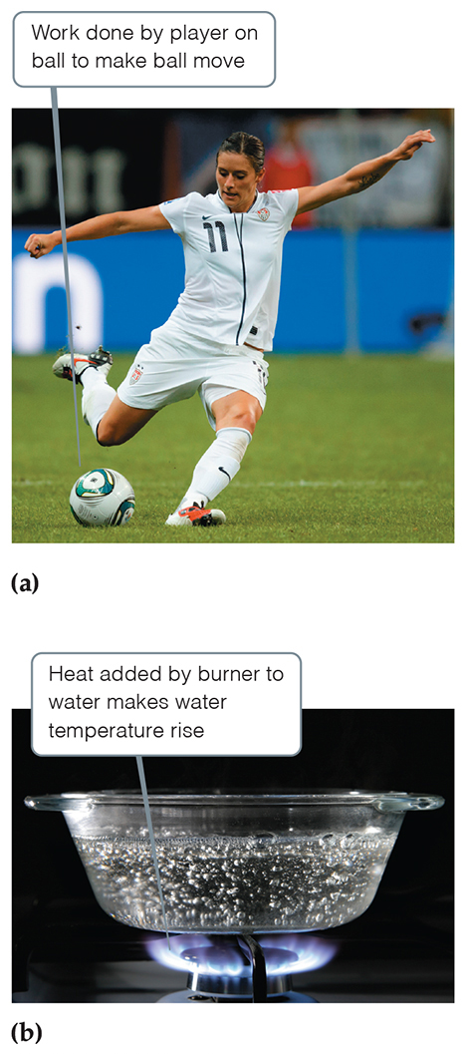
Energy (1 of 2)
Energy is the capacity to do work or transfer heat.
Work is the energy transferred when a force exerted on an object causes a displacement of that object.
Heat is the energy used to cause the temperature of an object to increase.
Force is any push or pull on an object.

Slide 25
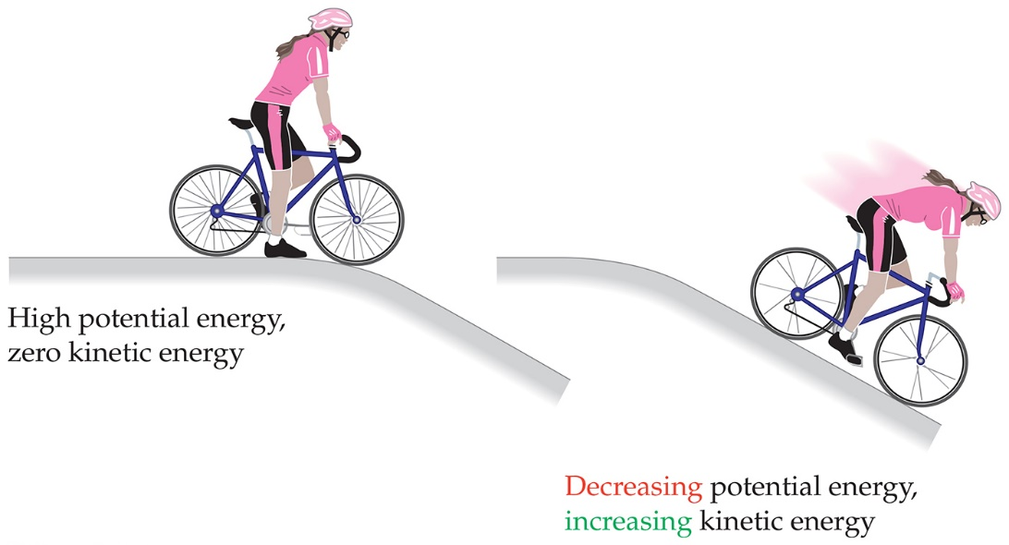
Two Fundamental Forms of Energy
Kinetic energy is the energy of motion.
Its magnitude depends on the object’s mass and its velocity:
Potential energy of an object depends on its relative position compared to other objects.

Slide 26
Numbers and Chemistry
Numbers play a major role in chemistry. Many topics are quantitative (have a numerical value).
Concepts of numbers in science
Units of measurement
Quantities that are measured and calculated
Uncertainty in measurement
Significant figures
Dimensional analysis

Slide 27
Units of Measurements—SI Units
Système International d’Unités (“The International System of Units”)
A different base unit is used for each quantity.
Table 1.3 SI Base Units
Physical Quantity | Name of Unit | Abbreviation
Length | Meter | m
Mass | Kilogram | kg
Temperature | Kelvin | K
Time | Second | s or sec
Amount of substance | Mole | mol
Electric current | Ampere | A or amp
Luminous intensity | Candela | cd

Slide 28
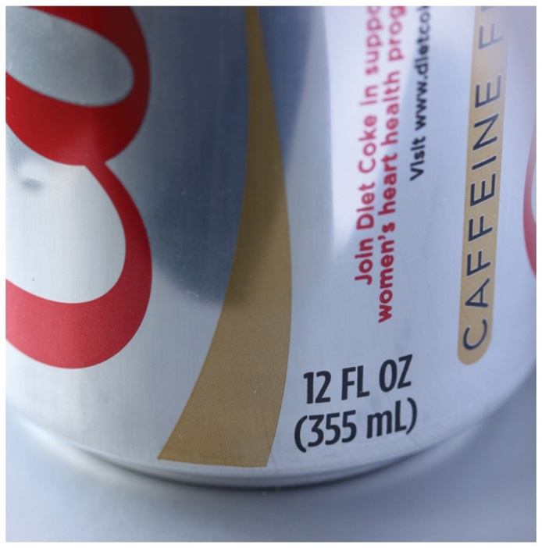
Units of Measurement—Metric System
The base units used in the metric system
Mass: gram (g)
Length: meter (m)
Time: second (s or sec)
Temperature: degrees Celsius (°C) or Kelvins (K)
Amount of a substance: mole (mol)
Volume: cubic centimeter
or liter (l)

Slide 29
Units of Measurement—Metric System Prefixes (1 of 3)
Prefixes convert the base units into units that are appropriate for common usage or appropriate measure (as seen with mL on the can in the last slide).

Slide 30
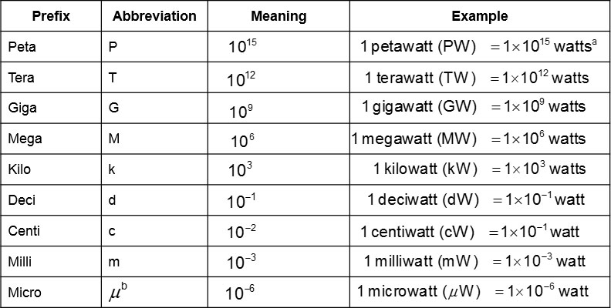
Units of Measurement—Metric System Prefixes (2 of 3)
Table 1.4 Prefixes Used in the Metric System and with SI Units

Slide 31
Units of Measurement—Metric System Prefixes (3 of 3)
[Table 1.4 continued]
ªThe watt (W) is the SI unit of power, which is the rate at which energy is either generated or consumed.
The SI unit of energy is the joule (J);
^{b}Greek letter mu, pronounced “mew.”

Slide 32
Mass and Length
These are basic units we measure in science.
Mass is a measure of the amount of material in an object. SI uses the kilogram as the base unit. The metric system uses the gram as the base unit.
Length is a measure of distance. The meter is the base unit.

Slide 33
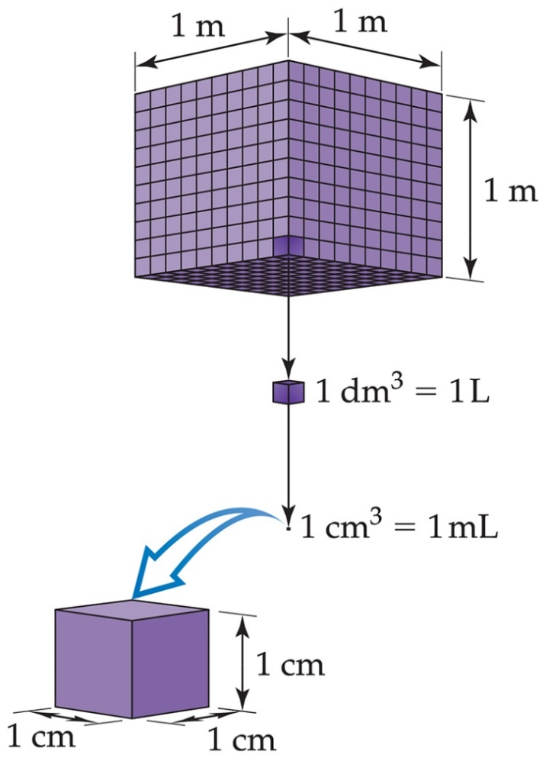
Volume
Note that volume is not a base unit for SI; it is a derived unit from length
The most commonly used metric units for volume are the liter (L) and the milliliter (mL).
A liter is a cube 1 decimeter (dm) long on each side.
A milliliter is a cube 1 centimeter (cm) long on each side, also called 1 cubic centimeter

Slide 34
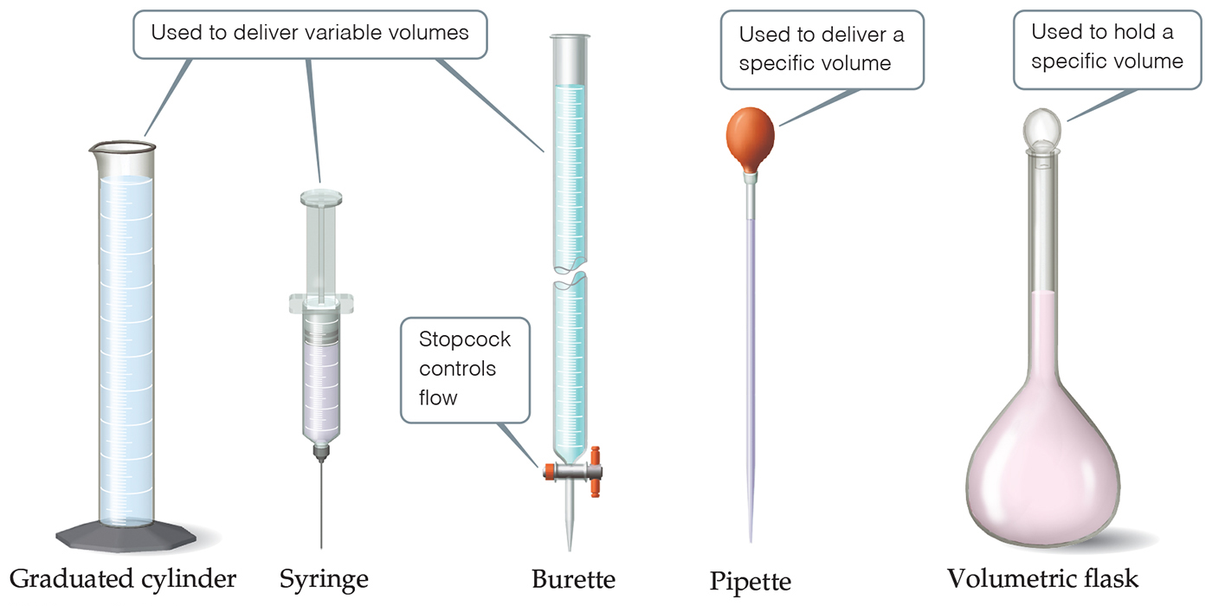
Glassware for Measuring Volume

Slide 35
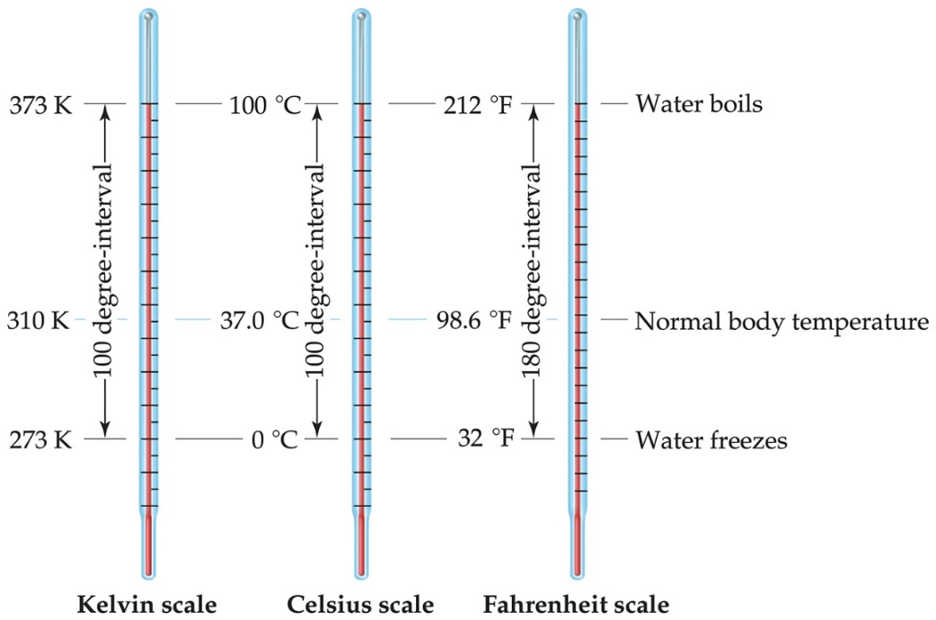
Temperature (1 of 3)
In general usage, temperature is considered the “hotness and coldness” of an object that determines the direction of heat flow.
Heat flows spontaneously from an object with a higher temperature to an object with a lower temperature.

Slide 36
Temperature (2 of 3)
In scientific measurements, the Celsius and Kelvin scales are most often used.
The Celsius scale is based on the properties of water.
0 degree Celsius is the freezing point of water.
100 degree Celsius is the boiling point of water.
The Kelvin is the SI unit of temperature.
It is based on the properties of gases.
There are no negative Kelvin temperatures.
The lowest possible temperature is called absolute zero (0 K).
K = degree Celsius + 273.15

Slide 37
Temperature (3 of 3)
The Fahrenheit scale is not used in scientific measurements, but you hear about it in weather reports!
The equations below allow for conversion between the Fahrenheit and Celsius scales:

Slide 38
Energy (2 of 2)
The unit of energy: Joule (J). It is a derived unit:
If the object is 2 kg, and it moves at 1 m/s, it will posses 1 J of kinetic energy:
The kJ is commonly used for chemical change.
Historically, the calorie was used: 1 cal = 4.184 J
This calorie is Not the nutritional Calorie. That one is a kcal.
1 nutritional Calorie = 1 Cal = 1000 cal

Slide 39
Density
Density is a physical property of a substance.
It has units that are derived from the units for mass and volume.
The most common units are g/mL or
Table 1.5 Densities of selected Substances at 25 degree Celsius
Substance | Density ( g / Centimeter cubed )
Air | 0.001
Balsa wood | 0.16
Ethanol | 0.79
Water | 1.00
Ethylene glycol | 1.09
Table sugar | 1.59
Table salt | 2.16
Iron | 7.9
Gold | 19.32

Slide 40
Numbers Encountered in Science
Exact numbers are counted or given by definition. For example, there are 12 eggs in 1 dozen.
Inexact (or measured) numbers depend on how they were determined. Scientific instruments have limitations (equipment errors) and individuals can read some instrumentation differently (human errors).

Slide 41
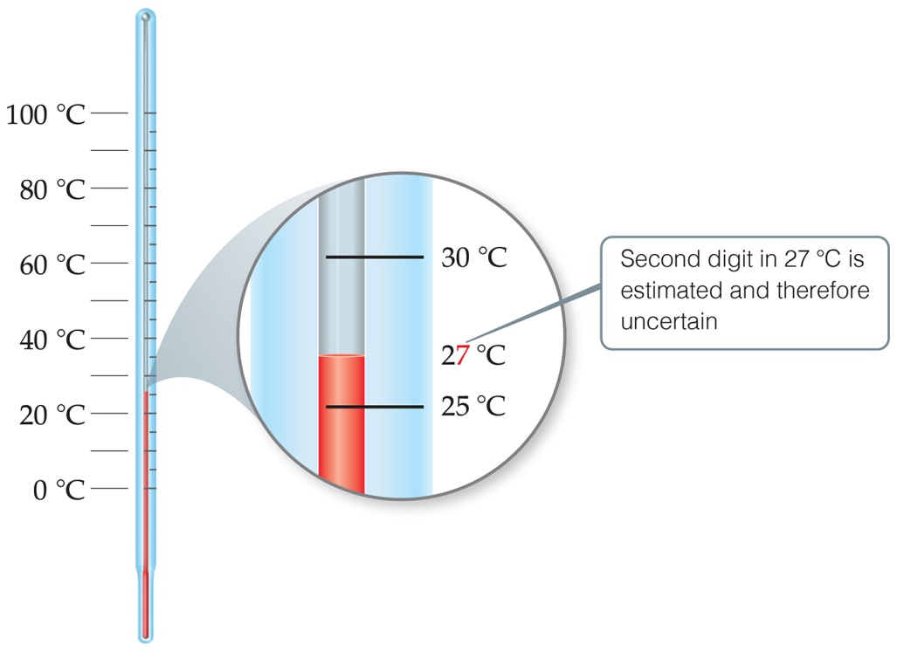
Uncertainty in Measurements
Different measuring devices have different uses and different degrees of accuracy.
All measured numbers have some degree of inaccuracy.
The last digit measured is considered reliable, but Not exact.

Slide 42
Accuracy versus Precision
Precision is a measure of how closely individual measurements agree with one another.
Accuracy refers to how closely individual measurements agree with the correct, or “true,” value.
Experimentally, we often take several measurements and determine a standard deviation.

Slide 43
Significant Figures (1 of 2)
All digits of a measured quantity, including the uncertain ones, are called significant figures.
When rounding calculated numbers, we pay attention to significant figures so we do not overstate the accuracy of our answers.

Slide 44
Significant Figures (2 of 2)
All nonzero digits are significant.
Zeroes between nonzero digits are significant.
Zeroes at the beginning of a number are never significant.
Zeroes at the end of a number are significant if it contains a decimal point.
Problem: whole numbers ending in zeroes.
1.03 times 10 to the fourth grams | (three significant figures)
1.030 times 10 to the fourth grams | (four significant figures)
1.0300 times 10 to the fourth grams | (five significant figures)

Slide 45
Significant Figures in Calculations
The least certain measurement limits the number of significant figures in the answer.
When addition or subtraction is performed, answers are rounded to the least significant decimal place.
When multiplication or division is performed, answers are rounded to the same number of digits as the measurement with the fewest number of significant figures.
Know the number of appropriate digits throughout, but round off at the end only!

Slide 46
Dimensional Analysis
Dimensional analysis is used to change units.
We apply conversion factors (e.g., 1 in = 2.54 cm), which are equalities.
We can set up a ratio of comparison for the equality:
1 in./2.54 cm or 2.54 cm/1 in.
We use the ratio which allows us to change units (puts the units we have in the denominator to cancel).
We can use multiple conversions, as long as each one is an equality.

Slide 47
Copyright

