Slide 1
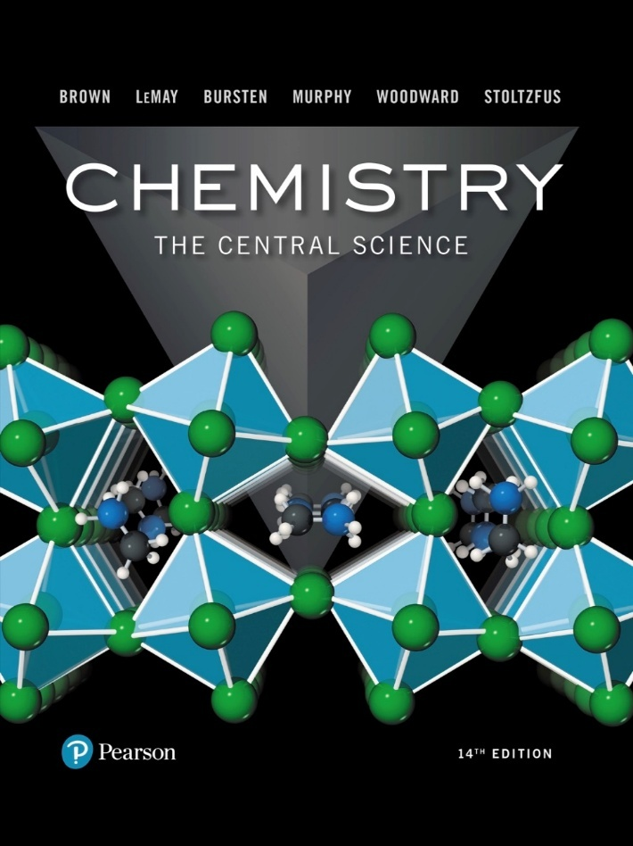
Chemistry: The Central Science
Fourteenth Edition
Chapter 3
Chemical Reactions and Reaction Stoichiometry
Copyright © 2018, 2015, 2012 Pearson Education, Inc. All Rights Reserved
Notes:
If this PowerPoint presentation contains mathematical equations, you may need to check that your computer has the following installed:
1) MathType Plugin
2) Math Player (free versions available)
3) NVDA Reader (free versions available)

Slide 2
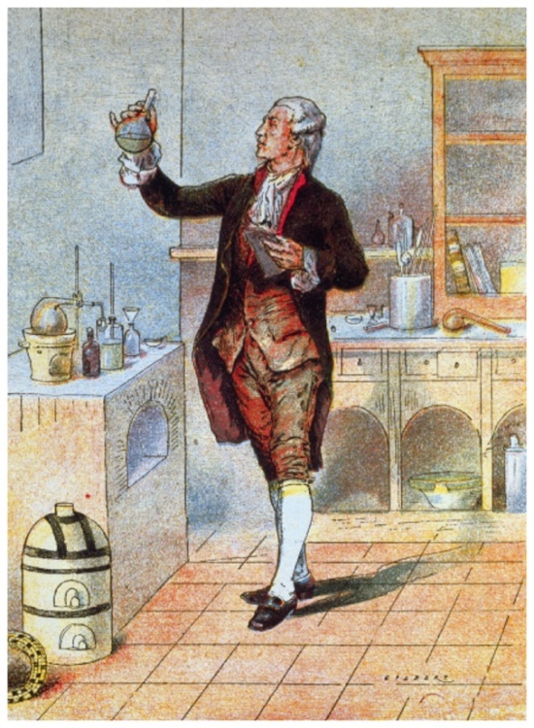
Stoichiometry
Area of study that examines the quantities of substances consumed and produced in chemical reactions
Based on the Law of Conservation of Mass (Antoine Lavoisier, 1789)
“We may lay it down as an incontestable axiom that, in all the operations of art and nature, nothing is created; an equal amount of matter exists both before and after the experiment. Upon this principle, the whole art of performing chemical experiments depends.”
—Antoine Lavoisier

Slide 3
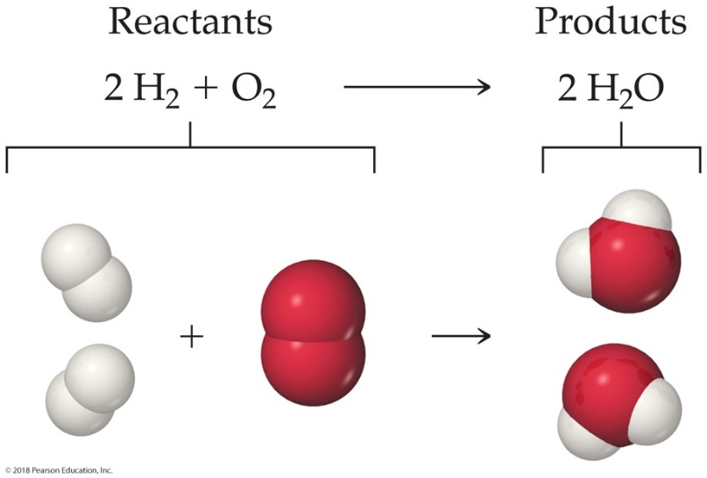
Chemical Equations
Chemical equations are how chemists represent chemical reactions on paper.
Arrows separate the starting materials (on the left), called reactants, from the ending materials (on the right), called products.
“+” separates multiple starting or ending materials.

Slide 4
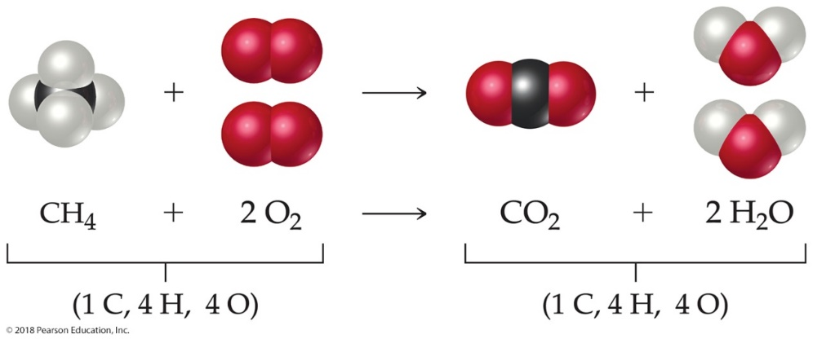
Balancing Equations
Follow the Law of Conservation of Mass, but how?
Start with an element that is only in one reactant and product (C below).
Balance it by changing coefficients, Not subscripts. (Like in math, a “1” is not written, but it is assumed.)
Move on to other elements, without changing coefficients that are set, until complete, checking all elements at the end (H, then O here; totals below).

Slide 5
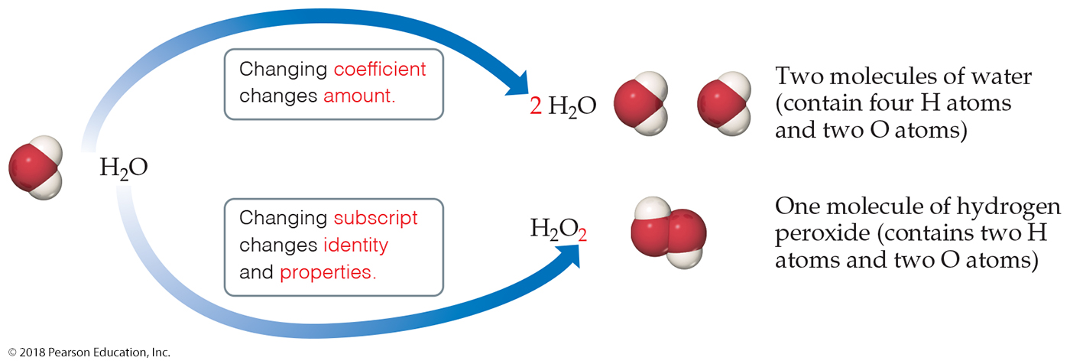
Why Do We Add Coefficients Instead of Changing Subscripts to Balance?
Hydrogen and oxygen can make water OR hydrogen peroxide
​
​
We don’t change the formula because we don’t drink hydrogen peroxide.

Slide 6
Other Symbols in Chemical Equations (1 of 2)
The states of matter for the reactants and products are often written in parentheses to the right of each formula or symbol.
(g) = gas; (l) = liquid; (s) = solid;
(aq) = dissolve in aqueous (water) solution

Slide 7
Other Symbols in Chemical Equations (2 of 2)
Other symbols can be used to represent conditions during the chemical reaction. One example is the use of Δ over the reaction arrow, which means heat is needed for the reaction to take place.

Slide 8
Simple Patterns of Chemical Reactivity
Types of reactions, which can be predicted at this point
Combination reactions
Decomposition reactions
Combustion reactions

Slide 9
Combination Reactions
In a combination reaction, two or more substances react to form one product.
Table 3.1: Combination and Decomposition Reactions

Slide 10
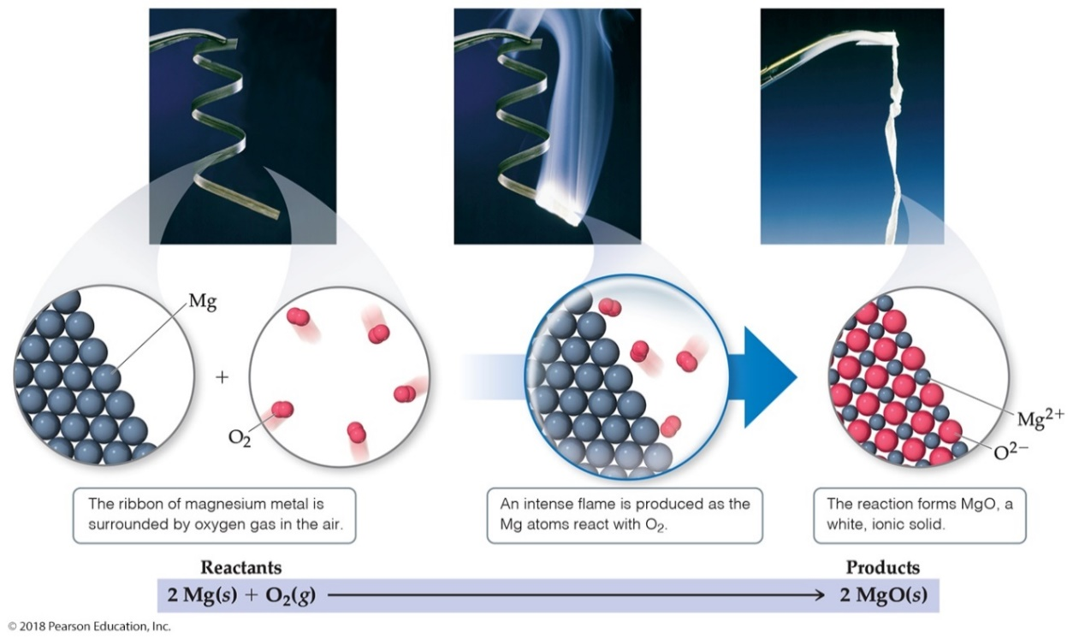
Combination Reaction Predictions: Metal and Nonmetal
You should be able to predict the product of a combination reaction between a metal and a nonmetal, like the one below. (Hint: Remember common charges for Groups!)

Slide 11
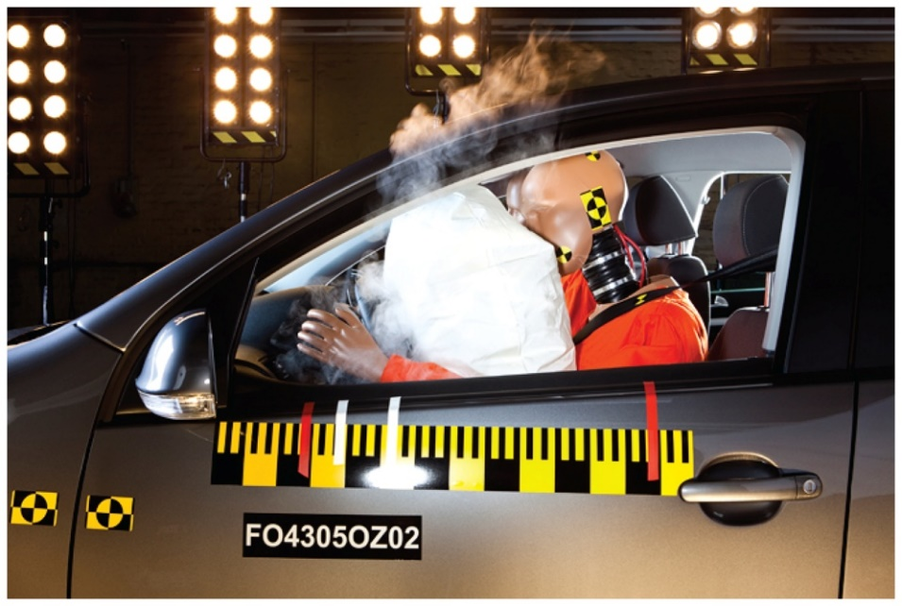
Decomposition Reactions
In a decomposition reaction one substance breaks down into two or more substances.
In the air bag, solid sodium azide releases nitrogen gas quickly.
Table 3.1: Combination and Decomposition Reactions

Slide 12
Decomposition Reaction Predictions: Heating a Metal Carbonate
Metal carbonates decompose when heated to give off carbon dioxide and a metal oxide.
Balancing these equations is based on the charge of the metal.

Slide 13
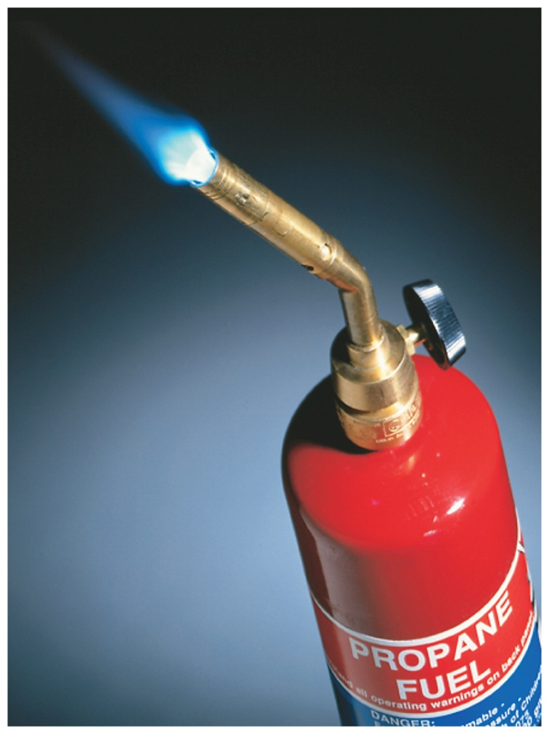
Combustion Reactions
Combustion reactions are rapid reactions that produce a flame.
Combustion reactions most often involve oxygen in the air as a reactant.

Slide 14
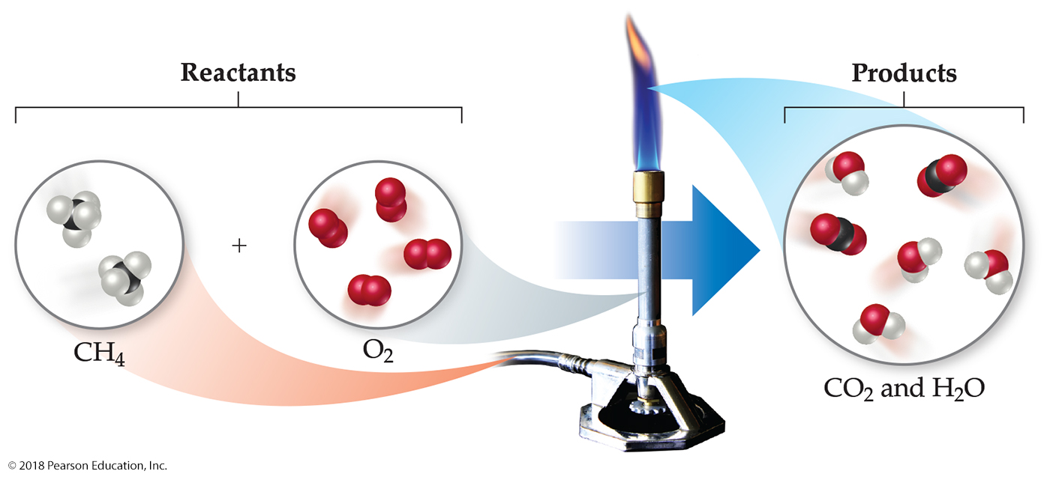
Combustion Reaction Predictions
When burning compounds with C and H in them, the products are C O₂ and H₂O.

Slide 15
Formula Weight (FW)
A formula weight is the sum of the atomic weights for the atoms in a chemical formula.
This is the quantitative significance of a formula.
For an element like sodium, N a, the formula weight is the atomic weight (23.0 a m u).
For an ionic compound, use the empirical formula.
The formula weight of sulfuric acid, H₂S O₄, would be
2(AW of H) + 1(AW of S) + 4(AW of O)
2(1.0 a m u) + 32.1 a m u + 4(16.0 a m u)
FW (H₂S O₄) = 98.1 a m u

Slide 16
Molecular Weight (MW)
If the substance is a molecule, the formula weight is also called its molecular weight.
A molecular weight is the sum of the atomic weights of the atoms in a molecule.
For glucose, which has a molecular formula of C₆H₁₂O₆, the molecular weight is
6(AW of C) + 12(AW of H) + 6(AW of O)
6(12.0 a m u) + 12(1.0 a m u) + 6(16.0 a m u)
MW (C₆H₁₂O₆) = 180.0 a m u

Slide 17
Percent Composition (1 of 2)
One can find the percentage of the mass of a compound that comes from each of the elements in the compound by using this equation:

Slide 18
Percent Composition (2 of 2)
So the percentage of carbon in glucose is:

Slide 19
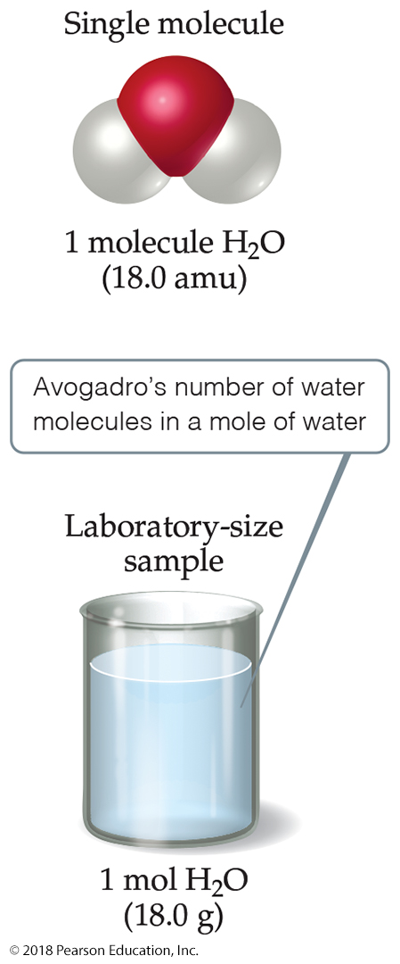
Avogadro’s Number
In a lab, we cannot work with individual molecules. They are too small.
One mole (abbreviated: m o l) is the amount of particles found in exactly 12 g of C-12.
atoms or molecules is the
number of particles in one mole.

Slide 20
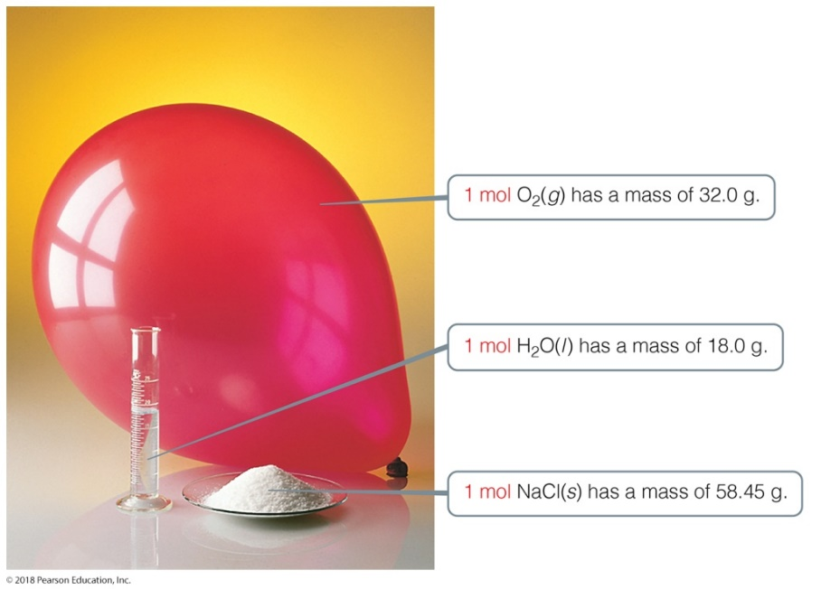
Molar Mass
A molar mass is the mass of 1 mol of a substance (i.e., g/mol).
The molar mass of an element is the atomic weight for the element from the periodic table. If it is diatomic, it is twice that atomic weight.
The formula weight (in a m u) will be the same number as the molar mass (in g/mol).

Slide 21
Mole Relationships
Table 3.2 Mole Relationship
ªRecall that the mass of an electron is more than 1800 times smaller than the masses of the proton and the neutron; thus, ions and atoms have essentially the same mass.
One mole of atoms, ions, or molecules contains Avogadro’s number of those particles.
The number of atoms of an element in a mole is the subscript in a formula (number of atoms of that element in the formula) times Avogadro’s number.

Slide 22
Converting Amounts
Moles provide a bridge from the molecular scale to the real-world scale.
Using equalities, we can convert from mass to atoms or from atoms to mass.
How many atoms in 3 g of copper (Cu)?

Slide 23
Determining Empirical Formulas
One can determine the empirical formula from the percent composition by following these three steps.

Slide 24
Determining Empirical Formulas—an Example (1 of 4)
The compound para-aminobenzoic acid (you may have seen it listed as PABA on your bottle of sunscreen) is composed of carbon (61.31%), hydrogen (5.14%), nitrogen (10.21%), and oxygen (23.33%). Find the empirical formula of PABA.

Slide 25
Determining Empirical Formulas—an Example (2 of 4)
Assuming 100.00 g of para-aminobenzoic acid and converting to moles:

Slide 26
Determining Empirical Formulas—an Example (3 of 4)
Calculate the mole ratio by dividing by the smallest number of moles:

Slide 27
Determining Empirical Formulas—an Example (4 of 4)
These are the subscripts for the empirical formula:
C₇H₇NO₂

Slide 28
Determining a Molecular Formula
Remember, the number of atoms in a molecular formula is a multiple of the number of atoms in an empirical formula.
If we find the empirical formula and know a molar mass (molecular weight) for the compound, we can find the molecular formula.

Slide 29
Determining a Molecular Formula—an Example
The empirical formula of a compound was found to be CH. It has a molar mass of 78 g/m o l. What is its molecular formula?
Solution:
C + H = 1(12) + 1(1) = 13
Whole-number multiple = 78/13 = 6
The molecular formula is C₆H₆.

Slide 30
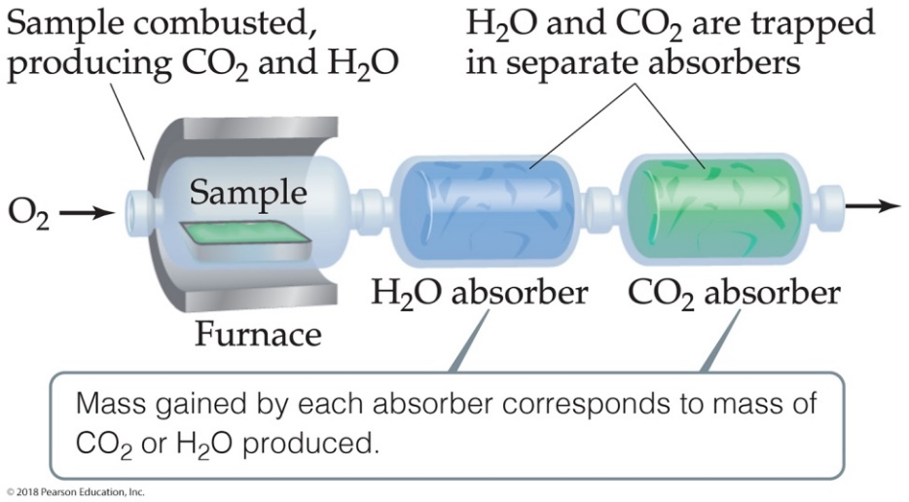
Combustion Analysis (1 of 3)
Compounds containing C, H, and O are routinely analyzed through combustion in a chamber.
Mass of C is determined from the mass of C O₂ produced.
Mass of H is determined from the mass of H₂O produced.
Mass of O is determined by the difference of the mass of the compound used and the total mass of C and H.
Note: The mass of O in the compound can NOT be determined from C O₂ and H₂O because oxygen is added during the combustion.

Slide 31
Combustion Analysis (2 of 3)
Mass of C is determined from the mass of C O₂ produced.

Slide 32
Combustion Analysis (3 of 3)
Mass of H is determined from the mass of H₂O produced.

Slide 33
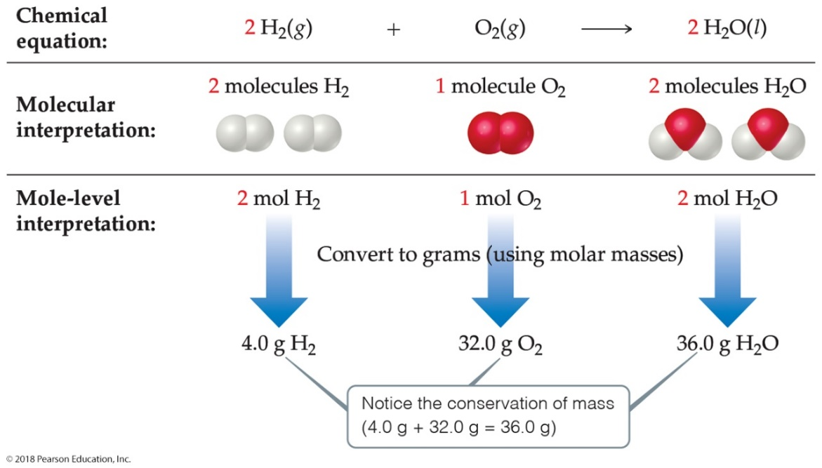
Quantitative Information from a Balanced Equation
The coefficients in the balanced equation show
Relative numbers of molecules of reactants and products
Relative numbers of moles of reactants and products, which can be converted to mass

Slide 34
Stoichiometric Calculations
We have already seen in this chapter how to convert from grams to moles or moles to grams.
The new calculation is how to compare two different materials, using the mole ratio from the balanced equation.
The mole ratio comes from the coefficients in the balanced equation.

Slide 35
An Example of a Stoichiometric Calculation (1 of 3)
How many grams of water can be produced from 1.00 g of glucose?
There is 1.00 g of glucose to start.
The first step is to convert it to moles.

Slide 36
An Example of a Stoichiometric Calculation (2 of 3)
The new calculation is to convert moles of one substance in the equation to moles of another substance.
The mole ratio comes from the coefficients in the balanced equation.

Slide 37
An Example of a Stoichiometric Calculation (3 of 3)
In the last step, moles of water is converted to grams of water.
This gives the answer we wanted.
You can do each step separately OR you can do them in one calculation, as seen above.

Slide 38
Heat and Stoichiometry
Heat does NOT appear in a balanced equation.
However, in Chapter 5 we will see how amounts of heat are related to a balanced equation.
Those amounts depend on stoichiometry as well.

Slide 39
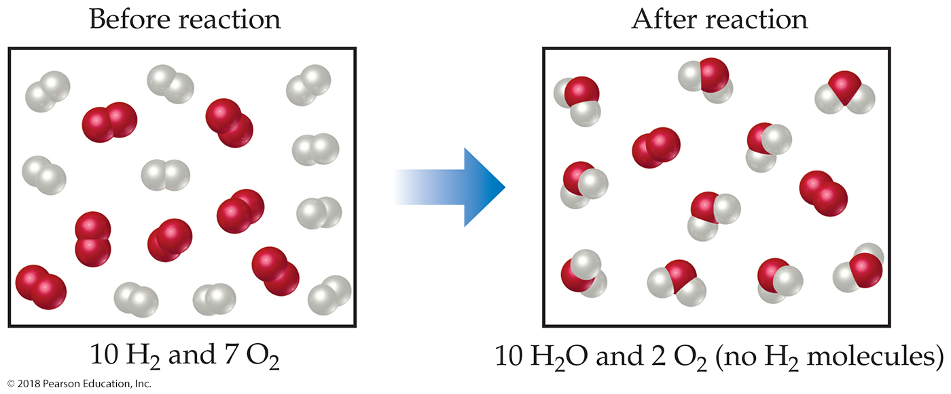
Limiting Reactants (1 of 3)
The limiting reactant is the reactant present in the smallest stoichiometric amount.
In other words, it is the reactant you will run out of first (in this case, the H₂).

Slide 40
Limiting Reactants (2 of 3)
In the example below, the O₂ would be the excess reagent.

Slide 41
Limiting Reactants (3 of 3)
The limiting reactant is used in all stoichiometry calculations to determine amounts of products that are produced and amounts of any other reactant(s) that are used in a reaction.

Slide 42
Theoretical Yield
The theoretical yield is the maximum amount of product that can be made.
In other words, it is the amount of product possible as calculated through the stoichiometry problem.
This is different from the actual yield, which is the amount one actually produces and measures.

Slide 43
Percent Yield
One finds the percent yield by comparing the amount actually obtained (actual yield) to the amount it was possible to make (theoretical yield):

Slide 44
Copyright

