Slide 1
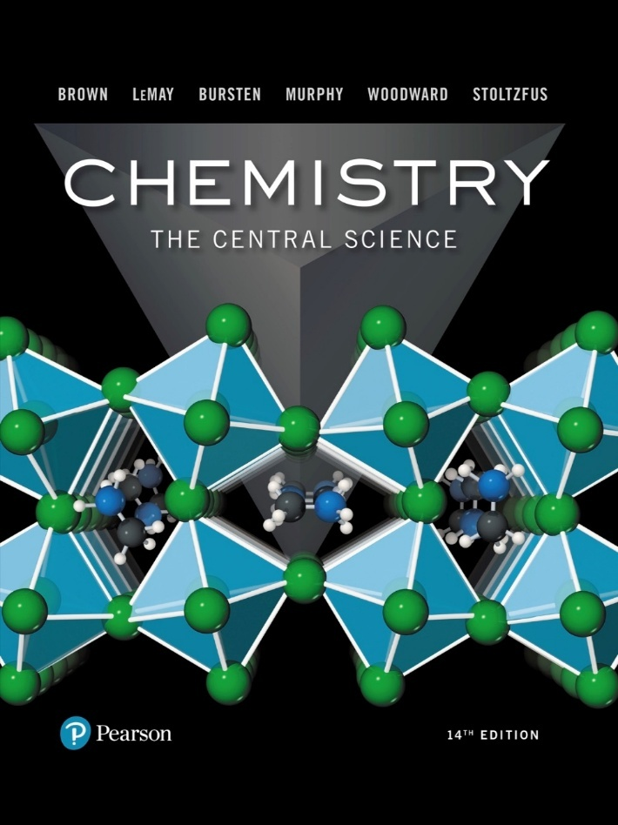
Chemistry: The Central Science
Fourteenth Edition
Chapter 10
Gases
Copyright © 2018, 2015, 2012 Pearson Education, Inc. All Rights Reserved
Notes:
If this PowerPoint presentation contains mathematical equations, you may need to check that your computer has the following installed:
1) MathType Plugin
2) Math Player (free versions available)
3) NVDA Reader (free versions available)

Slide 2
Characteristics of Gases
Physical properties of gases are all similar.
Composed mainly of nonmetallic elements with simple formulas and low molar masses.
Unlike liquids and solids, gases
expand to fill their containers.
are highly compressible.
have extremely low densities.
Two or more gases form a homogeneous mixture.

Slide 3
Some Common Gases
Table 10.1 Some Common Compounds That Are Gases at Room Temperature
Formula | Name | Characteristics
H C N | Hydrogen cyanide | Very toxic, slight odor of bitter almonds
H₂S | Hydrogen sulfide | Very toxic, odor of rotten eggs
C O | Carbon monoxide | Toxic, colorless, odorless
C O₂ | Carbon dioxide | Colorless, odorless
CH₄ | Methane | Colorless, odorless, flammable
C₂H₄ | Ethene (Ethylene) | Colorless, ripens fruit
C₃H₈ | Propane | Colorless, odorless, bottled gas
N₂O | Nitrous oxide | Colorless, sweet odor, laughing gas
N O₂ | Nitrogen dioxide | Toxic, red-brown, irritating odor
NH₃ | Ammonia | Colorless, pungent odor
S O₂ | Sulfur dioxide | Colorless, irritating odor

Slide 4
Properties That Define the State of a Gas Sample
Temperature
Pressure
Volume
Amount of gas, usually expressed as number of moles
Having already discussed three of these, we need to define pressure.

Slide 5
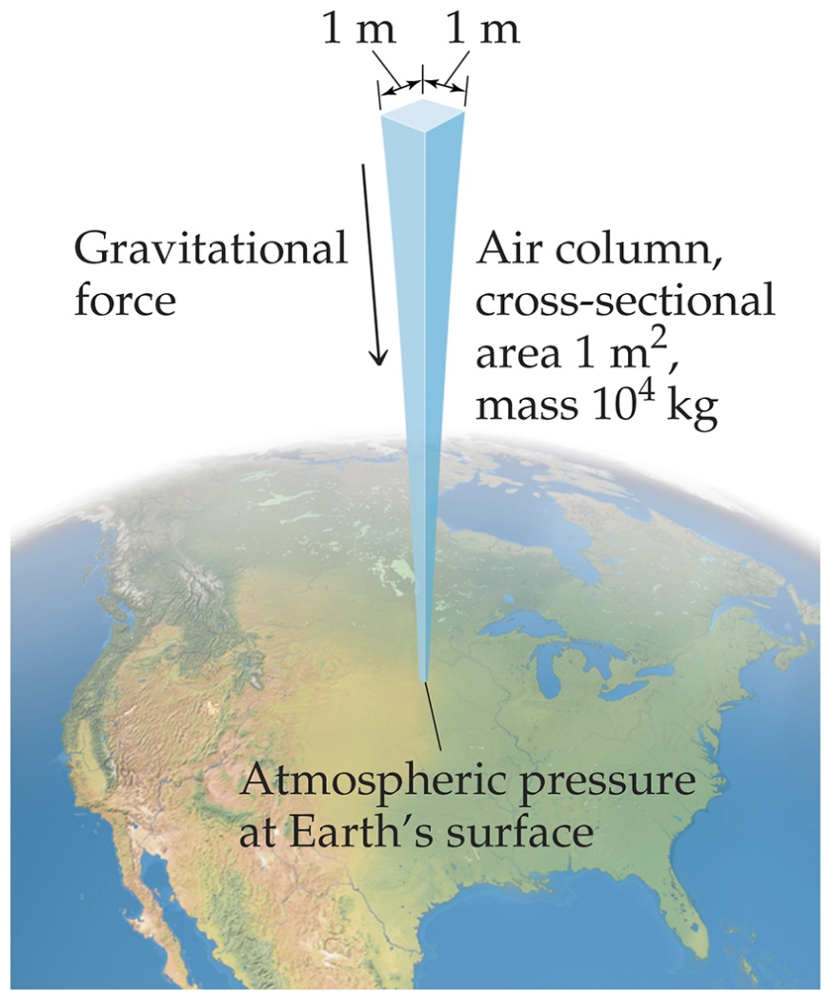
Pressure
Pressure is the amount of force applied to an area:
Atmospheric pressure is the weight of air per unit of area.

Slide 6
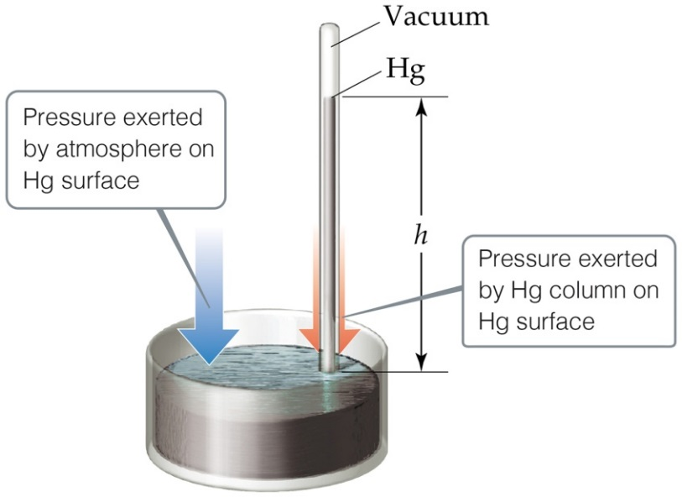
Units of Pressure
Pascals:
(SI unit of pressure)
Bar:
Pa = 100 kPa
mm Hg or torr: These units are literally the difference in the heights measured in millimeters of two connected columns of mercury, as in the barometer in the figure.
Atmosphere:
1 atm = 760. torr = 760. mm
Hg = 101.325 kPa = 1.10325 bar

Slide 7
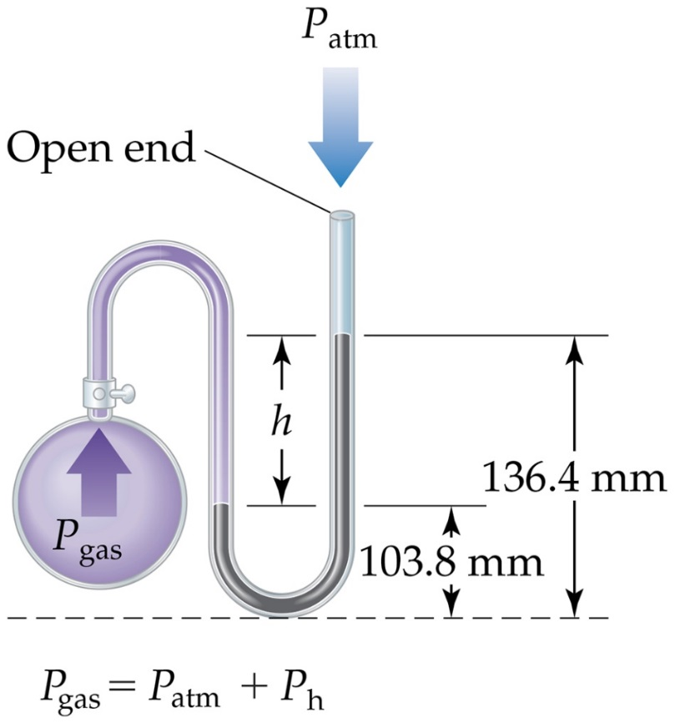
Manometer
The manometer is used to measure the difference in pressure between atmospheric pressure and that of a gas in a vessel. (The barometer seen on the last slide is used to measure the pressure in the atmosphere at any given time.)

Slide 8
Standard Pressure
Normal atmospheric pressure at sea level is referred to as standard atmospheric pressure.
It is equal to
1 atm
760 torr (760 mmHg)
101.325 kPa

Slide 9
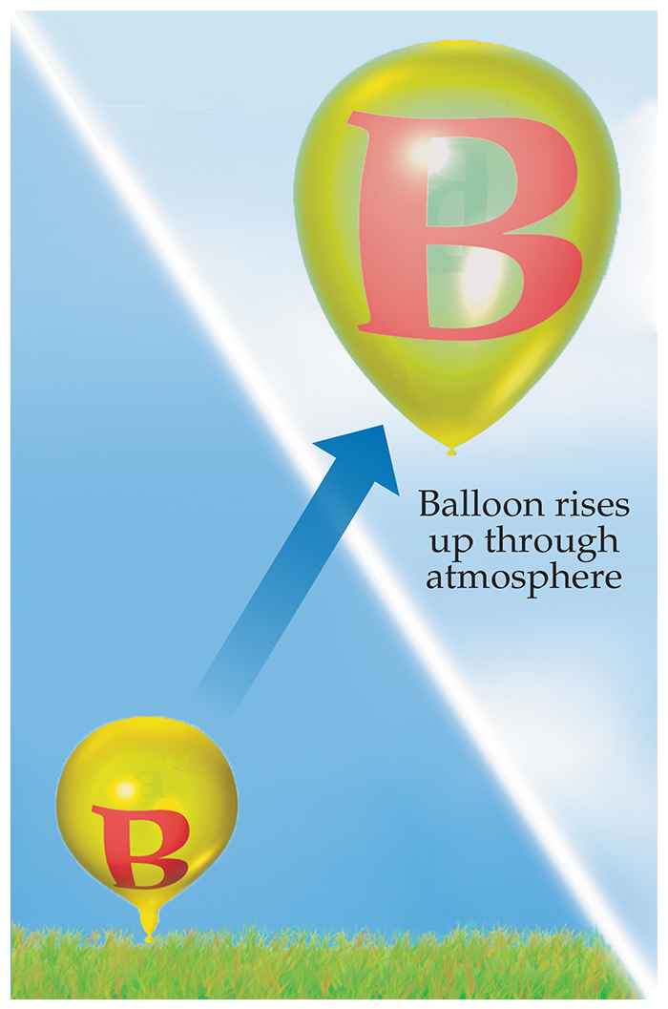
Boyle’s Law
The volume of a fixed quantity of gas at constant temperature is inversely proportional to the pressure.

Slide 10
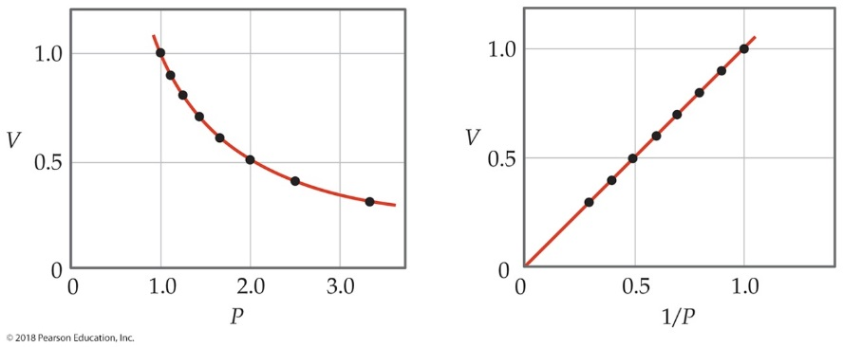
Mathematical Relationships of Boyle’s Law
P V = a constant.
This means, if we compare two conditions:
P₁V₁ = P₂V₂.
Also, if we make a graph of V vs. P, it will not be linear. However, a graph of V vs.
will result in a
linear relationship!

Slide 11
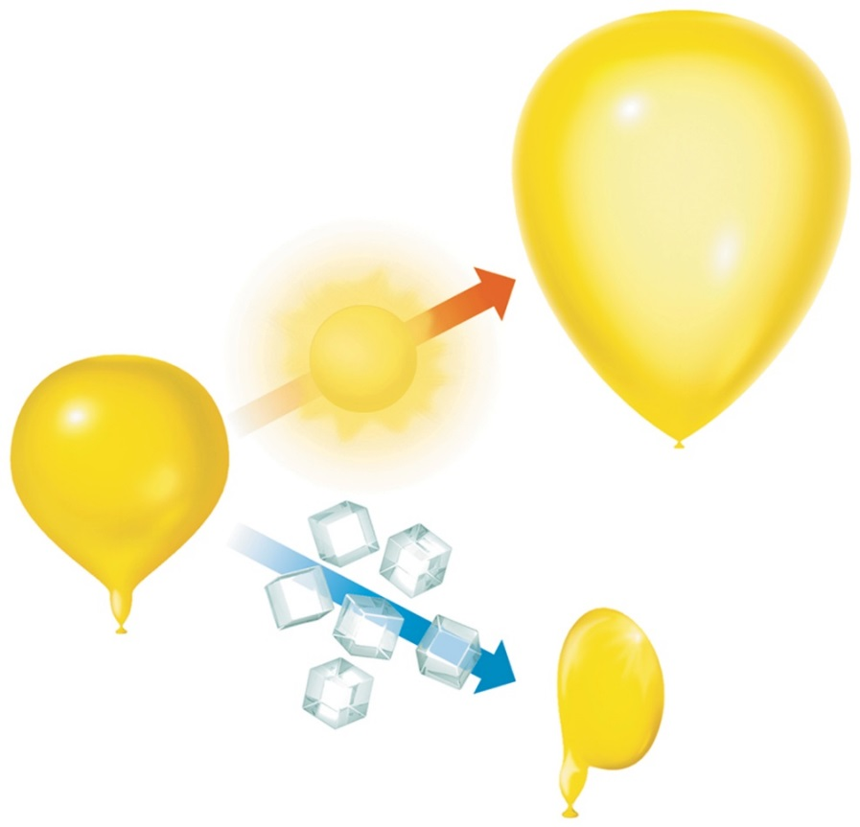
Charles’s Law
The volume of a fixed amount of gas at constant pressure is directly proportional to its absolute temperature.

Slide 12
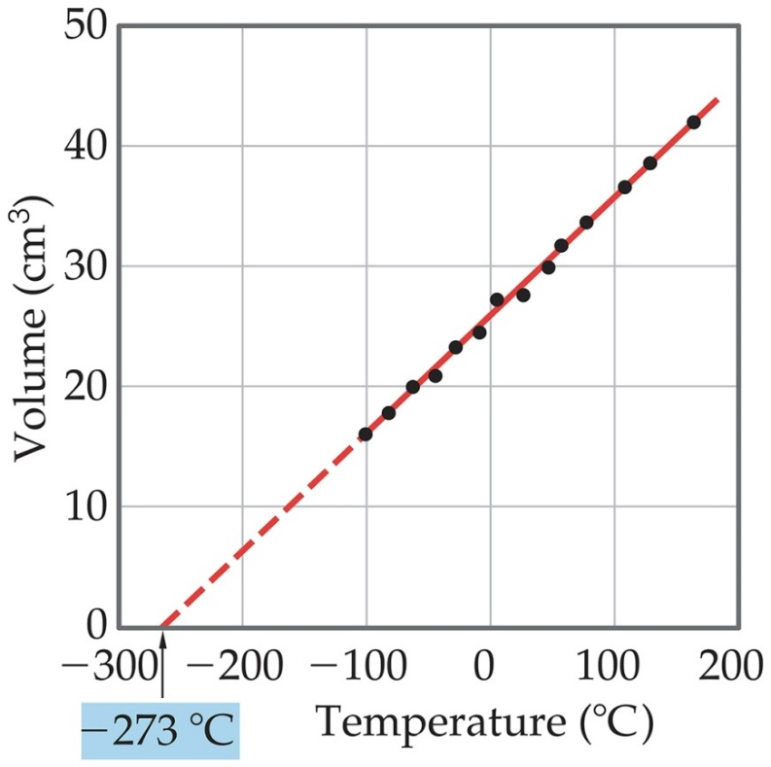
Mathematical Relationships of Charles’s Law
​
This means, if we compare two conditions:
Also, if we make a graph of V vs. T, it will be linear.

Slide 13
Gay-Lussac’s Law of Combining Volumes
At a given temperature and pressure, the volume of gases that react with each other is in small whole numbers.
Example: two volumes of hydrogen gas and one volume of oxygen gas will make two volumes of water vapor.
Stoichiometry based!
Led to …

Slide 14
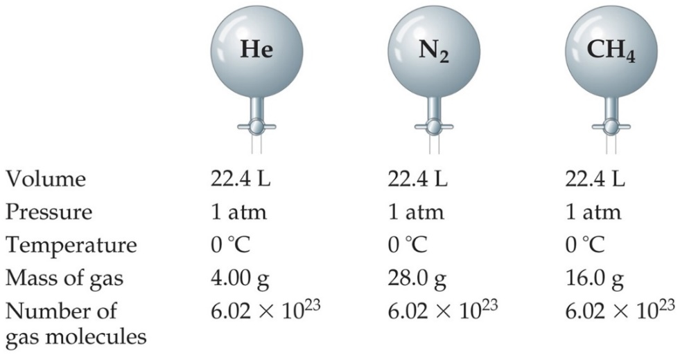
Avogadro’s Law
The volume of a gas at constant temperature and pressure is directly proportional to the number of moles of the gas.
So, at S T P, one mole of ANY gas occupies 22.4 L.
Mathematically:

Slide 15
Ideal-Gas Equation
So far we’ve seen that
Combining these, we get
Finally, to make it an equality, we use a constant of proportionality (R) and reorganize; this gives the ideal-gas equation: P V = n R T.

Slide 16
R
The ideal gas constant makes the equation and equality, not only a proportion.
P V = n R T
Table 10.2 Numerical Values of the Gas Constant R in Various Units
Unit | Numerical Value
L - atm/mol - K | 0.08206
J/mol - K* | 8.314
cal/mol - K | 1.987
m cubed - Pa / mol - k asterisk | 8.314
L - torr/mol - k | 62.36
*SI unit

Slide 17
Density of Gases
If we divide both sides of the ideal-gas equation by V and by R T, we get
Also:
If we multiply both sides by M, we get
and
is density, d; the result is:

Slide 18
Density and Molar Mass of a Gas
To recap:
One needs to know only the molecular mass, the pressure, and the temperature to calculate the density of a gas.
​
Also, if we know the mass, volume, and temperature of a gas, we can find its molar mass.
​

Slide 19
Volume and Chemical Reactions
The balanced equation tells us relative amounts of moles in a reaction, whether the compared materials are products or reactants.
P V = n R T.
So, we can relate volume for gases, as well.
Reminder: Gay-Lussac’s law of combining volumes.

Slide 20
Dalton’s Law of Partial Pressures
If two gases that don’t react are combined in a container, they act as if they are alone in the container.
The total pressure of a mixture of gases equals the sum of the pressures that each would exert if it were present alone.
In other words,
P_{t} = P₁ + P₂ + P₃ + …

Slide 21
Mole Fraction
Because each gas in a mixture acts as if it is alone, we can relate amount in a mixture to partial pressures:
That ratio of moles of a substance to total moles is called the mole fraction,

Slide 22
Pressure and Mole Fraction
The end result is

Slide 23
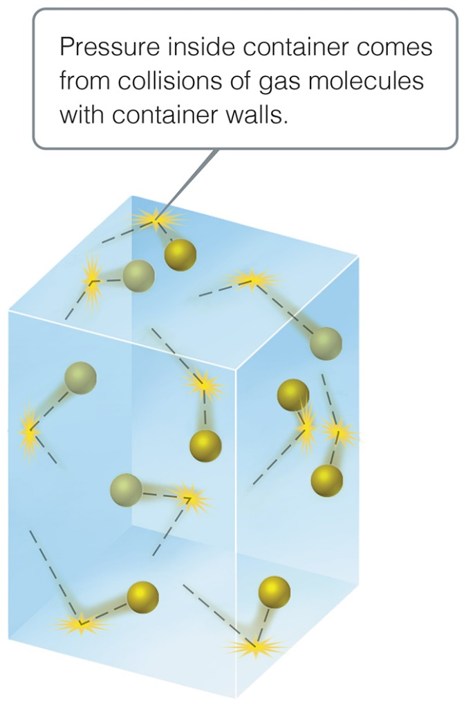
Kinetic-Molecular Theory
Laws tell us what happens in nature. Each of the gas laws we have discussed tells us what is observed under certain conditions.
Why are these laws observed? We will discuss a theory to explain our observations.

Slide 24
Main Tenets of Kinetic-Molecular Theory (1 of 2)
Gases consist of large numbers of molecules that are in continuous, random motion.
The combined volume of all the molecules of the gas is negligible relative to the total volume in which the gas is contained.
Attractive and repulsive forces between gas molecules are negligible.

Slide 25
Main Tenets of Kinetic-Molecular Theory (2 of 2)
Energy can be transferred between molecules during collisions, but the average kinetic energy of the molecules does not change with time, as long as the temperature of the gas remains constant.
The average kinetic energy of the molecules is proportional to the absolute temperature.

Slide 26
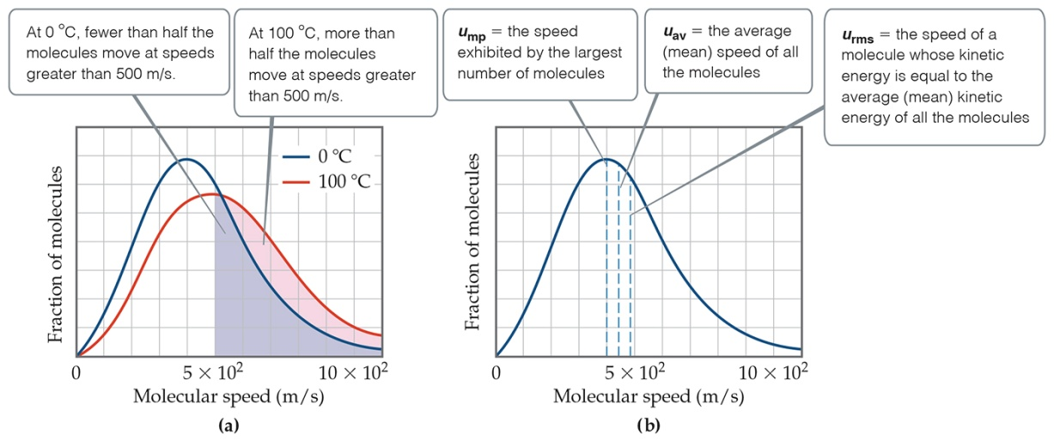
How Fast Do Gas Molecules Move?
Temperature is related to the average kinetic.
Individual molecules can have different speeds.
The figure shows three different speeds:
u_{mp} is the most probable.
u_{av} is the average speed of the molecules.
u_{rms}, the root-mean-square speed, is the one associated with their average kinetic energy.

Slide 27
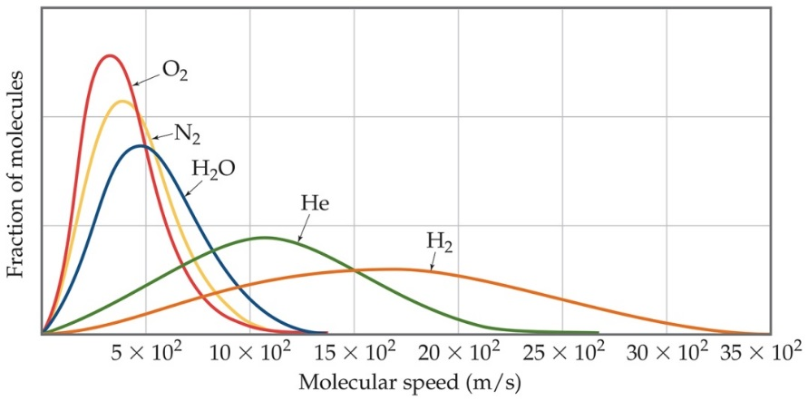
u_{rms} and Molecular Mass
At any given temperature, the average kinetic energy of molecules is the same.
So,
is the same for two gases at the same
temperature.
If a gas has a low mass, its speed will be greater than for a heavier molecule.

Slide 28
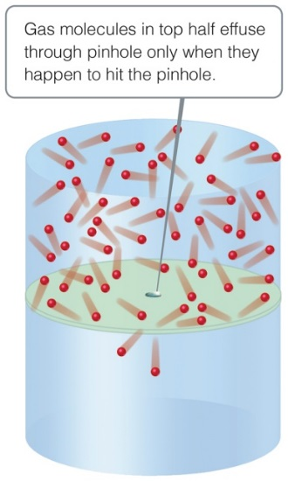
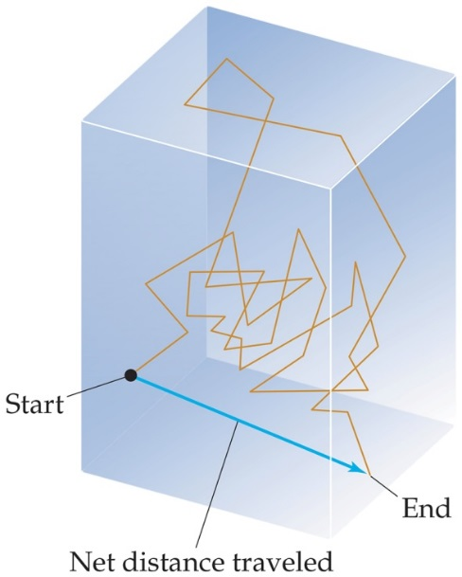
Effusion and Diffusion
Effusion is the escape of gas molecules through a tiny hole into an evacuated space.
Diffusion is the spread of one substance throughout a space or a second substance.

Slide 29
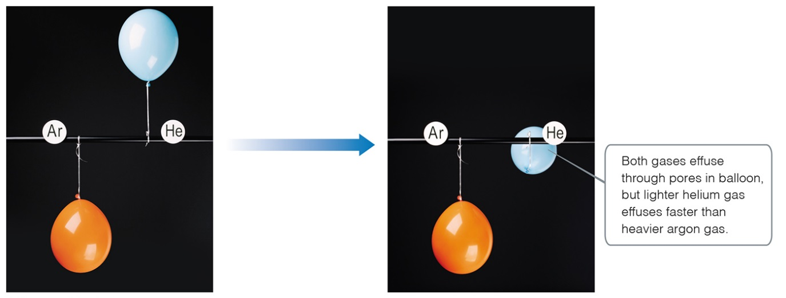
Graham’s Law Describes Diffusion and Effusion
Graham’s law relates the molar mass of two gases to their rate of speed of travel.
The “lighter” gas always has a faster rate of speed.

Slide 30
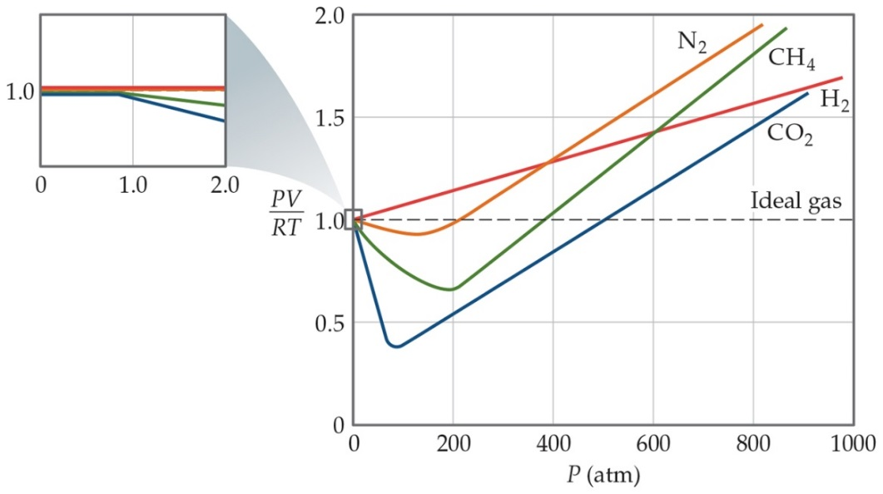
Real Gases
In the real world, the behavior of gases conforms to the ideal-gas equation only at relatively high temperature and low pressure.
Even the same gas will show wildly different behavior under high pressure at different temperatures.

Slide 31
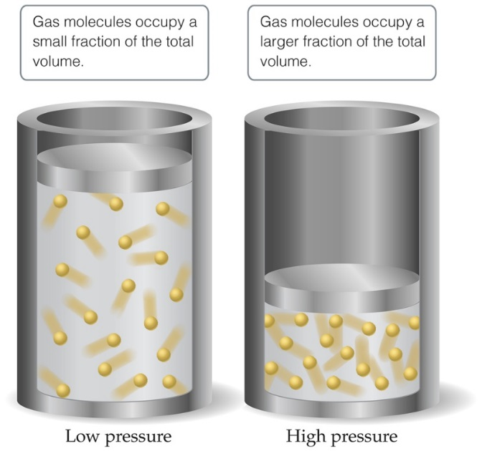
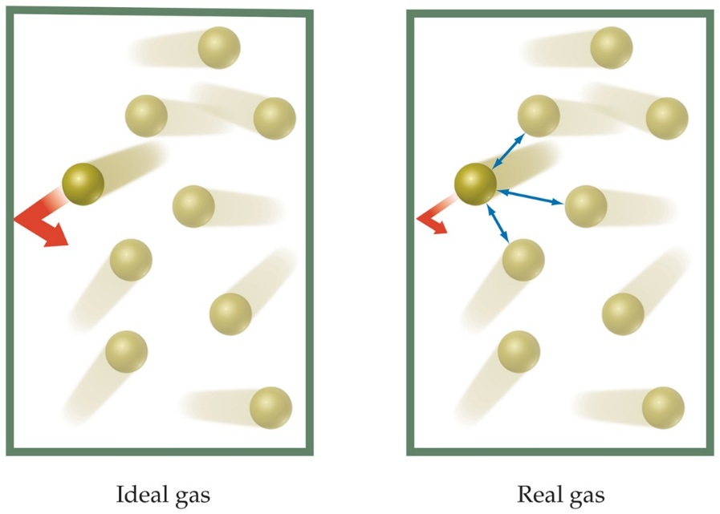
Deviations from Ideal Behavior
The assumptions made in the kinetic-molecular model (negligible volume of gas molecules themselves, no attractive forces between gas molecules, etc.) break down at high pressure and/or low temperature.

Slide 32
Corrections for Nonideal Behavior
The ideal-gas equation can be adjusted to take these deviations from ideal behavior into account.
One equation corrected for real gases is known as the van der Waals equation.
The pressure adjustment is due to the fact that molecules attract and repel each other.
The volume adjustment is due to the fact that molecules occupy some space on their own.

Slide 33
The van der Waals Equation
Table 10.3 Van der Waals Constants for Gas Molecules
Substance | ay ( L squared - atm / mol squared ) | b(L/mol)
H e | 0.0341 | 0.02370
N e | 0.211 | 0.0171
Ar | 1.34 | 0.0322
Kr | 2.32 | 0.0398
Xe | 4.19 | 0.0510
H₂ | 0.244 | 0.0266
N₂ | 1.39 | 0.0391
O₂ | 1.36 | 0.0318
F₂ | 1.06 | 0.0290
Cl₂ | 6.49 | 0.0562
H₂O | 5.46 | 0.0305
NH₃ | 4.17 | 0.0371
CH₄ | 2.25 | 0.0428
CO₂ | 3.59 | 0.0427
CCl₄ | 20.4 | 0.1383

Slide 34
Copyright

