Slide 1
Sample Exercise 21.1 Predicting the Product of a Nuclear Reaction
What product is formed when radium-226 undergoes alpha emission?
Solution
Analyze We are asked to determine the nucleus that results when radium-226 loses an alpha particle.
Plan We can best do this by writing a balanced nuclear reaction for the process.
Solve The periodic table shows that radium has an atomic number of 88. The complete chemical symbol for radium-226 is therefore . An alpha particle is a helium-4 nucleus, and so its symbol is . The alpha particle is a product of the nuclear reaction, and so the equation is of the form
where A is the mass number of the product nucleus and Z is its atomic number. Mass numbers and atomic numbers must balance, so
226 = A + 4
and
88 = Z + 2
Hence,
A = 222 and Z = 86

Slide 2
Sample Exercise 21.1 Predicting the Product of a Nuclear Reaction
Continued
Again, from the periodic table, the element with Z = 86 is radon (Rn). The product, therefore, is , and the nuclear equation is
Practice Exercise 1
What product forms when plutonium-238 undergoes alpha emission?
(a) Plutonium-234 (b) Uranium-234 (c) Uranium-238 (d) Thorium-236 (e) Neptunium-237
Practice Exercise 2
Which element undergoes alpha emission to form lead-208?

Slide 3
Sample Exercise 21.2 Writing Nuclear Equations
Write nuclear equations for (a) mercury-201 undergoing electron capture; (b) thorium-231 decaying to protactinium-231.
Solution
Analyze We must write balanced nuclear equations in which the masses and charges of reactants and products are equal.
Plan We can begin by writing the complete chemical symbols for the nuclei and decay particles that are given in the problem.
Solve
(a) The information given in the question can be summarized as
The mass numbers must have the same sum on both sides of the equation:
201 + 0 = A
Thus, the product nucleus must have a mass number of 201. Similarly, balancing the atomic numbers gives
80 – 1 = Z

Slide 4
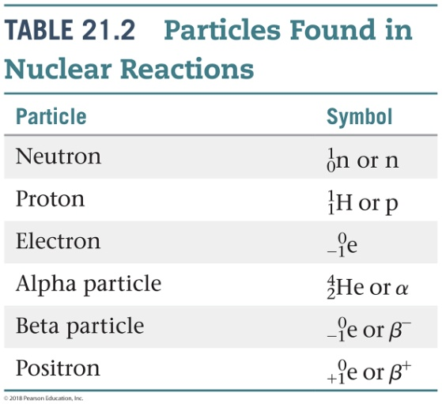
Sample Exercise 21.2 Writing Nuclear Equations
Continued
Thus, the atomic number of the product nucleus must be 79, which identifies it as gold (Au):
(b) In this case, we must determine what type of particle is emitted in the course of the radioactive decay:
From 231 = 231 + A and 90 = 91 + Z, we deduce A = 0 and Z = –1. According to Table 21.2, the particle with these characteristics is the beta particle (electron). We therefore write

Slide 5
Sample Exercise 21.2 Writing Nuclear Equations
Continued
Practice Exercise 1
The radioactive decay of thorium-232 occurs in multiple steps, called a radioactive decay chain. The second product produced in this chain is actinium-228. Which of the following processes could lead to this product starting with thorium-232?
(a) Alpha decay followed by beta emission
(b) Beta emission followed by electron capture
(c) Positron emission followed by alpha decay
(d) Electron capture followed by positron emission
(e) More than one of the above is consistent with the observed transformation.
Practice Exercise 2
Write a balanced nuclear equation for the reaction in which oxygen-15 undergoes positron emission.

Slide 6
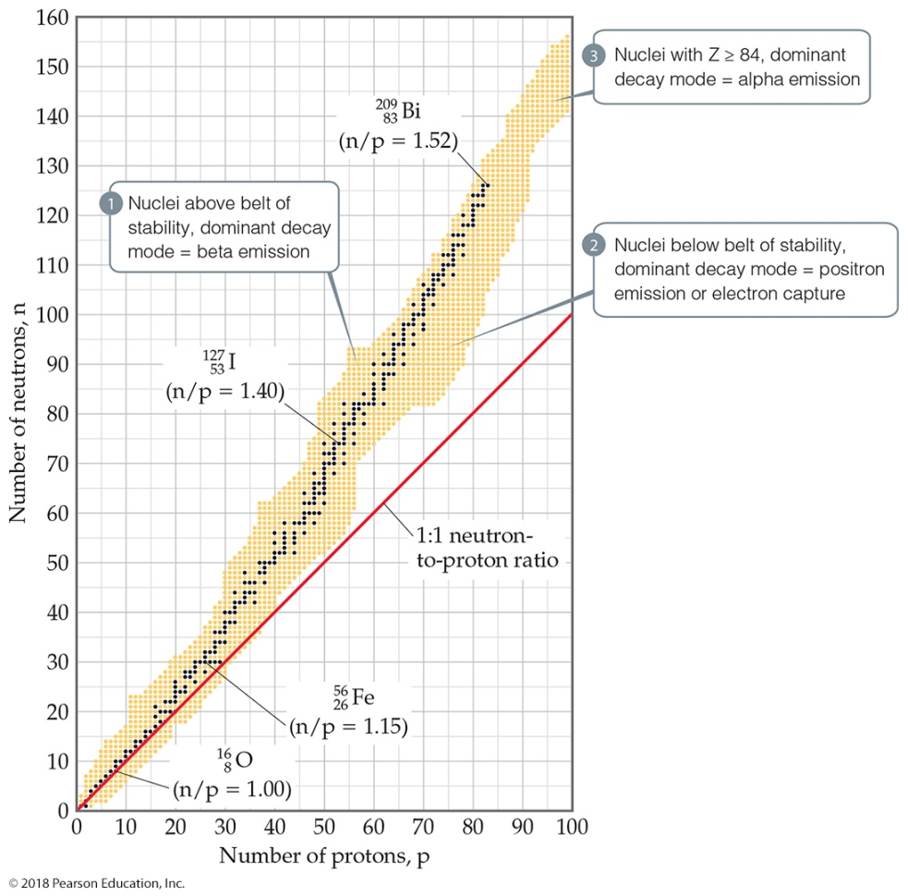
Sample Exercise 21.3 Predicting Modes of Nuclear Decay
Predict the mode of decay of (a) carbon-14, (b) xenon-118.
Solution
Analyze We are asked to predict the modes of decay of two nuclei.
Plan To do this, we must locate the respective nuclei in Figure 21.1 and determine their positions with respect to the belt of stability in order to predict the most likely mode of decay.
Solve
(a) Carbon is element 6. Thus, carbon-14 has 6 protons and 14 – 6 = 8 neutrons, giving it a neutron-to-proton ratio of 1.25. Elements with Z < 20 normally have stable nuclei that contain approximately equal numbers of neutrons and protons (n/p = 1). Thus, carbon-14 is located above the belt of stability, and we expect it to decay by emitting a beta particle to decrease the n/p ratio:
This is indeed the mode of decay observed for carbon-14, a reaction that lowers the n/p ratio from 1.25 to 1.0.

Slide 7
Sample Exercise 21.3 Predicting Modes of Nuclear Decay
Continued
(b) Xenon is element 54. Thus, xenon-118 has 54 protons and 118 – 54 = 64 neutrons, giving it an n/p ratio of 1.18. According to Figure 21.1, stable nuclei in this region of the belt of stability have higher neutron-to-proton ratios than xenon-118. The nucleus can increase this ratio by either positron emission or electron capture:
In this case, both modes of decay are observed.
Comment Keep in mind that our guidelines do not always work. For example, thorium-233, which we might expect to undergo alpha decay, actually undergoes beta emission. Furthermore, a few radioactive nuclei lie within the belt of stability. Both and , for example, are stable and lie in the belt of stability. , however, which lies between them, is radioactive.
Practice Exercise 1
Which of the following radioactive nuclei is most likely to decay via emission of a β – particle?
(a) nitrogen-13 (b) magnesium-23 (c) rubidium-83 (d) iodine-131 (e) neptunium-237
Practice Exercise 2
Predict the mode of decay of (a) plutonium-239, (b) indium-120.

Slide 8
Sample Exercise 21.4 Writing a Balanced Nuclear Equation
Write the balanced nuclear equation for the process summarized as (n, α) .
Solution
Analyze We must go from the condensed descriptive form of the reaction to the balanced nuclear equation.
Plan We arrive at the balanced equation by writing n and a, each with its associated subscripts and superscripts.
Solve The n is the abbreviation for a neutron ( ), and α represents an alpha particle ( ). The neutron is the bombarding particle, and the alpha particle is a product. Therefore, the nuclear equation is
Practice Exercise 1
Consider the following nuclear transmutation: . What is the identity of nucleus X?
(a) (b) (c) (d) (e)
Practice Exercise 2
Write the condensed version of the nuclear reaction

Slide 9
Sample Exercise 21.5 Calculation Involving Half-Lives
The half-life of cobalt-60 is 5.27 yr. How much of a 1.000-mg sample of cobalt-60 is left after 15.81 yr?
Solution
Analyze We are given the half-life for cobalt-60 and asked to calculate the amount of cobalt-60 remaining from an initial 1.000-mg sample after 15.81 yr.
Plan We will use the fact that the amount of a radioactive substance decreases by 50% for every half-life that passes.
Solve Because 5.27 × 3 = 15.81, 15.81 yr is three half-lives for cobalt-60. At the end of one half-life, 0.500 mg of cobalt-60 remains, 0.250 mg at the end of two half-lives, and 0.125 mg at the end of three half-lives.
Practice Exercise 1
A radioisotope of technetium is useful in medical imaging techniques. A sample initially contains 80.0 mg of this
isotope. After 24.0 h, only 5.0 mg of the technetium isotope remains. What is the half-life of the isotope?
(a) 3.0 h (b) 6.0 h (c) 12.0 h (d) 16.0 h (e) 24.0 h
Practice Exercise 2
Carbon-11, used in medical imaging, has a half-life of 20.4 min. The carbon-11 nuclides are formed, and the carbon atoms are then incorporated into an appropriate compound. The resulting sample is injected into a patient, and the medical image is obtained. If the entire process takes five half-lives, what percentage of the original carbon-11 remains at this time?

Slide 10
Sample Exercise 21.6 Calculating the Age of Objects Using Radioactive Decay
A rock contains 0.257 mg of lead-206 for every milligram of uranium-238. The half-life for the decay of uranium-238 to lead-206 is 4.5 × 10⁹ yr. How old is the rock?
Solution
Analyze We are asked to calculate the age of a rock containing uranium-238 and lead-206, given the half-life of the uranium-238 and the relative amounts of the uranium-238 and lead-206.
Plan Lead-206 is the product of the radioactive decay of uranium-238. We will assume that the only source of lead-206 in the rock is from the decay of uranium-238, which has a known half-life. To apply first-order kinetics expressions (Equations 21.19 and 21.20) to calculate the time elapsed since the rock was formed, we first need to calculate how much initial uranium-238 there was for every 1 mg that remains today.
Solve Let’s assume that the rock currently contains 1.000 mg of uranium-238 and therefore 0.257 mg of lead-206. The amount of uranium-238 in the rock when it was first formed therefore equals 1.000 mg plus the quantity that has decayed to lead-206. Because the mass of lead atoms is not the same as the mass of uranium atoms, we cannot just add 1.000 mg and 0.257 mg. We have to multiply the present mass of lead-206 (0.257 mg) by the ratio of the mass number of uranium to that of lead, into which it has decayed. Therefore, the original mass of was

Slide 11
Sample Exercise 21.6 Calculating the Age of Objects Using Radioactive Decay
Continued
Using Equation 21.19, we can calculate the decay constant for the process from its half-life:
Rearranging Equation 21.20 to solve for time, t, and substituting known quantities gives
Practice Exercise 1
Cesium-137, which has a half-life of 30.2 yr, is a component of the radioactive waste from nuclear power plants. If the activity due to cesium-137 in a sample of radioactive waste has decreased to 35.2% of its initial value, how old is the sample?
(a) 1.04 yr (b) 15.4 yr (c) 31.5 yr (d) 45.5 yr (e) 156 yr
Practice Exercise 2
A wooden object from an archeological site is subjected to radiocarbon dating. The activity due to ¹⁴C is measured to be 11.6 disintegrations per second. The activity of a carbon sample of equal mass from fresh wood is 15.2 disintegrations per second. The half-life of ¹⁴C is 5700 yr. What is the age of the archeological sample?

Slide 12
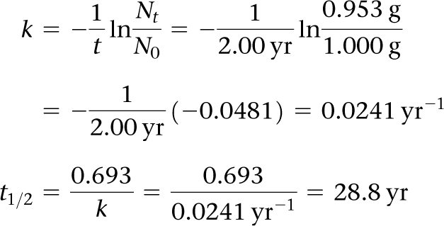
Sample Exercise 21.7 Calculations Involving Radioactive Decay and Time
If we start with 1.000 g of strontium-90, 0.953 g will remain after 2.00 yr. (a) What is the half-life of strontium-90? (b) How much strontium-90 will remain after 5.00 yr?
Solution
Analyze (a) We are asked to calculate a half-life, t_{1/2}, based on data that tell us how much of a radioactive nucleus has decayed in a time interval t = 2.00 yr and the information N₀ = 1.000 g, N_{t} = 0.953 g. (b) We are asked to calculate the amount of a radionuclide remaining after a given period of time.
Plan (a) We first calculate the rate constant for the decay, k, and then we use that to compute t_{1/2}. (b) We need to calculate N_{t}, the amount of strontium present at time t, using the initial quantity, N₀, and the rate constant for decay, k, calculated in part (a).
Solve
(a) Equation 21.20 is solved for the decay constant, k, and then Equation 21.19 is used to calculate half-life, t_{1/2}:

Slide 13
Sample Exercise 21.7 Calculations Involving Radioactive Decay and Time
Continued
(b) Again using Equation 21.20, with k = 0.0241 yr^{–1}, we have:
N_{t} /N₀ is calculated from ln( N_{t} /N₀) = –0.120 using the e^{x} or INV LN function of a calculator:
Because N₀ = 1.000 g, we have: N_{t} = (0.887)N₀ = (0.887)(1.000 g) = 0.887 g
Practice Exercise 1
As mentioned in the previous Practice Exercise 1, cesium-137, a component of radioactive waste, has a half-life of 30.2 yr. If a sample of waste has an initial activity of 15.0 Ci due to cesium-137, how long will it take for the activity due to cesium-137 to drop to 0.250 Ci?
(a) 0.728 yr (b) 60.4 yr (c) 78.2 yr (d) 124 yr (e) 178 yr
Practice Exercise 2
A sample to be used for medical imaging is labeled with ¹⁸F, which has a half-life of 110 min. What percentage of the original activity in the sample remains after 300 min?

Slide 14
Sample Exercise 21.8 Calculating Mass Change in a Nuclear Reaction
How much energy is lost or gained when 1 mol of cobalt-60 undergoes beta decay, + ? The mass of a atom is 59.933819 amu, and that of a atom is 59.930788 amu.
Solution
Analyze We are asked to calculate the energy change in a nuclear reaction.
Plan We must first calculate the mass change in the process. We are given atomic masses, but we need the masses of the nuclei in the reaction. We calculate these by taking account of the masses of the electrons that contribute to the atomic masses.
Solve
A atom has 27 electrons. The mass of an electron is 5.4858 × 10^{–4} amu. (See the list of fundamental constants in the back inside cover.) We subtract the mass of the 27 electrons from the mass of the atom to find the mass of the nucleus:
59.933819 amu – (27)(5.4858 × 10^{–4} amu) = 59.919007 amu (or 59.919007 g/mol)
Likewise, for , the mass of the nucleus is:
59.930788 amu – (28)(5.4858 × 10^{–4} amu) = 59.915428 amu (or 59.915428 g/mol)

Slide 15
Sample Exercise 21.8 Calculating Mass Change in a Nuclear Reaction
Continued
The mass change in the nuclear reaction is the total mass of the products minus the mass of the reactant:
Thus, when a mole of cobalt-60 decays,
Δm = –0.003030 g
Because the mass decreases (Δm < 0), energy is released (ΔE < 0). The quantity of energy released per mole of cobalt-60 is calculated using Equation 21.22:

Slide 16
Sample Exercise 21.8 Calculating Mass Change in a Nuclear Reaction
Continued
Practice Exercise 1
Electricity is generated in space vehicles from the heat produced by the radioactive decay of plutonium-238:
. The atomic masses of plutonium-238 and uranium-234 are 238.049554 amu and 234.040946 amu, respectively. The mass of an alpha particle is 4.001506 amu. How much energy in kJ is released when 1.00 g of plutonium-238 decays to uranium-234?
(a) 2.27 × 10⁶ kJ (b) 2.68 × 10⁶ kJ (c) 3.10 × 10⁶ kJ
(d) 3.15 × 10⁶ kJ (e) 7.37 × 10⁸ kJ
Practice Exercise 2
Positron emission from ¹¹C, , occurs with release of 2.87 × 10¹¹ J per mole of ¹¹C. What is the mass change per mole of ¹¹C in this nuclear reaction? The masses of ¹¹B and ¹¹C are 11.009305 and 11.011434 amu, respectively.

Slide 17
Sample Integrative Exercise Putting Concepts Together
Potassium ion is present in foods and is an essential nutrient in the human body. One of the naturally occurring
isotopes of potassium, potassium-40, is radioactive. Potassium-40 has a natural abundance of 0.0117% and a half-life t_{1/2} = 1.28 × 10⁹ yr. It undergoes radioactive decay in three ways: 98.2% is by electron capture, 1.35% is by beta emission, and 0.49% is by positron emission. (a) Why should we expect ⁴⁰K to be radioactive? (b) Write the nuclear equations for the three modes by which ⁴⁰K decays. (c) How many ⁴⁰K⁺ ions are present in 1.00 g of KCl? (d) How long does it take for 1.00% of the ⁴⁰K in a sample to undergo radioactive decay?
Solution
(a) The ⁴⁰K nucleus contains 19 protons and 21 neutrons. There are very few stable nuclei with odd numbers of both protons and neutrons (Section 21.2).
(b) Electron capture is capture of an inner-shell electron by the nucleus:
Beta emission is loss of a beta particle ( ) by the nucleus:
Positron emission is loss of a positron ( ) by the nucleus:
(c) The total number of K⁺ ions in the sample is:
Of these, 0.0117% are ⁴⁰K⁺ ions:

Slide 18
Sample Integrative Exercise Putting Concepts Together
Continued
(d) The decay constant (the rate constant) for the radioactive decay can be calculated from the half-life, using Equation 21.19:
The rate equation, Equation 21.20, then allows us to calculate the time required:
That is, it would take 18.6 million years for just 1.00% of the ⁴⁰K in a sample to decay.

