Slide 1
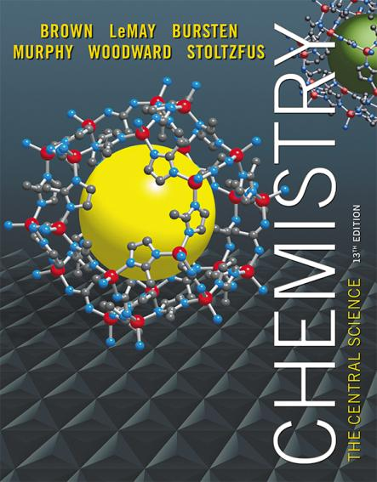
Lecture Presentation
Chapter 24 The Chemistry of Life: Organic and Biological Chemistry
James F. Kirby
Quinnipiac University
Hamden, CT

Slide 2
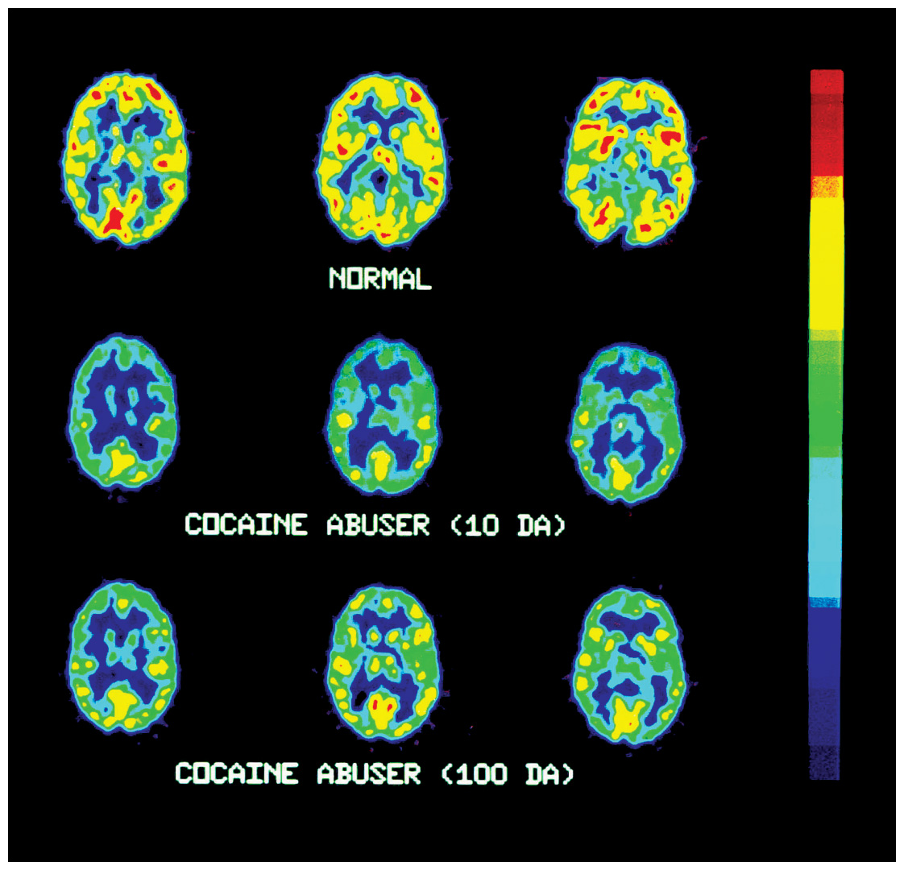
Organic Chemistry and Biochemistry
Chapter focus: the molecules that bridge chemistry & biology
Most common elements: C, H, O, N
Organic chemistry: study of compounds containing carbon
Biochemistry: the study of chemistry of living systems

Slide 3
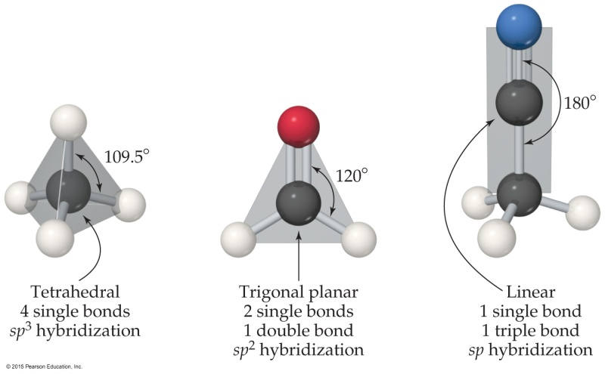
General Characteristics of Organic Molecules
Carbon makes four bonds.
All single bonds: tetrahedral; sp³ hybridized
One double bond: trigonal planar; sp² hybridized
One triple bond: linear; sp hybridized
C—H are most common.
C forms stable (strong) bonds with many elements, including C, H, O, N, and the halogens.
Groups of atoms that determine how an organic molecule reacts are called functional groups.

Slide 4
Solubility
Most prevalent bonds are C—C and C—H, which are nonpolar; solubility in water is low for many organic compounds.
Organic molecules, such as glucose, that have polar groups are soluble in polar solvents.
Molecules with long nonpolar regions and polar regions act as surfactants, bringing polar material into aqueous solution (used in detergents and soaps).

Slide 5
Acid–Base Properties
Many organic molecules contain acidic or basic functional groups.
Carboxylic acids (—COOH) are the most common acids.
Amines (—NH₂, —NHR, or —NR₂, where R is an organic group made up of C and H atoms) are the most common bases.

Slide 6
Hydrocarbons
Hydrocarbons consist of ONLY carbon and hydrogen.
They are grouped based on the number of bonds between carbon atoms.
There are four basic types of hydrocarbons:
Alkanes
Alkenes
Alkynes
Aromatic hydrocarbons

Slide 7
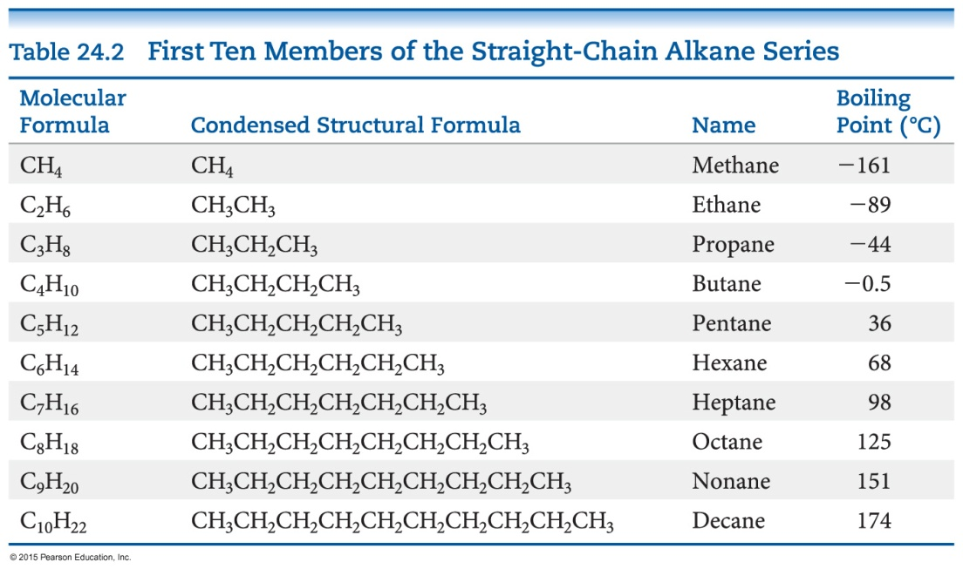
Properties Common to Hydrocarbons
Since they are nonpolar, they are insoluble in water but soluble in nonpolar solvents.
Melting points and boiling points are determined by dispersion forces (low molar mass hydrocarbons are gases; moderate molar mass hydrocarbons are liquids; high molar mass hydrocarbons are solids).

Slide 8
Uses of Some Simple Alkanes
Methane (CH₄): in natural gas (heating fuel)
Propane (C₃H₈): in bottled gas (heating and cooking fuel)
Butane (C₄H₁₀): in disposable lighters and fuel canisters for camping
Alkanes with 5 to 12 C atoms: gasoline

Slide 9
Methods for Writing Formulas
There are a few common methods for writing the structures in organic chemistry.
Structural formulas show how atoms are bonded to each other.
Condensed structural formulas don’t show all C—H; they condense them to groupings, like CH₃.

Slide 10
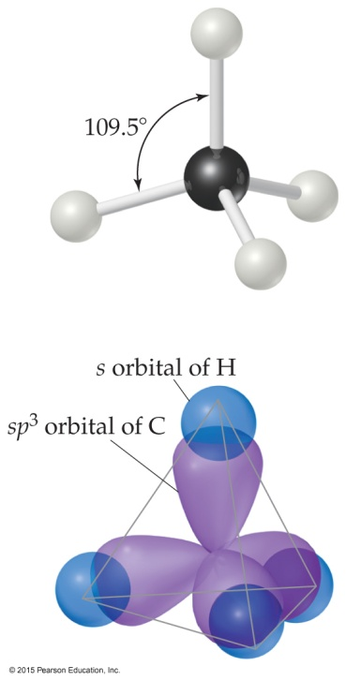
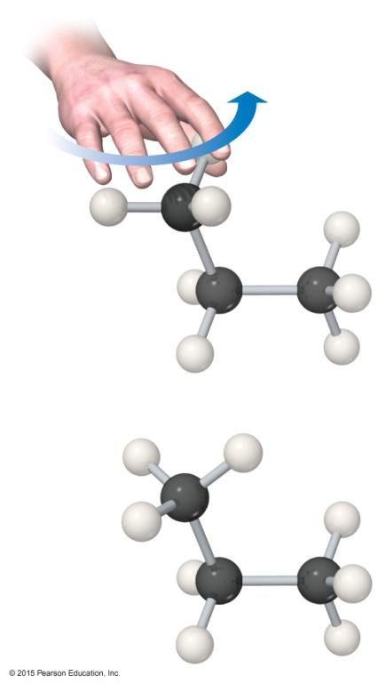
Structure of Alkanes
Carbons in alkanes are sp³ hybridized, tetrahedral, and have 109.5° bond angles.
In the straight chain form, all carbons connect in a continuous chain.
C can make four bonds, so it is possible for a carbon atom to bond to three or four C atoms, making a branched alkane.
Compounds with the same molecular formula but different connections of atoms are called structural isomers, as seen on the next slide.

Slide 11
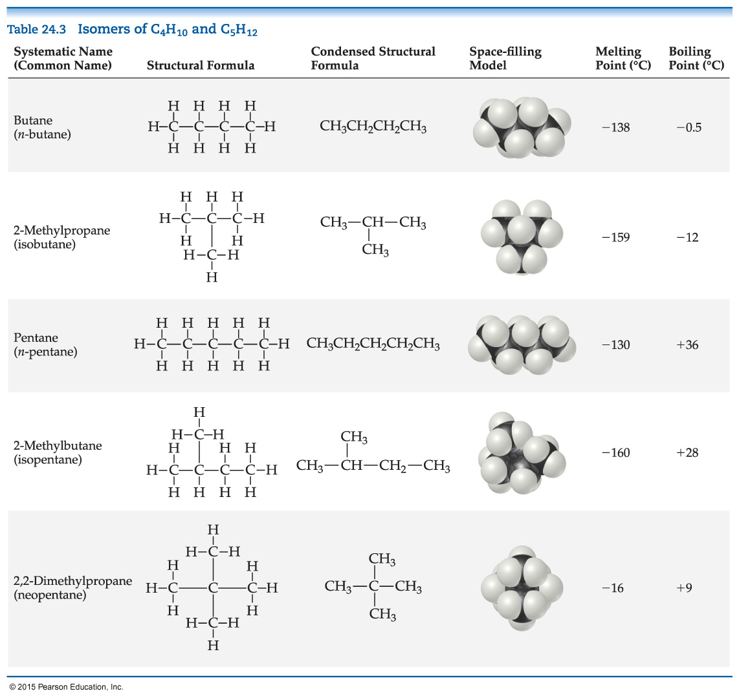
Structural Isomers

Slide 12
Systematic Nomenclature of Organic Compounds
There are three parts to a compound name:
Base: This tells how many carbons are in the longest continuous chain.
Suffix: This tells what type of compound it is.
Prefix: This tells what groups are attached to the chain.

Slide 13
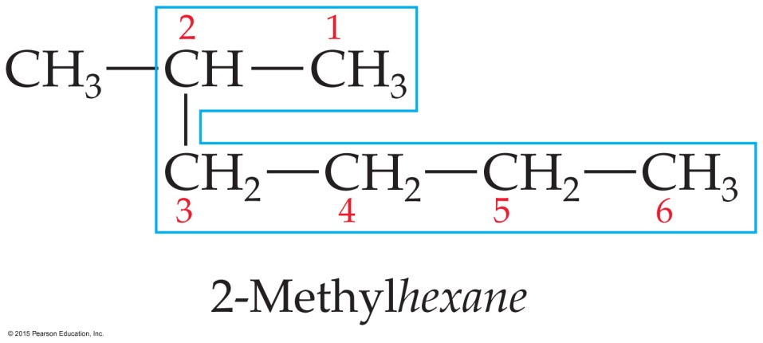
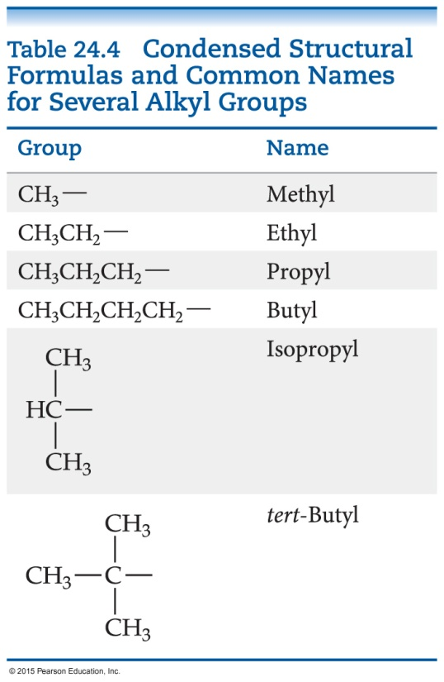
How to Name a Compound
Find the longest continuous chain of C atoms, and use this as the base name.
Number the chain from the end nearest the first substituent encountered.
Name each substituent. (Side chains that are based on alkanes are called alkyl groups.)

Slide 14
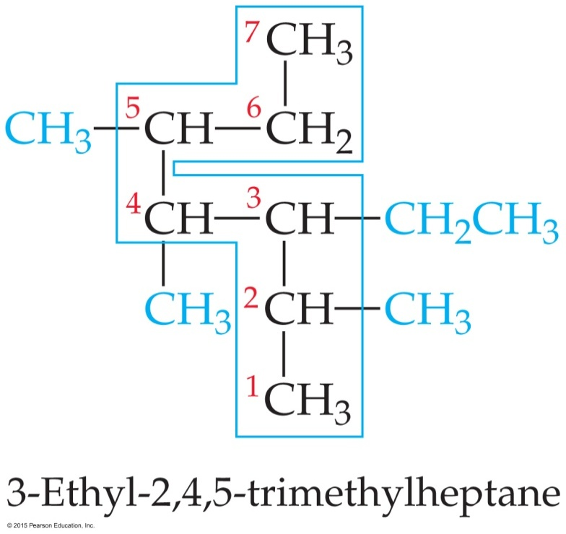
How to Name a Compound
Begin the name with the number(s) on the C atom(s) to which each substituent is bonded.
When two or more substituents are present, list them alphabetically.

Slide 15
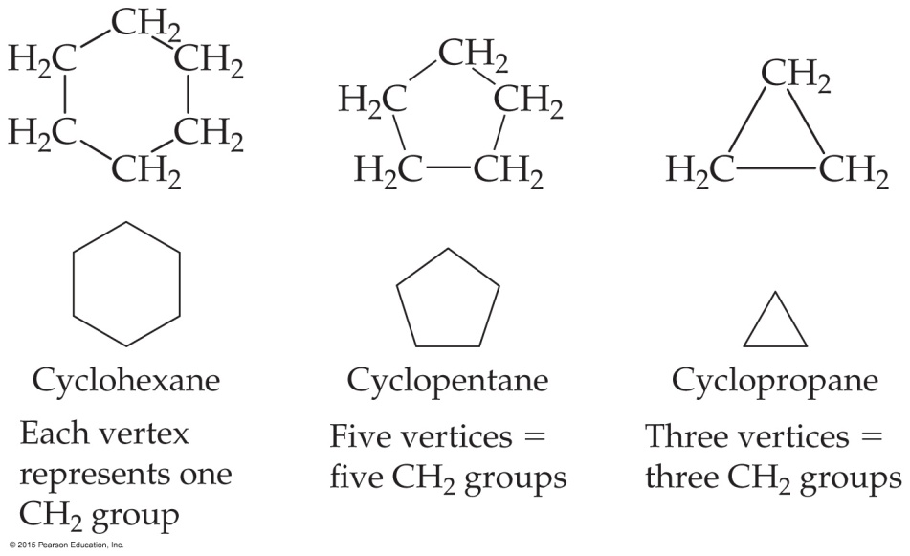
Cycloalkanes
Alkanes that form rings or cycles
Possible with at least three C atoms, but sp³ hybridization requires 109.5° angles—not a very stable molecule.
Four-C ring is also not very stable.
Five-C and more have room for proper bond angle.
Naming: add cyclo- as a prefix to alkane name.

Slide 16
Reactions of Alkanes
Alkanes are relatively unreactive due to the lack of polarity and presence of only C—C and C—H σ bonds, which are very stable.
They do not react with acids, bases, or oxidizing agents.
However, the most important reaction observed is combustion:
2 C₂H₆(g) + 7 O₂(g) → 4 CO₂(g) + 6 H₂O(l)
(exothermic! ΔH° = –2885 kJ)

Slide 17
Saturated vs. Unsaturated
Hydrocarbons with single bonds only are called saturated hydrocarbons. These are the alkanes.
Alkenes, alkynes, and aromatic hydrocarbons have fewer hydrogen atoms than alkanes with the same number of carbon atoms. They are called unsaturated hydrocarbons.
Unsaturated hydrocarbons are more reactive than saturated hydrocarbons.

Slide 18
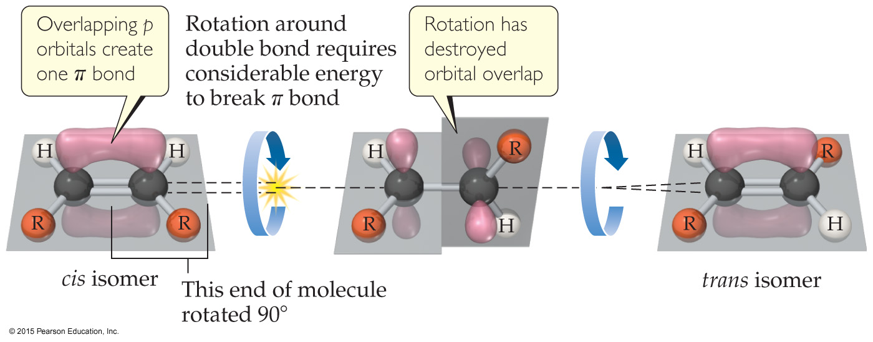
Alkenes
Contain at least one C C bond
No free rotation about the double bond
Naming: longest chain must include BOTH carbon atoms that share the double bond; end name in -ene; lowest number possible given to double-bond carbon atoms; isomers also indicated.

Slide 19
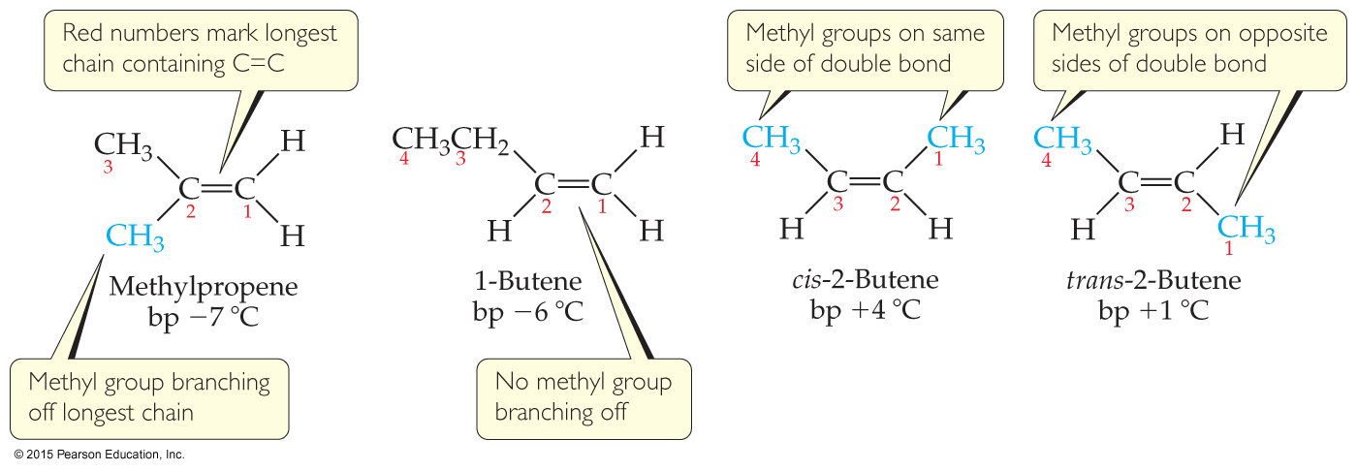
Geometric Isomers
Since there is no free rotation around the double bond, the direction of the longest chain can differ for four or more C atoms.
Compounds that have all atoms connected to the same atoms but differ in three-dimensional arrangement are geometric isomers.
Alkenes have cis (same side of the double bond) or trans (opposite side of the double bond) isomers.

Slide 20
Alkynes
Contain at least one C C
Unsaturated
Naming: longest continuous chain containing both carbon atoms in the triple bond; name ends in -yne (instead of -ane or -ene); give C atoms in triple bond lowest number.

Slide 21
Addition Reactions of Alkenes and Alkynes
Add atoms to the double or triple bond, making it saturated or more saturated
π bonds are broken and electrons form σ bonds to added atoms.
Work with H₂ (hydrogenation), HX (hydrogen halides or water), or X₂ (halogenation)

Slide 22
Aromatic Hydrocarbons
Aromatic hydrocarbons have six-membered rings containing localized and delocalized electrons.
The π ring is much more stable than a π bond. So, aromatic hydrocarbons are much less reactive than alkenes and alkynes.
They undergo substitution reactions rather than addition reactions: groups replace H on a ring (e.g., nitration, halogenation, alkylation).

Slide 23
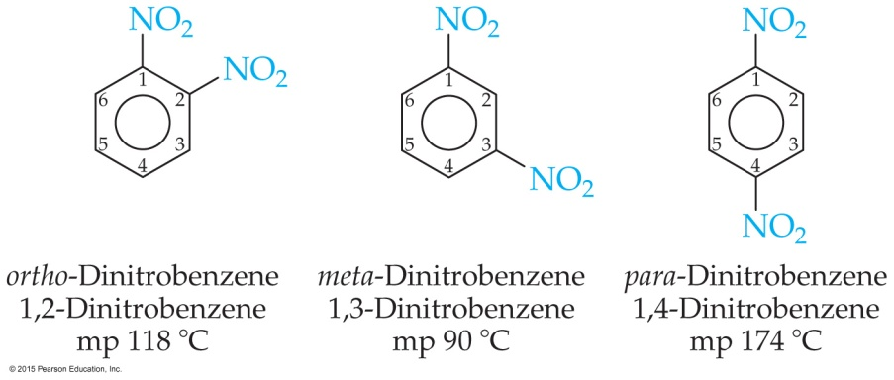
Aromatic Nomenclature
Many aromatic hydrocarbons are known by their common names.
Others are named as derivatives of benzene.
Substitution positions for two substituents: 1,2 = ortho-; 1,3 = meta-; 1,4 = para-

Slide 24
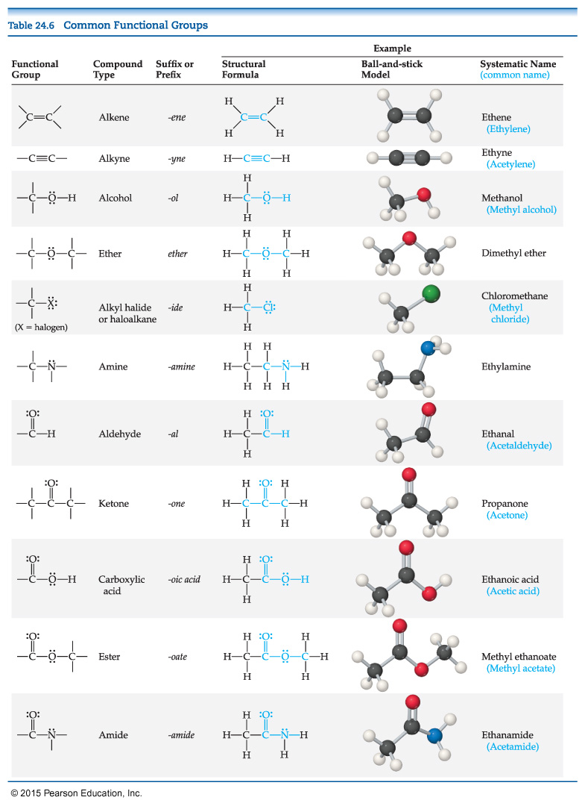
Functional Groups
The chemistry of an organic molecule is largely determined by the functional groups it contains.
R represents the alkyl portion (C,H) of an organic molecule.

Slide 25
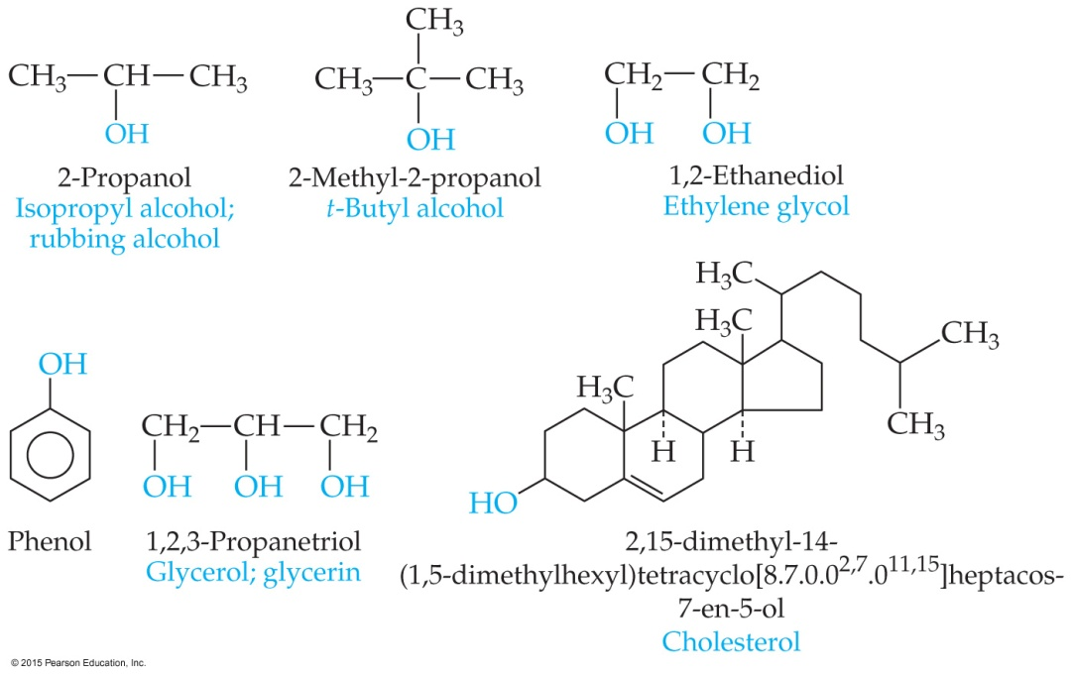
Alcohols
Alcohols contain one or more —OH group (the alcohol group or the hydroxyl group).
They are named from the parent hydrocarbon; the suffix is changed to -ol and a number designates the carbon to which the —OH group is attached.

Slide 26
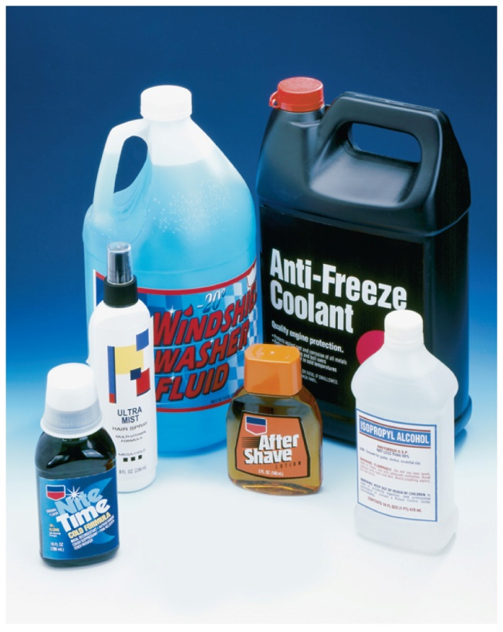
Properties and Uses of Alcohols
Polar molecules: lead to water solubility and higher boiling points
Methanol: used as a fuel additive
Ethanol: in alcoholic beverages
Ethylene glycol: in antifreeze
Glycerol: cosmetic skin softener and food moisturizer
Phenol: making plastics and dyes; topical anesthetic in throat sprays
Cholesterol: important biomolecule in membranes, but can precipitate and form gallstones or block blood vessels

Slide 27
Ethers
R—O—R
Formed by dehydration between alcohol molecules
Not very reactive (except combustion)
Used as solvents for organic reactions.

Slide 28
Functional Groups Containing the Carbonyl Group
The carbonyl group is C O.
Functional groups containing C O:
Aldehydes
Ketones
Carboxylic acids
Esters
Amides

Slide 29
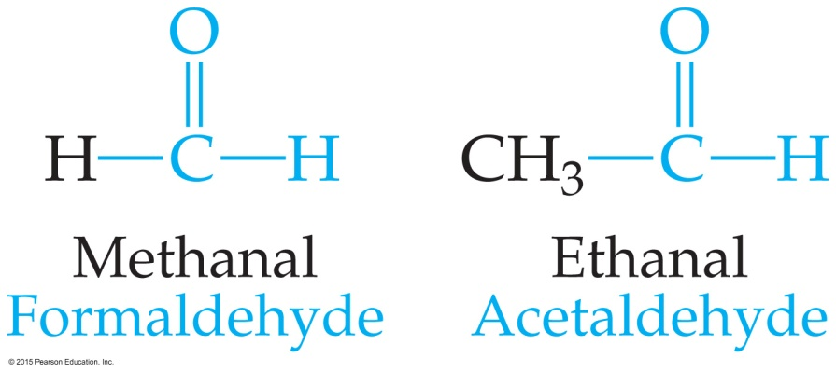
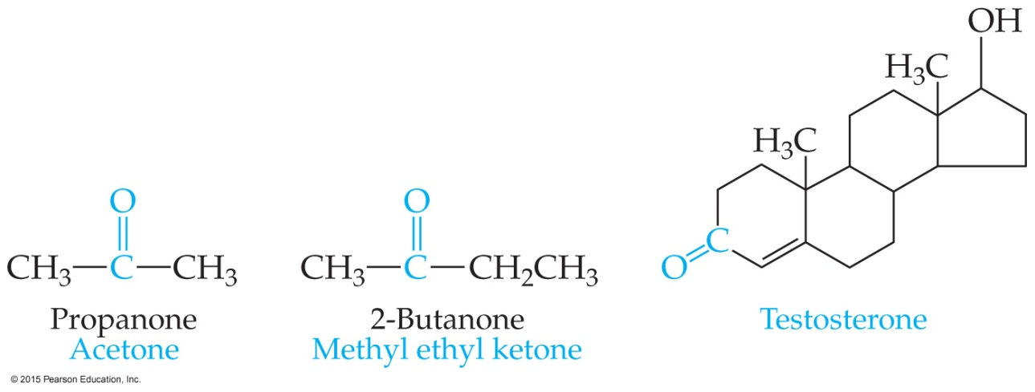
Aldehydes and Ketones
Aldehydes have at least one hydrogen atom attached to the carbonyl carbon atom.
Ketones have two R groups attached to the carbonyl carbon atom.

Slide 30
Important Aldehydes and Ketones
Many aldehydes are natural flavorings: vanilla, cinnamon, spearmint, and caraway are from aldehydes.
Ketones are used extensively as solvents; the most important solvent other than water is acetone, which dissolves in water and dissolves many organic compounds.

Slide 31
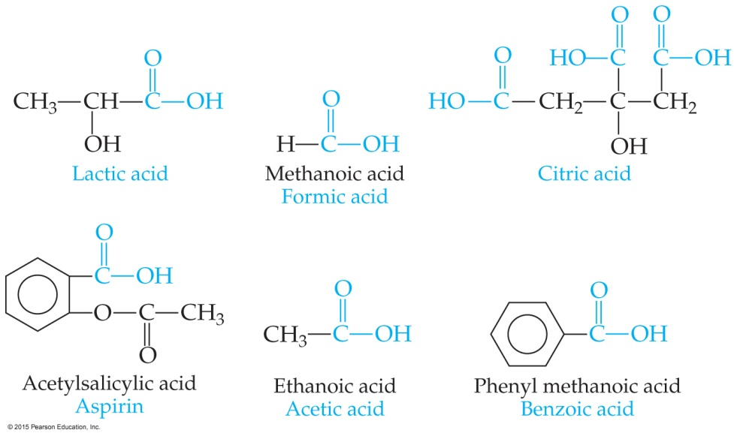
Carboxylic Acids
Structure: hydroxyl group bonded to the carbonyl group
H on the hydroxyl group is weakly acidic.
Important in manufacturing polymers for films, fibers, and paints
Oxidation product of alcohols (some make aldehydes)

Slide 32
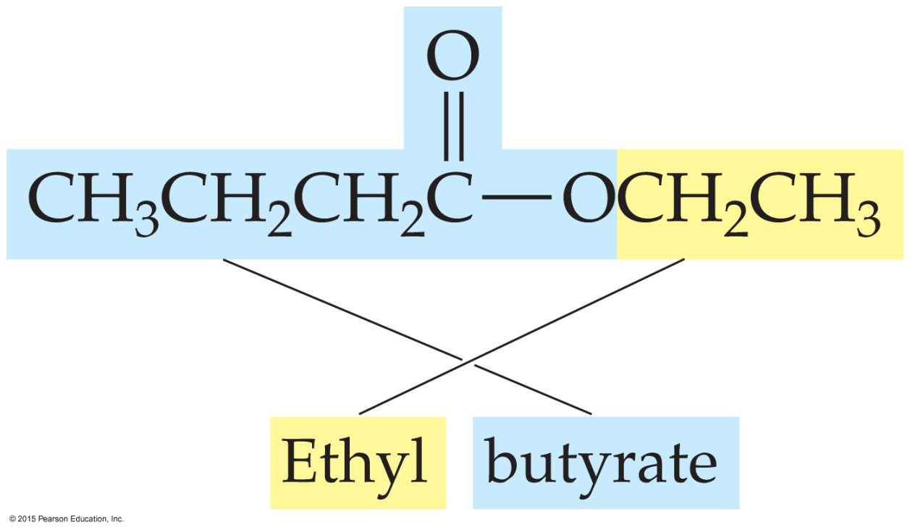
Esters
Esters are the products of reactions between carboxylic acids and alcohols.
They are found in many fruits and perfumes.
Naming: name the alcohol part as an alkyl name; separate word is the acid part as an -ate anion.

Slide 33
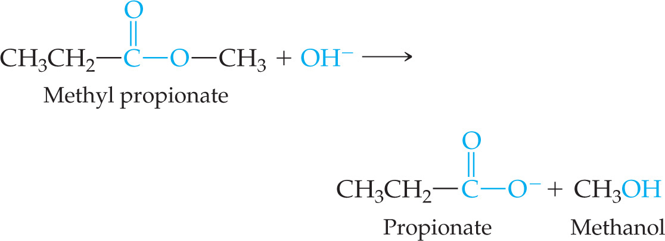
Decomposition of Esters
Heating an ester in the presence of an acid catalyst and water can decompose the ester. (This is the reverse reaction of the preparation of an ester; it is an equilibrium.)
Heating an ester in the presence of a base results in saponification (making soap).

Slide 34
Nitrogen Containing Organic Compounds
Amines are organic derivatives of ammonia (NH₃). One, two, or all three H atoms can be replaced by R groups (the same or different R groups).
If H in NH₃ or an amine is replaced by a carbonyl group (N directly attached to C O), an amide is formed.

Slide 35
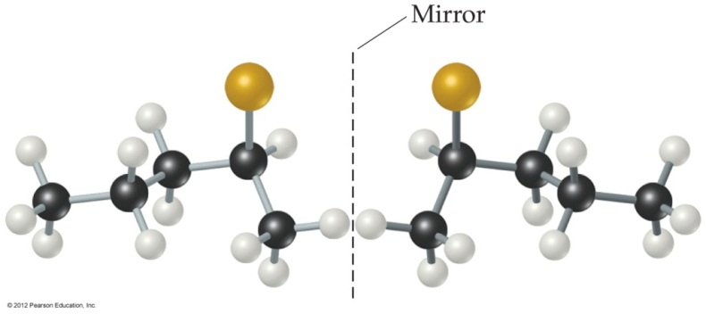
Chirality
Carbons with four different groups attached to them are chiral.
These are optical isomers, or enantiomers.
Enantiomers have the same physical and chemical properties when they react with nonchiral reagents.
Enantiomers rotate plane-polarized light in opposite directions.

Slide 36
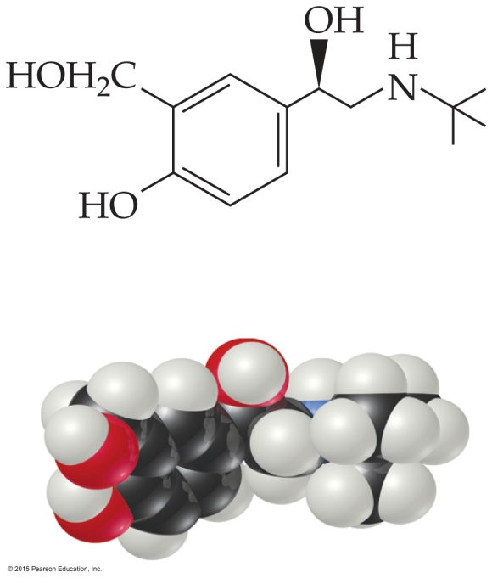
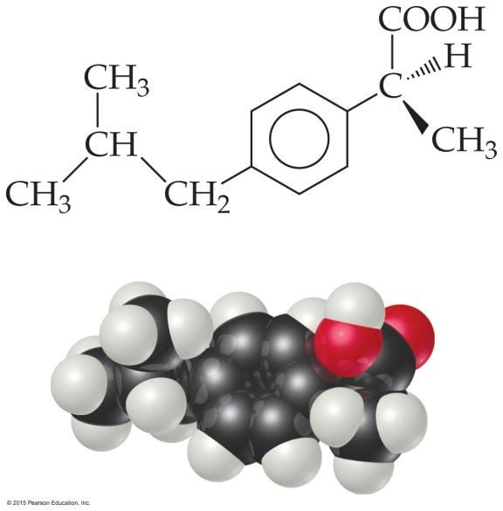
Chirality and Pharmaceuticals
Many drugs are chiral compounds.
Equal mixtures of enantiomers is called a racemic mixture. Often only one enantiomer is clinically active; the other can be inert OR harmful.

Slide 37
Biomolecules
Biopolymers (large biological molecules built from small molecules)
Proteins
Polysaccharides (carbohydrates)
Nucleic acids
Lipids are large biomolecules, but they are NOT polymers.

Slide 38
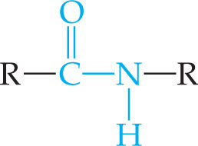
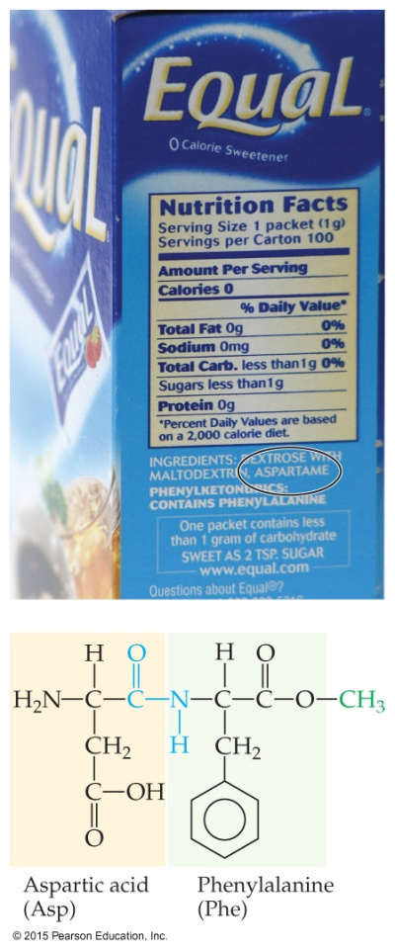
Amino Acids and Proteins
Amino acids have amine and carboxylic acid functional groups.
Proteins are polymers of α-amino acids.
A condensation reaction between the amine end of one amino acid and the acid end of another produces a peptide bond, which is an amide linkage.

Slide 39
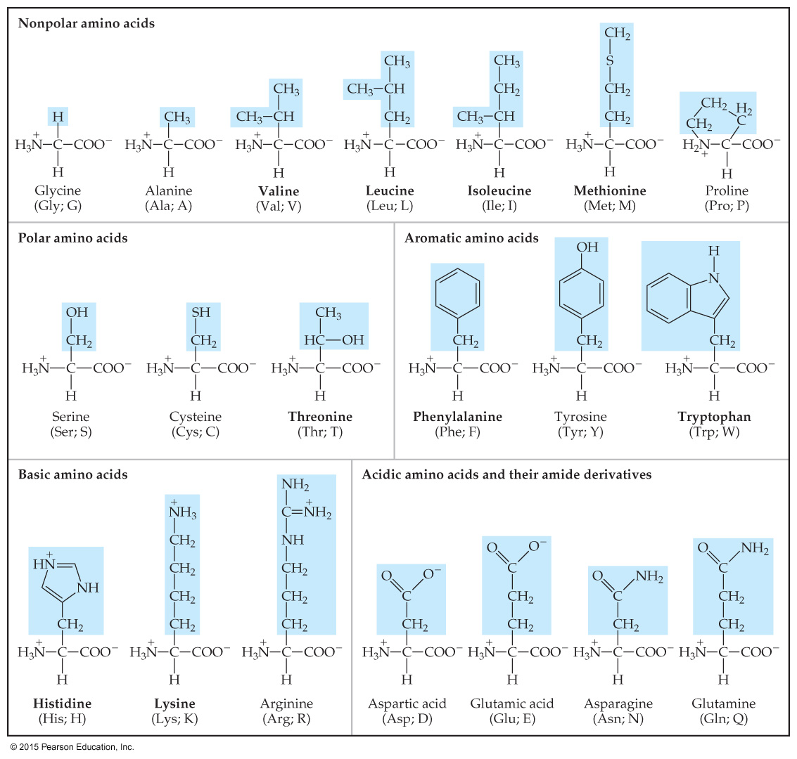
The Natural α-Amino Acids

Slide 40
Protein Structure
Primary structure: the sequence of amino acids in the polypeptide/protein chain
Secondary structure: interactions between the chain atoms (C O and N—H atoms) that give structure to proteins
Tertiary structure: “intermolecular” forces between side-chain atoms that give structure to proteins
Quaternary structure: arrangement of multiple units and/or incorporation of non–amino acid portions of proteins

Slide 41
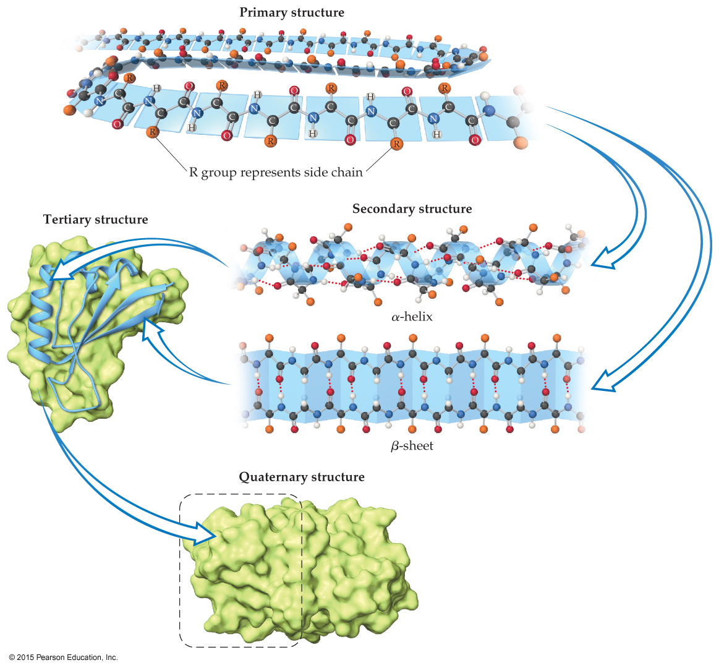
Protein Structure

Slide 42
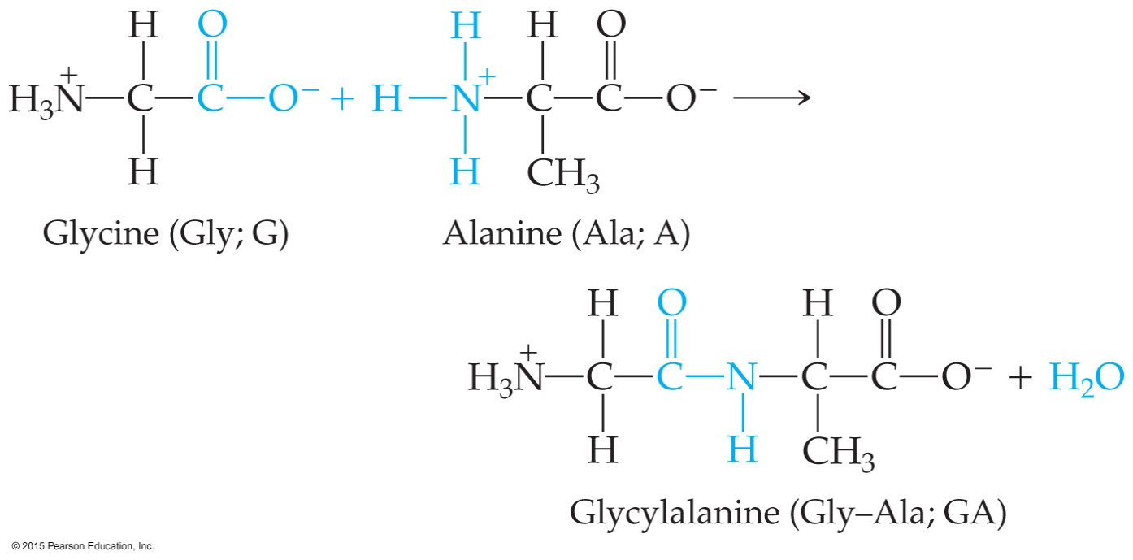
Primary Structure
Formation of the amide bond between amino acids
Repeats MANY times for a polypeptide/protein

Slide 43
Secondary Structure
Two common types:
α-Helix: looks like a corkscrew or spiral staircase; the C O forms H bonds with the N—H from another amino acid in the chain.
β-Sheets: two or more “pleated” regions (looking like the shape of a pleated skirt or corrugated cardboard) are held together by the same H bonds as in an α-helix; one major difference is how far apart from each other the amino acids are in the amino acid sequence (α-helix atoms are much closer together).

Slide 44
Tertiary Structure
Side chains interact with each other and the surrounding environment (usually aqueous environment).
The forces we called “intermolecular” are mostly what drives tertiary structure.
The side chains have polar, nonpolar, and charged groups; these give rise to ion–ion, ion–dipole, dipole–dipole, and dispersion force interactions.

Slide 45
Quaternary Structure
Some proteins are made up of more than one polypeptide chain.
Some proteins contain portions that are NOT amino acid in nature.
The combination of subunits is quaternary structure.

Slide 46
Classifying Proteins
One method to classify proteins is based on solubility:
Globular proteins are roughly spherical and dissolve in aqueous environments.
Fibrous proteins are usually long fibers that are insoluble in water and are used as structural materials.

Slide 47
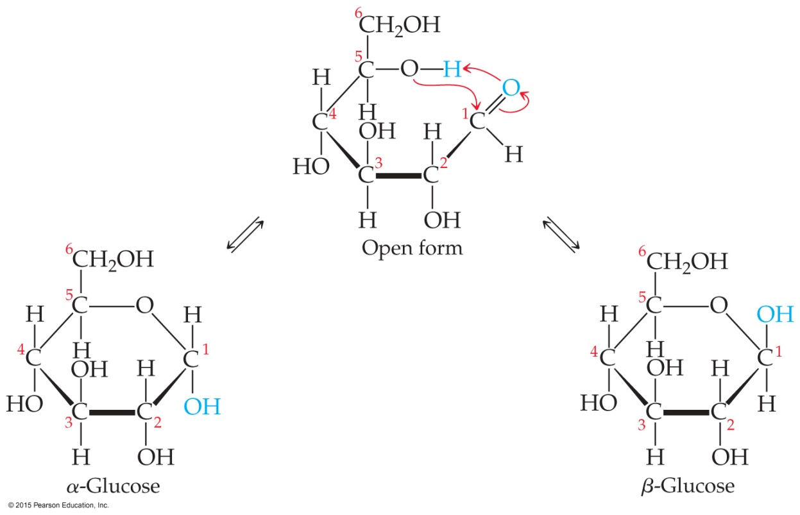
Carbohydrates
The name comes from an empirical formula for sugars: C_{x}(H₂O)_{y}—for the simplest sugars, x = y.
Simple sugars (monosacchharides) are polyhydroxy aldehydes or ketones. They are often drawn as chains but most frequently exist as rings in solution.

Slide 48
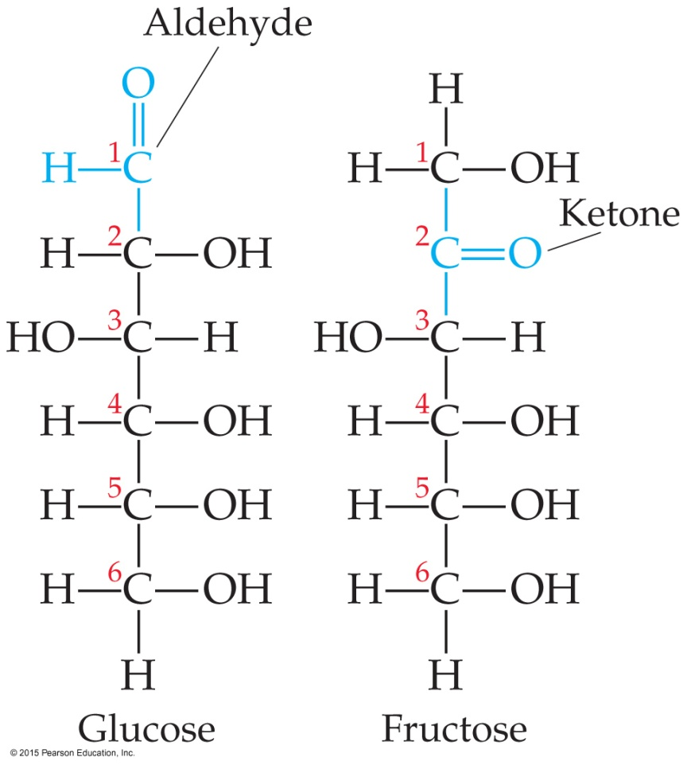
Monosaccharides
The two most common monosaccharides are glucose and fructose.
Glucose is an aldehyde; fructose is a ketone.

Slide 49
Disaccharides
Dehydration between two monosaccharides forms a disaccharide.
Sucrose and lactose are both disaccharides.
Disaccharides are often referred to as sugars.

Slide 50
Polysaccharides
Dehydration can create long-chain polysaccharides.
The three most common are starch, glycogen, and cellulose.
Starch consists of many different-sized and various branching chains of glucose prepared by plants to store energy.
Glycogen is often called “animal starch”—it is for temporary energy storage in animals (which use fats for long-term energy storage).
Cellulose is a structural polysaccharide in plants, making up cell walls; it is unbranched.

Slide 51
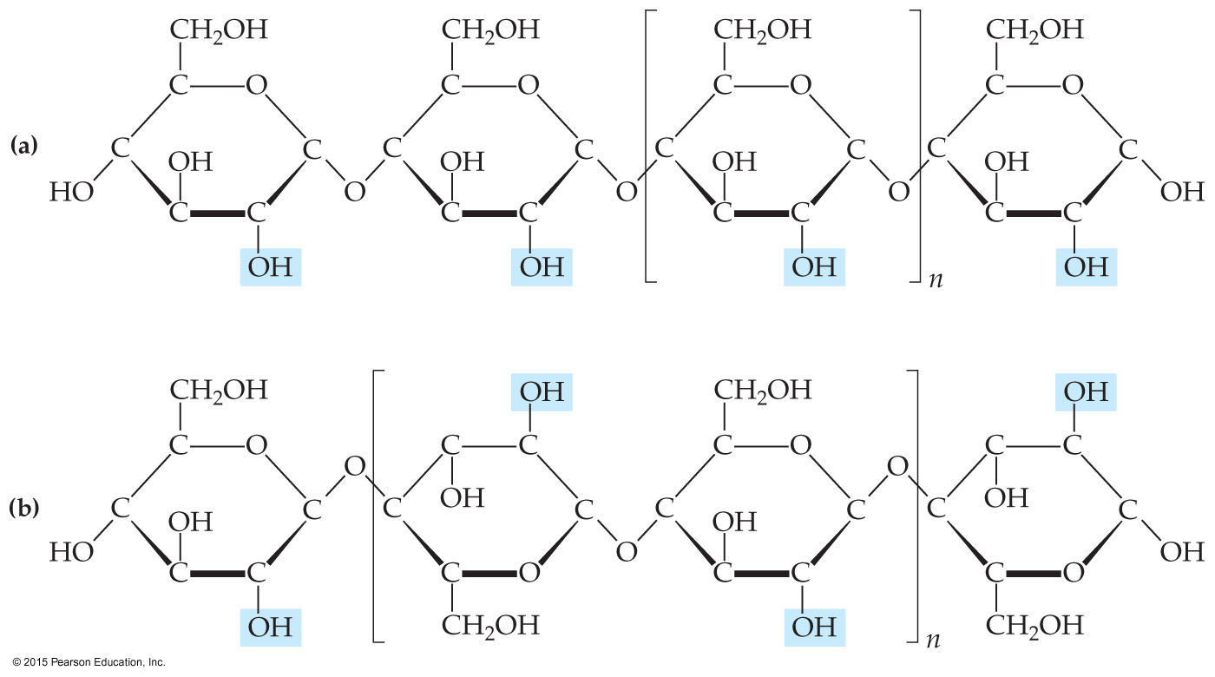
Polysaccharides

Slide 52
Lipids
Lipids are a broad class of nonpolar bioorganic molecules. They are grouped because they are insoluble in water.
They are used biologically to store energy (fats, oils) and for biological structure (phospholipids in cell membranes).

Slide 53
Fats and Oils
Fats and oils are made from long-chain carboxylic acids and glycerol.
Fats have only saturated carboxylic acids. They are solids. These are often called the “bad” fats in your diet.
Oils have at least one unsaturated carboxylic acid. They are liquids. The more unsaturated, the better for you (polyunsaturated versus monounsaturated fats).
Essential fatty acids (with double bonds) must be included in our diet. Our bodies can’t produce them. They are often called omega-3 and omega-6 fatty acids.

Slide 54
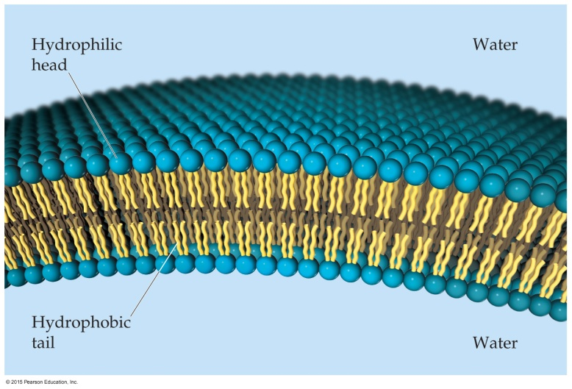
Phospholipids
How their structure is similar to fats: glycerol with ester linkage to two fatty acids (instead of three)
How it differs: the third site has a phosphate ester linkage connected to a charged or polar group, such as choline.
They cluster together in water: polar regions pointing toward water; nonpolar fatty acid regions pointing toward each other—forming a “lipid bilayer”—the start of a cell membrane.

Slide 55
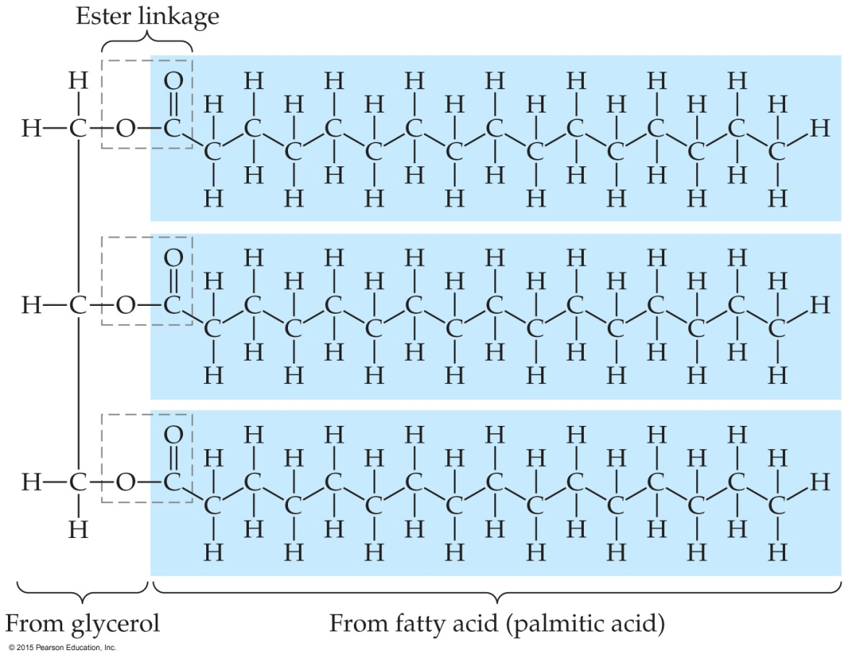
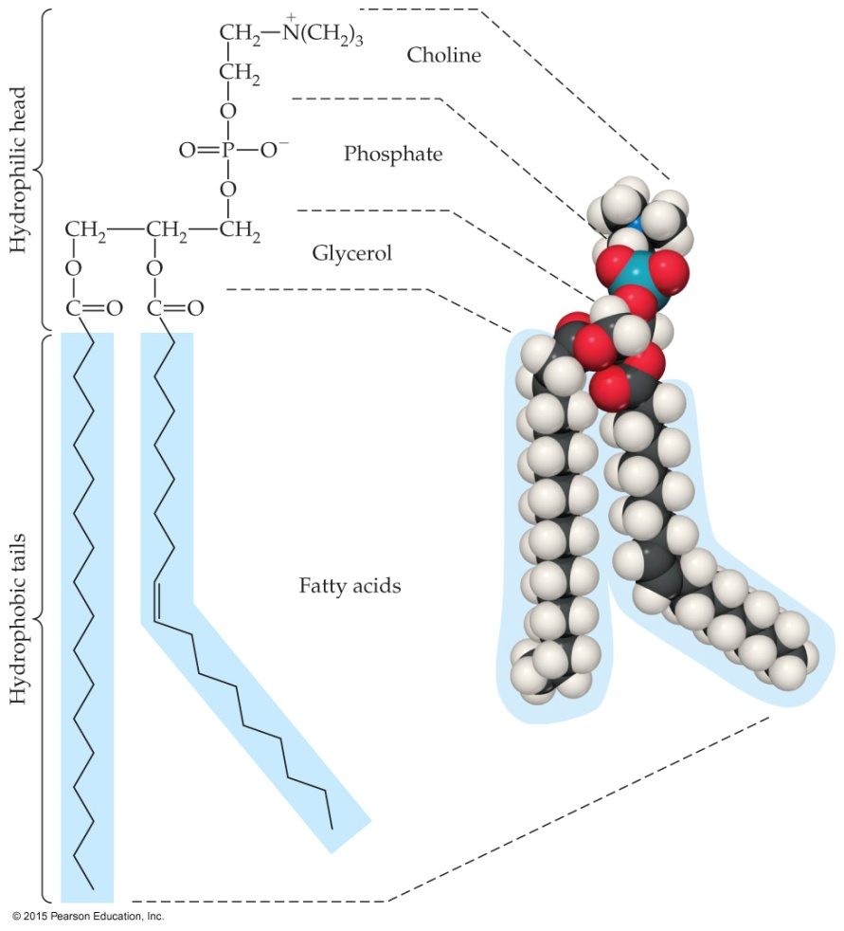
Comparing Phospholipids to Fats

Slide 56
Nucleic Acids
Class of biopolymers that are chemical carriers of genetic information
Two types:
Deoxyribonucleic acid (DNA)
Ribonucleic acid (RNA)

Slide 57
Comparing Nucleic Acid Types
DNA
RNA
Huge molecules (6 to 16 million amu)
Primarily in nucleus of the cell
Stores genetic information
Specifies which proteins the cell can synthesize
Smaller molecules (20,000–40,000 amu)
Mostly outside of nucleus (in cytoplasm)
Carries stored info from DNA into cytoplasm
Information is used in protein synthesis outside of nucleus

Slide 58
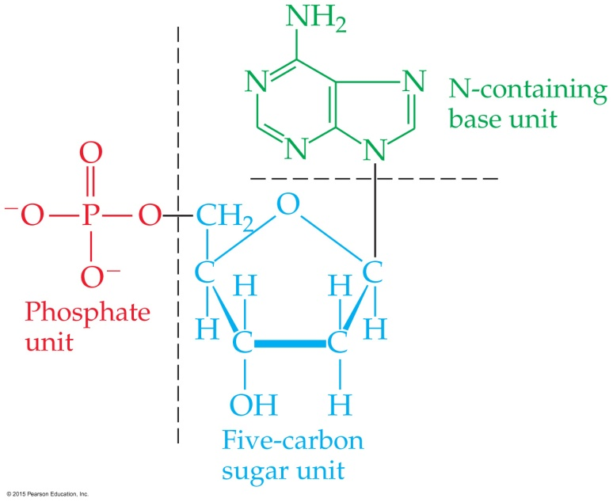
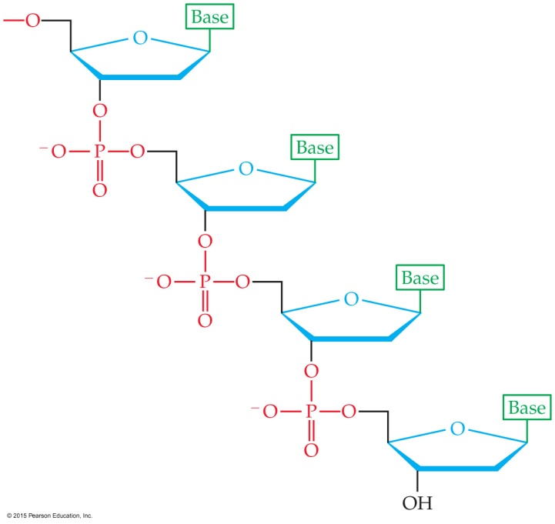
Structure of Nucleic Acids
Nucleic acids consist of
a five-C sugar (ribose or deoxyribose);
a phosphate group;
a N-containing base (adenine, guanine, cytosine, and thymine or uracil).
Polynucleotides form by condensation reactions between a phosphate and a sugar —OH.

Slide 59
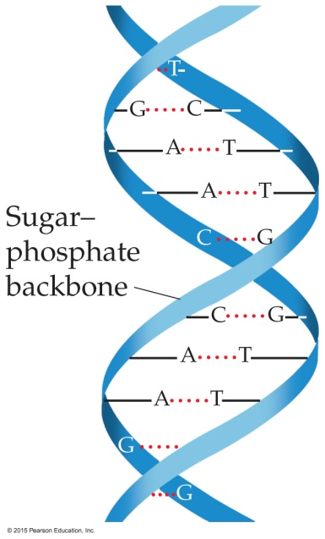
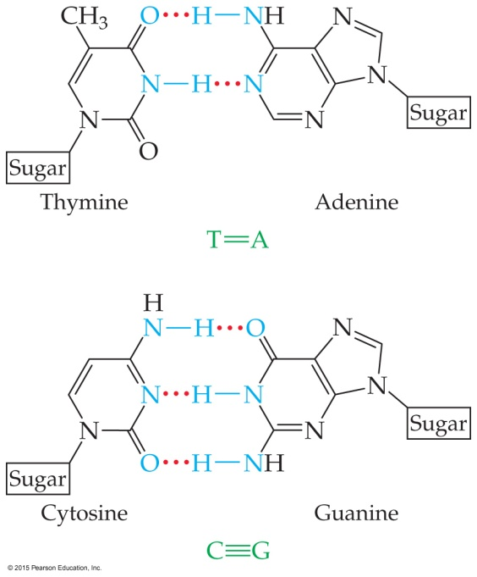
The Double Helix
Nucleotides combine to form the familiar double-helix form of the nucleic acids.
H-bonding, dipole–dipole interactions, and dispersion forces hold the double helix together.
Complementary base pairs form ideal H-bonding partners: A T; C G. (Note: number of H-bonds, NOT a double/triple bond!)

