Slide 1
Sample Exercise 13.1 Predicting Solubility Patterns
Predict whether each of the following substances is more likely to dissolve in the nonpolar solvent carbon tetrachloride (CCl₄) or in water: C₇H₁₆, Na₂SO₄, HCl, and I₂.
Solution
Analyze We are given two solvents, one that is nonpolar (CCl₄) and the other that is polar (H₂O), and asked to determine which will be the better solvent for each solute listed.
Plan By examining the formulas of the solutes, we can predict whether they are ionic or molecular. For those that are molecular, we can predict whether they are polar or nonpolar. We can then apply the idea that the nonpolar solvent will be better for the nonpolar solutes, whereas the polar solvent will be better for the ionic and polar solutes.
Solve C₇H₁₆ is a hydrocarbon, so it is molecular and nonpolar. Na₂SO₄, a compound containing a metal and nonmetals, is ionic. HCl, a diatomic molecule containing two nonmetals that differ in electronegativity, is polar. I₂, a diatomic molecule with atoms of equal electronegativity, is nonpolar. We would therefore predict that C₇H₁₆ and I₂ (the nonpolar solutes) would be more soluble in the nonpolar CCl₄ than in polar H₂O, whereas water would be the better solvent for Na₂SO₄ and HCl (the ionic and polar covalent solutes).

Slide 2
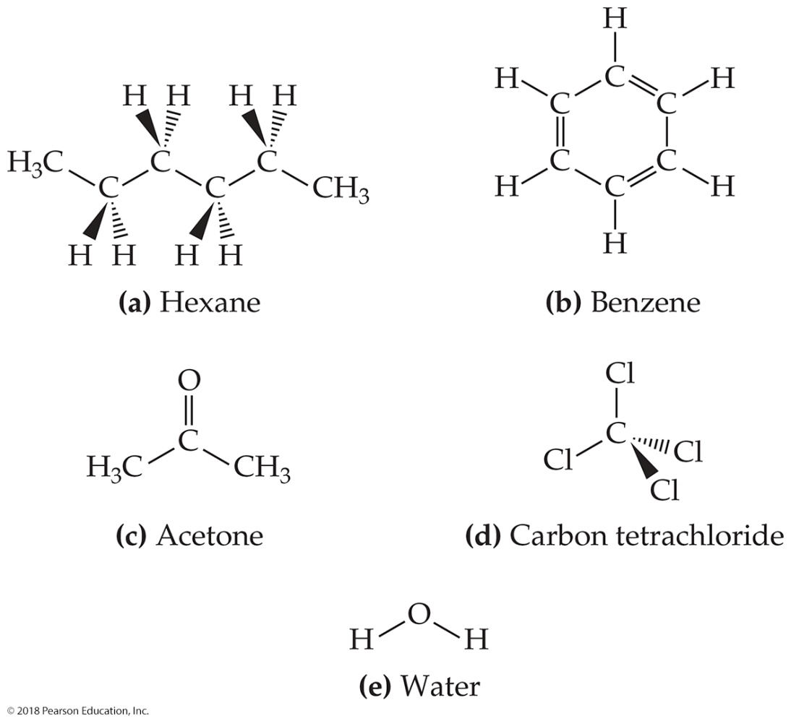
Sample Exercise 13.1 Predicting Solubility Patterns
Continued
Practice Exercise 1
Which of the following solvents will best dissolve wax, which is a complex mixture of compounds that mostly are CH₃–CH₂–CH₂–CH₂–CH₂–?

Slide 3
Sample Exercise 13.1 Predicting Solubility Patterns
Continued
Practice Exercise 2
Arrange the following substances in order of increasing solubility in water:

Slide 4
Sample Exercise 13.2 A Henry’s Law Calculation
Calculate the concentration of CO₂ in a soft drink that is bottled with a partial pressure of CO₂ of 4.0 atm over the liquid at 25 °C. The Henry’s law constant for CO₂ in water at this temperature is 3.4 × 10^{–2} mol/L-atm.
Solution
Analyze We are given the partial pressure of CO₂, P_{CO2}, and the Henry’s law constant, k, and asked to calculate the concentration of CO₂ in the solution.
Plan With the information given, we can use Henry’s law, Equation 13.4, to calculate the solubility, S_{CO2}.
Solve
Check The units are correct for solubility, and the answer has two significant figures consistent with both the partial pressure of CO₂ and the value of the Henry’s law constant.
Practice Exercise 1
You double the partial pressure of a gas over a liquid at constant temperature. Which of these statements is then true?
(a) The Henry’s law constant is doubled.
(b) The Henry’s law constant is decreased by half.
(c) There are half as many gas molecules in the liquid.
(d) There are twice as many gas molecules in the liquid.
(e) There is no change in the number of gas molecules in the liquid.

Slide 5
Sample Exercise 13.2 A Henry’s Law Calculation
Continued
Practice Exercise 2
Calculate the concentration of CO₂ in a soft drink after the bottle is opened and the solution equilibrates at 25 °C under a CO₂ partial pressure of 3.0 × 10^{–4} atm.

Slide 6
Sample Exercise 13.3 Calculation of Mass-Related Concentrations
(a) A solution is made by dissolving 13.5 g of glucose (C₆H₁₂O₆) in 0.100 kg of water. What is the mass percentage of solute in this solution?
(b) A 2.5-g sample of groundwater was found to contain 5.4 µg of Zn²⁺. What is the concentration of Zn²⁺ in parts per million?
Solution
(a) Analyze We are given the number of grams of solute (13.5 g) and the number of grams of solvent (0.100 kg = 100 g). From this, we must calculate the mass percentage of solute.
Plan We can calculate the mass percentage by using Equation 13.5. The mass of the solution is the sum of the mass of solute (glucose) and the mass of solvent (water).
Solve
Comment The mass percentage of water in this solution is (100 – 11.9)% = 88.1%.
(b) Analyze In this case we are given the number of micrograms of solute. Because 1 µg is 1 × 10^{–6} g, 5.4 µg = 5.4 × 10^{–6} g.
Plan We calculate the parts per million using Equation 13.6.

Slide 7
Sample Exercise 13.3 Calculation of Mass-Related Concentrations
Continued
Solve
Practice Exercise 1
Calculate the mass percentage of NaCl in a solution containing 1.50 g of NaCl in 50.0 g of water.
(a) 0.0291% (b) 0.0300% (c) 0.0513% (d) 2.91% (e) 3.00%
Practice Exercise 2
A commercial bleaching solution contains 3.62% by mass of sodium hypochlorite, NaOCl. What is the mass of NaOCl in a bottle containing 2.50 kg of bleaching solution?

Slide 8
Sample Exercise 13.4 Calculation of Molality
A solution is made by dissolving 4.35 g of glucose (C₆H₁₂O₆) in 25.0 mL of water at 25 °C. Calculate the molality of glucose in the solution. Water has a density of 1.00 g/mL.
Solution
Analyze We are asked to calculate a solution concentration in units of molality. To do this, we must determine the number of moles of solute (glucose) and the number of kilograms of solvent (water).
Plan We use the molar mass of C₆H₁₂O₆ to convert grams of glucose to moles. We use the density of water to convert milliliters of water to kilograms. The molality equals the number of moles of solute (glucose) divided by the number of kilograms of solvent (water).
Solve
Use the molar mass of glucose, 180.2 g/mol, to convert grams to moles:
Because water has a density of 1.00 g/mL, the mass of the solvent is:

Slide 9
Sample Exercise 13.4 Calculation of Molality
Continued
Finally, use Equation 13.9 to obtain the molality:
Practice Exercise 1
Suppose you take a solution and add more solvent, so that the original mass of solvent is doubled. You take this new solution and add more solute, so that the original mass of the solute is doubled. What happens to the molality of the final solution, compared to the original molality?
(a) It is doubled.
(b) It is decreased by half.
(c) It is unchanged.
(d) It will increase or decrease depending on the molar mass of the solute.
(e) There is no way to tell without knowing the molar mass of the solute.
Practice Exercise 2
What is the molality of a solution made by dissolving 36.5 g of naphthalene (C₁₀H₈) in 425 g of toluene (C₇H₈)?

Slide 10
Sample Exercise 13.5 Calculation of Mole Fraction and Molality
An aqueous solution of hydrochloric acid contains 36% HCl by mass. (a) Calculate the mole fraction of HCl in the solution. (b) Calculate the molality of HCl in the solution.
Solution
Analyze We are asked to calculate the concentration of the solute, HCl, in two related concentration units, given only the percentage by mass of the solute in the solution.
Plan In converting concentration units based on the mass or moles of solute and solvent (mass percentage, mole fraction, and molality), it is useful to assume a certain total mass of solution. Let’s assume that there is exactly 100 g of solution. Because the solution is 36% HCl, it contains 36 g of HCl and (100 – 36) g = 64 g of H₂O. We must convert grams of solute (HCl) to moles to calculate either mole fraction or molality. We must convert grams of solvent (H₂O) to moles to calculate mole fractions and to kilograms to calculate molality.
Solve
(a) To calculate the mole fraction of HCl, we convert the masses of HCl and H₂O to moles and then use Equation 13.7:

Slide 11
Sample Exercise 13.5 Calculation of Mole Fraction and Molality
Continued
(b) To calculate the molality of HCl in the solution, we use Equation 13.9. We calculated the number of moles of HCl in part (a), and the mass of solvent is 64 g = 0.064 kg:
Notice that we can’t readily calculate the molarity of the solution because we don’t know the volume of the 100 g of solution.
Practice Exercise 1
The solubility of oxygen gas in water at 40 °C is 1.0 mmol per liter of solution. What is this concentration in units of mole fraction?
(a) 1.00 × 10^{–6} (b) 1.80 × 10^{–5} (c) 1.00 × 10^{–2}
(d) 1.80 × 10^{–2} (e) 5.55 × 10^{–2}
Practice Exercise 2
A commercial bleach solution contains 3.62% by mass of NaOCl in water. Calculate (a) the mole fraction and (b) the molality of NaOCl in the solution.

Slide 12
Sample Exercise 13.6 Calculation of Molarity Using the Density of the Solution
A solution with a density of 0.876 g/mL contains 5.0 g of toluene (C₇H₈) and 225 g of benzene. Calculate the molarity of the solution.
Solution
Analyze Our goal is to calculate the molarity of a solution, given the masses of solute (5.0 g) and solvent (225 g) and the density of the solution (0.876 g/mL).
Plan The molarity of a solution is the number of moles of solute divided by the number of liters of solution (Equation 13.8). The number of moles of solute (C₇H₈) is calculated from the number of grams of solute and its molar mass. The volume of the solution is obtained from the mass of the solution (mass of solution = mass of solute + mass of solvent = 5.0 g + 225 g = 230 g) and its density.
Solve
The number of moles of solute is:
The density of the solution is used to convert the mass of the solution to its volume:

Slide 13
Sample Exercise 13.6 Calculation of Molarity Using the Density of the Solution
Continued
Molarity is moles of solute per liter of solution:
Check The magnitude of our answer is reasonable. Rounding moles to 0.05 and liters to 0.25 gives a molarity of (0.05 mol)/(0.25 L) = 0.2 M.
The units for our answer (mol/L) are correct, and the answer, 0.21, has two significant figures, corresponding to the number of significant figures in the mass of solute (2).
Comment Because the mass of the solvent (0.225 kg) and the volume of the solution (0.263) are similar in magnitude, the molarity and molality are also similar in magnitude: (0.054 mol C₇H₈)/(0.225 kg solvent) = 0.24 m.
Practice Exercise 1
Maple syrup has a density of 1.325 g/mL, and 100.00 g of maple syrup contains 67 mg of calcium in the form of Ca²⁺ ions. What is the molarity of calcium in maple syrup?
(a) 0.017 M (b) 0.022 M (c) 0.89 M (d) 12.6 M (e) 45.4 M

Slide 14
Sample Exercise 13.6 Calculation of Molarity Using the Density of the Solution
Continued
Practice Exercise 2
A solution containing equal masses of glycerol (C₃H₈O₃) and water has a density of 1.10 g/mL. Calculate (a) the molality of glycerol, (b) the mole fraction of glycerol, (c) the molarity of glycerol in the solution.

Slide 15
Sample Exercise 13.7 Calculation of Vapor Pressure of a Solution
Glycerin (C₃H₈O₃) is a nonvolatile nonelectrolyte with a density of 1.26 g/mL at 25 °C. Calculate the vapor pressure at 25 °C of a solution made by adding 50.0 mL of glycerin to 500.0 mL of water. The vapor pressure of pure water at 25 °C is 23.8 torr (Appendix B), and its density is 1.00 g/mL.
Solution
Analyze Our goal is to calculate the vapor pressure of a solution, given the volume of solute and solvent and the density of the solute.
Plan We can use Raoult’s law (Equation 13.10) to calculate the vapor pressure of a solution. The mole fraction of the solvent in the solution, X_{solvent}, is the ratio of the number of moles of solvent (H₂O) to total moles of solution (moles C₃H₈O₃ + moles H₂O).
Solve
To calculate the mole fraction of water in the solution, we must determine the number of moles of C₃H₈O₃ and H₂O:

Slide 16
Sample Exercise 13.7 Calculation of Vapor Pressure of a Solution
Continued
We now use Raoult’s law to calculate the vapor pressure of water for the solution:
Comment The vapor pressure of the solution has been lowered by 23.8 torr – 23.2 torr = 0.6 torr relative to that of pure water. The vapor–pressure lowering can be calculated directly using Equation 13.11 together with the mole fraction of the solute, C₃H₈O₃: ΔP = X_{C3H8O3}P°_{H2O} = (0.024)(23.8 torr) = 0.57 torr. Notice that the use of Equation 13.11 gives one more significant figure than the number obtained by subtracting the vapor pressure of the solution from that of the pure solvent.
Practice Exercise 1
The vapor pressure of benzene, C₆H₆, is 100.0 torr at 26.1 °C. Assuming Raoult’s law is obeyed, how many moles of a nonvolatile solute must be added to 100.0 mL of benzene to decrease its vapor pressure by 10.0% at 26.1 °C? The density of benzene is 0.8765 g/cm³.
(a) 0.011237 (b) 0.11237 (c) 0.1248 (d) 0.1282 (e) 8.765
Practice Exercise 2
The vapor pressure of pure water at 110 °C is 1070 torr. A solution of ethylene glycol and water has a vapor pressure of 1.00 atm at 110 °C. Assuming that Raoult’s law is obeyed, what is the mole fraction of ethylene glycol in the solution?

Slide 17
Sample Exercise 13.8 Calculation of Boiling-Point Elevation and Freezing-Point Depression
Automotive antifreeze contains ethylene glycol, CH₂(OH)CH₂(OH), a nonvolatile nonelectrolyte, in water. Calculate the boiling point and freezing point of a 25.0% by mass solution of ethylene glycol in water.
Solution
Analyze We are given that a solution contains 25.0% by mass of a nonvolatile, nonelectrolyte solute and asked to calculate the boiling and freezing points of the solution. To do this, we need to calculate the boiling-point elevation and freezing-point depression.
Plan To calculate the boiling-point elevation and the freezing-point depression using Equations 13.12 and 13.13, we must express the concentration of the solution as molality. Let’s assume for convenience that we have 1000 g of solution. Because the solution is 25.0% by mass ethylene glycol, the masses of ethylene glycol and water in the solution are 250 and 750 g, respectively. Using these quantities, we can calculate the molality of the solution, which we use with the molal boiling-point-elevation and freezing-point-depression constants (Table 13.3) to calculate ΔT_{b} and ΔT_{f}. We add ΔT_{b} to the boiling point and ΔT_{f} to the freezing point of the solvent to obtain the boiling point and freezing point of the solution.
Solve
The molality of the solution is calculated as follows:

Slide 18
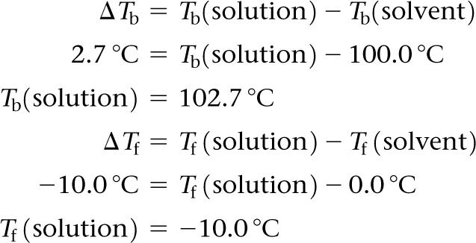
Sample Exercise 13.8 Calculation of Boiling-Point Elevation and Freezing-Point Depression
Continued
We can now use Equations 13.12 and 13.13 to calculate the changes in the boiling and freezing points:
Hence, the boiling and freezing points of the solution are readily calculated:
Comment Notice that the solution is a liquid over a larger temperature range than the pure solvent.

Slide 19
Sample Exercise 13.8 Calculation of Boiling-Point Elevation and Freezing-Point Depression
Continued
Practice Exercise 1
Which aqueous solution will have the lowest freezing point?
(a) 0.050 m CaCl₂ (b) 0.15 m NaCl (c) 0.10 m HCl
(d) 0.050 m CH₃COOH (e) 0.20 m C₁₂H₂₂O₁₁
Practice Exercise 2
Referring to Table 13.3, calculate the freezing point of a solution containing 0.600 kg of CHCl₃ and 42.0 g of eucalyptol (C₁₀H₁₈O), a fragrant substance found in the leaves of eucalyptus trees.

Slide 20
Sample Exercise 13.9 Osmotic Pressure Calculations
The average osmotic pressure of blood is 7.7 atm at 25 °C. What molarity of glucose (C₆H₁₂O₆) will be isotonic with blood?
Solution
Analyze We are asked to calculate the concentration of glucose in water that would be isotonic with blood, given that the osmotic pressure of blood at 25 °C is 7.7 atm.
Plan Because we are given the osmotic pressure and temperature, we can solve for the concentration, using Equation 13.14. Because glucose is a nonelectrolyte, i = 1.
Solve
Comment In clinical situations, the concentrations of solutions are generally expressed as mass percentages. The mass percentage of a 0.31 M solution of glucose is 5.3%. The concentration of NaCl that is isotonic with blood is 0.16 M, because i = 2 for NaCl in water (a 0.155 M solution of NaCl is 0.310 M in particles). A 0.16 M solution of NaCl is 0.9% mass in NaCl. This kind of solution is known as a physiological saline solution.

Slide 21
Sample Exercise 13.9 Osmotic Pressure Calculations
Continued
Practice Exercise 1
Which of the following actions will raise the osmotic pressure of a solution? (a) decreasing the solute concentration
(b) decreasing the temperature (c) adding more solvent (d) increasing the temperature (e) none of the above
Practice Exercise 2
What is the osmotic pressure, in atm, of a 0.0020 M sucrose (C₁₂H₂₂O₁₁) solution at 20.0 °C ?

Slide 22
Sample Exercise 13.10 Molar Mass from Freezing-Point Depression or Boiling-Point Elevation
A solution of an unknown nonvolatile nonelectrolyte was prepared by dissolving 0.250 g of the substance in 40.0 g of CCl₄. The boiling point of the resulting solution was 0.357 °C higher than that of the pure solvent. Calculate the molar mass of the solute.
Solution
Analyze Our goal is to calculate the molar mass of a solute based on knowledge of the boiling-point elevation of its solution in CCl₄, ΔT_{b} = 0.357 °C, and the masses of solute and solvent. Table 13.3 gives K_{b} for the solvent (CCl₄), K_{b} = 5.02 °C/m.
Plan We can use Equation 13.12, ΔT_{b} = iK_{b}m, to calculate the molality of the solution. Because the solute is a nonelectrolyte, i = 1. Then we can use molality and the quantity of solvent (40.0 g CCl₄) to calculate the number of moles of solute. Finally, the molar mass of the solute equals the number of grams per mole, so we divide the number of grams of solute (0.250 g) by the number of moles we have just calculated.

Slide 23
Sample Exercise 13.10 Molar Mass from Freezing-Point Depression or Boiling-Point Elevation
Continued
Solve
From Equation 13.12, we have:
Thus, the solution contains 0.0711 mol of solute per kilogram of solvent. The solution was prepared using 40.0 g = 0.0400 kg of solvent (CCl₄). The number of moles of solute in the solution is therefore:
The molar mass of the solute is the number of grams per mole of the substance:

Slide 24
Sample Exercise 13.10 Molar Mass from Freezing-Point Depression or Boiling-Point Elevation
Continued
Practice Exercise 1
A mysterious white powder could be powdered sugar (C₁₂H₂₂O₁₁), cocaine (C₁₇H₂₁NO₄), codeine (C₁₈H₂₁NO₃), norfenefrine (C₈H₁₁NO₂), or fructose (C₆H₁₂O₆). When 80 mg of the powder is dissolved in 1.50 mL of ethanol (d = 0.789 g/cm³, normal freezing point –114.6 °C, K_{f} = 1.99 °C/m), the freezing point is lowered to –115.5 °C. What is the identity of the white powder?
(a) powdered sugar (b) cocaine (c) codeine (d) norfenefrine (e) fructose
Practice Exercise 2
Camphor (C₁₀H₁₆O) melts at 179.8 °C, and it has a particularly large freezing-point-depression constant, K_{f} = 40.0 °C/m. When 0.186 g of an organic substance of unknown molar mass is dissolved in 22.01 g of liquid camphor, the freezing point of the mixture is found to be 176.7 °C. What is the molar mass of the solute?

Slide 25
Sample Exercise 13.11 Molar Mass from Osmotic Pressure
The osmotic pressure of an aqueous solution of a certain protein was measured to determine the protein’s molar mass. The solution contained 3.50 mg of protein dissolved in sufficient water to form 5.00 mL of solution. The osmotic pressure of the solution at 25 °C was found to be 1.54 torr. Treating the protein as a nonelectrolyte, calculate its molar mass.
Analyze Our goal is to calculate the molar mass of a high-molecular-mass protein, based on the osmotic pressure and a knowledge of the mass of protein and solution volume. Since the protein will be considered as a nonelectrolyte, i = 1.
Plan The temperature (T = 25 °C) and osmotic pressure (Π = 1.54 torr) are given, and we know the value of R so we can use Equation 13.14 to calculate the molarity of the solution, M. In doing so, we must convert temperature from °C to K and the osmotic pressure from torr to atm. We then use the molarity and the volume of the solution (5.00 mL) to determine the number of moles of solute. Finally, we obtain the molar mass by dividing the mass of the solute (3.50 mg) by the number of moles of solute.
Solve
Solving Equation 13.14 for molarity gives:

Slide 26
Sample Exercise 13.11 Molar Mass from Osmotic Pressure
Continued
Because the volume of the solution is 5.00 mL = 5.00 × 10^{–3} L, the number of moles of protein must be:
The molar mass is the number of grams per mole of the substance. Because we know the sample has a mass of 3.50 mg = 3.50 × 10^{–3} g, we can calculate the molar mass by dividing the number of grams in the sample by the number of moles we just calculated:
Comment Because small pressures can be measured easily and accurately, osmotic pressure measurements provide a useful way to determine the molar masses of large molecules.

Slide 27
Sample Exercise 13.11 Molar Mass from Osmotic Pressure
Continued
Practice Exercise 1
Proteins frequently form complexes in which 2, 3, 4, or even more individual proteins (“monomers”) interact specifically with each other via hydrogen bonds or electrostatic interactions. The entire assembly of proteins can act as one unit in solution, and this assembly is called the “quaternary structure” of the protein. Suppose you discover a new protein whose monomer molar mass is 25,000 g/mol. You measure an osmotic pressure of 0.0916 atm at 37 °C for 7.20 g of the protein in 10.00 mL of an aqueous solution. How many protein monomers form the quaternary protein structure in solution? Treat the protein as a nonelectrolyte.
(a) 1 (b) 2 (c) 3 (d) 4 (e) 8
Practice Exercise 2
A sample of 2.05 g of polystyrene of uniform polymer chain length was dissolved in enough toluene to form 0.100 L of solution. The osmotic pressure of this solution was found to be 1.21 kPa at 25 °C. Calculate the molar mass of the polystyrene.

Slide 28
Sample Integrative Exercise Putting Concepts Together
A 0.100-L solution is made by dissolving 0.441 g of CaCl₂(s) in water. (a) Calculate the osmotic pressure of this solution at 27 °C, assuming that it is completely dissociated into its component ions. (b) The measured osmotic pressure of this solution is 2.56 atm at 27 °C. Explain why it is less than the value calculated in (a), and calculate the van’t Hoff factor, i, for the solute in this solution. (c) The enthalpy of solution for CaCl₂ is ΔH = –81.3 kJ/mol. If the final temperature of the solution is 27 °C, what was its initial temperature? (Assume that the density of the solution is 1.00 g/mL, that its specific heat is 4.18 J/g-K, and that the solution loses no heat to its surroundings.)
Solution
(a) The osmotic pressure is given by Equation 13.14, Π = iMRT. We know the temperature, T = 27 °C = 300 K, and the gas constant, R = 0.0821 L-atm/mol-K. We can calculate the molarity of the solution from the mass of CaCl₂ and the volume of the solution:
Soluble ionic compounds are strong electrolytes. (Sections 4.1 and 4.3) Thus, CaCl₂ consists of metal cations (Ca²⁺) and nonmetal anions (Cl–). When completely dissociated, each CaCl₂ unit forms three ions (one Ca²⁺ and two Cl–). Hence, the calculated osmotic pressure is:

Slide 29
Sample Integrative Exercise Putting Concepts Together
Continued
(b) The actual values of colligative properties of electrolytes are less than those calculated because the electrostatic interactions between ions limit their independent movements. In this case, the van’t Hoff factor, which measures the extent to which electrolytes actually dissociate into ions, is given by:
Thus, the solution behaves as if the CaCl₂ has dissociated into 2.62 particles instead of the ideal 3.
(c) If the solution is 0.0397 M in CaCl₂ and has a total volume of 0.100 L, the number of moles of solute is:
Hence, the quantity of heat generated in forming the solution is:
The solution absorbs this heat, causing its temperature to increase. The relationship between temperature change and heat is given by Equation 5.22:

Slide 30
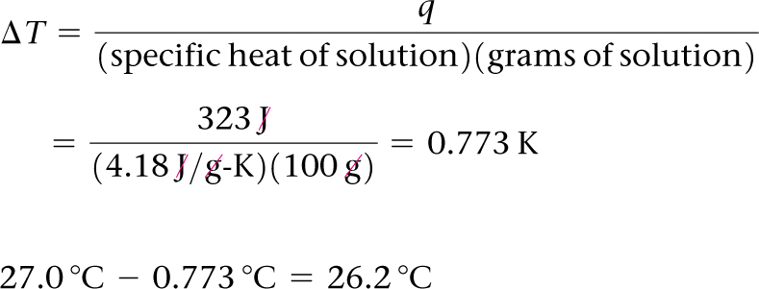
Sample Integrative Exercise Putting Concepts Together
Continued
The heat absorbed by the solution is q = +0.323 kJ = 323 J. The mass of the 0.100 L of solution is (100 mL)(1.00 g/mL) = 100 g (to three significant figures). Thus, the temperature change is:
A kelvin has the same size as a degree Celsius. (Section 1.4) Because the solution temperature increases by 0.773 °C, the initial temperature was:

