Slide 1
Welcome Back

Slide 2
Welcome Back
Time for Any Question

Slide 3
CHAPTER # 01
REVIEW

Slide 4
Chapter 01
Managerial Accounting Concepts and

Slide 5
Chapter 01
Managerial Accounting Concepts and Principles

Slide 6
Purpose of Managerial Accounting

Slide 7
Managerial Accounting Basics
Managerial accounting
provides financial and
nonfinancial information
for managers of an
organization and other
decision makers.
C 1
Notes:
Managerial accounting is an activity that provides financial and nonfinancial information to an organization’s managers. Managers include, for example, employees in charge of a company’s divisions; the heads of marketing, information technology, and human resources; and top-level managers such as the chief executive officer (CEO) and chief financial officer (CFO). To do their jobs, such managers need more than just the general-purpose financial statements provided by the financial accounting system. This section explains the purpose of managerial accounting (also called management accounting) and compares it with financial accounting.

Slide 8
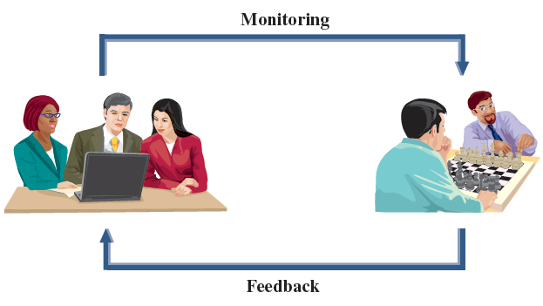
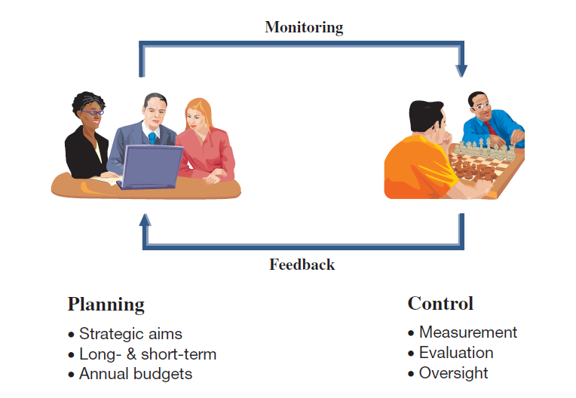
Purpose of Managerial Accounting
C 1
Notes:
The purpose of managerial accounting is to provide useful information to managers of an organization. Managerial accounting helps managers with three key tasks: (1) determining the costs of an organization’s products and services, (2) planning future activities, and (3) comparing actual results to planned results.

Slide 9
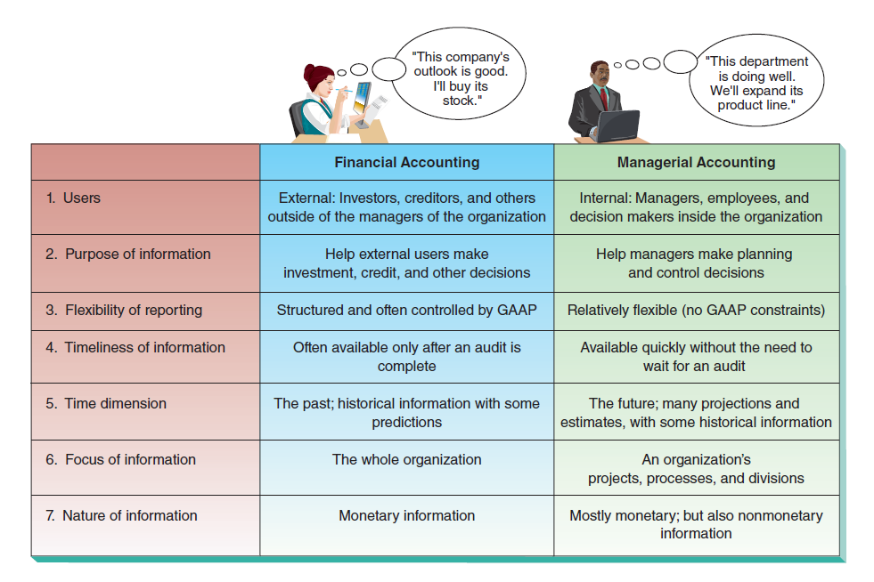
Nature of Managerial Accounting
C 1
Notes:
Managerial accounting differs from financial accounting. We discuss seven key differences in this section, as summarized in this slide.

Slide 10
Fraud and Ethics in
Managerial Accounting
Fraud affects all business and it is costly: A 2014 Report to the Nation from the Association of Certified Fraud Examiners (ACFE) estimates the average U.S. business loses 5% of its annual revenues to fraud.
The Institute of Management Accountants has issued a code of ethics to help accountants involved in solving ethical dilemmas.
C 1
Notes:
Fraud, and the role of ethics in reducing fraud, are important factors in running business operations. Fraud involves the use of one’s job for personal gain through the deliberate misuse of the employer’s assets. Examples include theft of the employer’s cash or other assets, overstating reimbursable expenses, payroll schemes, and financial statement fraud. Three factors must exist for a person to commit fraud: opportunity, financial pressure, and rationalization. This is known as the fraud triangle. Fraud affects all business and it is costly: A 2014 Report to the Nation from the Association of Certified Fraud Examiners (ACFE) estimates the average U.S. business loses 5% of its annual revenues to fraud.
Combating fraud and other dilemmas requires ethics in accounting. Ethics are beliefs that distinguish right from wrong. They are accepted standards of good and bad behavior. Identifying the ethical path can be difficult. The Institute of Management Accountants (IMA), the professional association for management accountants, has issued a code of ethics to help accountants involved in solving ethical dilemmas. The IMA’s Statement of Ethical Professional Practice requires that management accountants be competent, maintain confidentiality, act with integrity, and communicate information in a fair and credible manner.

Slide 11
Cost Classifications

Slide 12
Types of Cost Classifications
Classification by Behavior
Cost behavior refers to how a cost will react to changes in the level of business activity.
  Total fixed costs do
  not change when activity changes.
  Total variable costs change in proportion
  to activity changes.
Cost
Activity
Cost
Activity
C 2
Notes:
Fixed versus Variable - At a basic level, a cost can be classified by how it behaves with changes in the volume of activity. Thus, a cost can be classified as fixed or variable. A fixed cost does not change with changes in the volume of activity (within a range of activity known as an activity’s relevant range). For example, straight-line depreciation on equipment is a fixed cost. A variable cost changes in proportion to changes in the volume of activity. Sales commissions computed as a percent of sales revenue are variable costs.

Slide 13
Types of Cost Classifications Classification by Traceability
Direct costs
Costs traceable to a single cost object.
Examples: material and labor cost for a product.
Indirect costs
Costs that cannot
be traced to a
single cost object.
Example: A maintenance expenditure
benefiting two or
more departments.
C 2
Notes:
A cost is often traced to a cost object, which is a product, process, department, or customer to which costs are assigned. Direct costs are traceable to a single cost object. Indirect costs cannot be easily and cost-beneficially traced to a single cost object.

Slide 14
Comparing Product and Period Costs

Slide 15
Types of Cost Classifications Classification by Function
Direct
Labor
Direct
Material
Manufacturing Overhead
Product
Period costs are expenses not attached to the product.
Selling costs are incurred to
obtain orders and to deliver
finished goods to customers.
Administrative costs are
non-manufacturing costs
of staff support and
administrative functions.
C 3
Notes:
All production (or factory) costs are product costs. Product costs are those production costs necessary to create a product and consist of: direct materials, direct labor, and factory overhead. Overhead refers to production costs other than direct materials and direct labor. Product costs are capitalized as inventory during and after completion of the products; they are recorded as cost of goods sold when those products are sold.
Period costs are non-production costs and are usually more associated with activities linked to a time period than with completed products. Common examples of period costs include salaries of the sales staff, wages of maintenance workers, advertising expenses, and depreciation on office furniture and equipment. Period costs and are expensed in the period when incurred either as selling expenses or as general and administrative expenses.

Slide 16
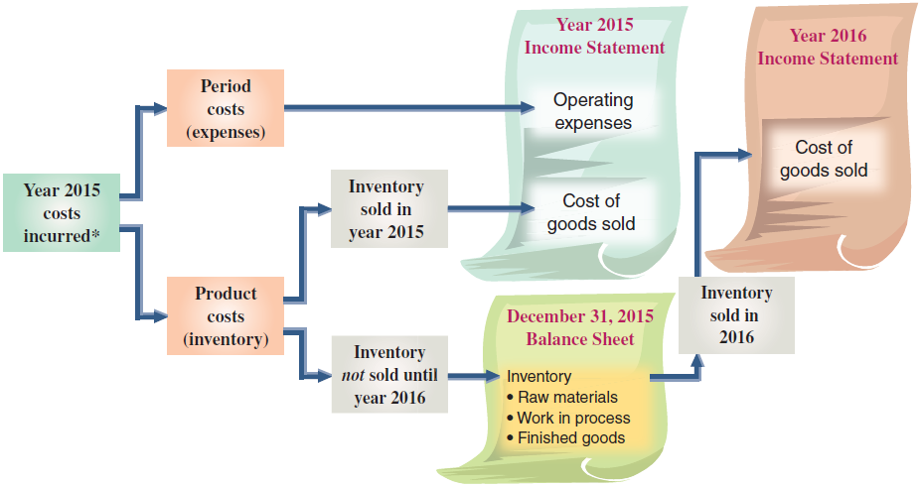
Period and Product Costs in Financial Statements
C 3
Notes:
This slide shows the different effects of product and period costs. Period costs flow directly to the current income statement as expenses. They are not reported as assets. Product costs are first assigned to inventory. Their final treatment depends on when inventory is sold or disposed of. Product costs assigned to finished goods that are sold in year 2015 are reported on the 2015 income statement as cost of goods sold. Product costs assigned to unsold inventory are carried forward on the balance sheet at the end of year 2015. If this inventory is sold in year 2016, product costs assigned to it are reported as cost of goods sold in that year’s income statement.

Slide 17
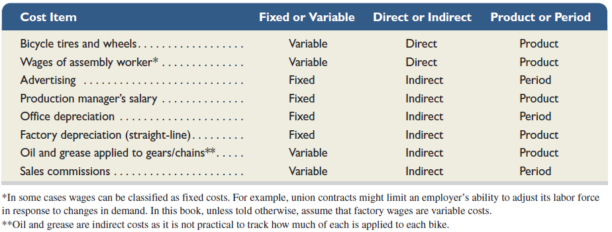
Identifications of
Cost Classifications
C 3
Notes:
It is important to understand that a cost can be classified using any one (or combination) of the three different means described here. Understanding how to classify costs in several different ways enables managers to use cost information for a variety of decisions. Factory rent, for instance, is classified as a product cost; it is fixed with respect to the number of units produced, and it is indirect with respect to the product. Potential multiple classifications are shown in this slide using different cost items incurred in manufacturing mountain bikes. The finished bike is the cost object. Proper allocation of these costs and the managerial decisions based on cost data depend on a correct cost classification.

Slide 18
Cost Concepts for
Service Companies
The cost concepts described are generally applicable to service organizations.
For example, the cost of beverages for passengers of Southwest Airlines is a variable cost based on number of passengers.
C 3
Notes:
The cost concepts described are generally also applicable to service organizations. For example, consider Southwest Airlines, and assume the cost object is a flight. The airline’s cost of beverages for passengers is a variable cost based on number of flights. The monthly cost of leasing an aircraft is fixed with respect to number of flights. We can also trace a flight crew’s salary to a specific flight whereas we likely cannot trace wages for the ground crew to a specific flight. Classification as product versus period costs is not relevant to service companies because services are not inventoried. Instead, costs incurred by a service firm are expensed in the reporting period when incurred.
To be effective, managers in service companies must understand and apply cost concepts. They seek and rely on accurate cost estimates for many decisions. For example, an airline manager must often decide between canceling or rerouting flights. The manager must be able to estimate costs saved by canceling a flight versus rerouting. Knowledge of fixed costs is equally important.
Review what you have learned in the following NEED-TO-KNOW Slide.

Slide 19
Following are the costs of a company that manufactures computer chips. Classify each as either a product
cost or a period cost. Then classify each of the product costs as direct material, direct labor, or factory
overhead.
1. Plastic board used to mount the chip
5. Real estate taxes paid on the factory
2. Advertising costs
6. Factory supervisor salary
3. Factory maintenance workers’ salaries
7. Depreciation on factory equipment
4. Real estate taxes paid on the sales office
8. Assembly worker hourly pay to make chips
Product Costs
Direct
Direct
Factory
Period
Material
Labor
Overhead
Cost
1. Plastic board used to mount the chip
X
2. Advertising costs
X
3. Factory maintenance workers’ salaries
X
4. Real estate taxes paid on the sales office
X
5. Real estate taxes paid on the factory
X
6. Factory supervisor salary
X
7. Depreciation on factory equipment
X
8. Assembly worker hourly pay to make chips
X
Product Costs
All Factory Costs
Assets on Balance Sheet
Period Costs
Non-Factory Costs
Expensed on Income Statement as Selling, General and Administrative
C2/C 3
Notes:
Following are the costs of a company that manufactures computer chips. Classify each as either a product cost or a period cost. Then classify each of the product costs as direct material, direct labor, or factory overhead.
Product costs represent all of the factory costs. Assets are valued on the balance sheet at all necessary costs to get the asset ready for its intended purpose. Product costs include direct material, direct labor, and all other factory costs, called factory overhead. Period costs are the non-factory costs. These costs are expensed on the income statement as incurred, as either selling expense, or general and administrative expense.
The plastic board used to mount the chip is a direct material cost. Advertising costs are non-factory costs, and are expensed in the period incurred. Factory maintenance workers' salaries are factory costs, and therefore product costs, but don't qualify as direct materials or direct labor. Therefore, these costs are classified as factory overhead. Real estate taxes paid on the sales office is non-factory related; this is a period cost. Real estate taxes paid on the factory is a factory cost, but it's not direct materials or direct labor, so again we classify it as factory overhead. The factory supervisor salary is also a product cost, part of factory overhead. Depreciation on factory equipment is also part of factory overhead. The assembly worker's hourly wage to make the chips can be traced directly to the product. Therefore, this factory cost is classified as direct labor.

Slide 20
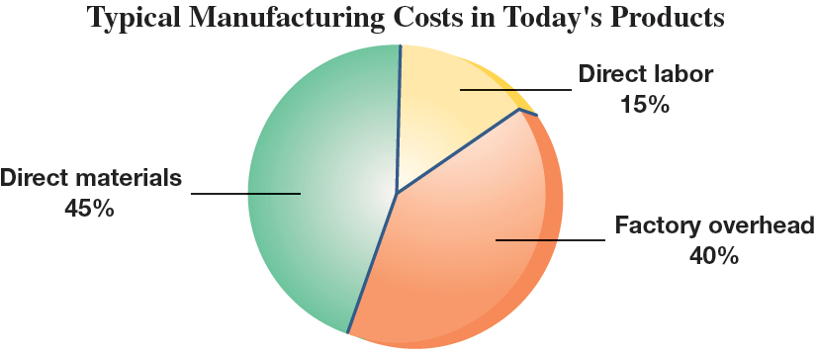
Manufacturer’s Costs
C 3
Notes:
Companies with manufacturing activities differ from both merchandising and service companies. The main difference between merchandising and manufacturing companies is that merchandisers buy goods ready for sale while manufacturers produce goods from materials and labor. Amazon.com is an example of a merchandising company. It buys and sells goods without physically changing them. Adidas is primarily a manufacturer of shoes, apparel, and accessories. It purchases materials such as leather, cloth, dye, plastic, rubber, glue, and laces and then uses employees’ labor to convert these materials to products.

Slide 21
Direct Materials
Direct material costs are the expenditures for direct materials that are separately and readily traced through the manufacturing process to finished goods.
Example:
Steel used in the
frame of a
mountain bike.
C 3
Notes:
Direct materials are tangible components of a finished product. Direct material costs are the expenditures for direct materials that are separately and readily traced through the manufacturing process to finished goods. Examples of direct materials in manufacturing a mountain bike include its tires, seat, frame, pedals, brakes, cables, gears, and handlebars.

Slide 22
Direct Labor
Direct labor costs are the wages and salaries for direct labor that are separately and readily traced through the manufacturing process to finished goods.
Example:
Wages paid to a
mountain bike
assembly worker.
C 3
Notes:
Direct labor refers to the efforts of employees who physically convert materials to finished product. Direct labor costs are the wages and salaries for direct labor that are separately and readily traced through the manufacturing process to finished goods. Examples of direct labor in manufacturing a mountain bike include operators directly involved in converting raw materials into finished products (welding, painting, forming) and assembly workers who attach materials such as tires, seats, pedals, and brakes to the bike frames.

Slide 23
Factory Overhead
Factory overhead consists of all manufacturing costs that are not direct materials or direct labor and the costs cannot be separately or readily traced to finished goods.
Examples:
Indirect labor – maintenance.
Indirect material – cleaning supplies.
Factory utility costs.
Supervisory costs.
C 3
Notes:
Factory overhead, also called manufacturing overhead, consists of all manufacturing costs that are not direct materials or direct labor. Factory overhead costs cannot be separately or readily traced to finished goods. Thus, all factory overhead costs are considered indirect costs. These costs include indirect materials, indirect labor, and other costs not directly traceable to the product. Indirect materials are materials used in manufacturing and become part of the final product, but they are not clearly identified with specific product units. Often, direct materials are classified as indirect materials when their costs are low. Examples include screws and nuts used in assembling mountain bikes, and staples and glue used in manufacturing shoes. Applying the materiality principle, companies may decide it does not make economic sense to individually trace costs of each of these materials to individual products. For example, keeping detailed records of the amount of glue used to manufacture one shoe is not cost-beneficial.

Slide 24
Prime and Conversion Costs
Manufacturing costs are often
combined as follows:
Direct
Material
Direct
Labor
Manufacturing
Overhead
Prime
Cost
Conversion
Cost
C 3
Notes:
Prime costs are expenditures directly associated with the manufacture of finished goods, which includes both direct material costs and direct labor costs. Conversion costs are expenditures incurred in the process of converting raw materials to finished goods, which includes both direct labor costs and manufacturing overhead costs. Notice that direct labor costs are considered both prime costs and conversion costs.

Slide 25
Balance Sheet

Slide 26
Reporting Manufacturing Activities
Merchandisers . . .
  Buy finished goods.
  Sell finished goods.
Manufacturers . . .
  Buy raw materials.
  Produce and sell finished goods.
SaleMart
C 4
Notes:
Companies with manufacturing activities differ from both merchandising and service companies. The main difference between merchandising and manufacturing companies is that merchandisers buy goods ready for sale while manufacturers produce goods from materials and labor.

Slide 27
Manufacturer’s Balance Sheet
MERCHANDISER
Current Assets
  Cash
  Receivables
  Merchandise Inventory
MANUFACTURER
Current Assets
  Cash
  Receivables
  Inventories
    Raw Materials
    Goods in Process
    Finished Goods
The primary difference is inventory.
C 4
Notes:
The primary difference in the Balance Sheet of a Merchandiser and a Manufacturer is the presentation of Inventory under the Current Assets section. Merchandisers have one category of inventory called Merchandise Inventory. Manufacturers have three major categories of inventory: Raw Materials, Goods in Process, and Finished Goods.

Slide 28
Manufacturer’s Balance Sheet
Raw
Materials
Goods in
Process
Finished
Goods
Materials
waiting to be
processed.
Can be direct
or indirect.
Partially complete
products.
Material to which
some labor and/or
overhead have
been added.
Completed
products
for sale.
C 4
Notes:
Manufacturers carry several unique assets and usually have three inventories instead of the single inventory that merchandisers carry. The three inventories are raw materials, work in process, and finished goods.

Slide 29
Income Statement

Slide 30
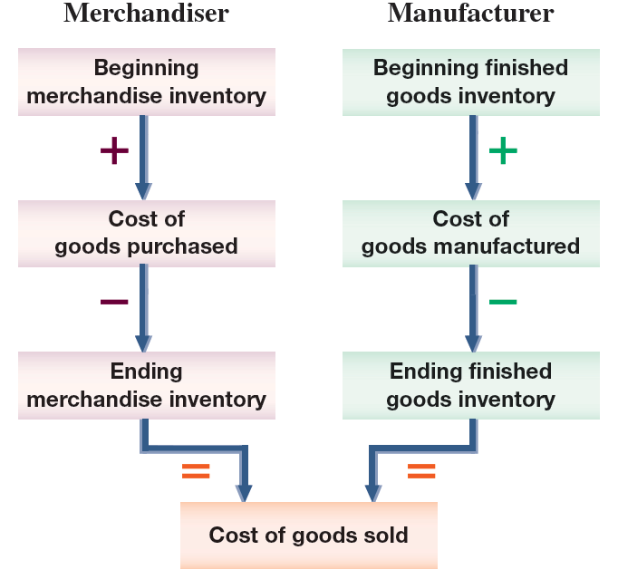
Manufacturer’s Income Statement
P 1
Notes:
The main difference between the income statement of a manufacturer and that of a merchandiser involves the items making up cost of goods sold.
This slide compares the components of cost of goods sold for a merchandiser with those for a manufacturer. To determine its cost of goods sold, a merchandiser adds cost of goods purchased to beginning merchandise inventory and then subtracts ending merchandise inventory. To determine its cost of goods sold, a manufacturer adds cost of goods manufactured to beginning finished goods inventory and then subtracts ending finished goods inventory.
In computing cost of goods sold, a merchandiser uses merchandise inventory while a manufacturer uses finished goods inventory. A manufacturer’s inventories of raw materials and work in process are not included in finished goods because they are not available for sale. A manufacturer also shows cost of goods manufactured instead of cost of goods purchased. This difference occurs because a manufacturer produces its goods instead of purchasing them ready for sale.

Slide 31
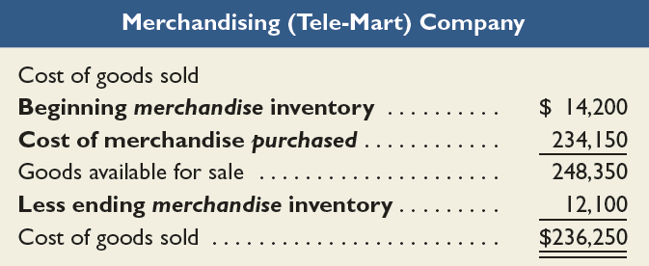
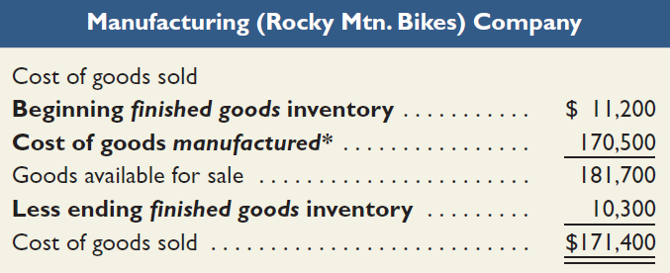
Cost of Goods Sold for a
Merchandiser and Manufacturer
Cost of goods sold for manufacturers differs only slightly from cost of goods sold for merchandisers.
P 1
Notes:
The Cost of Goods Sold sections for both a merchandiser (Tele-Mart) and a manufacturer (Rocky Mountain Bikes) are shown in this slide to highlight these differences. The remaining income statement sections are similar for merchandisers and manufacturers.
Although the cost of goods sold computations are similar, the numbers in these computations reflect different activities. A merchandiser’s cost of goods purchased is the cost of buying products to be sold. A manufacturer’s cost of goods manufactured is the sum of direct materials, direct labor, and factory overhead costs incurred in producing products.
Review what you have learned in the following NEED-TO-KNOW Slide.

Slide 32
NEED-TO-KNOW
Indicate whether the following financial statement items apply to a manufacturer, a merchandiser, or a
service provider. Some items apply to more than one type of organization.
1. Merchandise inventory
4. Operating expenses
2. Finished goods inventory
5. Cost of goods manufactured
3. Cost of goods sold
6. Supplies inventory
Manufacturer
Produces units for sale
Balance Sheet includes:
Raw Materials Inventory
Work in Process Inventory
Finished Goods Inventory
Merchandiser
Purchases units for resale
Balance Sheet includes:
Merchandise Inventory
Service Provider
Does not provide a product to its customers; no inventories.
Manufacturer
Merchandiser
Service Provider
1. Merchandise inventory
X
2. Finished goods inventory
X
3. Cost of goods sold
X
X
4. Operating expenses
X
X
X
5. Cost of goods manufactured
X
6. Supplies inventory
X
X
X
P 1
Notes:
Indicate whether the following financial statement items apply to a manufacturer, a merchandiser, or a service provider. Some items apply to more than one type of organization.
A manufacturer produces the units that it will sell. The balance sheet includes three different inventories: Raw Materials Inventory, Work in Process Inventory, and Finished Goods Inventory.
A merchandiser does not manufacture its units; instead it purchases units for resale. The balance sheet of a merchandiser includes a single inventory, Merchandise Inventory.
A service provider, as the name indicates, does not provide a product; instead it provides a service. The balance sheet of a service provider will not report any inventories for sale or resale.
So, the Merchandise Inventory account appears on the merchandiser's balance sheet. Finished goods Inventory appears on a manufacturer's balance sheet. Cost of goods sold is inventory expense. Both the manufacturer and the merchandiser carry inventories, and will therefore report cost of goods sold on the income statement. Operating expenses are incurred by all three types of organizations. Cost of goods manufactured only applies to the manufacturer. Cost of goods manufactured represents the cost of units that are completed during the current period, and transferred from the Work in Process Inventory account to the Finished Goods Inventory account. Supplies inventory can apply to all three types of organizations.

Slide 33
Flow of Manufacturing Activities

Slide 34
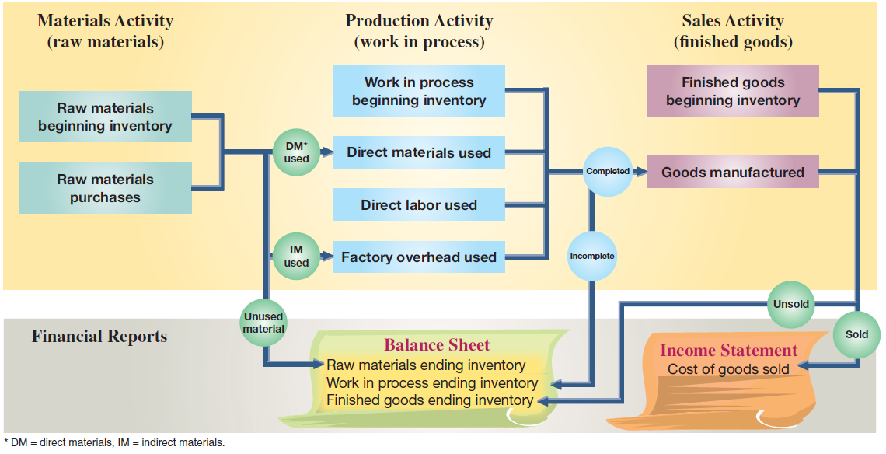
Activities and Cost Flows in Manufacturing
C 5
Notes:
In addition to income statements and balance sheets, manufacturing companies typically prepare additional reports to help managers plan and control the manufacturing process. In order to understand these reports, we must first understand the flow of manufacturing activities and costs. This slide shows the flow of manufacturing activities and the cost flows of those activities. As you can see (across the top row), the activities flow consists of materials activity followed by production activity followed by sales activity. The boxes below those activities show the costs for each activity and how costs flow across the three manufacturing activities.

Slide 35
Schedule of Cost of Goods Manufactured

Slide 36
Schedule of Cost of Good Manufactured
Summarizes the types and amounts of costs
incurred in a company’s manufacturing process.
Direct Materials Used
+ Direct Labor
+ Factory Overhead
= Total Manufacturing Costs
+ Beginning Work in Process
– Ending Work in Process
= Cost of Goods Manufactured
P 2
Notes:
Managers of manufacturing firms typically analyze product costs in detail. Such analysis can help managers make better decisions about materials, labor, and overhead in order to reduce the cost of goods manufactured and maximize the company’s profits. A company’s manufacturing activities are described in a separate report, called a schedule of cost of goods manufactured. (It is also called a manufacturing statement, a statement of cost of goods manufactured, or a similar term.) By whatever name, the schedule of cost of goods manufactured summarizes the types and amounts of costs incurred in a company’s manufacturing process.

Slide 37
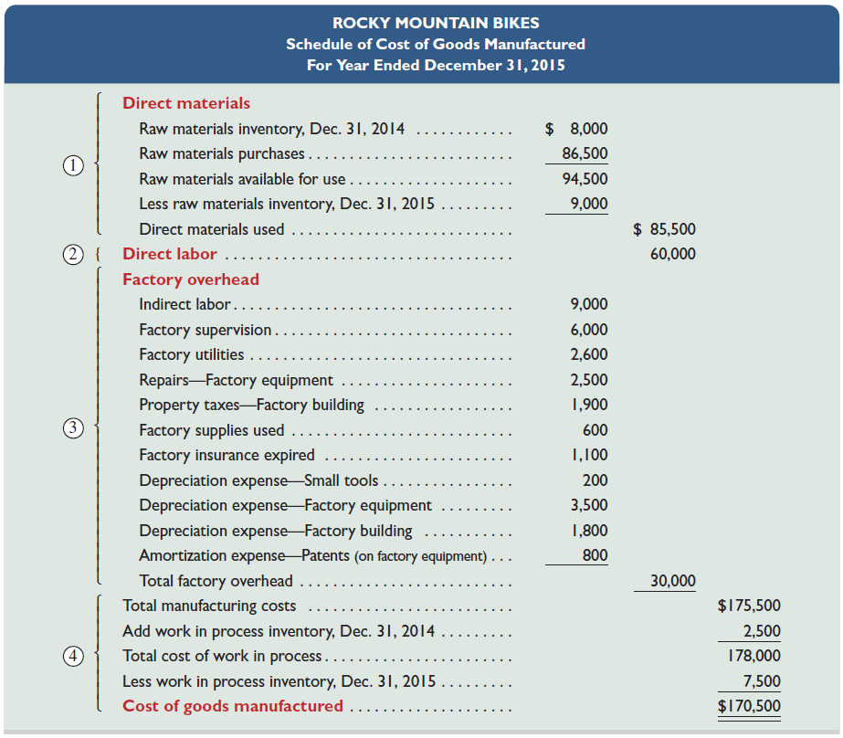
Manufacturing Statement
P 2
Notes:
This slide shows the schedule of cost of goods manufactured for Rocky Mountain Bikes. The schedule is divided into four parts: direct materials, direct labor, overhead, and computation of cost of goods manufactured.

Slide 38
Manufacturing Statement
P 2
Notes:
1. Compute direct materials used. Add the beginning raw materials inventory of $8,000 to the current period’s purchases of $86,500. This yields $94,500 of total raw materials available for use. A physical count of inventory shows $9,000 of ending raw materials inventory. If $94,500 of materials were available for use, and $9,000 of materials remains in inventory, then $85,500 of materials were used in the period. (Note: All raw materials are direct materials for Rocky Mountain Bikes.)

Slide 39
Manufacturing Statement
Include all direct labor costs incurred during the current period.
P 2
Notes:
2. Compute direct labor costs used. Rocky Mountain Bikes had total direct labor costs of $60,000 for the period. This amount includes payroll taxes and fringe benefits.

Slide 40
Manufacturing Statement
P 2
Notes:
3. Compute total factory overhead costs used. The statement lists each important factory overhead item and its cost. All of these costs are indirectly related to manufacturing activities. In addition, period expenses, such as selling expenses and other costs not related to manufacturing activities, are not reported on this statement. Total factory overhead cost for the period is $30,000. Some companies report only total factory overhead on the schedule of cost of goods manufactured and attach a separate schedule listing individual overhead costs.

Slide 41
Manufacturing Statement
P 2
Notes:
4. Compute the cost of goods manufactured. Total manufacturing costs for the period are $175,500 ($85,500 + $60,000 + $30,000), the sum of direct materials used and direct labor and overhead costs incurred. This amount is added to beginning work in process inventory. This gives the total work in process during the period of $178,000 ($175,500 + $2,500). A physical count shows $7,500 of work in process inventory remains at the end of the period. We then compute the current period’s cost of goods manufactured of $170,500 by taking the $178,000 total work in process and subtracting the $7,500 cost of ending work in process inventory. The cost of goods manufactured amount is also called net cost of goods manufactured or cost of goods completed.

Slide 42
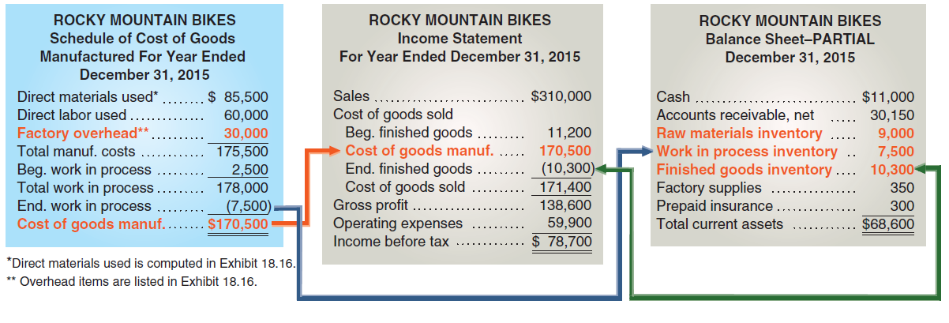

Overhead Cost Flows Across Accounting Reports
P 2
Notes:
This slide summarizes how product costs flow through the accounting system: Direct materials, direct labor, and overhead costs are summarized in the schedule of cost of goods manufactured; then the amount of the cost of goods manufactured from that statement is used to compute cost of goods sold on the income statement. Physical counts determine the dollar amounts of ending raw materials inventory and work in process inventory, and those amounts are included on the end-of-period balance sheet. (Note: This exhibit shows only partial reports.)
Review what you have learned in the following NEED-TO-KNOW Slides.

Slide 43
NEED-TO-KNOW
Compute the following three measures using the information below.
1. Cost of materials used
$70,900
Cost of Direct Materials transferred from Raw Materials Inventory to Work in
Process Inventory.
2. Cost of goods manufactured
$173,900
Cost of goods completed in the current period and transferred from Work in
Process Inventory to Finished Goods Inventory.
3. Cost of goods sold
$160,500
Cost of goods leaving Finished Goods Inventory and going to the customer.
Expensed on the income statement.
Beginning raw materials inventory
$15,500
Ending raw materials inventory
$10,600
Beginning work in process inventory
29,000
Ending work in process inventory
44,000
Beginning finished goods inventory
24,000
Ending finished goods inventory
37,400
Raw materials purchased
66,000
Direct labor used
38,000
Total factory overhead used
80,000
Raw Materials Inventory
Work in Process Inventory
Finished Goods Inventory
Beg. Inv.
15,500
Beg. Inv.
29,000
Beg. Inv.
24,000
Purchases
66,000
Matls. Used
70,900
Cost of GM
173,900
Direct Labor
38,000
Fact. OH
80,000
Avail for Use
81,500
Avail for Mfg.
217,900
Avail for Sale
197,900
Matls. Used
70,900
Cost of GM
173,900
Cost of GS
160,500
End. Inv.
10,600
End. Inv.
44,000
End. Inv.
37,400
P1/P 2
Notes:
Compute the following three measures using the accounting information below. Cost of materials used; Cost of goods manufactured, and Cost of goods sold. Cost of materials used is the cost of Direct Materials transferred from Raw Materials Inventory to Work in Process Inventory. Cost of goods manufactured is the cost of goods completed in the current period and transferred from Work in Process Inventory to Finished Goods Inventory. And Cost of goods sold is the cost of goods leaving Finished Goods Inventory and going to the customer. The cost of these goods are expensed on the income statement.
So let's set up the T-accounts for Raw Materials, Work in Process and Finished Goods.

Slide 44
NEED-TO-KNOW
Raw Materials Inventory
Work in Process Inventory
Finished Goods Inventory
Beg. Inv.
15,500
Beg. Inv.
29,000
Beg. Inv.
24,000
Purchases
66,000
Matls. Used
70,900
Cost of GM
173,900
Direct Labor
38,000
Fact. OH
80,000
Avail for Use
81,500
Avail for Mfg.
217,900
Avail for Sale
197,900
Matls. Used
70,900
Cost of GM
173,900
Cost of GS
160,500
End. Inv.
10,600
End. Inv.
44,000
End. Inv.
37,400
Balance Sheet
Current assets:
Raw Materials Inventory
$10,600
Work in Process Inventory
44,000
Finished Goods Inventory
37,400
Income Statement
Sales
$XXXXX
Cost of Goods Sold
(160,500)
P1/P 2
Notes:
The beginning inventory of raw materials is $15,500. The beginning inventory of work in process is $29,000, and the beginning inventory of finished goods is $24,000. During the current period, the company purchased $66,000 of raw materials. These costs are debited to the Raw Materials Inventory account. Total cost of materials available for use is $81,500.
At the end of the period, Raw materials has an inventory balance of $10,600. The difference between $81,500 of materials available for use and the amount on hand at the end of the period, $10,600, is the amount that was transferred to Work in Process; cost of materials used, $70,900. $70,900 of materials were transferred from the Raw Materials inventory to the factory, Work in Process. The cost of the direct materials are added to the beginning inventory, along with the cost of direct labor used, $38,000, and factory overhead, $80,000. The total cost of goods available for manufacture is $217,900. At the end of the period, Work in Process Inventory has a value of $44,000. The difference between $217,900 of goods available for manufacture, and $44,000 of goods on hand at the end of the period, represents the cost of completed units. Cost of goods manufactured is $173,900. $173,900 of goods were transferred from Work in Process into the Finished Goods inventory.
The beginning inventory of Finished Goods plus cost of goods manufactured equals cost of goods available for sale, $197,900. The value of Finished Goods Inventory at the end of the period is $37,400. The difference between $197,900 available for sale and the ending inventory balance of $37,400 represents cost of goods sold, $160,500. $160,500 of merchandise was sold to the customer in the current period. The current asset section of the balance sheet will include the three ending inventory balances: Raw Materials Inventory, Work in Process Inventory and Finished Goods Inventory. The income statement will report Sales minus Cost of goods sold.

Slide 45
Trends in Managerial Accounting

Slide 46
Trends in Managerial Accounting
Customer Orientation
Global
Economy
Service Economy
E-Commerce
Lean Practices
Value Chain
C 6
Notes:
The analytical tools and techniques of managerial accounting have always been useful, and their relevance and importance continue to increase. This is so because of changes in the business environment. This slide presents some of these changes. We will discuss a few of these topics in the following slides.

Slide 47
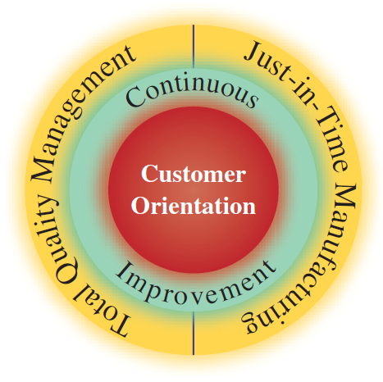
Customer Orientation
C 6
Notes:
There is an increased emphasis on customers as the most important constituent of a business. Customers expect to derive a certain value for the money they spend to buy products and services. Specifically, they expect that their suppliers will offer them the right service (or product) at the right time and the right price. This implies that companies accept the notion of customer orientation, which means that employees understand the changing needs and wants of their customers and align their management and operating practices accordingly.

Slide 48
Total Quality Management
Quality improvement
applied to all aspects of
business activities.
Seek and uncover
waste.
Constant Focus on Higher Standards
Employees encouraged
to try new methods
to improve quality.
Company emphasizes
value of quality through
quality awards.
C 6
Notes:
Total quality management focuses on quality improvement and applies this standard to all aspects of business activities. In doing so, managers and employees seek to uncover waste in business activities including accounting activities such as payroll and disbursements. To encourage an emphasis on quality, the U.S. Congress established the Malcolm Baldrige National Quality Award (MBNQA). Entrants must conduct a thorough analysis and evaluation of their business using guidelines from the Baldrige committee.

Slide 49
Just-In-Time (JIT) Manufacturing
Receive
customer
orders
Complete products
just-in-time to
ship to customers
Schedule
Production
Receive materials
just-in-time for
production
Complete parts
just-in-time for
assembly into products
C 6
Notes:
Just-in-time manufacturing is a system that acquires inventory and produces only when needed. An important aspect of JIT is that companies manufacture products only after they receive an order (a demand-pull system) and then deliver the customer’s requirements on time. This means that processes must be aligned to eliminate any delays and inefficiencies including inferior inputs and outputs. Companies must also establish good relations and communications with their suppliers. On the downside, JIT is more susceptible to disruption than traditional systems. As one example, several General Motors plants were temporarily shut down due to a strike at an assembly division; the plants supplied components just in time to the assembly division.

Slide 50

Value Chain
The value chain refers to the series of activities that add value to a company’s products or services. Companies can use lean practices to increase efficiency and profits.
C 6
Notes:
The value chain refers to the series of activities that add value to a company’s products or services. This slide illustrates a possible value chain for a retail cookie company. Companies can use lean practices across the value chain to increase efficiency and profits.

Slide 51
Raw Materials Inventory Turnover and Days’ Sales

Slide 52
1) Raw Materials Inventory Turnover
Raw materials Inventory turnover = | Raw materials used
 | Average materials inventory
A1
Notes:
A business manager can assess how effectively a company manages its raw materials inventory by computing the raw materials inventory turnover ratio as shown in this slide.
This ratio reveals how many times a company turns over (uses in production) its raw materials inventory during a period. Generally, a high ratio of raw materials inventory turnover is preferred, as long as raw materials inventory levels are adequate to meet demand.

Slide 53
Important Stuff
Raw materials Inventory turnover = Raw materials used / Average materials inventory
Manufacturers cost of Goods Sold (COGS) = Beg. Inventory + Purchases Costs – End. Inventory = COGS
Merchandisers Cost of Goods Sold = Beg. Inventory + Cost of Goods Manufactured – End. Inventory = COGS
Cost of Goods Manufactured = Direct Materials + Direct Labors + Factory Overhead = Total Manufacturing Costs + Beg. Work in Progress - End. Work in Progress = Cost of Goods Manufactured

Slide 54
Chapter 02
Job Order Costing and

Slide 55
Chapter 02
Job Order Costing and Analysis

Slide 56
Job Order Costing

Slide 57
Cost Accounting Systems
Process
Costing
Job
Costing
Chapter 7
Used for production of large, unique, or
high-cost items.
Built to order rather than mass produced.
Many costs can be directly traced to each job.
C 1
Notes:
The two basic types of cost accounting systems are job order costing and process costing.
Many companies produce products individually designed to meet the needs of a specific customer. Each customized product is manufactured separately and its production is called job order production.
Process operations, also called process manufacturing or process production, is the mass production of products in a continuous flow of steps. Unlike job order production, where every product differs depending on customer needs, process operations are designed to mass-produce large quantities of identical products.

Slide 58
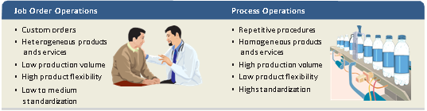
Job Order Production
C 1
Notes:
This slide lists important features of job order and process operations. Both types of operations are used by manufacturers and also by service companies. Movies made by Walt Disney and financial audits done by KPMG are examples of job order service operations. Order processing in large mail-order firms like L.L. Bean is an example of a process service operation.

Slide 59
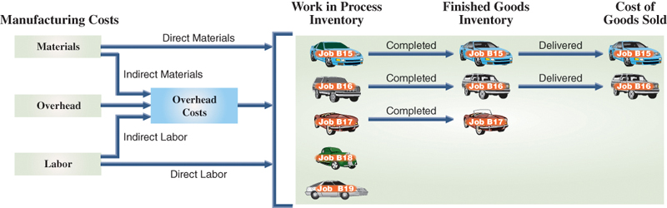
Job Order Production Activities
C 1
Notes:
An overview of job order production activity and cost flows is shown. This slide shows the March production activity of Road Warriors, which installs entertainment systems and security devices in cars and trucks. The company customizes any vehicle by adding speakers, amplifiers, video systems, alarms, and reinforced exteriors.
Job order production for Road Warriors requires materials, labor, and overhead costs. Recall that direct materials are used in manufacturing and can be clearly identified with a particular job. Similarly, direct labor is effort devoted to a particular job. Overhead costs support production of more than one job. Common overhead items are depreciation on factory buildings and equipment, factory supplies (indirect materials), supervision and maintenance (indirect labor), cleaning, and utilities.
This slide shows that materials, labor, and overhead are added to Jobs B15, B16, B17, B18, and B19, which were started during the month (March). Alarm systems are added to Jobs B15 and B16; Job B17 receives a high-end audio and video entertainment system. Road Warriors completed Jobs B15, B16, and B17 in March and delivered Jobs B15 and B16 to customers. At the end of March, Jobs B18 and B19 remain in work in process inventory and Job B17 is in finished goods inventory.

Slide 60
Job Cost Sheet

Slide 61
Job Order Cost Documents
The primary document for tracking the costs associated with a given job is the job cost sheet.
C 2
Notes:
A major aim of a job order costing system is to determine the cost of producing each job or job lot. In the case of a job lot, the system also aims to compute the cost per unit. The accounting system must include separate records for each job to accomplish this, and it must capture information about costs incurred and charge these costs to each job.
A job cost sheet is a separate record maintained for each job.

Slide 62
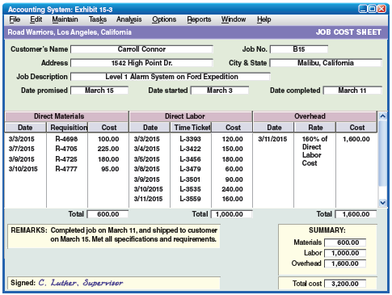
Job Cost Sheet
C 2
Notes:
This slide shows a job cost sheet for Road Warriors. This job cost sheet identifies the customer, the job number assigned, the product, and key dates. Only product costs are recorded on job cost sheets. Direct materials and direct labor costs actually incurred on the job are immediately recorded on this sheet. Estimated overhead costs are included on job cost sheets, through a process we discuss later in the chapter. When each job is complete, the supervisor enters the date of completion, records any remarks, and signs the sheet. The balance in the Work in Process Inventory account at any point in time is the sum of the costs on job cost sheets for all jobs that are not yet complete. The balance in the Finished Goods Inventory account at any point in time is the sum of the costs on job cost sheets for all jobs that are complete and awaiting sale. The balance in Cost of Goods Sold is the sum of all job sheets for jobs that have been sold and delivered to the customer. Managers use job cost sheets to monitor costs incurred to date and to predict and control costs for each job. In the next section we use Road Warriors’ production and sales activity for March to illustrate job order costing and the use of job cost sheets.

Slide 63
Materials Cost Flows and Documents

Slide 64
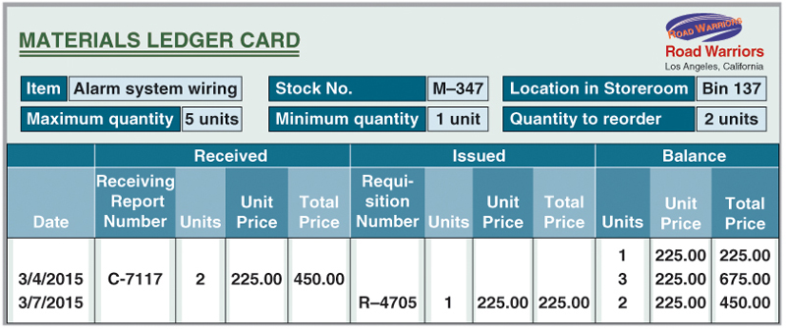
Materials Ledger Card
P 1
Notes:
This slide shows a materials ledger card for one type of material received and issued by Road Warriors. The card identifies the item as alarm system wiring and shows the item’s stock number, its location in the storeroom, information about the maximum and minimum quantities that should be available, and the reorder quantity. For example, two units of alarm system wiring were purchased on March 4, 2015, as evidenced by receiving report C-7117. After this purchase the company has three units of alarm system wiring on hand. Materials ledger cards would also be updated for each of the other materials purchased.

Slide 65
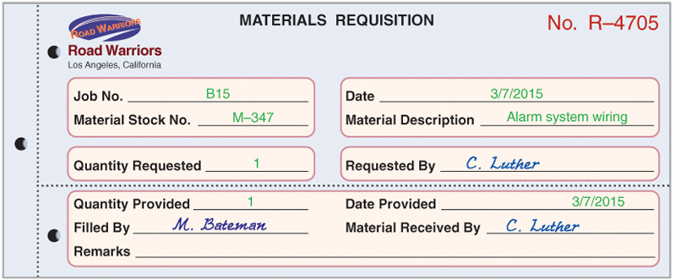
Materials Requisition
P 1
Notes:
When materials are needed in production, a production manager prepares a materials requisition and sends it to the materials manager. For direct materials, the requisition shows the job number, the type of material, the quantity needed, and the signature of the manager authorized to make the requisition.
This slide shows the materials requisition for alarm system wiring for Job B15. For requisitions of indirect materials, which cannot be traced to individual jobs, the “Job No.” line in the requisition form might read, “For General Factory Use.”

Slide 66
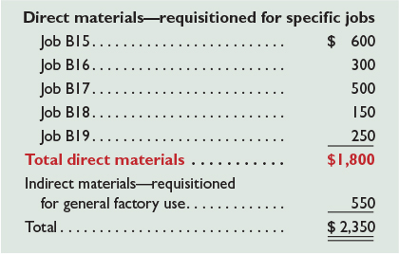

Materials Requisition
P 1
Notes:
Requisitions are often accumulated and recorded in one journal entry. The frequency of entries depends on the job, the industry, and management procedures. In this example, Road Warriors records materials requisitions at the end of each week. These materials requisitions are shown here.
The use of direct materials for the week (including alarm system wiring for Job B15) yields the entry shown.
This entry is posted both to general ledger accounts and to subsidiary records. Posting to subsidiary records includes debits to job cost sheets and credits to materials ledger cards.
Review what you have learned in the following NEED-TO-KNOW Slide.

Slide 67
NEED-TO-KNOW
A manufacturing company purchased $1,200 of materials (on account) for use in production. The company
used $200 of direct materials on Job 1 and $350 of direct materials on Job 2. Prepare journal entries
to record the above transactions.
General Journal
Debit
Credit
Purchase
Raw Materials Inventory
1,200
Accounts Payable
1,200
Use - DM
Work in Process Inventory
550
Raw Materials Inventory
550
Raw Materials Inventory
Work in Process Inventory
Beg. Inv.
XXX
Beg. Inv.
Purchases
1,200
Direct Materials
550
Direct Material
550
Direct Labor
Factory OH
Job 1
Job 2
Direct Materials
200
Direct Materials
350
Direct Labor
Direct Labor
Factory OH
Factory OH
P 1
Notes:
A manufacturing company purchased $1,200 of materials (on account) for use in production. The company used $200 of direct materials on Job 1 and $350 of direct materials on Job 2. Prepare journal entries to record the above transactions.
The journal entry to record the purchase of materials on account is a debit to Raw Materials Inventory, $1,200, and a credit to Accounts payable. The journal entry to record the use of direct materials on the jobs is a debit to Work in Process Inventory for the total, $550, and a credit to Raw Materials Inventory. $200 of direct materials was charged to Job 1 and $350 of direct materials was charged to Job 2. The job sheets act as a subsidiary ledger to Work in Process Inventory, the control account.

Slide 68
Labor Cost Flows and Documents

Slide 69
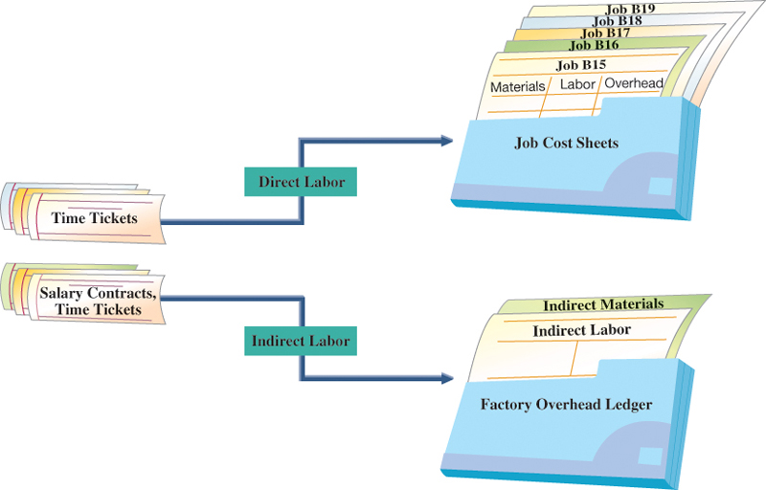
Labor Cost Flows
P 2
Notes:
Labor is the next manufacturing cost to account for. This slide shows that factory labor costs are classified as either direct or indirect. Direct labor costs flow to individual job cost sheets.

Slide 70
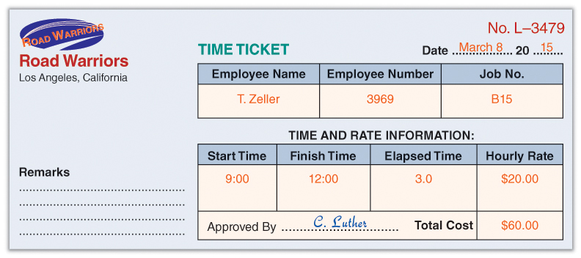
Labor Time Ticket
P 2
Notes:
This slide shows a time ticket reporting the time a Road Warrior employee spent working on Job B15. The employee’s supervisor signed the ticket to confirm its accuracy. The hourly rate and total labor cost are computed after the time ticket is turned in.

Slide 71

Labor Time Ticket
Direct labor—traceable to specific jobs
Job B15 . . . . . . . . . . . . . . . . . . . . . . . . . | $ 1,000
Job B16 . . . . . . . . . . . . . . . . . . . . . . . . . | 800
Job B17 . . . . . . . . . . . . . . . . . . . . . . . . . | 1,100
Job B18 . . . . . . . . . . . . . . . . . . . . . . . . . | 700
Job B19 . . . . . . . . . . . . . . . . . . . . . . . . . | 600
Total direct labor . . . . . . . . . . . . . . . | $4,200
Indirect labor . . . . . . . . . . . . . . . . . . . . . . | 1,100
Total . . . . . . . . . . . . . . . . . . . . . . . . . . . . . | $ 5,300
P 2
Notes:
Time tickets are often accumulated and recorded in one journal entry. The frequency of these entries varies across companies. In this example, Road Warriors journalizes direct labor monthly. During March, Road Warriors’ factory payroll costs total $5,300. Of this amount, $4,200 can be traced directly to jobs, and the remaining $1,100 is classified as indirect labor, as shown here.
The entry shown records direct labor for the month, based on all the direct labor time tickets for the month.
Review what you have learned in the following NEED-TO-KNOW Slide.

Slide 72
NEED-TO-KNOW
A manufacturing company used $5,400 of direct labor in production activities in May. Of this amount,
$3,100 of direct labor was used on Job A1 and $2,300 of direct labor was used on Job A2. Prepare the
journal entry to record direct labor used.
General Journal
Debit
Credit
Work in Process Inventory
5,400
Factory Wages Payable
5,400
Work in Process Inventory
Factory Wages Payable
Beginning Inv.
Direct Materials
5,400
Direct Labor
5,400
Factory OH
Job A1
Job A2
Direct Materials
Direct Materials
Direct Labor
3,100
Direct Labor
2,300
Factory OH
Factory OH
P 2
Notes:
A manufacturing company used $5,400 of direct labor in production activities in May. Of this amount, $3,100 of direct labor was used on Job A1 and $2,300 of direct labor was used on Job A2. Prepare the journal entry to record direct labor used.
The journal entry for direct labor is a debit to Work in Process Inventory, $5,400, and a credit to the liability account, Factory Wages Payable. $3,100 of direct labor was charged to Job A1, and $2,300 of direct labor is charged to Job A2. The job sheets act as subsidiary ledgers to the control account, Work in Process. Total direct labor charged to the job sheets will always agree with the total charged to Work in Process.

Slide 73
Overhead Cost Flows and Documents

Slide 74
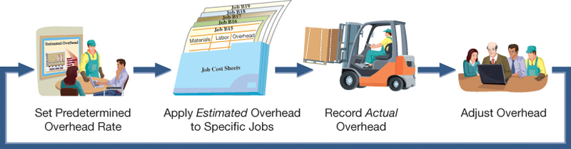
Overhead Cost Flows and Predetermined Overhead Rate
P 3
Notes:
We turn now to overhead costs. Unlike direct materials and direct labor, overhead costs cannot be traced directly to individual jobs. Instead, the accounting for overhead costs follows the four-step process shown in this slide. Overhead accounting requires managers to first estimate what total overhead costs will be for the coming period. We cannot wait until the end of a period to allocate overhead to jobs, because a job order costing system uses perpetual inventory records that require up-to-date costs. This estimated overhead cost, even if it is not exactly precise, is needed to estimate a job’s total costs before its completion. Such estimated costs are useful for managers in many decisions, including setting prices and identifying costs that are out of control. At the end of the year, the company adjusts its estimated overhead to the actual amount of overhead incurred for that year, and then considers whether to change its predetermined overhead rate for the next year.

Slide 75

Predetermined Overhead Rate
Road Warriors uses a predetermined overhead rate (POHR) based on direct labor cost to apply overhead to jobs.
P 3
Notes:
Being able to estimate overhead in advance requires a predetermined overhead rate, also called predetermined overhead allocation (or application) rate. The predetermined overhead rate requires an estimate of total overhead cost and an allocation factor such as total direct labor cost before the start of the period. This slide shows the usual formula for computing a predetermined overhead rate (estimates are commonly based on annual amounts). This rate is used during the period to allocate estimated overhead to jobs. Some companies use multiple activity (allocation) bases and multiple predetermined overhead rates for different types of products and services.
To illustrate, Road Warriors applies (also termed allocates, assigns, or charges) overhead by linking it to direct labor. At the start of the current year, management estimates total direct labor costs of $125,000 and total overhead costs of $200,000. Using these estimates, management computes its predetermined overhead rate as 160% of direct labor cost ($200,000 / $125,000).

Slide 76

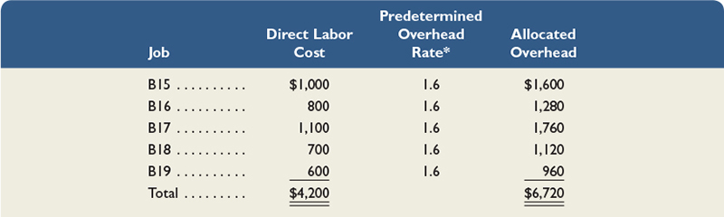
Predetermined Overhead Rate
P 3
Notes:
Earlier we showed that Road Warriors used $4,200 of direct labor in March. We then use the predetermined overhead rate of 160% to allocate $6,720 (equal to $4,200 x 1.60) of overhead. The entry to record this allocation is shown.
Then, overhead is allocated to each individual job based on the amount of the activity base that job used (in this example, direct labor). This slide shows these calculations for Road Warriors’ March production activity.
Review what you have learned in the following NEED-TO-KNOW Slide.

Slide 77
NEED-TO-KNOW
A manufacturing company estimates it will incur $240,000 of overhead costs in the next year. The company
allocates overhead using machine hours, and estimates it will use 1,600 machine hours in the next year.
During the month of June, the company used 80 machine hours on Job 1 and 70 machine hours on Job 2.
1. Compute the predetermined overhead rate to be used to apply overhead during the year.
Predetermined Overhead Rate =
Estimated Overhead Costs
$240,000
Estimated Activity Base
1,600 machine hours
=
$150 per machine hour
2. Determine how much overhead should be applied to Job 1 and to Job 2 for June.
Machine Hours Used
x Predetermined OH rate
= OH Applied
Job 1
80 hours
x $150 per hour
= $12,000 OH applied
Job 2
70 hours
x $150 per hour
= $10,500 OH applied
Total
150 hours
x $150 per hour
= $22,500 OH applied
3. Prepare the journal entry to record overhead applied for June.
General Journal
Debit
Credit
Work in Process Inventory
22,500
Factory Overhead
22,500
P 3
Notes:
A manufacturing company estimates it will incur $240,000 of overhead costs in the next year. The company allocates overhead using machine hours, and estimates it will use 1,600 machine hours in the next year. During the month of June, the company used 80 machine hours on Job 1 and 70 machine hours on Job 2.
1. Compute the predetermined overhead rate to be used to apply overhead during the year. The predetermined overhead rate is calculated by taking the estimated overhead costs and dividing by the estimated activity base. This company has determined that machine hours drive the overhead costs; the base is the estimated machine hours used. $240,000 in estimated overhead costs divided by 1,600 machine hours is a predetermined overhead rate of $150 per machine hour.
2. Determine how much overhead should be applied to Job 1 and to Job 2 for June. Job 1 used a total of 80 machine hours. 80 machine hours multiplied by the predetermined overhead rate of $150 per hour is total overhead applied to Job 1 of $12,000. Job 2 used fewer machine hours. 70 machine hours multiplied by $150 per hour results in a lower amount of overhead applied, $10,500. The total for the month, 150 hours multiplied by $150 per hour, is a total of $22,500.
3. Prepare the journal entry to record overhead applied for June. Debit Work in Process Inventory for the total applied, $22,500, and credit Factory Overhead.

Slide 78
Recording Actual Overhead
Indirect Material
Indirect Labor
Other
P 3
Notes:
Factory overhead includes all factory costs other than direct materials and direct labor. Two sources of overhead costs are indirect materials and indirect labor. These costs are recorded from materials requisition forms for indirect materials and from salary contracts or time tickets for indirect labor. Two other sources of overhead are (1) vouchers authorizing payment for factory items such as supplies or utilities and (2) adjusting journal entries for costs such as depreciation on factory assets.
Factory overhead usually contains many different costs. These costs are recorded with debits to the Factory Overhead general ledger account, and with credits to various accounts. Next we show how to record journal entries for actual overhead costs. While journal entries for different types of overhead costs might be recorded with varying frequency, in our example we assume these entries are each made at the end of the month.

Slide 79

Recording Indirect Materials Used
P 3
Notes:
During March, Road Warriors incurred $550 of actual indirect materials costs, as supported by materials requisitions. The use of these indirect materials yields the following entry.
This entry is posted to the general ledger accounts, Factory Overhead and Raw Materials Inventory, and is posted to Indirect Materials in the subsidiary factory overhead ledger. Note that unlike the recording of direct materials, actual indirect materials costs incurred are not immediately recorded in Work in Process Inventory and are not posted to job cost sheets.

Slide 80

Recording Indirect Labor Used
P 3
Notes:
During March, Road Warriors incurred $1,100 of actual indirect labor costs. These costs might be supported by time tickets for maintenance workers or by salary contracts for production supervisors. The use of this indirect labor yields the following entry.
This entry is posted to the general ledger accounts, Factory Overhead and Factory Wages Payable, and is posted to Indirect Labor in the subsidiary factory overhead ledger. Note that unlike the recording of direct labor, actual indirect labor costs incurred are not recorded immediately in Work in Process Inventory and are not posted to job cost sheets.

Slide 81
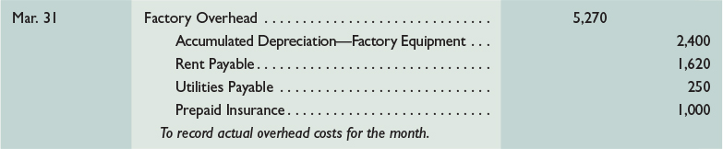
Recording Other Overhead Costs
P 3
Notes:
During March, Road Warriors incurred $5,270 of actual other overhead costs. These costs could include items such as factory building rent, depreciation on the factory building, factory utilities, and other such costs indirectly related to production activities. These costs are recorded with debits to Factory Overhead and credits to other accounts such as Cash, Accounts Payable, Utilities Payable, and Accumulated Depreciation—Factory Equipment. The entry to record these other overhead costs for March is as follows.
This entry is posted to the general ledger account, Factory Overhead, and is posted to separate accounts for each of the overhead items in the subsidiary factory overhead ledger. Note that actual overhead costs incurred are not recorded in Work in Process Inventory and are not posted to job cost sheets. Only applied overhead is recorded in Work in Process Inventory and posted to job cost sheets.
Review what you have learned in the following NEED-TO-KNOW Slide.

Slide 82
NEED-TO-KNOW
A manufacturing company used $400 of indirect materials and $2,000 of indirect labor during the month.
The company also incurred $1,200 of depreciation on factory equipment, $500 of depreciation on office
equipment, and $300 of factory utilities. Prepare the journal entry to record actual factory overhead costs
incurred during the month.
General Journal
Debit
Credit
Factory Overhead
3,900
Raw Materials Inventory
400
Factory Wages Payable
2,000
Accumulated Depreciation - Factory Equipment
1,200
Utilities Payable
300
Factory Overhead
Actual OH Incurred
OH Applied to Production
Ind. Materials
400
Ind. Labor
2,000
Fact. Deprec.
1,200
Fact. Utilities
300
3,900
P 3
Notes:
A manufacturing company used $400 of indirect materials and $2,000 of indirect labor during the month. The company also incurred $1,200 of depreciation on factory equipment, $500 of depreciation on office equipment, and $300 of factory utilities.
Prepare the journal entry to record actual factory overhead costs incurred during the month. The Factory Overhead account is debited for actual overhead incurred and credited for overhead applied to production. This journal entry is to record the actual factory overhead costs; we'll be debiting the Factory Overhead account. Indirect materials result in a debit to Factory Overhead and a credit to Raw Materials Inventory. Indirect labor is a debit to Factory Overhead and a credit to Factory Wages Payable. Depreciation on Factory Equipment is a debit to Factory Overhead, and a credit to Accumulated Depreciation - Factory Equipment.
Factory utilities of $300 result in a debit to Factory Overhead and a credit to Utilities payable. Total actual Factory Overhead incurred is $3,900; the total debit to Factory Overhead.
Note that the depreciation on office equipment is not a product cost; this is a period cost and will be expensed in the month incurred.

Slide 83
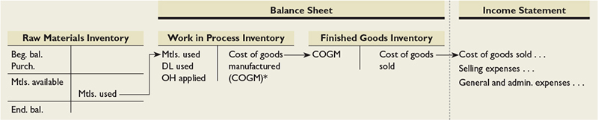
Summary of Cost Flows
P 3
Notes:
This slide shows that direct materials used, direct labor used, and factory overhead applied flow through the Work in Process Inventory and Finished Goods balance sheet accounts. The cost of goods manufactured (COGM) is computed and shown on the schedule of cost of goods manufactured. When goods are sold, their costs are transferred from Finished Goods Inventory to the income statement as cost of goods sold.
Period costs do not impact inventory accounts. As a result, they do not impact cost of goods sold, and they are not reported on the schedule of cost of goods manufactured. They are reported on the income statement as operating expenses.
.

Slide 84
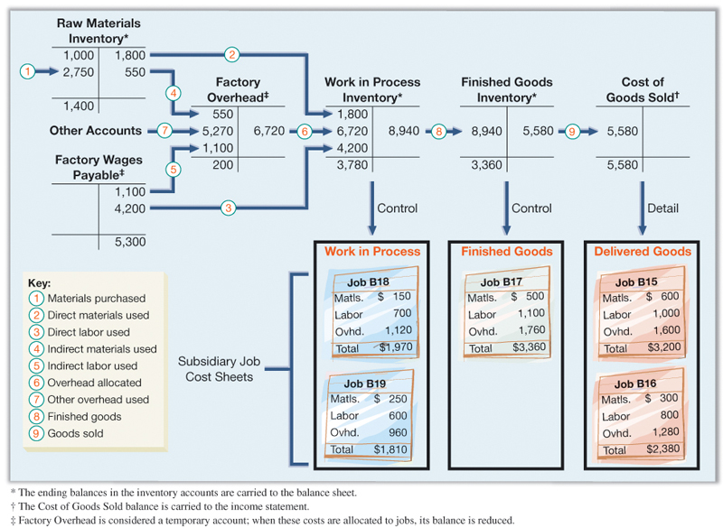
Summary of Cost Flows
P 3
Notes:
The upper part of Exhibit 15.16 shows the flow of Road Warriors’ product costs through general ledger accounts. Arrow lines are numbered to show the flows of costs for March. Each numbered cost flow reflects journal entries made in March. The lower part of Exhibit 15.16 shows summarized job cost sheets and their status at the end of March. The sum of costs assigned to the two jobs in process ($1,970 + $1,810) equals the $3,780 balance in Work in Process Inventory. Also, costs assigned to Job B17 equal the $3,360 balance in Finished Goods Inventory. These balances in Work in Process Inventory and Finished Goods Inventory are reported on the end-of-period balance sheet. The sum of costs assigned to Jobs B15 and B16 ($3,200 + $2,380) equals the $5,580 balance in Cost of Goods Sold. This amount is reported on the income statement for the period.

Slide 85
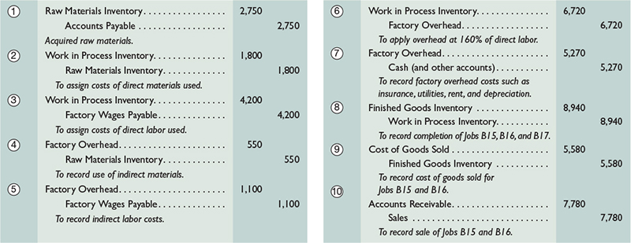
Summary of Cost Flows
P 3
Notes:
This slide shows the journal entries made in March. Each entry is numbered to link with the arrow lines in the prior slide. In addition, this slide concludes with the summary journal entry to record the sales (on account) of Jobs B15 and B16.

Slide 86
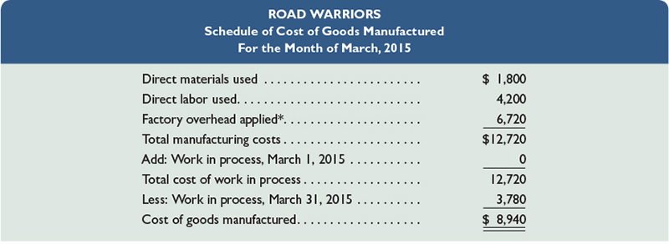
Schedule of Cost of Goods Manufactured
P 3
Notes:
We end the Road Warriors example with the schedule of cost of goods manufactured shown here. This schedule is similar to the one reported in the previous chapter, with one key difference: Total manufacturing costs includes overhead applied rather than actual overhead costs. In this example, actual overhead costs were $6,920, while applied overhead was $6,720. We discuss how to account for this difference next.

Slide 87

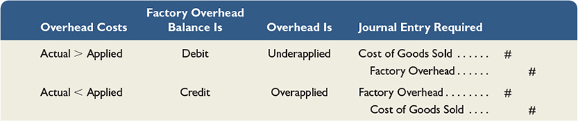
Adjusting Factory Overhead
P 3
Notes:
The top graphic in this slide shows a Factory Overhead T-account. The company applies overhead (credits the Factory Overhead account) using a predetermined rate estimated at the beginning of the year. During the year, the company records actual overhead costs with debits to the Factory Overhead account. Exhibit 15.20 shows what to do when, at year-end, actual overhead does not equal applied overhead. First, we determine whether the applied overhead is more or less than the actual overhead:
When less overhead is applied than is actually incurred, the remaining debit balance in the Factory Overhead account is called underapplied overhead.
When more overhead is applied than is actually incurred, the resulting credit balance in the Factory Overhead account is called overapplied overhead.
When overhead is underapplied, it means that individual jobs have not been charged enough overhead during the year, and cost of goods sold for the year is too low. When overhead is overapplied, it means that jobs have been charged too much overhead during the year, and cost of goods sold is too high. In either case, a journal entry is needed to adjust Factory Overhead and Cost of Goods Sold.
The bottom graphic summarizes this entry.

Slide 88
Underapplied or Overapplied Overhead

Slide 89

Underapplied or Overapplied Overhead
P 4
Notes:
To illustrate, assume that Road Warriors applied $200,000 of overhead to jobs during 2015. This equals the amount of overhead that management estimated in advance for the year. We further assume that Road Warriors incurred a total of $200,480 of actual overhead costs during 2015. Thus, at the end of the year, the Factory Overhead account has a debit balance of $480.
The $480 debit balance reflects manufacturing costs not assigned to jobs. This means that the balances in Work in Process Inventory, Finished Goods Inventory, and Cost of Goods Sold do not include all production costs incurred. The required journal entry depends on whether the difference (under- or overapplied) is material. When the underapplied overhead amount is immaterial, it is closed to the Cost of Goods Sold account with the following adjusting entry.
The $480 debit (increase) to Cost of Goods Sold reduces income by $480. After this entry, the Factory Overhead account has a zero balance. (When the underapplied or overapplied overhead is material, the amount is normally allocated to the Cost of Goods Sold, Finished Goods Inventory, and Work in Process Inventory accounts. This process is covered in advanced courses.) We treat overapplied overhead at the end of the period in the same way we treat underapplied overhead, except that we debit Factory Overhead and credit Cost of Goods Sold for the amount.
Review what you have learned in the following NEED-TO-KNOW Slides.

Slide 90
NEED-TO-KNOW
A manufacturing company applied $300,000 of overhead to its jobs during the year. For the independent
scenarios below, prepare the journal entry to adjust over- or underapplied overhead. Assume the adjustment
amounts are not material.
1. Actual overhead costs incurred during the year equal $305,000.
Factory Overhead
Actual OH Incurred
OH Applied to Production
305,000
300,000
Underapplied OH
5,000
General Journal
Debit
Credit
Cost of Goods Sold
5,000
Factory Overhead
5,000
P 4
Notes:
A manufacturing company applied $300,000 of overhead to its jobs during the year. For the independent scenarios below, prepare the journal entry to adjust over- or underapplied overhead. Assume the adjustment amounts are not material.
In the first scenario, actual overhead costs incurred during the year equal $305,000. The Factory Overhead account is debited for actual overhead incurred and credited for overhead applied to production. In this scenario, actual overhead incurred is $305,000 but the amount applied to production is only $300,000. The Factory Overhead account has a debit balance of $5,000. Since the amount applied to production is less than the actual costs, this is referred to as an underapplied balance of $5,000. Each job produced during the period has been somewhat undercharged for overhead. This amount is not considered material however, so at the end of the period, we simply close the overhead balance to Cost of goods sold. Credit Factory Overhead, $5,000, and debit Cost of goods sold.

Slide 91
NEED-TO-KNOW
A manufacturing company applied $300,000 of overhead to its jobs during the year. For the independent
scenarios below, prepare the journal entry to adjust over- or underapplied overhead. Assume the adjustment
amounts are not material.
2. Actual overhead costs incurred during the year equal $298,500.
Factory Overhead
Actual OH Incurred
OH Applied to Production
298,500
300,000
Overapplied
1,500
General Journal
Debit
Credit
Factory Overhead
1,500
Cost of Goods Sold
1,500
P 4
Notes:
Assume instead that actual overhead costs incurred during the year equal $298,500. The total amount applied to production remains at $300,000, but now the debits to Factory Overhead, actual overhead incurred, is only $298,500. The balance in the Factory Overhead account at the end of the period is a credit balance of $1,500. Since the amount of overhead applied to production exceeds the actual overhead incurred, this is referred to as an overapplied balance. To close the balance at the end of the period, assuming the amount is not material, we debit Factory Overhead, $1,500, and credit Cost of goods sold.

Slide 92
Global View
Porsche AG manufactures high-performance cars. Each car is built according to individual customer specifications. Customers can use the Internet to place orders for their dream cars. Porsche employs just-in-time inventory techniques to ensure a flexible production process that can respond rapidly to customer orders. For a recent year, Porsche reported €33,781 million in costs of materials and €9,038 million in personnel costs, which helped generate €57,081 million in revenue.
Notes:
Porsche AG manufactures high-performance cars. Each car is built according to individual customer specifications. Customers can use the Internet to place orders for their dream cars. Porsche employs just-in-time inventory techniques to ensure a flexible production process that can respond rapidly to customer orders. For a recent year, Porsche reported €33,781 million in costs of materials and €9,038 million in personnel costs, which helped generate €57,081 million in revenue.

Slide 93
Homework assignment
Using Connect – 6 Questions for 60 Points.
Complete the “Connect Orientation” at Connect web site for 10 points, before 2/15/2016.
Prepare chapter 3 “Process Costing and Analysis.”
Happiness is having all homework up to date

Slide 94
Thank you and See You Wednesday at the Same Time, Take Care

