Slide 1
Welcome Back

Slide 2
Welcome Back
Time for Any Question

Slide 3
Homework assignment
Using Connect – 7 Questions for 60 Points; Chapter 7.
Prepare chapters 4, 5, and 6 for EXAM # 2 on 3/21/2016 in class.
Last day of the homework for chapters 4, 5, and 6 is 3/20/2016 midnight.
No class on 3/14/2016 OR 3/16/216 for “SPRING BREAK.” see you on 3/21/2016.
Happiness is having all homework up to date

Slide 4
Chapter 07
Master Budgets and

Slide 5
Chapter 07
Master Budgets and Performance Planning

Slide 6
5 RATIOS FOR 10 POINTS
1) Raw materials Inventory turnover = Raw Material Used / Average Material Inventory
2) Cost of Goods Manufactured = Direct Material + Direct Labor + Factory Overhead
3) Predetermined Overhead Rate = Estimated Overhead Costs / Estimated Activity Base
4) Income Under Absorption Costing = Income under variable costing + Fixed overhead cost in ending inventory - Fixed overhead cost in beginning inventory
5) Break-Even Point in Units = Fixed Costs / Contribution margin per Unit

Slide 7
Budget Process and Administration

Slide 8
Enhances coordination so that
activities of all units contribute to
meeting the company’s overall goals.
4) Provides a benchmark
for evaluating
performance.
2) Promotes analysis
and a focus on
the future.
Benefits of
Budgeting
3) Converts long-term
strategic plans into
short-term financial
plans.
5) Communicates
management plans
throughout the
organization.
1) Motivates employees through
participation in the budgeting process
and the establishment of attainable goals.
WARNING: If not properly applied, budgets can have a negative effect on a company…so make sure that budgets are realistic!
C 1
Notes:
The budgeting process with a company, coordinates the activities of various departments in order to meet the company’s overall goals. Most companies prepare long-term strategic plans spanning 5 to 10 years. Then they prepare shorter-term financial plans, called budgets, to guide their actions toward achieving the goals set forth in the strategic plan. Budgets are most often prepared on an annual basis, but can be prepared for any period of time. Budgets help fulfill the key managerial functions of planning and controlling. There are several benefits to having a written budget:
A budget focuses on the future opportunities and threats to the organization. This focus on
the future is important, because the daily pressures of operating an organization can divert
management’s attention to planning.
Since budgeted performance takes into account important company, industry, and economic
factors, a comparison of actual to budgeted performance provides an effective monitoring
and control system.
Ensures that the activities of all departments contribute to meeting the company’s overall goals. This requires coordination. Budgeting helps to achieve this coordination across departments.
A written budget provides a benchmark for evaluating performance, and communicates management’s plans throughout the organization.
Converts long-term strategic plans into short-term financial plans, and promotes analysis and a focus on the future.
Motivates employees through participation in the budgeting process and the establishment of attainable goals.
Managers must also be aware of potential negative outcomes of budgeting. Some employees might be tempted to understate sales budgets and overstate expense budgets to allow themselves to more easily meet budget targets. Also, pressure to meet budgeted results might lead employees to engage in unethical behavior or commit fraud. Finally, some employees might always spend their budgeted amounts, even on unnecessary items, to ensure their budgets aren’t reduced for the next period.

Slide 9
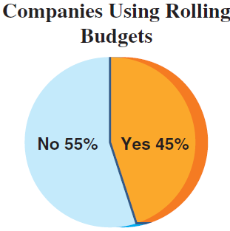
Budget Reporting and Timing
Annual Budget
2015
2016
2017
2018
The annual budget
may be divided into quarterly
or monthly budgets.
A continuous or rolling budget is a twelve-month
budget that rolls forward one month as the
current month is completed.
C 1
Notes:
We need to choose a budgeting period. The budget period usually coincides with the accounting period. Most companies prepare at least an annual budget, which reflects the objectives for the next year. To provide specific guidance, the annual budget usually is separated into quarterly or monthly budgets. These short-term budgets allow management to periodically evaluate performance and take corrective action.
Some companies use a continuous or rolling budget either exclusively or in conjunction with an annual budget. Rolling budgets drop off the immediate past month or quarter and add one future month or quarter as the year progresses. A rolling budget allows a company to continuously work with a full one-year budget in place.

Slide 10
Budget Committee
Flow of budget data is a bottom-up process.
C 1
Notes:
The task of preparing a budget should not be the sole responsibility of any one department.
Similarly, the budget should not be simply handed down as top management’s final word.
Instead, budget figures and budget estimates developed through a bottom-up process usually are more useful. In a bottom-up budgeting process, information flows upward from lower levels of the business to top management. Lower-level managers have more detailed knowledge because they are closer to the day-to-day activities and operations of the business.

Slide 11

Budget Committee
The budget committee is responsible for budgeting policies and for coordinating the efforts of all participants in the budgeting process.
Consists of managers from all departments of the organization.
Provides central guidance to insure that individual budgets submitted from all departments are realistic and coordinated.
C 1
Notes:
Most large companies have a standing budget committee that is responsible for budgeting policies and for coordinating the efforts of all participants in the budgeting process. Most budgets should be developed by a bottom-up process, but the budgeting system requires central guidance. The budget committee provides this guidance. It is made up of department heads and other executives responsible for seeing that budgeted amounts are realistic and coordinated.

Slide 12
Master Budget
Components

Slide 13
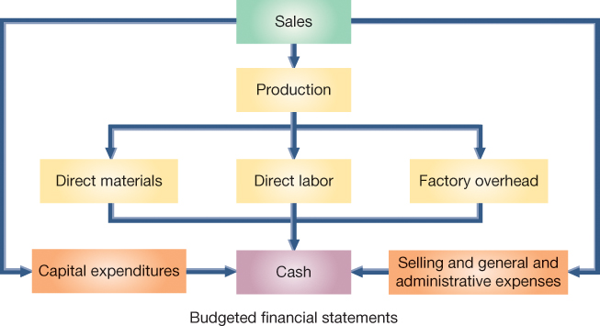
Master Budget Process for a Manufacturer
C 2
Notes:
This slide summarizes the master budgeting process for a company that manufacturers a product. The master budgeting process typically begins with the sales budget and ends with a cash budget and budgeted financial statements. The master budget includes individual budgets for sales, production (or purchases), various expenses, capital expenditures, and cash.

Slide 14
I - Operating Budgets

Slide 15
1) Sales Budget
The first step in preparing the master budget is the sales budget, which shows the planned sales units and the expected dollars from these sales.
Sales
Budget
Estimated
Unit Sales
Estimated
Unit Price
Analysis of economic and market conditions
+
Forecasts of customer needs from marketing personnel
P 1
Notes:
The first step in preparing the master budget is the sales budget, which shows the planned sales units and the expected dollars from these sales. The sales budget is the starting point in the budgeting process because plans for most departments are linked to sales. The marketing department is usually responsible for developing the sales budget. A company’s sales personnel are usually asked to develop predictions of sales for each territory and department. Companies may also take a broader view by using economic forecasting models.

Slide 16
Sales Budget
Example: In September 2015, Toronto Sticks Company sold 700 hockey sticks at $60 each. Toronto Sticks prepared the following sales budget for the next three months:
P 1
Notes:
To illustrate the budgeting process, we are going to prepare a detailed budget for Toronto Sticks Company, a manufacturer of youth hockey sticks. We will begin with the sales budget. TSC sold 700 hockey sticks at $60 per unit. After considering sales predictions and market conditions, TSC prepares its sales budget for the next three months. Let’s take a look…

Slide 17
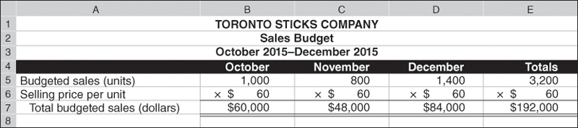
Sales Budget
Example: TSC sold 700 hockey sticks at $60 per unit. After considering sales predictions and market conditions, TSC prepares its sales budget for the next three months.
P 1
Notes:
In September of 2015, TSC sold 700 hockey sticks at $60 per unit. After considering sales predictions and market conditions, TSC prepares its sales budget for the next three months. The Sales budget will include forecasts of both unit sales and unit prices.
Using this pricing information and the forecasted unit sales for the colder months of the fall season, the sales budget for the remaining three months of the year can be prepared.

Slide 18
2) Production Budget
A manufacturer prepares a production budget, which shows the number of units to be produced in a period.
The production budget is based on the unit sales projected in the sales budget, along with inventory considerations.
Note: A production budget does not show costs; it is always expressed in units of product.
P 1
Notes:
A manufacturer prepares a production budget, which shows the number of units to be produced in a period.
The production budget is based on the unit sales projected in the sales budget, along with inventory considerations.
This slide depicts the general computation for the production required for a period. We start with budgeted ending inventory. Then, we add the budgeted sales units for the period which came from the Sales budget. This will give us the required units needed for the period. Then, we subtract the number of units in beginning inventory and we are left with the total units to be produced in the period.
A production budget does not show costs; it is always expressed in units of product.

Slide 19
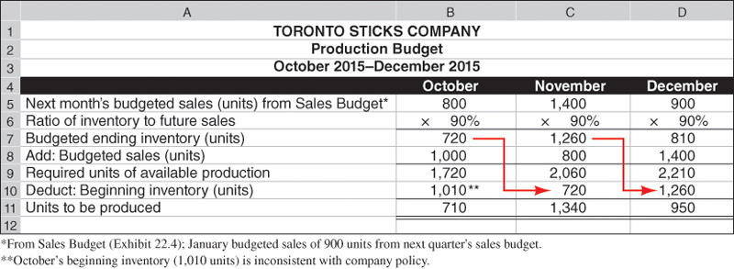
Production Budget
The production budget is based on the unit sales projected in the sales budget, along with inventory considerations.
P 1
Notes:
The production budget for Toronto Sticks Company (TSC) is prepared next. Manufacturing companies, like TSC, prepare a production budget, which shows the number of units to be produced in a period. The production budget is based on the unit sales projected in the sales budget, along with inventory considerations.
The first three lines of TSC’s production budget determine the budgeted ending inventories (in units). Budgeted unit sales are then added to the budgeted ending inventory to give the required units of production. We then subtract beginning inventory to determine the budgeted number of units to be produced. The information about units to be produced provides the basis for manufacturing budgets for the production costs of those units—direct materials, direct labor, and overhead.

Slide 20
NEED-TO-KNOW 7-1
A manufacturing company predicts sales of 220 units for May and 250 units for June. The company wants
each month’s ending inventory to equal 30% of next month’s predicted unit sales. Beginning inventory for
May is 66 units.
Compute the company’s budgeted production in units for May.
Budgeted ending inventory for May
75
30% of 250 (June’s expected sales)
Plus: Budgeted sales for May
220
Required units of available production
295
Less: Beginning inventory (units)
(66)
Total units to be produced
229
P 1
Notes:
A manufacturing company predicts sales of 220 units for May and 250 units for June. The company wants each month’s ending inventory to equal 30% of next month’s predicted unit sales. Beginning inventory for May is 66 units. Compute the company’s budgeted production in units for May.
The budgeted ending inventory for May equals 30% of 250 units, June's expected sales. 75 units need to be on hand as of May 31.
They also need to produce enough units to cover the budgeted sales for May, 220 units. The total required units of available production is 295.
We subtract the number of units that are already on hand in beginning inventory, 66, to calculate the total number of units to be produced, 229.

Slide 21
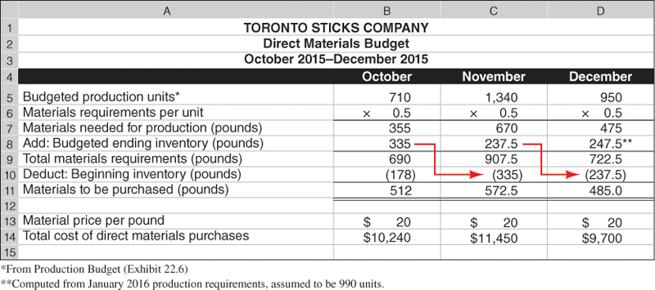
A - Direct Materials Budget
The direct materials budget shows the budgeted costs for the direct materials that will need to be purchased to satisfy the estimated production for the period
P 1
Notes:
The direct materials budget shows the budgeted costs for the direct materials that will need to be purchased to satisfy the estimated production for the period. Whereas the production budget shows units to be produced, the direct materials budget translates the units to be produced into budgeted costs. It is based on the budgeted production volume from the production budget. The direct materials budget for Toronto Sticks company is shown on your screen. The direct materials budget is driven by the budgeted materials needed to satisfy each month’s production requirement. This budget begins with the budgeted production, taken directly from the production budget. Next, TSC needs to know the amount of direct materials needed for each of the units to be produced—in this case, half a pound (.5) of wood. With these two inputs we can now compute the amount of direct materials needed for production. For example, to produce 710 hockey sticks in October, TSC will need 355 pounds of wood (710 units x 0.5 lbs. = 355 lbs.). The company then needs to consider its safety stock of direct materials. TSC has determined that it wants to have a safety stock of direct materials on hand at the end of each month to complete 50% of the budgeted units to be produced in the next month. Since TSC expects to produce 1,340 units in November, requiring 670 pounds of materials, it needs ending inventory of direct materials of 335 pounds (50% x 670) at the end of October. TSC’s total direct materials requirement for October is therefore 690 pounds (355 + 335). Since TSC already has 178 pounds of direct materials in its beginning inventory it deducts the amount of direct materials that were in beginning inventory from the total materials requirements for the month. For October, the calculation is 690 pounds - 178 pounds, resulting in the need for 512 pounds of direct materials to be purchased in October.
The direct materials budget next translates the pounds of direct materials to be purchased into budgeted costs. TSC estimates that the cost of direct materials will be $20 per pound over the quarter. At $20 per pound, purchasing 512 pounds of direct materials for October production will cost $10,240.

Slide 22
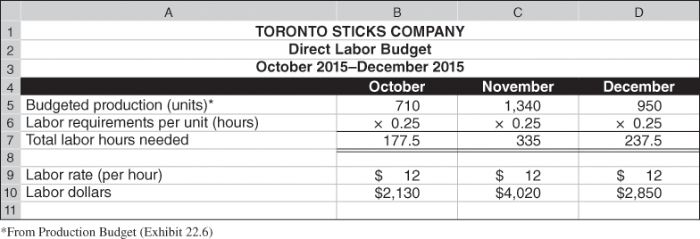
B - Direct Labor Budget
The direct labor budget shows the budgeted costs for the direct labor that will be needed to satisfy the estimated production for the period.
P 1
Notes:
The direct labor budget shows the budgeted costs for the direct labor that will be needed to satisfy the estimated production for the period. About 15 minutes (one-fourth of an hour) of labor time is required to produce one unit. Labor is paid at the rate of $12 per hour. Budgeted labor hours are computed by multiplying the budgeted production level for each month by one-quarter (0.25) of an hour. Direct labor cost is then computed by multiplying budgeted labor hours by the labor rate of $12 per hour.

Slide 23
NEED-TO-KNOW 7-2
A manufacturing company budgets production of 800 units during June and 900 units during July. Each
unit of finished goods requires 2 pounds of direct materials, at a cost of $8 per pound. The company maintains
an inventory of direct materials equal to 10% of next month’s budgeted production. Beginning direct
materials inventory for June is 160 pounds. Each finished unit requires 1 hour of direct labor at the rate of
$14 per hour.
Compute the budgeted (a) cost of direct materials purchases for June and (b) direct labor cost for June.
Budgeted production (units)
800
Materials requirements per unit (lbs.)
2
Materials needed for production (lbs.)
1,600
Add: Budgeted ending inventory (lbs.)
180
(July production of 900 units x 2 lbs. per unit x 10%)
Total materials requirements (lbs.)
1,780
Less: Beginning inventory (lbs.)
(160)
Materials to be purchased (lbs.)
1,620
Material price per pound
$8
Total cost of direct materials purchases
$12,960
Budgeted production (units)
800
Labor requirements per unit (hrs.)
1
Total direct labor hours needed
800
Labor rate (per hour)
$14
Total cost of direct labor
$11,200
P 1
Notes:
A manufacturing company budgets production of 800 units during June and 900 units during July. Each unit of finished goods requires 2 pounds of direct materials, at a cost of $8 per pound. The company maintains an inventory of direct materials equal to 10% of next month’s budgeted production. Beginning direct materials inventory for June is 160 pounds. Each finished unit requires 1 hour of direct labor at the rate of $14 per hour.
Compute the budgeted (a) cost of direct materials purchases for June and (b) direct labor cost for June.
The company requires 800 units to be produced during June. Each unit will require 2 pounds of direct materials.
The company requires a total of 1,600 pounds of direct materials for the current month's production.
They also require an ending inventory equal to 10% of next month's budgeted production.
July's production of 900 units multiplied by 2 pounds per unit, 1,800 pounds, multiplied by 10% is 180 pounds in ending inventory.
Total materials requirements, 1,780 pounds.
We subtract the number of pounds in beginning inventory, 160, to calculate the number of pounds to be purchased, 1,620.
Each pound of direct materials costs $8.
The total cost of direct materials purchases, 1,620 pounds at $8 per pound, is a total cost of $12,960.
Budgeting the direct labor cost is simpler, as there is no beginning or ending inventory of labor hours to consider.
The budgeted production in units is 800. Each of the 800 units requires 1 hour of direct labor, a total of 800 direct labor hours are required.
We multiply by the labor rate, $14 per hour, to calculate the total cost of direct labor, $11,200.

Slide 24
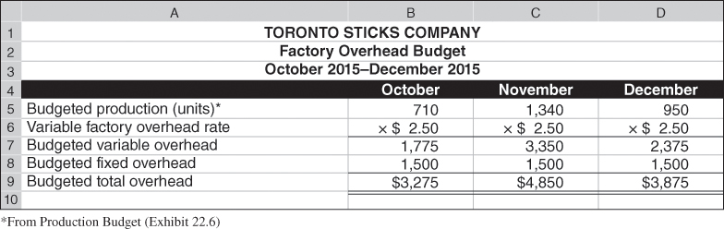
C - Factory Overhead Budget
The factory overhead budget shows the budgeted costs for factory overhead that will be needed to complete the estimated production for the period.
The variable portion of factory overhead is assigned at the rate of $2.50 per unit of production. The fixed overhead is $1,500 per month.
P 1
Notes:
The factory overhead budget shows the budgeted costs for factory overhead that will be needed to complete the estimated production for the period. TSC’s factory overhead budget is shown on your screen. TSC separates variable and fixed overhead costs in its overhead budget, as do many companies. The variable portion of factory overhead is assigned at the rate of $2.50 per unit of production. The fixed overhead is $1,500 per month.

Slide 25
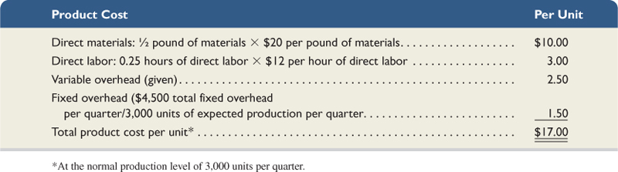
Product Cost Per Unit
With the information from the three manufacturing budgets (direct materials, direct labor, and factory overhead), we can compute TSC’s product cost per unit.
For budgeting purposes, TSC assumes it will normally produce 3,000 units of product each quarter, yielding fixed overhead of $1.50 per unit. TSC’s other product costs are all variable.
P 1
Notes:
With the information from the three manufacturing budgets (direct materials, direct labor, and factory overhead), we can compute TSC’s product cost per unit. This is useful in computing cost of goods sold and preparing a budgeted income statement, as we show later. For budgeting purposes, TSC assumes it will normally produce 3,000 units of product each quarter, yielding fixed overhead of $1.50 per unit. TSC’s other product costs are all variable. This slide summarizes the product cost per unit calculation.

Slide 26

3) Selling Expense Budget
The selling expense budget is an estimate of the types and amounts of selling expenses expected during the budget period.
TSC pays sales commissions equal to 10 percent of total sales.
TSC pays a monthly salary of $2,000 to its sales manager.
Let’s prepare the selling expense budget for
Toronto Sticks Company.
P 1
Notes:
The selling expense budget is an estimate of the types and amounts of selling expenses expected during the budget period. It is usually prepared by the vice president of marketing or an equivalent sales manager. Budgeted selling expenses are based on the sales budget, plus a fixed amount of sales manager salaries.
We use the sales budget to prepare a selling expense budget for TSC. Sales commissions are variable, based on a percentage of sales revenue. The sales manager’s salary is a fixed expense.

Slide 27
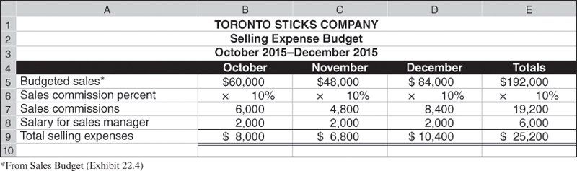
Selling Expense Budget
From TSC’s sales budget
TSC pays sales commissions equal to 10 percent of total sales.
TSC pays a monthly salary of $2,000 to its sales manager.
P 1
Notes:
We begin the selling expense budget with sales revenues amounts taken from the sales budget. Next, we compute sales commissions for each month by multiplying sales revenue for each month times 10 percent. The sales manager’s salary of $2,000 per month is then added to sales commissions to get the total selling expense for each month.

Slide 28

4) General and Administrative
Expense Budget
The general and administrative expense budget plans the predicted operating expenses not included in the selling expenses or manufacturing budgets.
Toronto Sticks Company has general and administrative salaries of $54,000 per year or $4,500 per month.
Let’s prepare the general and administrative
expense budget for TSC.
P 1
Notes:
The general and administrative expense budget plans the predicted operating expenses not included in the selling expenses or manufacturing budgets. These expenses may be either variable or fixed with respect to sales volume. The office manager responsible for general administration often is responsible for preparing the general and administrative expense budget.
Toronto Sticks Company’s general and administrative expense budget includes salaries of $54,000 per year, or $4,500 per month. Let’s see what their general and administrative expense budget looks like.

Slide 29
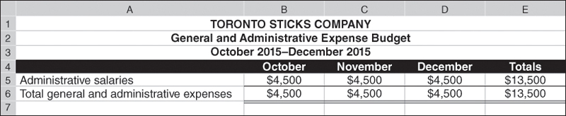
General and Administrative
Expense Budget
Toronto Sticks Company has general and administrative salaries of $54,000 per year or $4,500 per month.
P 1
Notes:
The general and administrative expense budget for each month is the administrative salaries of $4,500. The total amount is the same each month since the amount is a fixed expense.

Slide 30
NEED-TO-KNOW 7-3
A manufacturing company budgets sales of $70,000 during July. It pays sales commissions of 5% of sales
and also pays a sales manager a salary of $3,000 per month. Other monthly costs include depreciation on
office equipment ($500), insurance expense ($200), advertising ($1,000), and office manager salary of
$2,500 per month. For the month of July, compute the total (a) budgeted selling expense and (b) budgeted
general and administrative expense.
Budgeted selling expense
Total
Sales commissions
($70,000 x 5%)
$3,500
Sales manager's salary
3,000
Advertising expense
1,000
Total budgeted selling expense
$7,500
Budgeted general and administrative expense
Total
Depreciation on office equipment
$500
Insurance expense
200
Office manager's salary
2,500
Total budgeted and administrative expense
$3,200
P 1
Notes:
A manufacturing company budgets sales of $70,000 during July. It pays sales commissions of 5% of sales and also pays a sales manager a salary of $3,000 per month. Other monthly costs include depreciation on office equipment ($500), insurance expense ($200), advertising ($1,000), and office manager salary of $2,500 per month. For the month of July, compute the total (a) budgeted selling expense and (b) budgeted general and administrative expense.
Selling expenses are costs that are targeting the customer, vs. general and administrative expenses which are non-customer related.
Sales commissions are selling expenses. 5% of $70,000 is $3,500.
The sales manager's salary is also a selling expense.
Depreciation on office equipment is non-customer related; it's considered a general and administrative expense.
Insurance expense is also considered general and administrative expense.
Advertising expense is customer related; it's included as part of the budgeted selling expense.
And the office manager's salary is a general and administrative expense.
Total budget selling expenses; $7,500.
Total budgeted general and administrative expense; $3,200.

Slide 31
II - CAPITAL EXPENDITURES Budgets

Slide 32
Capital Expenditures Budget
The capital expenditures budget shows dollar amounts estimated to be spent to purchase additional plant assets the company will use to carry out its budgeted business activities.
TSC does not anticipate disposal of any plant assets through December 2015, but management is planning to acquire additional equipment for $25,000 cash in December 2015.
It also shows any amounts expected to be received from plant asset disposals, as companies replace old assets with new ones.
*Since this is the only budgeted capital expenditure for the quarter, no separate budget is shown.
P 1
Notes:
The capital expenditures budget lists dollar amounts to be received from plant asset disposals and spent on additional plant assets. Since TSC only plans one capital expenditure of $25,000 and no disposals of plant assets, this information will be incorporated into the cash budget.

Slide 33
III - Cash Budget

Slide 34
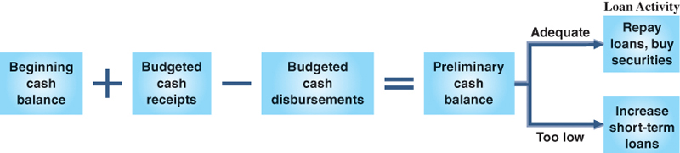
Cash Budgets
After developing budgets for sales, manufacturing costs, expenses, and capital expenditures, the next step is to prepare the cash budget, which shows expected cash inflows and outflows during the budget period.
The general formula for a cash budget is:
The cash budget is especially important because it helps the company maintain a cash balance necessary to meet ongoing obligations.
P 2
Notes:
After developing budgets for sales, manufacturing costs, expenses, and capital expenditures, the next step is to prepare the cash budget, which shows expected cash inflows and outflows during the budget period. The cash budget is especially important because it helps the company maintain a cash balance necessary to meet ongoing obligations. Let’s prepare TSC’s budgets for cash receipts and cash disbursements.

Slide 35
Budgeted Cash Receipts (from Sales)
40% of TSC’s sales are for cash.
The remaining 60% are credit sales that are collected in full in the month following the sale.
Let’s prepare the cash receipts budget for TSC.
P 2
Notes:
Managers use the sales budget, combined with knowledge about how frequently customers pay on credit sales, to budget monthly cash receipts. Forty percent of TSC’s sales are for cash. The remaining 60 percent of sales are credit sales. None of the sales on account are collected in the month of sale. However they are expected to be collected in the month following the sale.

Slide 36
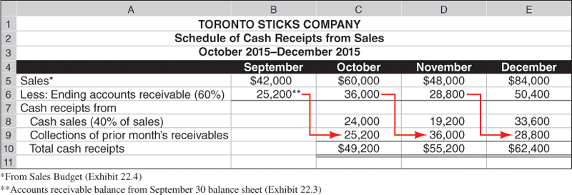
Budgeted Cash Receipts from Sales
Cash sales are 40%
of each month’s sales
From TSC’ sales budget
Accounts receivable balance at the end of each month is 60% of that month’s budgeted sales.
P 2
Notes:
We begin the cash receipts budget with sales revenues amounts taken from the sales budget. September sales revenue is included because 60 percent of September sales will be collected in October.
The accounts receivable balance at the end of each month is 60 percent of that month’s budgeted sales. Cash sales are 40 percent of each month’s sales.
The accounts receivable balance at the end of each month is collected in full during the next month. Cash sales are added to accounts receivable collections to get total cash receipts for the month.
We now can compute the budgeted cash receipts from customers, as shown in the table on this slide. October’s budgeted cash receipts consist of $24,000 from expected cash sales ($60,000 x 40%) plus the anticipated collection of $25,200 of accounts receivable from the end of September.

Slide 37

Cash Payments for Materials
Managers use the beginning balance sheet and the direct materials budget prepared earlier, to help prepare a schedule of cash disbursements for materials.
TSC’s purchases of materials are entirely on account.
Full payment is made in the month following the purchase.
Let’s look at the schedule of cash payments
for materials for TSC.
P 2
Notes:
We’re now ready to prepare the cash payments for materials budget. Managers use the beginning balance sheet and the direct materials budget prepared earlier, to help prepare a schedule of cash disbursements for materials. Managers must also know how TSC purchases direct materials (pay cash or on account), and for credit purchases, how quickly TSC pays.
TSC’s materials purchases are entirely on account. It makes full payment during the month following its purchases. Using this information, the schedule of cash payments for materials can be prepared. Let’s take a look at it on the next slide.

Slide 38
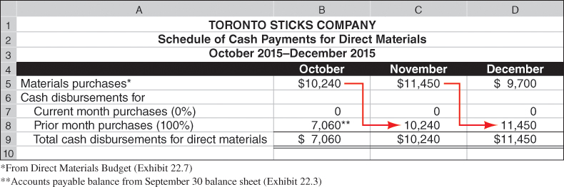
Cash Payments for Direct Materials
TSC’s purchases of materials are entirely on account.
Full payment is made in the month following the purchase.
From direct materials budget
P 2
Notes:
Remember that TSC’s materials purchases are entirely on account. It makes full payment during the month following its purchases. We start with the direct materials budget and that budget told TSC to purchase $10,240 of materials in October. But none of these purchases will be paid for this month—instead those material costs end up in November’s column.. We then add the balance owed from the previous month’s purchases (September) of $7,060. The total cash disbursements for direct materials in October, is $7,060.

Slide 39
Preparing the Cash Budget
Beginning
Cash
Balance
Budgeted
Cash Receipts
Budgeted
Cash Disbursements
Preliminary
Cash
Balance
+
–
=
If adequate, repay loans or buy securities.
If inadequate, increase short-term loans.
Additional information for TSC’s cash budget:
  Has a September 30 cash balance of $20,000.
  Will pay a cash dividend of $3,000 in November.
Continue
P 2
Notes:
Now that we have completed the following budgets: cash receipts from sales budget, cash payments for direct materials, cash payments for direct labor, cash payments for variable overhead, cash payments for selling expenses and cash payments for general and administrative expenses, we are ready to complete the cash budget. When preparing a cash budget, we add expected cash receipts to the beginning cash balance and deduct expected cash disbursements. If the expected ending cash balance is inadequate, additional cash requirements appear in the budget as planned increases from short-term loans. If the expected ending cash balance exceeds the desired balance, the excess is used to repay loans or to acquire short-term investments.
Some additional events affecting TSC’s cash are displayed on your screen. You may need to make a few notes from this information to keep from referring back to this screen as we use this information. We will continue with the additional information on the next slide.

Slide 40
Cash Budget
Toronto Sticks Company:
  Has an income tax liability of $20,000 from the previous quarter that will be paid in October.
  Will purchase $25,000 of equipment in December.
  Has an agreement with its bank for loans at the end of each month to enable a minimum cash balance of $20,000.
  Pays interest each month equal to one percent of the prior month’s ending loan balance.
  Repays loans when the ending cash balance exceeds $20,000.
  Owes $10,000 on this loan arrangement on September 30.
  Has 40 percent income tax rate.
  Will pay taxes for current quarter next year.
P 2
Notes:
Here is the remainder of the information needed to complete TSC’s cash budget. Again, you my find it helpful to take a few notes summarizing this information.

Slide 41
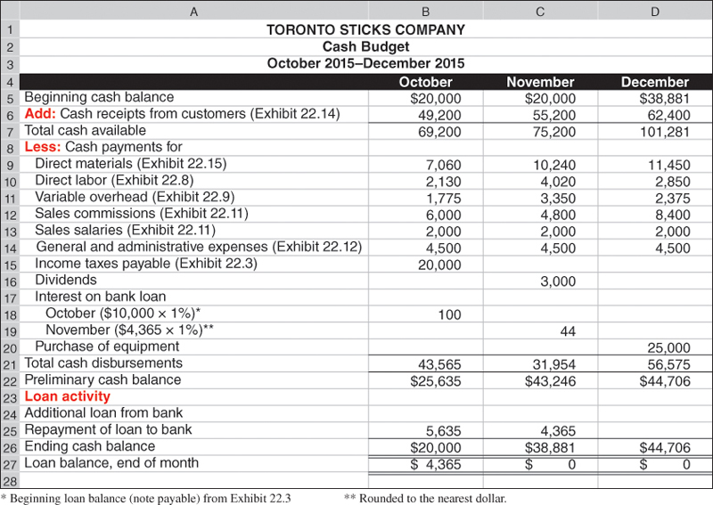
From Cash Receipts Budget
TSC’s cash balance at the beginning of October is $20,000. Budgeted cash receipts for October are $49,200, resulting in a total of $69,200 available for the month.
Now we are ready to look at TSC’s cash disbursements
P 2
Notes:
We begin the cash budget with October. TSC’s cash balance at the beginning of October is $20,000. Budgeted cash receipts for October are $49,200, resulting in a total of $69,200 available for the month.
Now we are ready to look at TSC’s cash disbursements.

Slide 42
We next subtract expected cash payments for direct materials, direct labor, overhead, selling expenses, and general and administrative expenses.
Income taxes of $20,000 were due as of the end of September 30, 2015, and payable in October.
P 2
Notes:
We next subtract expected cash payments for direct materials, direct labor, overhead, selling expenses, and general and administrative expenses. Income taxes of $20,000 were due as of the end of September 30, 2015, and payable in October.
Now we are ready to use some of the additional information affecting cash. Let’s take a look at the next slide.

Slide 43
TSC has a dividend payment of $3,000 that it plans to pay in November.
TSC has a $10,000 loan and pays interest at the rate of one percent per month. October’s interest is $100.
P 2
Notes:
TSC has a $10,000 loan and pays interest at the rate of one percent per month. The preliminary cash balance for October is $25,635. TSC has a dividend payment of $3,000 that it plans to pay in November.

Slide 44
TSC has an agreement with its bank for loans at the end of each month to provide a minimum cash balance of $20,000. If the cash balance exceeds $20,000 at a month-end, as it does here, TSC uses the excess to repay loans.
P 2
Notes:
TSC has an agreement with its bank for loans at the end of each month to provide a minimum cash balance of $20,000. If the cash balance exceeds $20,000 at a month-end, TSC uses the excess to repay loans. If the cash balance is less than $20,000 at month-end, the bank loans TSC the difference. At the end of each month, TSC pays the bank interest on any outstanding loan amount, at the monthly rate of 1% of the beginning balance of these loans. For October, this payment is 1% of the $10,000 note payable amount reported on its balance sheet.
Based on our cash budget for the month of October, the preliminary cash balance increases to $25,635 (before any loan-related activity). This amount is more than the $20,000 minimum. Thus, TSC will pay off $5,635 of its outstanding loan.

Slide 45
Ending cash balance for October
is the beginning November balance.
TSC interest on it’s outstanding loan amount in November is $44.
P 2
Notes:
The expected loan repayment of $5,635 is deducted from the preliminary cash balance in October. October’s ending cash balance of $20,000 becomes the beginning cash balance in November.
For November, TSC expects to pay interest of $44, computed as 1% of the $4,365 expected loan balance at October 31. No interest is budgeted for December because the company expects to repay the loans in full at the end of November.

Slide 46
One last item, before our cash budget is complete…TSC plans to pay $25,000 in December to purchase new equipment.
P 2
Notes:
The cash budget is completed with the December cash information. TSC plans to pay $25,000 in December to purchase new equipment. This large cash disbursement will reduce the December preliminary cash balance to $56,575 and leave an ending cash balance in December of $44,706.

Slide 47
Budgeted Financial Statements

Slide 48
Budgeted Income Statement
The budgeted income statement is a managerial accounting report showing predicted amounts
of sales and expenses for the budget period.
Cash
Budget
Budgeted
Income
Statement
Completed
Let’s prepare the budgeted income
statement for Toronto Sticks Company.
P 3
Notes:
Now that we have completed the cash budget, we are ready to prepare a budgeted income statement for the quarter. The budgeted income statement is a managerial accounting report showing predicted amounts of sales and expenses for the budget period. It summarizes the income effects of the budgeted activities. Information needed to prepare a budgeted income statement is primarily taken from already-prepared budgets. Let’s look at the budgeted income statement for Toronto Sticks Company.

Slide 49
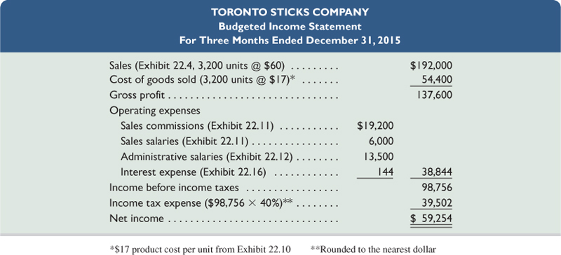
Budgeted Income Statement
All information in this budgeted income statement is taken from the component budgets we’ve examined on previous slides.
The predicted amount of income tax expense for the quarter, computed as 40% of the budgeted pretax income, is included.
P 3
Notes:
TSC’s condensed budgeted income statement is shown on this slide. All information in this statement is taken from the component budgets we’ve examined on previous slides. Also, we now can predict the amount of income tax expense for the quarter, computed as 40% of the budgeted pretax income. For TSC, these taxes are not payable until January 31, 2016. Thus, these taxes are not shown on the October–December 2015 cash budget. We can now move on to the budgeted balance sheet.

Slide 50
Budgeted Balance Sheet
The budgeted balance sheet shows predicted amounts for the company’s assets, liabilities, and
equity as of the end of the budget period.
Budgeted
Income
Statement
Budgeted
Balance
Sheet
Completed
Let’s prepare the budgeted balance
sheet for Toronto Sticks Company.
P 3
Notes:
Now that we have completed the income statement for the quarter, we can prepare the balance sheet. The final step in preparing the master budget is summarizing the company’s financial position. The budgeted balance sheet shows predicted amounts for the company’s assets, liabilities, and equity as of the end of the budget period.

Slide 51
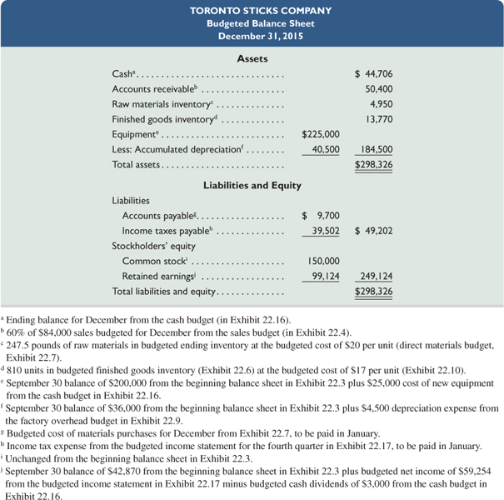
Budgeted Balance Sheet
The budgeted balance sheet for TSC is prepared using
information from the other budgets.
P 3
Notes:
TSC’s budgeted balance sheet is shown on this slide. It is prepared using information from the other budgets.

Slide 52

Global View
Royal Phillips Electronics of the Netherlands is a diversified company. Preparing budgets and evaluating progress helps the company achieve its goals. In a recent annual report, the company reports that it budgets sales to grow at a faster pace than overall economic growth. Based on this sales target, company managers prepare detailed operating, capital expenditures, and financial budgets.
Budgeted and actual results of companies that do business globally are impacted by changes in foreign currency exchange rates as well as global and political uncertainties. Forecasting in that environment is difficult.
Notes:
Royal Phillips Electronics of the Netherlands is a diversified company. Preparing budgets and evaluating progress helps the company achieve its goals. In a recent annual report, the company reports that it budgets sales to grow at a faster pace than overall economic growth. Based on this sales target, company managers prepare detailed operating, capital expenditures, and financial budgets.
Budgeted and actual results of companies that do business globally are impacted by changes in foreign currency exchange rates as well as global and political uncertainties. Forecasting in that environment is difficult.

Slide 53
Activity- Based Budgeting

Slide 54
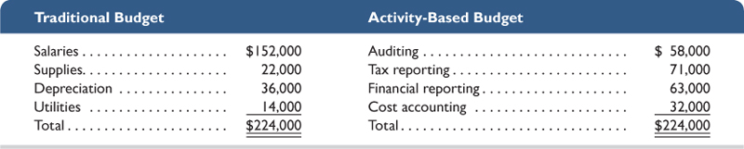
Activity-Based Budgeting
Activity-based budgeting is based on activities rather than traditional items such as salaries, supplies, depreciation, and utilities.
Accounting Department
Comparison of Activity-Based Budget with Traditional Budget
An understanding of the resources required to perform the activities, the costs associated with these resources, and the way resource use changes with changes in activity levels allows management to better assess how expenses will change to accommodate changes in activity levels.
A 1
Notes:
Activity-based budgeting is based on expected activities instead of the traditional budget categories that we normally see. Activity-based budgets enable management to more easily plan resource consumption to match related changes in activity.
Traditional budgeting systems list items such as salaries, supplies, equipment, and utilities. With a traditional budget, management often makes across-the-board budget cuts or increases. For example, management might decide that each of the line items in the traditional budget must be cut by 5%. This might not be a good strategic decision.
In contrast, ABB requires management to list activities performed by, say, the accounting department such as auditing, tax reporting, financial reporting, and cost accounting. An understanding of the resources required to perform the activities, the costs associated with these resources, and the way resource use changes with changes in activity levels allows management to better assess how expenses will change to accommodate changes in activity levels.

Slide 55
Homework assignment
Using Connect – 7 Questions for 60 Points; Chapter 7.
Prepare chapter 8 “Flexible Budgets and Standard Costs.”
Happiness is having all homework up to date

Slide 56
Thank you and See You Next week at the Same Time, Take Care

Slide 57
7A-P4 (Appendix): Merchandise Purchases Budget

Slide 58
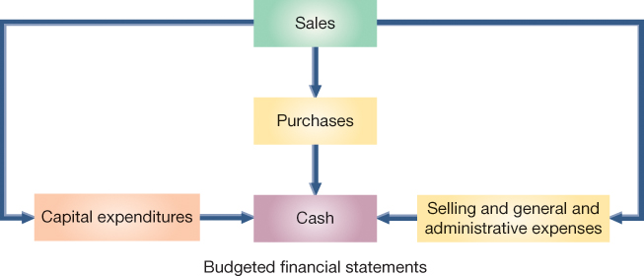
Merchandise Purchases Budget
Unlike a manufacturing company, a merchandiser must prepare a merchandise purchases budget rather than a production budget.
Example: Let’s look at the merchandise purchases budget for Hockey Den (HD), a retailer of hockey sticks…
P 4
Notes:
Unlike a manufacturing company, a merchandiser must prepare a merchandise purchases budget rather than a production budget. In addition, a merchandiser does not prepare direct materials, direct labor, or factory overhead budgets. Let’s look at the merchandise purchases budget for Hockey Den (HD), a retailer of hockey sticks

Slide 59
Merchandise Purchases Budget
Example: Hockey Den buys hockey sticks for $60 each and maintains an ending inventory equal to 90 percent of the next month’s budgeted sales. On September 30, 1,010 hockey sticks are on hand.
The general layout for the purchases budget in equation form is:
Let’s prepare the purchases budget for Hockey Den.
P 4
Notes:
A merchandiser usually expresses a merchandise purchases budget in both units and dollars. The slide shows the general layout for this budget in equation form. If this formula is expressed in units and only one product is involved, we can compute the number of dollars of inventory to be purchased for the budget by multiplying the units to be purchased by the cost per unit.
Once we have completed the sales budget, we can prepare the merchandise purchases budget that will incorporate Hockey Den’s sales demand and inventory policy. To prevent potential stock-outs of inventory items, and to have a good selection of merchandise on hand for its customers, Hockey Den always wants its ending inventory for a month to be equal to 90 percent of the next month’s sales. On September 30, 1,010 of hockey sticks were on hand, an amount equal to 90 percent of hockey sticks budgeted for October sales.

Slide 60
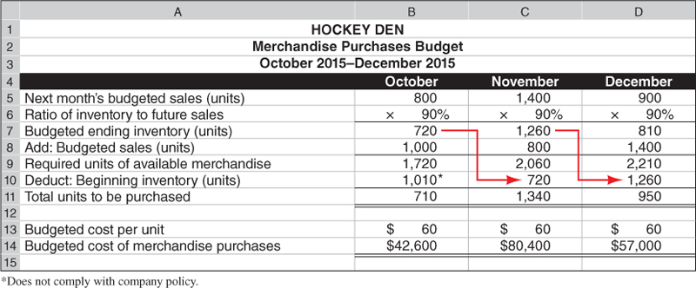
Merchandise Purchases Budget
Next we add the unit sales for each month to the desired ending inventory to get the total needs for each month.
From the sales budget.
Ending inventory for a month in units, should equal 90% of next month’s unit sales.
P 4
60
Notes:
We begin the purchases budget by computing the desired ending inventory for each of the three months. Recall that Hockey Den always wants its ending inventory for a month in units to be equal to 90 percent of the next month’s unit sales. The unit sales figures are from the sales budget.

Slide 61
Merchandise Purchases Budget
Required units of available merchandise.
Budgeted cost of the purchases, computed by:
number of units X cost per unit.
Subtract beginning inventory to determine the budgeted number of units to be purchased.
P 4
Notes:
After we calculate the required units of available merchandise. We then subtract beginning inventory to determine the budgeted number of units to be purchased. The last line is the budgeted cost of the purchases, computed by multiplying the number of units to be purchased by the predicted cost per unit.
Here’s our completed merchandise purchases budget. Notice that the ending inventory for each month becomes the beginning inventory for the next month.

Slide 62
NEED-TO-KNOW 7-4
In preparing monthly budgets for the third quarter, a company budgeted sales of 120 units for July and 140
units for August. Management wants each month’s ending inventory to be 60% of next month’s sales. The
June 30 inventory consists of 50 units, which does not comply with the company's inventory policy. How
many units should be purchased in July?
Next month's budgeted sales (units)
140
Ratio of inventory to future sales
60%
Budgeted ending inventory (units)
84
Add: Budgeted sales (units)
120
Required units of available merchandise
204
Deduct: Beginning inventory (units)
(72)
Units to be purchased
132
P 4
Notes:
In preparing monthly budgets for the third quarter, a company budgeted sales of 120 units for July and 140 units for August. Management wants each month’s ending inventory to be 60% of next month’s sales.
The June 30 inventory consists of 50 units, which does not comply with the company's inventory policy. How many units should be purchased in July?
At the end of July, the company wants to have ending inventory equal to 60% of August sales.
140 units budgeted to be sold in August multiplied by 60% is an ending inventory of 84 units.
The company must also have enough units on hand for the current month's sales, 120 units.
The required units of available merchandise is 204.
Since the company already has 72 units in beginning inventory, they only need to purchase the difference, 132 units.

