Slide 1
Welcome Back

Slide 2
Welcome Back
Time for Any Question

Slide 3
Homework assignment
Using Connect – 6 Questions for 60 Points; Chapter 8.
Prepare chapter 9 “Performance Measurement and Responsibility Accounting.”
Happiness is having all homework up to date

Slide 4
Chapter 09
Performance Measurement and

Slide 5
Chapter 09
Performance Measurement and Responsibility Accounting

Slide 6

Decentralization
Common ways to
decentralize organizations
By
Geography
By
Product
line
Notes:
Companies are divided into smaller units, called divisions, segments, departments, or subunits, when they become too large to be managed effectively as a single unit. In these decentralized organizations, decisions are made by managers throughout the company rather than by a few top executives. Common ways to decentralize organizations are by geography or product line (also called brand). In this section we discuss the motivation for and the advantages and disadvantages of decentralization. In later sections of this PowerPoint presentation, we will look at performance measurement in decentralized organizations.

Slide 7
Advantages of Decentralization
Providing lower-level managers with decision-making authority offers several advantages.
Timely
access to
information
Enables
top-level
managers
to focus on
long-term
strategy
Good
training
for
employees
Boosts
employee
morale and
retention
Notes:
Many companies are so large and complex that they are broken into separate divisions for efficiency and/or effectiveness purposes. Providing lower-level managers with decision-making authority offers several advantages:
Lower-level managers have timely access to detailed information about their departments.
Providing lower-level managers with authority to make day-to-day decisions for their departments enables top-level managers to focus more on long-term strategy for the entire organization.
Managing a division can be good training for employees who later might be promoted to top-level management.
Having decision-making authority often boosts employee morale and retention.

Slide 8
Disadvantages of Decentralization
Decentralization has potential disadvantages which organizations should consider:
Department
managers
are too
focused
on own
department
Decisions
of individual
departments
might conflict
with one
another
Departments
might
duplicate
certain
activities
Notes:
Decentralization has potential disadvantages which organizations should consider:
Because they are so focused on their own department, department managers might make decisions that do not reflect the organization’s overall strategy.
When an organization has several departments, the decisions of individual departments might conflict with one another.
Departments might duplicate certain activities, for example, payroll accounting or purchasing.

Slide 9
Performance Evaluation
The accounting system provides information about resources used and outputs achieved. Managers use this information to control operations, appraise performance, allocate resources, and plan strategy. The type of accounting information provided depends on whether the department is a . . .
Cost
center
Profit
center
Investment
center
Evaluated on
ability to
control costs.
Evaluated on ability
to generate revenues
in excess of expenses.
Evaluated on ability
to generate return on investment in assets.
Notes:
All departments, whether production, sales, or service, use resources to achieve a desired output. If our decentralized accounting system is properly designed and implemented, we can control operations, appraise performance, allocate resources, and plan strategy. One of top management’s objectives for this type of system is to be able to allocate more resources to those departments who are performing at the highest level.
Financial information used to evaluate a department depends on whether it is evaluated as a cost center, profit center, or investment center. Cost centers incur costs without directly generating revenues. Cost centers are evaluated on their ability to control costs. Profit center managers are judged on their ability to generate revenues in excess of the profit center’s costs. In addition to generating revenues and controlling costs, investment center managers make asset investment decisions and are evaluated based on the investment return on those investments.
A responsibility accounting system can be set up to control costs and evaluate managers’ performance by assigning costs to the managers responsible for controlling them. We will look at responsibility accounting and cost control in the next section of this presentation.

Slide 10
Controllable versus
Uncontrollable Costs
A cost is controllable if a manager has the power to determine or at least significantly affect the amount incurred.
Uncontrollable costs
are not within the manager’s control or influence.
Supplies used in the manager’s department
The department manager’s own salary
Notes:
A manager’s performance using responsibility accounting reports should be evaluated using costs that the manager can control. A cost is controllable if a manager has the power to determine or at least significantly affect the amount incurred. Uncontrollable costs are not within the manager’s control or influence. For example, department managers rarely control their own salaries. However, they can control or influence items such as the cost of supplies used in their department.
Distinguishing between controllable and uncontrollable costs often depends on the level of management and the time period under analysis. For example, the cost of property insurance is usually not controllable at lower levels of management, especially in the short term. However, in the long term, management executives can make decisions to change insurance coverage contracts. All costs are controllable at some management level if the time period is sufficiently long.

Slide 11
Responsibility Accounting

Slide 12
Responsibility Accounting System
An accounting system that
provides information . . .
Relating to the
responsibilities of
individual managers.
To evaluate
managers on
controllable items.
P 1
Notes:
A responsibility accounting system uses the concept of controllable costs to evaluate a manager’s performance. Responsibility for controllable costs is clearly defined and performance is evaluated based on the ability to manage and control those costs. Prior to each reporting period, a company prepares plans that identify costs and expenses under each manager’s control. These responsibility accounting budgets are typically based on the flexible budgeting approach covered in chapter 8.

Slide 13
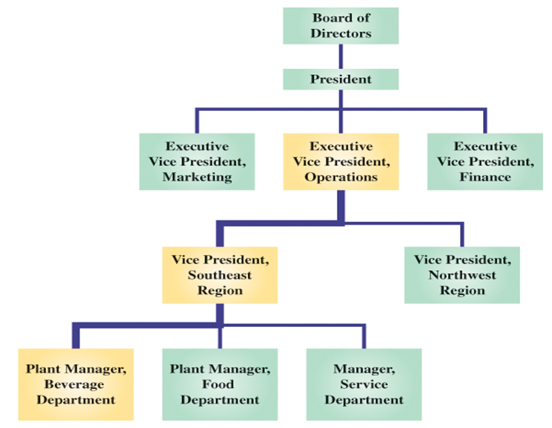
Successful implementation of responsibility accounting may use organization charts with clear lines of authority and clearly defined levels of responsibility.
P 1
Notes:
A responsibility accounting system makes use of organizational charts to determine lines of authority and levels of responsibility. Performance reports for low-level management typically cover few controllable costs. Responsibility and control broaden for higher-level managers; therefore, their reports span a wider range of costs. The lines in this chart connecting the managerial positions reflect channels of authority.

Slide 14
Responsibility Accounting
Performance Reports
Amount of detail varies according to the level in the organization.
A store manager receives summarized information from each department.
A department manager
receives detailed reports.
P 1
Notes:
The amount of detail in performance reports varies according to the level in the organization. The number of controllable costs reported varies across management levels. At lower levels, managers have limited responsibility and thus few controllable costs. Responsibility and control broaden for higher-level managers; therefore, their reports span a wider range of costs. In general, lower-level managers receive detailed reports, but the level of detail decreases at higher levels. Top management receives reports that are highly summarized. If a problem arises, top management can request greater detail to look into the problem.

Slide 15
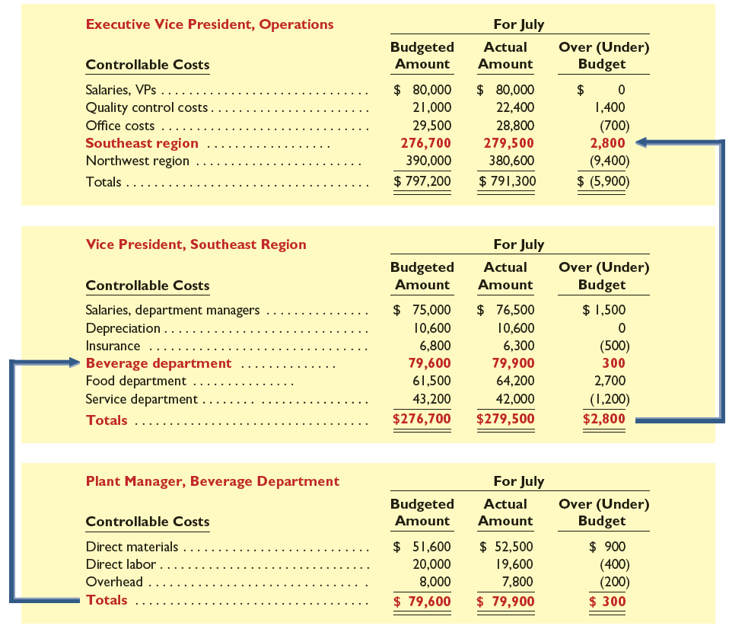
Responsibility Accounting Performance Reports
P 1
Notes:
Exhibit 9.2 shows summarized performance reports for three management levels. The beverage department is a cost center, and its manager is responsible for controlling costs. This exhibit shows that costs under the control of the beverage department plant manager are totaled and included among the controllable costs of the VP of the Southeast region. Costs under the control of the VP are totaled and included among the controllable costs of the EVP of operations. In this way, responsibility accounting reports provide relevant information for each management level. A good responsibility accounting system makes every effort to provide relevant information to the right person (the one who controls the cost) at the right time (before a cost is out of control).

Slide 16
Direct and Indirect Expenses

Slide 17
Direct and Indirect Expenses
Direct expenses are
incurred for the sole
benefit of a specific
department.
Salary of employee who works in only one department.
Indirect expenses
benefit more than one
department and are
allocated among
departments benefited.
Multiple departments share rent, electricity, and heat.
C 1
Notes:
Direct expenses can be readily traced to one department. They are incurred for the sole benefit of one department. A good example of a direct expense is the salary of an employee who works in only one department. Indirect expenses cannot be traced to one department because they are incurred for the benefit of two or more departments. For example, if two or more departments share a single building, all enjoy the benefits of the expenses for rent, heat, and light. Since we cannot trace indirect expenses to individual departments, we must allocate them to departments on the basis of the relative benefits each department receives from the shared indirect expenses. Ideally, we allocate indirect expenses by using a cause-effect relation.

Slide 18
Illustration of Indirect
Expense Allocation, Exhibit 9.3
Classic Jewelry pays its janitorial service $800 per month to clean its store. Management allocates this cost to its three departments according to the floor space each occupies.
C 1
Notes:
Classic Jewelry has three departments in one store location, Jewelry, Watch repair, and China and silver. Janitorial services to clean the store cost $800 per month. Classic Jewelry allocates the $800 janitorial cost based on the square footage of each department.
First, we add the square footage in each department to get a total of 4,000 square feet. Then, we divide the square footage in each department by this total to get the allocation percentages. Last, we multiply the allocation percentages times the janitorial cost of $800 to get the amount allocated to each department. For example, the allocation percentage for Jewelry is 2,400 square feet divided by 4,000 square feet, which equals 60 percent. Now, we multiply 60 percent times $800 to get the $480 that is allocated to the Jewelry Department.

Slide 19
Allocation of Indirect Expenses

Slide 20
Allocation of Indirect Expenses
Indirect expenses can be allocated to departments
using a number of allocation bases. Some common indirect
expenses and their allocation bases are:
P 2
Notes:
Indirect expenses can be allocated to departments using a number of allocation bases. Some common indirect expenses and their allocation bases are shown on your screen.

Slide 21
Service Department Expenses
Service department costs are shared, indirect expenses that support the activities of two or more production departments.
Commonly used bases to allocate service department expenses include:
P 2
Notes:
To generate revenues, operating departments require support services provided by departments such as personnel, payroll, and purchasing. Such service departments are typically evaluated as cost centers because they do not produce revenues. A departmental accounting system can accumulate and report costs incurred by each service department for this purpose. The system then allocates a service department’s expenses to operating departments benefiting from them. This slide shows some commonly used bases for allocating service department’s expenses to operating departments. The Classic Jewelry example used square footage as the allocation base.

Slide 22
Departmental Income Statements

Slide 23
Departmental Income Statements
Let’s prepare departmental income statements using the following steps:
  Accumulating revenues and direct expenses by department.
  Allocating indirect expenses across departments.
  Allocating service department expenses to operating departments.
  Preparing departmental income statements.
P 3
Notes:
Now that we have discussed direct expenses and the allocation of indirect expenses, we are ready to put our knowledge to work by preparing departmental income statements. These statements are the primary tool for evaluating departmental performance. Before we prepare the departmental income statements, we must determine the expenses for each department using the first three steps of the four-step process that you see on your screen.
Step 1: Accumulating revenues and direct expenses by department.
Step 2: Allocating indirect expenses across departments.
Step 3: Allocating service department expenses to operating departments.
Step 4: Preparing departmental income statements.

Slide 24
Departmental Income Statements
Step 1: Accumulating revenues and direct expenses by department
Revenues and/or Direct expenses are traced
to each department without allocation.
Revenues and Direct Expenses
Direct Expenses
Direct Expenses
Revenues and Direct Expenses
Service
Dept.
(Cost Center) General Office
Service
Dept.
(Cost Center) Purchasing
Operating
Dept.
(Profit Center)
Hardware
Operating
Dept.
(Profit Center) Housewares
P 3
Notes:
Step One is to accumulate revenues and direct expenses by department. Recall that direct expenses are incurred for the sole benefit of one department. Note that two of the departments on your screen, the Hardware department and the Housewares department, are both operating departments, and two, the General Office and the Purchasing departments, are service departments. Service departments may have direct expenses, but no revenue. After we have accumulated all of the expenses in the service departments, we will allocate the total from each service department to the operating departments.

Slide 25
Departmental Income Statements
Step 2: Allocating indirect expense across departments
Indirect expenses are allocated to all departments
using appropriate allocation bases.
Allocation
Allocation
Allocation
Allocation
Service Dept.
(Cost Center) General Office
Service Dept.
(Cost Center) Purchasing
Operating
Dept.
(Profit Center)
Hardware
Operating
Dept.
(Profit Center) Housewares
P 3
Notes:
Step Two is the allocation of indirect expenses across departments. Indirect expenses can included items such as depreciation, rent, advertising, and any other expenses that cannot be directly assigned to a department. Indirect expenses are first recorded in company accounts. Then, an allocation base is identified for each expense, and costs are allocated using a departmental expense allocation spreadsheet. Now each department has a combination of direct expenses and allocated expenses.

Slide 26
Departmental Income Statements
Step 3: Allocating service department expenses to operating departments
Service department total expenses (original direct expenses + allocated indirect expenses) are
allocated to operating departments.
Service
Dept.
(Cost Center) General Office
Service
Dept.
(Cost Center) Purchasing
Allocation
Allocation
Operating
Dept.
(Profit Center)
Hardware
Operating
Dept.
(Profit Center) Housewares
P 3
Notes:
Step Three is the allocation of service department expenses to operating departments. The total expense to be allocated from each service department is made up of the service department’s direct expenses from step one and the allocated expenses from step two.
We will illustrate this three-step process using the Ames Hardware Company.

Slide 27
Departmental Expense Allocation Spreadsheet
Step 1: Direct expenses are traced to service departments and sales departments without allocation.
P 3
Notes:
Ames Hardware Company sells two hammer models, regular (Sales Department One) and deluxe (Sales Department Two). The company has two service departments, Service Department One and Service Department Two. Each department has direct expenses for salaries and supplies. In Step 1, we trace these direct expenses to the individual departments without allocation.

Slide 28
Departmental Expense Allocation Spreadsheet
Of a total of 2,000 square feet, the service departments occupy 200 square feet each, Sales Department One occupies 600 square feet, and Sales Department Two occupies 1,000 square feet.
Step 2: Indirect expenses are allocated to both the service and the sales departments based on floor space occupied.
Ex. 200 sq ft
2000 sq ft
P 3
X $10,000
= $1,000
Notes:
In Step 2, we allocate the company’s indirect expenses, rent and utilities, to both the service and the sales departments based on floor space occupied. The total floor space is 2,000 square feet. Both service departments occupy 200 square feet, or 10 percent of the total for each service department. Sales department one occupies 600 square feet, or 30 percent of the total. Sales department two occupies 1,000 square feet, or 50 percent of the total. We allocate the indirect expenses by multiplying the allocation percentage for each department times the total indirect expenses. For example, we allocate rent to service department one by multiplying ten percent times the $10,000 total rent to get $1,000. Last, we total all expenses, both direct and indirect for each service department to prepare for the allocation in Step 3. The total for service department one is $2,200 and the total for service department two is $3,400. You should verify the numbers in the spreadsheet on your screen by working through the allocations for the remaining indirect expenses.

Slide 29
Departmental Expense Allocation Spreadsheet
Sales department one has $40,000 in sales and sales department two has $48,000 in sales. Total sales = $88,000
Step 3: Service department total expenses (original direct expenses + allocated indirect expenses) are allocated to sales departments.
(In this example, based on sales dollars for each department)
Ex. $40,000 sales dept. one
$88,000 total sales
P 3
X $2,200
= $1,000
Notes:
In Step 3, we total the expenses for each service department and allocate the total to the operating departments. We will allocate the total expenses in service department one based on sales of the two sales departments, $40,000 for sales department one and $48,000 for sales department two.
To begin the allocation, we add the sales for the two sales departments to get a total of $88,000. Then we divide the sales in each sales department by this total to get the allocation percentage. The sales department one allocation percentage is computed by dividing $40,000 by the $88,000 total. Last, we multiply the allocation percentage for each sales department times the $2,200 indirect cost of service department one to get the amounts allocated, $1,000 to sales department one and $1,200 to sales department two. Again, you should verify the numbers in the spreadsheet on your screen by working through the allocations for service department one.

Slide 30
Departmental Expense Allocation Spreadsheet
Step 3 (cont.): Service department total expenses (original direct expenses + allocated indirect expenses) are allocated to sales departments.
(In this example, the allocation is based on number of employees.)
Sales department one has 28 employees and sales department two has 40 employees. Total employees = 68
Ex. 28 employees sales dept. one
68 total employees
P 3
X $3,400
= $1,400
Notes:
We will complete Step 3 by allocating the total expenses from service department two to each of the sales departments. We will allocate the total expenses in service department two based on the number of employees in each sales department, 28 employees for sales department one and 40 employees for sales department two.
To begin the allocation, we add the employees for the two sales departments to get a total of 68 employees. Then, we divide the number of employees in each sales department by this total to get the allocation percentage. The sales department one allocation percentage is computed by dividing 28 employees by the 68 employee total. Last, we multiply the allocation percentage for each sales department times the $3,400 indirect cost of service department two to get the amounts allocated, $1,400 to sales department one and $2,000 to sales department two. Again, you should verify the numbers in the spreadsheet on your screen by working through the allocations for service department two.
Now that we know the expenses, we can prepare departmental income statements.

Slide 31
Departmental Income Statements for Ames Hardware Company
Direct Expenses
Allocated Indirect Expenses
Allocated service dept. expenses
P 3
Notes:
The departmental expense allocation spreadsheet can now be used to prepare performance reports. The service departments one and two, are cost centers, and their managers will be evaluated on their control of costs. This screen depicts the sales and the costs for each of the two operating departments, sales dept. one and sales dept. two. By subtracting the cost of goods sold for each sales department, we can calculate the gross profit generated in each department. Next, we see the operating expenses. Recall that salaries and supplies are direct expenses from Step 1, while rent and utilities are allocated expenses from Step 2. Next, we see the service department expenses that were allocated in Step 3. Adding all of the expenses and subtracting from gross profit, results in net income. You may refer back to the allocation spreadsheet to find the detail for our operating expenses and the total expenses of $12,100 for sales department one and $20,400 for sales department two.

Slide 32
Departmental Contribution to Overhead
Departmental revenue
– Direct expenses
= Departmental contribution to overhead
Departmental contribution . . .
  Is used to evaluate departmental performance.
  Is not a function of arbitrary allocations of indirect expenses.
A department may be a candidate for elimination when its departmental contribution is negative.
P 3
Notes:
Departmental contribution to overhead, is an important concept for managers. We subtract departmental direct expenses from departmental revenue to get departmental contribution to overhead. It is the amount that a department contributes to covering indirect expenses of the company. If the total of all the departments’ contribution is not sufficient to cover indirect costs, the company’s net income will be negative. If an individual department’s contribution is negative, it contributes nothing toward covering indirect costs and should be a candidate for elimination.
Let’s redo the Ames Hardware Company’s departmental income statement so that we can see the contribution generated by each department.

Slide 33
Departmental Contribution to Overhead
Departmental contributions to indirect expenses (overhead) are emphasized. Departmental contributions are positive so neither department is a candidate for elimination.
P 3
Net income for the company is still $17,500.
Notes:
Notice that the net income is still the same. The indirect expenses from Step Two and Step Three of the allocation are not allocated. Instead, they are deducted from the total contribution of the company to get net income. Only the direct expenses are deducted from gross profit to get departmental contribution.
Now we can see exactly how much each sales department is contributing toward the indirect expenses of the company. Both of Ames Company’s sales departments have positive departmental contributions, so neither department is a candidate for elimination.

Slide 34
10 Minutes Break

Slide 35
Evaluating Investment Center Performance

Slide 36
Evaluating
Investment Center Performance
Investment center managers are responsible for generating profit and for the investment of assets. They will be evaluated based on their ability to generate enough operating income to justify the investment in assets used to generate the operating income.
Two performance measures are:
Investment Center Return on Assets
Investment Center Residual Income
A 1
Notes:
Investment center managers are responsible for generating profit and for the investment of assets. They will be evaluated based on their ability to generate enough operating income to justify the investment in assets used to generate the operating income. Typically, investment center managers are evaluated using performance measures that combine income and assets. Several of those measures will be described on the slides that follow including: Return on assets and residual income. Let’s take a look…

Slide 37
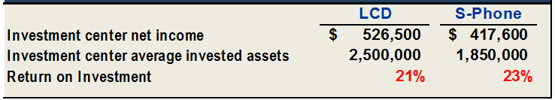
1) Investment Center Return on Assets Invested (ROI)
Investment Center Net Income
Investment Center Average Invested Assets
ROI =
LCD Division earned more dollars of income, but it was less
efficient in using its assets to generate income compared
to S-Phone Division.
A 1
Notes:
An investment center’s performance is often evaluated using a measure called return on investment (ROI). ROI is defined as operating income divided by average invested assets.
Consider the following data for Ztel, a company that operates two divisions: LCD and S-Phone. The LCD Division manufactures liquid crystal display (LCD) monitors and sells them for use in computers, cellular phones, and other products. The S-Phone division sells smartphones. Exhibit 9.17 shows current year income and assets for those divisions. Based on this information, we can determine the ROI or return on investment for each. The ROI for LCD is 21 percent, while the ROI for S-Phone is 23 percent.
LCD Division earned more dollars of income, but it was less efficient in using its assets to generate income compared to S-Phone Division.

Slide 38
1) Investment Center Return on Assets Invested (ROI)
Return on
investment (ROI)
Profit
Margin
Investment
turnover
=
×
Investment center income
Investment center sales
Investment center sales
Investment center average assets
A 2
Notes:
We can further examine investment center (division) performance by splitting return on investment into two measures: profit margin and investment turnover.
Profit margin measures the income earned per dollar of sales. Investment turnover measures how efficiently an investment center generates sales from its invested assets. It is calculated as investment center sales divided by investment center average assets. Profit margin is expressed as a percentage, while investment turnover is interpreted as the number of times assets were converted into sales. Higher profit margin and higher investment turnover indicate better performance. To illustrate, consider Walt Disney Co., which reports results for two of its operating segments: Media Networks and Parks and Resorts.
Disney's Media Networks division generates 33.49 cents of profit for every dollar of sales, while its Parks and Resorts division generates 15.76 cents of profit per dollar of sales. The Media Networks division (0.71 investment turnover) is slightly more efficient than the Parks and Resorts division (0.66 investment turnover) in using assets. Top management can use profit margin and investment turnover to evaluate the performance of division managers. The measures can also aid management when considering further investment in its divisions.
Let’s review what you have learned in the following NEED-TO-KNOW Slide.

Slide 39
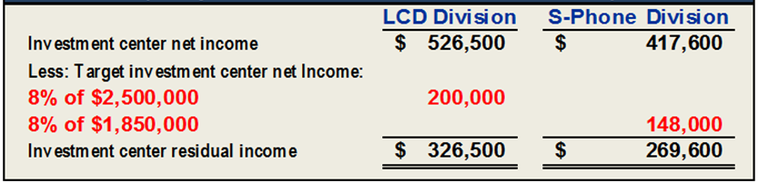
2) Investment Center Residual Income
Residual
Income
=
Investment Center
Net Income
–
Target Investment
Center Net Income
A 1
Notes:
Another way to evaluate division performance is to compute investment center residual income. Residual income is the difference between the investment center net income and target investment center net income. The target investment center net income is the minimum rate of return on investment center invested assets.
Exhibit 9.18: Let’s assume that the target net income for the LCD and S-Phone Divisions is 8 percent. When we compute the target investment center net income for each division and subtract it from net income, we see that the LCD division has a higher residual income.
One of the real advantages of residual income is that it encourages managers to make profitable investments that might be rejected by managers whose performance is evaluated on the basis of ROI. This occurs when the ROI associated with an investment opportunity exceeds the company’s minimum required return, but is less than the ROI being earned by the division manager contemplating the investment. Regardless of the division’s current return on investment, its residual income will increase as long as the manager invests only in projects that exceed the company’s minimum required return.
Let’s review what you have learned in the following NEED-TO-KNOW Slide.

Slide 40
NEED-TO-KNOW
The media division of a company reports income of $600,000, average invested assets of
$7,500,000, and a target income of 6% of invested assets. Compute the division’s
(a) return on investment and (b) residual income.
Return on Investment (ROI) represents the earnings power of invested assets.
Return on investment = Net Income
Average Invested Assets
$600,000
$7,500,000
8%
A 1
Notes:
The media division of a company reports income of $600,000, average invested assets of $7,500,000, and a target income of 6% of invested assets.
Compute the division’s return on investment and residual income.
Return on Investment (ROI) represents the earnings power of invested assets.
It's calculated by taking net income and dividing by average invested assets. $600,000
divided by $7,500,000 is 8%.
Every $1.00 of invested assets yields $.08 in net income.

Slide 41
NEED-TO-KNOW
The media division of a company reports income of $600,000, average invested assets of
$7,500,000, and a target income of 6% of invested assets. Compute the division’s
(a) return on investment and (b) residual income.
Residual income is the amount earned above a targeted amount.
Net income $600,000
Target income ($7,500,000 x .06) 450,000
Residual income $150,000
A 1
Notes:
Residual income is the amount earned above a targeted amount.
Net income is $600,000.
Targeted income is calculated as 6% of the average invested assets of $7,500,000,
$450,000.
Residual income is the amount earned above 6%, $150,000.

Slide 42
Investment Center Profit Margin and Investment Turnover

Slide 43

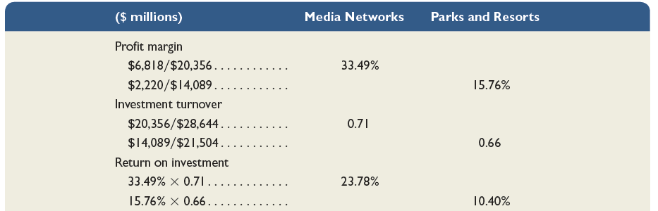
Investment Center Profit Margin and Investment Turnover
Return on
investment (ROI)
Profit
Margin
Investment
turnover
=
×
Investment center income
Investment center sales
Investment center sales
Investment center average assets
Media Networks ROI = 23.78%
A 2
Parks and Resorts ROI= 10.4%
Notes:
We can further examine investment center (division) performance by splitting return on investment into two measures: profit margin and investment turnover.
Profit margin measures the income earned per dollar of sales. Investment turnover measures how efficiently an investment center generates sales from its invested assets. It is calculated as investment center sales divided by investment center average assets. Profit margin is expressed as a percentage, while investment turnover is interpreted as the number of times assets were converted into sales. Higher profit margin and higher investment turnover indicate better performance. To illustrate, consider Walt Disney Co., which reports results for two of its operating segments: Media Networks and Parks and Resorts.
Disney's Media Networks division generates 33.49 cents of profit for every dollar of sales, while its Parks and Resorts division generates 15.76 cents of profit per dollar of sales. The Media Networks division (0.71 investment turnover) is slightly more efficient than the Parks and Resorts division (0.66 investment turnover) in using assets. Top management can use profit margin and investment turnover to evaluate the performance of division managers. The measures can also aid management when considering further investment in its divisions.
Let’s review what you have learned in the following NEED-TO-KNOW Slide.

Slide 44
NEED-TO-KNOW
A division reports sales of $50,000, income of $2,000, and average invested assets of $10,000.
Compute the division’s (a) profit margin, (b) investment turnover, and (c) return on investment.
Profit margin measures the income earned per dollar of sales.
Profit margin = Net Income
Sales
$2,000
$50,000
4%
A 2
Notes:
A division reports sales of $50,000, income of $2,000, and average invested assets of $10,000.
Compute the division’s (a) profit margin, (b) investment turnover, and (c) return on investment.
Profit margin measures the income earned per dollar of sales. It's calculated by taking net income and dividing by
sales.
Net income of $2,000 divided by $50,000 in sales is 4%.
$0.04 of every $1.00 of sales is profit.

Slide 45
Need to Know (24-2b)
NEED-TO-KNOW
A division reports sales of $50,000, income of $2,000, and average invested assets of $10,000.
Compute the division’s (a) profit margin, (b) investment turnover, and (c) return on investment.
Investment turnover measures how efficiently an investment center generates sales from its invested assets.
Investment turnover = Sales
Average Invested Assets
$50,000
$10,000
5
A 2
Notes:
Investment turnover measures how efficiently an investment center generate sales from its invested assets. It's calculated by taking sales and dividing by average invested assets.
$50,000 in sales divided by average invested assets of $10,000 is an investment turnover of 5.
Every $1.00 of invested assets yields $5.00 in sales.

Slide 46
Need to Know (24-2c)
NEED-TO-KNOW
A division reports sales of $50,000, income of $2,000, and average invested assets of $10,000.
Compute the division’s (a) profit margin, (b) investment turnover, and (c) return on investment.
Return on Investment (ROI) represents the earnings power of invested assets.
Return on investment = Net Income
Average Invested Assets
$2,000
$10,000
20%
A 2
Notes:
Return on investment represents the earnings power of invested assets.
It's calculated by taking net income and dividing by the average invested assets.
Net income of $2,000 divided by average invested assets of $10,000 is a return on investment of 20%.

Slide 47
Need to Know (24-2d)
NEED-TO-KNOW
A division reports sales of $50,000, income of $2,000, and average invested assets of $10,000.
Compute the division’s (a) profit margin, (b) investment turnover, and (c) return on investment.
Return on Investment (ROI) represents the earnings power of invested assets.
Return on investment = Profit Margin x Investment Turnover
Net Income = Net Income Sales
Average Invested Assets Sales Average Invested Assets
20% = 4% x 5
A 2
Notes:
An alternative way to calculate return on investment is to take the profit margin and multiply by the investment turnover.
Because if we divide by sales in the profit margin and multiply by sales in the investment turnover, we're left with net income divided by average invested assets.
The 20% return on investment is equal to the 4% profit margin multiplied by the investment turnover of 5.

Slide 48
Nonfinancial Performance Evaluation Measures

Slide 49
Balanced Scorecard
Collects information on several key performance indicators within each of the four perspectives.
Customer Perspective
How do our
customers see us?
Innovation/Learning
How can we continually
improve and create value?
Performance
Indicators
Internal
Processes
In which activities
must we excel?
Financial Perspective
How do we look
to the firm’s owners?
A 3
Notes:
A balanced scorecard consists of an integrated set of performance measures that are derived from and support a company’s vision and strategy. The balanced scorecard is used to assess company and division manager performance. The balanced scorecard requires managers to think of their company from four perspectives:
1. customer perspective: What do customers think of us?
2. internal processes: Which of our operations are critical to meeting customer needs?
3. innovation and learning: How can we improve?
4. financial: What do our owners think of us?
In the balanced scorecard approach, we continually develop indicators that help us analyze or answer questions such as: how do we appear to our owners; how do we appear to our customers; what kind of continual innovation and learning is taking place; and which processes within the organization are excellent and which need improvement?
The key sequence of events in the balanced scorecard approach is that learning improves business processes. Improved business processes translate to improved customer satisfaction. When we have a high degree of customer satisfaction, we have improved financial results.

Slide 50
Global View
L’Oreal is an international cosmetics company incorporated in France. With multiple brands and operations in over 100 countries, the company uses concepts of departmental accounting and controllable costs to evaluate performance. A recent annual report shows the following for the major divisions in L’Oreal’s cosmetics branch:
L’Oreal’s non-allocated costs include costs that are not controllable by division managers. Excluding noncontrollable costs enables L’Oreal to prepare more meaningful division performance evaluations.
Notes:
L’Oreal is an international cosmetics company incorporated in France. With multiple brands and operations in over 100 countries, the company uses concepts of departmental accounting and controllable costs to evaluate performance. A portion of a recent L’Oreal annual report is shown on your screen.
L’Oreal’s non-allocated costs include costs that are not controllable by division managers, including fundamental research and development and costs of service operations like insurance and banking. Excluding noncontrollable costs enables L’Oreal to prepare more meaningful division performance evaluations.

Slide 51
Cycle Time and Cycle Efficiency

Slide 52
Cycle Time and Cycle Efficiency
A metric that measures the time involved in manufacturing a product.
Order Received
Production
Started
Goods Shipped
Process Time + Inspection Time
+ Move Time + Wait Time
Manufacturing Cycle Time
Total Time
Process time is the time spent producing the product and it is the only value-added time!
A 4
Notes:
Total time is the elapsed time from when a customer order is received to when the completed order is shipped. The manufacturing cycle time is the amount of time required to turn raw materials into completed products. This includes process time, inspection time, move time, and wait time. Process time is the time spent producing the product and it is the only value-added activity of the four components of cycle time because it is the only activity in cycle time that adds value to the product form the customer’s perspective.

Slide 53
Cycle Time and Cycle Efficiency
Order Received
Production
Started
Goods Shipped
Process Time + Inspection Time
+ Move Time + Wait Time
Manufacturing Cycle Time
Total Time
Cycle
Efficiency
Value-added time
Cycle time
=
A 4
Notes:
Companies strive to reduce non-value-added time to improve cycle efficiency (CE), which is a measure of production efficiency. Cycle efficiency (CE) is computed by dividing value-added time by cycle (throughput) time. A CE less than one indicates that non-value-added time is present in the production process and they need to evaluate it to identify ways to reduce non-value-added activities.

Slide 54
Homework assignment
Using Connect – 8 Questions for 60 Points; Chapter 9.
Prepare chapter 10 “Relevant Costing for Managerial Decisions.”
Happiness is having all homework up to date

Slide 55
Thank you and See You Next Week at the Same Time, Take Care

Slide 56
(Appendix 9A):
Transfer Pricing

Slide 57


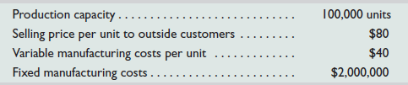
Appendix 9A: Transfer Pricing
A transfer price is the amount charged when one
division sells goods or services to another division.
LCD Displays
S-Phone Division
LCD Division
S-Phone can purchase displays for $80 from other companies.
C 2
Notes:
Appendix 9A: Transfer Pricing
Divisions in decentralized companies sometimes do business with each other. Because these transactions are transfers within the same company, the price to record them is called the transfer price. For example, the LCD division of ZTel manufactures liquid crystal display (LCD) touch-screen monitors for use in ZTel’s S-Phone division’s smartphones. The LCD monitors can also be used in other products. So, the LCD division can sell its monitors to buyers other than the S-Phone division. Likewise, the S-Phone division can purchase monitors from suppliers other than the LCD division.
The manager of the LCD division wants to report a division profit; thus, this manager will not accept a transfer price less than $40 (variable manufacturing cost per unit) because doing so would cause the division to lose money on each monitor transferred. On the other hand, the S-Phone division manager also wants to report a division profit. Thus, this manager will not pay more than $80 per monitor because similar monitors can be bought from outside suppliers at that price. As any transfer price between $40 and $80 per monitor is possible, how does ZTel determine the transfer price? The answer depends in part on whether the LCD division has excess capacity to manufacture monitors.

Slide 58
Appendix 9A: Transfer Pricing
The LCD division is producing and selling 100,000 units to
outside customers.
(No excess capacity)
Transfer price = $80
LCD Displays
LCD Division
S-Phone Division
With no excess capacity, the LCD manager will not accept a transfer price less than $80 per monitor. The S-Phone manager cannot buy monitors for less than $80 from outside suppliers, so the $80 price is acceptable.
C 2
Notes:
If the LCD division can sell every monitor it produces, a market-based transfer price of $80 per monitor is preferred. At that price, the LCD division manager is willing to either transfer monitors to S-Phone or sell to outside customers. The S-Phone division manager cannot buy monitors for less than $80 from outside suppliers, so the $80 price is acceptable. Further, with a transfer price of $80 per monitor, top management of Ztel is indifferent to the S-Phone division buying from the LCD division or buying similar-quality monitors from outside suppliers. With no excess capacity, the LCD manager will not accept a transfer price less than $80 per monitor. For example, suppose the S-Phone division manager suggests a transfer price of $70 per monitor. At that price, the LCD manager incurs an unnecessary opportunity cost of $10 per monitor (computed as $80 market price minus $70 transfer price). This would lower the LCD division’s income and hurt its performance evaluation.

Slide 59
Appendix 9A: Transfer Pricing
The LCD division is producing and selling less than100,000 units to outside customers. (Excess capacity)
Transfer price = $40 to $80
LCD Displays
LCD Division
S-Phone Division
At a transfer price greater than $40, the LCD division receives contribution margin. At a transfer price less than $80, the S-Phone division manager is pleased to buy from the LCD division, since that price is below the market price of $80.
C 2
Notes:
Assume that the LCD division has excess capacity. For example, the LCD division might currently be producing only 80,000 units. Consequently, with excess capacity, the LCD division should accept any transfer price of $40 per unit or greater and the S-Phone division should purchase monitors from the LCD division. For example, if a transfer price of $50 per monitor is used, the S-Phone manager is pleased to buy from the LCD division, since that price is below the market price of $80. For each monitor transferred from the LCD division to the S-Phone division at $50, the LCD division receives a contribution margin of $10 (computed as $50 transfer price less $40 variable cost) to contribute towards its fixed costs and increase ZTel’s overall profits. This form of transfer pricing is called cost-based transfer pricing. Under this approach, the transfer price might be based on variable costs, total costs, or variable costs plus a markup.

Slide 60
9-C3 (Appendix 9B):
Joint Costs and Their Allocation

Slide 61
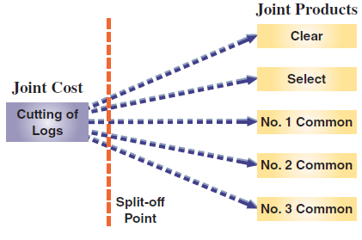
Appendix 9B: Joint Costs and Their Allocation
Joint costs are costs incurred to produce or purchase two or more products at the same time. Consider a sawmill company:
How should the joint costs be allocated to the different products?
C 3
Notes:
Appendix 9B: Joint Costs and Their Allocation
Joint costs are costs incurred to produce or purchase two or more products at the same time. For example, a sawmill company incurs a joint cost when it buys logs that it cuts into lumber. The joint cost includes the logs (raw material) and its cutting (conversion) into boards classified as Clear, Select, No. 1 Common, No. 2 Common, No. 3 Common, and other types of lumber and by-products.
Financial statements prepared according to GAAP must assign joint costs to products. To do this, management must decide how to allocate joint costs across products benefiting from these costs. If some products are sold and others remain in inventory, allocating joint costs involves assigning costs to both cost of goods sold and ending inventory. The two usual methods to allocate joint costs are: (1) the physical basis and (2) the value basis.

Slide 62
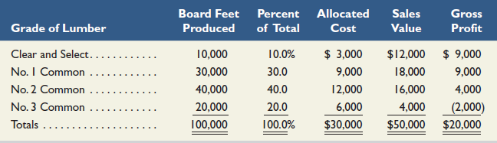
Appendix 9B: Joint Costs and Their Allocation
Physical Basis Allocation of Joint Cost
In this sawmill, joint costs include the logs and their being cut into boards. This joint cost will need to be allocated to the different products resulting from it. We will focus on board feet produced…
10,000 ÷ 100,000 = 10%
10% of $30,000 = $3,000
C 3
Notes:
The physical basis allocation of joint costs typically involves allocating joint cost using physical characteristics such as the ratio of pounds, cubic feet, or gallons of each joint product to the total pounds, cubic feet, or gallons of all joint products flowing from the cost. Consider a sawmill that bought logs for $30,000. When cut, these logs produce 100,000 board feet of lumber in the grades and amounts shown. The logs produce 20,000 board feet of No. 3 Common lumber, which is 20% of the total. With physical allocation, the No. 3 Common lumber is assigned 20% of the $30,000 cost of the logs, or $6,000 ($30,000 × 20%). Because this low-grade lumber sells for $4,000, this allocation gives a $2,000 loss from its production and sale. The physical basis for allocating joint costs does not reflect the extra value flowing into some products or the inferior value flowing into others. That is, the portion of a log that produces Clear and Select grade lumber is worth more than the portion used to produce the three grades of common lumber, but the physical basis fails to reflect this. Consequently, this method is not preferred because the resulting cost allocations do not reflect the relative market values the joint cost generates. The preferred approach is the value basis, which allocates joint cost in proportion to the sales value of the output produced by the process at the “split-off point.”

Slide 63
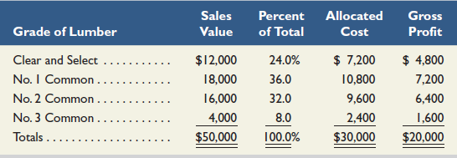
Appendix 9B: Joint costs and Their Allocation
Allocating Joint Costs on a Value Basis
In this sawmill, joint costs include the logs and their being cut into boards. This joint cost will need to be allocated to the different products resulting from it. We will focus on sales value…
$12,000 ÷ $50,000 = 24%
24% of $30,000 = $7,200
C 3
Notes:
The value basis method of joint cost allocation determines the percentage of the total costs allocated to each grade by the ratio of each grade’s sales value to the total sales value, at the split-off point, to the total sales value of $50,000 (sales value is the unit selling price multiplied by the number of units produced). The Clear and Select lumber grades receive 24% of the total cost ($12,000 ÷ $50,000) instead of the 10% portion using a physical basis. The No. 3 Common lumber receives only 8% of the total cost, or $2,400, which is much less than the $6,000 assigned to it using the physical basis. An outcome of value basis allocation is that each grade produces exactly the same 40% gross profit at the split-off point. This 40% rate equals the gross profit rate from selling all the lumber made from the $30,000 logs for a combined price of $50,000.

