Slide 1
Welcome Back

Slide 2
Welcome Back
Time for Any Question

Slide 3
Homework assignment
Using Connect – 8 Questions for 60 Points; Chapter 9.
Prepare chapter 10 “Relevant Costing for Managerial Decisions.”
Happiness is having all homework up to date

Slide 4
Chapter 10
Relevant Costing for Managerial Decisions

Slide 5
Describe the importance of relevant costs for short-term decisions.
Notes:
10-C1:
Describe the importance of relevant costs for short-term decisions.

Slide 6
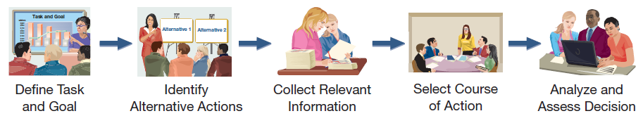
Decision Making
C 1
Decision making involves five steps:
  Define the decision task.
  Identify alternative courses of action.
  Collect relevant information on alternatives.
  Select the preferred course of action.
  Analyze and assess decisions made.
Notes:
These five steps represent an orderly, structured decision-making process that will lead to better decisions. First, we need to clearly define the decision task and consider all feasible alternatives. Next, we need to gather information. Some of the information might not be relevant, so we need to discard that information and concentrate on using only relevant information to select the best alternative. After the decision is made, we should review the outcome in an effort to become even better decision makers in the future.

Slide 7

Relevant Costs
C 1
Three types of costs that are pertinent to the discussion of relevant costs are:
Sunk costs
Out-of-pocket costs
Opportunity costs.
  Costs that are applicable
  to a particular decision.
  Costs that should have a bearing on which alternative a manager selects.
  Costs that are avoidable.
  Future costs that differ
  between alternatives.
Notes:
Relevant costs are future costs that differ between alternatives. A relevant cost is a cost that will be incurred if an alternative is selected but avoided if the alternative is rejected. For example, if you are deciding between walking to class and driving to class, the cost of gasoline would be a relevant cost.
There are three types of costs that are pertinent to our discussion of relevant costs: sunk costs, out-of-pocket costs, and opportunity costs. Let’s take a closer look at these costs…

Slide 8
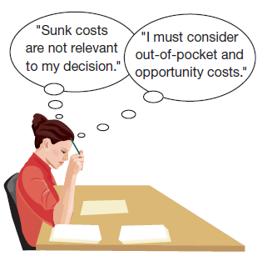
Relevant Costs
C 1
Sunk costs are the result of past decisions and cannot be changed by any current or future decisions.
Sunk costs are irrelevant to current or future decisions.
Out-of-pocket costs are future outlays
of cash associated with a particular decision. Out-of-pocket costs are relevant to decisions.
Opportunity costs are the potential benefits given up when one alternative is selected over another. Opportunity costs are relevant to decisions.
Management must also consider relevant benefits.
8
Notes:
Sunk costs cannot be changed by any decision we make as they have been incurred in the past and cannot possibly differ between any alternative that we might currently choose. Sunk costs should not be considered in the decision process. For example, if you bought an automobile two years ago for $15,000, that amount is a sunk cost. Whether you drive the car, park it, trade it, or sell it, the $15,000 cost will not change.
An out-of-pocket cost is a future outlay of cash associated with a particular decision alternative. Out-of-pocket costs are relevant costs as they are future costs that differ between alternatives. For example, in considering the decision to take a vacation or stay at home, you will have travel costs (out-of-pocket costs) only if you choose a vacation.
Opportunity costs are the potential benefits that are given up when one alternative is selected over another. Opportunity costs are not actual dollar outlays; however, they may impact our decisions. For example, the opportunity cost of attending college is the lost salary that you could have earned by working.
Besides relevant costs, management must also consider the relevant benefits associated with a decision. Relevant benefits refer to the additional or incremental revenue generated by selecting a particular course of action over another.

Slide 9
Evaluate short-term managerial decisions using relevant costs.
Notes:
10-A1:
Evaluate short-term managerial decisions using relevant costs.

Slide 10
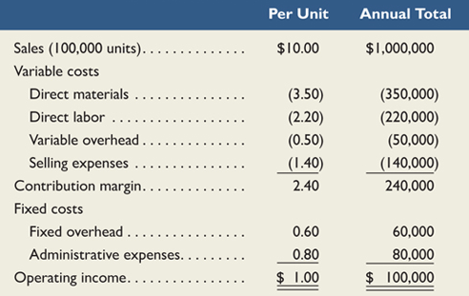
Accepting Additional Business
The decision to accept additional business should be based on incremental costs and incremental revenues.
Incremental amounts are those that occur if the company decides to accept the new business.
FasTrac currently sells 100,000 units of its product. They are operating at 80% of full capacity. The company has per unit and annual total sales and costs as shown in the following contribution margin income statement.
Notes:
On occasion, we may have the opportunity to accept additional business. We should make the decision to accept or reject the additional business using incremental revenues and incremental costs. Some of our costs may not change if we accept additional business. Those costs are not relevant as they do not differ between the alternatives: accept or reject the additional business.
FasTrac makes 100,000 units of a single product that normally sells for $10.00 per unit. They are currently operating at its normal level of 80% of full capacity. Total cost to make one unit is $9.00, resulting in a $1.00 profit per unit.

Slide 11

Accepting Additional Business
A current buyer of FasTrac’s products wants to purchase additional units of its product and export them to another country. This buyer offers to buy 10,000 units of the product at $8.50 per unit, or $1.50 less than the current price. The offer price is low, but FasTrac is considering the proposal because this sale would be several times larger than any single previous sale and it would use idle capacity.
Should FasTrac accept the offer?
Notes:
A current buyer of FasTrac’s products wants to purchase additional units of its product and export them to another country. This buyer offers to buy 10,000 units of the product at $8.50 per unit, or $1.50 less than the current price. The offer price is low, but FasTrac is considering the proposal because this sale would be several times larger than any single previous sale and it would use idle capacity.
Should FasTrac accept this special order?

Slide 12
Identify relevant costs and apply them to managerial decisions.
Notes:
10-P1:
Identify relevant costs and apply them to managerial decisions.

Slide 13
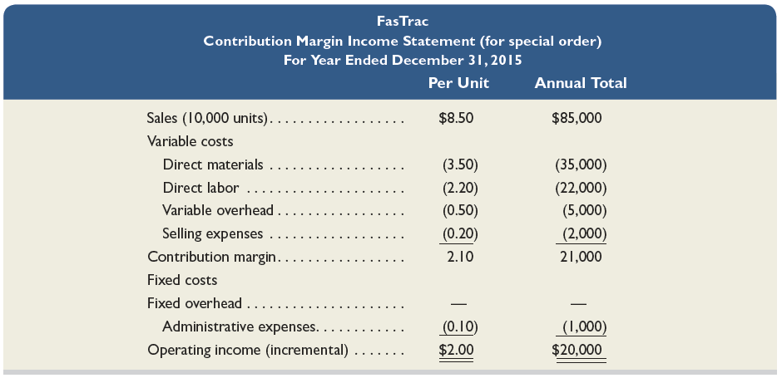
Accepting Additional Business
To determine whether to accept or reject this order, management needs to know whether accepting the offer will increase net income.
FasTrac should accept the offer.
Notes:
To determine whether to accept or reject this order, management needs to know whether accepting the offer will increase net income. We can see from this analysis that the additional business at $8.50 per unit will increase income by $20,000. Let’s look at the reasons why this is the case.
To correctly make its decision, FasTrac must analyze the costs of this potential new business differently. The $9.00 historical cost per unit is not necessarily the incremental cost of this order.
If we decide to accept this one-time special order, revenue will increase by $85,000 (10,000 units at $8.50 per unit).
The variable manufacturing costs to produce this order will be the same as for FasTrac's normal business --$3.50 per unit for direct materials, $2.20 per unit for direct labor, and $0.50 per unit for variable overhead.
* Selling expenses for this order will be $0.20 per unit, which is lower than FasTrac's normal business.
* Fixed overhead expenses will not change whether this order is accepted or not.
* This order will incur incremental administrative expenses of $1,000 for clerical work. These are additional fixed costs due to this order.
By comparing incremental revenue of $85,000 with the total incremental costs of $65,000, we see why the income from the additional business is $20,000. Now we can make the correct decision to accept the additional business.

Slide 14
Need to Know 10.1
P 1
A company receives a special order for 200 units that requires stamping the buyer’s name on
each unit, yielding an additional fixed cost of $400 to its normal costs. Without the order, the
company is operating at 75% of capacity and produces 7,500 units of product at the
costs below. The company's normal selling price is $22 per unit. The sales price for the
special order is $18 per unit.
Costs
Variable
Fixed costs
(7,500
costs per
units)
unit
Direct materials
$37,500
$5.00
Direct labor
60,000
$8.00
Overhead (30% variable)
20,000
$0.80
$14,000
Selling expenses (60% variable)
25,000
$2.00
$10,000
The special order will not affect normal unit sales and will not increase fixed overhead and
selling expenses. Variable selling expenses on the special order are reduced to one-half
the normal amount. Should the company accept the special order?
In order for the special order to be accepted, it must 1) increase net income; the incremental
revenue must exceed the incremental expense, and 2) not adversely impact normal sales.
Notes:
Need-to-Know 10.1
A company receives a special order for 200 units that requires stamping the buyer’s name on each unit,
yielding an additional fixed cost of $400 to its normal costs.
Without the order, the company is operating at 75% of capacity and produces 7,500 units of product at the costs below.
The company's normal selling price is $22 per unit. The sales price for the special order is $18 per unit. The special order will not affect normal unit sales and will not increase fixed overhead and selling expenses. Variable selling expenses on the special order are reduced to one-half the normal amount. Should the company accept the special order?
First we need to determine which costs are variable, costs that will increase on a per unit basis, and which costs are fixed.
Direct materials are variable costs. $37,500 divided by 7,500 units is a variable cost per unit of $5.
Direct labor is also a variable cost. $60,000 divided by 7,500 units is a variable cost per unit of $8.
30% of the overhead is variable. 30% of $20,000 is $6,000. $6,000 divided by 7,500 units is a variable cost per unit of $0.80.
The remaining 70%, $14,000, is a fixed cost.
Selling expenses: 60% are variable. 60% of $25,000 is $15,000.
$15,000 divided by 7,500 units is a variable cost per unit of $2.
The remaining 40%, $10,000, is a fixed cost.
So, now, we can look at the profitability of the additional 200 units. In order for the special order to be accepted, it
must increase net income; the incremental revenue must exceed the incremental expense, and the special order must not adversely impact normal sales.

Slide 15
Need to Know 10.1
P 1
A company receives a special order for 200 units that requires stamping the buyer’s name on
each unit, yielding an additional fixed cost of $400 to its normal costs. Without the order, the
company is operating at 75% of capacity and produces 7,500 units of product at the
costs below. The company's normal selling price is $22 per unit. The sales price for the
special order is $18 per unit.
Costs
Variable
Fixed costs
(7,500
costs per
units)
unit
Direct materials
$37,500
$5.00
Direct labor
60,000
$8.00
Overhead (30% variable)
20,000
$0.80
$14,000
Selling expenses (60% variable)
25,000
$2.00
$10,000
The special order will not affect normal unit sales and will not increase fixed overhead and
selling expenses. Variable selling expenses on the special order are reduced to one-half
the normal amount. Should the company accept the special order?
Incremental revenues
(200 units x $18.00)
$3,600
Direct materials
(200 units x $5.00)
$1,000
Direct labor
(200 units x $8.00)
1,600
Overhead (30% variable)
(200 units x $0.80)
160
Selling expenses (60% variable)
(200 units x $2.00 x 50%)
200
Additional fixed costs
(Stamping costs)
400
Total incremental expenses
3,360
Net income increases by:
$240
Yes, the company should accept the special order.
Notes:
Need-to-Know 10.1
The incremental revenue for this order, 200 units at $18 per unit, $3,600.
The incremental costs will include direct materials: 200 units at $5 per unit, $1,000; Direct labor, 200 units at $8 per unit, $1,600; the variable portion of the overhead, 200 units at
$0.80 per unit, $160; variable selling expenses, 200 units multiplied by the $2 per unit multiplied by 50%, as the as the variable selling expenses are reduced to one-half the normal amount, $200.
The special order will also have additional fixed cost for the stamping of $400.
Total incremental expenses are $3,360.
Net income will increase by $240.
So yes, the company should accept the special order.

Slide 16


Make or Buy Decisions
P 1
Incremental costs are important in the
decision to make a product or purchase it from a supplier.
The cost to produce an item must include:
(1) direct materials,
(2) direct labor, and
(3) incremental overhead.
We should not use the predetermined overhead
application rate to determine product cost in the decision.
Notes:
The managerial decision to make or buy a component is common. The “Make or Buy” decision involves the question of whether it is more economical to produce some goods internally or purchase them from an outside supplier. We will again concentrate on incremental costs for this decision. Incremental costs will include the direct materials cost, the direct labor cost and the incremental overhead incurred. We must be careful not to use the historical predetermined overhead application rate to determine the product cost that will be used in the decision.

Slide 17
Make or Buy Decisions
P 1
FasTrac currently makes Part 417, assigning overhead at 100 percent of direct labor cost, with the following unit cost:
Normal, predetermined overhead application rate is 100% of direct labor cost.
Notes:
FasTrac is now making Part 417, which is a component part in its final product. As shown on your screen, the unit cost of the part includes direct material, direct labor, and factory overhead. Currently, FasTrac’s normal predetermined overhead application rate is 100% of direct labor cost.

Slide 18
Make or Buy Decisions
FasTrac can buy Part 417 from a supplier for $1.20. How much overhead do we have to eliminate before we should buy this part?
Assume management computes an incremental overhead rate of $0.20 per unit if it makes the part. . .
Continue to make the part!
?
We must eliminate $0.25 per unit ($1.20 - $0.95) of overhead,
to make the total cost of making the component
less than the purchase price of $1.20.
Notes:
An outside supplier offers to make Part 417, and sell it to FasTrac for $1.20 per unit. We know that $1.20 is less than FasTrac’s $1.45 unit cost. Should FasTrac stop making the part and buy it from the outside supplier for $1.20 per unit?
We know that FasTrac will avoid the direct material cost and the direct labor cost if it buys the part instead of making it. But that total is only $0.95. FasTrac cannot afford to pay $1.20 per unit if it will only avoid $0.95 per unit. It must also be able to avoid some of the factory overhead. How much overhead does FasTrac avoid in order to justify buying the part?
FasTrac must be able to eliminate (avoid) a minimum of $0.25 per unit ($1.20-$0.95) in factory overhead costs to justify buying the part. If the avoidable amount of factory overhead per unit is greater than $0.25, FasTrac should buy the part instead of making it. On the other hand, if the avoidable amount of factory overhead per unit is less than $0.25, then FasTrac should continue making the part. In this instance, assume management computes an incremental overhead rate of $0.20 per unit if it makes the part. Based on the per unit analysis on this slide, it is cheaper to make the part than to buy it.
To make the correct make or buy decision, we must always determine the relevant (avoidable) costs of making the part and then compare these avoidable costs to the outside purchase cost. In almost all make or buy decisions, a significant amount of the factory overhead will be unavoidable, and therefore irrelevant to the decision as it will be the same for either alternative.

Slide 19
Need to Know 10.2
P 1
A company currently buys a key part for a product it manufactures. The company buys the part for $5 per
unit and believes it can make the part for $1.50 per unit for direct materials and $2.50 per unit for direct
labor. The company allocates overhead costs at the rate of 50% of direct labor. Incremental overhead costs
to make this part are $0.75 per unit. Should the company make or buy the part?
(per unit)
Make
Buy
Direct materials
$1.50
Direct labor
2.50
Overhead
0.75
Cost to buy the part
$5.00
Total
$4.75
$5.00
The company should make the part, because the $4.75 cost to make is less than the $5.00 cost to buy.
Notes:
Need-to-Know 10.2
A company currently buys a key part for a product it manufactures. The company buys the part for $5 per unit and believes it can make the part for $1.50 per unit for direct materials and $2.50 per unit for direct labor.
The company allocates overhead costs at the rate of 50% of direct labor.
Incremental overhead costs to make this part are $0.75 per unit.
Should the company make or buy the part?
The costs to make the part include: Direct materials, $1.50 per unit; Direct labor, $2.50 per unit, and variable
overhead, $0.75 per unit.
The cost to buy the part is $5.00 per unit.
The total cost to make each unit is $4.75, which is $0.25 less per unit than the cost to buy the units.
The company should make the part.

Slide 20
Scrap or Rework
P 1
Often in manufacturing processes, we have products that do not pass inspection. We can either sell them as is, or rework them to improve the quality.
As long as rework costs are recovered through sale of the product, and rework
does not interfere with normal production, we should rework rather than scrap.
Costs incurred in manufacturing units of product that do not meet quality standards are sunk costs and cannot be recovered so they are irrelevant.
Notes:
Often in manufacturing processes, we have products that do not pass inspection. We can either sell them as is, or rework them to improve the quality. Once reworked, the products will likely be sold for a higher price. The decision to rework or sell as is should be based on incremental revenues and incremental costs. The costs of manufacturing the product up to the inspection point are sunk and therefore irrelevant.

Slide 21
Scrap or Rework
P 1
Example: FasTrac has 10,000 defective units that cost $1.00 each to make. The units can be scrapped now for $0.40 each or reworked at an additional cost of $0.80 per unit. If reworked, the units can be sold for the normal selling price of $1.50 each. Reworking the defective units will prevent the production of 10,000 new units that would also sell for $1.50.
Should FasTrac scrap or rework?
Notes:
Let’s look at an example of a scrap or rework decision… Let’ assume that FasTrac has 10,000 defective units of a product that have already cost $1 per unit to manufacture. They can be sold as is for $0.40 per unit, or reworked and sold for $1.50. The cost of reworking the defective units is $0.80 each. The $1.00 per unit original cost to make the defective units is a sunk cost and irrelevant to the decision.
FasTrac does not have the capacity to rework the defective units and continue with its normal production. Reworking the defective units will prevent the production of 10,000 new units that would also sell for $1.50.
What should FasTrac do?

Slide 22
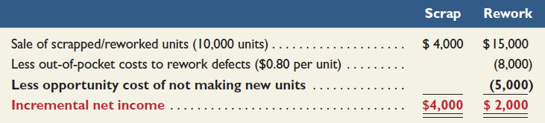
Scrap or Rework
P 1
10,000 units × $0.40 per unit
($.50 per unit)
10,000 units × $1.50 per unit
10,000 units × $0.80 per unit
10,000 units × ($1.50 - $1.00) per unit
Decision: FasTrac should scrap the units now.
Notes:
Sale of the 10,000 defective units as is for $0.40 will generate incremental income of $4,000. Reworking and selling each unit for $1.50 will generate $15,000.
The total cost to rework the 10,000 defective units at $0.80 each will be $8,000. We must also include the opportunity cost of the 10,000 units of regular production that would be prevented by the rework. The regular units sell for $1.50 each and cost $1.00 per unit to make. We give up the opportunity to earn this $5,000 if we rework the defective units.
FasTrac should sell the defective units as is for $4,000, as the net return is $2,000 higher than reworking the defective units. Note that if FasTrac does not include the opportunity cost of the displaced regular production, the company will make an incorrect decision to rework the defective product. Failing to include the opportunity cost of $5,000, the rework option would have shown an income of $7,000 instead of $2,000, mistakenly making reworking appear more favorable than scrapping.

Slide 23
Sell or Process Further
P 1
Businesses are often faced with the decision to sell partially completed products as is or to process them further for sale as other products.
As a general rule, we process further only if incremental revenues exceed incremental costs.
Example: FasTrac has 40,000 units of partially finished product Q. Processing costs to date are $30,000. The 40,000 unfinished units can be sold as is, for $50,000 or they can be processed further to produce finished products X, Y, and Z. Processing the units further will cost an additional $80,000 and will yield total revenues of $150,000.
FasTrac must decide whether the added revenues from selling finished products X, Y, and Z , exceed the costs of finishing them. . .
Notes:
Many products can be sold in an unfinished state, or processed further into a finished product that will sell for a higher price. The decision to sell or process should be based on incremental revenues and incremental costs. The costs of manufacturing the product up to the sell or process decision point are sunk and therefore irrelevant.
FasTrac has 40,000 partially completed units of product Q that can be sold for a total of $50,000. FasTrac also has the option of further processing the 40,000 units of product Q to obtain products X, Y, and Z. Processing the units further will cost an additional $80,000 and will yield total revenues of $100,000.
What should FasTrac do? First, we need some additional information that is on the next slide before we can make a decision.

Slide 24
Sell or Process Further
P 1
 | Sell as Product Q | Process Further into Products X, Y, and Z
Incremental revenue | $50,000 | $150,000
Incremental cost | ----0---- | (80,000)
Incremental income | $50,000 | $70,000
Decision: FasTrac should process further; by doing so,
it will earn an additional $20,000 of income ($70,000 – $50,000).
The $30,000 of previously incurred manufacturing costs are excluded from the analysis. These costs are sunk, and they are not relevant to the decision!
Notes:
The incremental income from processing further is $70,000. This is greater than the incremental income of $50,000 that would be earned from selling Product Q as is. Therefore, FasTrac should process further; by doing so, it will earn an additional $20,000 of income ($70,000 – $50,000).
Notice that the $30,000 of previously incurred manufacturing costs are excluded from the analysis. These costs are sunk, and they are not relevant to the decision. The incremental revenue from selling Product Q as is ($50,000) is properly included. It is the opportunity cost associated with processing further.

Slide 25
10 Minutes Break

Slide 26
Need-to-Know 10.3
P 1
For each of the two independent scenarios below, determine whether the company should sell the partially
completed product as is or process it further into other saleable products.
1. $10,000 of manufacturing costs have been incurred to produce Product Alpha. Alpha can be sold as is
for $30,000 or processed further into two separate products, BB and CC. The further processing will
cost $15,000, and products BB and CC can be sold for total revenues of $60,000.
2. $5,000 of manufacturing costs have been incurred to produce Product Delta. Delta can be sold as is for
$150,000 or processed further into two separate products, YY and ZZ. The further processing will cost
$75,000, and Products YY and ZZ can be sold for total revenues of $200,000.
Notes:
Need-to-Know 10.3
For each of the two independent scenarios below, determine whether the company should sell the partially completed product as is or process it further into other saleable products.

Slide 27
Need-to-Know 10.3
P 1
1. $10,000 of manufacturing costs have been incurred to produce Product Alpha. Alpha can be sold as is
for $30,000 or processed further into two separate products, BB and CC. The further processing will
cost $15,000, and products BB and CC can be sold for total revenues of $60,000.
Alpha
Sell as is
Process Further
Incremental revenue
$30,000
$60,000
Incremental cost
0
(15,000)
Incremental income
$30,000
$45,000
Alpha should be processed further; doing so will yield an extra $15,000 ($45,000 - $30,000) of income.
2. $5,000 of manufacturing costs have been incurred to produce Product Delta. Delta can be sold as is for
$150,000 or processed further into two separate products, YY and ZZ. The further processing will cost
$75,000, and Products YY and ZZ can be sold for total revenues of $200,000.
Delta
Sell as is
Process Further
Incremental revenue
$150,000
$200,000
Incremental cost
0
(75,000)
Incremental income
$150,000
$125,000
Delta should be sold as is; doing so will yield an extra $25,000 ($150,000 - $125,000) of income.
Notes:
Need-to-Know 10.3
1. $10,000 of manufacturing costs have been incurred to produce Product Alpha. Alpha can be sold as is for $30,000 or processed further into two separate products, BB and CC. The further processing will cost $15,000, and products BB and CC can be sold for total revenues of $60,000. The incremental revenue is $30,000 if we sell the products as is.
If the units are processed further, they can be sold for $60,000. There is no incremental cost if we sell the products
as is.
If we process the units further, the additional cost will be $15,000.
The incremental income if we sell the units as is, $30,000, vs. $45,000 if the units are processed further.
Alpha should be processed further; doing so will yield an extra $15,000 ($45,000 - $30,000) of income.
2. $5,000 of manufacturing costs have been incurred to produce Product Delta. Delta can be sold as is for $150,000 or processed further into two separate products, YY and ZZ.
The further processing will cost $75,000, and Products YY and ZZ can be sold for total revenues of $200,000.
If we sell the units as is, incremental revenue is $150,000. If they're processed further, incremental revenue is
$200,000.
There is no additional cost if we sell the units as is.
The incremental cost if the units are processed further is $75,000.
Incremental income if we sell the units as is, $150,000, vs. incremental income if the units are processed further, $125,000.
Delta should be sold as is; doing so will yield an extra $25,000 ($150,000 - $125,000) of income.

Slide 28
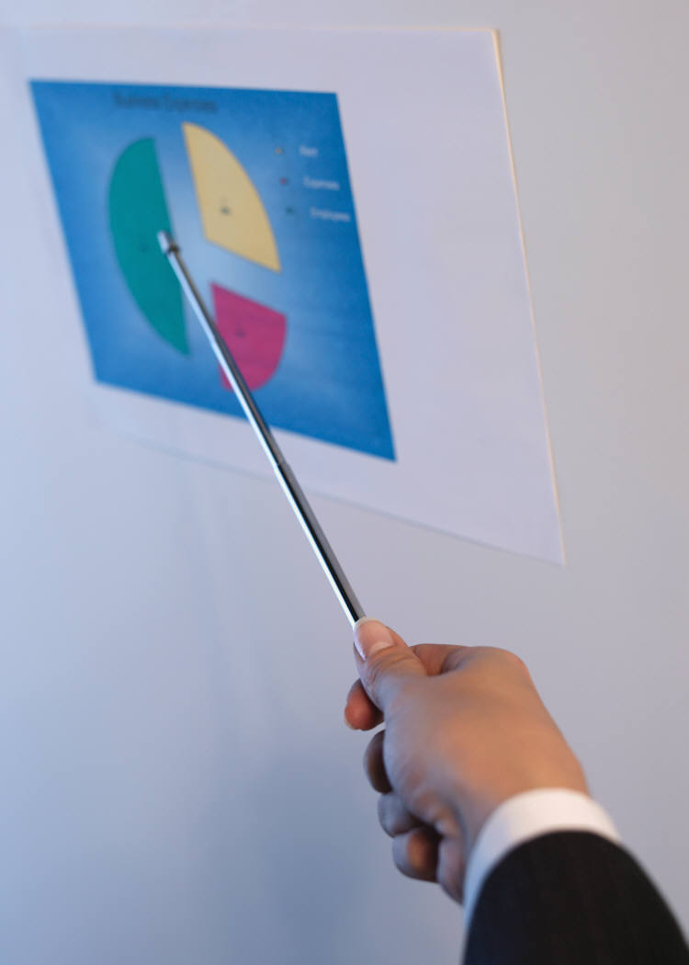
Sales Mix Selection
P 1
When a company sells a variety of products, some are likely to be more profitable than others.
Management concentrates sales efforts on more profitable products.
If production facilities or other factors are limited, producing more of one product usually means producing less of others.
In this case, management must identify the most profitable combination, or sales mix of products.
Management focuses on the contribution margin per unit of scarce resource.
Notes:
All businesses face constraints that affect production and sales decisions. They must make decisions to best utilize constrained resources. When a company sells a variety of products, some are likely to be more profitable than others. Management concentrates sales efforts on more profitable products. If production facilities or other factors are limited, producing more of one product usually means producing less of others.
In this case, management must identify the most profitable combination, or sales mix of products. Management focuses on the contribution margin per unit of scarce resource.
Let’s look at an example.

Slide 29
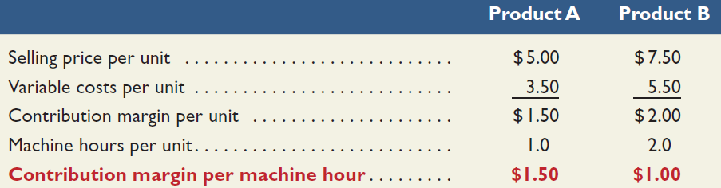
Sales Mix Selection (w/ limited resources)
Example: FasTrac makes and sells two products, A and B using the same machines. A and B have the following selling prices and variable costs per unit:
Per unit | Product A | Product B
Selling price | $5.00 | $7.50
Variable costs | 3.50 | 5.50
However, it takes one hour to produce one unit of Product A,
while it takes two hours to produce one unit of Product B.
We need to figure each product’s contribution margin per machine hour.
(a)
(b)
(a) Times (b)
Decision: Even though Product A’s unit contribution is less, it has a higher contribution margin per machine hour. FasTrac should produce more Product A!
Notes:
FasTrac produces Product A and Product B. The selling prices and variable costs of each product are shown in the top table. In the bottom table, Product A is shown to have a contribution margin of $1.50 per unit and Product B has a contribution margin of $2.00 per unit. If each product requires the same time to make, and the demand is unlimited for each product, FasTrac should produce only Product B because it has the higher contribution per unit.
However, it takes one hour to produce one unit of Product A, while it takes two hours to produce one unit of Product B. If we divide the contribution per unit by the hours required to produce each unit, we find that we generate more contribution per hour if we make Product A, even though its unit contribution is less.
If demand for Products A and B is unlimited, we should produce as many units of Product A as possible, even if that means producing no Product B. By producing Product A, we make $1.50 contribution margin per machine hour worked, which is higher than the $1.00 contribution margin per machine hour that Product B generates.
If demand for Product A is limited, we should produce Product A first, until we satisfy the sales demand; thereafter, we should use any remaining machine time to produce Product B.

Slide 30
Need-to-Know 10.4
P 1
A company produces two products, Gamma and Omega. Gamma sells for $10 per unit and Omega sells
for $12.50 per unit. Variable costs are $7 per unit of Gamma and $8 per unit of Omega. The company has
a capacity of 5,000 machine hours per month. Gamma uses 1 machine hour per unit, and Omega uses 3
machine hours per unit.
1. Compute the contribution margin per machine hour for each product.
2. Assume demand for Gamma is limited to 3,800 units per month, and demand for Omega is
limited to 1,000 units per month. How many units of Gamma and Omega should the company
produce, and what will be the total contribution margin from this sales mix?
(per unit)
Gamma
Omega
Sales
$10.00
$12.50
Variable costs
(7.00)
(8.00)
Contribution margin per unit
$3.00
$4.50
Machine hours per unit
1
3
Contribution margin per machine hour
$3.00
$1.50
Total machine hours available
5,000
Machine hours used for production of Gamma
(3,800 units x 1 MH per unit)
3,800
Machine hours available for production of Omega
1,200
Machine hours used for production of Omega
(1,200 MHs / 3 MH per unit = 400 units)
1,200
Remaining machine hours
0
Notes:
Need-to-Know 10.4
A company produces two products, Gamma and Omega. Gamma sells for $10 per unit and Omega sells for $12.50 per unit.
Variable costs are $7 per unit of Gamma and $8 per unit of Omega.
The company has a capacity of 5,000 machine hours per month. Gamma uses 1 machine hour per unit, and Omega
uses 3 machine hours per unit.
1. Compute the contribution margin per machine hour for each product.
Contribution margin per unit is equal to sales:
$10.00 per unit for Gamma, and $12.50 per unit for Omega; minus variable costs; $7.00 per unit for Gamma and $8.00 per unit for Omega.
Contribution margin is $3.00 per unit for Gamma and $4.50 per unit for Omega.
At first glance, it may look like the production of Omega is more profitable, but we need to consider the limiting resources, in this case machine hours. It only takes one machine hour to produce 1 unit of Gamma, generating $3.00 in contribution margin per machine hour. It takes 3 machine hours to produce each unit of Omega; the contribution margin per machine hour is only $1.50.
2. Assume demand for Gamma is limited to 3,800 units per month, and demand for Omega is limited to 1,000 units per month.
How many units of Gamma and Omega should the company produce, and what will be the total contribution margin from this sales mix?
With the 5,000 available machine hours, the company should choose to produce the units with the highest contribution margin per machine hour, Gamma, producing as many units as the market demands.
The market demand for Gamma is 3,800 units per month, which will require 3,800 machine hours (1 hour per unit).
With the remaining 1,200 machine hours, the company should produce the less profitable units, Omega.
1,200 machine hours divided by 3 MHs per unit will allow the production of 400 units of Omega.

Slide 31
Need-to-Know 10.4
P 1
A company produces two products, Gamma and Omega. Gamma sells for $10 per unit and Omega sells
for $12.50 per unit. Variable costs are $7 per unit of Gamma and $8 per unit of Omega. The company has
a capacity of 5,000 machine hours per month. Gamma uses 1 machine hour per unit, and Omega uses 3
machine hours per unit.
1. Compute the contribution margin per machine hour for each product.
2. Assume demand for Gamma is limited to 3,800 units per month, and demand for Omega is
limited to 1,000 units per month. How many units of Gamma and Omega should the company
produce, and what will be the total contribution margin from this sales mix?
(per unit)
Gamma
Omega
Sales
$10.00
$12.50
Variable costs
(7.00)
(8.00)
Contribution margin per unit
$3.00
$4.50
Machine hours per unit
1
3
Contribution margin per machine hour
$3.00
$1.50
Contribution margin (calculated on a per unit basis)
Gamma
3,800 units x $3.00 contribution margin per unit
$11,400
Omega
400 units x $4.50 contribution margin per unit
1,800
Total contribution margin
$13,200
Contribution margin (calculated on a per machine hour basis)
Gamma
3,800 machine hours x $3.00 contribution margin per machine hour
$11,400
Omega
1,200 machine hours x $1.50 contribution margin per machine hour
1,800
Total contribution margin
$13,200
Notes:
Need-to-Know 10.4
At this sales mix, 3,800 units of Gamma, each contributing $3.00 per unit is a total contribution margin of $11,400 for Gamma,
and 400 units of Omega, each contributing $4.50 per unit is a total contribution margin of $1,800 for Omega.
and 400 units of Omega, each contributing $4.50 per unit is a total contribution margin of $1,800 for Omega.
Total contribution margin is $13,200.
We can prove this answer by calculating the contribution margin per machine hour.
While producing Gamma, the machines run for 3,800 hours generating a contribution margin of $3.00 per machine hour, $11,400.
While producing Omega, the machines run 1,200 hours generating a contribution margin of $1.50 per machine hour, $1,800.
Total contribution margin, $13,200.

Slide 32

Segment Elimination
P 1
A segment is a candidate for elimination if its revenues are less than its avoidable expenses.
Avoidable expenses are amounts the company
would not incur if it eliminated the segment.
FasTrac is considering eliminating its Treadmill Division because it reported a $500 operating loss for the recent year…
Let’s take a closer look at the division’s expenses...
Notes:
Managers should consider eliminating poorly performing segments. A segment may be a division, territory, store, or product line. You have no doubt seen a segment eliminated. It might have been a large segment such as an automobile or it may have been a much smaller segment such as a store or restaurant closing.
How should we make segment elimination decisions? Let’s look at an example from FasTrac whose Treadmill Division’s total expenses are greater than its sales.

Slide 33
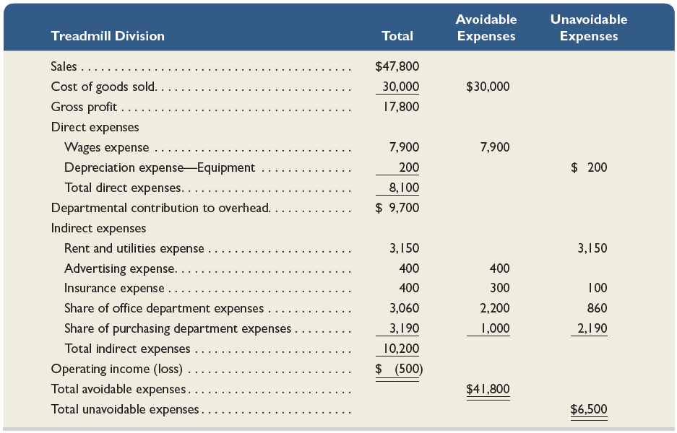
Segment Elimination
P 1
Exhibit 10.11
Notes:
Here we see the total costs in the Treadmill Division. To make the correct decision, we need to know the amount of costs that will be avoided (saved) if we eliminate the Treadmill Division. A segment is a candidate for elimination only if its revenues are less than its avoidable costs.
If we eliminate the Treadmill Division, we will avoid total costs of $41,800. The last column in the table shows the unavoidable expenses of the division. The $6,500 of expenses shown in this column, are unavoidable and would be incurred even if the Treadmill Division is discontinued. These costs are irrelevant to the decision because they are the same for either alternative. Let’s focus on Avoidable expenses and revenues…

Slide 34

Segment Elimination
P 1
Do not eliminate
the Treadmill Division!
Notes:
Because this division’s sales are $47,800, eliminating the division would reduce FasTrac’s income by $6,000 ($47,800-$41,800).
The Treadmill Division’s sale revenue is greater than its avoidable expenses by $6,000. If FasTrac eliminates the Treadmill Division, the company’s income will be $6,000 less. We would have made an incorrect decision using total costs. Remember-we must compare avoidable expenses to sales revenue to make the correct decision.

Slide 35
Need-to-Know 10.5
P 1
A bike maker is considering eliminating its tandem bike division because it operates at a loss of $6,000
per year. Sales for the year total $40,000, and the company reports the costs for this division as shown
below. Should the tandem bike division be eliminated?
Avoidable Expenses
Unavoidable Expenses
Cost of goods sold
$30,000
Direct expenses
8,000
Indirect expenses
2,500
$3,000
Service department costs
250
2,250
Total
$40,750
$5,250
Keep Tandem Division
Eliminate Tandem Division
Sales
$40,000
$0
Total costs and expenses
46,000
5,250
Net income (loss)
($6,000)
($5,250)
Quantitative Analysis: Total avoidable costs of $40,750 are greater than the division’s sales of $40,000, suggesting the division should be eliminated.
Other factors might be relevant, since the shortfall in sales ($750) is low. For example,
are sales expected to increase in the future? Does the sale of tandem bikes help sales of other types
of products?
Notes:
Need-to-Know 10.5
A bike maker is considering eliminating its tandem bike division because it operates at a loss of $6,000 per year.
Sales for the year total $40,000, and the company reports the costs for this division as shown below.
Should the tandem bike division be eliminated?
If the tandem division is kept, sales of $40,000 minus total costs and expenses, both the avoidable and unavoidable expenses of $46,000 is an operating loss of $6,000.
If the division is eliminated, sales will be $0, but the unavoidable expenses of $5,250 will remain.
The operating loss is $5,250.
Based on this information alone, the tandem division should be eliminated.
It makes sense to give up $40,000 in revenues if, in doing so, you can avoid $40,750 in expenses. You are $750 better off.
Of course, other factors might be relevant. For example, are sales expected to increase in the future? Does the sale of tandem bikes help sales of other types of products?

Slide 36
Keep or Replace Equipment
FasTrac can purchase a new machine for $100,000 and receive $25,000 in return for trading in an old machine with a market value of $25,000. The new machine will reduce manufacturing costs by $18,000 per year.
*18,000 x 4 years
Decision: FasTrac should not replace the old equipment with this newer version as it will decrease income by $3,000!
Notes:
Businesses periodically must decide whether to keep using equipment or replace it.
For example, FasTrac has a piece of manufacturing equipment with a book value (cost minus accumulated depreciation) of $20,000 and a remaining useful life of four years. At the end of four years the equipment will have a salvage value of zero. The market value of the equipment is currently $25,000.
FasTrac can purchase a new machine for $100,000 and receive $25,000 in return for trading in its old machine. The new machine will reduce FasTrac’s variable manufacturing costs by $18,000 per year over the four-year life of the new machine. FasTrac’s incremental analysis is shown in this slide.
FasTrac should not replace the old equipment with this newer version as it will decrease income by $3,000.

Slide 37
Determine product selling price based on total costs.
Notes:
10-A2:
Determine product selling price based on total costs.

Slide 38
Setting Product Price
A 2
There are several methods to help management in setting prices for their products. The cost-plus methods are probably the most common, where management adds a markup to cost to reach a target price.
The total cost method, is described below.
Four Steps:
Step 1: Determine total costs
Total costs =
Production (DM, DL
& OH) costs
Nonproduction (selling and admin) costs
+
Step 2: Determine total cost per unit
Total cost per unit = Total costs ÷ Total units expected to be produced and sold
Step 3: Determine the dollar markup per unit:
Markup % =
Desired profit
Total costs
Markup per unit = Total costs per unit x Markup percentage
Step 4: Determine selling price per unit:
Selling price per unit = Total costs per unit + Markup per unit
Notes:
Relevant costs are useful to management in determining prices for special short-term decisions. But longer run pricing decisions of management need to cover both variable and fixed costs, and yield a profit.
There are several methods to help management in setting prices. The cost-plus methods are probably
the most common, where management adds a markup to cost to reach a target price. The total cost method, where management sets price equal to the product’s total costs plus a desired profit on
the product is described on this slide. It is a four-step process:
Step 1: Determine total costs. The formula to determine this is:
Total costs will equal Production costs that include (direct materials, direct labor, and overhead) and then we add Nonproduction costs including (selling and &administrative costs).
Step 2: Determine total cost per unit. The formula is:
Total cost per unit is equal to Total costs divided by Total units expected to be produced and sold
Step 3: We need to determine the dollar markup per unit. The formula for this is
Markup per unit is equal to Total cost per unit times the Markup percentage. Where the markup percentage is equal to the desired profit divided by the total costs from step #1.
Step 4: The final step is to determine the actual selling price per unit.
The Selling price per unit is equal to Total cost per unit + Markup per unit from step #3
Let’ look at one example…

Slide 39
Setting Product Price
A 2
A company that produces MP3 players desires a 20% return on its assets of $1,000,000 and expects to produce and sell 10,000 players. Cost information follows
Variable costs (per unit)
Production costs | $44
Nonproduction costs | 6
Fixed costs (in dollars)
Overhead | $140,000
Nonproduction | 60,000
We apply our four-step process to determine price.
Step 1: Determine total costs
Total costs =
[($44 x 10,000 units) + $140,000]
+
[($6 x 10,000 units) + $60,000] = $700,000
Step 2: Determine total cost per unit
= $700,000/ 10,000 units= $70/per unit
Step 3: Determine the dollar markup per unit:
$70 x [(20% x $1,000,000)/$700,000] = $20/per unit
Step 4: Determine selling price per unit:
Selling price per unit = $70 + $20 = $90
Notes:
To illustrate, consider a company that produces MP3 players. The company desires a 20% return on its
assets of $1,000,000, and it expects to produce and sell 10,000 players. The variable and fixed costs for the company are shown in the table. To determine the product price, we will apply our four-step process as shown on the screen.
The selling price will be $90 which includes the total cost per unit of $70 plus a $20 markup.
Companies use cost-plus pricing as a starting point for determining selling prices. Many factors determine price, including consumer preferences and competition.

Slide 40
Setting Product Price
A 2
A company that produces MP3 players desires a 20% return on its assets of $1,000,000 and expects to produce and sell 10,000 players. Cost information follows
Variable costs (per unit)
Production costs | $44
Nonproduction costs | 6
Fixed costs (in dollars)
Overhead | $140,000
Nonproduction | 60,000
Let’s verify the price yielded the desired profit of $200,000 (20% x $1,000,000.)
= $70 + $20 = $90
In Step 4 we Determined the selling price need to be:
Simplified Income Statement
Sales ($90 x 10,000) | $900,000
Expenses:
Variable ($50 x 10,000) | 500,000
Fixed ($140,000 + $60,000) | 200,000
Income | $200,000
A simplified income statement using the above information and our estimated selling price of $90, yields a $200,000 profit which is a 20% return on our $1,000,000 of assets.
Notes:
To verify that our price yields the $200,000 desired profit (20% x $1,000,000), we compute the following simplified income statement using the cost information for the company.
Based on a estimated selling price of $90 per unit, the company estimates that it will earn a $200,000 profit. This is a 20% return on its assets of $1,000,000.

Slide 41
Homework assignment
Using Connect – 8 Questions for 60 Points; Chapter 10.
Prepare for EXAM # 3 covers Chapters 7, 8, and 9 on 4/18.
Last day of the Homework for Chapters 7, 8, and 9 is 4/17 at 11:59 PM.
Prepare chapter 11 “Capital Budgeting and Investment Analysis.” for 4/26 meeting
Happiness is having all homework up to date

Slide 42
Thank you, and see you, Next Week at the Same Time

