Slide 1
Visual Analysis Process
Follow Visual Analysis Process to research, describe and analyze the following images:
Identify the artist or photographer who created the image.
Research the context, original audience and background of when and where he created it.
Describe the picture in specific detail.
Analyze the image and explore its possible meanings or (mis)interpretations.

Slide 2
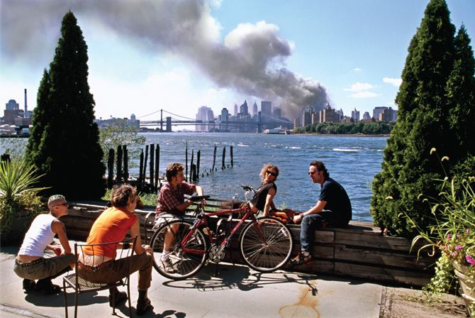
FIGURE 14.1 New York City, September 11, 2001. © Thomas Hoepker/Magnum.

Slide 3
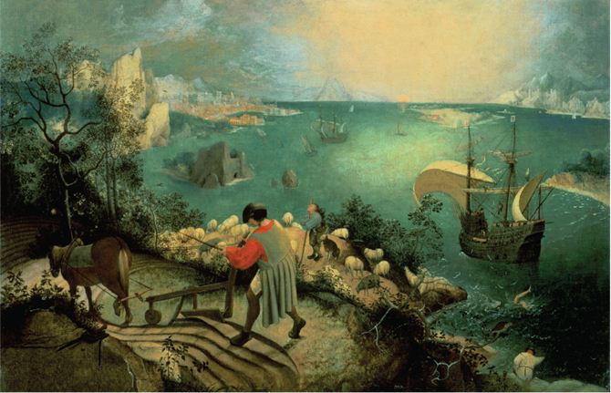
FIGURE 14.2 Pieter Breughel’s Fall of Icarus (ca 1554–1555).

Slide 5
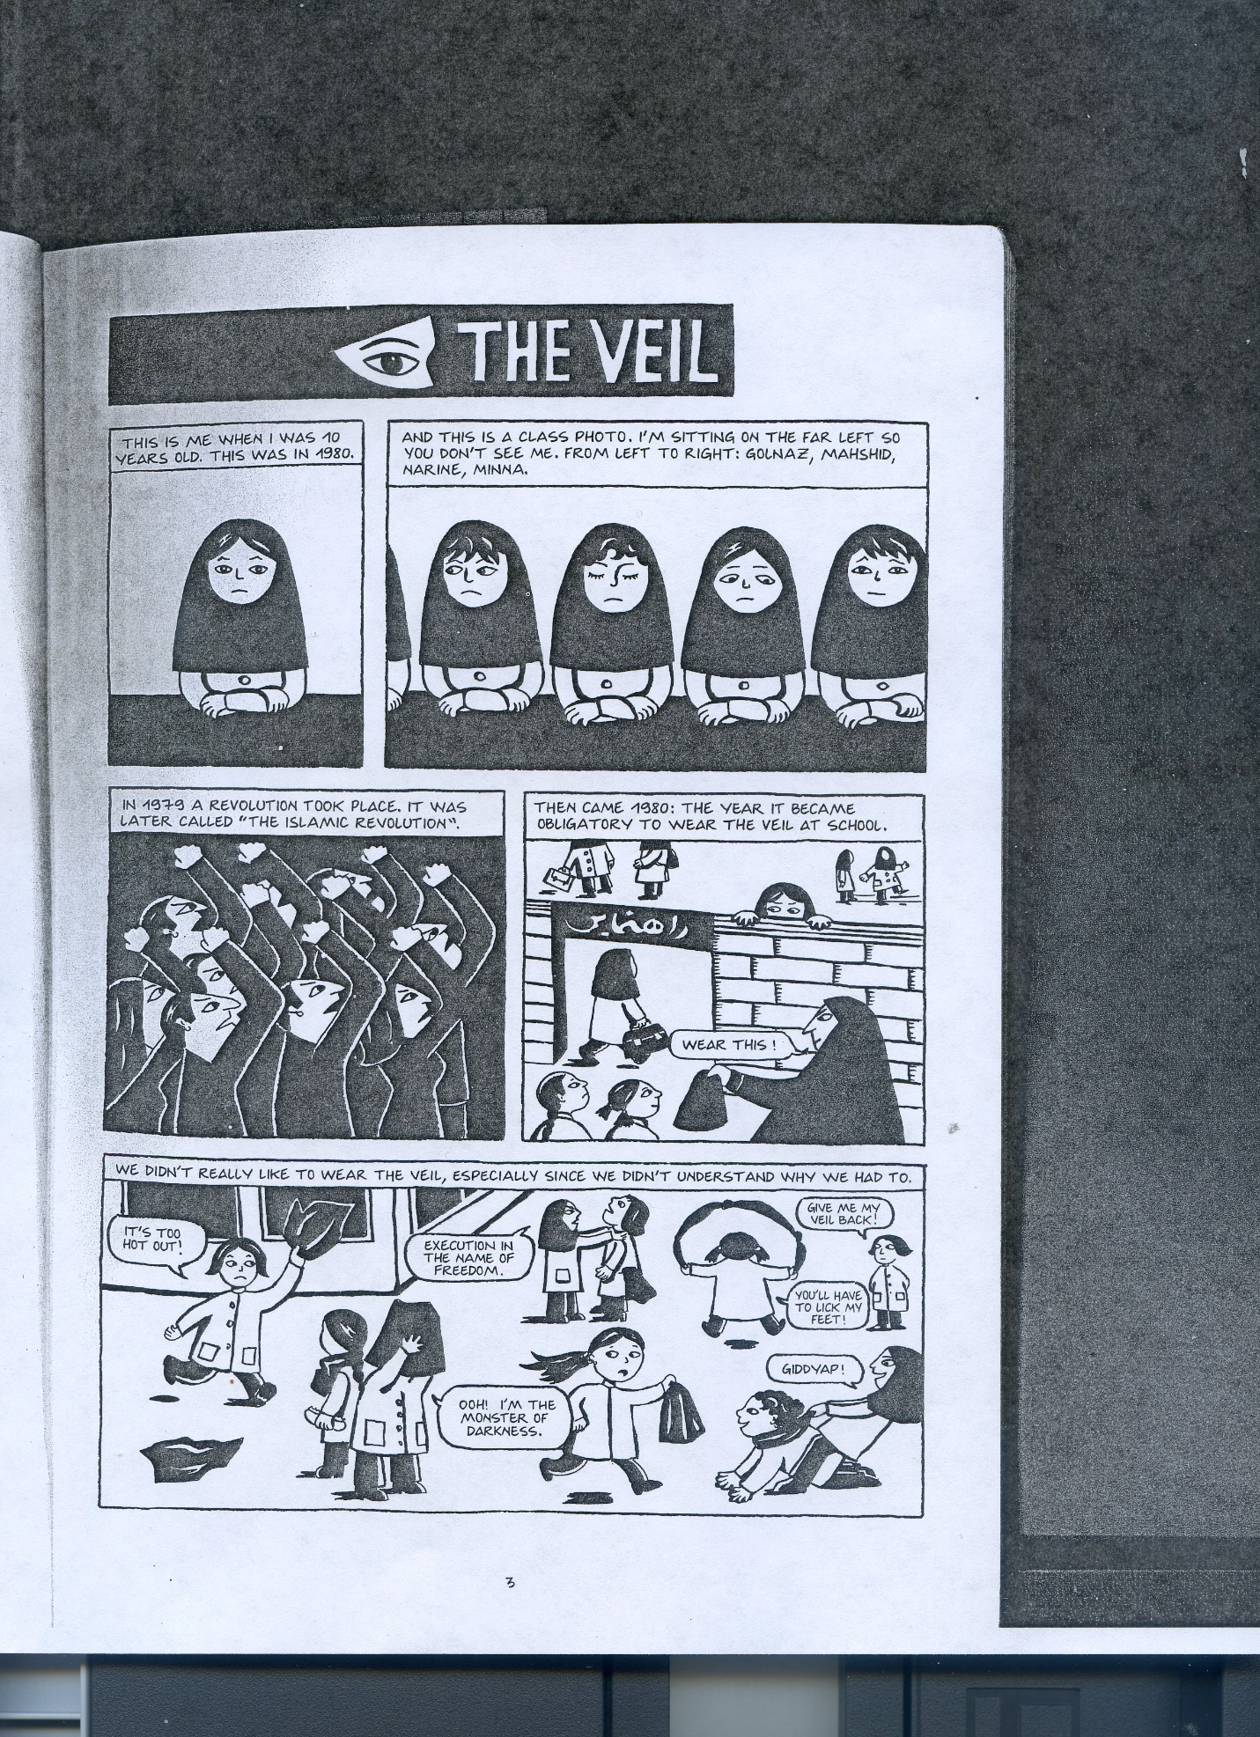

Slide 6
Visual Analysis Process
Describe your First Impressions of the Visual Text: Identify what kind of picture or image this is (photo, painting, graphic novel, etc.) and whether it is purely visual or multimedia.
Provide your first responses and impressions of the picture.
Explore the Visual Elements and Describe Important Details: Describe the painting, photo or drawings. In particular, explore the artist’s use of black and white or color, point of view, composition, drawing style, use of light/dark contrast, close-ups or unusual angles, focus of attention, lettering and other visual elements.
Consider the context and history of the image: Identify the author, artist or photographer, and find out when, where and for whom this picture was originally created. Explore the purposes, audience and background of the image. Explain the personal, historical or cultural influences on the painting or drawings.
Research the process used to create the image: If this image is multimedia, how does it combine words with pictures, photos and drawings. What are the size, style or font of the lettering, and where is it placed?
Reconsider your initial reactions: Interpret the different possible meanings of the graphic novel’s story and drawings. Write a persuasive interpretation, including your first impressions and reconsiderations.

