Slide 1
The French in Texas

Slide 2
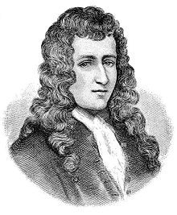
René-Robert Cavelier, Sieur de La Salle

Slide 3
Traveled from Canada down the Mississippi River and to the Gulf
Settled and colonized a land calling it Louisiana in honor of Louis XIV
Presence of La Salle and the French threatened the Spanish

Slide 4
Spanish had colonies in Florida and Mexico
French colony would increase their influence over the Indians with the rich fur trade and bring them closer to Spanish lands with silver mines.
Got permission from the King to enter the Mississippi a second time.
Headed back and got off track or miscalculated his original maps and landed in the Gulf region of Texas.
With men, women and children disaster soon struck the French expedition.

Slide 5
Trying to aim for the Nueces River and its mouth, La Salle ended up around Aransas Pass.
Marched back to Matagorda Bay heading back to the Mississippi River.
Belle safely made the trip up the pass and channel (Pass Cavallo)
Aimable attempted to pass through the channel and got stuck.

Slide 6
La Salle and his crew met the Karankawas
The Indians quickly helped themselves to the cargo and a clash broke out between the Indians and French.
The captain of the Joly offered to get help, but was declined.
The Joly and its crew finally left to France leaving La Salle alone with 200 colonists.

Slide 7
La Salle made many efforts to explore the area around Matagorda Bay area.
La Salle and a small party headed west to the Pecos River and Rio Grande and came back.
Headed north to Canada and encountered a fraction of the Caddo tribes called the Hasinais Indians between the Trinity and Sabine Rivers.
The Indians welcomed them with comfort and food.
Many of La Salle’s men lived with the Indians, while others died and other went with La Salle.
La Salle was shot, ambushed and later killed when he went to look and find his men who had splintered from group.

Slide 8
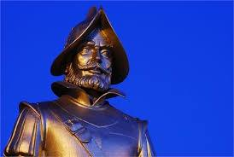
Alonso de León

Slide 9
The Spanish learned about La Salle’s travel in Texas and sent many expeditions to go and find any trace of La Salle, the French and their colony.
From the mid 1680s to late 1680s, Spanish explorers went from the Rio Grande to Gulf, up the coast to East Texas.
They eventually found the remains of the colony in Matagorda and the Belle and Aimable.

Slide 10
