Slide 1
Spanish Texas in Age of Revolutions

Slide 2
Cattle from Texas to Louisiana
During the American Revolution war
Aid and provide meat to Spanish soldiers in 1779.

Slide 3
Settlements in Spanish Texas
Land was given to those who paid a fee
4,428 acres of land was the norm of land given out
Ranching in Spanish Texas was the new norm and growing industry
Men and women in Spanish Texas lived to survive
Most were illiterate and their children were too

Slide 4
Transportation in Spanish Texas
Roads were thin and spread out
1st: stretch of road was the Kings Highway – San Bautista (Rio Grande to San Antonio) to Natchitoches
2nd: Laredo to La Bahia then NE to connect with Camino Real at the Trinity River

Slide 5
Conflicts with Indians
Indians and Spain constantly battled or established trading posts and relationships
Apaches and Comanches were fighting and facing turmoil in land and resources.
Eventually the Spanish made peace and treaties with the Comanches and the defeat of the Apaches left Karankawa only hostile Indians to the Spanish

Slide 6
Spain had to keep a wary eye on the US after the Revolutionary War ended
Expansion west from 13 colonies across Mississippi River became a threat with extension of slaves.

Slide 7
Spain began to work on lessening the threat from the US by opening trade/commerce/immigration in Spanish lands touching or close to US lands.
French Revolution erupted and caused many Europeans to wage war against France
Spain welcomed lots of immigrants into Louisiana in late 1700s.

Slide 8
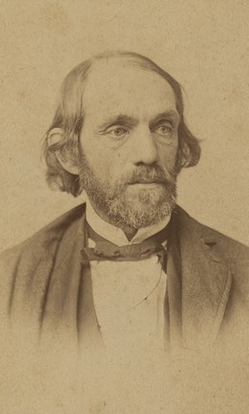
Philip Nolan

Slide 9
Philip Nolan
First known intruder from the US into Texas
He got permission from LA governor and was detained with his goods
He made another attempt to cross into Texas from LA
Crossed over the Trinity River
Set up camp on a tributary of the Brazos River
Captured mustangs in area
Traded with Caddos and Wichitas

Slide 10
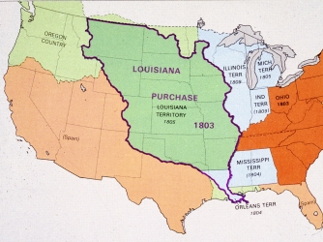
Louisiana Purchase
Napoleon Bonaparte sold the land to Jefferson for $15 million

Slide 11
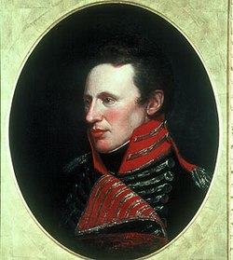
Zebulon Montgomery Pike

Slide 12
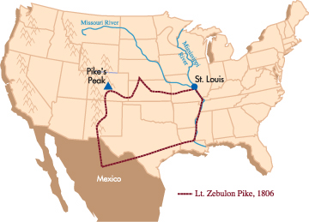
Zebulon Montgomery Pike Expedition

