Slide 1
The U.S. Economy:
Public and Private Sectors
Please listen to the audio as you work through the slides.

Slide 2
The U. S. Economy:
Private and Public Sectors:
Household, Business, Government
Learning objectives
Students should be able to thoroughly and completely explain:
The roles of Government.
Market failure – definitions, sources, spillover costs, spillover benefits.
Public goods and private goods – including the free-rider problem.
The circular flow model with government.
The characteristics of federal, state, and local financing.

Slide 3
Household Sector

Slide 4
Household Income
Functional distribution of income
Types of income
Wage, rent, interest, profit
Personal distribution of income
Division among households by quintile
4-4

Slide 5
Functional Distribution of Income 2007
National Income Received (Percent)
0 10 20 30 40 50 60 70
Wages &
Salaries
71%
Rents
1%
Income By Function Performed
Interest
5%
Proprietor’s
Income
9%
Corporate
Profits
14%
Source: Bureau of Economic Analysis
4-5

Slide 6
Personal Distribution of Income 2006
Personal Income Received (Percent)
0 10 20 30 40 50 60
Lowest
20%
3.4%
Second
20%
8.6%
Income Group (Households)
Middle
20%
14.5%
Fourth
20%
22.9%
Highest
20%
50.5%
Source: Bureau of the Census
4-6

Slide 7
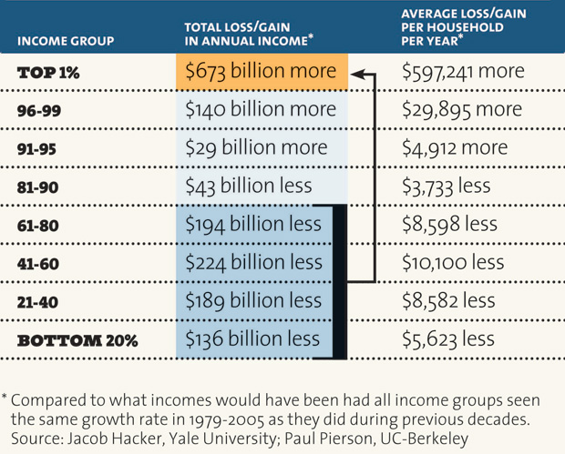
Income Redistribution 1979 to 2005

Slide 8
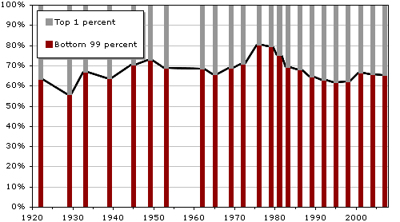
Share of wealth held by the Bottom 99% and Top 1%
in the United States, 1922-2007.

Slide 9
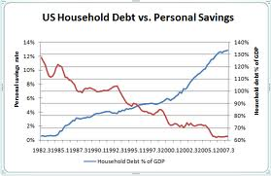
1982 to 2007
Personal debt
Personal Savings rate

Slide 10
Income and wealth gaps
The Price of Income Inequality
By
Professor Joseph Stiglitz
A very readable book for those interested in learning more about Income Inequality

Slide 11
Households as Spenders
Uses of household income
Personal taxes (13%)
Personal saving (1%)
Personal consumption (86%)
Durables (11%)
Nondurables (29%)
Services (60%)
4-11

Slide 12
Business Sector

Slide 13
The Business Population
Plant
Firm
Multiplant (Multi-location) Firms
Vertical Integration
Merger of firms at different stages of production and/or distribution in the same industry When a firm acquires its input supplier it is called backward integration, when it acquires firms in its output distribution chain it is called forward integration.
Oil company acquires oil fields and refineries, tankers, trucks, and gas stations. How about food companies?
Horizontal Integration
The acquisition of additional business activities at the same level of the value chain, often through mergers and acquisitions.
An auto manufacturer acquires a SUV manufacturer
Media company acquires radio, TV, newspapers, and magazines. An east coast retailer merges with a west coast retailer of similar products. United and Continental airlines.
Conglomerates
Industry

Slide 14
Some Legal Forms of Business Organization
Sole proprietorship
Partnership
Corporation
20%
Corporations
8%
Partnerships
Corporations
84%
72%
Sole Proprietorships
Partnerships
11%
Sole Proprietorships
5%
Percentage of Firms
Percentage of Sales
Source: U. S. Census Bureau
4-14

Slide 15
Some Legal Forms of Business Organization
Sole Proprietorship
Advantages
Easy to Organize
Proprietor is Own “Boss”
Disadvantages
Limited Resources
No Help With Decision Making
Unlimited Liability

Slide 16
Some Legal Forms of Business Organization
Partnership
Advantages
Easy to Organize
More Management Skills
Greater Resources Available
Disadvantages
Difficulty Making Decisions
Possibly Limited Financial Resources
Partnership Continuity Problems
Unlimited Liability

Slide 17
Some Legal Forms of Business Organization
Corporation
Advantages
Most Effective Raising Capital - Stocks, Bonds
Limited Liability
Easy Expansion of Size & Scope
Infinite Life
Disadvantages
Corporate Regulations & Legal Expenses
Some Unscrupulous Practices
Double Taxation
Separation of Ownership & Control

Slide 18
Some Legal Forms of Business Organization
Some Hybrid Corporate Structures
Limited-Liability Company (LLC)
Like partnership for tax purposes, but like a corporation relative to liability.
S-Corporation
75 or less shareholders
Profit flows to owners like sole proprietorship, no double taxation, limited liability.

Slide 19
Citizens United Supreme Court Case
First Amendment rights of corporations, a bitterly divided Supreme Court ruled that the government may not ban political spending by corporations in candidate elections.
Connect the dots:
what are the implications of this Court decision?

Slide 20
Principal-Agent Problem
A potential disadvantage of corporations
Stockholders are principals
Executives are agents
Conflict of interest?
4-20

Slide 21
Government Sector AKA Public Sector

Slide 22
The Public Sector
Federal, state, and local government
What is the role of the government in the economy?
4-22

Slide 23
Government's Roles
1. Provide the legal structure
Set the laws we live by
2. Maintain competition
Fight Monopoly, antitrust laws
3. Redistribute income
Transfer payments
Market intervention
Taxation
Reallocate resources
Promoting stability
4-23

Slide 24
Government's Role
1. Providing the Legal Structure
Legislative and Judicial branches
(state, local, federal)
2. Maintaining Competition
No Monopoly - one firm dominating the market
Examples ? - Comcast & Time Warner Cable
Regulation
Banking – Glass–Steagall Act 1933 repealed in 1999
FTC – Federal Trade Commission
FCC – Federal Communications Commission
Antitrust Division of Justice Department
Regulated Monopolies – Utilities

Slide 25
Government's Role
3. Redistributing Income – some approaches
Transfer Payments – welfare checks, food stamps, etc.
Market Intervention – above-market farm prices, agricultural subsidies, minimum wage
Taxation – progressive income tax
Government subsidies to corporations – agriculture, oil, ethanol, Boeing, coal, corn, hybrid and electric cars, nuclear power plants, etc.

Slide 26
Government's Role
4. Reallocating Resources to address Market Failures
Market Failure defined:
The market system produces the wrong amount of goods and services, or
Fails to allocate resources to goods and services that are economically justified!
Some results of Market Failure:
Global warming
Food Insecurity
Poverty

Slide 27
Government's Role
4. Reallocating Resources
Market Failure
Sources of Market Failure
Imperfect Market Structures
The existence of Public Goods
Presence of External Costs and External Benefits
Imperfect Information

Slide 28
Sources of Market Failure
Imperfect Market Structures
Single or small number of firms have some control over price, output, and compensation, etc.
Oligopoly – small number of firms with large market share
Examples?
Food, Oil, etc.
Monopoly – one firm that dominates the market
Leads to inefficient allocation of resources

Slide 29
Sources of Market Failure
The existence of Public Goods:
Definition: Goods and services that bestow collective benefits on members of society – Examples?
Everyone can receive the benefits of the good.
No one can be excluded from receiving the benefits of Public Goods.
In an unregulated market economy, public goods and services would be under-produced or not produced.

Slide 30
Sources of Market Failure
Imperfect Information between buyers and sellers
Absence of full knowledge concerning product characteristics, available prices, etc.
Food
Insurance
Cars
Healthcare
Leads to mis-allocation of resources

Slide 31
Sources of Market Failure
Spillovers or Externalities
Costs or benefits that are passed on to someone other than the seller or buyer (a third party)

Slide 32
Spillover Costs
A production or consumption cost inflicted on a third party without compensation.
Some Examples:
Poultry production
Beef Production
Farming
Auto Manufacturing
Oil production
http://rt.com/usa/wvirginia-chemical-spill-again-water-617/

Slide 33
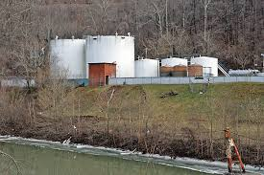
2014 Elk River Chemical Spill in West Virginia
The Elk River chemical spill occurred on January 9, 2014 when crude 4-methylcyclohexanemethanol (MCHM) was released from
a Freedom Industries facility into the Elk River, a tributary of the Kanawha River, in Charleston in the U.S. state of West Virginia.

Slide 34
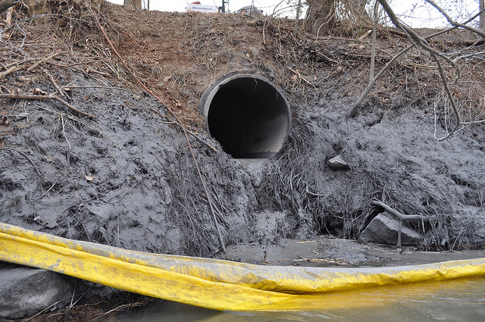
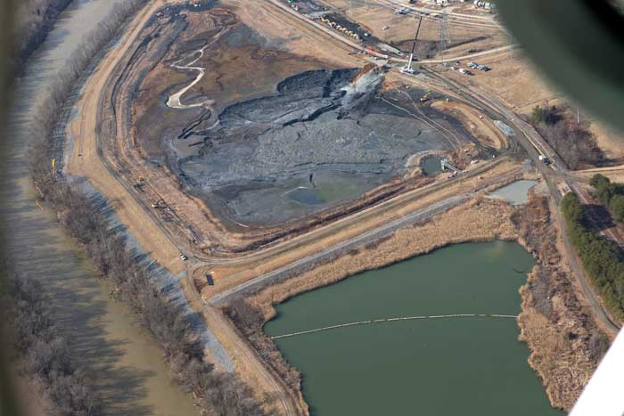
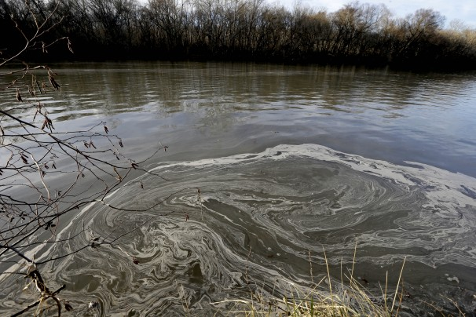
Duke Energy Apologizes for North Carolina Coal Ash Spill

Slide 35
Economic Effects of Spillover Costs
Firm avoids costs, why?
Supply curve shifts to right, why?
Product price is too low and output is too high to achieve economic efficiency.
Market failure occurs as an overallocation of resources to the production of the good.
What does this really mean?

Slide 36
Correcting Spillover Costs
Correcting the problem of overallocation of resources
Operate on the supply curve
Make offenders cover their spillover costs. (Internalize the external costs).
Approaches:
Legislation / regulation (most direct)
prohibit or limit, legal threat how would this work?
Specific Taxes (less direct) – impacts the supply
curve via costs. How would this work?
Want to impact the producers supply curve via cost, to shift it to the left and eliminate the overallocation of resources to that good.

Slide 37
Spillover Benefits
Spillover Benefits – spillovers of benefits to third parties without compensating payment. Could be to individuals as well as the community at large.
Examples:
getting free use of your neighbors’ wifi
College education
A contribution to public television benefits some who watch it but have not contributed themselves
Market demand curve understates total benefits. Why?
Market demand curve lies further to the left than if the market took all benefits into account because not all demands were revealed. Why?
Result – smaller amount of product will be produced, under allocation of resources to the product = market failure

Slide 38
Spillover Benefits
Correcting spillover benefits
Operate on both supply and demand curves
Subsidize Consumers (to increase demand) – student loans increase the demand for education.
Subsidize producers (to increase supply) – state governments subsidizing colleges and lower the cost of producing higher education (increase supply)
Government Provision – US postal service, federal aircraft control systems

Slide 39
Public versus Private Goods
Private Goods – produced through competitive market system
Characteristics of private goods
Rivalry – one person buys, no on else can buy that particular item
Excludability – buyers who are willing and able to pay get the benefit.
These characteristics enable profitable production by a private firm

Slide 40
Public Goods and Services
Characteristics
Nonrivalry & Nonexcludability
Nonrivalry - everyone can obtain the benefits at once. national defense, street lighting, environmental protection.
Nonexcludability - No way to exclude once the good exists.
Free-Rider Problem
Created by the inability to exclude from the benefits. People can receive benefits from a public good without contributing to paying for it.
Quasi-Public Goods
Exclusion possible but government provides anyway. Education, police and fire protection, streets, libraries, museums, etc

Slide 41
PUBLIC SECTOR: Government's Role
5. Promoting Stability
The economy’s level of output depends on level of total spending relative to production capacity.
Unemployment – private sector spending too low
Inflation – excessive total spending pushes prices up

Slide 42
The Circular Flow Revisited
Resource
Market
Costs
Money Income
Resources
Input Factors
Expenditures
Resources
Goods &
Services
Goods &
Services
Businesses
Government
Households
Net Taxes
Net Taxes
Expenditures
Goods &
Services
Goods & Services
Goods & Services
Product
Market
Revenue
Consumption
4-42

Slide 43
The Circular Flow Revisited
Import & export
Resource
Market
Money flows
Costs
Money Income
Resources
Input Factors
Expenditures
Resources
Goods &
Services
Goods &
Services
Businesses
Government
Households
Rest
Of the
World
Net Taxes
Net Taxes
Expenditures
Goods &
Services
Goods & Services
Import & export
Goods & Services
Money flows
Product
Market
Revenue
Consumption
4-43

Slide 44
Government Finance
Government purchases
Government transfers
35
30
25
20
15
10
5
0
Government
Transfer
Payments
32%
27%
5%
13%
Percentage of U.S. Output
22%
19%
Government
Purchases
1960
2007
4-44

Slide 45
Government Revenue
Total Tax Revenue, Approximate Percentage of GDP, 2007
10 20 30 40 50
Sweden
Denmark
Finland
France
Italy
Germany
United Kingdom
Canada
Australia
United States
Japan
South Korea
58
55
51
51
46
43
42
40
35
34
33
32
Source: Organization for Economic Cooperation and Development
4-45

Slide 46
Federal Expenditures
Percentage of total expenditure ($2,731 billion), 2007
0 10 20 30 40 50
Pensions &
Income Security
34%
National
Defense
21%
Health
24%
Interest on the
Public Debt
9%
Source: U. S. Office of Management and Budget
4-46

Slide 47
Federal Tax Revenues
Sources of total tax revenue ($2,568 billion), 2007
0 10 20 30 40 50
Personal
Income Tax
45%
Payroll
Taxes
34%
Corporate
Income Taxes
14%
Excise
Taxes
3%
All
Other
4%
Source: U. S. Office of Management and Budget
4-47

Slide 48
Personal Income Tax
Progressive tax rates
Brackets of income
Marginal tax rate
Average tax rate
4-48

Slide 49
State Finances
Primary Revenues
Sales & Excise Taxes (47%)
Personal Income Taxes (35%)
Corporate Income Taxes
& License Fees (18%)
4-49

Slide 50
State Finances
Primary Expenditures
Education (36%)
Public Welfare (28%)
Health & Hospitals (7%)
Highways (7%)
Public Safety (4%)
Other (18%)
4-50

Slide 51
Local Finances
Primary Revenues
Property Taxes 73%
Sales & Excise Taxes 17%
Primary Expenditures
Education 44%
Welfare, Health & Hospitals 12%
Public Safety 11%
Housing, Parks, & Sewers 8%
Streets & Highways 5%
4-51

Slide 52
Financing Social Security
Demographic changes
Long-run shortfall in funding
Pay-as-you-go plan
Trust fund withdrawals by Government
Trust fund exhausted in 2041
Benefit reductions?
Tax revenue increases?
4-52

Slide 53
Financing Social Security
Possible solutions
Stock & bond investments
Payroll tax increases
Individually directed accounts
Privately owned and managed accounts
Consensus difficult
4-53

Slide 54
Key Terms
monopoly
externality
negative externalities
positive externalities
public goods
free-rider problem
quasi-public goods
government purchases
transfer payments
personal income tax
marginal tax rate
average tax rate
payroll taxes
corporate income tax
sales and excise taxes
property taxes
functional distribution of income
personal distribution of income
durable goods
nondurable goods
services
plant
firm
industry
sole proprietorship
partnership
corporation
stock
bond
limited liability
principal-agent problem
4-54

