Slide 1
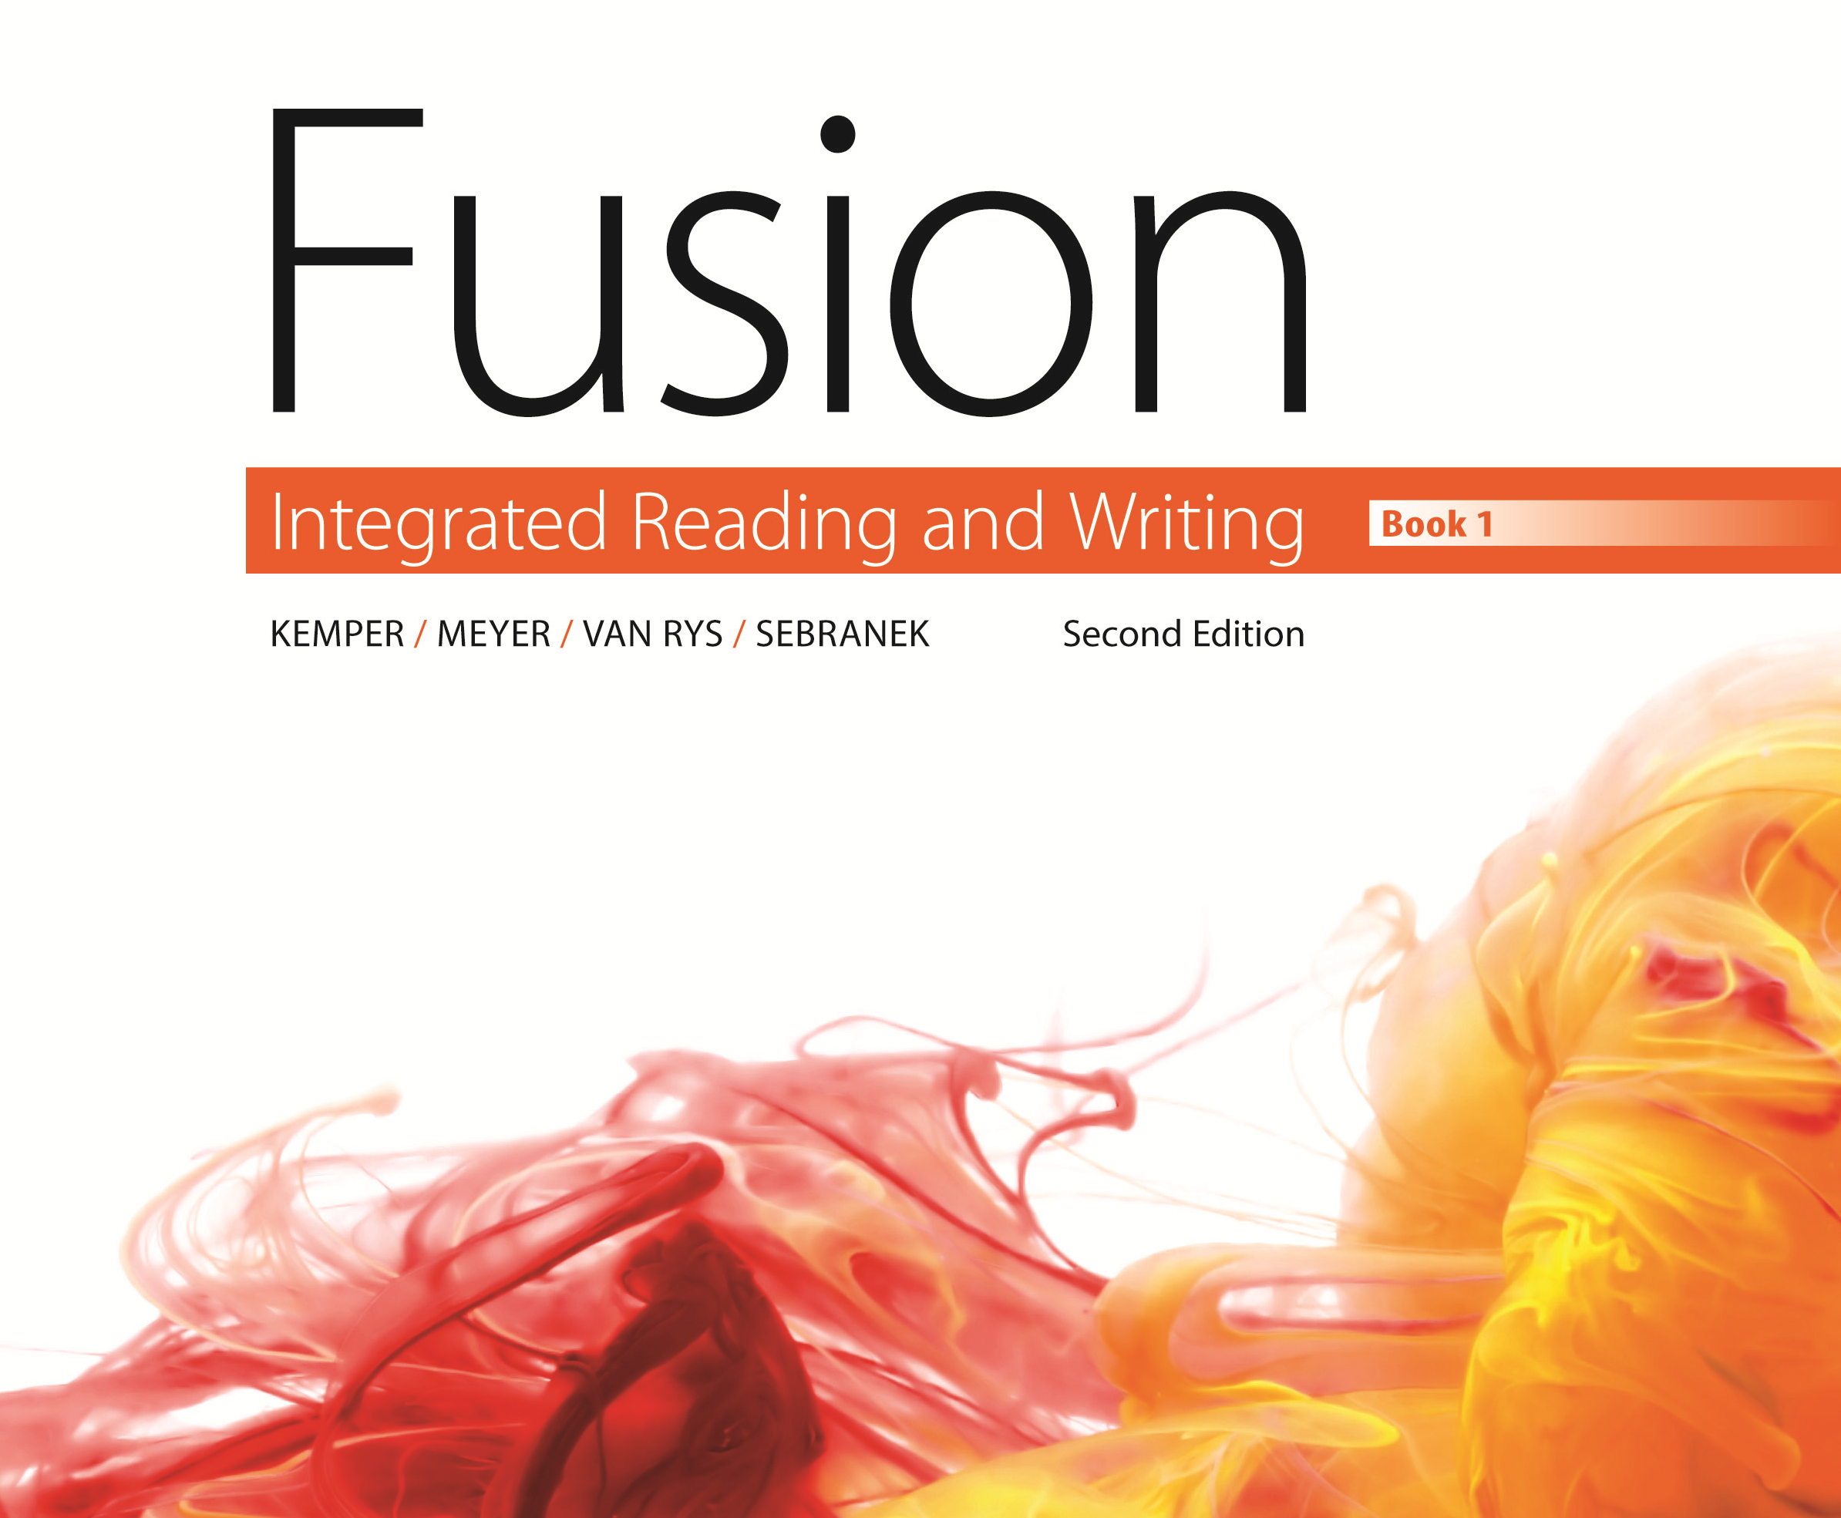
Ch. 18 - Noun

Slide 2
Opening Activity
Identify the underlined nouns as common nouns or proper nouns.
Independence Day is July 4th.
Many bank assistants have Fridays off.
Missy exchanged her dollars for euros.
The Department of Homeland Security works with local airports.

Slide 3
Answers
Identify the underlined nouns as common nouns or proper nouns.
Independence Day is July 4th. (PROPER)
Many bank assistants have Fridays off. (COMMON)
Missy exchanged her dollars for euros. (COMMON)
The Department of Homeland Security works with local airports. (PROPER)

Slide 4
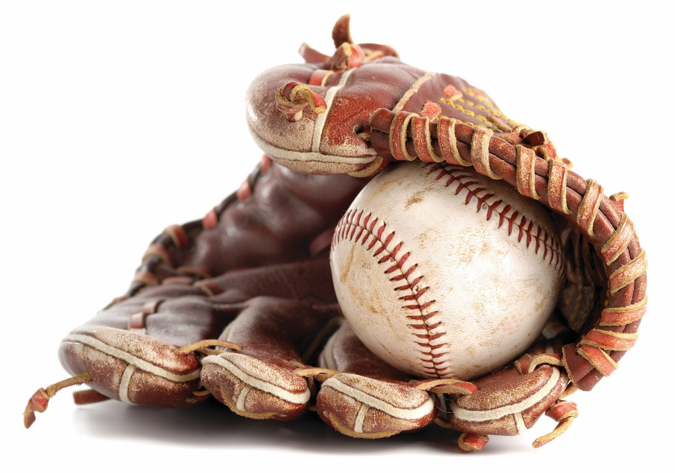
Learning Outcomes
By the time you finish reading and studying this chapter, you should be able to:
Recognize and use
LO1 Classes of Nouns
LO2 Number of Nouns
LO3 Count and Noncount Nouns
L04 Articles with Nouns
L05 Other Noun Markers

Slide 5
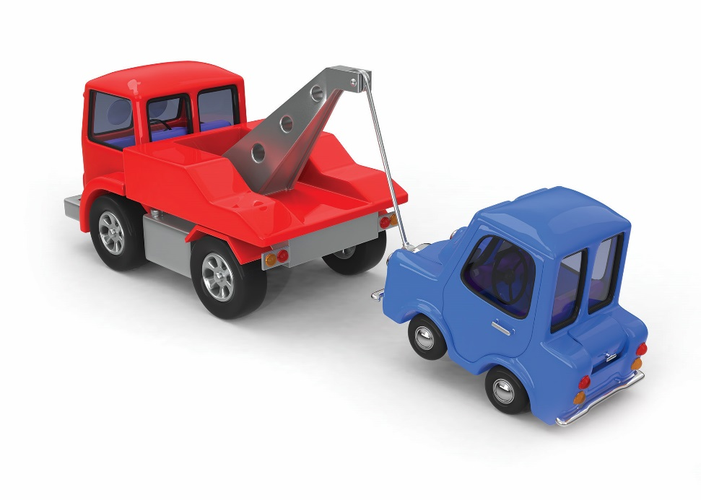
Classes of Nouns
Common noun - noun referring to a general person, place, thing, or idea. A common noun is not capitalized as a name.
hummingbird
truck
state
Proper noun - noun referring to a specific person, place, thing, or idea. A proper noun is capitalized as a name.
Ruby-Throated Hummingbird
Toyota Tundra
California

Slide 6
Classes of Nouns
Individual noun - noun referring to one person or thing
brother
lion
fish
Collective noun - noun referring to a group of people or animals
family
pride
school

Slide 7
Concrete and Abstract Nouns
Concrete- noun that can be seen heard, smelled, tasted or touched
courtroom
frown
library
Abstract- (a condition, idea, feeling) noun that cannot be sensed
justice
sadness
education

Slide 8
Singular or Plural
Singular - referring to one thing
neighbor
carrot
Plural - referring to more than one thing
neighbors
carrots
Irregular plural - a plural noun formed by changing the word rather than by adding s
mouse – mice
man – men
person – people

Slide 9
Tricky Plurals
Nouns Ending in y - If a common noun ends in y after a consonant, change the y to i and add es. If the noun ends in y after a vowel, leave the y and add s.
fly – flies
penny – pennies
tray – trays
Nouns Ending in f or fe - If a common noun ends in f or fe, change the f or fe to a v and add es — unless the f sound remains in the plural form. Then just add an s.
calf – calves
self – selves
proof – proofs

Slide 10
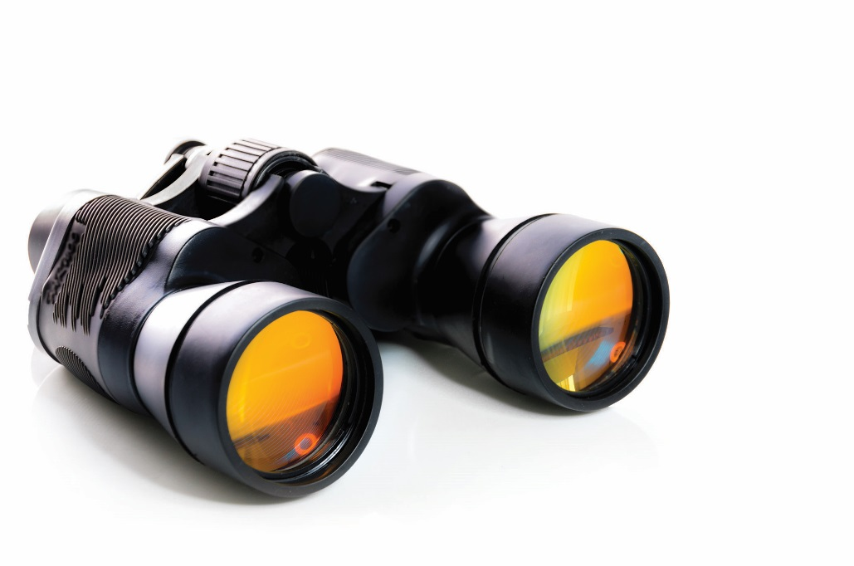
Tricky Plurals
Compound noun - made up of two or more words that function together as a single noun.
Whether the compound is hyphenated or not, make it plural by placing the s or es on the most important word in the compound.
bird watcher – bird watchers
editor in chief – editors in chief
well-wisher – well-wishers

Slide 11
Count and Noncount Nouns
Count nouns - name things that can be counted—pens, people, votes, cats, and so forth. They can be singular or plural, and they can be preceded by numbers or articles (a, an, or the).
shoe - shoes
moment - moments
Noncount nouns - name things that cannot be counted. They are used in singular form, and they can be preceded by the, but rarely by a or an.
rice
wool
Two-way nouns - can function as count or noncount nouns, depending on their context.
The meat will spoil soon.
January purchases several pounds of meat.

Slide 12
Articles
Article - the most common type of noun marker (a, an, or the). Articles help you to know if a noun refers to a specific thing or to a general thing.
Definite article - the word the, used to mark a noun that refers to a specific person, place, or thing.
Barbara asked her employees to join her in the office.
Indefinite article - the words a or an, used to mark a noun that refers to a general person, place, or thing. The word a is used before nouns that begin with consonant sounds, and the word an is used before nouns that begin with vowel sounds.
Barbara pulled up a chair for Glen.
Barbara pulled up an unusual, antique chair for Glen.

Slide 13
Other Noun Markers
Possessive adjective - the possessive form of a noun or pronoun, showing ownership of another noun.
Bella’s necklace fell in the water.
The Carters’ restaurant served Italian food.
Indefinite adjective - an indefinite pronoun (many, much, some) used as an adjective to mark a nonspecific noun.
each
all
Demonstrative adjective - a demonstrative pronoun (this, that, these, those) used as an adjective to mark a specific noun.
Those shrubs need trimming.
This card belongs to that man standing by the door.

Slide 14
Closing Activity
Identify the appropriate indefinite article (a or an) for each of the words below. Then tell if they are concrete or abstract.
___ Labrador Retriever
___ education
___ ocean
___ accident
___ love

Slide 15
Answers
Identify the appropriate indefinite article (a or an or neither) for each of the words below. Then tell if they are concrete or abstract? Are they count or non count?
A Labrador Retriever (concrete)
An education (abstract)
An ocean (concrete)
An accident (concrete)
A love (abstract)

