Slide 1
CH. 3 HERDEDITY AND ENVIRONMENT
MR. ALAS, MS
HCC- STAFFORD
SPRING 2015

Slide 2
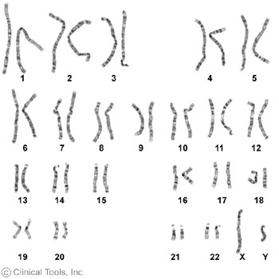

Slide 3
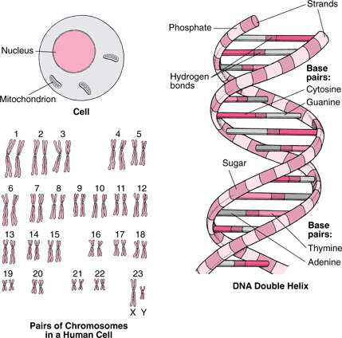

Slide 4
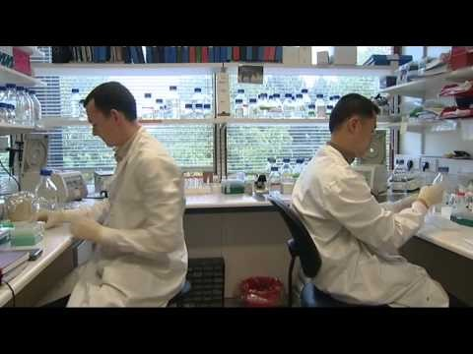
STEM CELL AND CONTROVERSY

Slide 5
DOWNS SYNDROME
http://www.telegraph.co.uk/news/worldnews/australiaandthepacific/australia/11005285/Australian-couple-abandon-surrogate-twin-with-Downs-syndrome-but-keep-his-sister.html

