Slide 1
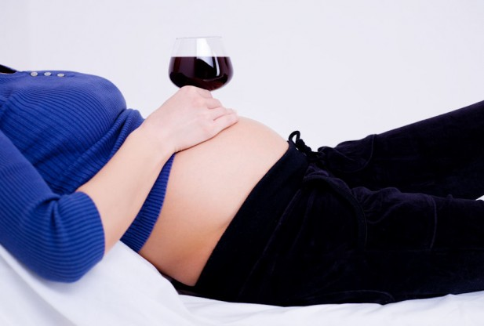
Ch. 4
MR. Alas, MA
HCC – STAFFORD
SPRING 2015

Slide 2
GENETIC SCREENING AND CONTROVERSY
https://www.youtube.com/watch?v=ICdWvlZFkdE

Slide 3
TAY SACHS
https://www.youtube.com/watch?v=Wkj67d5V3hU

Slide 4
TAY SACHS
https://www.youtube.com/watch?v=bWDb1Iqi0s4

Slide 5
TAYS SACHS IN IRISH POPULATION
https://www.youtube.com/watch?v=RzEpkBU-ITA

Slide 6
DOWN SYNDROME BABY
https://www.youtube.com/watch?v=Ju-q4OnBtNU

Slide 7
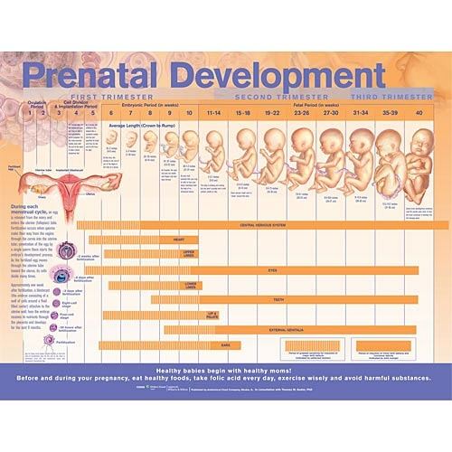

Slide 8
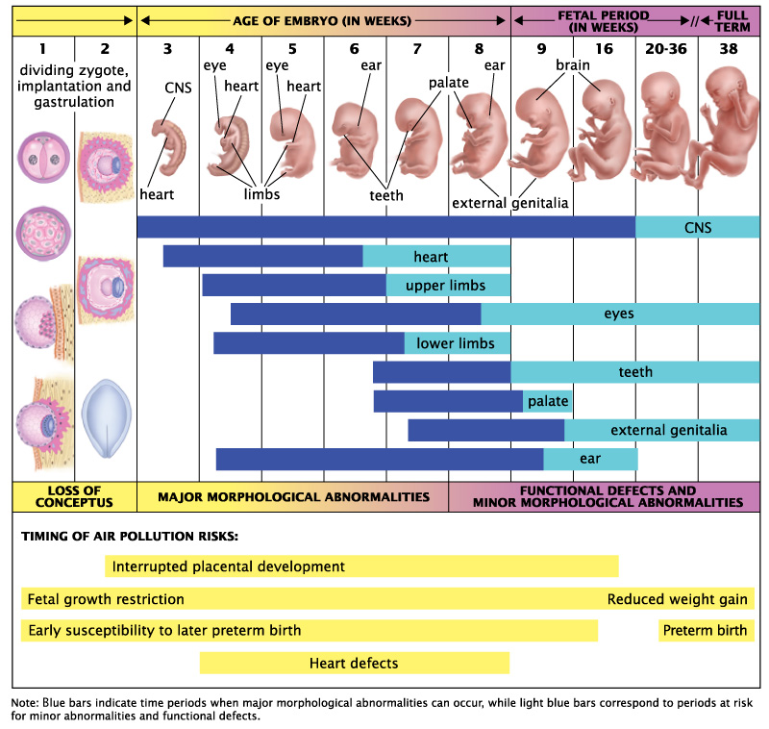

Slide 9
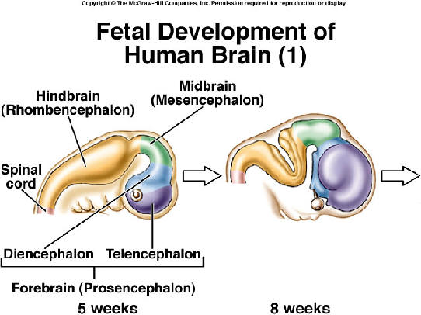

Slide 10
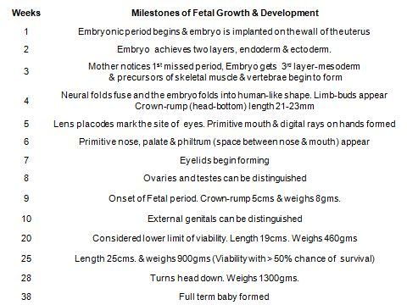

Slide 11
4 STAGES OF PRENATAL DEVELOPMENT
1. ZYGOTE STAGE
2. GERMINAL STAGE
2. EMBRYONIC STAGE
3. FETAL STAGE

Slide 12

ZYGOTE STAGE…

Slide 13
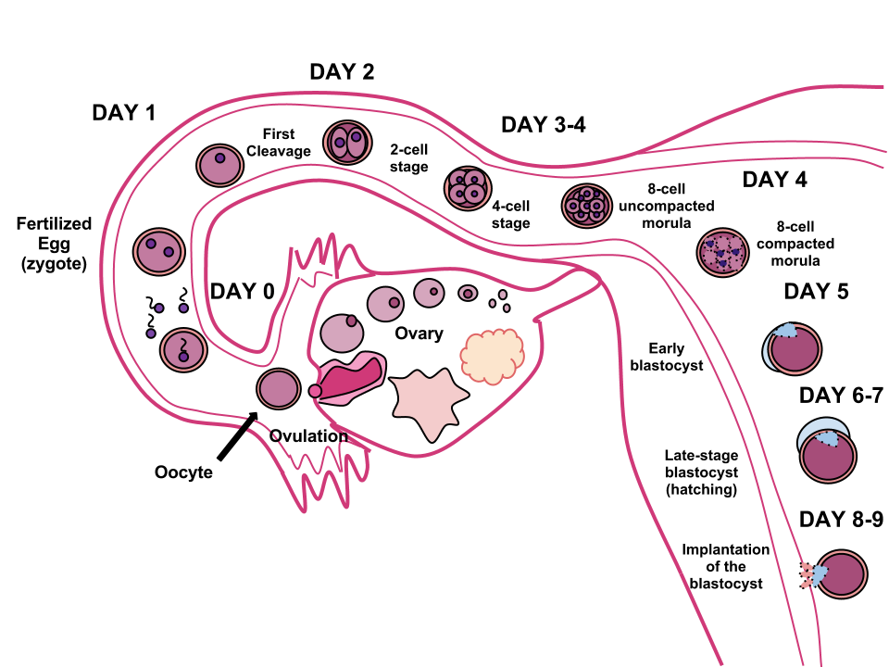
GERMINAL STAGE

Slide 14
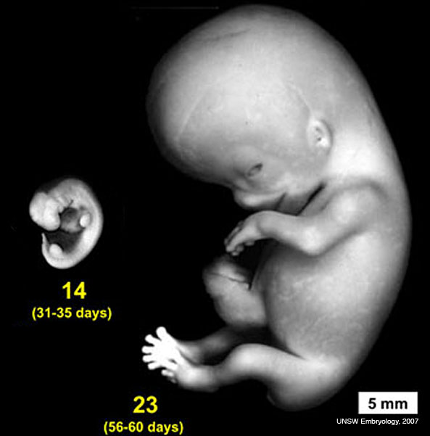
EMBRYONIC STAGE
Lasts 6 weeks, from week 2 to week eight.
At Beginning three types of cells can be differentiated.
    Some become the nervous system
    Some will become internal organs
    Others become muscles, skeleton, and blood vessels.
  Unborn organism most sensitive to external or environmental influences.

Slide 15
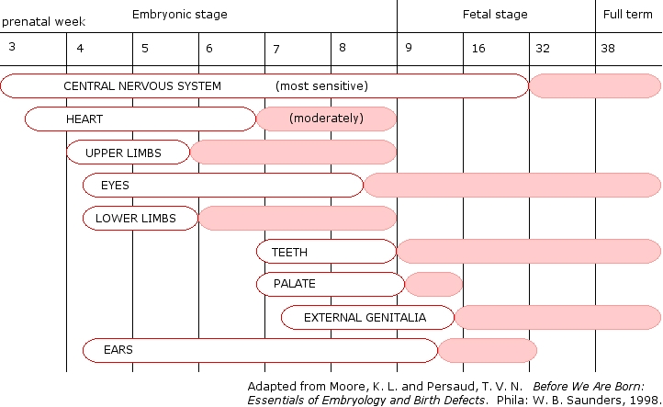
EMBRYONIC STAGE – MOST SENSITIVE TO ENVIRONMENT

Slide 16
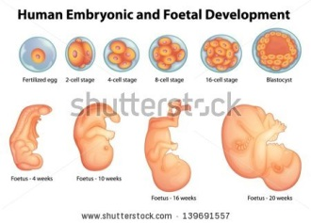
FETAL STAGE
longest, lasting until birth.
  Organs grow and begin functioning
  Arms and legs move by end of third month
  By 7 month reaches viability - can survive if born prematurely.
  Fetus ready to be born at about 270 days.

Slide 17
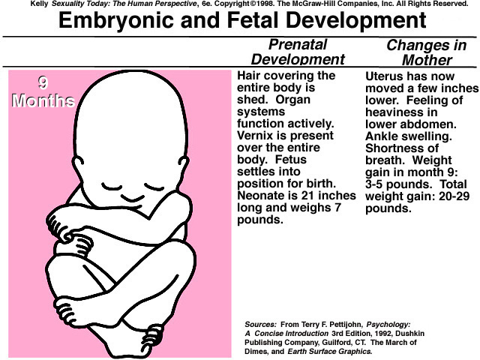
FETAL

Slide 18
Environmental Influences On Prenatal Development
During rapid stage prenatal development, even small environmental disturbances can have serious and lasting consequences.
Maternal malnutrition - increases in miscarriages, stillbirths, and premature births
Drugs and chemicals
Maternal stress causes hormone changes and reduces oxygen available to fetus
Role of father
  one third Down's syndrome babies result from difficulties with sperm
  Undernourishment, alcohol or drug abuse, or stress in father near time of conception may have developmental consequences on child.

Slide 19
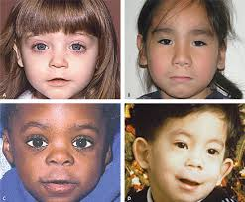
FETAL ALCHOHOL SYNDROME
  Alcohol - heavy drinking increases probability of having smaller babies
  babies with retarded physical growth
  poor coordination,
  poor muscle tone,
  and intellectual retardation

Slide 20
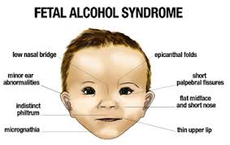
FACIAL FEATURES OF A FAS BABY

Slide 21
BABY BRAIN DEVELOPMENT
https://www.youtube.com/watch?v=MS5HUDVNbGs

Slide 22
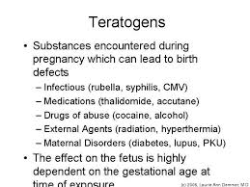

Slide 23
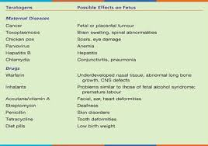

Slide 24
