Slide 1
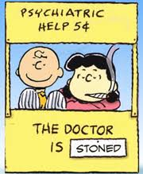
INTRO TO PSYCHOLOGY CHAPTER 1
MR. ALAS
HCC
2015

Slide 2
PSYCHOLOGY
http://www.youtube.com/watch?v=mMBrAj4bwNE

Slide 3
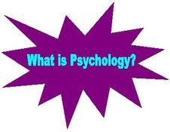

Slide 4
WHAT IS THE GOAL OF PSYCHOLOGY?
Psychology has the immediate goal of understanding individuals and groups by both establishing general principles and researching specific cases,

Slide 5
PSYCHOLOGY
Psychology has the immediate goal of understanding individuals and groups by both establishing general principles and researching specific cases,
An academic and applied discipline that involves the scientific study of mental functions and behaviors

Slide 6
PSYCHOLOGY
Has a LONG history with an ETIOLOGY
Hunter and Gatherers
Tribes / Clans
Pre and Modern Civilization

Slide 7
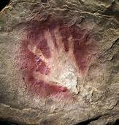
BEGINNING OF PSYCHOLOGY

Slide 8
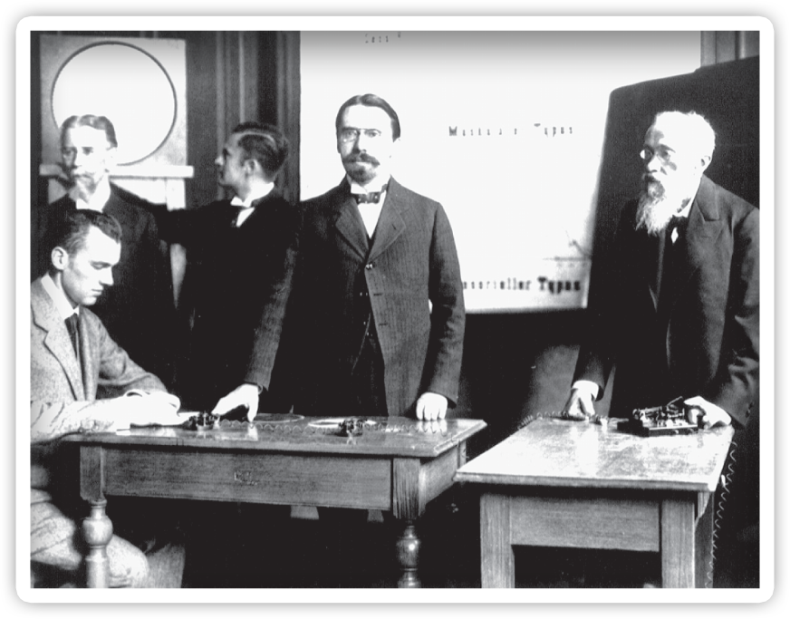
How Psychology Developed
Psychology Today
Seven Unifying Themes
Personal Application
Notes:
Wundt is known as a voluntarist because he was interested in volitional behavior
He founded what is considered to be the first psychology laboratory in Leipzig, Germany in 1879
He used the technique known as introspection to probe the perceptual processes of his experimental subjects

Slide 9
MENTAL ILLNESS THROUGHOUT TIME
Causes of mental illness included:
Supernatural causes such as demons and demonic possession.
Witchcraft and sorcery.
Mass hysteria.
Melancholy and stress.
Treatments for mental illness included:
Exorcism.
Shaving the pattern of a cross in the head-hair.
Believe that those suffering from mental illness could benefit from hearing mass.
Drinking ice-cold water.

Slide 10
PSYCHOLOGICAL TREATMENT - TREPANATION

Slide 11
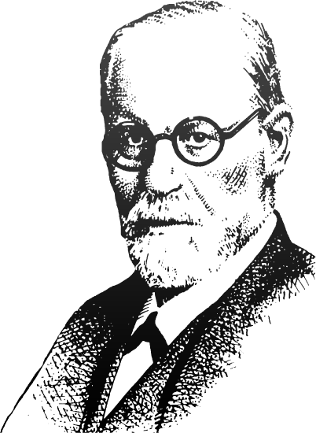
Psychoanalytic Perspective (1900 - Present)
Carl Jung
Alfred Adler
Sigmund Freud
How Psychology Developed
Psychology Today
Seven Unifying Themes
Personal Application
Notes:
Psychoanalysts study the unconscious determinants of behavior - they believe that unconscious motives and experiences in early childhood govern personality and mental disorders.

Slide 12
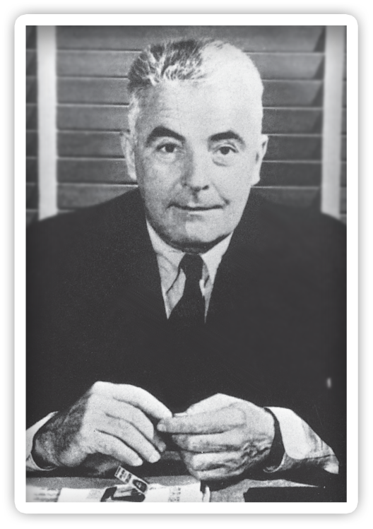
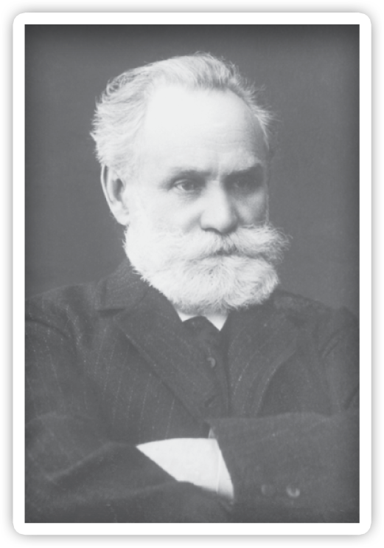
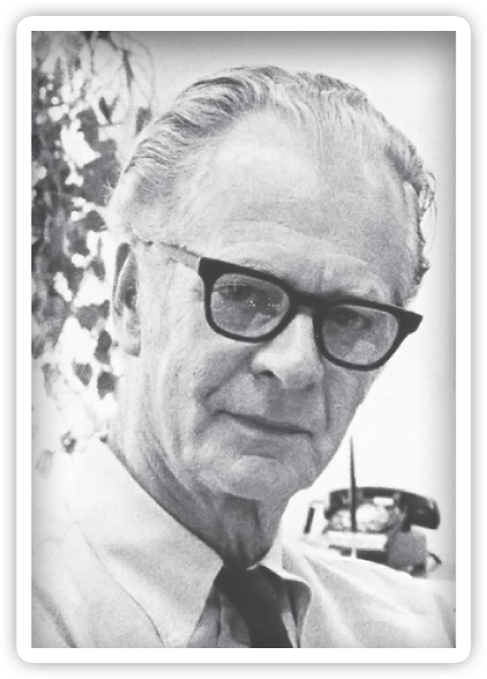
Behavioral Perspective (1913 - Present)
John B. Watson
Ivan Pavlov
B.F. Skinner
How Psychology Developed
Psychology Today
Seven Unifying Themes
Personal Application
Notes:
Psychology does not provide us with a unitary understanding of the mind.
There are numerous viewpoints that compete and complement one another.
These perspectives have all grown from the work of early psychologists.
Behaviorists believed that only observable events can be studied scientifically, and studied the effects of environment on the overt behavior of humans and animals.

Slide 13
Biological Perspective (1950s - Present)
James Olds
Roger Sperry
David Hubel
Torsten Weisel
How Psychology Developed
Psychology Today
Seven Unifying Themes
Personal Application
Notes:
Advocates of the biological perspective believe that an organism’s functioning can be explained in terms of the bodily structures and biochemical process that underlie behavior.
They study the physiological bases of behavior in humans and animals.

Slide 14
BIOLOGICAL – “PHINEAS GAGE”
http://dotsub.com/view/5e1e16f4-4327-4ea2-943e-f39519ef7f72

Slide 15
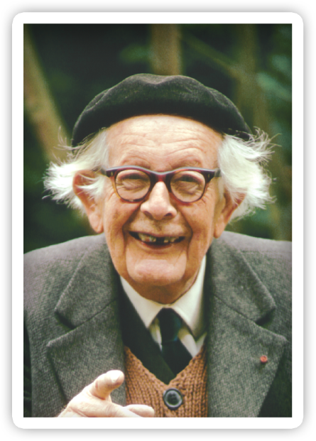
Cognitive Perspective (1950s - Present)
Noam Chomsky
Herbert Simon
Jean Piaget
How Psychology Developed
Psychology Today
Seven Unifying Themes
Personal Application
Notes:
The cognitive perspective involves the study of thoughts and mental processes.
Cognitive theorists believe that human behavior cannot be fully understood without examining how people acquire, process, and store information.

Slide 16
Evolutionary Perspective (1980s - Present)
David Buss
Martin Daly
Margo Wilson
Leda Cosmides
John Tooby
How Psychology Developed
Psychology Today
Seven Unifying Themes
Personal Application
Notes:
Evolutionary theorists study the evolutionary bases of behavior in humans and animals.
They believe that behavior patterns have evolved to solve adaptive problems, and that natural selection favors behaviors that enhance reproductive success.

Slide 17
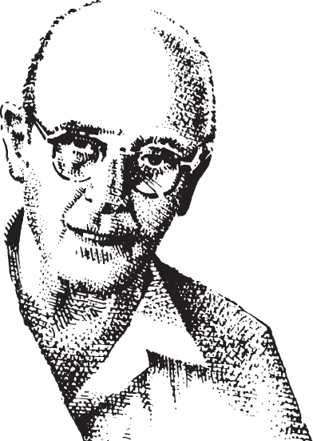
Humanistic Perspective (1950s - Present)
Abraham Maslow
Carl Rogers
How Psychology Developed
Psychology Today
Seven Unifying Themes
Personal Application
Notes:
Humanists believe that humans are free, rational beings with the potential for personal growth - fundamentally different from animals.
Humanists study the unique aspects of human experience.

Slide 18
BIOPSYCHOSOCIAL MODEL
http://www.centerforsystemschange.org/view.php?nav_id=108

