Slide 1
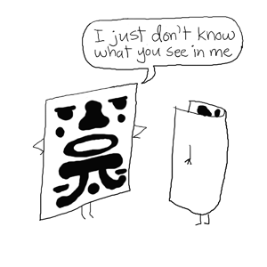
TEST 3 REVIEW
PROF. ALAS, MS
HCC – W. LOOP
FALL 2014

Slide 2

INSTRUCTIONS FOR RV SHEET
  1. Name
  2. Date
  3. Class time
  4. PLAGERISM
  STATEMENT:
  CITE ALL SOURCES

Slide 3
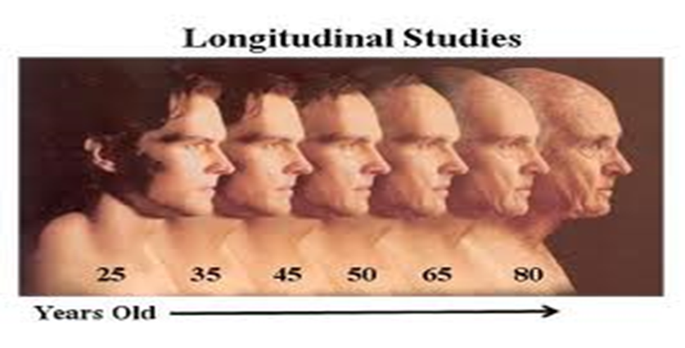
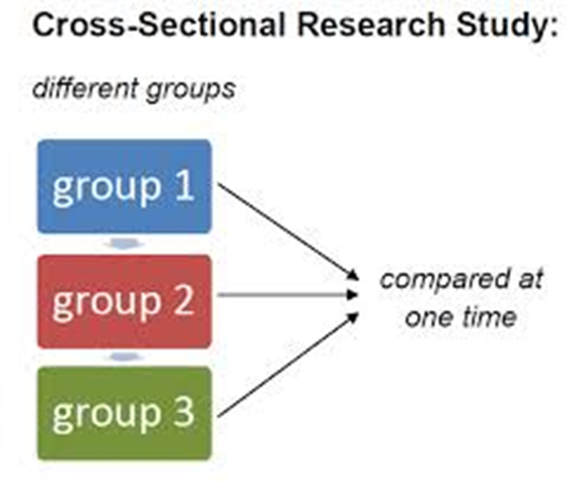
TYPES OF RESEARCH DESIGNS

Slide 4
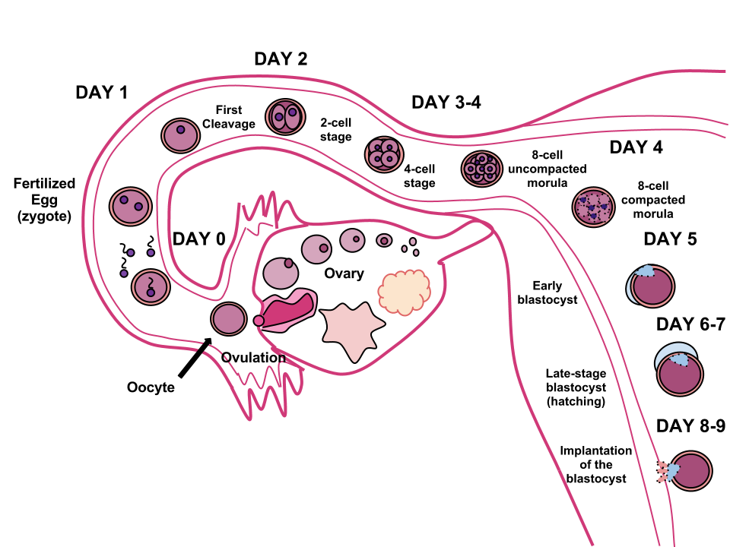
GERMINAL STAGE

Slide 5
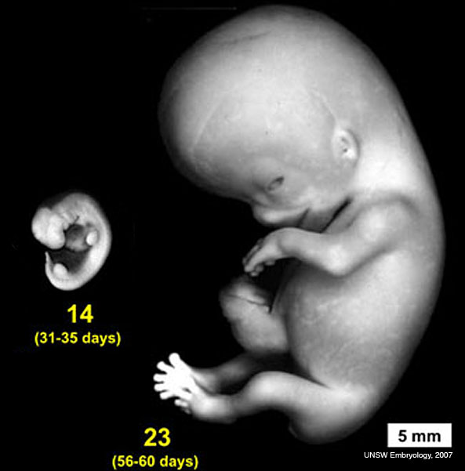
EMBRYONIC STAGE
Lasts 6 weeks, from week 2 to week eight.
At Beginning three types of cells can be differentiated.
    Some become the nervous system
    Some will become internal organs
    Others become muscles, skeleton, and blood vessels.
  Unborn organism most sensitive to external or environmental influences.

Slide 6
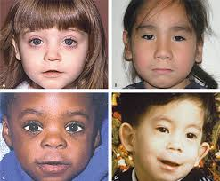
FETAL ALCHOHOL SYNDROME
  Alcohol - heavy drinking increases probability of having smaller babies
  babies with retarded physical growth
  poor coordination,
  poor muscle tone,
  and intellectual retardation

Slide 7
ATTACHMENT
Harlow showed attachment due to what?
1. Physical Nourishment
2. Contact Comfort
3. Emotional Nourishment

Slide 8
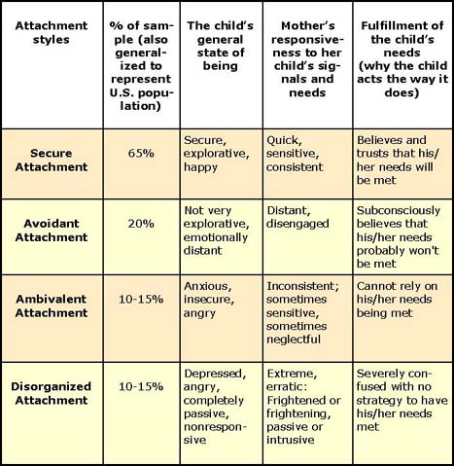

Slide 9
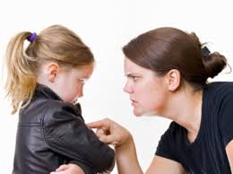
Characteristics of the Authoritarian Parenting Style
Have strict rules and expectations.
Very demanding, but not responsive.
Don't express much warmth or nurturing.
Utilize punishments with little or no explanation.
Don't give children choices or options.

Slide 10
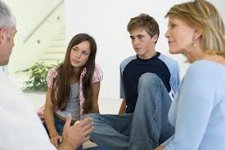
AUTHORATIATIVE PARENTING
Authoritative parents:
Listen to their children
Encourage independence
Place limits, consequences and expectations on their children's behavior
Express warmth and nurturance
Allow children to express opinions
Encourage children to discuss options
Administer fair and consistent discipline

Slide 11
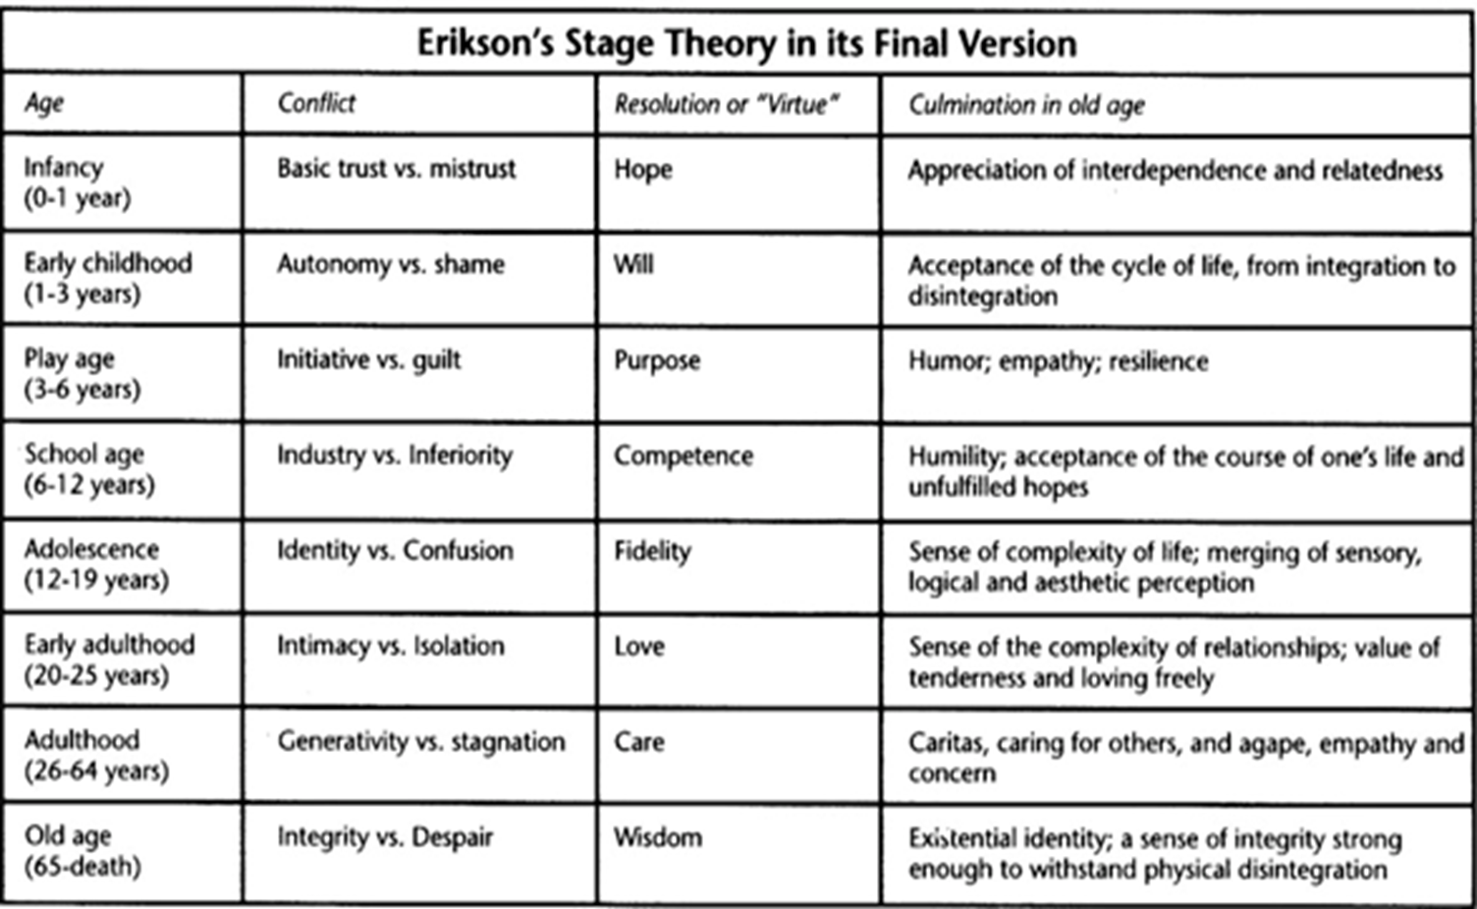

Slide 12
ERIKSON’S STAGES OF DEVELOPMENT
Primary student receives praise in school and home. According to Erikson the child will develop what?
1. Industry
2. Superiority
3. Generativity
4. Trust

Slide 13
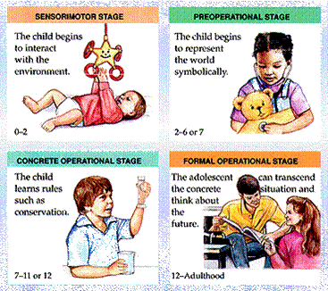
PIAJET’S STAGES OF DEVELOPMENT

Slide 14
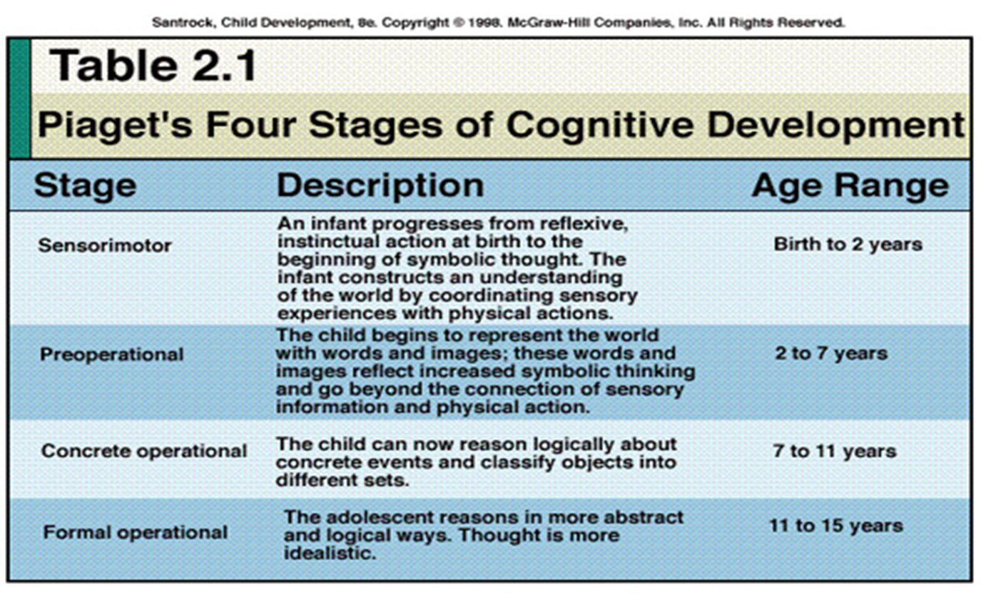

Slide 15
PIAJET’S STAGES OF DEVELOPMENT
Bobby is very hungry and demands 2 tacos for lunch. Mom cuts taco into HALF making Bobby happy. Behavior indicates Bobby does not understand _____________ and is in the _____________ stage of cognitive development.
1. object permeance; formal
2. object permeance; sensorimotor
3. conservation; preoperational
4. conservation; concrete operational

Slide 16
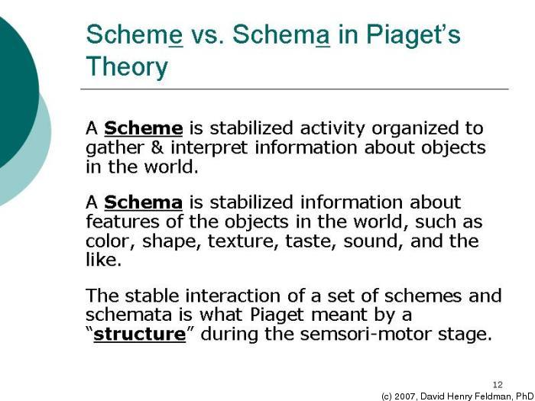

Slide 17
PIAJET’S STAGES OF DEVELOPMENT
Water is poured from a short glass to a tall glass. Child indicates the amount of water only change in container. The child is in which stage of development?
1. sensorimotor
2. concrete operational
3. preoperational
4. preconventional

Slide 18
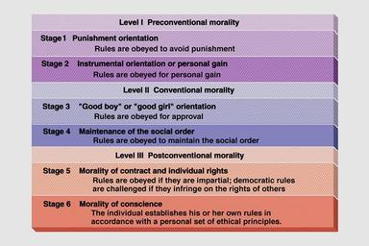
KOHLBERG’S STAGE THEORY

Slide 19
KOHLBERG’S STAGES THEORY
Kohlberg based theory on?
A. “yes” or “no” answers
B. level of confidence of the person
C. overt behaviors exhibited in lab
D. explanation the person gave concerning reasoning for response

Slide 20
AGING
Dementia vs. Alzheimer’s Disease
Abnormal condition marked by cognitive deficits including memory impairment

Slide 21
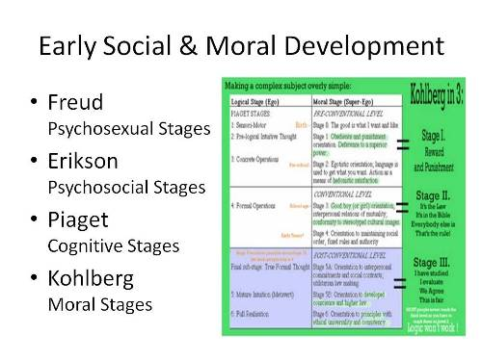

Slide 22
GENDER DIFFERENCE
Expectation about what is appropriate behavior for each SEX?
Gender stereotypes
Gender behaviors
Gender differences
Gender roles

Slide 23
HUMANISM
What is the FOCUS of HUMANISMISM on personality?
ROGER’S type of LOVE INFLUENCE

Slide 24
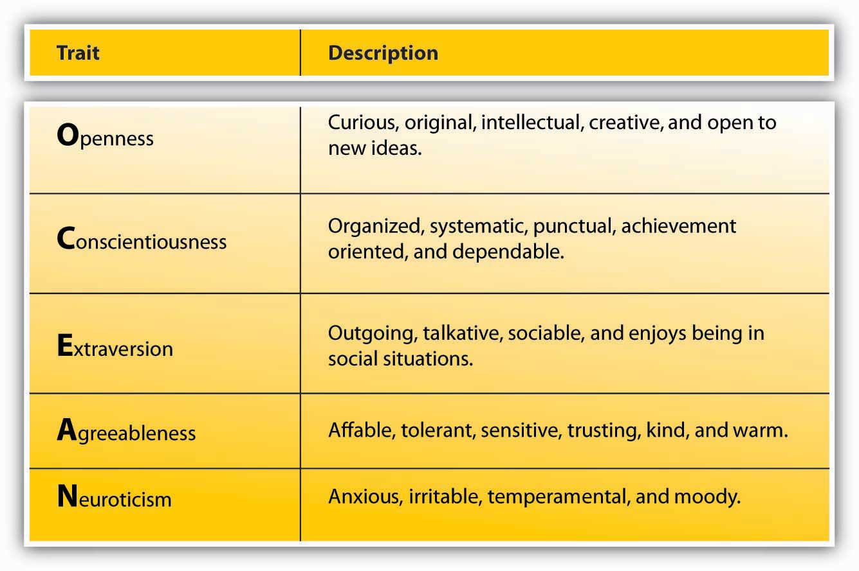
PERSONALITY – BIG FIVE

Slide 25
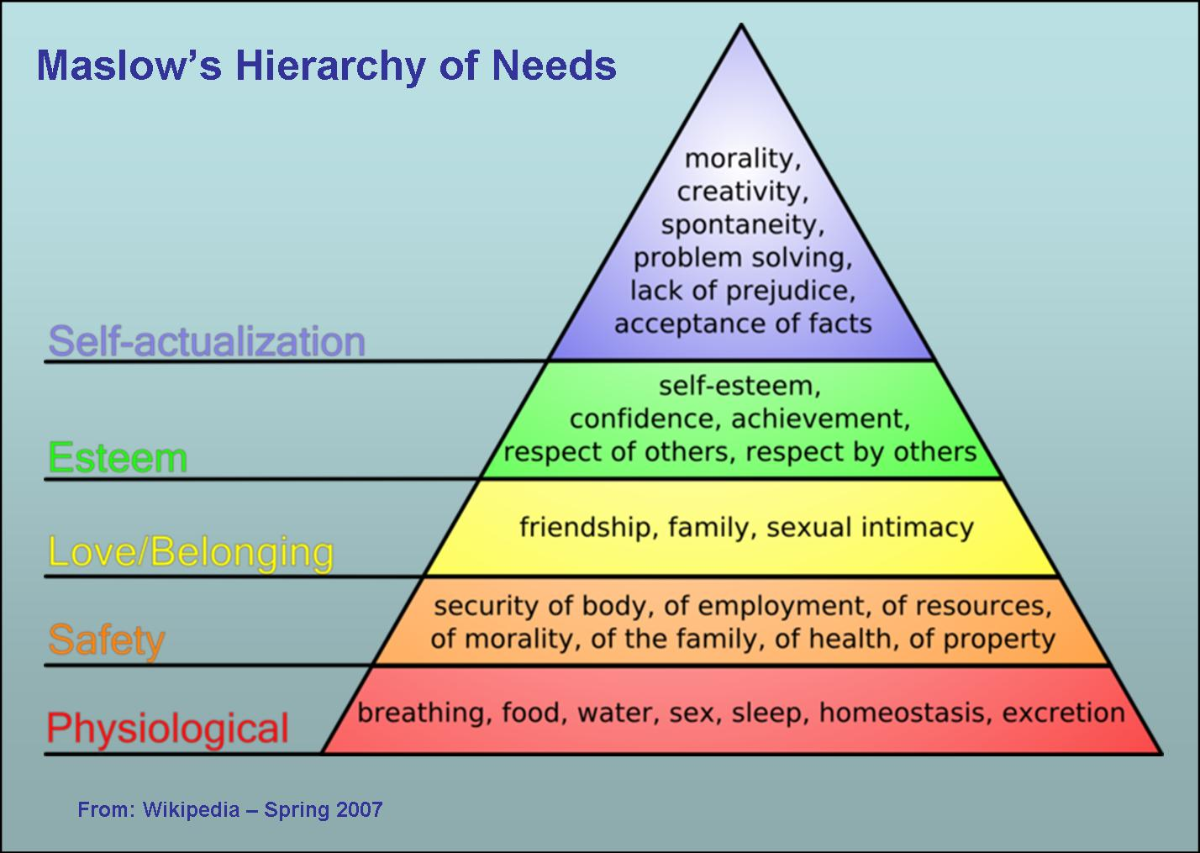

Slide 26
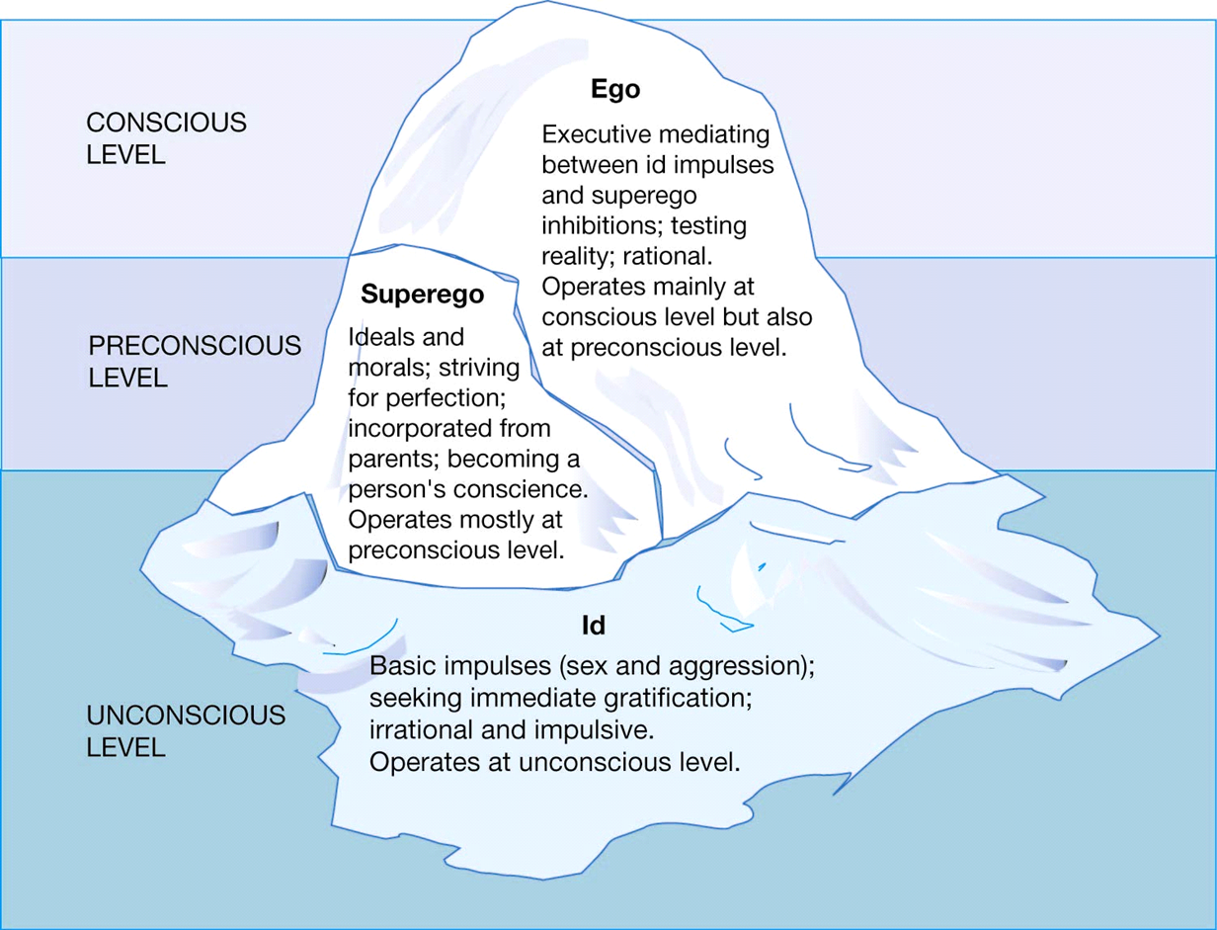
SIGMUND FREUD

Slide 27
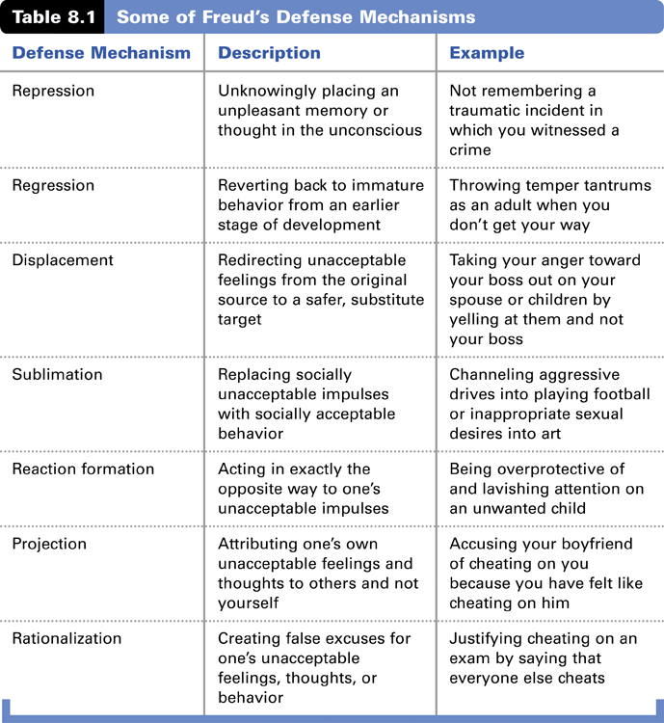

Slide 28
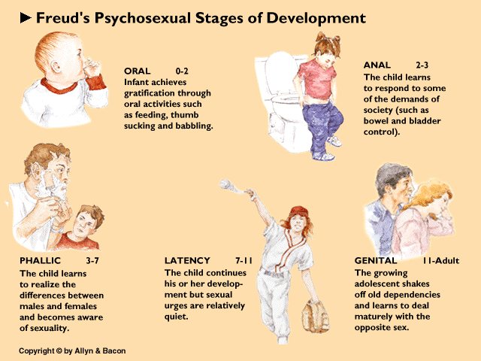

Slide 29
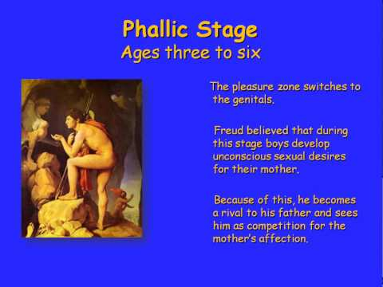

Slide 30
BEHAVIORAL GENETICS
PURPOSE OF TWIN STUDIES AND ENVIRONMENT

Slide 31
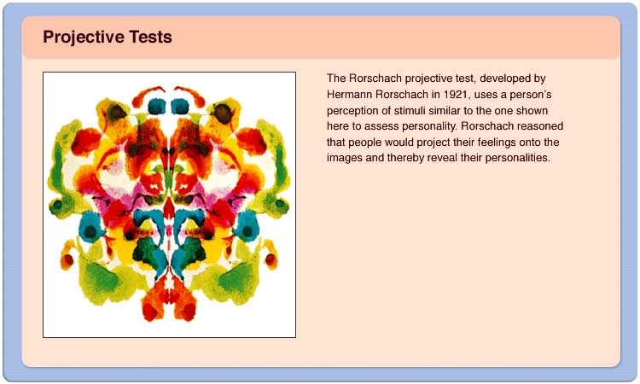

Slide 32
THE END
ANY QUESTIONS?????
DON’T FORGET
1. SCANTRON
2. ONE SIDED CHEAT SHEET (EVERYONE)

