Slide 1
Ethics Bowl
cinnamon.jenson@hccs.edu
jason.jenson@hccs.edu

Slide 2
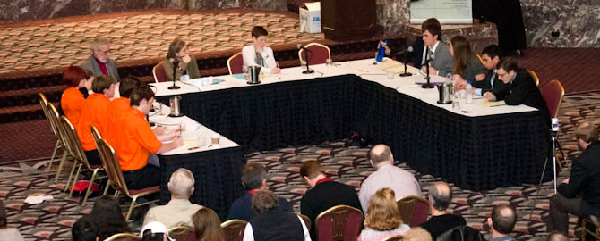
What is Ethics Bowl?
Ethics Bowl is a fun and educational academic competition in the areas of practical and professional ethics.
Ethics Bowl competitions exist at both the high school and intercollegiate level including two-year colleges, liberal arts colleges, and four-year research universities.

Slide 3
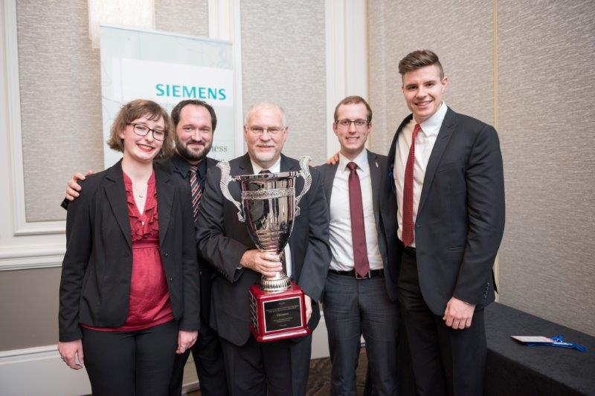
What is Ethics Bowl?
Ethics Bowl is a program of the Association for Practical and Professional Ethics (APPE) an international organization advancing scholarship, education, and practice in practical and professional ethics.
APPE website: https://appe-ethics.org/cases-rules-and-guidelines/
20th Intercollegiate Ethics Bowl Championship Winner 2016
Whitworth University

Slide 4
What is Ethics Bowl?
Hundreds of students and teams from the U.S. and Canada compete in 11 Regional Ethics Bowl competitions each fall.
The teams argue and defend their moral assessments of the most current and complex ethical issues facing society today.

Slide 5
How the Ethics Bowl is Played?
A moderator poses ethical problems on topics which are provided in advance ranging from areas such as the classroom (e.g. cheating, grade inflation, or plagiarism), personal relationships, professional ethics (e.g. business, medicine, law, etc.), and social and political topics (e.g. free speech, healthcare, gun control, etc.).
Each team (3-5 students) answers its questions after a brief moment to confer. A panel of three judges is allowed to ask some follow up questions.
Each team responds to what their opponent has presented and hears rebuttal from them.
The judges then rate the teams based on intelligibility, focus on ethically relevant considerations, avoidance of ethical irrelevance, and deliberative thoughtfulness.

Slide 6
Ethics Bowl class
Phil 2289: Cooperative in Philosophy
Taught Fall semesters only
Includes a trip to San Antonio in November, for the Texas Regional Competition
Please contact the Ethics Bowl coaches for more information, and permission codes to register:
Cinnamon.jenson@hccs.edu
Jason.jenson@hccs.edu

Slide 7
Ethics Bowl Class
In the class we will prepare students for the competition by analyzing cases, and preparing presentations and commentaries.
We review major ethical theories such as deontology, utilitarianism, Rawls’ theory of justice, etc.

Slide 8
How will student’s benefit?
Looks great on a resume or CV.
Develops professional skills in public speaking, teamwork, leadership, civic engagement, confidence, and critical thinking.
Gives ambitious students an opportunity to shine.
It’s an opportunity to make friends in a collaborative environment and have fun.

Slide 9
Flexible work load
The class is flexible to student’s schedules and workload.

Slide 10
Who can participate?
Any HCC student who wishes to participate can take the class. We will especially encourage students who have already taken Philosophy, Humanities, and Speech classes to participate.

Slide 11
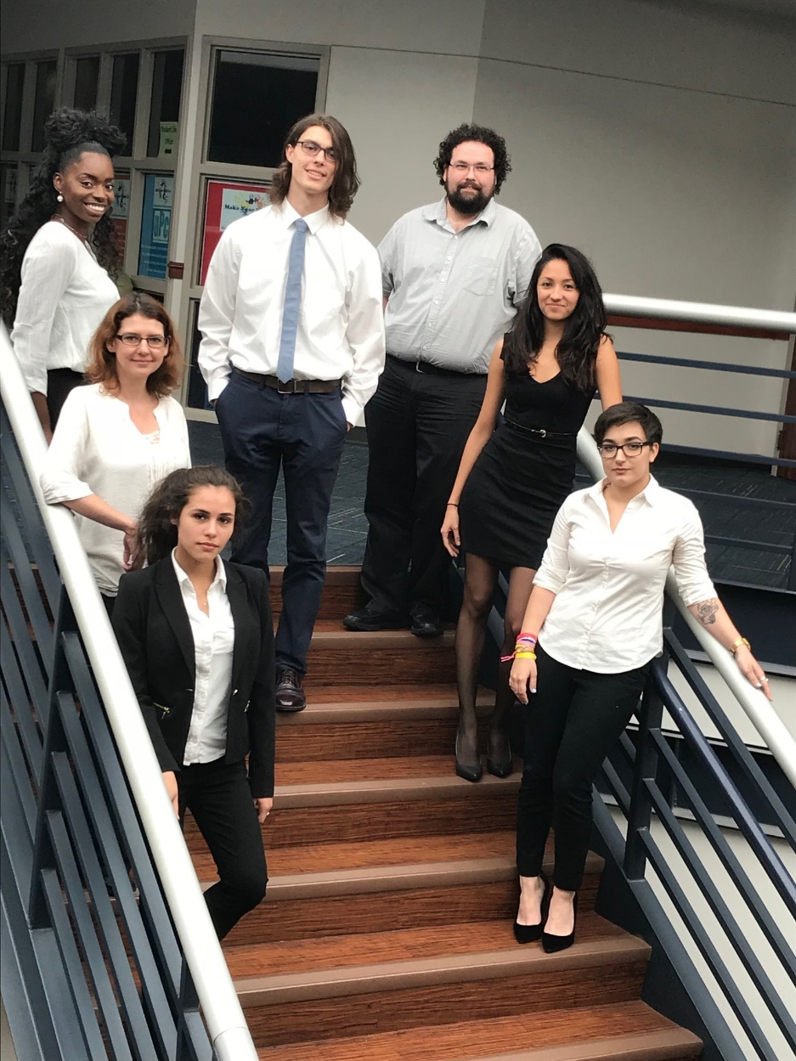
2017 Inaugural HCC Ethics Bowl team
The 2017 HCC team won 15 place out of 22 universities
Competed at the Texas Regional Competition in San Antonio.
Teams included universities from Oklahoma, Texas, New Mexico, and Arkansas.
Raesheena Brown, Phoenix Thompson, Jason Chris Jenson (coach)
Cinnamon Jenson (coach), Rebecca Rivera
Yancy Elguezabal, Mia Perez

Slide 12
Resources
HCC Ethics Bowl Learning Web page: https://learning.hccs.edu/faculty/cinnamon.jenson/ethics-bowl
National APPE Ethics Bowl website: http://appe.indiana.edu/ethics-bowl/ethics-bowl/
For more info contact Cinnamon Jenson cinnamon.jenson@hccs.edu or Jason Chris Jenson jason.jenson@hccs.edu

