Slide 1
The Confederation Government
The Critical Period
Finance
  Growing debt
Notes:
Once the Articles of Confederation were ratified, they immediately went into effect. This occurred during the American Revolution. Under the Articles, there was no executive branch of the government to oversee the coordination of the laws Congress passed. That was Congress’s job. It was felt that having an executive branch was too much like having a king, and that was something the framers of the Articles wished to avoid.
One of the biggest problems that Congress had under the Articles was that it did not have the power to tax. It had to ask the states to give them money, and the states did not have to pay. As a result, Congress had to look elsewhere to get the money to pay off its debts.

Slide 2
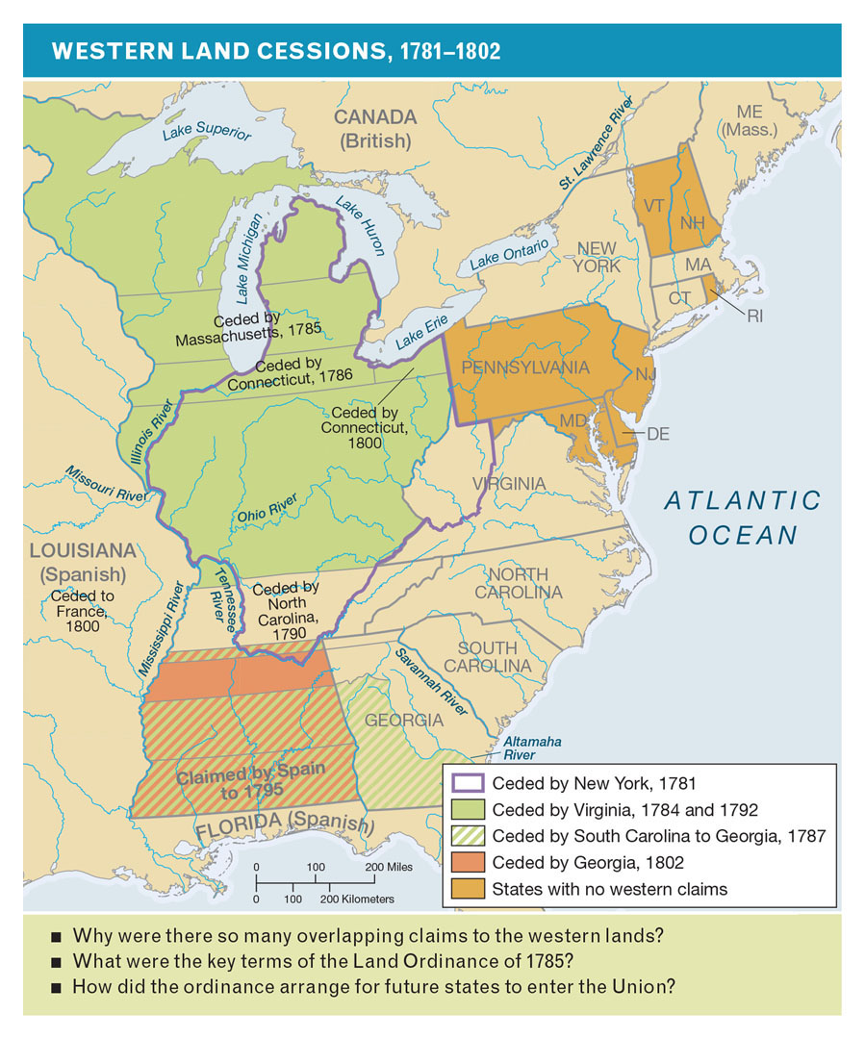
Western Land Cessions, 1781–1802
Notes:
Why were there so many overlapping claims to the western lands? What were the terms of the Land Ordinance of 1785? How did it arrange for future states to enter the Union?

Slide 3
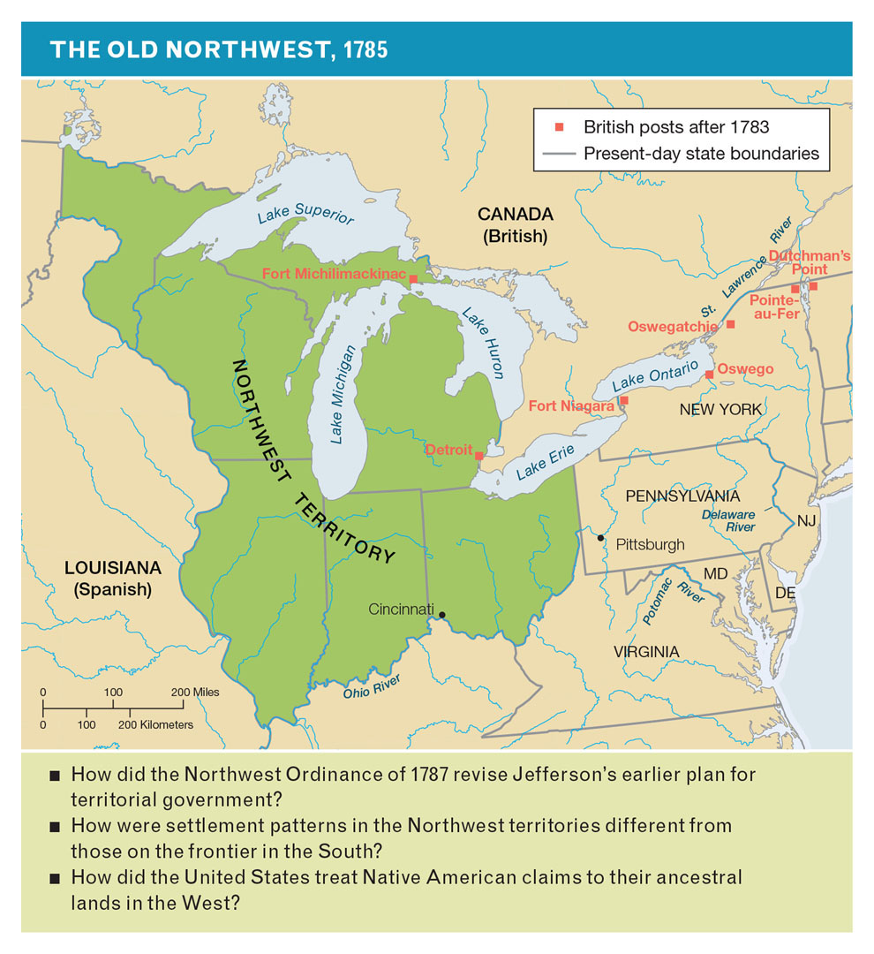
The Old Northwest, 1785
Notes:
How did the Northwest Ordinance of 1787 revise Jefferson’s plan for territorial government? How were settlement patterns in the Northwest territories different from those on the frontier in the South? How did the United States treat Indian claims to territory in the West?

Slide 4
Land Policy
Easy income source for Congress
History of the land west of the colonies
The Northwest Ordinance
Notes:
Since Congress could not tax, the national government turned to the one source of income that seemed inexhaustible, the land between the Mississippi River and the western boundaries of the original colonies.
Previous laws passed by Congress had stated that these lands would not be made into colonies but would be allowed to enter the Union as full states.
The Northwest Ordinance was the first major allotment of land to be opened for settlement, with the premise that once settlers comprised a certain number, they would be allowed to enter the Union as a state. One major proviso of this ordinance was that slavery was not allowed.

Slide 5
Diplomacy
Flaws in the Articles begin to surface
Problems with Britain to the west
Problems with Spain to the south
Notes:
The new nation now had to develop a diplomatic corps and dispatch it to other nations to try and secure new treaties for economic and political alliances.
Although the Treaty of Paris of 1783 had ended the American War for Independence and stipulated that Britain must leave the Northwest territory, it retained a string of forts in the area. When confronted with this problem, England countered that the former colonies had not paid their debts, as also required in the treaty.
With Spain, the subject was the southern border, on which both Spain and the United States held a claim. Spain held Florida and an area stretching from it to Louisiana. The Treaty of Paris decreed that American citizens were allowed to ship goods down the Mississippi, but in 1784, the Spanish governor of Louisiana closed the port of New Orleans (where goods shipped south would be reloaded on seaworthy ships) to the United States.

Slide 6
Trade and Economy
Great Britain closes West Indies to the United States
Notes:
During the American Revolution, farmers, who at the time primarily farmed enough to keep themselves and their families fed, were not bothered much. In some areas, the British army would free slaves to use them as servants for themselves. During the war, Great Britain had the largest navy in the world, and as the colonies had relied on the assistance of the navy before independence, those colonies whose economies revolved around trade were not happy when that protection was no longer provided. As a result, trade was substantially harmed.
After the war, Great Britain would forbid the United States to trade with the West Indies, which had to import most of its food.

Slide 7
The Confederation’s Problems
No central control over states’ policies
No central control over monetary concerns
Notes:
The framers of the Articles had wanted a loose organization of states with more power than the central government. While this may have been a good idea when crafted, it was not long into practice that severe problems emerged. Congress could not stop one state from raising taxes on imports while another one lowered them to persuade new customers to their markets.
The same thing occurred with money. Congress could not stop states from printing money to pay their debts. Many states printed freely, with nothing of value backing the money. Such reckless decisions led to inflation and made the paper money worthless.

Slide 8
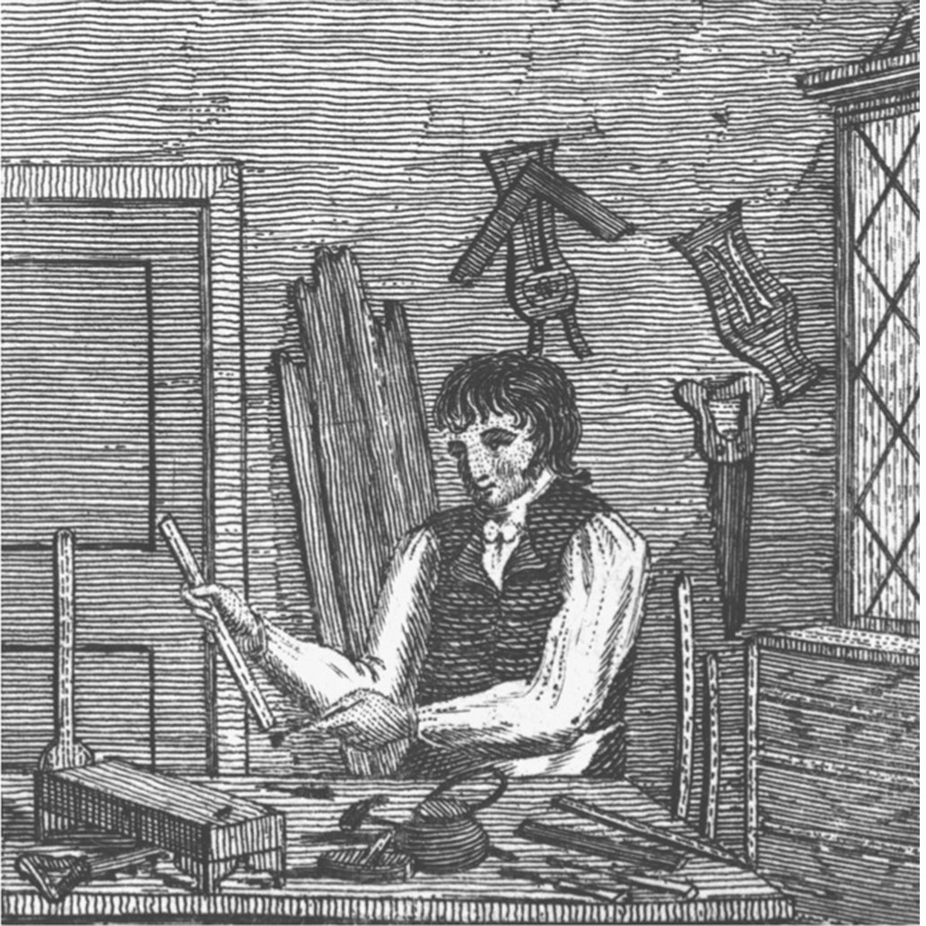
Domestic Industry
Notes:
American craftsmen, such as this cabinetmaker, favored tariffs on foreign goods that competed with their own products.

Slide 9
Shays’s Rebellion
The problem
The “rebellion”
The result
Notes:
Massachusetts had not fallen victim to the desire to print substantial amounts of money, while at the same time it had high property and poll taxes (taxes allowing people to vote). As a result, farmers led by Daniel Shays held courthouses in Massachusetts hostage to prevent the courts from foreclosing on their lands due to lack of paper currency.
Militiamen were sent in to put down the “rebellion” and four farmers were killed.
Many have linked this rebellion to the death knell of the Articles of Confederation. The federal government needed to be stronger to prevent similar situations from occurring across the United States.

Slide 10
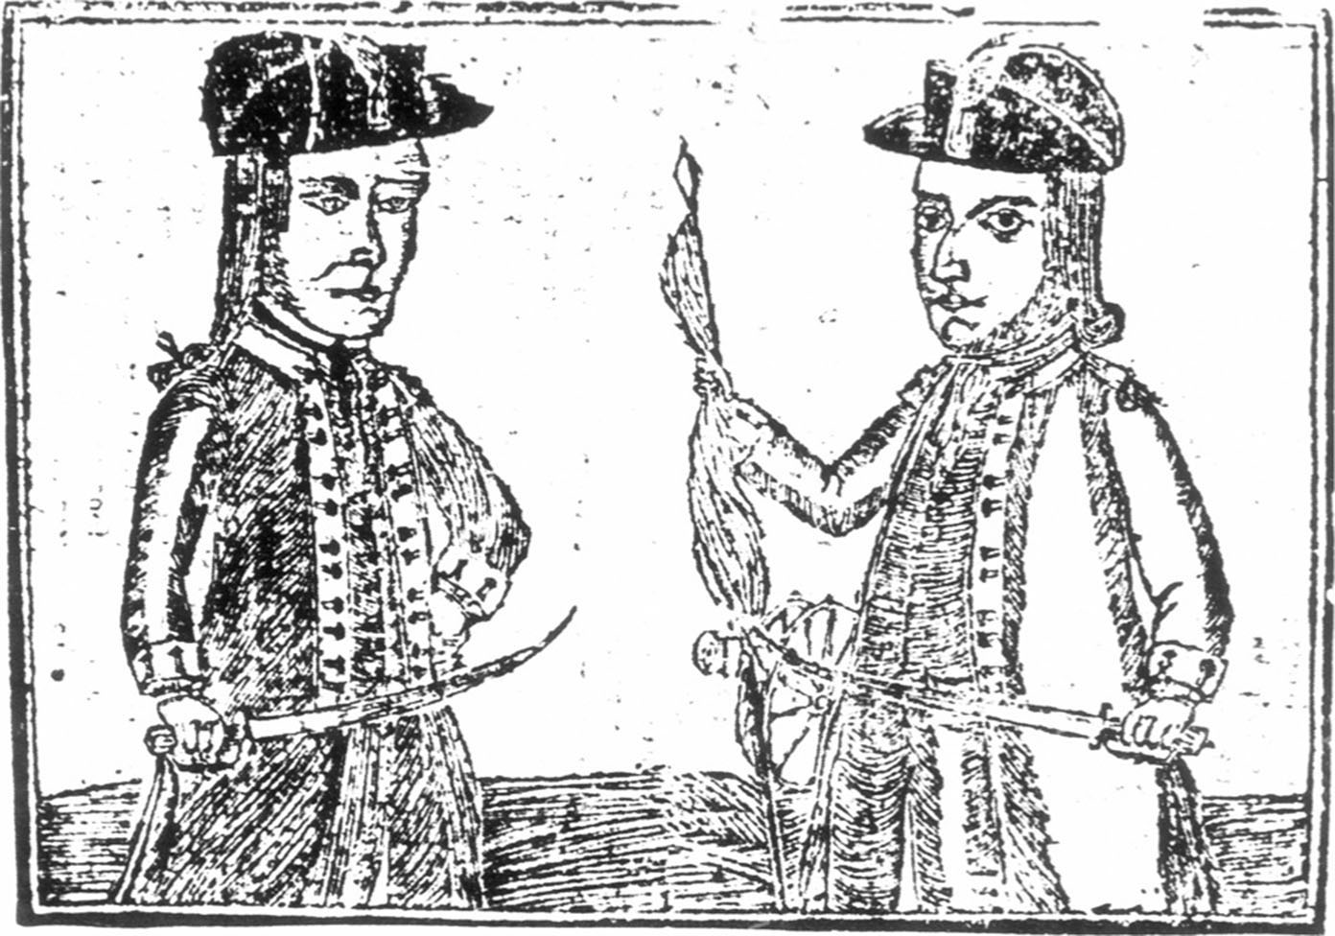
Shays’s Rebellion, Lithograph
Notes:
Shays and his followers demanded a more flexible monetary policy and the right to postpone paying taxes until the postwar agricultural depression lifted.

Slide 11
Calls for a Stronger Government
The need for a Constitutional Convention
Notes:
By 1785, it was apparent that the Articles of Confederation needed to be strengthened, but a major stumbling point was that to amend them, unanimous support was needed.
In meetings at Washington’s home at Mount Vernon and the Annapolis Convention, delegates met to discuss the future of the nation. Although the Annapolis Convention was a failure, Alexander Hamilton secured from the delegation a resolution calling for a Constitutional Convention to strengthen the federal government (but not the Articles) of the United States.

Slide 12
Creating the Constitution
The Constitutional Convention
  Delegates in attendance
  The emergence of James Madison
The Virginia and New Jersey Plans
Notes:
The delegates to the Constitutional Convention represented the broad spectrum of U.S. citizens: lawyers, farmers, college graduates, and merchants. Each had a belief that there was at least one area in which the Articles could do a better job. It was not long before these delegates were divided into two camps, one for the big states (such as Virginia, New York, and Pennsylvania) and the other for the small states (such as Rhode Island, Massachusetts, and Delaware).
Both sides offered plans of what they wanted to see as the new form of government for their nation. It was clear that a grand compromise would be necessary to bring the two sides together.

Slide 13
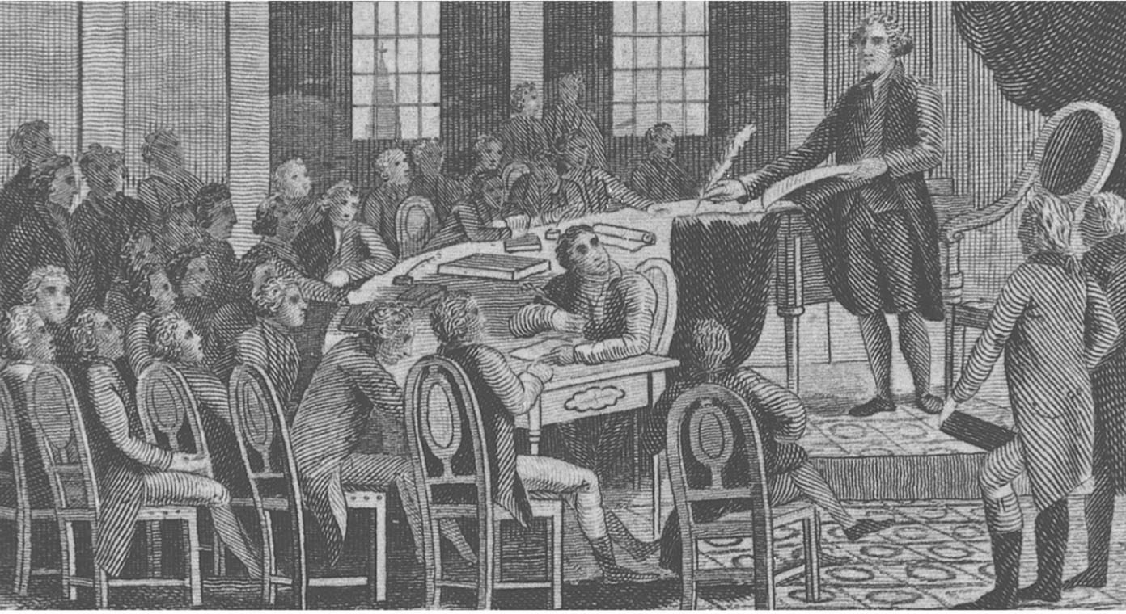
Drafting the Constitution
Notes:
George Washington presides over a session of the Constitutional Convention in Philadelphia.

Slide 14
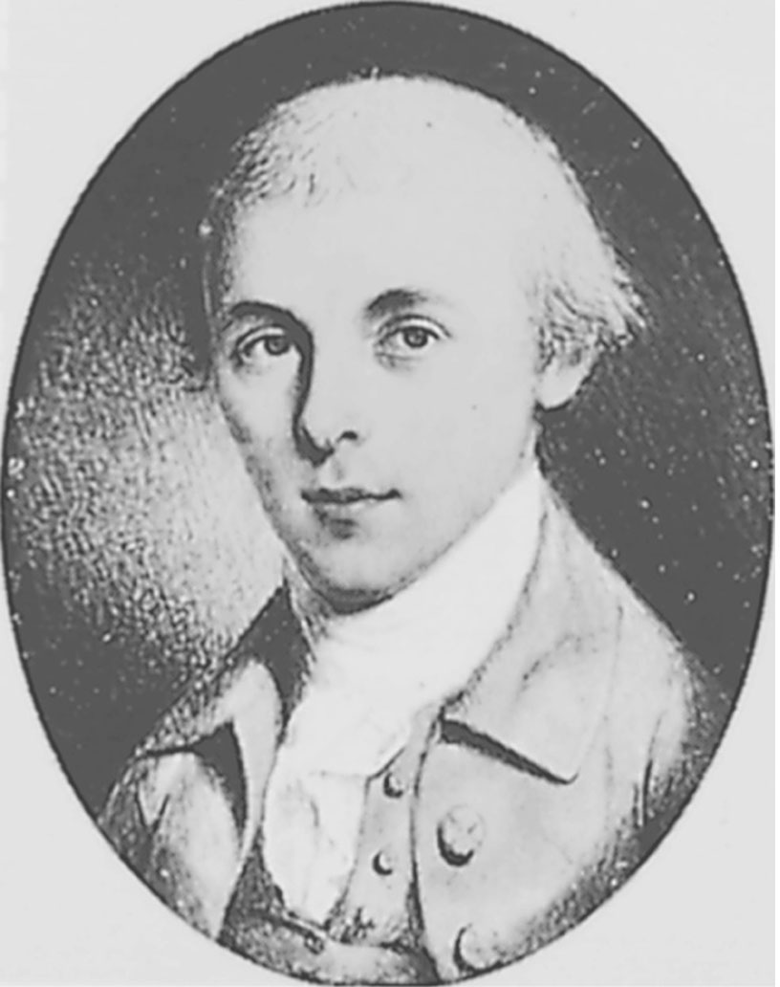
James Madison
Notes:
Madison was only thirty-six when he assumed a major role in the drafting of the Constitution. This miniature (1783) is by Charles Willson Peale.

Slide 15
The Constitution
The Great Compromise
Principles Incorporated into the Constitution
  Separation of powers
  Nature of the presidency
  Nature of the judicial branch
  Examples of countervailing forces in the new government
Notes:
The Great Compromise was the end result of the debate between the Virginia and New Jersey Plans.
Within the Constitution, the framers established a clear separation of powers, so that one entity in the new government could not be lawmaker, law enforcer, and judge. This, they hoped, would provide a system in which the nation would not be dominated by one branch of government.
The president is charged with ensuring that all laws passed by Congress are enforced. He does not have the authority to create laws on his own.
The Constitution created only one court in the judicial branch, the Supreme Court, and established only one member on that court, the chief justice. This way, Congress can create as many courts underneath the Supreme Court as is deemed necessary and may place as many judges and justices in these positions as it sees fit.
Examples of countervailing forces are the veto to kill laws, the ability of Congress to overturn a veto, and the power to impeach and removed members of the executive and judicial branches.

Slide 16
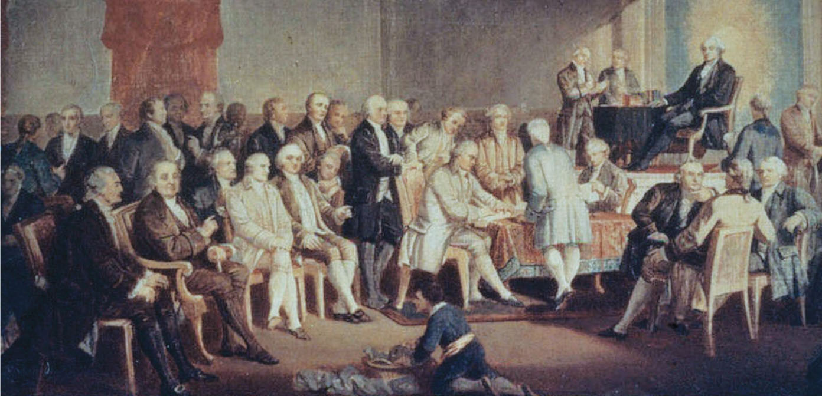
Signing the Constitution,
September 17, 1787
Notes:
Signing the Constitution, September 17, 1787
Thomas Pritchard Rossiter’s painting shows George Washington presiding over what Thomas Jefferson called “an assembly of demi-gods” in Philadelphia.

Slide 17
Crafting the Constitution
The Fight for Ratification
  Federalists versus anti-Federalists
Arguments for Ratification
Arguments against Ratification
Notes:
Once the Constitution was submitted to each state to ratify, two distinct camps emerged. The Federalists, which included Alexander Hamilton and James Madison, published essays arguing for the ratification. Members of the anti-Federalists, such as Richard Henry Lee and Patrick Henry, were not as well organized in their rebuttals but were still widely read.
Arguments for ratification included standardized monetary supply, reduction of taxes, and repayment of the war bonds.
Arguments against ratification included the fact that there was no Bill of Rights (this was added in 1791), that the Constitution provided a similar government system to Great Britain so similar power struggles might follow, and that the ratification process was illegal under the Articles.

Slide 18
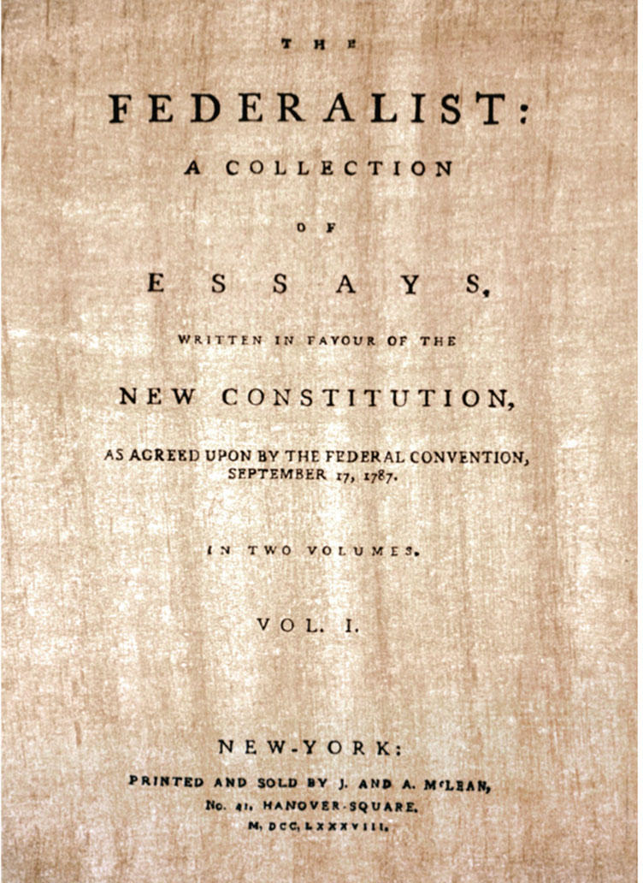
The Federalist Papers
Notes:
The Federalist
Alexander Hamilton, James Madison, and John Jay published this series of essays in 1788 defending the concept of strong central government and urging ratification of the Constitution.

Slide 19
Crafting the Constitution, continued
The Decision of the States
  Small states adopt it first
Demand for a Bill of Rights
New Hampshire Becomes Ninth State to Ratify
  Government is formed
Notes:
The small states did not have as many vocal opponents to the Constitution as the larger states. Without New York and Virginia ratifying, the new government would be but a shell. Once they did, it was a fait accompli. The new government was formed and the old was disbanded. New York was chosen as the site for the first capitol.

Slide 20
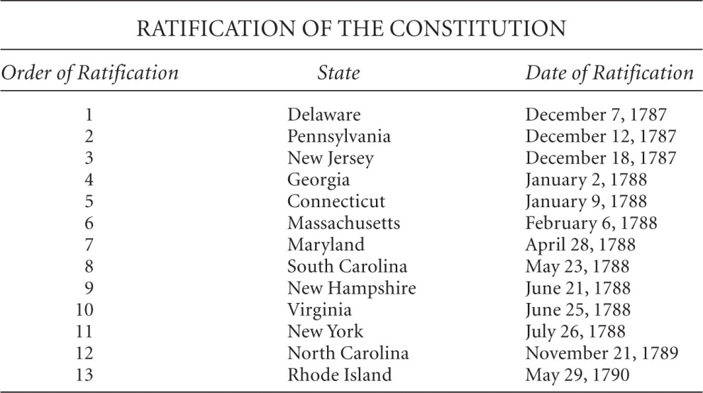
Order of Ratification

Slide 21
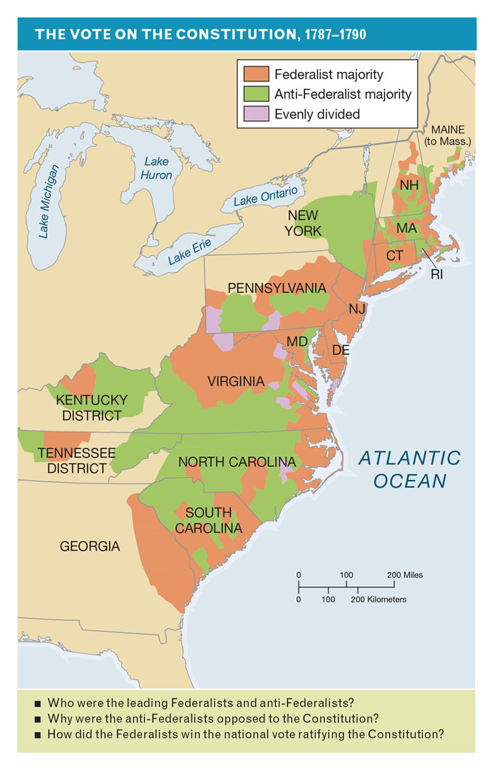
Vote on the Constitution, 1787–1790
Notes:
Who were the leading Federalists and anti-Federalists? Why were the anti-Federalists opposed to the Constitution? How did the Federalists win the ratification of the Constitution?

Slide 22
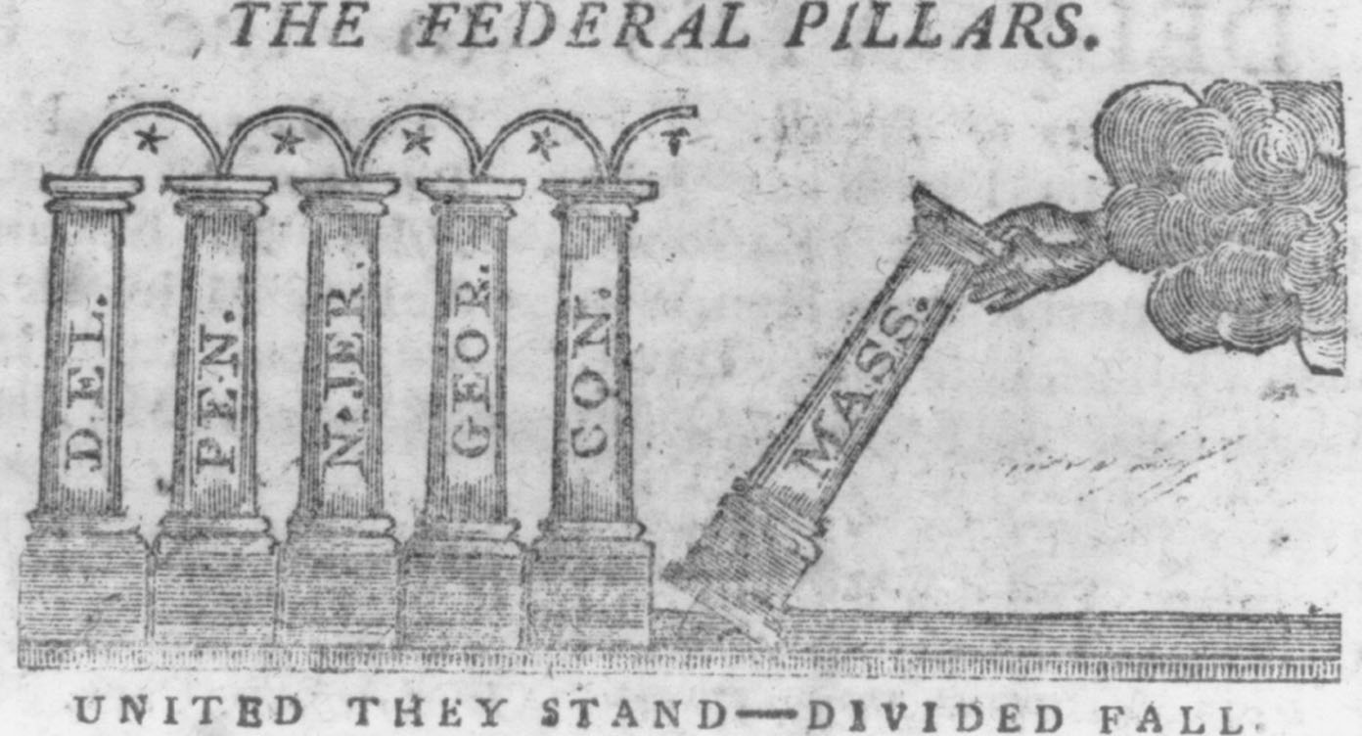
The Sixth Pillar
Notes:
An engraving published in 1788 in The Massachusetts Centinel after Massachusetts became the sixth state to ratify the Constitution. By the end of 1788, five more states would approve and the Constitution would go into effect. The last two states to ratify were North Carolina in 1789 and Rhode Island in 1790.

Slide 23
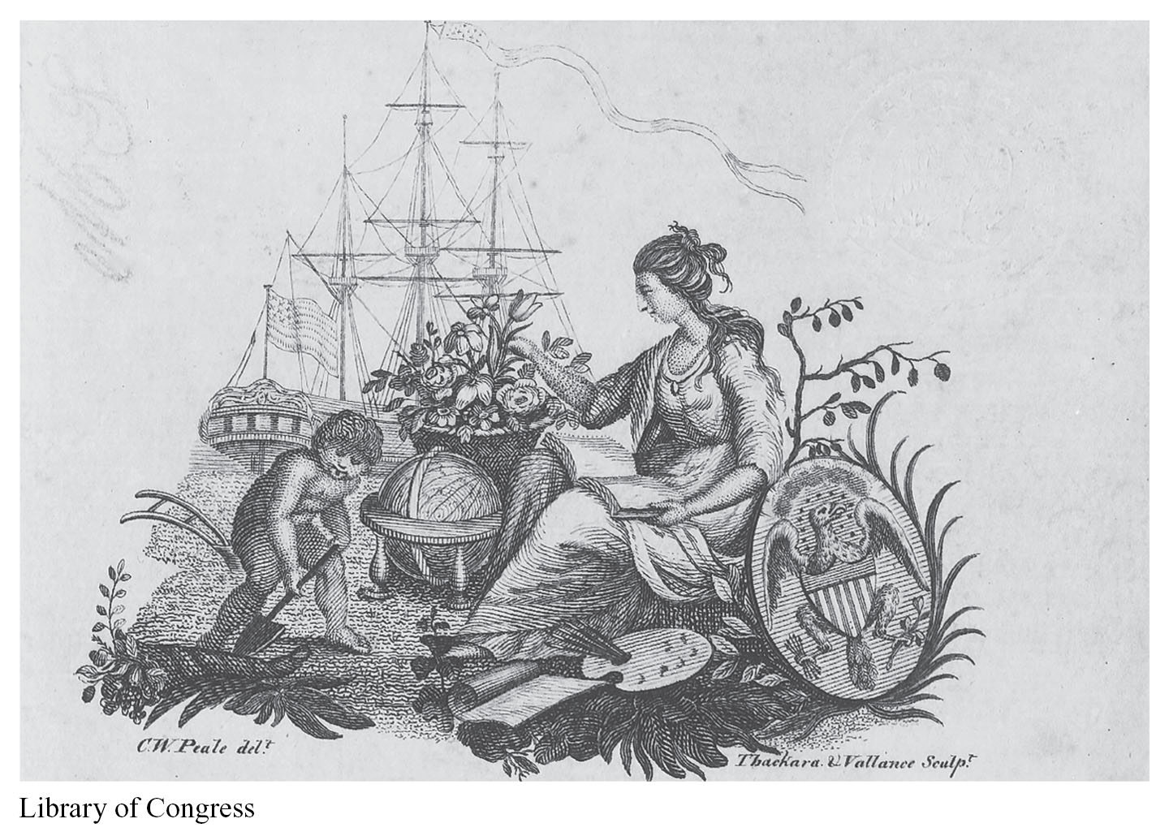
New Beginnings
Notes:
The Constitution
Many local newspapers published the Constitution in 1787, allowing Americans across the country to read and discuss it.

Slide 24
The Federalist Era
America in 1789
A New Government
Notes:
Hosting almost 4 million people and stretching from the Great Lakes to the Gulf of Mexico, the Eastern Seaboard, and the mighty Mississippi, the United States was experiencing economic and demographic growth on a large scale.
The differences between the agrarian society in the South and the shipping-focused North continued to increase.
As the first president of the United States, Washington appreciated the delicate position he was in, for everything that he did would be looked upon by future generations as precedent for further actions.

Slide 25
The Federalist Era, continued
The Government’s Structure
The Executive Branch
  Department of State
  Department of the Treasury
  Department of Justice
The Judicial Branch
Notes:
In order to fulfill his role as chief executive, Washington established his cabinet, which was composed of the leaders of the executive departments.
The Department of State is responsible for the diplomatic matters of the United States, and the first secretary was Thomas Jefferson. The Department of the Treasury is the chief banker of the United States, first overseen by Alexander Hamilton as secretary. The Department of Justice was the domain of the attorney general, Edmund Randolph.
The Supreme Court was the only court created by the Constitution, and the only member specifically mentioned was the presiding officer, the chief justice. Congress was given the authority to create as many levels of jurisdiction of courts and as many justices and judges as was deemed necessary.
John Jay was the first chief justice.

Slide 26
A New Nation
The Bill of Rights
Religious Freedom
Notes:
To calm fears about an overbearing national government, the Bill of Rights was added to the Constitution to ensure the rights of the citizen as well as the state in the new government. It was ratified in 1791.
When the Constitution was ratified, the United States was the only nation in the world that did not, in some form, sponsor a set religion or mandate some form of religious requirement to hold office. In the First Amendment, Congress was forbidden from endorsing a religion or in preventing others from worshipping as they saw fit.

Slide 27
Hamilton’s Financial Vision
Raising Revenue
Establishing the Public Credit
Notes:
Originally, the only method Congress had of raising money was by placing taxes on imports. This is known as a tariff. Taxing of an individual’s income would not come until the twentieth century in the form of the Sixteenth Amendment.
Hamilton was a man who had “pulled himself up by the bootstraps” and was a firm believer in a national economic policy that would strengthen the role of the central government, while at the same time enriching the national economy.
As secretary of the treasury, Hamilton won approval to absorb all of the states’ individual wartime debt, along with that of the national governments, so that by paying them all off as one debt, the establishment of a national bank along the lines of the Bank of England would bolster the economy of the United States and provide for an excellent credit rating for the new nation.

Slide 28
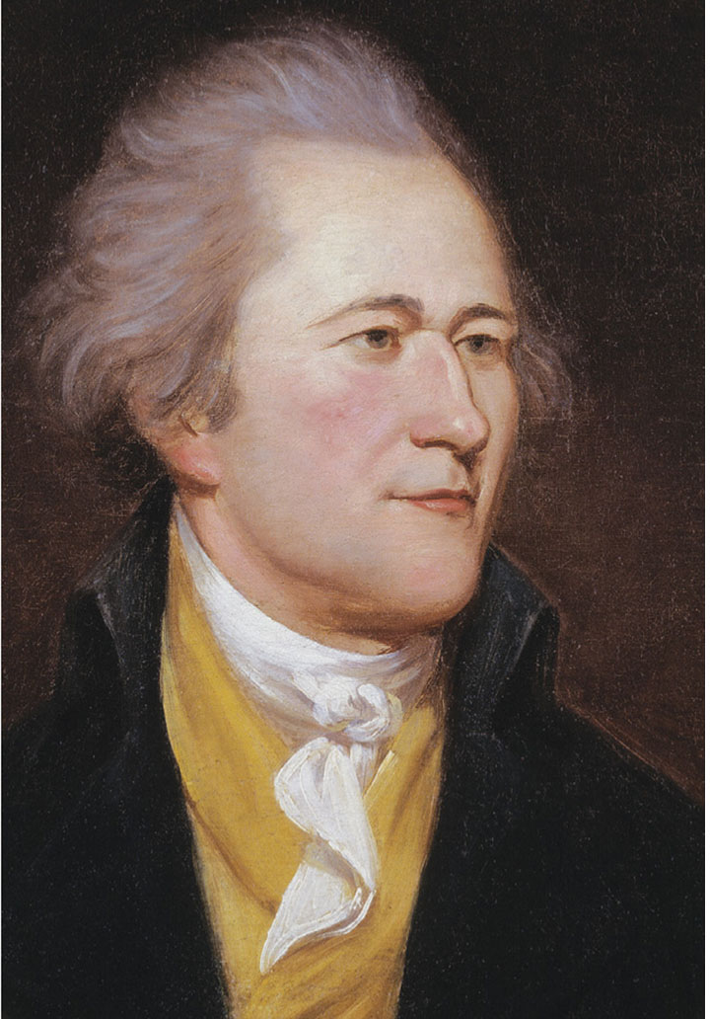
Alexander Hamilton
Notes:
Alexander Hamilton
Secretary of the Treasury from 1789 to 1795.

Slide 29
Hamilton’s Financial Vision, continued
The Emergence of Sectional Differences
A National Bank
Notes:
The downside to Hamilton’s plan was that it would strengthen the hand of the northern shippers and merchants in the government over that of the agrarian south. His plan would be the first to illustrate the sectional differences in the nation between North and South.
Having won the debt payment debate, Hamilton would move to his vision of a national bank to control the monetary supply. His vision was that a centralized banking authority that would allow the government to prevent the inflation or deflation of the dollar. However, the power to create a bank was not specifically mentioned in the Constitution, and the debate that emerged was the first great debate on constitutional interpretation to be heard in Congress. In the end, the bank was approved.

Slide 30
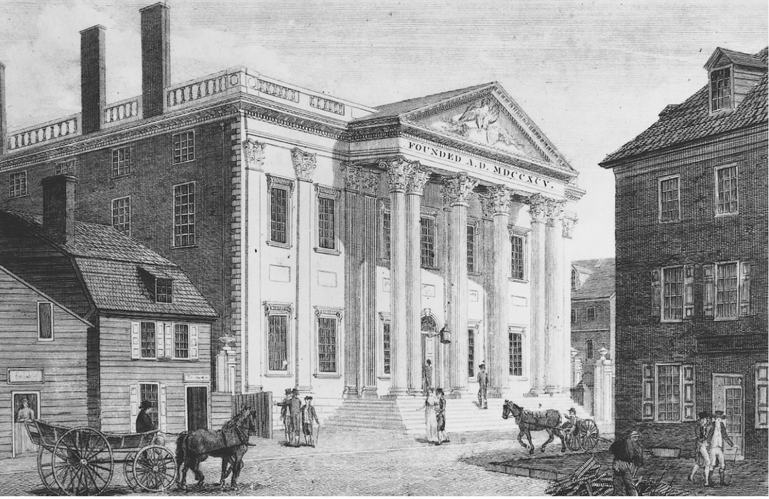
The Bank of the United States
Notes:
The Bank of the United States
Proposed by Alexander Hamilton, the bank opened in Philadelphia in 1791.

Slide 31
Hamilton’s Achievement
Encouraging Manufacturers
Notes:
As part of the mercantilist system of Great Britain, the American colonies had been forbidden from developing a manufacturing base. Once that symbiotic relationship was severed, it was imperative that the United States develop such a base in order to survive.
In order to encourage this growth, the price of items being imported that had a local competitor had to be kept higher, so that the local market could grow until they were able to stand on their own. Hamilton won the creation of “protective tariffs” to do this.
Thanks to Hamilton’s vision and drive, the war debts were paid off, a manufacturing base was burgeoning, and once again foreign credit began to flood the American markets.

Slide 32
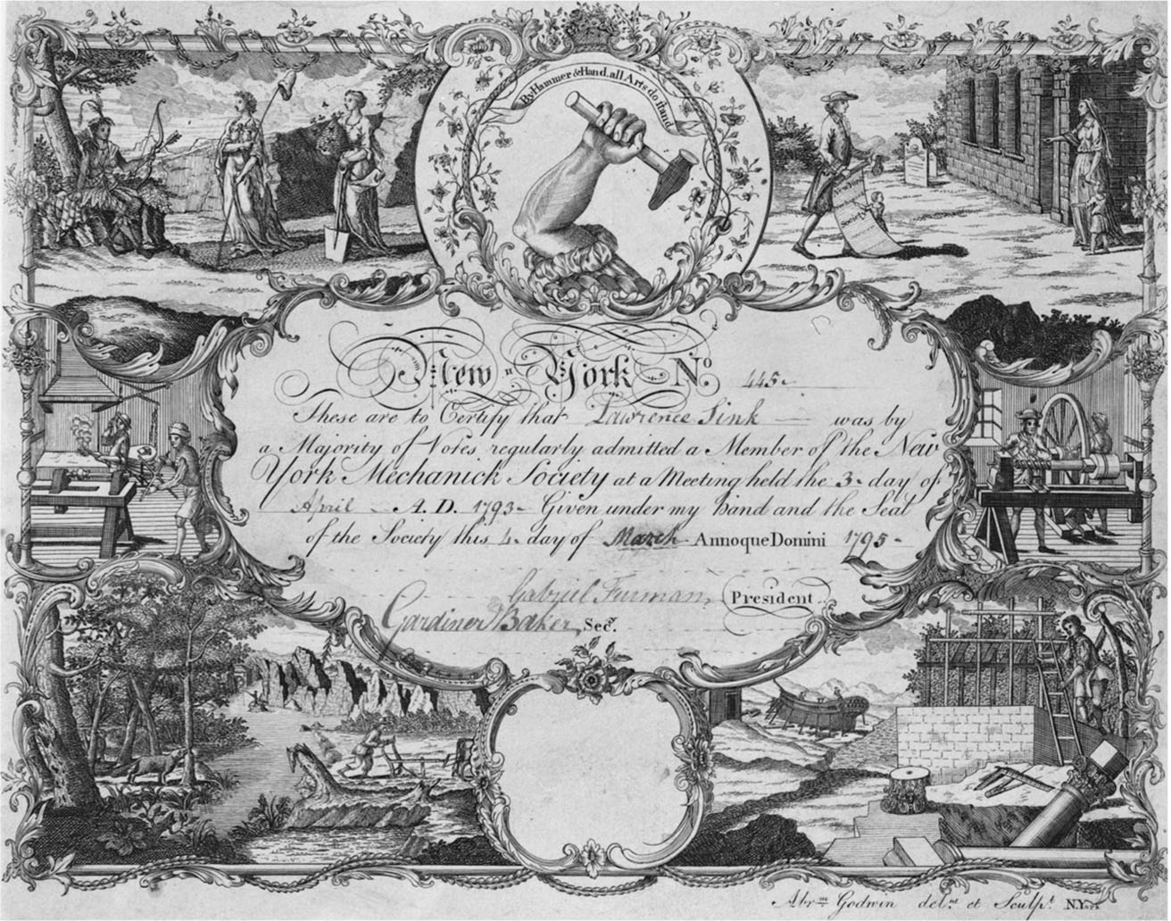
Certificate of the New York
Mechanick Society
Notes:
An illustration of the growing diversification of labor, by Abraham Godwin (ca. 1785)

Slide 33
The Republican Alternative
Birth of the First Political Parties
Federalists
Republicans or Democratic Republicans
Notes:
Although successful, the heavy-handed manner and what some viewed as unconstitutional actions of Hamilton to secure the National Bank and to pay off the war debts led to the creation of the first political parties.
Hamilton and his followers created the Federalist party, which promoted a strong central government.
Jefferson and Madison, who opposed Hamilton’s views, created the Republicans, or Democratic Republicans party. They stood for the rights of the states and a strict reading of the Constitution.

Slide 34
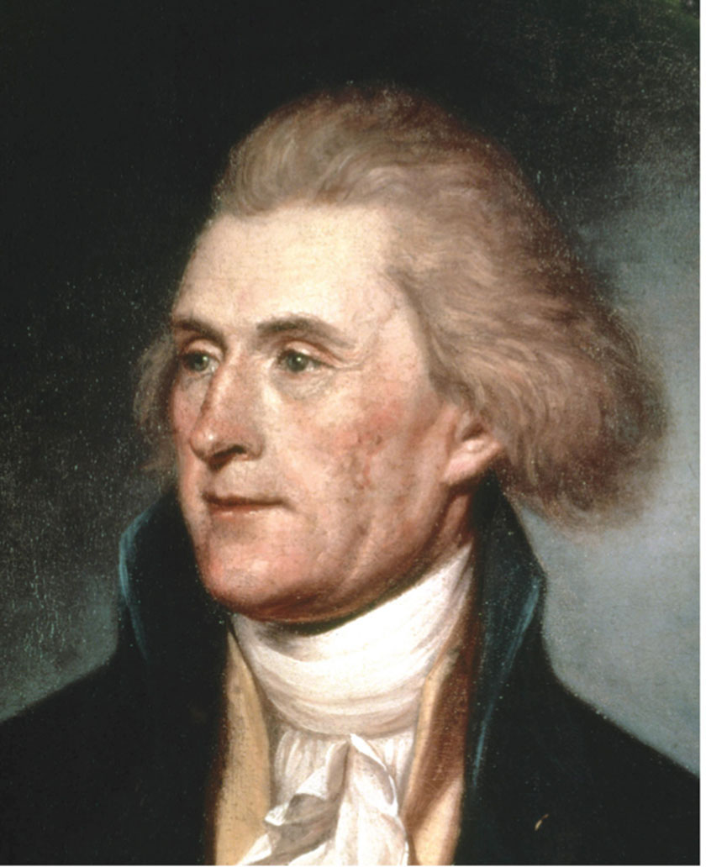
Thomas Jefferson
Notes:
A portrait by Charles Willson Peale (1791)

Slide 35
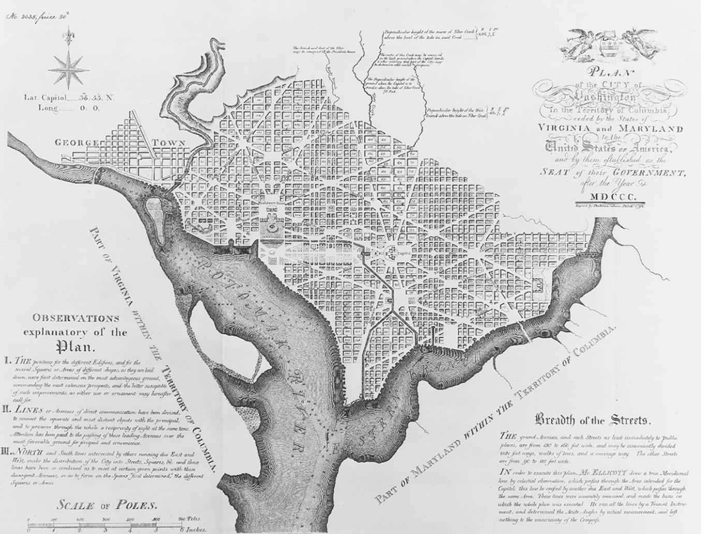
The New Federal City
Notes:
Plan of Washington, D.C., from 1792

Slide 36
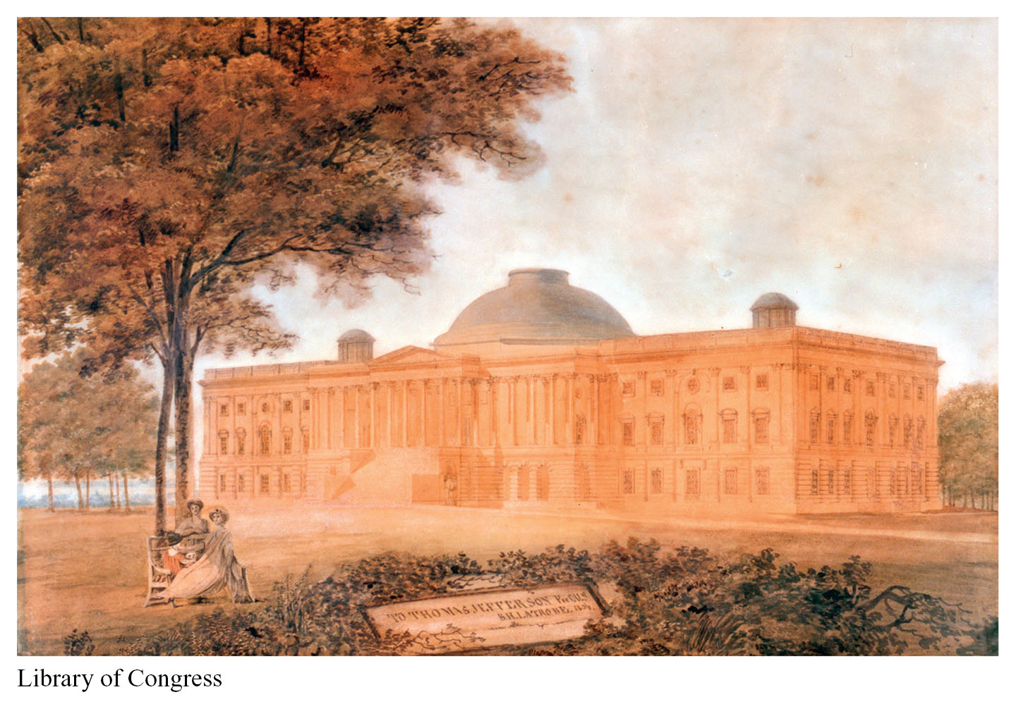
The Capitol Building
Notes:
This 1806 watercolor was painted by the building’s architect Benjamin Henry Latrobe, and inscribed to Thomas Jefferson. A prominent dome would be added later, after the building was damaged in the War of 1812.

Slide 37
Domestic Crises
The Whiskey Rebellion
Pinckney’s Treaty
Notes:
Hamilton had levied a tax against whiskey in 1791, which had angered farmers, for whom it was their principle crop. At the time, it was easier to move jugs of whiskey across the Appalachian Mountains than it was to move sheaves of wheat. The farmers feared this was another attempt to fleece the poor to subsidize the rich. Events erupted in 1794 in western Pennsylvania where federal revenue officers were being terrorized. Washington called out the militia, but by the time they got there, the rebels had vanished. A few were captured and marched in irons through Philadelphia, but the rebellion had ended.
In Pinckney’s Treaty of 1795, Thomas Pinckney secured the use of New Orleans, the land north of the 31st parallel to the Tennessee River and west to the Mississippi.

Slide 38
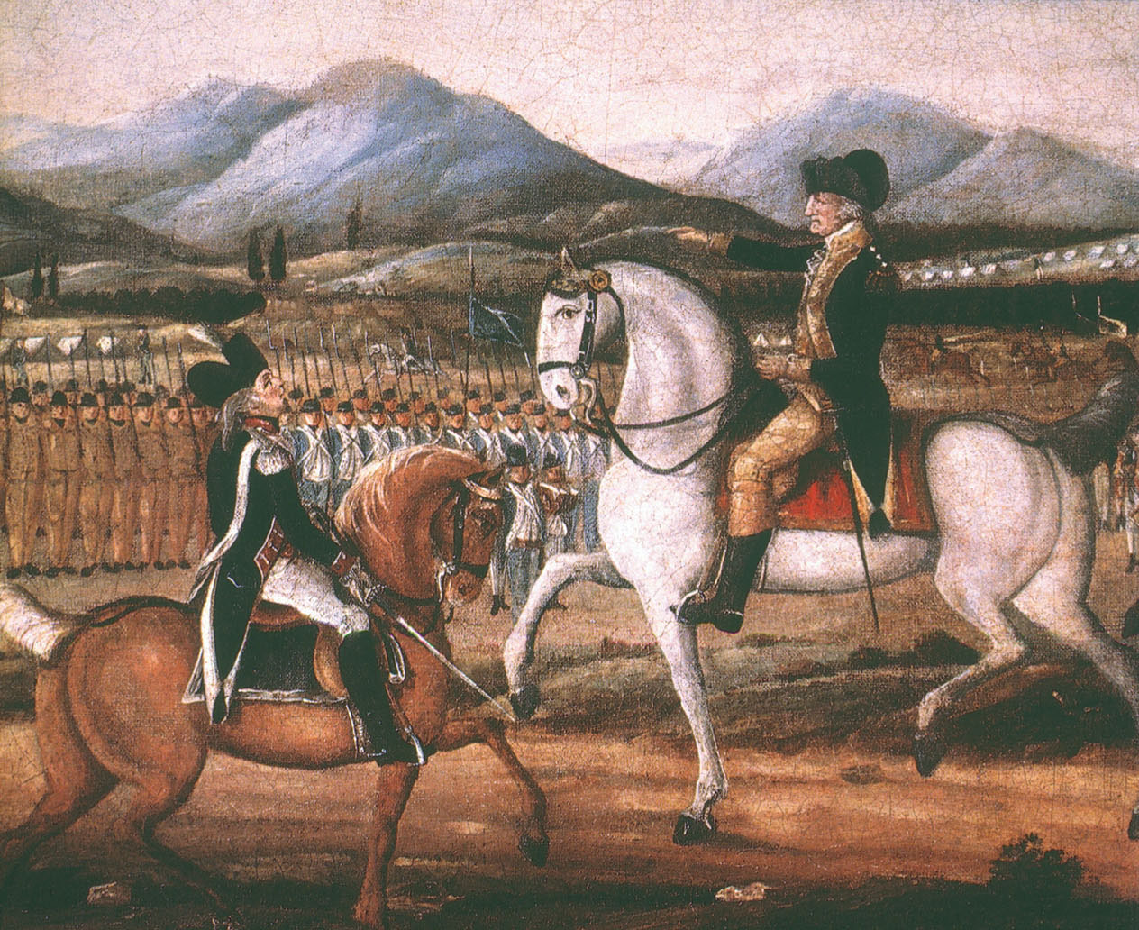
Whiskey Rebellion
Notes:
George Washington as commander in chief reviews the troops mobilized to quell the Whiskey Rebellion in 1794.

Slide 39
Foreign and Domestic Crises
The French Revolution of 1789
The Treaty of Alliance, 1778
Washington’s Proclamation of 1793
Notes:
Originally, the French Revolution was viewed in the United States as an action similar to their own in 1776. All that changed in 1792 when France declared war on Prussia and Austria and began to slaughter their nobility. This would cause problems in the United States because the Treaty of Alliance with France, signed in 1778, stated that these two countries were perpetual allies and were obligated to defend each other.
Washington’s Proclamation of 1793 declared that the United States was neutral in the European wars and that any citizen caught aiding in these wars would be prosecuted.

Slide 40
Foreign and Domestic Crises, continued
Citizen Genet
Jay’s Treaty
Notes:
The French diplomat to the United States during the early days of the French Revolution was Citizen Edmond Genet. Genet had begun hiring privateers to attack Spanish Florida and harass British ships. Washington worried that Genet’s actions would lead to America’s entrance into the war against England, which he did not want, and demanded Genet’s recall. By the time the demand reached France, another revolution had swept out Genet’s supporters and his arrest was ordered. Genet begged for asylum to prevent being returned.
In an effort to soothe relations with Great Britain while at the same time securing promises to pull British forts out of the Ohio River Valley, John Jay was sent to England. His negotiations secured very few of the demands of Congress, and his treaty, though offensive to many, was ratified to avoid embarrassment abroad.

Slide 41
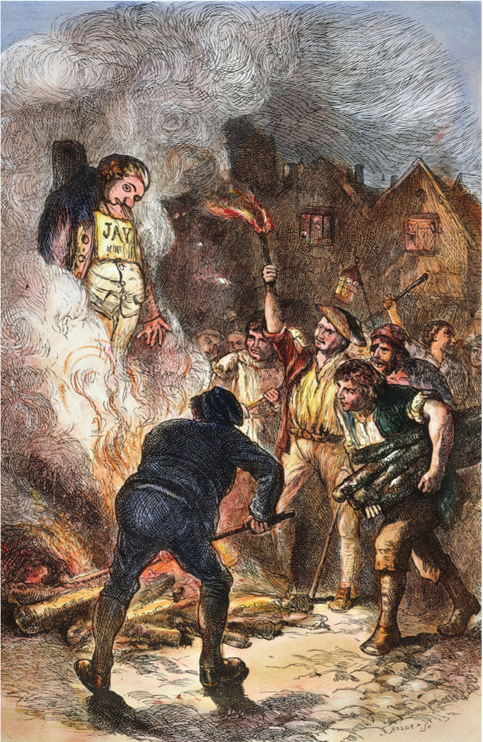
Jay’s Treaty
Notes:
A firestorm of controversy greeted Jay’s Treaty in America. Opponents of the treaty rioted and burned Jay in effigy.

Slide 42
Frontier Tensions
The Battle of Fallen Timbers
The Treaty of Greenville, 1795
Notes:
Washington sent General “Mad” Anthony Wayne into the Northwest Territory in 1793 to protect settlers from Native Americans.
At the Battle of Fallen Timbers, Wayne’s soldiers inflicted heavy casualties on the Native American warriors and then burned their villages. The Indians had no other choice than to surrender their land in the Treaty of Greenville and move west.

Slide 43
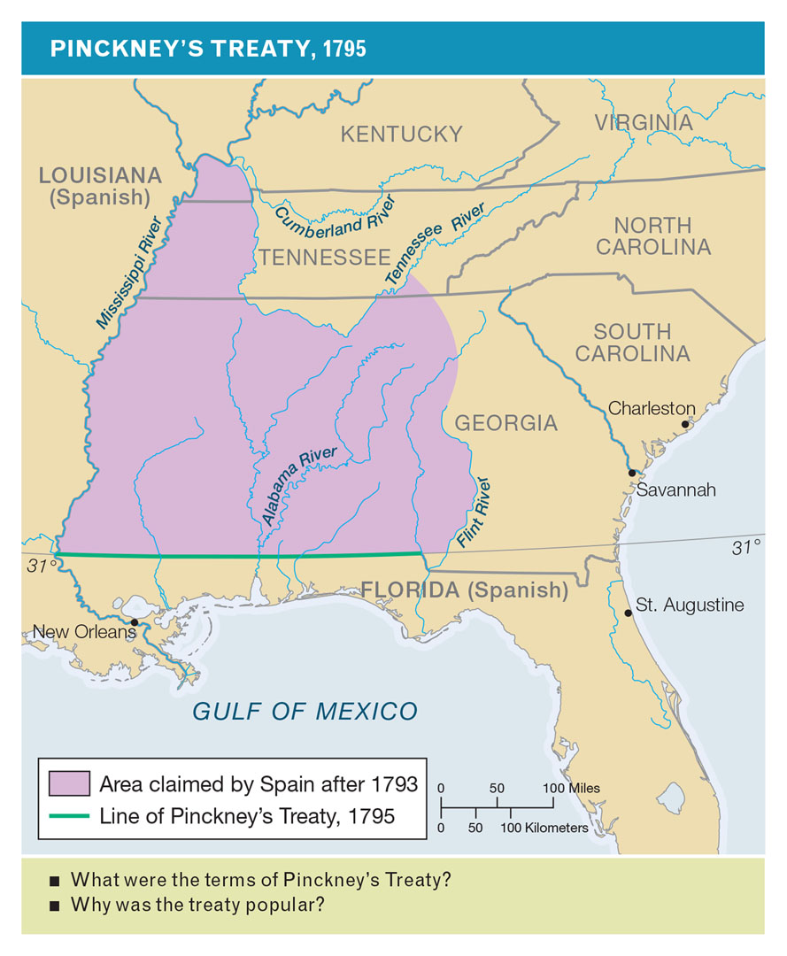
Pinckney’s Treaty, 1795
Notes:
Why did settlers in Tennessee start destroying Indian villages? What were the terms of Pinckney’s Treaty? Why was the treaty popular?

Slide 44
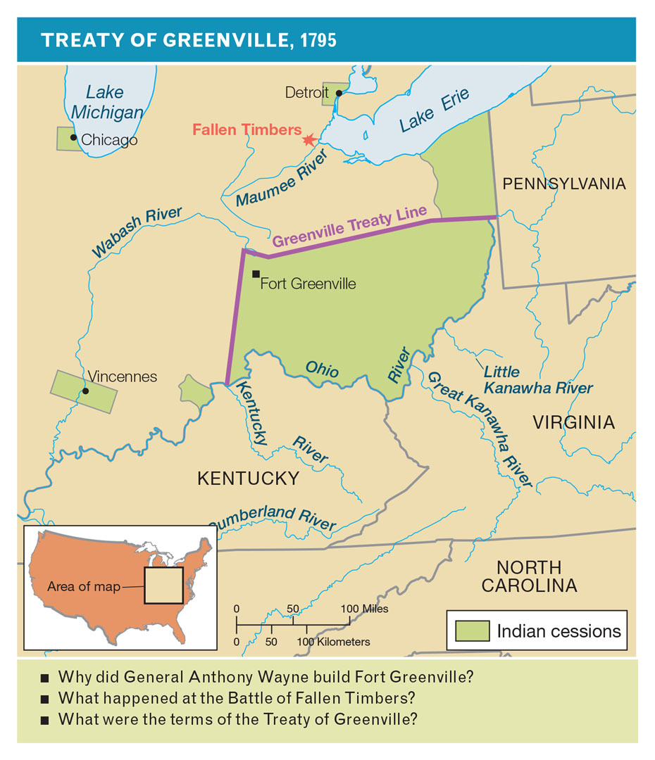
Treaty of Greenville, 1795
Notes:
Why did General Wayne build Fort Greenville? What happened at the Battle of Fallen Timbers? What were the terms of the Treaty of Greenville?

Slide 45
Western Settlement
Land Policy
The Wilderness Road
Notes:
With the Land Act of 1796, Congress extended the rectangular surveys of land that had been accepted in 1785 and agreed to sell the land at $2 per acre, with 640 acres being the minimum sold. This was well beyond the means of most farmers, and it was not until 1800, when it was revised to 320 acres minimum and a down payment was allowed, that it became affordable.
In 1795, Daniel Boone expanded a Native American trail between the Appalachian Mountains known as the Cumberland Gap and opened what has since become the Wilderness Road. This allowed for easier access to the back country and for the flow of goods and settlers into the area east of the mountain range.

Slide 46
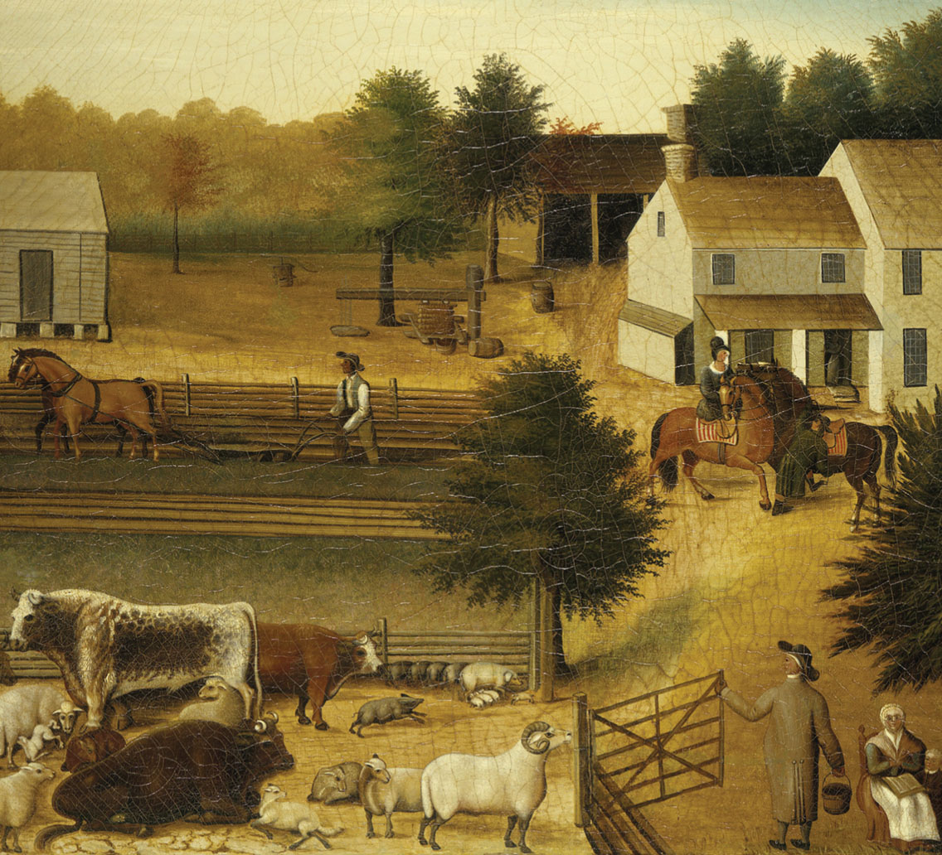
The Prevalence of Agriculture
Crises
Notes:
This American folk painting by Edward Hicks shows the residence of David Twining, a Pennsylvania farmer, as it appeared in 1787.

Slide 47
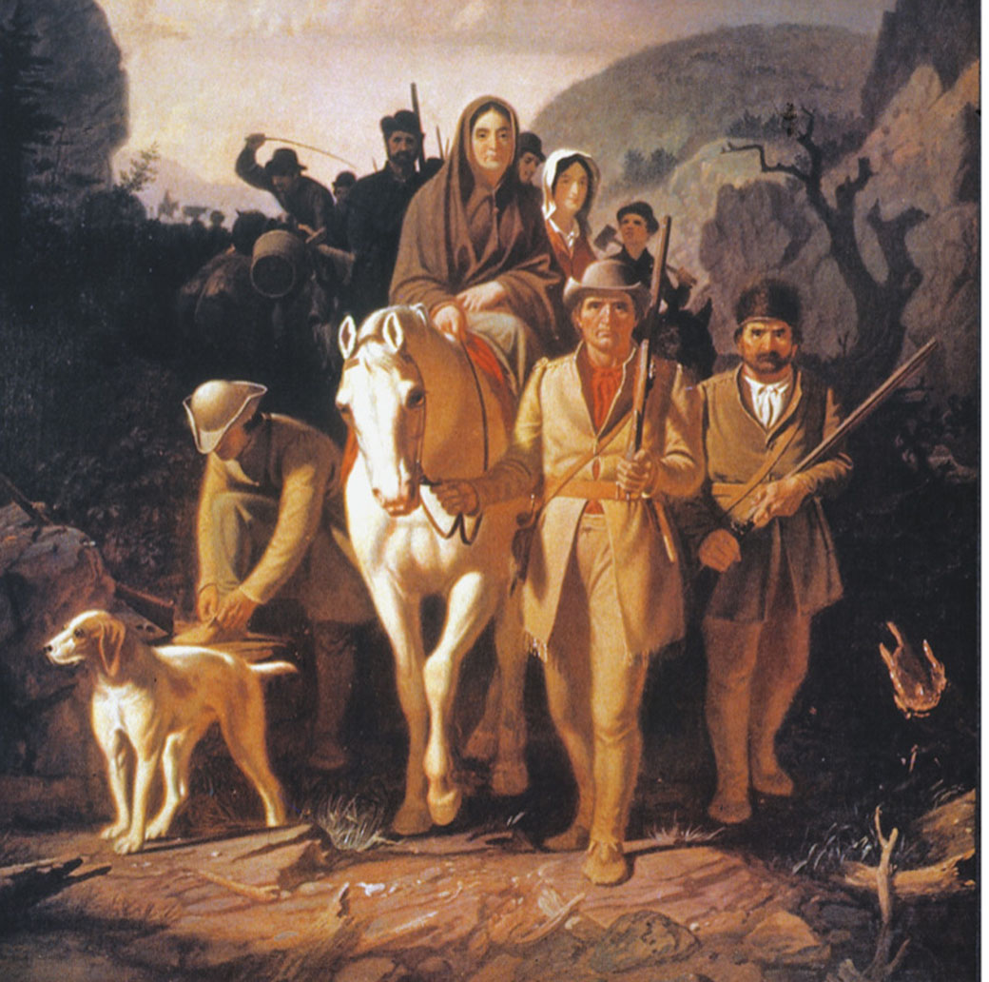
The Wilderness Road
Notes:
Daniel Boone Escorting Settlers through the Cumberland Gap by George Caleb Bingham

Slide 48
Transfer of Power
Washington’s Farewell
The Election of 1796
Notes:
After serving two terms in office, Washington was ready to retire. In his farewell address to the nation, he called for American citizens to forgo political parties as well as to avoid entangling alliances with foreign nations.
In all three elections prior to 1804 for president, the candidate with the second-highest number of votes would become vice-president. (After the 1800 election, this was discontinued.) In the 1796 election, John Adams would win the presidency and Thomas Jefferson would become vice-president, even though they were of different parties.

Slide 49
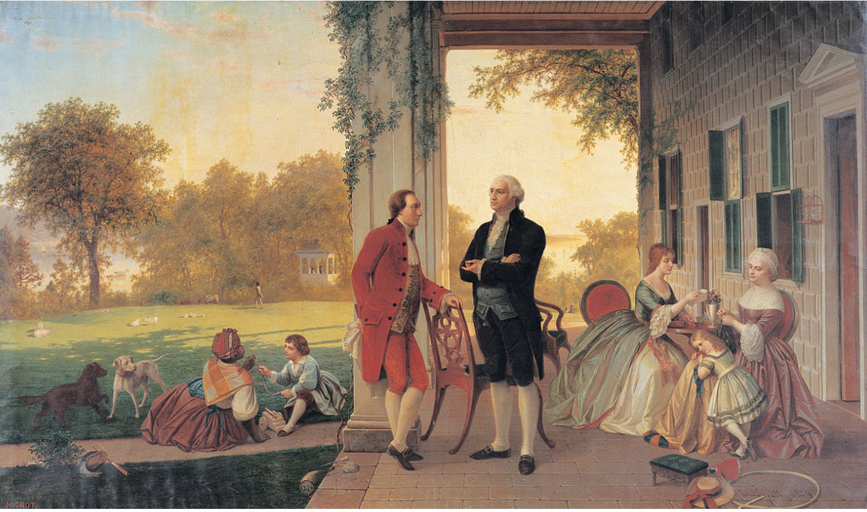
Mount Vernon
Notes:
George Washington and the Marquis de Lafayette at Mount Vernon in 1784. Washington enlarged the estate, which overlooks the Potomac River, to nearly eight thousand acres, dividing it among five farms.

Slide 50
The Adams Administration
The War with France
The XYZ Affair
Notes:
By the time Adams came into office, the United States was in an undeclared war with France. Over 300 American ships had been plundered by French ships and the United States had broken off diplomatic relations with its former ally. In an effort to prevent a declared war, Adams sent a delegation to France to seek a diplomatic end. Before the delegation was allowed to meet with their French counterparts, three French officials, whom Adams would name X, Y, and Z in his report to Congress, demanded a bribe before they would gain an audience. When this became known in the United States, it was greeted with a cry for war with France. French officials, realizing their mistake, apologized.

Slide 51
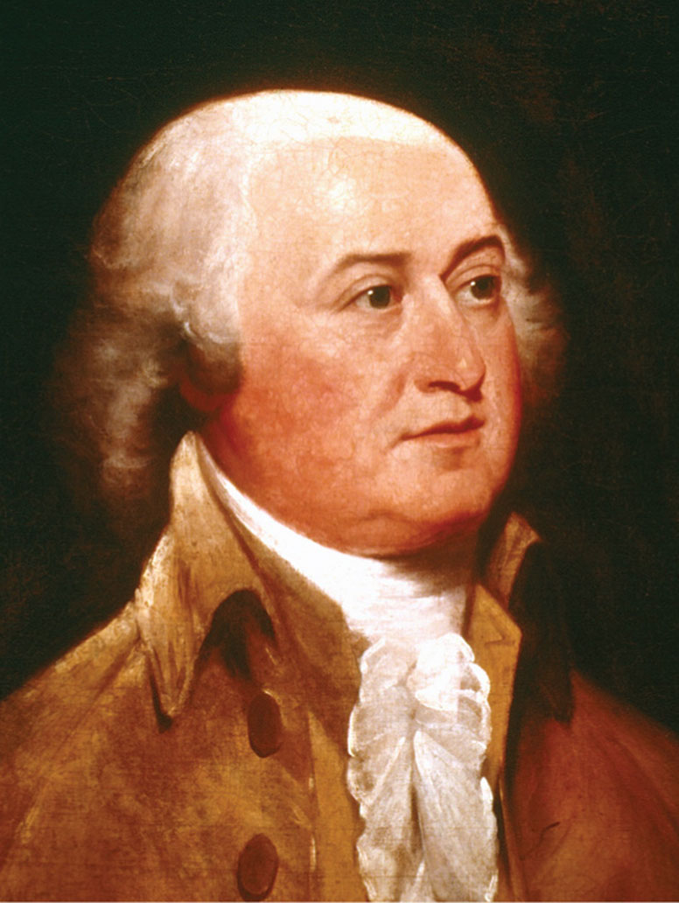
John Adams
Notes:
Political philosopher and politician, Adams was the first president to take up residence in the White House, in early 1801.

Slide 52
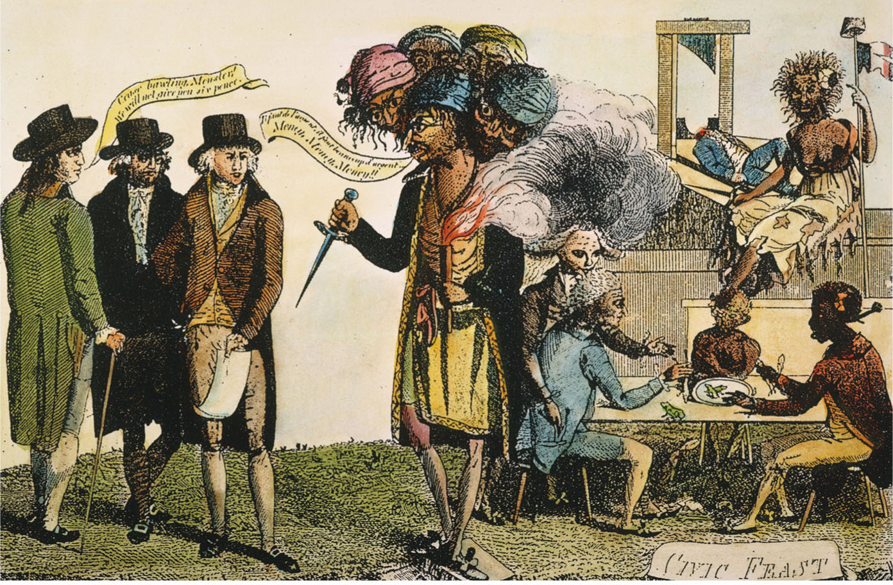
Conflict with France
Notes:
A cartoon indicating the anti-French sentiment generated by the XYZ affair. The three American negotiators (at left) reject the Paris Monster’s demand for money.

Slide 53
The Adams Years
The War at Home
  The Naturalization Act
  The Alien Act
  The Alien Enemies Act
  The Sedition Act
Notes:
To counteract what was conceived of as Republican attempts to undermine his presidency, John Adams signed the following acts, thus committing the greatest mistake of his presidency and thereby dooming his chance for reelection.
The Naturalization Act changed the time period necessary to become a citizen from five to fourteen years of residency.
The Alien Act empowered the presidency with the ability to deport “dangerous” aliens.
The Alien Enemies Act was designed to expel from America enemy aliens at will during a time of war.
The Sedition Act forbade writing, publishing, or speaking ill of the government or its officers.

Slide 54
Republican Victory in 1800
Republican Victory
Notes:
In the election of 1800, no candidate won a majority of the electoral college. Thomas Jefferson and Aaron Burr tied, and in accordance with the Constitution, the election was to be decided by the House of Representatives. Finally, Jefferson won.

Slide 55
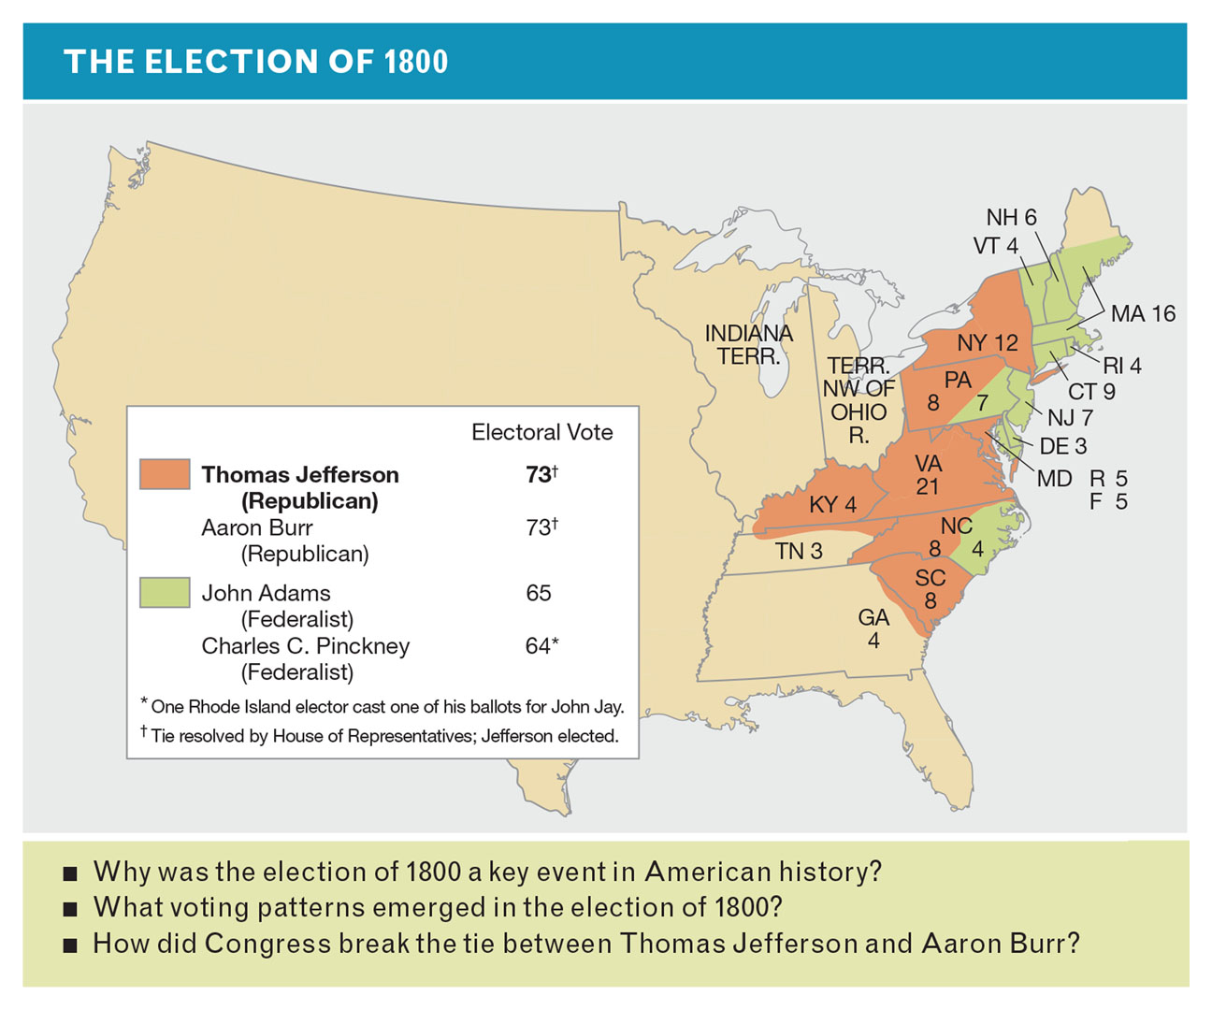
The Election of 1800
Notes:
Why was the election of 1800 a key moment in American history? How did the Republicans win New York and South Carolina? How did Congress break the tie between Jefferson and Burr?

