Slide 1
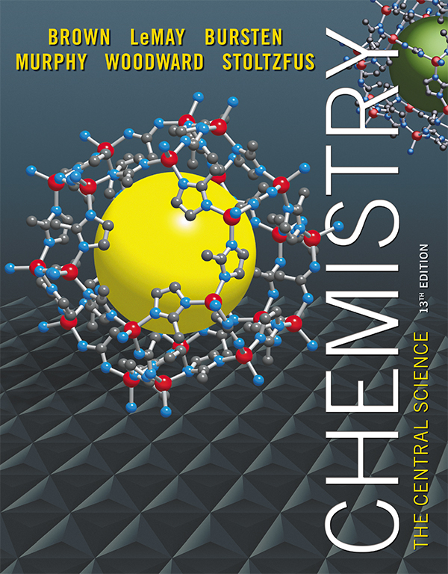
Clicker Questions Chapter 3
Barbara Mowery
York College

Slide 2
For the reaction X → Y, X is referred to as the
yield.
reactant.
product.
d. coefficient.
Notes:
Answer: b

Slide 3
For the reaction X → Y, X is referred to as the
yield.
reactant.
product.
d. coefficient.
Notes:
Answer: b

Slide 4
Hydrocarbons burn to form
H₂O and CO₂.
charcoal.
methane.
d. O₂ and H₂O.
Notes:
Answer: a

Slide 5
Hydrocarbons burn to form
H₂O and CO₂.
charcoal.
methane.
d. O₂ and H₂O.
Notes:
Answer: a

Slide 6
C₆H₆ + O₂ → CO₂ + H₂O When this equation is correctly balanced, the coefficients are
1, 7 → 6, 3.
1, 8 → 6, 3.
2, 15 → 12, 6.
d. 2, 16 → 12, 6.
Notes:
Answer: c

Slide 7
C₆H₆ + O₂ → CO₂ + H₂O When this equation is correctly balanced, the coefficients are
1, 7 → 6, 3.
1, 8 → 6, 3.
2, 15 → 12, 6.
d. 2, 16 → 12, 6.
Notes:
Answer: c

Slide 8
2 NaN₃ → 2 Na + 3 N₂ This is an example of a _______ reaction.
decomposition
combination
combustion
d. replacement
Notes:
Answer: a

Slide 9
2 NaN₃ → 2 Na + 3 N₂ This is an example of a _______ reaction.
decomposition
combination
combustion
d. replacement
Notes:
Answer: a

Slide 10
The formula weight of any substance is also known as
Avogadro’s number.
atomic weight.
density.
d. molar mass.
Notes:
Answer: d

Slide 11
The formula weight of any substance is also known as
Avogadro’s number.
atomic weight.
density.
d. molar mass.
Notes:
Answer: d

Slide 12
The formula weight of Na₃PO₄ is _______ grams per mole.
70
164
265
d. 116
Notes:
Answer: b

Slide 13
The formula weight of Na₃PO₄ is _______ grams per mole.
70
164
265
d. 116
Notes:
Answer: b

Slide 14
The percentage by mass of phosphorus in Na₃PO₄ is
44.0.
11.7.
26.7.
d. 18.9.
Notes:
Answer: d

Slide 15
The percentage by mass of phosphorus in Na₃PO₄ is
44.0.
11.7.
26.7.
d. 18.9.
Notes:
Answer: d

Slide 16
One millionth of one mole of a noble gas = _______ atoms.
6.02 × 10¹⁷
6.02 × 10²⁰
6.02 × 10¹⁴
d. Atoms are too small to count.
Notes:
Answer: a

Slide 17
One millionth of one mole of a noble gas = _______ atoms.
6.02 × 10¹⁷
6.02 × 10²⁰
6.02 × 10¹⁴
d. Atoms are too small to count.
Notes:
Answer: a

Slide 18
Ethanol contains 52.2% carbon, 13.0% hydrogen, and 34.8% oxygen by mass. The empirical formula of ethanol is
C₂H₅O₂.
C₂H₆O.
C₂H₆O₂.
d. C₃H₄O₂.
Notes:
Answer: b

Slide 19
Ethanol contains 52.2% carbon, 13.0% hydrogen, and 34.8% oxygen by mass. The empirical formula of ethanol is
C₂H₅O₂.
C₂H₆O.
C₂H₆O₂.
d. C₃H₄O₂.
Notes:
Answer: b

Slide 20
Ribose has a molecular weight of 150 grams per mole and the empirical formula CH₂O. The molecular formula of ribose is
C₄H₈O₄.
C₅H₁₀O₅.
C₆H₁₄O₄.
d. C₆H₁₂O₆.
Notes:
Answer: b

Slide 21
Ribose has a molecular weight of 150 grams per mole and the empirical formula CH₂O. The molecular formula of ribose is
C₄H₈O₄.
C₅H₁₀O₅.
C₆H₁₄O₄.
d. C₆H₁₂O₆.
Notes:
Answer: b

Slide 22
When 3.14 g of Compound X is completely combusted, 6.91 g of CO₂ and 2.26 g of H₂O form. The molecular formula of Compound X is
C₇H₁₆. b. C₆H₁₂O.
c. C₅H₈O₂. d. C₄H₄O₃.
Notes:
Answer: c

Slide 23
When 3.14 g of Compound X is completely combusted, 6.91 g of CO₂ and 2.26 g of H₂O form. The molecular formula of Compound X is
C₇H₁₆. b. C₆H₁₂O.
c. C₅H₈O₂. d. C₄H₄O₃.
Notes:
Answer: c

Slide 24
C₆H₆ + 2 Br₂ → C₆H₄Br₂ + 2 HBr When 10.0 g of C₆H₆ and 30.0 g of Br₂ react as shown above, the limiting reactant is
Br₂.
C₆H₆.
HBr.
d. C₆H₄Br₂.
Notes:
Answer: a

Slide 25
C₆H₆ + 2 Br₂ → C₆H₄Br₂ + 2 HBr When 10.0 g of C₆H₆ and 30.0 g of Br₂ react as shown above, the limiting reactant is
Br₂.
C₆H₆.
HBr.
d. C₆H₄Br₂.
Notes:
Answer: a

Slide 26
2 Fe + 3 Cl₂ → 2 FeCl₃ When 10.0 g of iron and 20.0 g of chlorine react as shown, the theoretical yield of FeCl₃ is
10.0 g.
20.0 g.
29.0 g.
d. 30.0 g.
Notes:
Answer: c

Slide 27
2 Fe + 3 Cl₂ → 2 FeCl₃ When 10.0 g of iron and 20.0 g of chlorine react as shown, the theoretical yield of FeCl₃ is
10.0 g.
20.0 g.
29.0 g.
d. 30.0 g.
Notes:
Answer: c

Slide 28
The percentage yield of a reaction is 100% × (Z), where Z is
theoretical yield/actual yield.
calculated yield/actual yield.
c. calculated yield/theoretical yield.
d. actual yield/theoretical yield.
Notes:
Answer: d

Slide 29
The percentage yield of a reaction is 100% × (Z), where Z is
theoretical yield/actual yield.
calculated yield/actual yield.
c. calculated yield/theoretical yield.
d. actual yield/theoretical yield.
Notes:
Answer: d

Slide 30
C₃H₄O₄ + 2 C₂H₆O → C₇H₁₂O₂ + 2 H₂O When 15.0 g of each reactant was mixed, 15.0 g of C₇H₁₂O₂ formed. The percentage yield of this product is
100%. b. 75%.
c. 65%. d. 50%.
Notes:
Answer: c

Slide 31
C₃H₄O₄ + 2 C₂H₆O → C₇H₁₂O₂ + 2 H₂O When 15.0 g of each reactant was mixed, 15.0 g of C₇H₁₂O₂ formed. The percentage yield of this product is
100%. b. 75%.
c. 65%. d. 50%.
Notes:
Answer: c

