Slide 1
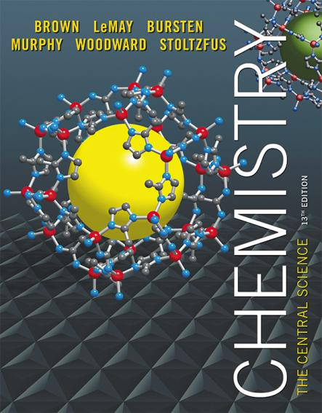
Chapter 3 Chemical Reactions and Reaction Stoichiometry
Lecture Presentation
James F. Kirby
Quinnipiac University
Hamden, CT

Slide 2
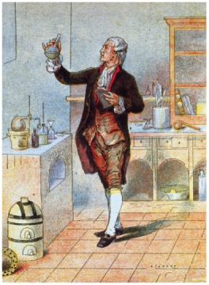
Stoichiometry
The study of the mass relationships in chemistry
Based on the Law of Conservation of Mass (Antoine Lavoisier, 1789)
“We may lay it down as an incontestable axiom that, in all the operations of art and nature, nothing is created; an equal amount of matter exists both before and after the experiment. Upon this principle, the whole art of performing chemical experiments depends.”
—Antoine Lavoisier

Slide 3
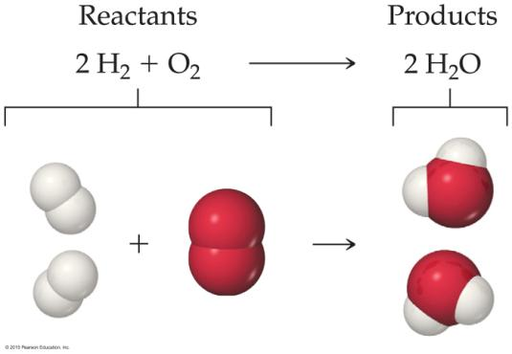
Chemical Equations
Chemical equations are concise representations of chemical reactions.

Slide 4
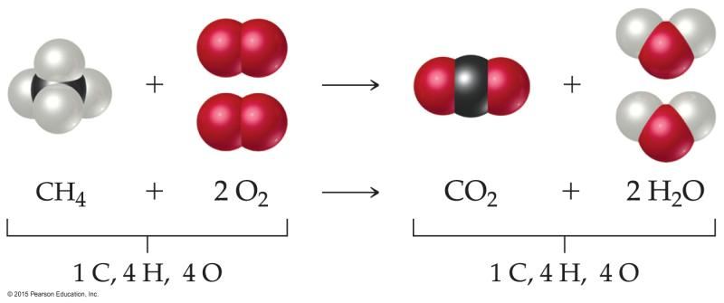
What Is in a Chemical Equation?
CH₄(g) + 2O₂(g) CO₂(g) + 2H₂O(g)
Reactants appear on the left side of the equation.

Slide 5
What Is in a Chemical Equation?
CH₄(g) + 2O₂(g) CO₂(g) + 2H₂O(g)
Products appear on the right side of the equation.

Slide 6
What Is in a Chemical Equation?
CH₄(g) + 2O₂(g) CO₂(g) + 2H₂O(g)
The states of the reactants and products are written in parentheses to the right of each compound.
(g) = gas; (l) = liquid; (s) = solid;
(aq) = in aqueous solution

Slide 7
What Is in a Chemical Equation?
CH₄(g) + 2O₂(g) CO₂(g) + 2H₂O(g)
Coefficients are inserted to balance the equation to follow the law of conservation of mass.

Slide 8
Why Do We Add Coefficients Instead of Changing Subscripts to Balance?
Hydrogen and oxygen can make water OR hydrogen peroxide:
2 H₂(g) + O₂(g) → 2 H₂O(l)
H₂(g) + O₂(g) → H₂O₂(l)

Slide 9
Three Types of Reactions
Combination reactions
Decomposition reactions
Combustion reactionsf

Slide 10
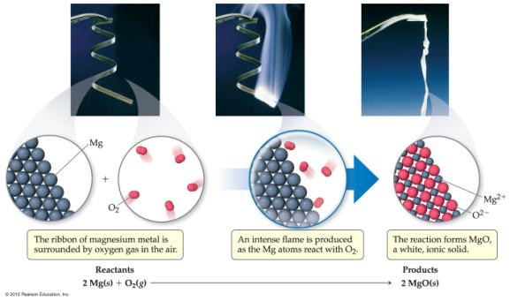
Combination Reactions
In combination reactions two or more substances react to form one product.
Examples:
2 Mg(s) + O₂(g) 2 MgO(s)
N₂(g) + 3 H₂(g) 2 NH₃(g)
C₃H₆(g) + Br₂(l) C₃H₆Br₂(l)

Slide 11
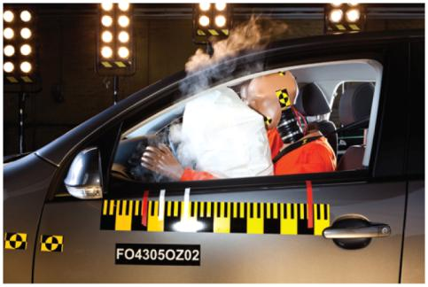
Decomposition Reactions
In a decomposition reaction one substance breaks down into two or more substances.
Examples:
CaCO₃(s) CaO(s) + CO₂(g)
2 KClO₃(s) 2 KCl(s) + O₂(g)
2 NaN₃(s) 2 Na(s) + 3 N₂(g)
Notes:
Potassium chlorate
Sodium Azide

Slide 12
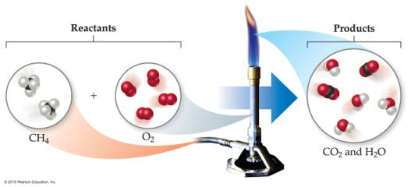
Combustion Reactions
Combustion reactions are generally rapid reactions that produce a flame.
Combustion reactions most often involve oxygen in the air as a reactant.
Examples:
CH₄(g) + 2 O₂(g) CO₂(g) + 2 H₂O(g)
C₃H₈(g) + 5 O₂(g) 3 CO₂(g) + 4 H₂O(g)

Slide 13
Formula Weight (FW)
A formula weight is the sum of the atomic weights for the atoms in a chemical formula.
This is the quantitative significance of a formula.
The formula weight of calcium chloride, CaCl₂, would be
Ca: 1(40.08 amu)
+ Cl: 2(35.453 amu)
110.99 amu

Slide 14
Molecular Weight (MW)
A molecular weight is the sum of the atomic weights of the atoms in a molecule.
For the molecule ethane, C₂H₆, the molecular weight would be
C: 2(12.011 amu)
+ H: 6(1.00794 amu)
30.070 amu

Slide 15
Ionic Compounds and Formulas
Remember, ionic compounds exist with a three-dimensional order of ions. There is no simple group of atoms to call a molecule.
As such, ionic compounds use empirical formulas and formula weights (not molecular weights).

Slide 16
Percent Composition
One can find the percentage of the mass of a compound that comes from each of the elements in the compound by using this equation:
(number of atoms)(atomic weight)
% Element =
× 100
(FW of the compound)

Slide 17
Percent Composition
So the percentage of carbon in ethane is
(2)(12.011 amu)
%C =
(30.070 amu)
24.022 amu
=
× 100
30.070 amu
= 79.887%

Slide 18
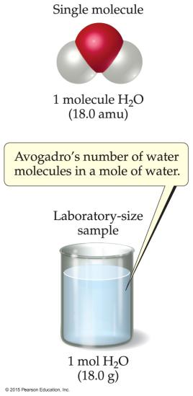
Avogadro’s Number
In a lab, we cannot work with individual molecules. They are too small.
6.02 × 10²³ atoms or molecules is an amount that brings us to lab size. It is ONE MOLE.
One mole of ¹²C has a mass of 12.000 g.

Slide 19
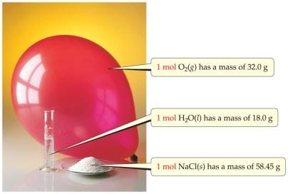
Molar Mass
A molar mass is the mass of 1 mol of a substance (i.e., g/mol).
The molar mass of an element is the atomic weight for the element from the periodic table. If it is diatomic, it is twice that atomic weight.
The formula weight (in amu’s) will be the same number as the molar mass (in g/mol).

Slide 20
Using Moles
Moles provide a bridge from the molecular scale to the real-world scale.

Slide 21
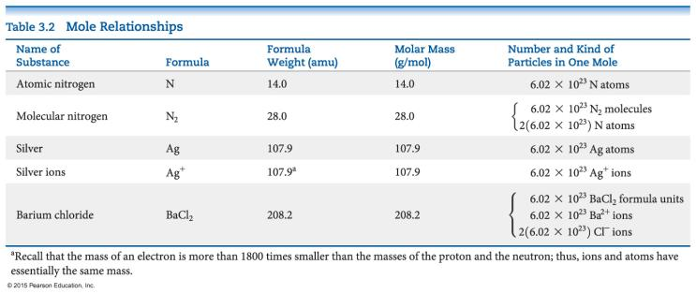
Mole Relationships
One mole of atoms, ions, or molecules contains Avogadro’s number of those particles.
One mole of molecules or formula units contains Avogadro’s number times the number of atoms or ions of each element in the compound.

Slide 22
Determining Empirical Formulas
One can determine the empirical formula from the percent composition by following these three steps.

Slide 23
Determining Empirical Formulas— an Example
The compound para-aminobenzoic acid (you may have seen it listed as PABA on your bottle of sunscreen) is composed of carbon (61.31%), hydrogen (5.14%), nitrogen (10.21%), and oxygen (23.33%). Find the empirical formula of PABA.

Slide 24
Determining Empirical Formulas— an Example
Assuming 100.00 g of para-aminobenzoic acid,
C: 61.31 g × = 5.105 mol C
H: 5.14 g × = 5.09 mol H
N: 10.21 g × = 0.7288 mol N
O: 23.33 g × = 1.456 mol O
1 mol
12.01 g
1 mol
1.01 g
1 mol
14.01 g
1 mol
16.00 g

Slide 25
Determining Empirical Formulas— an Example
Calculate the mole ratio by dividing by the smallest number of moles:
5.105 mol
0.7288 mol
C: = 7.005 ≈ 7
H: = 6.984 ≈ 7
N: = 1.000
O: = 2.001 ≈ 2
5.09 mol
0.7288 mol
0.7288 mol
0.7288 mol
1.458 mol
0.7288 mol

Slide 26
Determining Empirical Formulas— an Example
These are the subscripts for the empirical formula:
C₇H₇NO₂

Slide 27
Determining a Molecular Formula
Remember, the number of atoms in a molecular formula is a multiple of the number of atoms in an empirical formula.
If we find the empirical formula and know a molar mass (molecular weight) for the compound, we can find the molecular formula.

Slide 28
Determining a Molecular Formula— an Example
The empirical formula of a compound was found to be CH. It has a molar mass of 78 g/mol. What is its molecular formula?
Solution:
Whole-number multiple = 78/13 = 6
The molecular formula is C₆H₆.

Slide 29
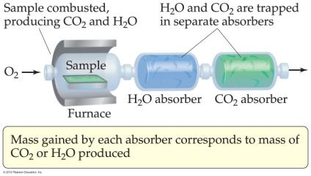
Combustion Analysis
Compounds containing C, H, and O are routinely analyzed through combustion in a chamber like the one shown in Figure 3.14.
C is determined from the mass of CO₂ produced.
H is determined from the mass of H₂O produced.
O is determined by the difference after C and H have been determined.

Slide 30
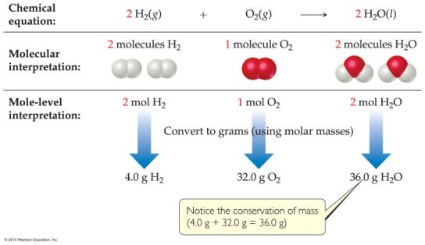
Quantitative Relationships
The coefficients in the balanced equation show
relative numbers of molecules of reactants and products.
relative numbers of moles of reactants and products, which can be converted to mass.

Slide 31
Stoichiometric Calculations
We have already seen in this chapter how to convert from grams to moles or moles to grams. The NEW calculation is how to compare two DIFFERENT materials, using the MOLE RATIO from the balanced equation!

Slide 32
An Example of a Stoichiometric Calculation
How many grams of water can be produced from 1.00 g of glucose?
C₆H₁₂O₆(s) + 6 O₂(g) → 6 CO₂(g) + 6 H₂O(l)
There is 1.00 g of glucose to start.
The first step is to convert it to moles.

Slide 33
An Example of a Stoichiometric Calculation
The NEW calculation is to convert moles of one substance in the equation to moles of another substance.
The MOLE RATIO comes from the balanced equation.

Slide 34
An Example of a Stoichiometric Calculation
There is 1.00 g of glucose to start.
The first step is to convert it to moles.

Slide 35
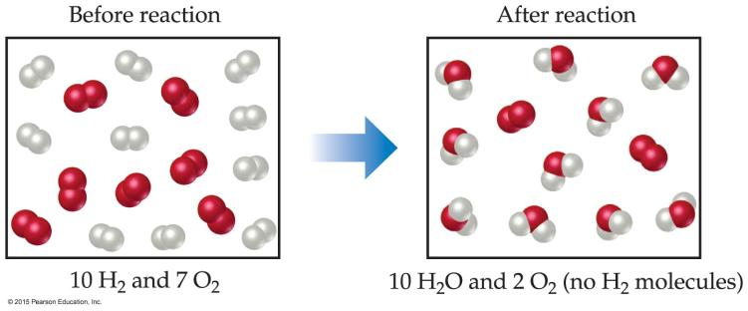
Limiting Reactants
The limiting reactant is the reactant present in the smallest stoichiometric amount.
In other words, it’s the reactant you’ll run out of first (in this case, the H₂).

Slide 36
Limiting Reactants
In the example below, the O₂ would be the excess reagent.

Slide 37
Limiting Reactants
The limiting reactant is used in all stoichiometry calculations to determine amounts of products and amounts of any other reactant(s) used in a reaction.

Slide 38
Theoretical Yield
The theoretical yield is the maximum amount of product that can be made.
In other words, it’s the amount of product possible as calculated through the stoichiometry problem.
This is different from the actual yield, which is the amount one actually produces and measures.

Slide 39
Percent Yield
One finds the percent yield by comparing the amount actually obtained (actual yield) to the amount it was possible to make (theoretical yield):
actual yield
theoretical yield
Percent yield = × 100

