Slide 1
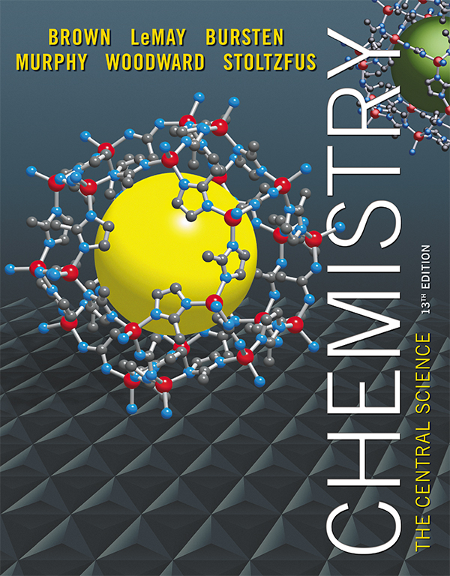
Dana and Michelle Chatellier
Clicker Questions Chapter 8
Barbara Mowery
York College

Slide 2
The two types of chemical bonds commonly found in compounds are
metallic and covalent.
ionic and electrolytic.
ionic and covalent.
electrolytic and compound.
Notes:
Answer: c

Slide 3
The two types of chemical bonds commonly found in compounds are
metallic and covalent.
ionic and electrolytic.
ionic and covalent.
electrolytic and compound.
Notes:
Answer: c

Slide 4
The Lewis symbol for a sulfur atom includes how many dots?
five
six
seven
eight
Notes:
Answer: b

Slide 5
The Lewis symbol for a sulfur atom includes how many dots?
five
six
seven
eight
Notes:
Answer: b

Slide 6
Which element never follows the octet rule?
C
H
P
Se
Notes:
Answer: b

Slide 7
Which element never follows the octet rule?
C
H
P
Se
Notes:
Answer: b

Slide 8
The octet rule states that atoms tend to gain, lose, or share electrons until they have _______ valence electrons.
five
six
seven
eight
Notes:
Answer: d

Slide 9
The octet rule states that atoms tend to gain, lose, or share electrons until they have _______ valence electrons.
five
six
seven
eight
Notes:
Answer: d

Slide 10
The most favorable characteristics for formation of ionic compounds from pure elements are
high IE, high EA.
low IE, low EA.
high IE, low EA.
low IE, high EA.
Notes:
Answer: d

Slide 11
The most favorable characteristics for formation of ionic compounds from pure elements are
high IE, high EA.
low IE, low EA.
high IE, low EA.
low IE, high EA.
Notes:
Answer: d

Slide 12
Which compound below has the largest lattice energy?
NaCl
KBr
CaO
CsI
Notes:
Answer: c

Slide 13
Which compound below has the largest lattice energy?
NaCl
KBr
CaO
CsI
Notes:
Answer: c

Slide 14
When a transition metal atom forms a +1 ion, it loses an electron from what type of orbital?
s
p
d
f
Notes:
Answer: a

Slide 15
When a transition metal atom forms a +1 ion, it loses an electron from what type of orbital?
s
p
d
f
Notes:
Answer: a

Slide 16
[Kr]4d¹⁰ is the electron configuration of
Ag⁺.
I⁻.
Pd.
Rb⁺.
Notes:
Answer: a

Slide 17
[Kr]4d¹⁰ is the electron configuration of
Ag⁺.
I⁻.
Pd.
Rb⁺.
Notes:
Answer: a

Slide 18
Which choice below correctly lists the elements in order of increasing electronegativity (least → most)?
C < N < O < F
N < C < O < F
N < C < F < O
C < N < F < O
Notes:
Answer: a

Slide 19
Which choice below correctly lists the elements in order of increasing electronegativity (least → most)?
C < N < O < F
N < C < O < F
N < C < F < O
C < N < F < O
Notes:
Answer: a

Slide 20
Which choice below correctly lists the elements in order of increasing electronegativity (least → most)?
F < Cl < Br < I
F < Cl < I < Br
I < Cl < Br < F
I < Br < Cl < F
Notes:
Answer: d

Slide 21
Which choice below correctly lists the elements in order of increasing electronegativity (least → most)?
F < Cl < Br < I
F < Cl < I < Br
I < Cl < Br < F
I < Br < Cl < F
Notes:
Answer: d

Slide 22
True or False: If a molecule has polar bonds, the molecule is polar.
True
False
Notes:
Answer: b

Slide 23
True or False: If a molecule has polar bonds, the molecule is polar.
True
False
Notes:
Answer: b

Slide 24
Select the incorrect statement about pairs of dots in Lewis structures of molecules.
They denote lone (nonbonding) pairs when shown on one atom.
They denote covalent bonds when shown between two atoms.
They are not counted in the octet rule.
All the statements are correct.
Notes:
Answer: c

Slide 25
Select the incorrect statement about pairs of dots in Lewis structures of molecules.
They denote lone (nonbonding) pairs when shown on one atom.
They denote covalent bonds when shown between two atoms.
They are not counted in the octet rule.
All the statements are correct.
Notes:
Answer: c

Slide 26
The carbon disulfide (CS₂) molecule has
two single bonds.
two double bonds.
a single bond and a double bond.
a single bond and a triple bond.
Notes:
Answer: b

Slide 27
The carbon disulfide (CS₂) molecule has
two single bonds.
two double bonds.
a single bond and a double bond.
a single bond and a triple bond.
Notes:
Answer: b

Slide 28
The hydrogen cyanide (HCN) molecule has
two single bonds.
two double bonds.
a single bond and a double bond.
a single bond and a triple bond.
Notes:
Answer: d

Slide 29
The hydrogen cyanide (HCN) molecule has
two single bonds.
two double bonds.
a single bond and a double bond.
a single bond and a triple bond.
Notes:
Answer: d

Slide 30
Which statement correctly describes triple bonds?
Three electrons are shared.
The octet rule is violated.
Three pairs of electrons are shared.
They are often formed by oxygen.
Notes:
Answer: c

Slide 31
Which statement correctly describes triple bonds?
Three electrons are shared.
The octet rule is violated.
Three pairs of electrons are shared.
They are often formed by oxygen.
Notes:
Answer: c

Slide 32
The formal charge on the nitrogen atom in the nitrate ion (NO₃^{1–}) is
+2.
+1.
0.
–1.
Notes:
Answer: b

Slide 33
The formal charge on the nitrogen atom in the nitrate ion (NO₃^{1–}) is
+2.
+1.
0.
–1.
Notes:
Answer: b

Slide 34
The formate ion (HCO₂^{1–}) is stabilized by resonance, which suggests that the oxygen atoms’ formal charges are
–1 and –1.
0 and 0.
–1 and 0.
–1/2 and –1/2.
Notes:
Answer: d

Slide 35
The formate ion (HCO₂^{1–}) is stabilized by resonance, which suggests that the oxygen atoms’ formal charges are
–1 and –1.
0 and 0.
–1 and 0.
–1/2 and –1/2.
Notes:
Answer: d

Slide 36
Which molecule below violates the octet rule?
PF₅
CH₄
NBr₃
OF₂
Notes:
Answer: a

Slide 37
Which molecule below violates the octet rule?
PF₅
CH₄
NBr₃
OF₂
Notes:
Answer: a

Slide 38
Which molecule below has an unpaired electron?
NO₂
NH₃
BF₃
PF₅
Notes:
Answer: a

Slide 39
Which molecule below has an unpaired electron?
NO₂
NH₃
BF₃
PF₅
Notes:
Answer: a

Slide 40
For atoms X and Y, the bond enthalpy of an X—Y bond is _______ the bond enthalpy of an X=Y bond.
greater than
less than
equal to
variable to (depending on X and Y)
Notes:
Answer: b

Slide 41
For atoms X and Y, the bond enthalpy of an X—Y bond is _______ the bond enthalpy of an X=Y bond.
greater than
less than
equal to
variable to (depending on X and Y)
Notes:
Answer: b

Slide 42
For atoms X and Y, the bond length of an X—Y bond is _______ the bond length of an X=Y bond.
greater than
less than
equal to
variable to (depending on X and Y)
Notes:
Answer: a

Slide 43
For atoms X and Y, the bond length of an X—Y bond is _______ the bond length of an X=Y bond.
greater than
less than
equal to
variable to (depending on X and Y)
Notes:
Answer: a

