Slide 1
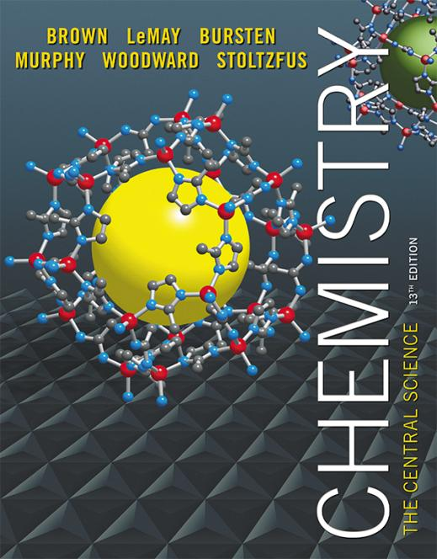
Clicker Questions Chapter 11
Barbara Mowery
York College

Slide 2
Which combination of kinetic energy (KE) and intermolecular forces (IF) results in formation of a solid?
KE much less than IF
KE much greater than IF
KE and IF comparable, and very large
KE and IF comparable, and very small
Notes:
Answer: a

Slide 3
Which combination of kinetic energy (KE) and intermolecular forces (IF) results in formation of a solid?
KE much less than IF
KE much greater than IF
KE and IF comparable, and very large
KE and IF comparable, and very small
Notes:
Answer: a

Slide 4
Which force below is the strongest intermolecular attractive force?
Hydrogen bonding
Ion-dipole forces
Dipole-dipole forces
d. London dispersion forces
Notes:
Answer: a

Slide 5
Which force below is the strongest intermolecular attractive force?
Hydrogen bonding
Ion-dipole forces
Dipole-dipole forces
d. London dispersion forces
Notes:
Answer: a

Slide 6
Which force below increases in strength as the molecular weight of the compound increases?
Hydrogen bonding
Ion-dipole forces
Dipole-dipole forces
d. London dispersion forces
Notes:
Answer: d

Slide 7
Which force below increases in strength as the molecular weight of the compound increases?
Hydrogen bonding
Ion-dipole forces
Dipole-dipole forces
d. London dispersion forces
Notes:
Answer: d

Slide 8
Which compound below is not capable of forming hydrogen bonds?
CH₄
NH₃
H₂O
d. HF
Notes:
Answer: a

Slide 9
Which compound below is not capable of forming hydrogen bonds?
CH₄
NH₃
H₂O
d. HF
Notes:
Answer: a

Slide 10
Which property is not affected by intermolecular forces?
boiling point
color
melting point
viscosity
Notes:
Answer: b

Slide 11
Which property is not affected by intermolecular forces?
boiling point
color
melting point
viscosity
Notes:
Answer: b

Slide 12
The ease of changing the charge distribution in a molecule is called its ___.
conductivity
solubility
polarizability
viscosity
Notes:
Answer: c

Slide 13
The ease of changing the charge distribution in a molecule is called its ___.
conductivity
solubility
polarizability
viscosity
Notes:
Answer: c

Slide 14
Which compound below has the highest boiling point?
H₂O
H₂S
H₂Se
d. H₂Te
Notes:
Answer: a

Slide 15
Which compound below has the highest boiling point?
H₂O
H₂S
H₂Se
d. H₂Te
Notes:
Answer: a

Slide 16
Which element below has the highest boiling point?
Kr
F₂
Cl₂
d. Br₂
Notes:
Answer: d

Slide 17
Which element below has the highest boiling point?
Kr
F₂
Cl₂
d. Br₂
Notes:
Answer: d

Slide 18
Which substance below has a greater density in its liquid state than in its solid state?
iron
glass
water
d. carbon dioxide
Notes:
Answer: c

Slide 19
Which substance below has a greater density in its liquid state than in its solid state?
iron
glass
water
d. carbon dioxide
Notes:
Answer: c

Slide 20
The resistance of a liquid to flow is called the _______ of the liquid.
density
viscosity
potential energy
d. flow rate
Notes:
Answer: b

Slide 21
The resistance of a liquid to flow is called the _______ of the liquid.
density
viscosity
potential energy
d. flow rate
Notes:
Answer: b

Slide 22
The energy required to convert a liquid to a vapor is called the _______ of the liquid.
boiling point
freezing point
heat of vaporization
d. heat of fusion
Notes:
Answer: c

Slide 23
The energy required to convert a liquid to a vapor is called the _______ of the liquid.
boiling point
freezing point
heat of vaporization
d. heat of fusion
Notes:
Answer: c

Slide 24
Isopropyl alcohol feels cool on the skin because it has an (X) heat of (Y).
a. X = exothermic, Y = vaporization
X = endothermic, Y = vaporization
X = exothermic, Y = fusion
X = endothermic, Y = fusion
Notes:
Answer: b

Slide 25
Isopropyl alcohol feels cool on the skin because it has an (X) heat of (Y).
a. X = exothermic, Y = vaporization
X = endothermic, Y = vaporization
X = exothermic, Y = fusion
X = endothermic, Y = fusion
Notes:
Answer: b

Slide 26
When heat is added to ice at zero degrees Celsius, what will happen?
The temperature will increase.
The temperature will decrease.
The temperature will not change.
A supercritical fluid will form.
Notes:
Answer: c

Slide 27
When heat is added to ice at zero degrees Celsius, what will happen?
The temperature will increase.
The temperature will decrease.
The temperature will not change.
A supercritical fluid will form.
Notes:
Answer: c

Slide 28
The highest temperature at which a substance can exist in its liquid state is called its _______ point.
boiling
freezing
triple
d. critical
Notes:
Answer: d

Slide 29
The highest temperature at which a substance can exist in its liquid state is called its _______ point.
boiling
freezing
triple
d. critical
Notes:
Answer: d

Slide 30
The temperature and pressure at which all three phases exist simultaneously is called the _______ point of a substance.
boiling
freezing
triple
d. critical
Notes:
Answer: c

Slide 31
The temperature and pressure at which all three phases exist simultaneously is called the _______ point of a substance.
boiling
freezing
triple
d. critical
Notes:
Answer: c

Slide 32
At high altitudes, the boiling point of water is
100 degrees Celsius.
b. greater than 100 degrees Celsius.
less than 100 degrees Celsius.
equal to its freezing point.
Notes:
Answer: c

Slide 33
At high altitudes, the boiling point of water is
100 degrees Celsius.
b. greater than 100 degrees Celsius.
less than 100 degrees Celsius.
equal to its freezing point.
Notes:
Answer: c

Slide 34
Which quantity is not used in calculating the total energy involved in converting 50 g of ice at 0°C to water at 95°C?
the mass of the sample
the heat of fusion of ice
the heat capacity of liquid water
the heat of vaporization of water
Notes:
Answer: d

Slide 35
Which quantity is not used in calculating the total energy involved in converting 50 g of ice at 0°C to water at 95°C?
the mass of the sample
the heat of fusion of ice
the heat capacity of liquid water
the heat of vaporization of water
Notes:
Answer: d

Slide 36
The substance that would evaporate most easily is one with ___ intermolecular forces and a ___molar mass.
weak; large
weak; small
strong; large
strong; small
Notes:
Answer: b

Slide 37
The substance that would evaporate most easily is one with ___ intermolecular forces and a ___molar mass.
weak; large
weak; small
strong; large
strong; small
Notes:
Answer: b

Slide 38
Substance X has a boiling point of 150 degrees F and a freezing point of 15 degrees F. The condensation point of X
is 150 degrees F.
is 15 degrees F.
is 165 degrees F.
d. is 135 degrees F.
Notes:
Answer: a

Slide 39
Substance X has a boiling point of 150 degrees F and a freezing point of 15 degrees F. The condensation point of X
is 150 degrees F.
is 15 degrees F.
is 165 degrees F.
d. is 135 degrees F.
Notes:
Answer: a

Slide 40
Which of the terms below does not describe a type of liquid crystal?
Eutectic
Nematic
Smectic
d. Cholesteric
Notes:
Answer: a

Slide 41
Which of the terms below does not describe a type of liquid crystal?
Eutectic
Nematic
Smectic
d. Cholesteric
Notes:
Answer: a

