Slide 1
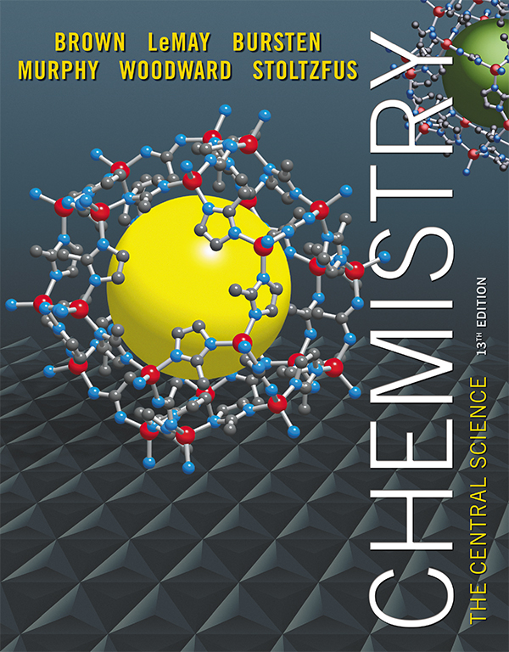
Clicker Questions Chapter 6
Barbara Mowery
York College

Slide 2
The wavelength of a photon multiplied by its frequency equals
c, the speed of light.
h, Planck’s constant.
Avogadro’s Number.
4.184.
Notes:
Answer: a

Slide 3
The wavelength of a photon multiplied by its frequency equals
c, the speed of light.
h, Planck’s constant.
Avogadro’s Number.
4.184.
Notes:
Answer: a

Slide 4
The energy of a photon divided by its frequency equals
c, the speed of light.
h, Planck’s constant.
Avogadro’s Number.
4.184.
Notes:
Answer: b

Slide 5
The energy of a photon divided by its frequency equals
c, the speed of light.
h, Planck’s constant.
Avogadro’s Number.
4.184.
Notes:
Answer: b

Slide 6
The “rainbow of colors” produced by sunlight striking a prism is called
a continuous spectrum.
monochromatic light.
a line spectrum.
a Balmer series.
Notes:
Answer: a

Slide 7
The “rainbow of colors” produced by sunlight striking a prism is called
a continuous spectrum.
monochromatic light.
a line spectrum.
a Balmer series.
Notes:
Answer: a

Slide 8
The lowest energy state of a hydrogen atom is called its _______ state.
bottom
ground
fundamental
original
Notes:
Answer: b

Slide 9
The lowest energy state of a hydrogen atom is called its _______ state.
bottom
ground
fundamental
original
Notes:
Answer: b

Slide 10
When an electron moves from the n = 3 orbit to the n = 2 orbit of a hydrogen atom, what wavelength of light is emitted?
410 nm
434 nm
486 nm
656 nm
Notes:
Answer: d

Slide 11
When an electron moves from the n = 3 orbit to the n = 2 orbit of a hydrogen atom, what wavelength of light is emitted?
410 nm
434 nm
486 nm
656 nm
Notes:
Answer: d

Slide 12
When an electron moves from the n = 4 orbit to the n = 2 orbit of a hydrogen atom, what wavelength of light is emitted?
410 nm
434 nm
486 nm
656 nm
Notes:
Answer: c

Slide 13
When an electron moves from the n = 4 orbit to the n = 2 orbit of a hydrogen atom, what wavelength of light is emitted?
410 nm
434 nm
486 nm
656 nm
Notes:
Answer: c

Slide 14
“It is impossible to simultaneously know both the position and the momentum of an electron in an atom” is
Hund’s rule.
deBroglie’s hypothesis.
Pauli’s exclusion principle.
Heisenberg’s uncertainty principle.
Notes:
Answer: d

Slide 15
“It is impossible to simultaneously know both the position and the momentum of an electron in an atom” is
Hund’s rule.
deBroglie’s hypothesis.
Pauli’s exclusion principle.
Heisenberg’s uncertainty principle.
Notes:
Answer: d

Slide 16
“No two electrons in an atom may have the same values for all four quantum numbers” is
Hund’s rule.
deBroglie’s hypothesis.
Pauli’s exclusion principle.
Heisenberg’s uncertainty principle.
Notes:
Answer: c

Slide 17
“No two electrons in an atom may have the same values for all four quantum numbers” is
Hund’s rule.
deBroglie’s hypothesis.
Pauli’s exclusion principle.
Heisenberg’s uncertainty principle.
Notes:
Answer: c

Slide 18
Which sequence lists types of electromagnetic energy in order of increasing energy?
microwave, IR, visible, UV
IR, microwave, UV, visible
UV, visible, IR, microwave
visible, UV, microwave, IR
Notes:
Answer: a

Slide 19
Which sequence lists types of electromagnetic energy in order of increasing energy?
microwave, IR, visible, UV
IR, microwave, UV, visible
UV, visible, IR, microwave
visible, UV, microwave, IR
Notes:
Answer: a

Slide 20
n and l are the principal and angular momentum quantum numbers. When n = 3, the allowed values of l are
1, 2, and 3.
1 and 2.
0, 1, 2, and 3.
0, 1, and 2.
Notes:
Answer: d

Slide 21
n and l are the principal and angular momentum quantum numbers. When n = 3, the allowed values of l are
1, 2, and 3.
1 and 2.
0, 1, 2, and 3.
0, 1, and 2.
Notes:
Answer: d

Slide 22
Which set of quantum numbers correctly describes an electron in the outermost orbital of a sulfur atom?
n = 3, l = 2, m_{l} = –2
n = 2, l = 1, m_{l} = –1
n = 2, l = 0, m_{l} = 0
n = 3, l = 1, m_{l} = –1
Notes:
Answer: d

Slide 23
Which set of quantum numbers correctly describes an electron in the outermost orbital of a sulfur atom?
n = 3, l = 2, m_{l} = –2
n = 2, l = 1, m_{l} = –1
n = 2, l = 0, m_{l} = 0
n = 3, l = 1, m_{l} = –1
Notes:
Answer: d

Slide 24
The only allowed values for the spin magnetic quantum number are
0 and 1.
0 and +1/2.
+1/2 and 1.
+1/2 and –1/2.
Notes:
Answer: d

Slide 25
The only allowed values for the spin magnetic quantum number are
0 and 1.
0 and +1/2.
+1/2 and 1.
+1/2 and –1/2.
Notes:
Answer: d

Slide 26
s orbitals are shaped like
four-leaf clovers.
dumbbells.
spheres.
triangles.
Notes:
Answer: c

Slide 27
s orbitals are shaped like
four-leaf clovers.
dumbbells.
spheres.
triangles.
Notes:
Answer: c

Slide 28
p orbitals are shaped like
four-leaf clovers.
dumbbells.
spheres.
triangles.
Notes:
Answer: b

Slide 29
p orbitals are shaped like
four-leaf clovers.
dumbbells.
spheres.
triangles.
Notes:
Answer: b

Slide 30
At a node, the probability of finding an electron is ___ %.
0
1
50
100
Notes:
Answer: a

Slide 31
At a node, the probability of finding an electron is ___ %.
0
1
50
100
Notes:
Answer: a

Slide 32
The electron configuration of a carbon atom is
[He]2s²2p⁶.
[He]2s²2p⁴.
[He]2s²2p².
[He]2s².
Notes:
Answer: c

Slide 33
The electron configuration of a carbon atom is
[He]2s²2p⁶.
[He]2s²2p⁴.
[He]2s²2p².
[He]2s².
Notes:
Answer: c

Slide 34
The electron configuration of a germanium atom is
[Ar]4s²4p².
[Ar]4s²3d¹⁰4p².
[Kr]4s²3d¹⁰4p².
d. [Kr]4s²3d¹⁰4p².
Notes:
Answer: b

Slide 35
The electron configuration of a germanium atom is
[Ar]4s²4p².
[Ar]4s²3d¹⁰4p².
[Kr]4s²3d¹⁰4p².
d. [Kr]4s²3d¹⁰4p².
Notes:
Answer: b

Slide 36
The electron configuration of a copper atom is
[Ar]4s²3d⁹.
[Ar]4s¹3d¹⁰.
[Ar]4s²3d¹⁰.
[Ar]4s²3d⁷.
Notes:
Answer: b

Slide 37
The electron configuration of a copper atom is
[Ar]4s²3d⁹.
[Ar]4s¹3d¹⁰.
[Ar]4s²3d¹⁰.
[Ar]4s²3d⁷.
Notes:
Answer: b

Slide 38
The valence electron configuration of elements in column 6A(16) of the Periodic Table is
np⁶.
ns⁰np⁶.
ns²np⁴.
d. impossible to predict because each element is unique.
Notes:
Answer: c

Slide 39
The valence electron configuration of elements in column 6A(16) of the Periodic Table is
np⁶.
ns⁰np⁶.
ns²np⁴.
d. impossible to predict because each element is unique.
Notes:
Answer: c

